Slide 1
FAZENDA BOA ESPERANÇA
BARREIRAS DO PIAUÍ - PIAUÍ - braZil

Slide 2
DESCRIPTION OF THE REAL STATE
A 4,649.79 hectares farm land, located in the southern end of the State of Piauí, in the municipality of Barreiras do Piauí. It is located 4 km distant from the asphalt road and lighting, and 11 km from the Coaceral Mountain Range, in the state of Bahia.
Distinguished property due to its location on top of a mountain range, denominated Serra da Boa Esperança.
It is called Farm Boa Esperança (Farm llha, regarding its unique natural characteristics, with the escarpment of the mountain range surrounding its entirety). This area has a differential that is its altitude of 720 to 740 meters, clay content, around 30% to 40% and medium to heavy cerrado vegetation , with sucupira, jatobá, ipê and aroeira.trees.

Slide 3
CLIMATE
Seasonal tropical forest climate (aw), with average rainfall of 1,200 mm to 1,600 mm annually, the relative humidity is between 50% and 70%, presenting high solar radiation, which favors photosynthesis to occur. Precipitation is influenced not only by the cold fronts from the South of the country, but also by the displacement of water vapour from the Amazon Rainforest, which allows a good level of rainfall regularity occurring from October to April.
Average temperature of 25 ° C, with maximum temperatures near 32 ° C and minimum of 16 ° C.
TOPOGRAPHY
Located on top of the Serra da Boa Esperança, the topography in this area is almost flat or gently rolling terrain areas, presenting slight slopes towards the edges of the chapadas, and there are no streams or hills and allows easy mechanization process.
VEGETATION
The floristic cover is typical of the Brazilian cerrado, therefore, of the average type, presenting some variations in terms of size, density and also the frequency of species. It is characterized as Cerradão, where trees reach more than 4 meters, predominantly cerrado native trees, such as Sucupira, Pequi, and Jatobá .

Slide 4
SOIL LANDSCAPE
According to the results of several granulometric analyzes and natural fertility, the soil is presented in almost all of its entirety with characteristics of Red Yellow Latosol, Alic, and Dark Red Latosol. The grounds are deep and very deep, with average texture in the surface and clayey textures in depth, well drained and shows flat relief. They are therefore considered suitable for use in agriculture, despite the toxicity of aluminum, but still easily correctable through the use of limestone.
LOCATION
Located at km 14 of BR 260, which connects BR 135 to the City of Barreiras do Piauí-PI, with geographic location: S 10 ° 02'09.45 '' and W 45 ° 26'38.38 ''

Slide 5
PIAUÍ STATE
It is the third largest Northeastern State, being smaller than Bahia and Maranhão, states. Piauí is the tenth Brazilian State, with an area of ​​252,358 km2 (data from IBGE - Brazilian Institute of Geography and Statistics), representing 2.95% of the total national territory, presenting altitudes recorded in plateaus up to 880 meters above sea level. Its population is estimated of 3.3 million inhabitants, and it has 224 municipalities.
Piauí state has ​​stood out as one of the states that mostly invests in the generation of energy from renewable sources.There are enterprises underway , and, as a result, the state should become the largest producer of solar energy in the country and one of the largest in Latin America. Some factors explain this boom. With a tropical climate and high average temperatures, varying between 18 ° and 39 °, Piauí state receives sunlight all year round, especially during the dry season, between September and December, with 12 hours of sunshine a day.
Piauí state has areas of ​​availability for plant imployment, and it also has transmission networks cutting off the State. The state also presents fiscal and financial incentives offered by the state government, which created the Piauiense Clean Energy Production Program (Propidel). Not only does the plan encourage the installation of power generation, but also it provides the adoption of differential tax treatment for companies which manufacture equipment and supplies intended to generate solar and wind energies in the State.

Slide 6
NATURAL CONDITIONS OF SERRA DA BOA ESPERANÇA
Serra da Boa Esperança farm is an unique property due to its natural characteristics.
It is located 23 km apart from the Electrical Power substation line LT Miracema -TO / Gilbués-Pi of 500 kV, generated from Belo Monte UHE.
The potential for production of Piauí's Solar and Wind Energy is in clear evidence, thanks to natural resources and the arrival of this transmission line, connecting to the South and northeast. There are numerous projects carried out that are standing out throughout the state.

Slide 7
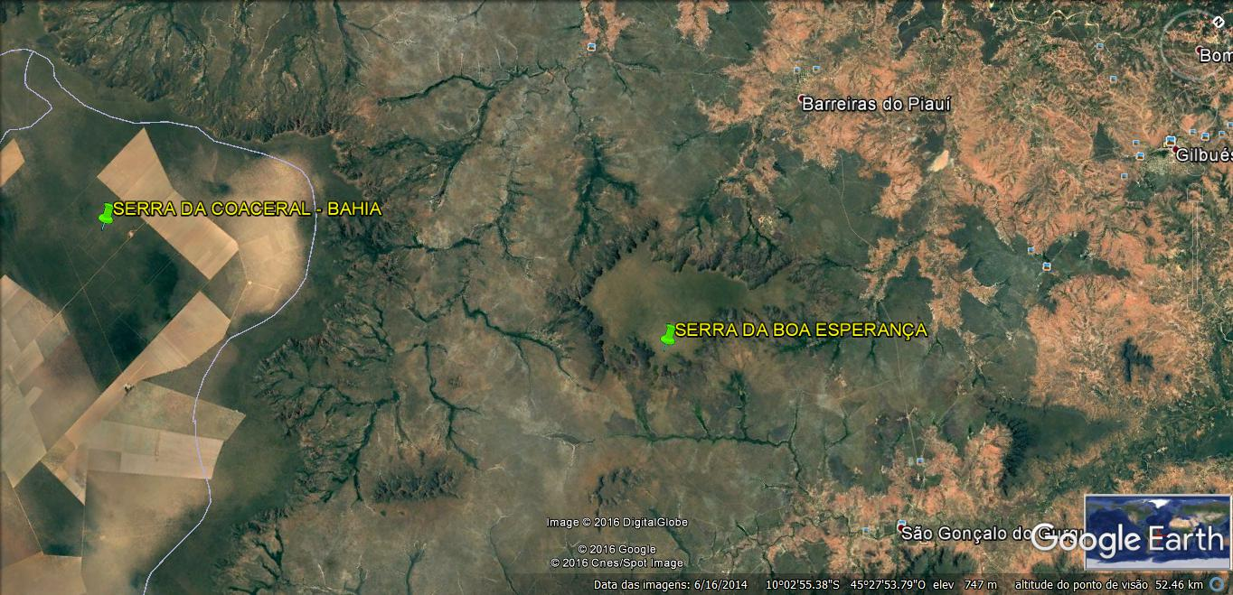

Slide 8
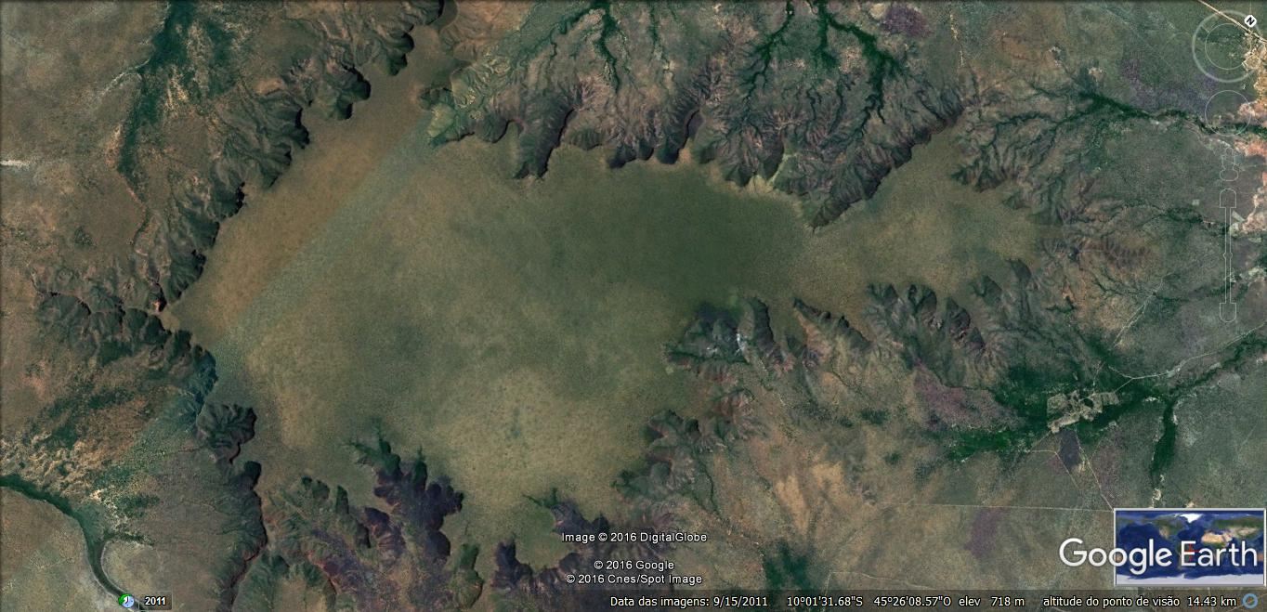

Slide 9
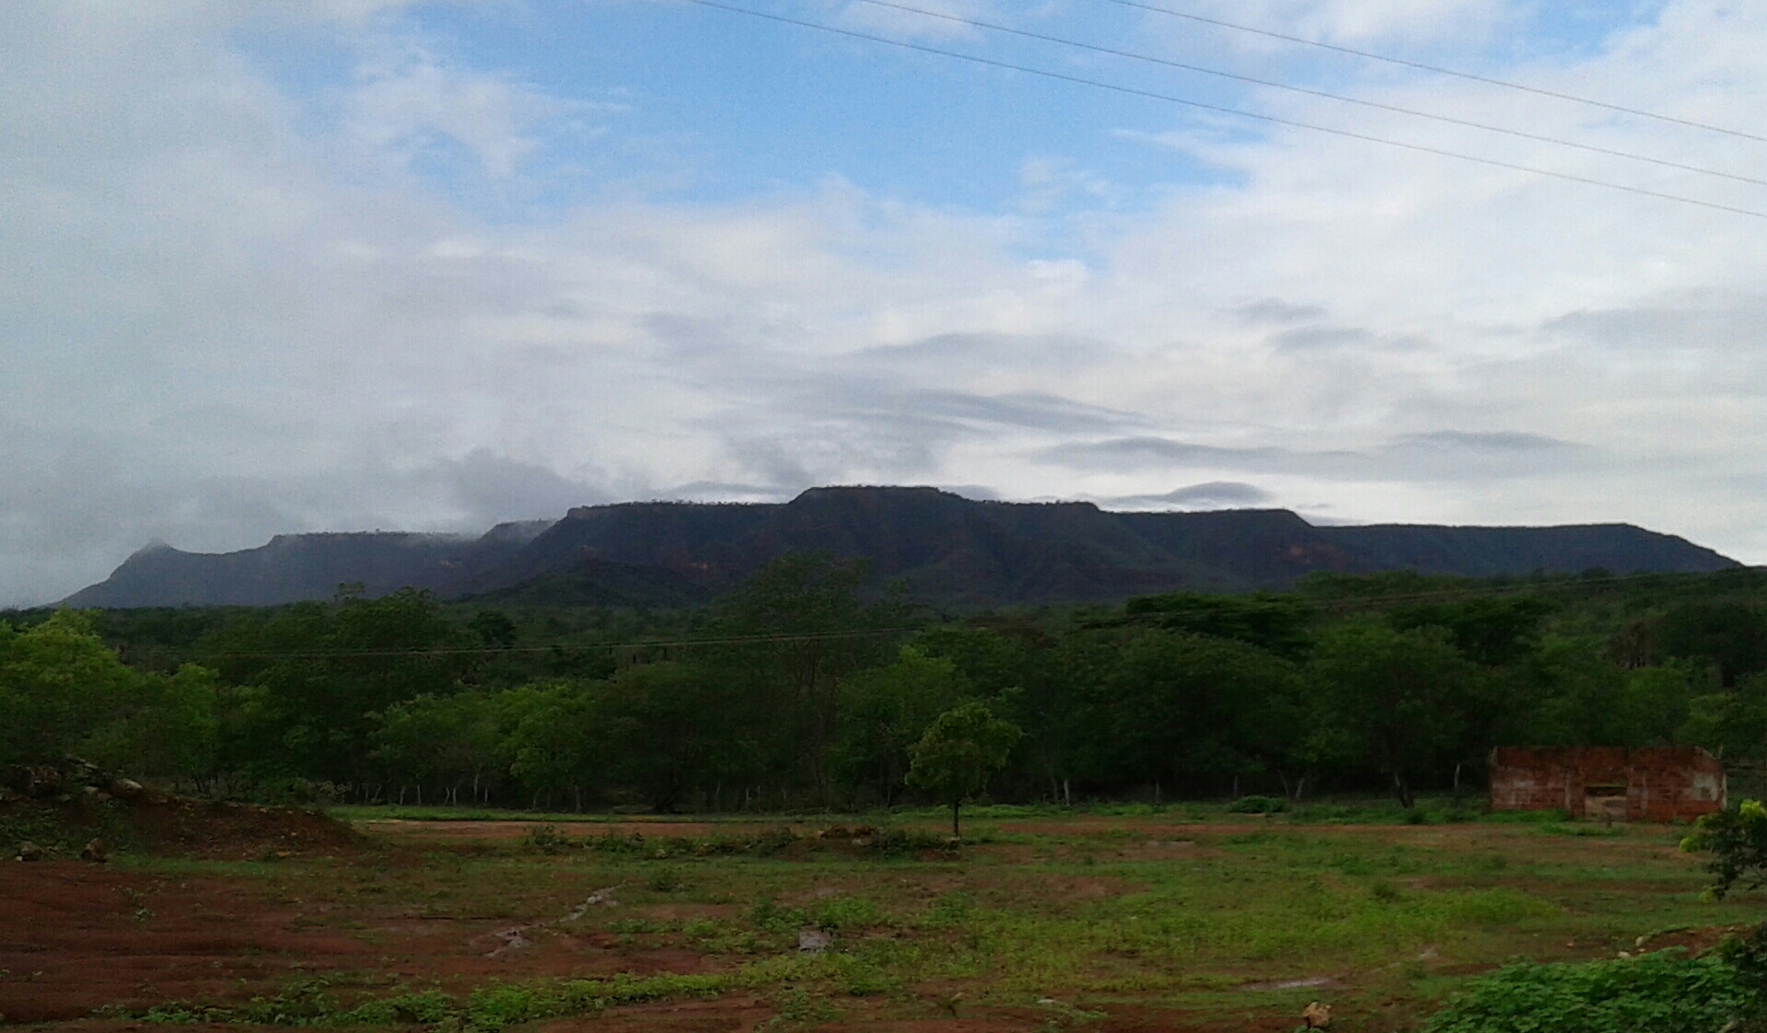

Slide 10
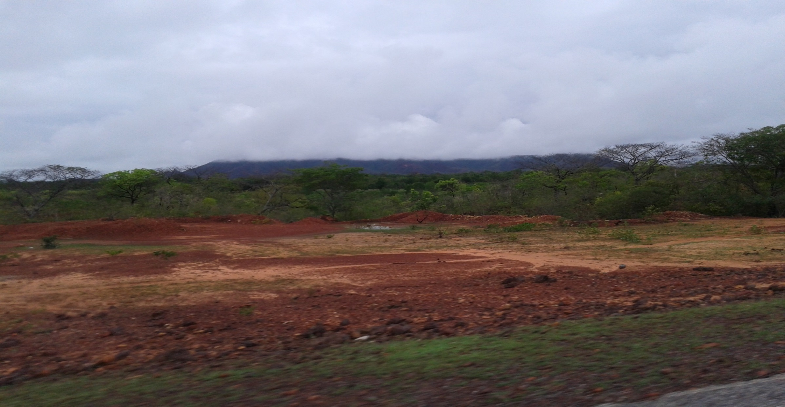

Slide 11
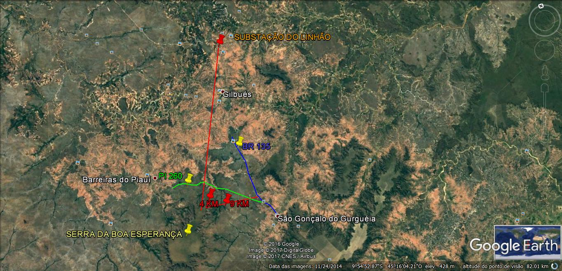

Slide 12
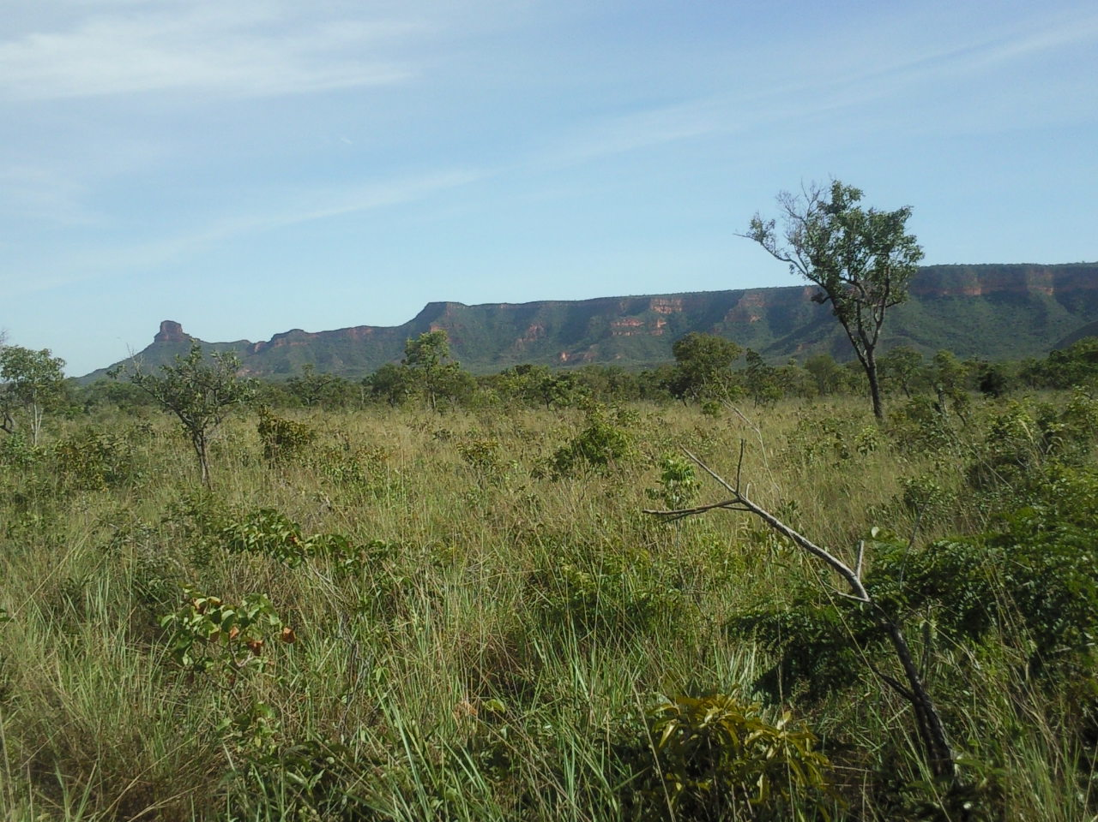

Slide 13
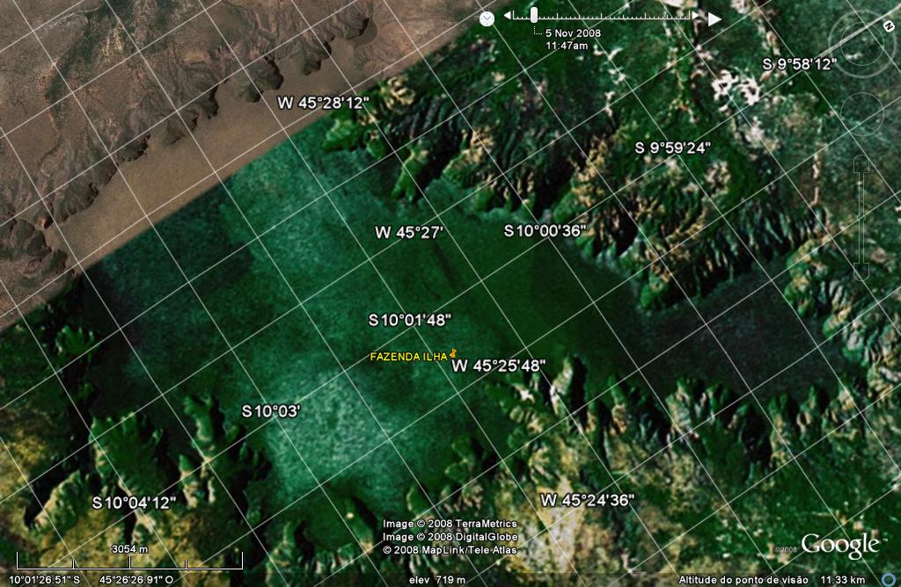

Slide 14
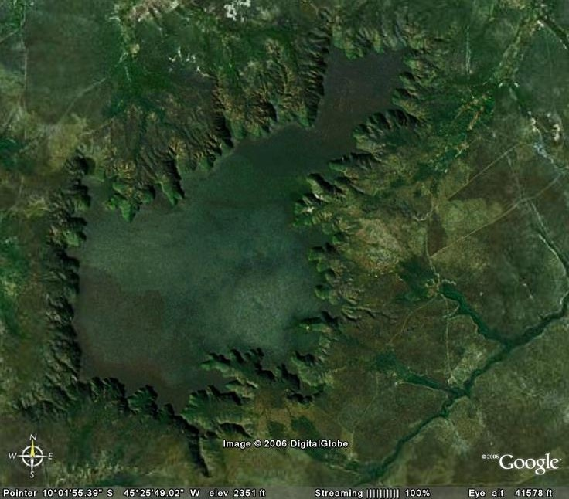

Slide 15
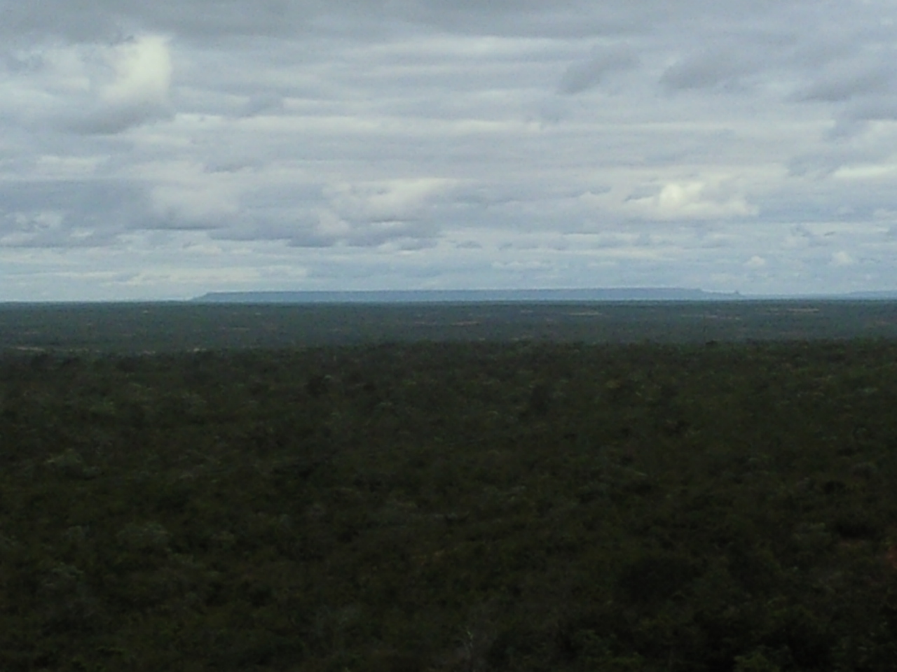

Slide 16
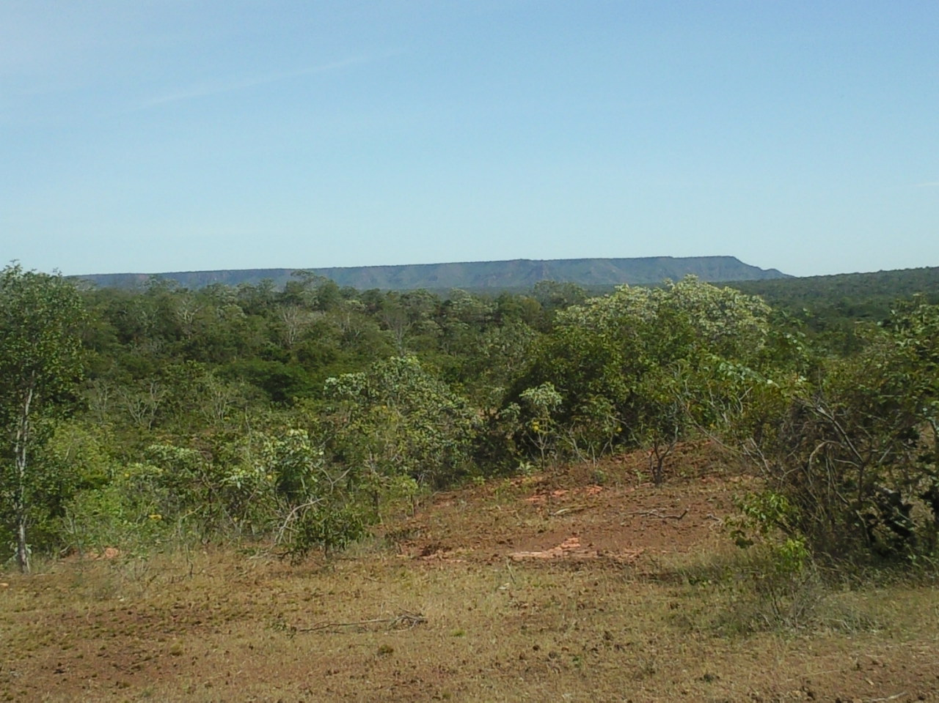

Slide 17
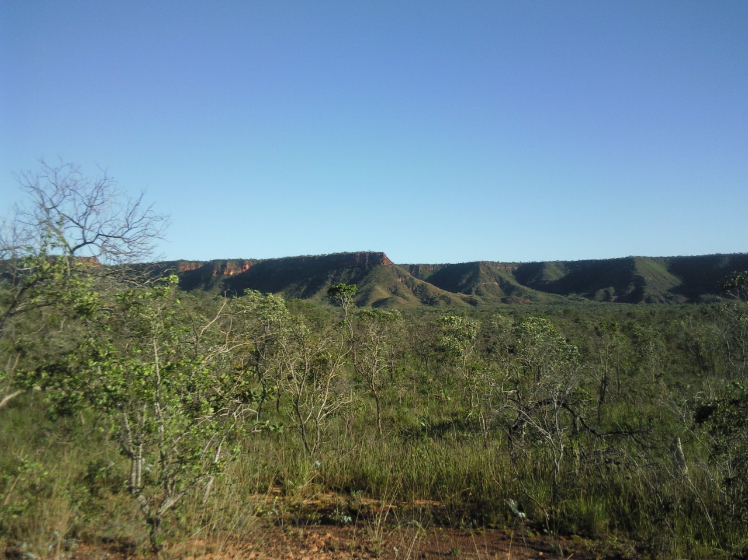

Slide 18
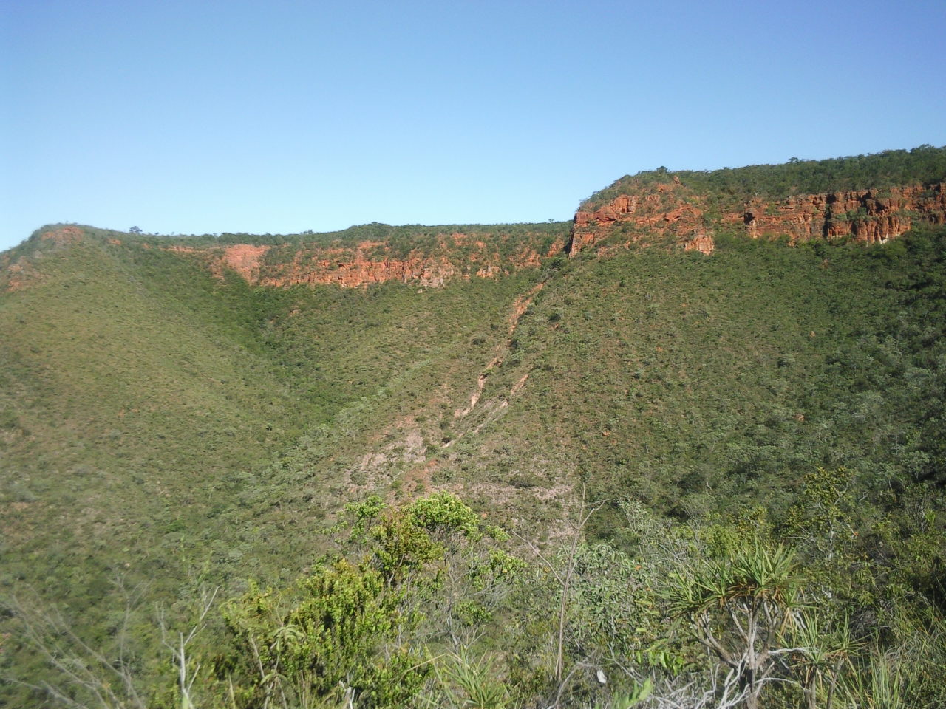

Slide 19
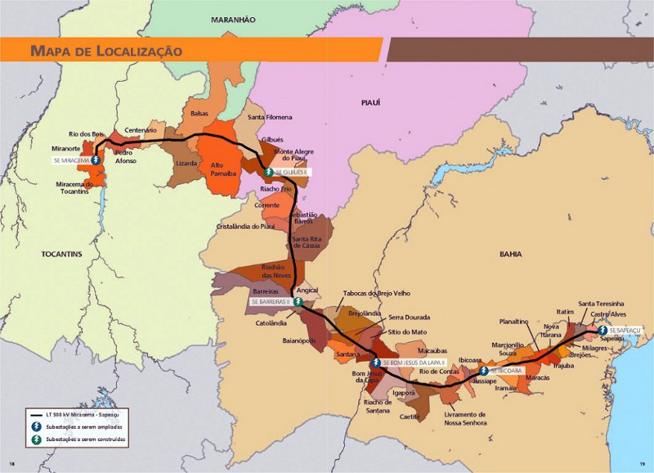

Slide 20
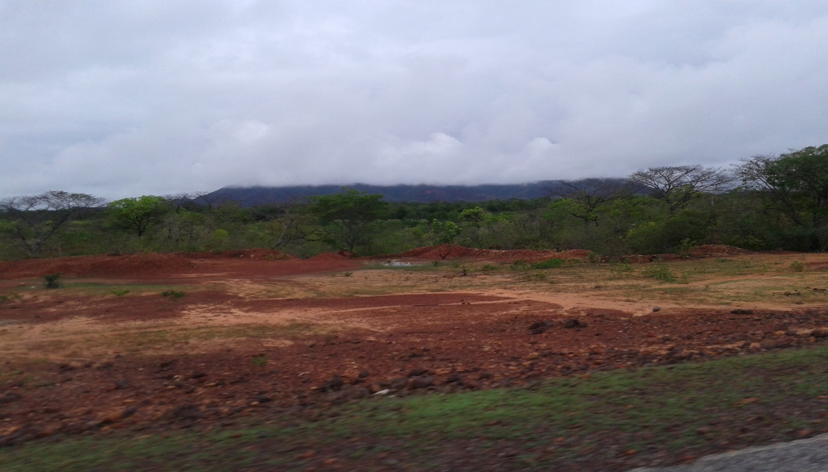

Slide 21
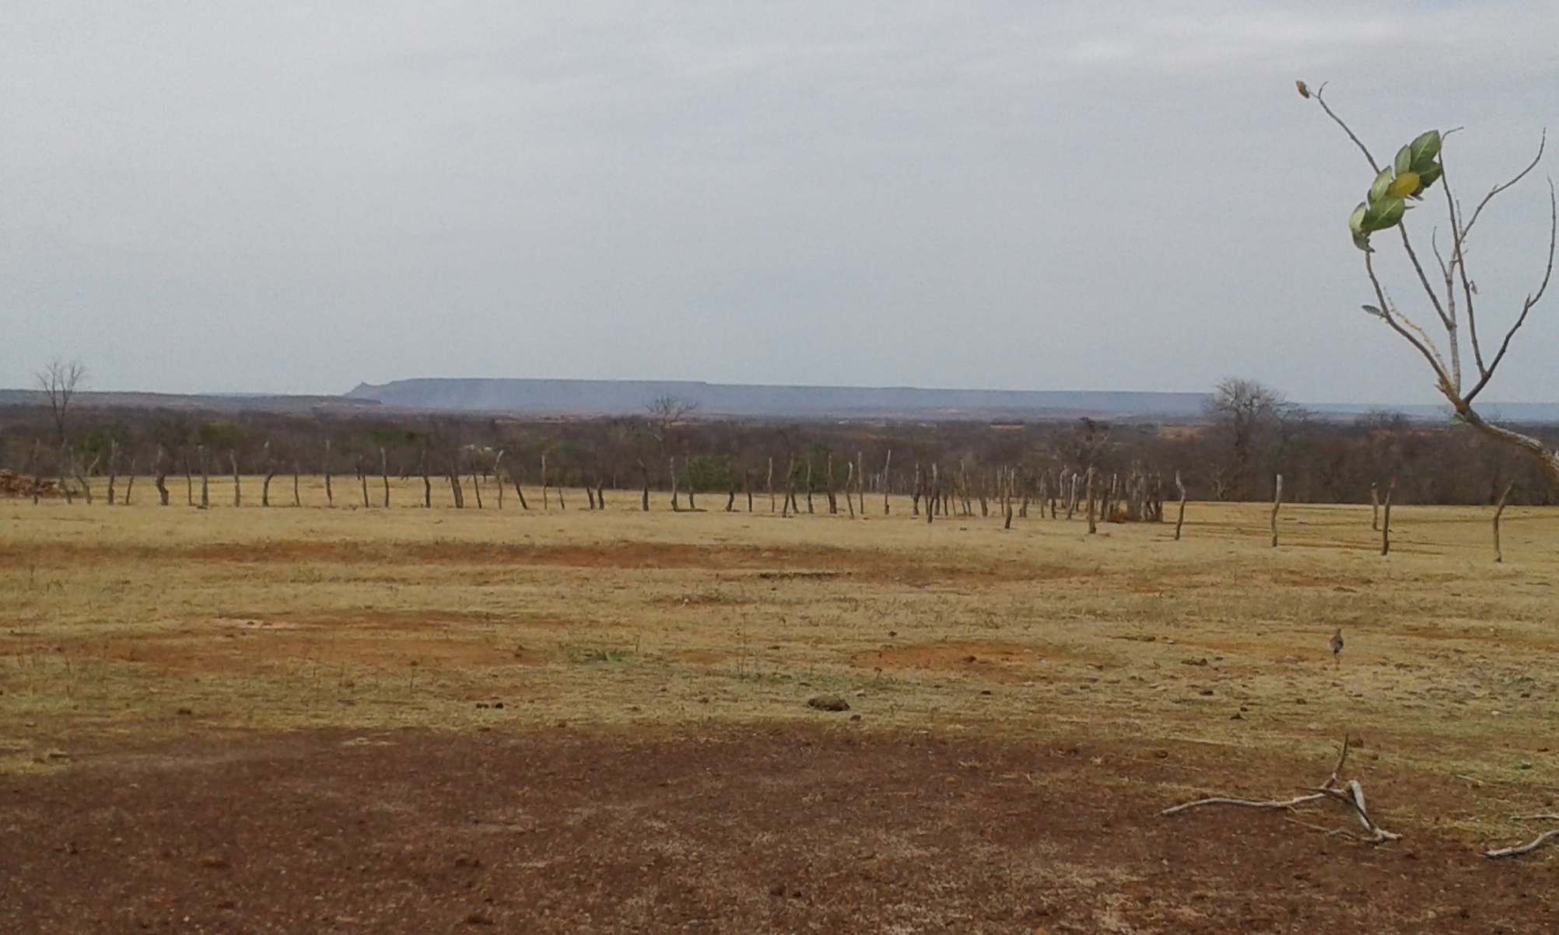

Slide 22
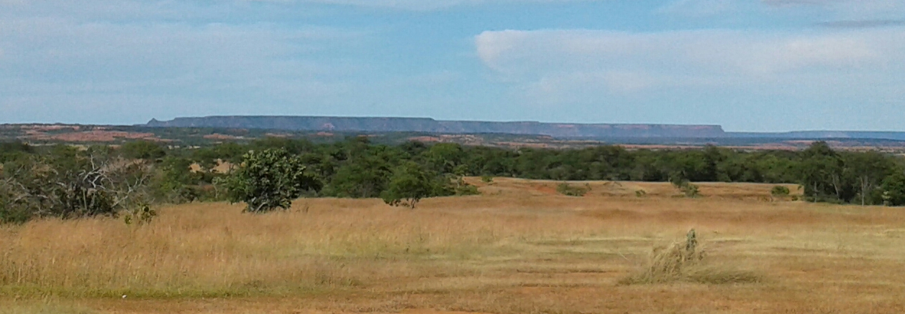

Slide 23
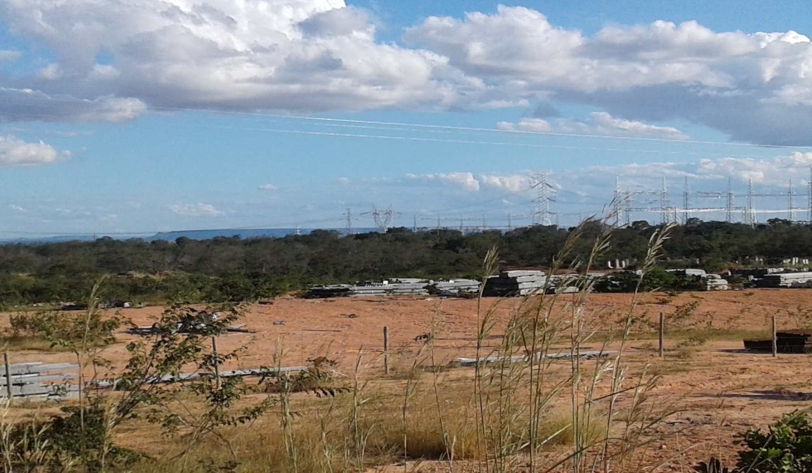
Eletrical Power substation of the transmission line LT Miracema - TO / Gilbués - Pi , 500 kV, generated from Belo Monte UHE. In the background, SERRA DA BOA ESPERANÇA, 23 km away

Slide 24
