Slide 1
2021 AGM
JANUARY 28, 2021

Slide 2
Preliminary
There are a lot of things that are still unknown. We are doing our best to find answers, but the situation in the world keeps changing, and we are doing our best to keep up.
We have from now until 9:30pm.
We need to spend most of, if not all the time tonight focused on how best to make this season go.
We are doing this AGM differently than in prior years because this is such a different year.
Everything is subject to change.
During the presentation, please put questions in the chat. There will be open discussion at the conclusion of the presentation.
Notes:
Focus for this meeting is similar to the letter we sent out some weeks ago. The goal is to be prepared for the season, to get a clearer idea of what it will look like, and to answer all of the questions we can.
It’s the coach in me – I’d like to have some expectations in place and a structure that we adhere to for this meeting – run it like a practice.

Slide 3
Agenda
Preliminary 8:00-8:05
Purpose of the Season 8:05-8:10
Rules Changes 8:10-8:20
Scheduling 8:20-8:25
Referees 8:25-8:30
PPE / Mandatory Safety Procedures 8:30-8:40
Contact Tracing? 8:40-8:45
Insurance 8:45-8:50
What happens if… 8:50-8:55
Not to be addressed tonight 8:55-9:00
Lynn 9:00-9:10
Discussion 9:10-9:28
Important Dates 9:28-9:30

Slide 4
Purpose of the Season
Keep kids engaged
Get touches
Keep clubs running
Get out and play
Medicine game
Have fun

Slide 5
Rules Changes
Rules changes this season because of:
Updates to the game
COVID

Slide 6
Scheduling
This year, please fill your own schedule as much as you can.
We will have a scheduling meeting on Apr 11th to fill in the gaps in your schedule, if any.
As of now:
April 12: First day of practices
April 19: First games
April 19 – May 31: Full Season

Slide 7
Referees
HS referees have not done a game in over a year if not two years.
Training is significantly diminished because we can’t go in a classroom.
We would like to have one adult referee and one HS referee at as many games as possible. We may have a Zoom Training for 2021 refs…TBD
Adult and HS referees are likely to be hard to find due to the compressed high school schedule.
Please coordinate with referees that you know.
OYL will assist with referee assignment to fill in the gaps. Please notify us by April 15th of any games for which you need officials.

Slide 8
PPE / Mandatory Safety Procedures
We will not be outliers, either to the side of ‘safety’ or to the side of ‘risk’.
We will use PPE based on the standards at the time. More detail to come about this as things evolve.
This will likely mean masks at all times for coaches and players, and for referees except as needed to use their whistle.
Whatever the requirements, each team is to be responsible for making sure their players and coaches are properly equipped.
Referees will warn once for violations of these requirements. A second infraction will immediately cancel the game.

Slide 9
Contact Tracing?
Do we need a system for this?
If yes, how can that be accomplished?

Slide 10
Insurance
OYL will ask each player and coach to complete a waiver and code of conduct form prior to competition to make sure expectations of players are clear.
Each club will send proof of general liability insurance policy with 1 million aggregate and add Oregon Youth Lacrosse as additional insured. This is due by April 10th.
Each club shall demonstrate an insurance policy sufficient to cover claims of COVID as a communicable disease.

Slide 11
What happens if…
There is a chance that circumstances cause the cancelation of the season or significant changes in the plans we’re making.
We will communicate as quickly as we can, and with as much detail as we can if it should come to pass.
We hope for the best, and will let you know if things change.
If there is any reasonable expectation that a coach or player on your team has been exposed to or exposed others to COVID, please hold any potentially contagious players or coaches out of participation. If that means canceling a game, please do so, and thank you for being responsible. If someone cancels on you, even with short notice, and this is the reason, please recognize this as looking out for your team, rather than as an inconvenience.

Slide 12
Not to be addressed tonight
Off-season player development
Club recruitment and growth
Finances
(we are required by our bylaws to give a financial update. We are solvent. We are happy to answer any questions you have about this at a different place and time)

Slide 13
LYN PORTERFIELD
Regional Director, Pacific & Mountain Membership and Regional Development

Slide 14
DISCUSSION
- We have until 9:25
- Let’s keep each topic to 2 or 3 minutes
* OYL will put out a memo in the next few days addressing anything we can’t conclude tonight.

Slide 15
Important Dates
Dues and Insurance due by April 10th, 2021
Dues Form is posted online under the 2021 tab
Schedules due to OYL April 10th??
List of Referees w/contact info due to OYL April 10th??
Notes:
To come from Lisa

Slide 16
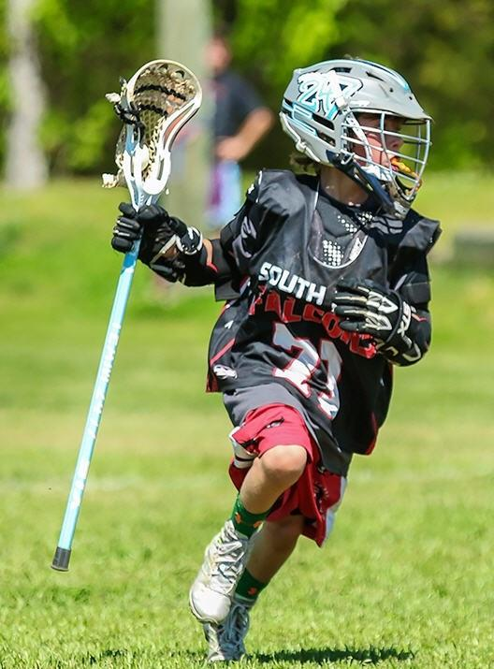
2021 OYL BOARD
Alex Tillson - President
Dave Sanford - Vice President
Lisa Hockman - Treasurer
Bob Looney - Secretary
Keith Kroeger - Scheduling
Bob Weyer - Officials
Nic Herriges - Officials
Tom Hoffert - Salem Representative
THANK YOU!

