Slide 1

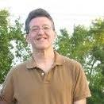

Know Yourself To Grow Yourself
Awakening Awareness Part 1
Greg Metz Ph.D.
Awesome All Around Life and Learning Coaching
Making The Most of You
Imagining Possibilities, Navigating Pathways, Optimizing Potentials
Life Coaching, Workshops, Training, Motivational Speaking
awesomeallaround.com

Slide 2
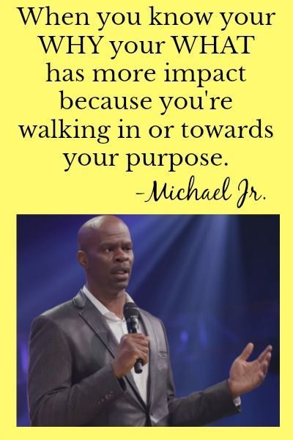
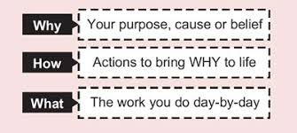
Michael Jr. Know Your Why
Ben Hunt Davis What Makes The Boat Go Faster
Michael Jr. Know Your Why - Know Your Why
Ben Hunt Davis Will It Make The Boat Go Faster - Will It Make Boat Go Faster
How does wither (or both) video clips pertains to any current challenges in your life?
What is one aspect of your life that you would really like to work on? (For example health and well being, work or school, relationships or something else)
How would you describe yourself at your best?
Describe the person you would like to be one year from now.
What is one or more near term action steps you can initiate to work on that aspect of your life and move towards that best self you want to be one year from now

Slide 3

SPARCK Questions
From Bill Johnson
Life Design Catalyst
  What is awesome in your life right now?
  What is missing in your life right now?
  What do you need to do more of to make progress on being your best self?
  What is THE most important action step you could take - starting today and going forward - to make progress towards - to "+1" - your best self.
  What is your greatest fear? How is it impacting your life? What can you do about it?

Slide 4
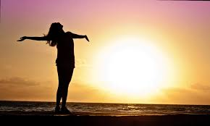
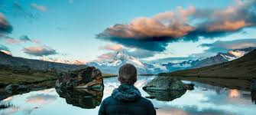
Popcorn Reading (From Bill Johnson)
Which Quote Resonates Most With Your Life? How?
Don’t let your past define you. Recognize it, accept it and move on.
Choose whether you want to be move forward into growth or back into safety.
Life’s greatest moments reside in the gap between where you are and where you want to be.
Challenge yourself. Get out of your comfort zone. It’s the only way you’ll grow.
Write yourself. Be your hero.
Know yourself intimately… become the best version of yourself.
Connect with people who will support you, help you grow, and (every once in a while) kick you in the butt.
At the end of the day ask yourself “did I add value today”?

Slide 5

  Awareness, Action and Alliances
  AWARENESS
  Who am I, how am I doing, who do I want to be, who can I be, what’s the gap, what’s in the way?
  ACTION
  What are my WIGS – wildly important goals (in various facets of my life), what actions do I need to take to make progress on them, what habits do I need to install and delete, how can I craft “masterpiece days”, how can I learn deeply (and still have a life)?
  ALLIANCES
  Who is on my “dream team” (my support team), who are my “swim buddies” and mentors and board of directors, how can I create and sustain my dream team, how can I serve others?

Slide 6

Let’s Keep On Keeping On

