Slide 1
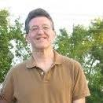

Cracking The Code of Motivation
Greg Metz Ph.D.
Awesome All Around Life and Learning Coaching
Reframing Limiting Beliefs, Revamping Disempowering Habits, Transforming Our Lives
Coaching, Workshops, Training, Motivational Speaking

Slide 2
Awesome All Around
Self Awareness, Confidence,
Resilience, Self-Compassion
Reframing Beliefs
Revamping Habits
Transforming Our Lives
Flourishing, Learning, Serving
Connectedness & Service
Energy & Vitality
Purpose, Motivation &
Time Management
Deep Learning

Slide 3
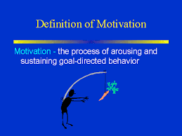
What is Motivation?
Greg’s Definition
Having that spark to do important stuff
(and even if and when we don’t feel like it)

Slide 4

Motivation Myths vs. Facts
Myth – Motivation is fixed. Motivation “is what it is”.
We either have it or we don’t.
Fact –We can create & cultivate our motivation.
Myth – We can’t teach motivation. We can’t motivate others. It all comes from within.
Fact – We can’t make other people do stuff.
We can help cultivate, awaken, guide motivation.

Slide 5
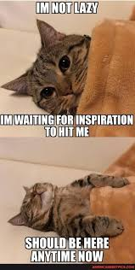

Motivation – More Myths vs. Facts
Myth – Motivation comes from inspiration.
Fact – well – sometimes. But do not wait around.
Inspiration might never arrive.
Myth – Motivation comes from feeling like doing something.
Fact – well – sometimes. But do not wait around. Action generates action.
A body in motion stays in motion. Actions produce feelings. So START.

Slide 6

We Are (Our Own) Computer Programmers
We create ourselves
We are responsible for ourselves
We can program our brains and bodies

Slide 7

Wanna Do’s and Gotta Do’s
Let’s program in our Wanna Do’s (the stuff we love to do)
&
Let’s program in our Gotta Do’s
(the stuff we may not love to do but need to do)
& then
HIT START

Slide 8

So – What Do I Wanna Do?
Reflect on these questions or discuss them with a trusted friend
What just lights me up (time streams by without me noticing)?
What fascinates me? What do I have a deep yearning to know more about?
What would I do even if I won the lottery?
Who (people, groups) do I want to help? How?

Slide 9
So – What Do I Gotta Do?
Reflect on these questions or discuss them with a trusted friend
What do I NEED to do each day -
To sustain and enhance my physical energy and well-being?
To accomplish my responsibilities as a student or employee?
To be a good family member, friend, partner, neighbor?

Slide 10
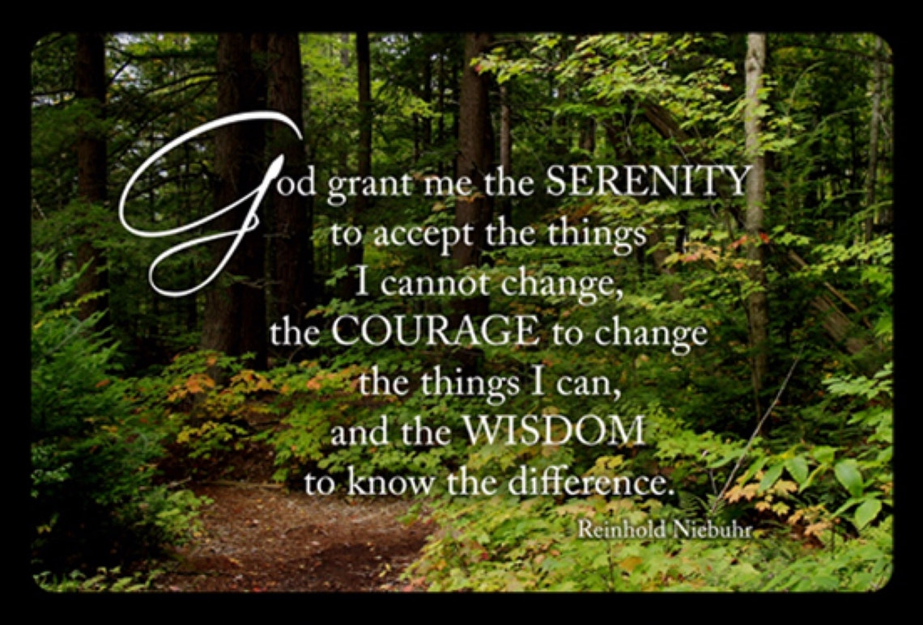
Serenity Prayer (For Gotta Do’s)

Slide 11
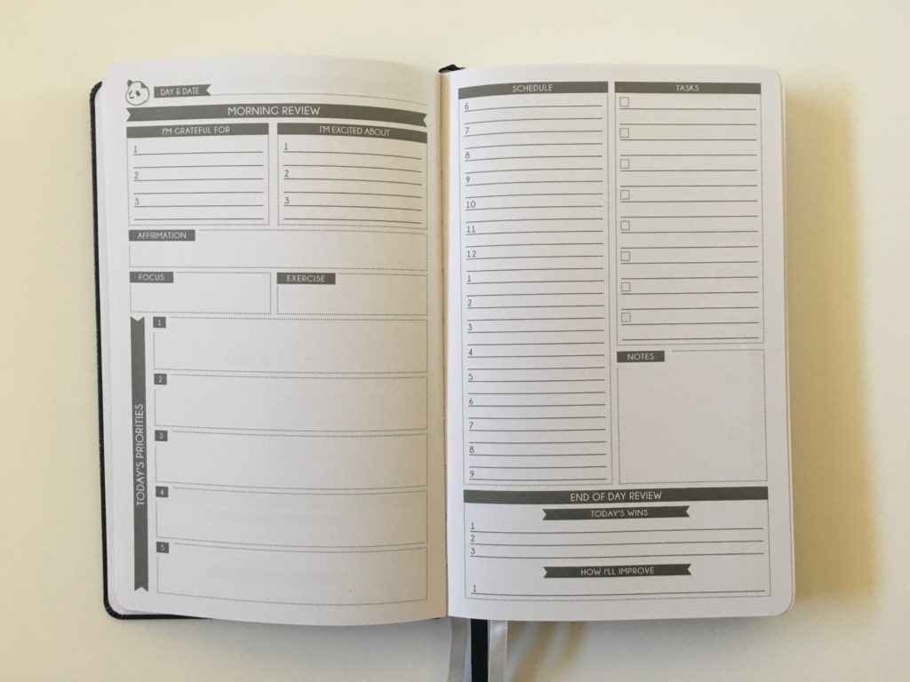

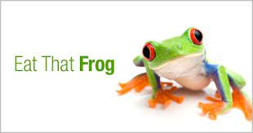
Hacks For Getting Started (and Keeping Moving Along)
Allocate time blocks each day for Wanna Do’s & Gotta Do’s
Decide what you can let go (desirable but not urgent or important)
Eat The Frog (start with something that you do not want to do)
54321 (count down, don’t think about it, start)
Keep in mind – small steps compound to big results (be patient)
Make a promise (to do it) to a trusted friend

Slide 12
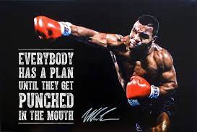
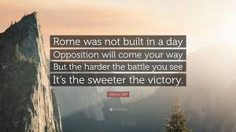
Keep On Keeping On, Get Up & Bounce Back

Slide 13
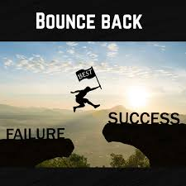
Your Bounce Back Story
What’s something REALLY HARD that you accomplished?
What was the deepest, darkest moment of doubt?
How did you overcome that moment?
How did that feel?
Celebrate and savor that accomplishment - ☺ -

Slide 14
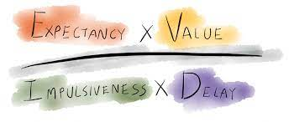
The Motivation Equation Game
The game – INCREASE THE NUMERATOR, DECREASE THE DENOMINATOR
Value – Does it really matter to us? Is it really important? 0-10
Expectancy- Do we believe we can do it? 0-10
Impulsivity – How low can we reduce distraction? 0-10
Delay – How low can we reduce the time window for getting to it? 0-10

Slide 15
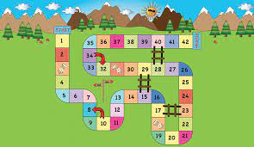
Let’s Play the Motivation Equation Game
Choose a goal & cycle it through the equation
Rate each component of equation 0-10
Value - how highly you value goal, Expectancy – confidence level for achieving it
Impulsivity - capacity to reduce distraction (lower score better)
Delay - time window for progressing on it (lower score better)
Determine score, share with trusted friend & discuss how to make it higher

Slide 16

Your “A Ha’s” and Next Steps
What’s one (or more) learnings or “a ha’s” that stuck with you?
What’s one (or more) actions you can take to bolster your motivation?

Slide 17

Greg’s Reminders
“Reframe” motivation myths
Get started
Connect with “tribe”

Slide 18

Questions & A Ha’s & Next Steps
What questions or thoughts do you have?
Please share your “a ha moments”!
What action are you going to take?

Slide 19

Let’s Do It

