Slide 1


How To Learn Deeply
(And Still Have a Life)
Greg Metz Ph.D.
Awesome All Around Life and Learning Coaching
Imagining Possibilities, Navigating Pathways, Optimizing Potentials
Life Coaching, Workshops, Training, Motivational Speaking
awesomeallaround.com

Slide 2
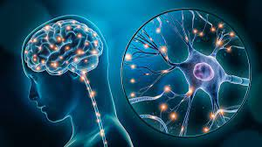
What is Deep Learning?
Engaging in learning continuously (vs. cramming)
Cultivating neuroplasticity – growing our neuron chains
Going beyond superficial surface memorization (short to long term memory)
Learning for understanding vs. grades
Understanding how things happen (how systems work) vs. just facts
Applying knowledge and understanding to solving problems

Slide 3
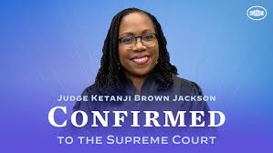
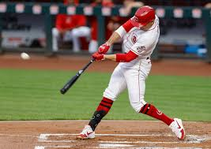
Reflection On Deep Learning
What is something you are really good at?
How did you get good at it?

Slide 4
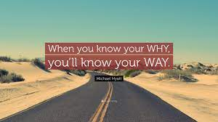
Knowing Our Why For Learning
Michael Jr. Know Your Why

Slide 5
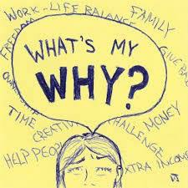
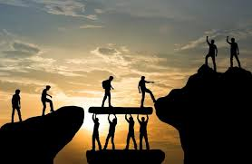
What’s My Why For Learning?
Rate each from 0 (not at all a why) to 10 (a huge why)
Add any additional personal why’s
-- Understanding Myself More
-- Intellectual Curiosity
-- Pleasing My Family
-- Finding Meaningful Work
-- Pursuing A Passion
-- Financial Comfort
-- Mental Health
-- Supporting Family
-- Giving Back To My Community
-- Citizenship

Slide 6
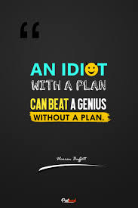
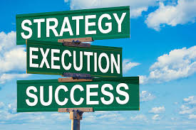
Knowing Our How For Learning
Defining and Refining Our Learning Game
Ben Hunt Davis Will It Make The Boat Go Faster

Slide 7

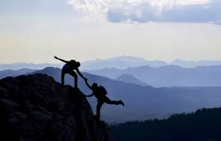
Reflection on Learning Tactics
What are 3 learning tactics (strategies or practices to enhance my learning) that I currently use?
What is one improvement I can make in my learning game?

Slide 8
Busting Learning Myths
Myth #1
Smart People Are Just Smart
Reality
Learning occurs through effort, focus and continuous activity
We have 86 billion neurons in our brains
Continuous focused activity causes neurons to connect to each other
Continuous focused activity supports long term memory linkages

Slide 9

Busting Learning Myths
Myth # 2
It’s All About Grades
-
Reality
A high grade does not necessarily signify deep learning
Learning is a process that we can control
Learning happens through continuous focused activity
Engaging in the learning process usually yields a high grade
If not – keep on keeping on or (eventually) pivot

Slide 10
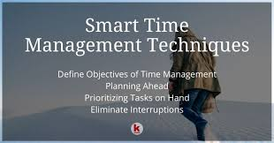
Busting Learning Myths
Myth # 3
I Don’t Have Enough Time
Deep Learning Will Ruin My Life
Reality
We can decide what matters more and what matters less
We can allocate our time to what matters more
We can improve focus, decrease distraction, say no, create time
We can be deep learners and have full lives

Slide 11
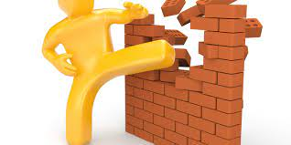
Reflection on Learning Myths
Can you think of any personal myths or limiting beliefs that could holding back your flourishing as a learner?

Slide 12
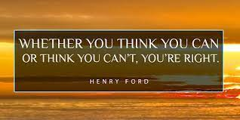
Seven Learning Empowerment Tactics
Tactic # 1
Confidence / Affirmation
What – Tell Yourself Every Day That You Are Capable of Learning
Tell Yourself What You Intend to Do Each Day To Learn
Why – Because You Are Capable. Because Your Brain is Neuroplastic.
Because You Are What You Believe You Are
How – Write Down and Share Your Affirmations For Each Day
Use A Planner

Slide 13

Tactic # 2
Allocation and Organization
(Or What Goes When and Where)
What – Decide Important Priorities For Day (In Various Life Areas)
Decide When and Where They Will Receive Attention
Why – Intention Activates Implementation
Reduce Worry and Anxiety
How – Allocate Time Blocks and Pomodoros
Use A Planner

Slide 14
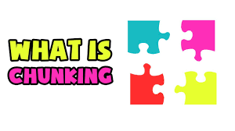
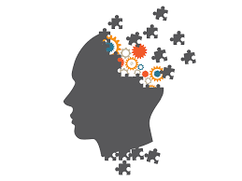
Tactic # 3
Chunking
(Or Inch By Inch Row By Row Gardens Grow)
What Spread Bits of Task Out Over Time
Why Our Brains Thrive Through Alternating Activity and Rest
Breaking A Project Into Bits Makes It Less Daunting
How Break Project Into Bits
Set Mini Goals, Enjoy Mini Rewards
Use BDA for Ongoing Study
Before – Preview, During – Notes, After – Review, Explain
Use A Planner

Slide 15
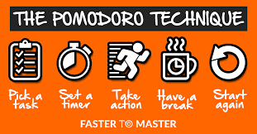
Tactic # 4
Focusing
Pomodoros, Deep Work Blocks & Rhythm Breaks
What Pomodoros – 25 minute blocks – no distractions
Deep Work Blocks – 60-90 minutes – 2-3 Pomodoros – Brief Breaks
Why Manageable Chunks, No Distractions, Built in Rests and Rewards
Optimize Time Use & Create Time for Other Facets of Life
How 25 Minute Distraction Free Blocks, Celebration & Rest in Between Blocks
Longer Break After Deep Work Blocks
Use A Planner

Slide 16
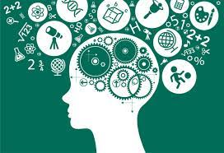
Tactic # 5
Metacognition
(Or Monitoring Our Learning Efficiency)
Thinking Learning
About + About
Our Thinking Our Learning
What Assessing Our Progress On Tasks As We Proceed
Assessing If We Are Understanding
Why So That We Can Make Adjustments As We Go
How Tracking How Well We Are Keeping Up With Our Plans
Testing Ourselves
Explaining Or Demonstrating What We Are Learning To Others

Slide 17

Tactic # 6
Find Your Tribe
(Cultivate Supportive Communities)
What Situate yourself in positive, supportive relationships
Why Learning is a team game (motivation contagion)
Making promises enhances follow through
We all need someone we can lean on
How Partner with a “swim buddy” (peer accountability partner)
Form a “board of directors” (dream team you meet with quarterly)
Work with mentors & Be a mentor

Slide 18

Tactic # 7
Track and Tune
(How Am I Doing, What’s Going Well, What Needs Work)
What Track and monitor task and goal progress each day
Why Helps us be conscious of how we are doing and stay on task
What we inspect is what we expect
How Write down priorities, blocks, pomodoros, schedules each day
Assess results each day – what went well, what needs work
Chill out on perfectionism & practice the serenity prayer
Keep on keeping on and have fun

Slide 19

Activate
Look back at the “power tactics”
Choose one or more to build into your routine
How, when, where and with whom will you build it in?

Slide 20

Draw Your Deep Learning Superhero Picture
Your deep learning superhero name
Your deep learning superhero picture
Your why for being a deep learner
The deep learning power tactics you will use
Who your swim buddy is
Who your dream team is
Your deep learning motto

Slide 21

Let’s Do It

Slide 22
Awesome All Around
Self Awareness, Confidence,
Resilience, Self-Compassion
Imagining Possibilities
Navigating Pathways
Optimizing Potentials
Flourishing, Learning, Serving
Connectedness, Community & Service
Energy, Vitality & Balance
Purpose, Motivation &
Time Management
Deep Learning

