Slide 1


Make It A Habit
Greg Metz Ph.D.
Awesome All Around Life and Learning Coaching
Reframing Limiting Beliefs, Revamping Disempowering Habits, Transforming Our Lives
Coaching, Workshops, Training, Motivational Speaking

Slide 2
Awesome All Around
Self Awareness, Confidence,
Resilience, Self-Compassion
Reframing Beliefs
Revamping Habits
Transforming Our Lives
Flourishing, Learning, Serving
Connectedness & Service
Energy & Vitality
Purpose, Motivation &
Time Management
Deep Learning

Slide 3
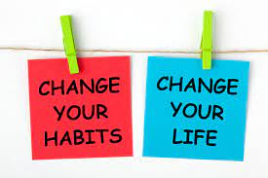

What Are Habits?
Habits are the small decisions you make and actions you perform every day.
Jamesclear.com/habits
Greg’s Definition
Behaviors that we repeat over and over again – good and bad, consciously and not. Behind the scenes patterns that drive our lives.

Slide 4


Why Habits Matter
WE want to be our best selves in various roles within our lives.
BUT villans behind the scenes – counterproductive habits - can disable our best selves.
WE can be THE HEROES of our story by CREATING HABITS that ENABLE our best selves.
We can DISABLE counterproductive habits

Slide 5
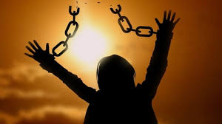
Habits Can Be Powerful and Persistent

Slide 6
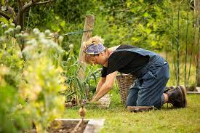

BUT WE CAN Actualize Our Potentials
Cultivating Enabling, Empowering Habits

Slide 7

We Are (Our Own) Computer Programmers
We create ourselves
We are responsible for ourselves
We can program our brains and bodies

Slide 8

The Good News on Habits
Habits have a CODE – a STRUCTURE
WE can LEARN the Code
WE can MODIFY the structure

Slide 9
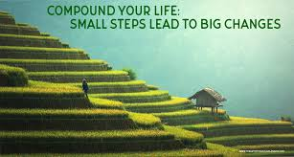
More Good News
Start a new habit
Change is barely noticeable at first
Then – IMPACT COMPOUNDS OVER TIME
VOILA – BIG CHANGE

Slide 10

Dominoes
Small To Big Dominoes Video

Slide 11

The Code
ABC – Anchor to Behavior to Celebration
(TJ Fogg – Tiny Habits)
CCRR – Cue to Craving to Response To Reward
(James Clear – Atomic Habits)

Slide 12
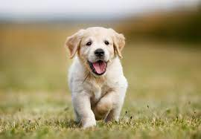
Example – Let’s Walk The Puppy
Cue – Set an alarm for 730 am – the time the puppy likes/needs to walk
Craving – Notice how eager the puppy that you love so much is to walk
Response – Walk the puppy at 730 am each day
Reward – See how happy the puppy is and do a happy dance
Eventually – The behavior becomes automatic

Slide 13

To STOP A Habit
Eliminate The Cue

Slide 14

Let’s Try Out Starting a New Habit
CHOOSE A BEHAVIOR YOU WOULD LIKE TO START
CHOOSE A CUE YOU WILL INSERT
CHOOSE A CRAVING THAT WILL DRAW YOU TOWARDS INITIATING THE BEHAVIOR
ENVISION ENGAGING IN THE BEHAVIOR
CHOOSE A REWARD FOR ENGAGING IN THE BEHAVIOR

Slide 15
Let’s Try Out Stopping a Habit
CHOOSE A BEHAVIOR YOU WOULD LIKE TO STOP
CHOOSE A CUE YOU WILL ELIMINATE
CHOOSE A CRAVING THAT WILL NOT HAPPEN (DUE TO NO CUE)
ENVISION THE BEHAVIOR NOT HAPPENING
CHOOSE A REWARD FOR ELIMINATING THE BEHAVIOR

Slide 16
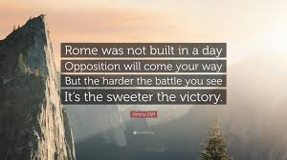
Tips and Takeaways
Make your cues SPECIFIC – precise behaviors, when, where, etc.
Be persistent and patient and resilient (change and compounding take time)
Stack Habits – make one habit a cue for a next habit
Keep in Mind – Goals and willpower are not enough – indicate steps and insert habits
Partner with a swim buddy or dream team (hold each other accountable)

Slide 17

Your “A Ha’s” and Next Steps
What’s one (or more) learnings or “a ha’s” that stuck with you?
What’s one habit you need to stop?
What’s one habit you need to start?
How can you do it?

Slide 18

Questions & A Ha’s & Next Steps
What questions or thoughts do you have?
What action are you going to take?

Slide 19

Let’s Do It

