Slide 1
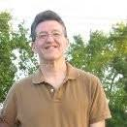

Making The Most of College
For Students and Student Support Teams
Greg Metz Ph.D.
Awesome All Around Life and Learning Coaching
Imagining Possibilities, Navigating Pathways, Optimizing Potentials
Life Coaching, Workshops, Training, Motivational Speaking
awesomeallaround.com

Slide 2


Barriers to Thriving In College
For Students
For Professionals Supporting Students
Students
Knowing My Why, Mobilizing Motivation, Staying Focused
Balancing Life Roles
Commitment & Resilience
Student Supporters
Limitations on Time and Resources
Reactive vs. Proactive Problem Solving
Surface vs. Deep Relationships With Students

Slide 3
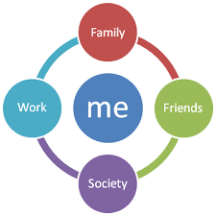
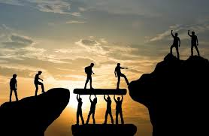
Making The Most of College
Program Objectives
Helping Students Cultivate Holistic Self Awareness, Navigate Life and College, Optimize Potentials
Helping Student Supporters Enhance Depth of Support, Go Beyond Reactive Problem Solving &
Be Transformative Catalysts

Slide 4


Making The Most of College Core Areas
Enhancing Holistic Self-Awareness
Cultivating Holistic Self Awareness & Confidence
Balancing and Navigating Life Roles
Clarifying Purpose & Mobilizing Motivation
Setting and Implementing Goals
Establishing Meaningful Goals
Activating Goals, Optimizing Time, Honing Habits
Learning Efficiently, Effectively and Deeply (And Still Having A Life)
Creating Community and “Tracking and Tuning” Goal Implementation
Cultivating and Sustaining Supportive Relationships
Assessing and Monitoring Progress
Engaging in Ongoing Professional and Peer to Peer Coaching

Slide 5
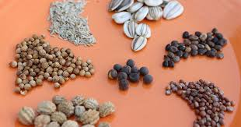
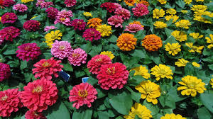
Making The Most Of College Structure -
Foundations Phase
What (4) Immersive, Engaging, Interactive Workshops
Why To Promote Capability & Forward Progress In The MMOC Core Areas
How Facilitated by Greg Metz
Small Group or 1-1
90 Minutes Per Workshop
Whole Day (All 4), Half Day (2) or By Arrangement

Slide 6
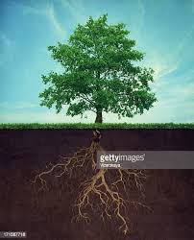
Foundation Phase Workshops
Enhancing Holistic Self Awareness Exploring and Sharing Life Stories, Assessing How Life Roles Are Going,
Knowing Our Why, Establishing Missions
Developing and Activating Goals Crafting Meaningful Goals, Developing Action Plans, Honing Habits,
Understanding How To Learn Deeply (and Still Have A Life)
Optimizing Time Use Planning and Implementing Masterpiece Days, Aligning Actions With Goals
Employing a Time Management System, Tracking and Tuning Daily Progress
Creating and Sustaining Community Engaging With Peer Accountability Partners, Mentors and Dream Teams

Slide 7
Activities For
Foundation Phase Workshops
Enhancing Holistic Self Awareness, Exploring Purpose and Values, Defining Missions
2) Developing and Activating Goals
Optimizing Time Utilization
Creating and Sustaining Community
Life Stories (Bill Johnson)
5 Elements of Catalyst Transformation (Bill Johnson)
Mission Statement (Bill Johnson)
Business Plan (Tony Aloise)
Make It A Habit (Greg Metz)
How To Learn Deeply & Still Have a Life (G Metz)
Masterpiece Days (Brian Johnson)
Reducing Procrastination (Greg Metz),
Using Daily Panda Planner (Panda Planner)
Swim Buddies (Brian Johnson)
Dream Team (Bill Johnson)
Engaging With A Mentor (Greg Metz),

Slide 8
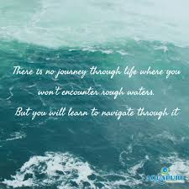
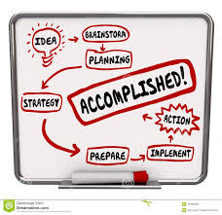
Making The Most Of College
Implementation Phase
Students Implement & Track and Tune Their Action Plans At College
Students Collaborate With Swim Buddies, Dream Teams & Mentors
Coach Provides Monthly Check-Ins for 6 Months (2 Semesters)
Coach Is Accessible Throughout – e mail, text, phone, zoom

Slide 9
awesomeallaround.com
Self Awareness, Confidence,
Resilience, Self-Compassion
Imagining Possibilities
Navigating Pathways
Optimizing Potentials
Flourishing, Learning, Serving
Connectedness & Service
Energy, Vitality & Balance
Purpose, Motivation &
Time Management
Deep Learning

Slide 10

Let’s Do It

