Slide 1
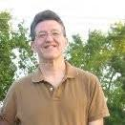

How and Why We Procrastinate &
What We Can Do About It
Greg Metz Ph.D.
Awesome All Around Life and Learning Coaching
Reframing Limiting Beliefs, Revamping Habits, Transforming Our Lives
Coaching, Workshops, Training, Motivational Speaking
For Students, Their Champions and Folks In Transition

Slide 2
Awesome All Around
Self Awareness, Confidence,
Grit, Self-Compassion
Reframing Beliefs
Revamping Habits
Transforming Our Lives
Flourishing, Learning, Serving
Connectedness & Service
Mind & Body
Vitality
Purpose, Motivation &
Time Mastery
Deep Learning

Slide 3
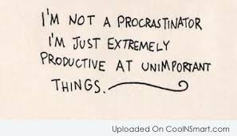
What is Procrastination
Greg’s Definition
Doing less important stuff when we could be doing more important stuff

Slide 4

Let’s Reflect
What is at least one important project, task or “to do” that you have been putting off?
How is procrastinating impacting you? For example – emotionally, practically or socially.

Slide 5
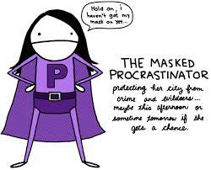
How I Procrastinate Reflection
We all are ingenious procrastinators. Check off any of the techniques that you commonly employ.
I just don’t feel like it so I don’t do it.
I get anxious about doing it so I do something else instead.
I feel too tired so I put it off.
I feel so tired that I sleep instead
I just do one more thing and then one more thing before I start.
I eat instead.
I check my phone instead.
I watch TV instead.
I just forget.
A friend or family member calls or comes by. I do stuff with them.
An emergency comes up.
What else? This is not a complete list. Add your stuff.

Slide 6

Why I Procrastinate Reflection
Check off any of the procrastination why’s that apply to you.
I am afraid I will fail on the project, assignment, task, etc.
I feel anxious about engaging in the project, task, etc.
I feel guilty that I have been avoiding the project, task, etc.
I am often just exhausted.
I cannot get or stay focused.
I am worried about other responsibilities.
I see no purpose in the project or task.
I cannot pull away from my phone – social media, etc.
I do not plan. I forget what I need or intend to do.
I don’t know how to start to stop procrastinating.
I am confused about the project or task.
People around me tempt or distract me to do other things instead.
I do not have friends or family members that help me stay on task with important projects or tasks.
What else? This is not a complete list. Why else do you procrastinate?

Slide 7

Your Top 3 How’s
Your Top 3 Why’s

Slide 8
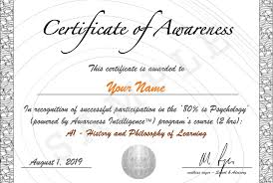
Self Awareness Kudos
Bravo - ☺ -

Slide 9
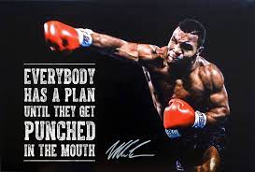
How To Reduce Procrastination
Confidence, Self-Awareness, Grit, Self-Compassion
We Are All In This Together
We Can Change Habits. It’s a Habit Not An Identity. Change It.
Notice Our Procrastination In The Moment – Flip The Switch
Cultivate Grit – Win or Learn. Get Back Up After A Fall.
Give Ourselves A Break. Practice the Silver Rule.
Self-Care
Start the Day Positively – Best Self Affirmations, Gratitude
Cultivate Focus – Meditation or Prayer
Eat Well – Less Sugar, Less Carbs, More Fruit, More Veggies
Cultivate Sleep – Movement, Caffeine Curfew, Digital Sunset

Slide 10

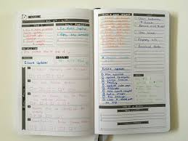
How to Reduce Procrastination
Purpose, Motivation, Time Mastery
Know our why (our purpose)
Know our who (our superhero identity)
Use a planner
Focus on near term outcomes
Put aside the “digital pacifier” (phone)
Get started
Activate Deep Learning
Recognize neuroplasticity
Chunk out the project or task
Spaced repetition (vs. cramming)
Explain it to a five year old

Slide 11


How to Reduce Procrastination
Connectedness & Service
Partner with a swim buddy
Find our tribe
Make a promise
Pay it forward

Slide 12

Reduce Procrastination Mission Statement
I, ___________________, am awesome as I am. However, sometimes I procrastinate.
What I do instead of my important stuff is (3 top how’s) ______________,
__________ and ____________________.
Why I procrastinate (3 top why’s) is ____________,
_____________ and _________________________.
I am actually not a procrastinator. I am (superhero name) _____________________
I will reduce my procrastination by (3 new habits to start) _______________
___________ and _______________.
My swim buddy (accountability partner) will be ________________

Slide 13
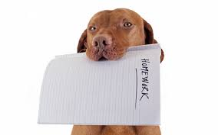
Next Steps
Refine the mission statement
Read it to yourelf our loud
Read it to your swim buddy out loud
Write or type it out nicely
Add pictures or inspirational quotes
Mount it on carboard
Enclose it in plastic cover or laminate it
Put it in a highly visible place (screensaver)
Put the mission into action – 54321
Meet with swim buddy routinely to track and tune
Give yourself grace. Rome wasn’t built in a day.

Slide 14
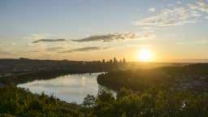
Let’s Do It

Slide 15

Testimonials and Q&A

