Slide 1

What you need to know about Healthy Sleep
Comprehensive Sleep Services
An Easy & Effective Solution for the Diagnosis and Treatment
of Obstructive Sleep Apnea

Slide 2
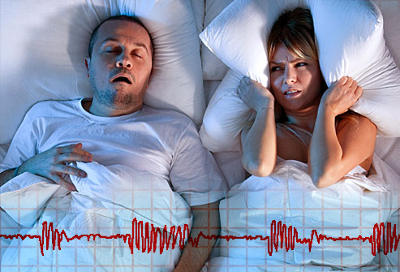
What you need to know about Healthy Sleep
What is Sleep Apnea?
Apnea – without breath
Sleep Apnea – without breath during sleep

Slide 3
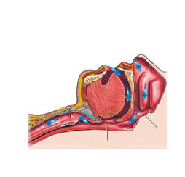
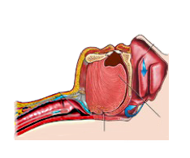
Snoring & Sleep Apnea Described
Normal Open Airway
Obstructed Airway
Nose
Nose
Chin
Chin
Throat
Throat
Tongue
Tongue
Open Airway
Blocked Airway

Slide 4






Costs of Undiagnosed Sleep Apnea
Workplace Accidents
Lost Productivity
$6.5 billion
TOTAL
$86.9 billion
Automobile Accidents
$149.6
billion
Comorbid Diseases
$26.2 billion
$30 billion
Source: “Hidden health crisis costing America billions” by American Academy of Sleep Medicine (AASM) 2016

Slide 5

Snoring & Sleep Apnea Facts
More than 50% of adult Americans snore.
Snoring is a precursor to Obstructive Sleep Apnea (OSA).
More than 70 million Americans are suffering from a sleep disorder.
Obstructive Sleep Apnea is the largest group of affected patients at over 29 million or approximately 12% of US adult population.
90% of adults with OSA are unidentified, undiagnosed – and will never know they have a chronic disease unless the medical and dental professions starts Screening, Testing, and Treating.
Of the 10 % that have been diagnosed, only 25% of them are actually receiving treatment during their entire sleep periods.

Slide 6

Comprehensive Sleep can help!
Quick, easy, affordable screening.
Quick, easy, affordable telemedicine visits with a physician trained in sleep to go over your screen and order your sleep test.
Quick, easy, affordable home sleep testing.
Quick, easy, affordable therapy with the Oral Sleep Appliance.
In-Network with 10 major insurance carriers for the lowest out of pocket expense to you.

Slide 7
What you need to know about Healthy Sleep
Comprehensive Sleep Services
An Easy & Effective Solution for the Diagnosis and Treatment
of Obstructive Sleep Apnea
Our Process

Slide 8

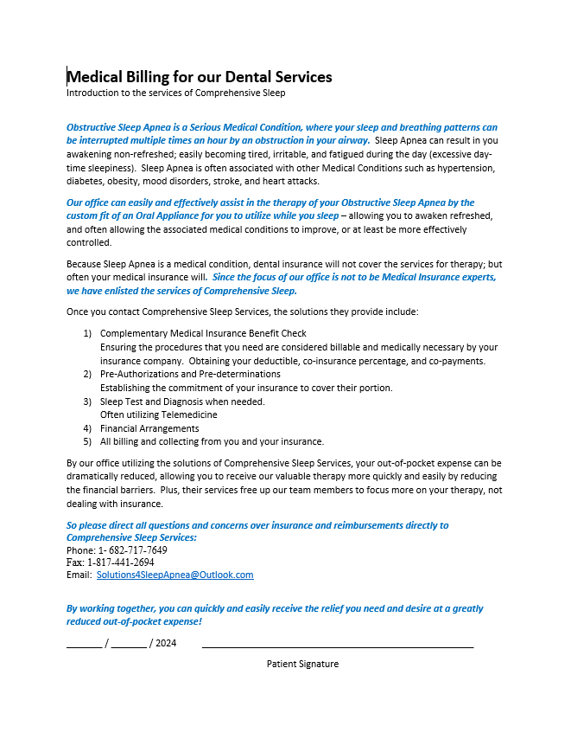
Comprehensive Sleep
Introductory Letter
Explaining the relationship between Comprehensive Sleep and your Dental Provider as well as the services we provide. Also provides our contact information.
Easy Sleep Model

Slide 9
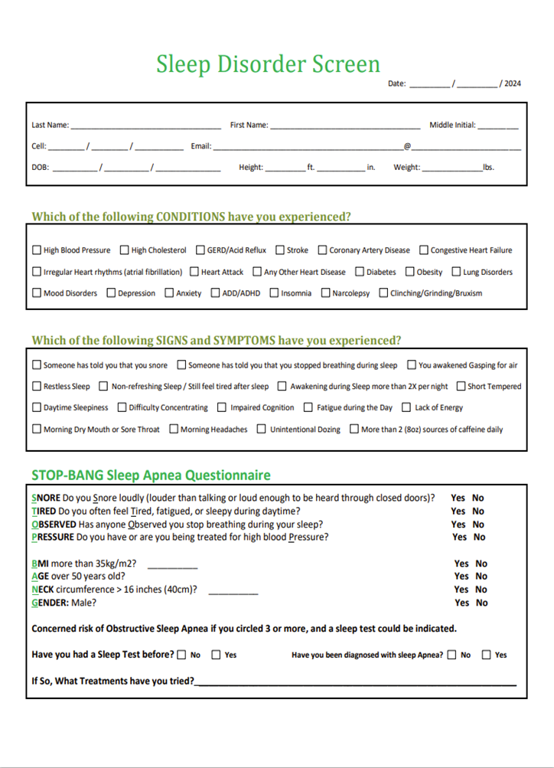
You Scored Positive for Sleep Apnea on a screen given to you by your Dental Provider.

Slide 10
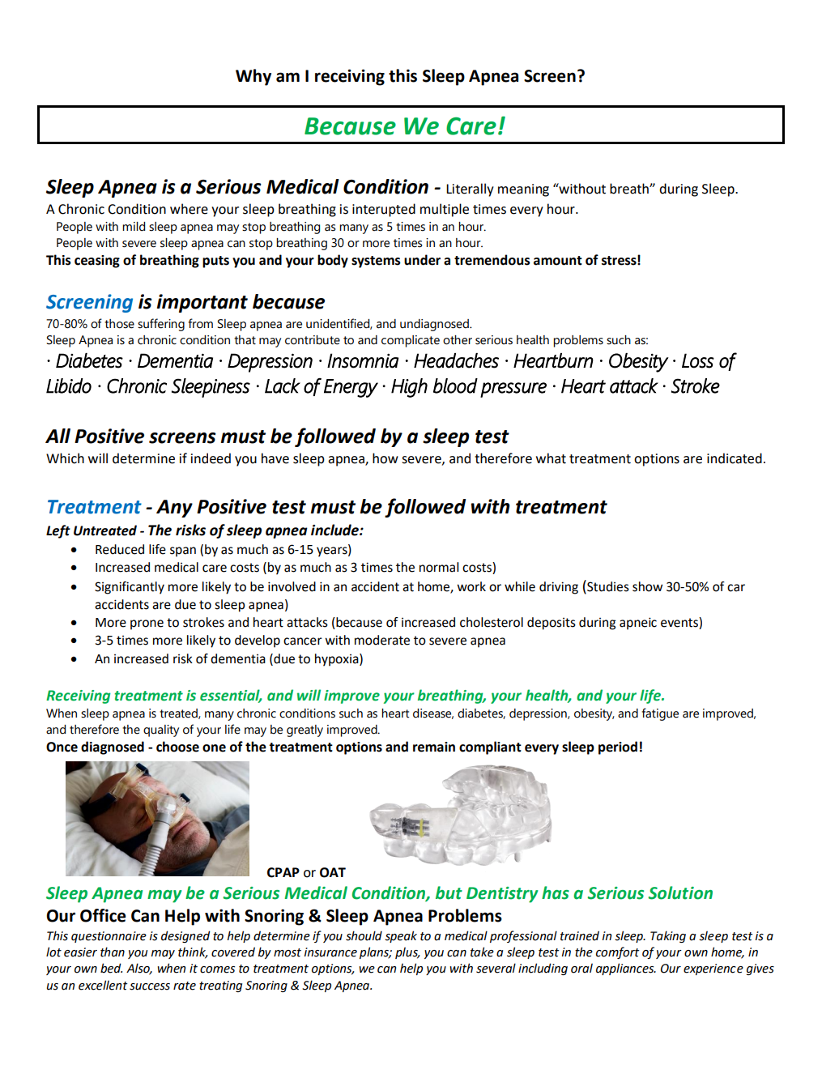
You were given this screen – because they care.
90% of adults with OSA are unidentified, undiagnosed – and will never know they have a chronic disease unless the medical and dental professions starts Screening, Testing, and Treating.

Slide 11
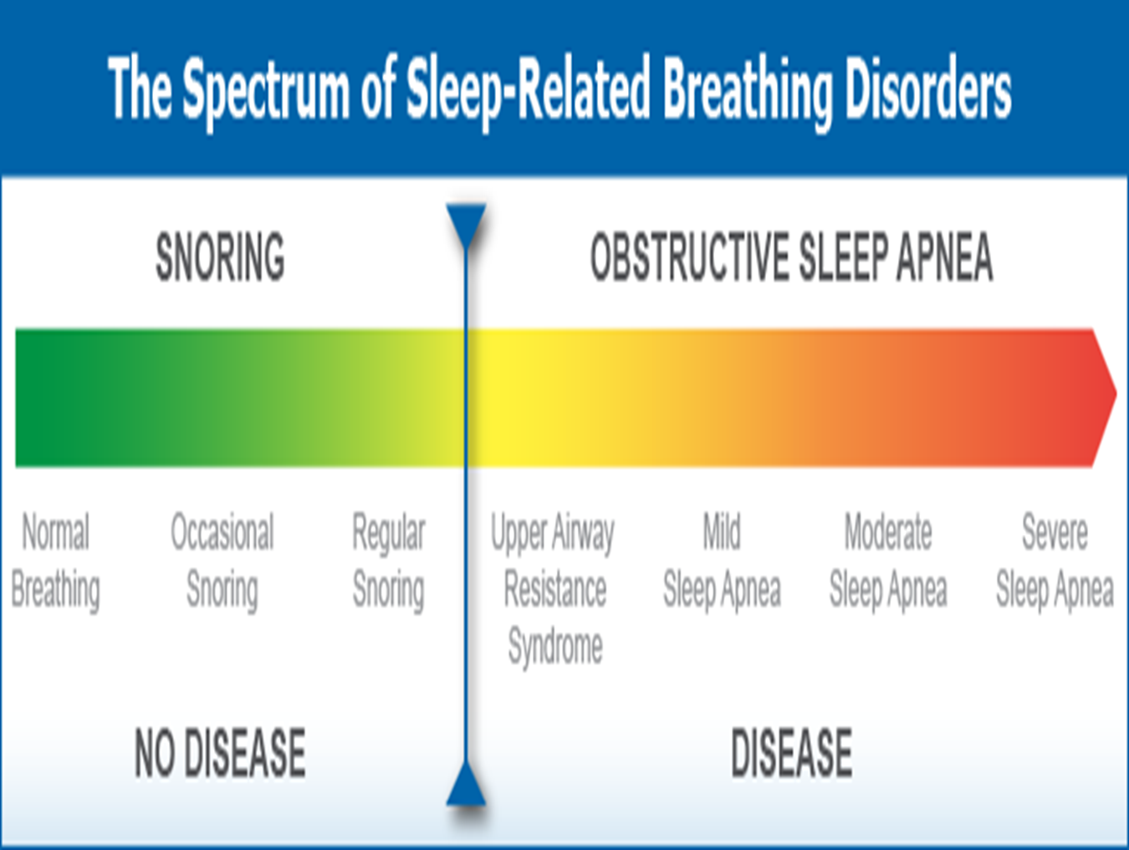
Once Screened POSITIVE, you need a SLEEP TEST to confirm where you are on the Spectrum

Slide 12
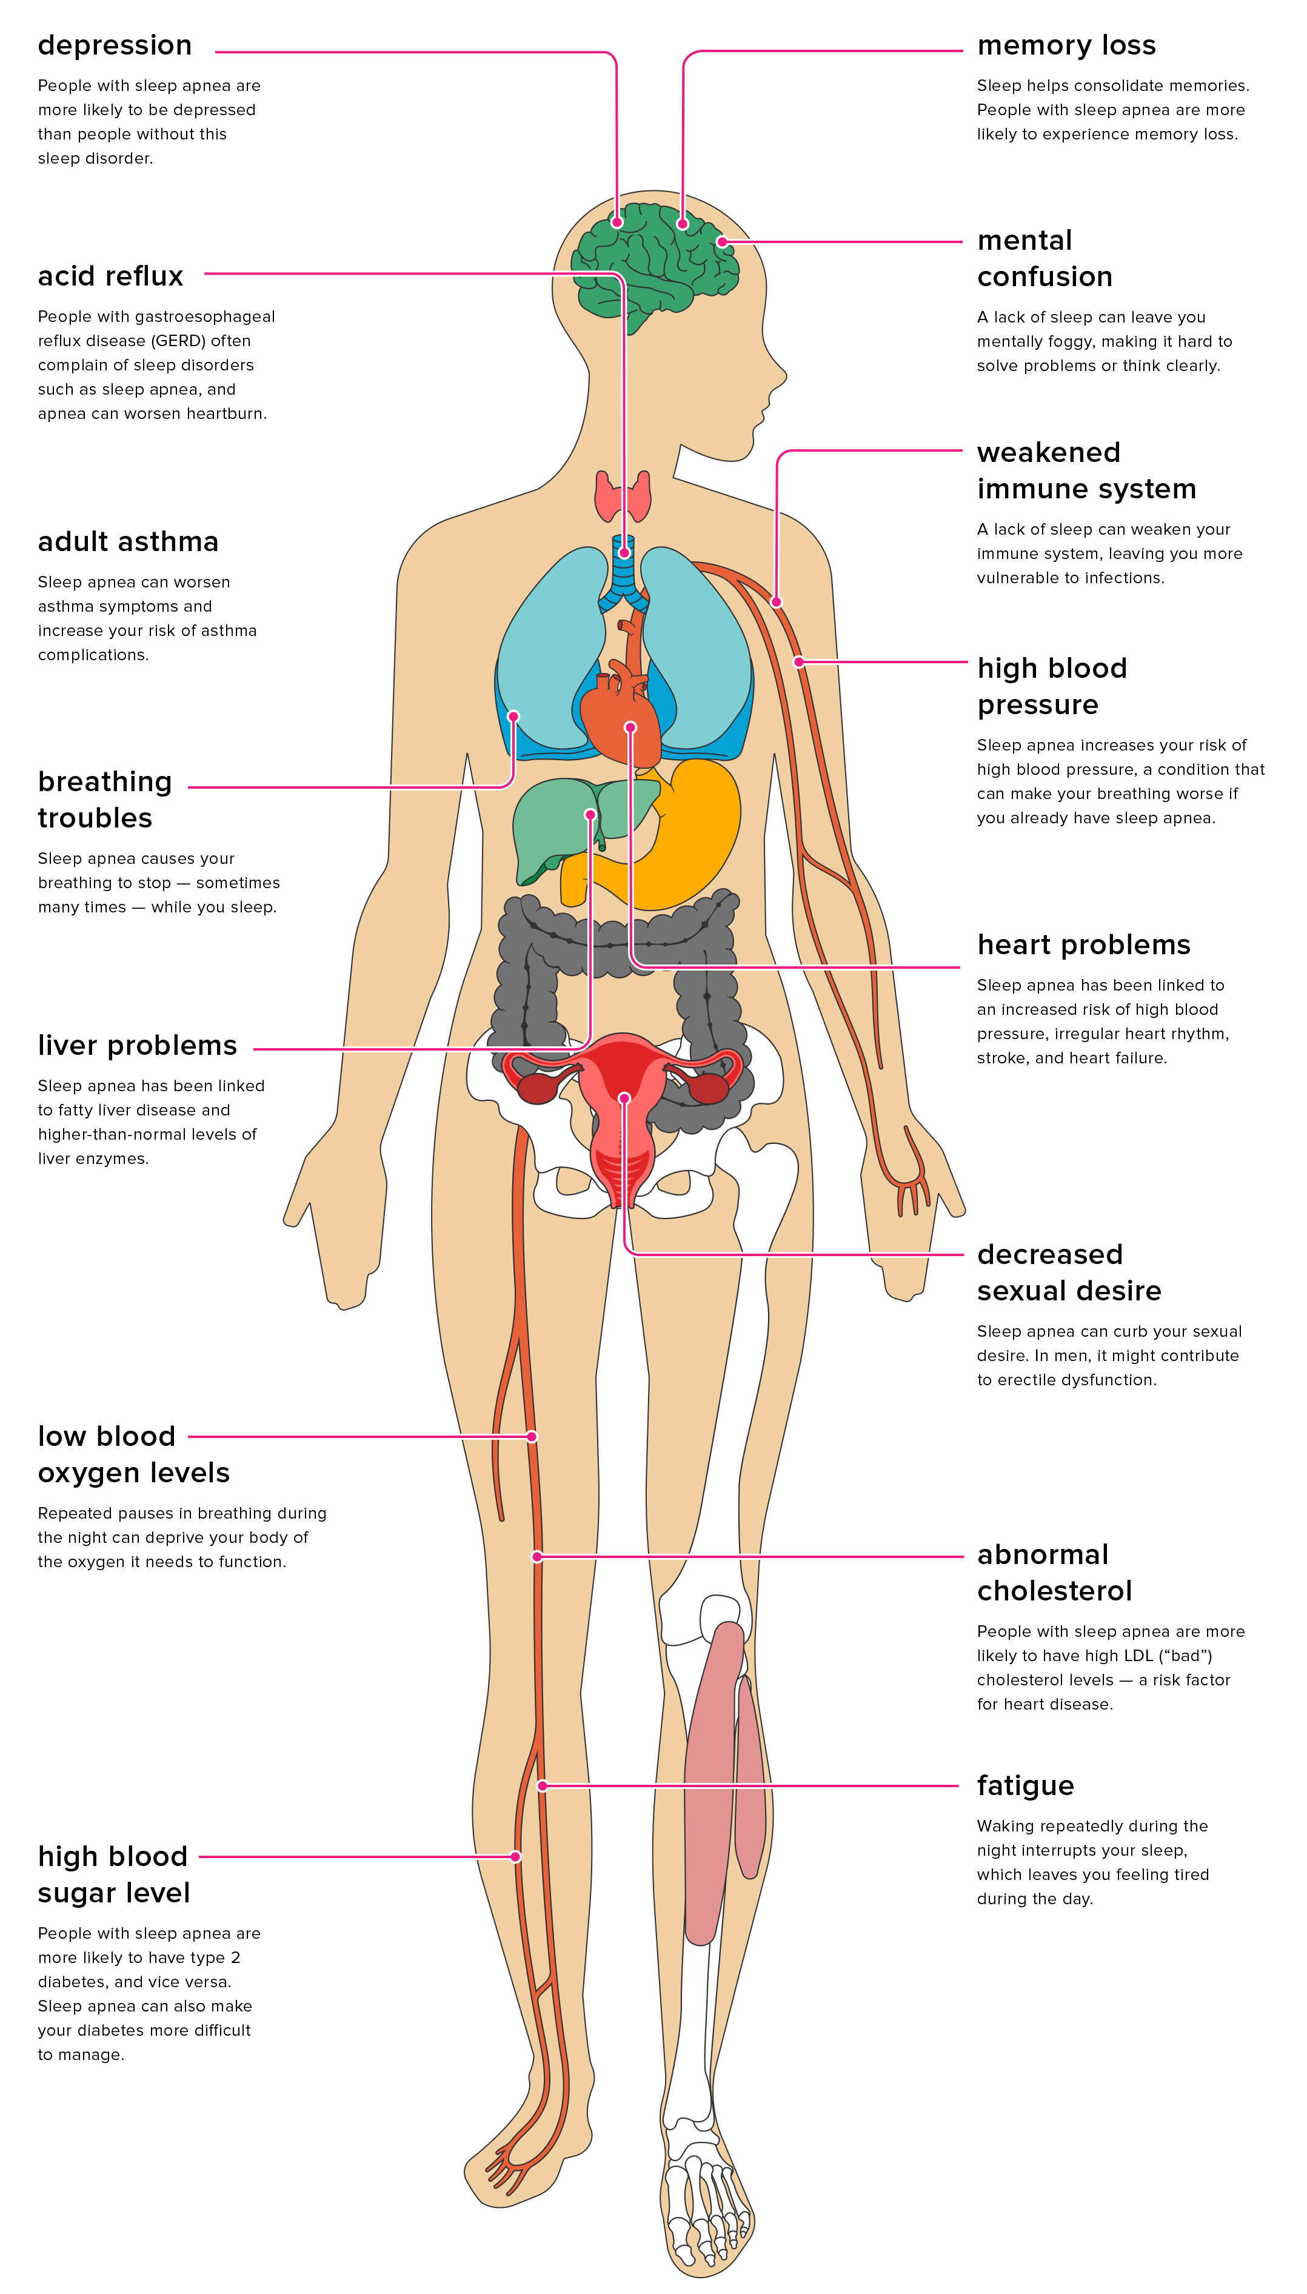
Comprehensive Sleep Model
Through the magic of telemedicine, our Physician trained in sleep will go over your screen and how your medical conditions relate to sleep apnea. He will then order a sleep test for you.

Slide 13
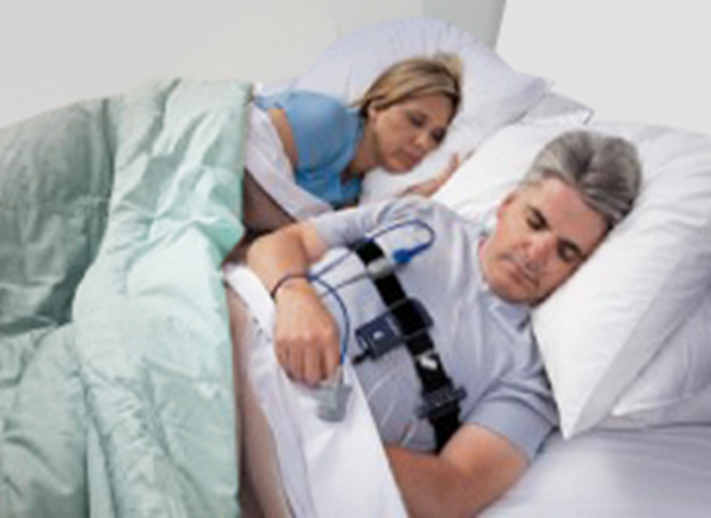
Once Screened POSITIVE, you need a SLEEP TEST
In Home Sleep Study – Effective – Comfortable - Affordable
Testing location - | In the comfort and convenience of your home.
Cost - | Approximately ¼ the cost of in lab study.
Patient Experience - | The Sleep Testing Device arrives in your mailbox. Testing is performed over two nights in the comfort of your own bed, and the data stored on the equipment is uploaded the following day and received by the clinic.
Testing Equipment - | Small nasal cannula to measure airflow. Finger clip to measure the oxygen saturation in the blood.

Slide 14
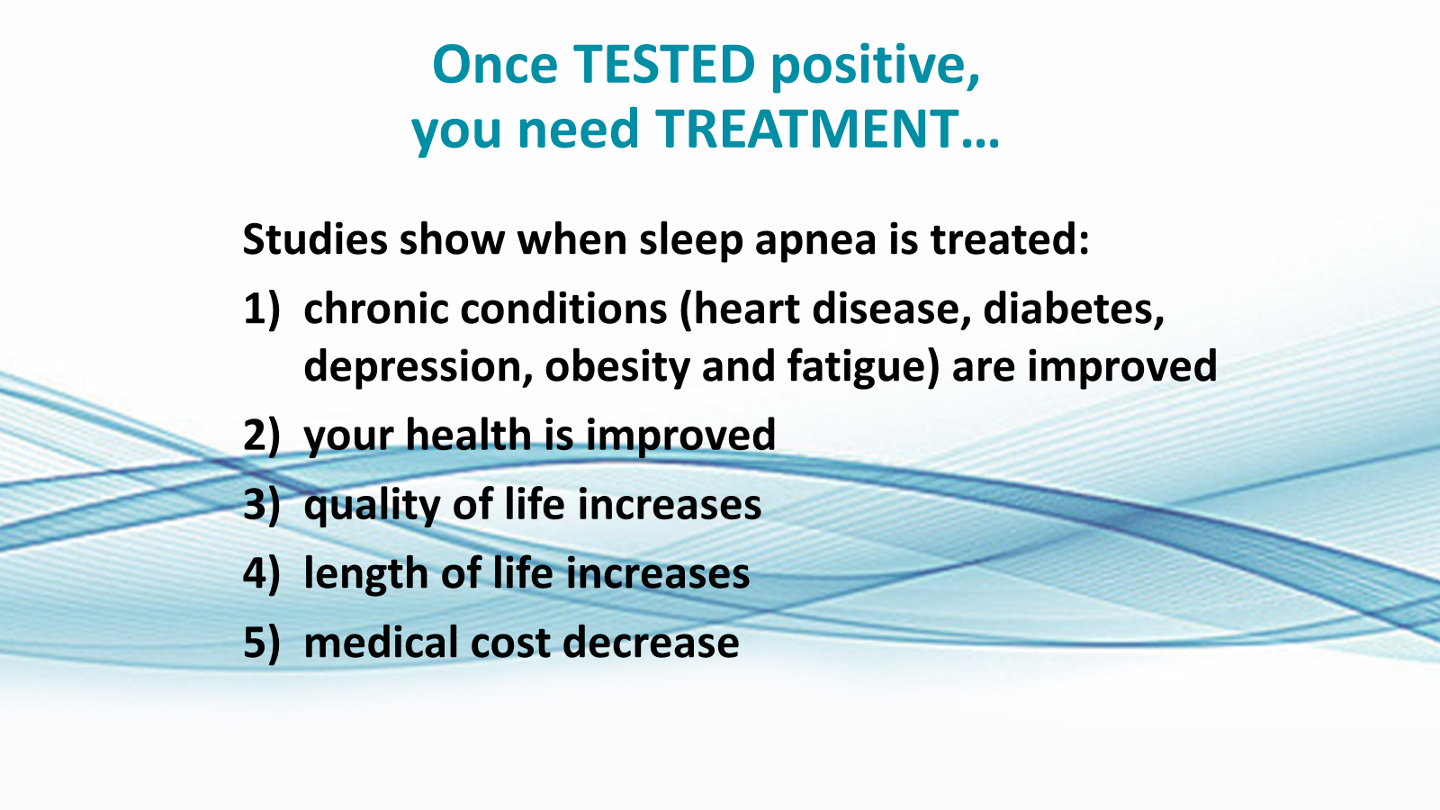

Slide 15
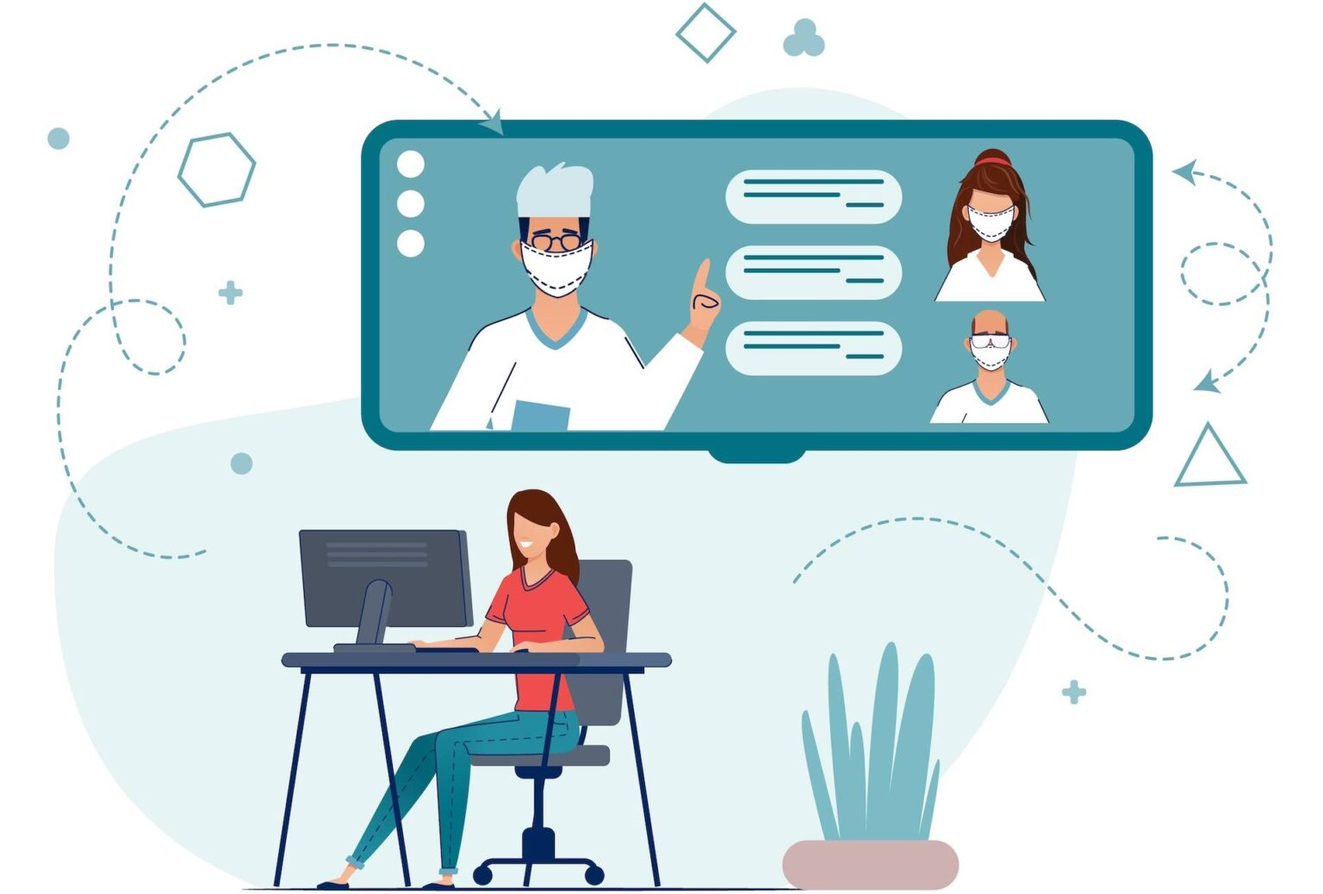
Comprehensive Sleep Model
Through the magic of telemedicine, our Physician trained in sleep will go over the results of your sleep test, the treatment options available for you, and order your therapy.

Slide 16
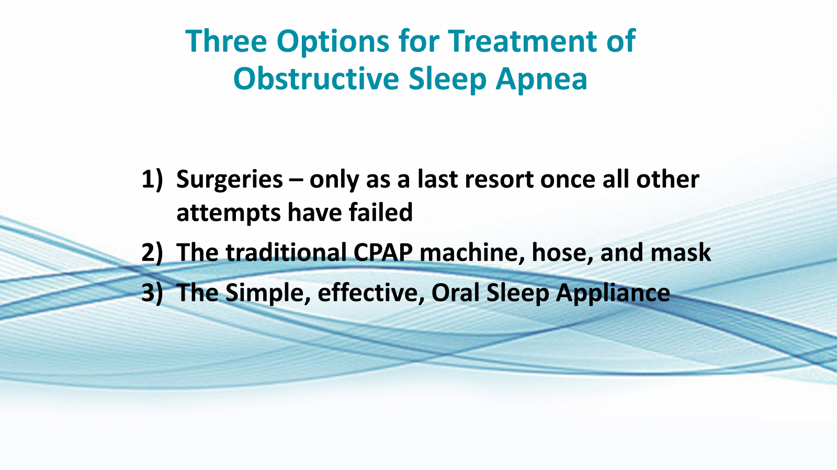

Slide 17

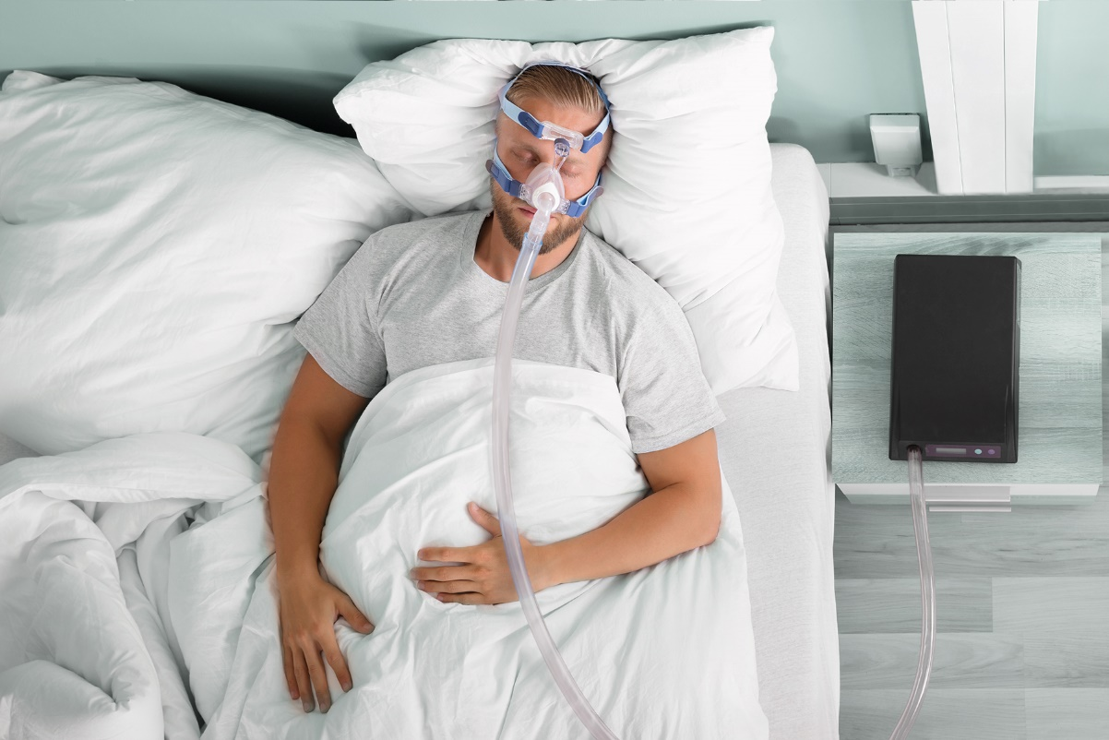
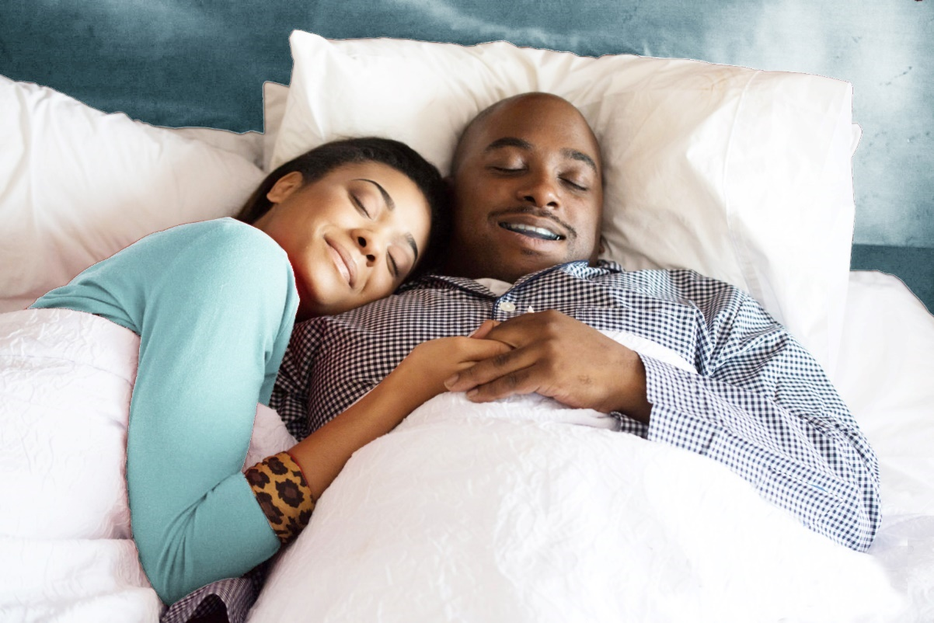
Sleep Apnea Treatment
Traditional CPAP
Our Simple Solution

Slide 18

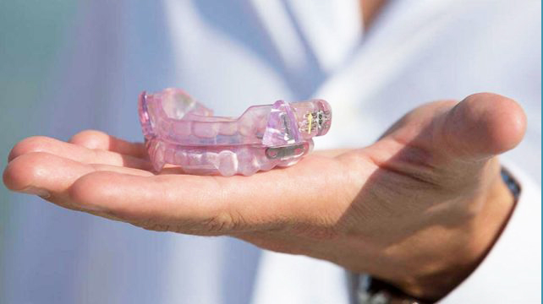
Sleep Apnea Treatment – Our Simple Solution
Oral Appliance Therapy – no CPAP Machine, Masks, or Hoses
How it works - | Gently moves the lower jaw forward, opening the airway and obstruction.
Traveling - | Easy and can be stored in a small retainer case and carried in a small retainer box, purse or briefcase.
Requires Electricity - | No.
Makes Noise - | No.
Can open mouth, talk or drink while wearing - | Yes.

Slide 19
WHY WE FEEL Oral Sleep Appliance IS BETTER
You are more apt to use it
Does not restrict your sleep positions
Easy to travel with
No more claustrophobia
Bed Partners like it!
Over 50% of patients prescribed Continuous Positive Airway Pressure (CPAP) discontinue use within one year.

Slide 20
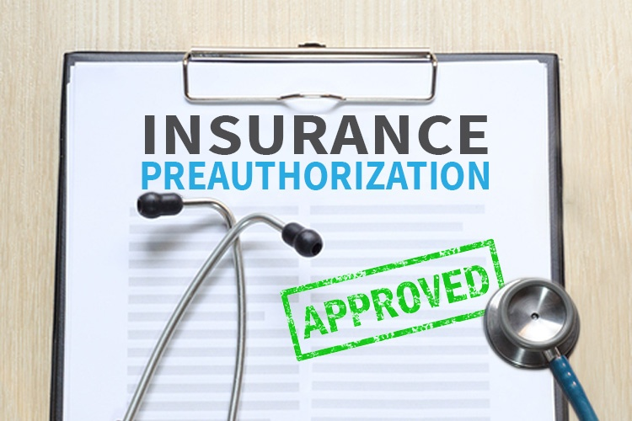
Comprehensive Sleep Model
Our therapy billing team will immediately send in a pre-authorization request for your Oral Sleep Appliance and the next day Aligner to your medical insurance.

Slide 21
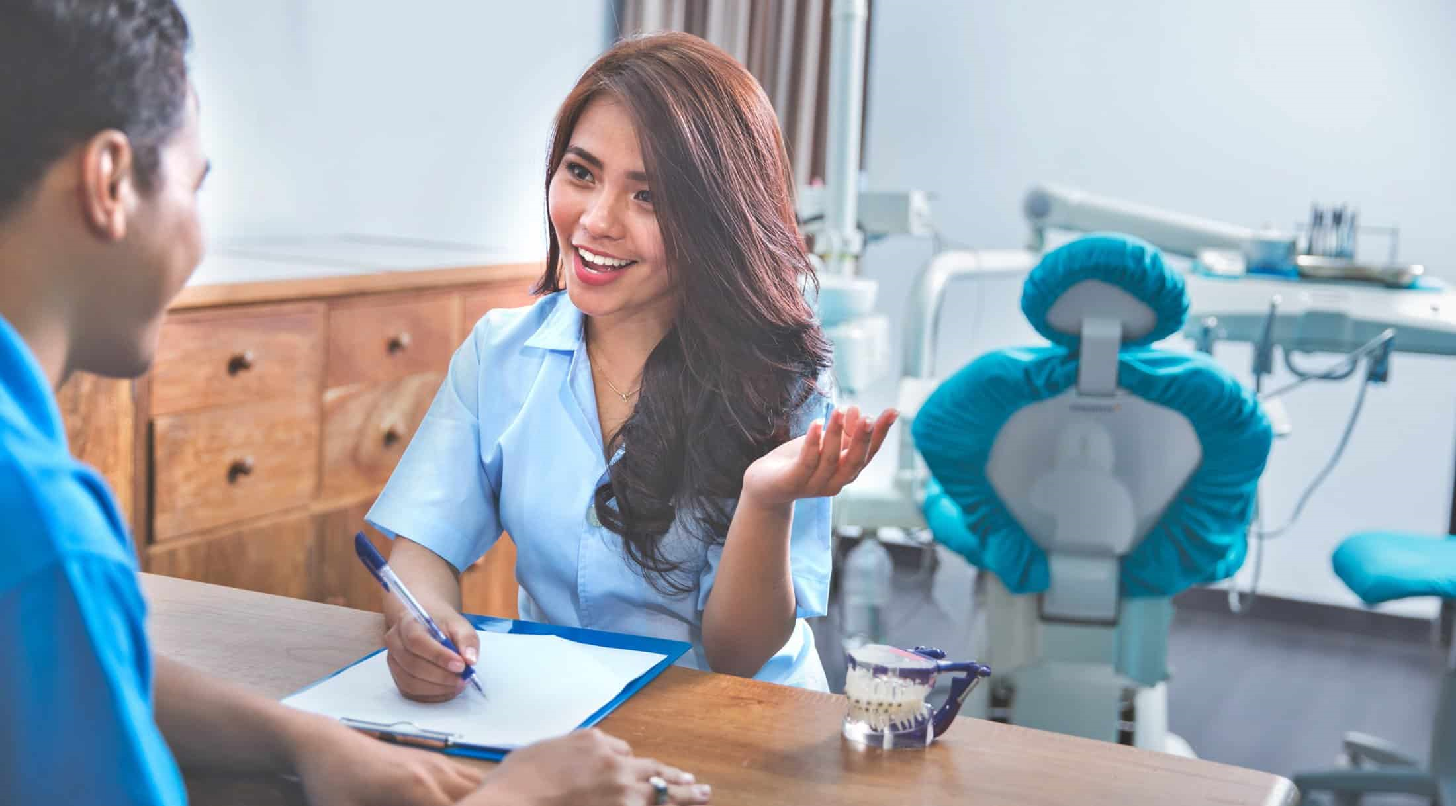
Comprehensive Sleep Model
Once the pre-authorization request for your therapy is received, our billing team will reach out to you with an exact out of pocket maximum for your Oral Sleep Appliance and the next day Aligner.

Slide 22
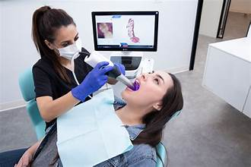
Impressions / Scans.
Once financial arrangements have been made, you will return back to your Dental Provider for the Impressions / Scans for your Oral Sleep Appliance and the next day Aligner.

Slide 23
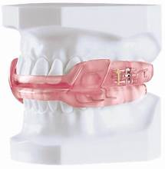
Delivery of your
Oral Sleep Appliance.
Two to four weeks later, you will return back to your Dental Provider for the Delivery of your Oral Sleep Appliance and the next day Aligner.

Slide 24
