Slide 1
Is it ethical for Big Pharma Companies to discourage generic drugs’ access to the market?
MARK BURKHARDT
ASHLEY EVDOKIMO
MJ MAJADLY

Slide 2
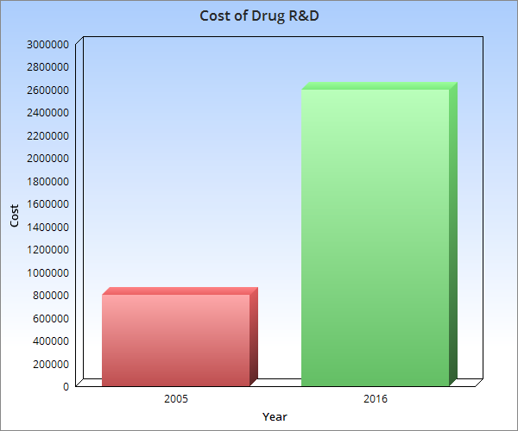

Slide 3
How big pharma lost due to generics
BMC Clinical Pharmacology in Finland
shows the impact of generic substitution (GS) on the pharmaceutical companies
one year (2004) and five years (2008) after the introduction of GS

Slide 4
What was the research on?
the impact of generic drug on the number of employees
the amount of prescription medicine marketing
the prescription medicine representatives’ visits to pharmacies and to physicians
the number of different packages of pharmaceutical products for sale
R&D of new pharmaceutical products
storage of pharmaceuticals

Slide 5
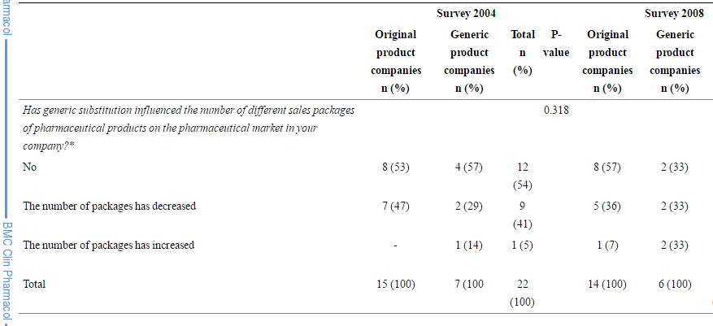
Impact of GS on the range of sales packages of pharmaceutical products on the market
More than half of the brand name companies reported that generic drugs had impacted the amount of prescription medicine marketing; most of which had decreased the amount of promotional activities after generic drugs came into the picture.

Slide 6
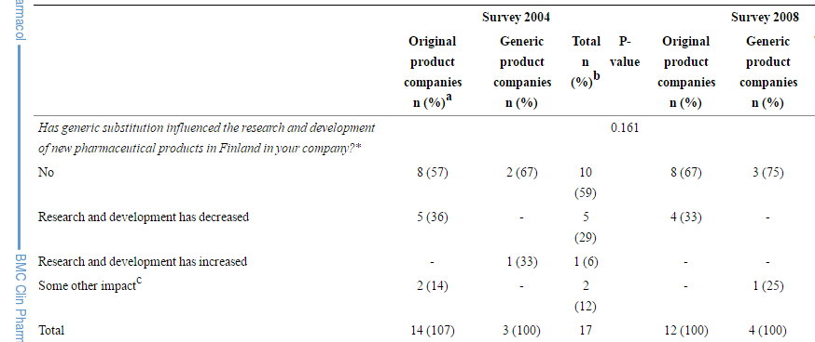
Impact of GS on the R&D of new pharmaceutical products in Finland
- Reduction in the R&D of new pharmaceutical products
- Sales volume of original products have decreased
- Generic drug affected the storage of pharmaceutical products in most brand drug companies; led to overstocking due to reduction of sales volume
- Reduction in the number of packages for sale

Slide 7
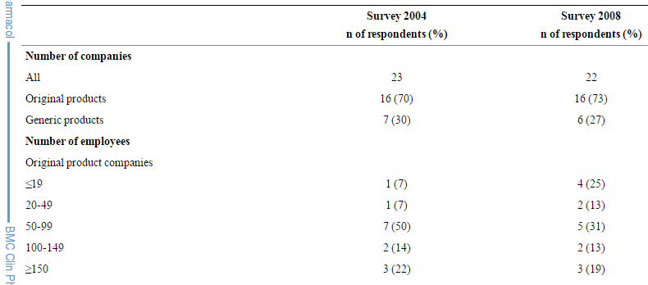
Background characteristics of the study companies in the 2004 and 2008 surveys.
The number of the brand drug company employees decreased in total of 800-900 people between 2003 and 2008

Slide 8
Authorized Generics
So-called “pseudogenerics”,
“ultragenerics”, or
“authorized generics”
are generics drugs that are made by firms controlled by brand-name companies.
Generic drug companies are trying to fight this new law by the FDA saying “such ‘authorized generics’ either reduce or kill the market for the generic firm”. "Patent Disputes." CQ Researcher

Slide 9
Imitation is the best form of flattery?
FDA website states “A generic drug is identical–or bioequivalent–to a brand name drug…”
Generic drugs are not “identical” to name Brand Names drugs.
  The process and inactive ingredients (excipients) differ.
Generics must be reversed engineered
  Develop different technologies to deliver active ingredients = different drug
Notes:
According to the FDA, generics must have the same active ingredient, label and dosage strength, and must be bioequivalent (more on this in a minute).What does not need to be the same is the process in which the drug is made and the inactive ingredients. When touting something as identical, shouldn’t everything be the same? Isn’t that the definition of identical? Yet having a different process and inactive ingredients leads to pills not only of different size and color, but ones that react differently in patients compared to Brand Name drugs, causing inconsistent results and different side effects. Further, according to author and pharmacologist Joe Graedon, “the physical characteristics or release properties of a brand name drug often stay under patent even after the active ingredient becomes available generically”, meaning generic companies have to reverse engineer the brand name drug and develop new and different technology to deliver active ingredients, which can have varying effects.

Slide 10
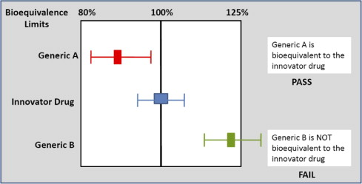
Bioequivalent
According to the FDA, Bioequivalence is “an equal rate and extent of drug absorbed in the bloodstream”.
Apparently equal means a range between 80% to 125%
Notes:
Bringing me to Bioequivalence. According to the FDA, Bioequivalence is “an equal rate and extent of drug absorbed in the bloodstream”. However, the FDA has “established bioequivalence limits... for the generic/reference comparison… to be within 80% to 125% [of the brand name drug].” That means there is a 45% range in which generics can be “equal” to their counterparts. That is a HUGE disparity, and has consequences...

Slide 11
Potency
Dr. James Hennesey.
  Three different forms of levothyroxine had varying potencies.
12.5% above, 9% above, and 3% above Brand Name.
Less than 10% difference in consider significant.
Notes:
Recently, Dr. James Hennesey, clinical director of the division of endocrinology at Beth Israel Deaconess Medical Center in Boston, presented three different forms of levothyroxine to the FDA’s advisory committee and “all were more potent than the branded version and varied from one another. One was 12.5% above, another 9% above, and another 3% above the brand name’s potency. All had been approved as bioequivalent.” Further, the doctor noted that anything less than a 10% difference was considered significant.

Slide 12
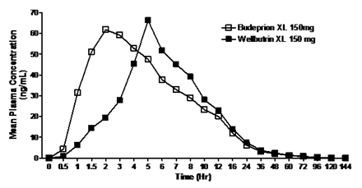
Budeprion XL 150
Generic version of Wellbutrin XL 150, an antidepresant.
1.5 to 2.5 hrs vs 5 to 6 hours to reach max blood concentration.
FDA does not measure hour to hour blood absorption.
Notes:
Finally, another example of a generic drug failing to meet brand name execution is Budeprion XL 150, the generic version of Wellbutrin XL 150, an antidepressant. According to the FDA (see Figure 1), the time it took for each drug to reach maximum blood concentration with Budeprion XL 150 was 1.5 to 2.5 hours, while it took 5 to 6 hours with Wellbutrin XL 150.⁹ An investigation done by ABCNews reported that because of the time release difference in the generic drug patients to became severly depressed, and even attempt suicide. Yet, because the FDA does not measure hour to hour blood absorption as part of its standards for generics, this drug was deemed viable. Thankfully, it eventually had its approval withdrawn. However, how many generic drugs are still out there that may do the same thing?

Slide 13


