Slide 1
TITLE
Charter for Racial Justice
Logo here
Congressional Outreach
January 14, 2023
Subtitle
Date

Slide 2
Congressional Outreach
By Joyce Pratt
GNJUWF Communications Coordinator

Slide 3
Congressional Outreach Introduction
The Greater New Jersey United Women in Faith (GNJUWF) plans to pursue our missions through additional social action efforts as state and federal legislature constituents by contacting and encouraging our legislators to review and act on bills that mirror the efforts of GNJUWF to improve our society -- Congressional Outreach.
“It takes more than one voice to make harmony.”

Slide 4
Congressional Outreach Agenda
Legislature
New Jersey Legislature
U.S. Legislature/The Legislative
Branch
Public Opinion and Government
Social Action/Justice
Congressional Outreach
Social Action Programs & Bills
Outreach Methods

Slide 5
Legislature New Jersey Legislature
40-member Senate and 80-member General Assembly located in the State House in Trenton.
Legislators elected from 40 legislative districts.
Legislature is considered part-time, and most legislators hold other employment.
The chief function of the Legislature is to enact laws.
Proposals for new laws or changes to or appeal of existing laws are presented as a bill
A bill must pass both Houses by a majority and approved by the Governor.
At least eleven (11) steps to how a bill becomes a law in New Jersey and the first step is sponsorship by a Legislator.

Slide 6
Legislature United States Legislature/The Legislative Branch
Established by Article I of the U.S. Constitution.
Consists of House of Representatives and the Senate which together form the U.S. Congress.
Sole authority to enact legislation and declare war, right to confirm or reject Presidential appointments, and substantial investigative powers.
House members elected every two years and also has exclusive powers.
Senate has 100 members, two for each state, and elected to six-year terms by each state.
Both House and Senate must pass the same bill.
First step in legislative process is introduction of bill by members of Congress.
Bills introduced must be reviewed by House and Senate committees.
Bills passed by both House and Senate are sent to President for approval.

Slide 7
Public Opinion and Government
Democratic process spurs citizens to form opinions on a number of issues.
Legislature may become a public issue if a significant number of people wish to make it one.
Public opinion is very important to a democratic system and may influence policy positively or negatively.
Political attitudes of people are often stimulated or reinforced by outside agencies who favor their own mandates.
Representation largely depends on a reactive public which watches and responds to what the government is doing.
When the public is not attentive or uninformed on their preference, little policy advantages are gained.
Legislators or candidates may poll the public to learn public opinion.
Regardless of polls taken, some government branches pay closer attention to public opinion than other branches.

Slide 8
Social Action and Social Justice
Social action is defined as the best way to inspire change by confronting decision makers in a concerted action.
It ranges from organizing letter-writing campaigns to assembling thousands of people in the state or national capitol to protest or encourage government actions.
Social justice is defined as fair and equitable division of resources, opportunities, and privileges in society.
Speak to your representatives when you want state and federal legislators to work better for you.
Call on legislators to support your efforts and/or run for office.
It has been reported that less than 20% of Americans approve of the job Congress is doing. Congress needs your input.
Once we have prepared our communities for social action, we can implement these actions through legislation – social justice.

Slide 9
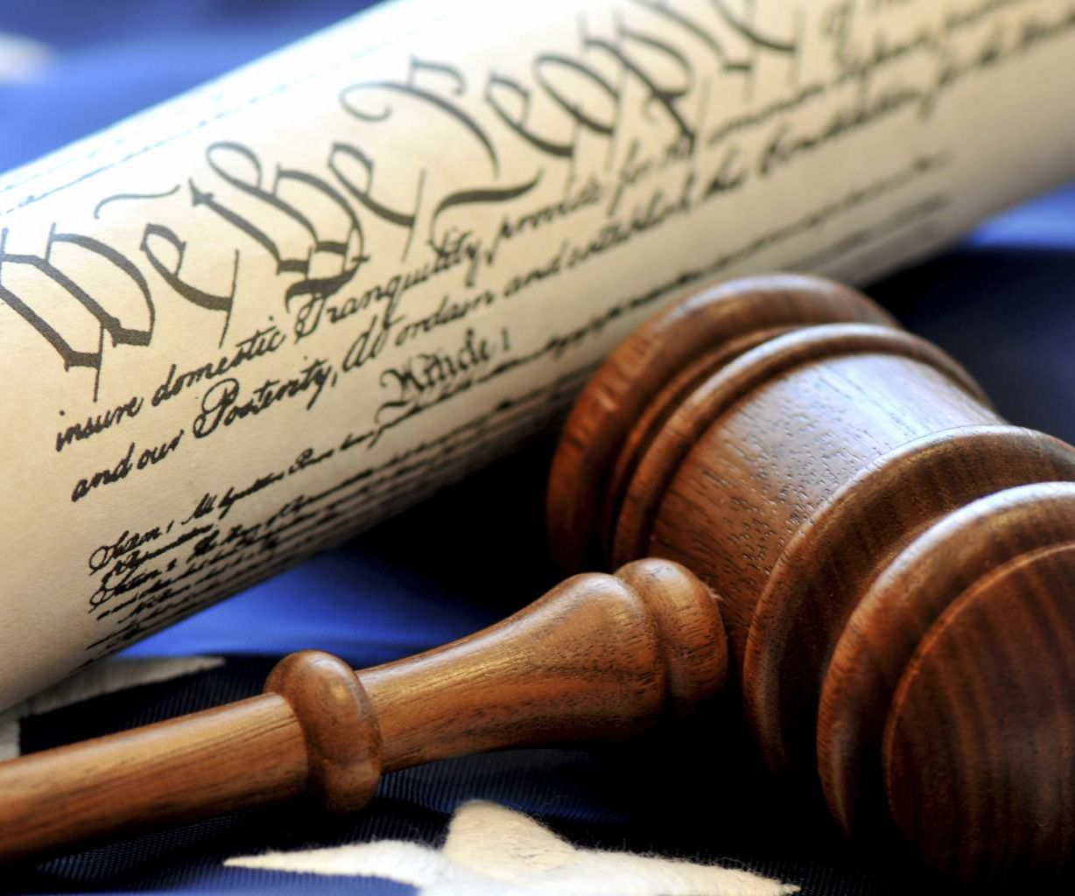
Congressional Outreach Social Action Programs & Bills
GNJUWF current initiatives | New Jersey Relevant Bills | U.S. Congress Relevant Bills
 | As of June 29, 2022, 50 pending bills. | Total of 24,784 current bills; 331 for Dec. 2022
Environmental Protection | 2 | 14
Gun Violence Immigration |  | 3 6
Inflation Racial Justice | 2 | 4
Women’s Rights |  | 2

Slide 10
Congressional Outreach - Methods Interest Group Committee
Social action efforts must be conducted as a committee to ensure individual and collective concerns.
Members should include at least one from each GNJUWF with a chairperson.
Total members to obtain legislative awareness.
Discussions on objectives aligned with GNJUWF mission.
Name committee such as “GNJUWF Special Interest Group.”
Maintain committee information on website.

Slide 11
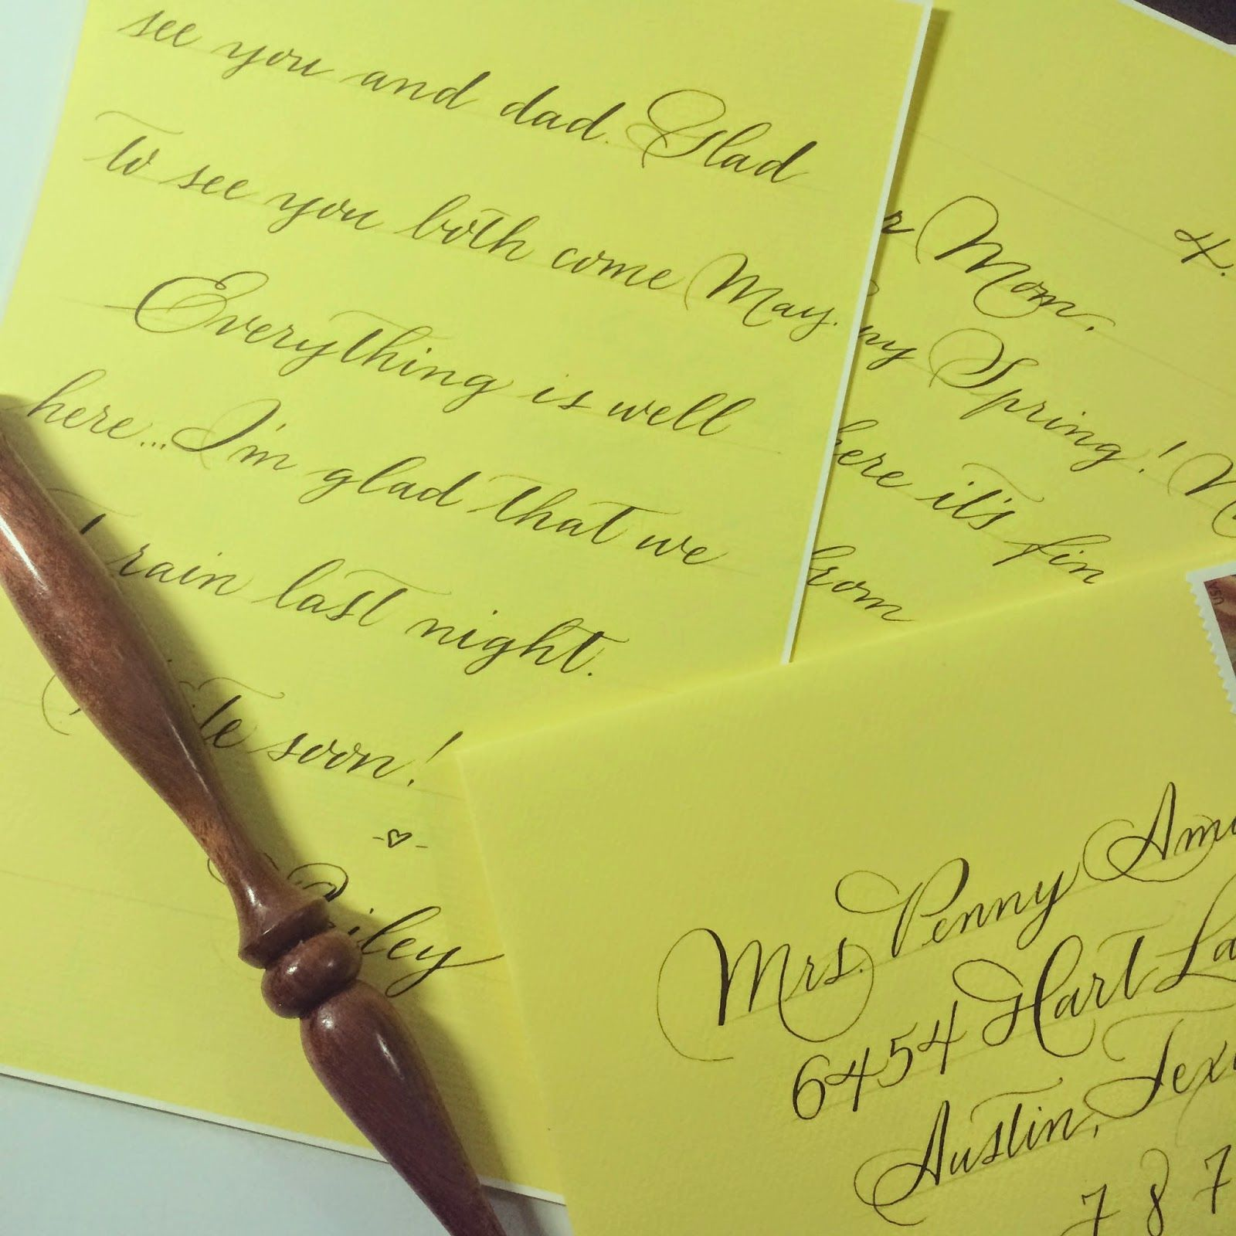
Congressional Outreach - Methods Letter Writing
Send letters and/or emails to NJ legislators and New Jersey’s two U.S. senators.
Insist on immediate attention to the bills you have selected that promote social justice efforts.
Follow-up on your correspondence with second mails or emails.
Contact no replies via telephone.
List of applicable legislators, letter templates, email and mailing addresses, and telephone numbers are available upon request.

Slide 12
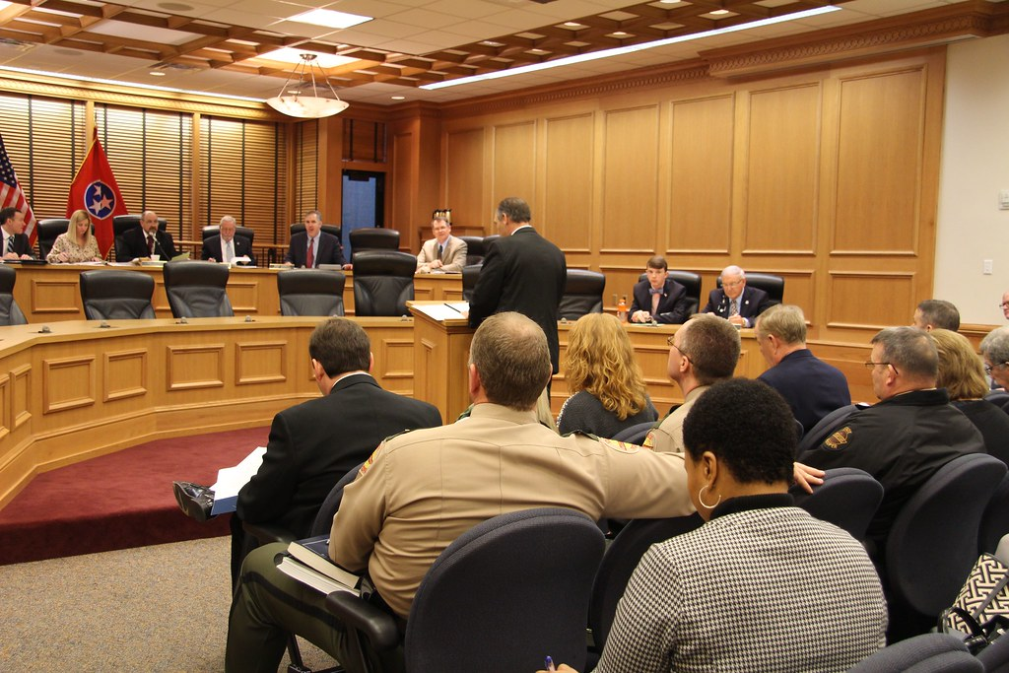
Congressional Outreach - Methods Legislative Visits
New Jersey
Schedule a “Day at the Capitol” to meet and speak with Governor Murphy and elected legislators.
Reservations are a must and can be made by calling the Tour Office at 609-847-3150.
Emphasize that you wish to visit as a Special Interest Group and not for a tour.
U.S. Congress
Contact your New Jersey Senators (Booker and Menendez) to schedule a meeting at their Washington, D.C. or New Jersey office.
Follow-up and confirm your scheduled visit before the date.
Bring related resource material and take photos for the newsletter.

Slide 13
Quote Government of the people, by the people, for the people, shall not perish from the Earth. Abraham Lincoln

Slide 14
Q&A Session – Think Tank

Slide 15
Thank You
Joyce Pratt
GNJUWF Communications Coordinator
www.gnjumw.org

