Slide 1
Pain Management in Endometriosis
Dr.Vinod Gadiyar
MBBS,MD,DA,FCARCSI,FFPMCAI,MSc(pain)
Consultant in Anaesthesia and Pain Medicine
Northern Care Alliance NHS FT

Slide 2
Kirsty
39 year old lady
Jan 2023- Referred with back pain radiating into both legs, showed disc prolapse, had epidural injection. Helped, but continued to have pain.
Ultrasound of abdomen showed ovarian cyst. MR scan showed endometriosis and adhesions.

Slide 3
Kirsty
Endometriosis was causing pain in pelvis, Low back.
Pain during urination, defecation, sexual intercourse.
Medications: Tapentadol 50 mg SR BD, Longtec 35mg BD, Oxynorm liquid prn, Amitriptyline 50 mg
About to undergo major surgery to excise endometriosis, ovarian cyst and ovary, adhesiolysis, bowel resection.

Slide 4
Definition of Pain
“An unpleasant sensory and emotional experience associated with, or resembling that associated with, actual or potential tissue damage,”
IASP May 2020
IASP1979

Slide 5
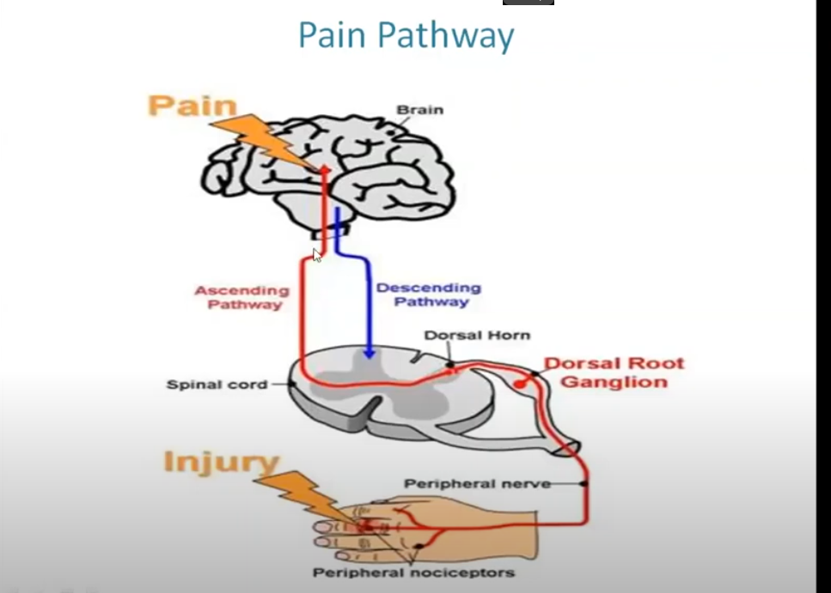

Slide 6
Endometriosis
A chronic inflammatory condition characterised by the presence of endometrium like tissue outside the uterus.
1in 10 reproductive age women.
1.5 million women in the UK.
What causes endometriosis?- Retrograde menstruation, immune dysfunction and inability to clear the fragments.

Slide 7
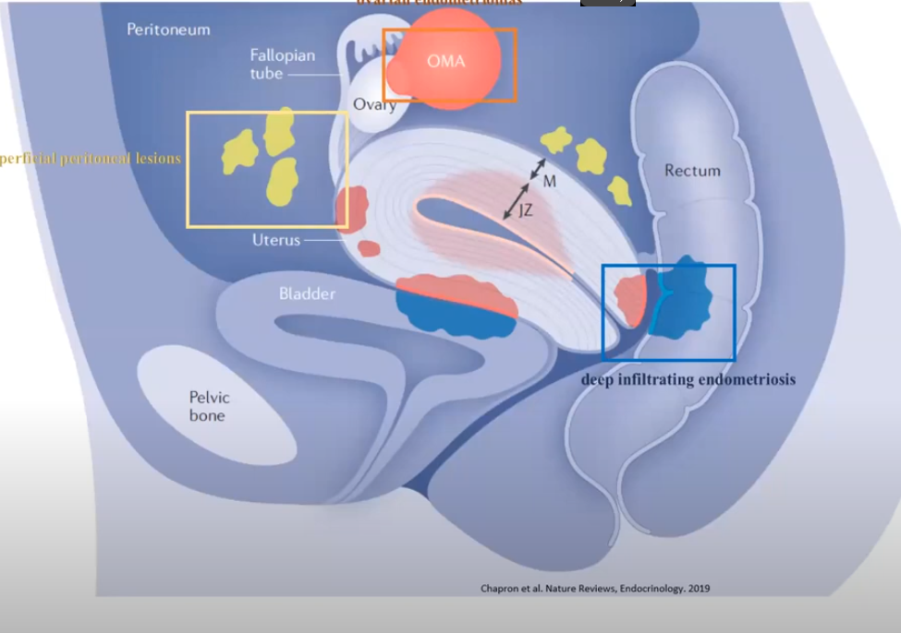

Slide 8
Symptoms
Pain and Fatigue-Most Common
Severe pain or cramps during menstruation
Cyclic or non cyclic pain, ovulation pain
Painful bowel and or bladder symptoms that occurs during or before menstruation
Urinary and bowel changes
Pain with sexual intercourse
Chronic fatigue
Infertility
Others: Pleuretic chest pain, haemoptysis, headache, pain in the surgical scars.

Slide 9
Endometriosis
Little relationship between symptoms and presence of disease.
No relationship between symptoms and site of disease
No correlation between stage of disease and symptom severity.

Slide 10
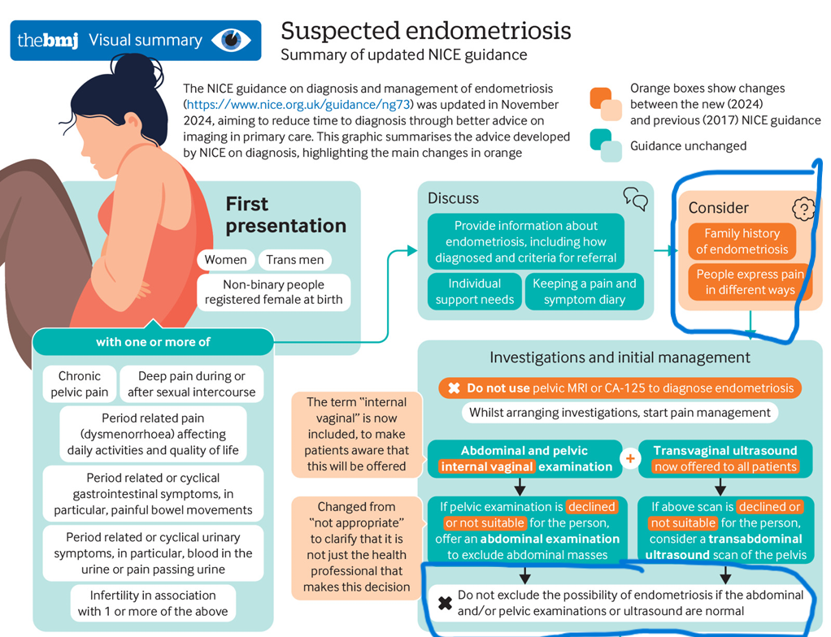

Slide 11
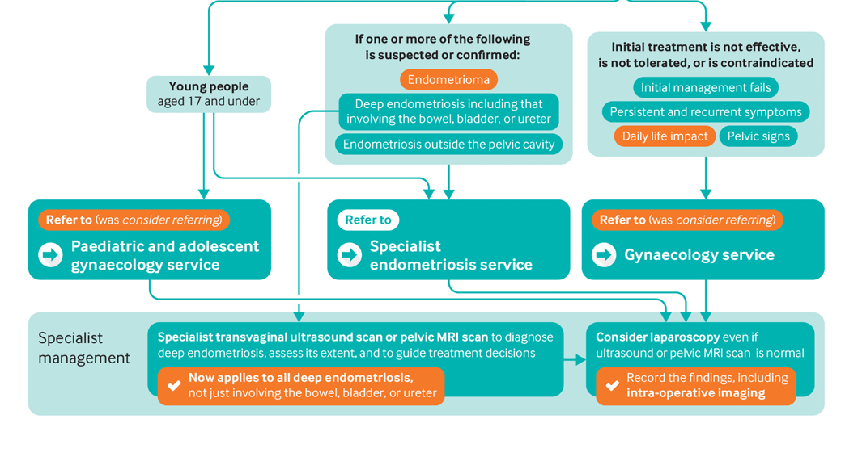

Slide 12
So, what is the problem?
Diagnostic delay- knowing the symptoms
Treatment delay- Investigation
Ultrasound scan-ovarian cyst
MRI Scan- Deep disease, endometrioma
Diagnostic laparoscopy.
Pain management.
Hormonal therapy.
Difficulty in accessing care.
Secondary problems- Psychological issues.

Slide 13
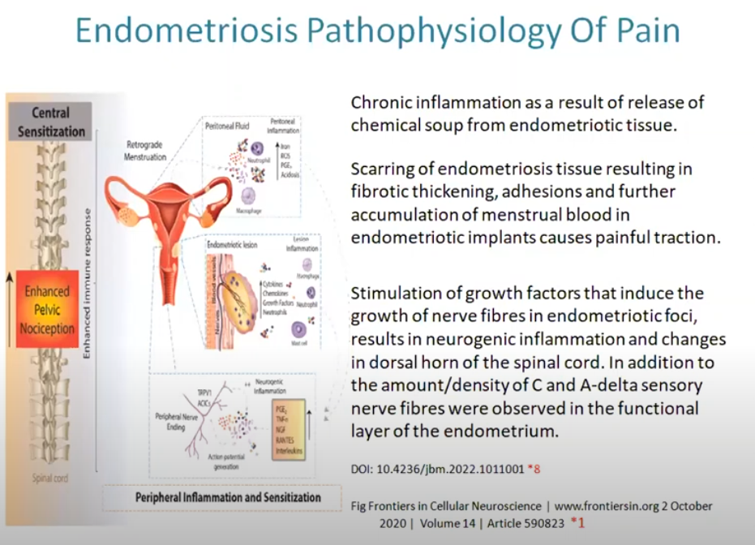

Slide 14
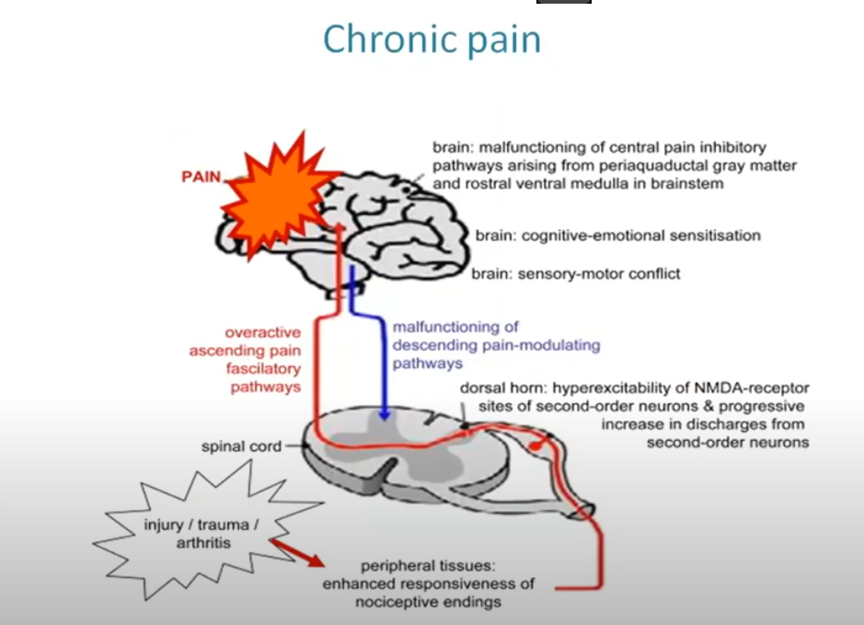

Slide 15
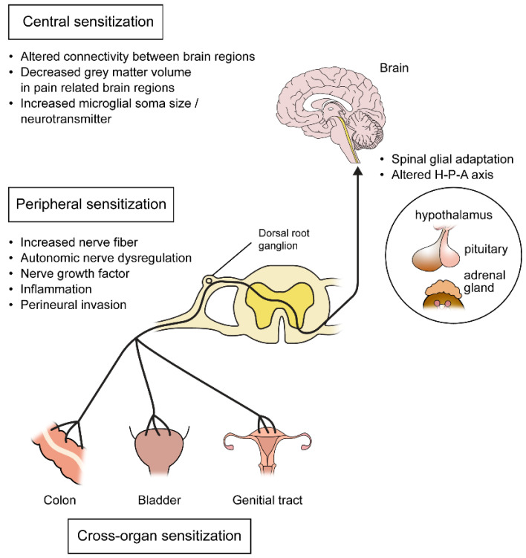

Slide 16
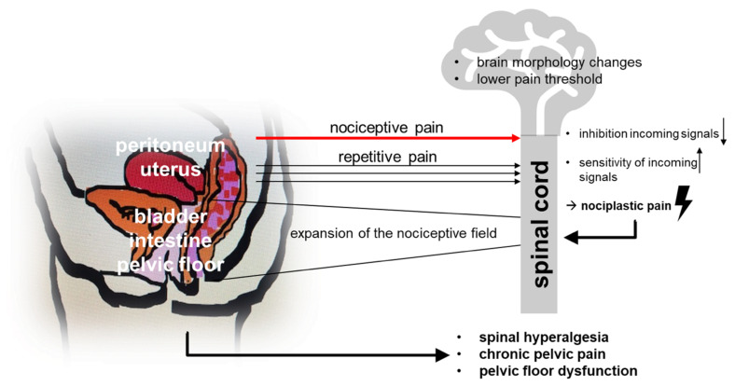

Slide 17
What causes pain?
Inflammation, release of inflammatory substances- peripheral sensitisation- Central sensitisation in the spinal cord- changes in the brain.
Menstruation can contribute to additional pain.
Deep endometriosis can cause scarring- affect bladder, bowel and sex.

Slide 18
What causes pain?
Pelvic organs sit closely- can affect function of bowel, bladder.
Reduced brain volume.
MSK Pain- Posture, repeated bowel and bladder emptying, traumatic exposure to sex, pelvic floor.
50% patients get pain outside of pelvis, widespread pain
Genetic Vulnerability.

Slide 19
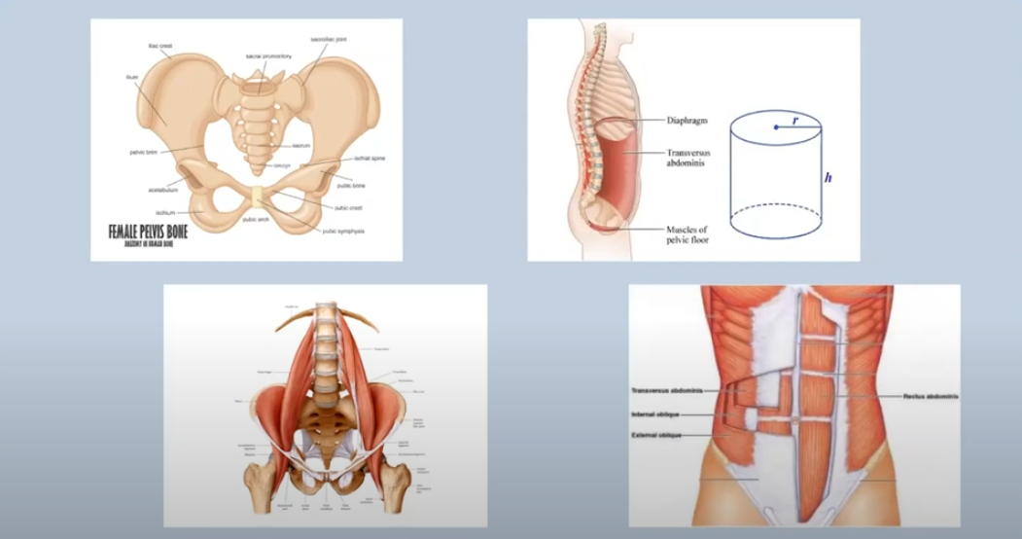

Slide 20
Types of pain
Nociceptive
Neuropathic
Nociplastic

Slide 21
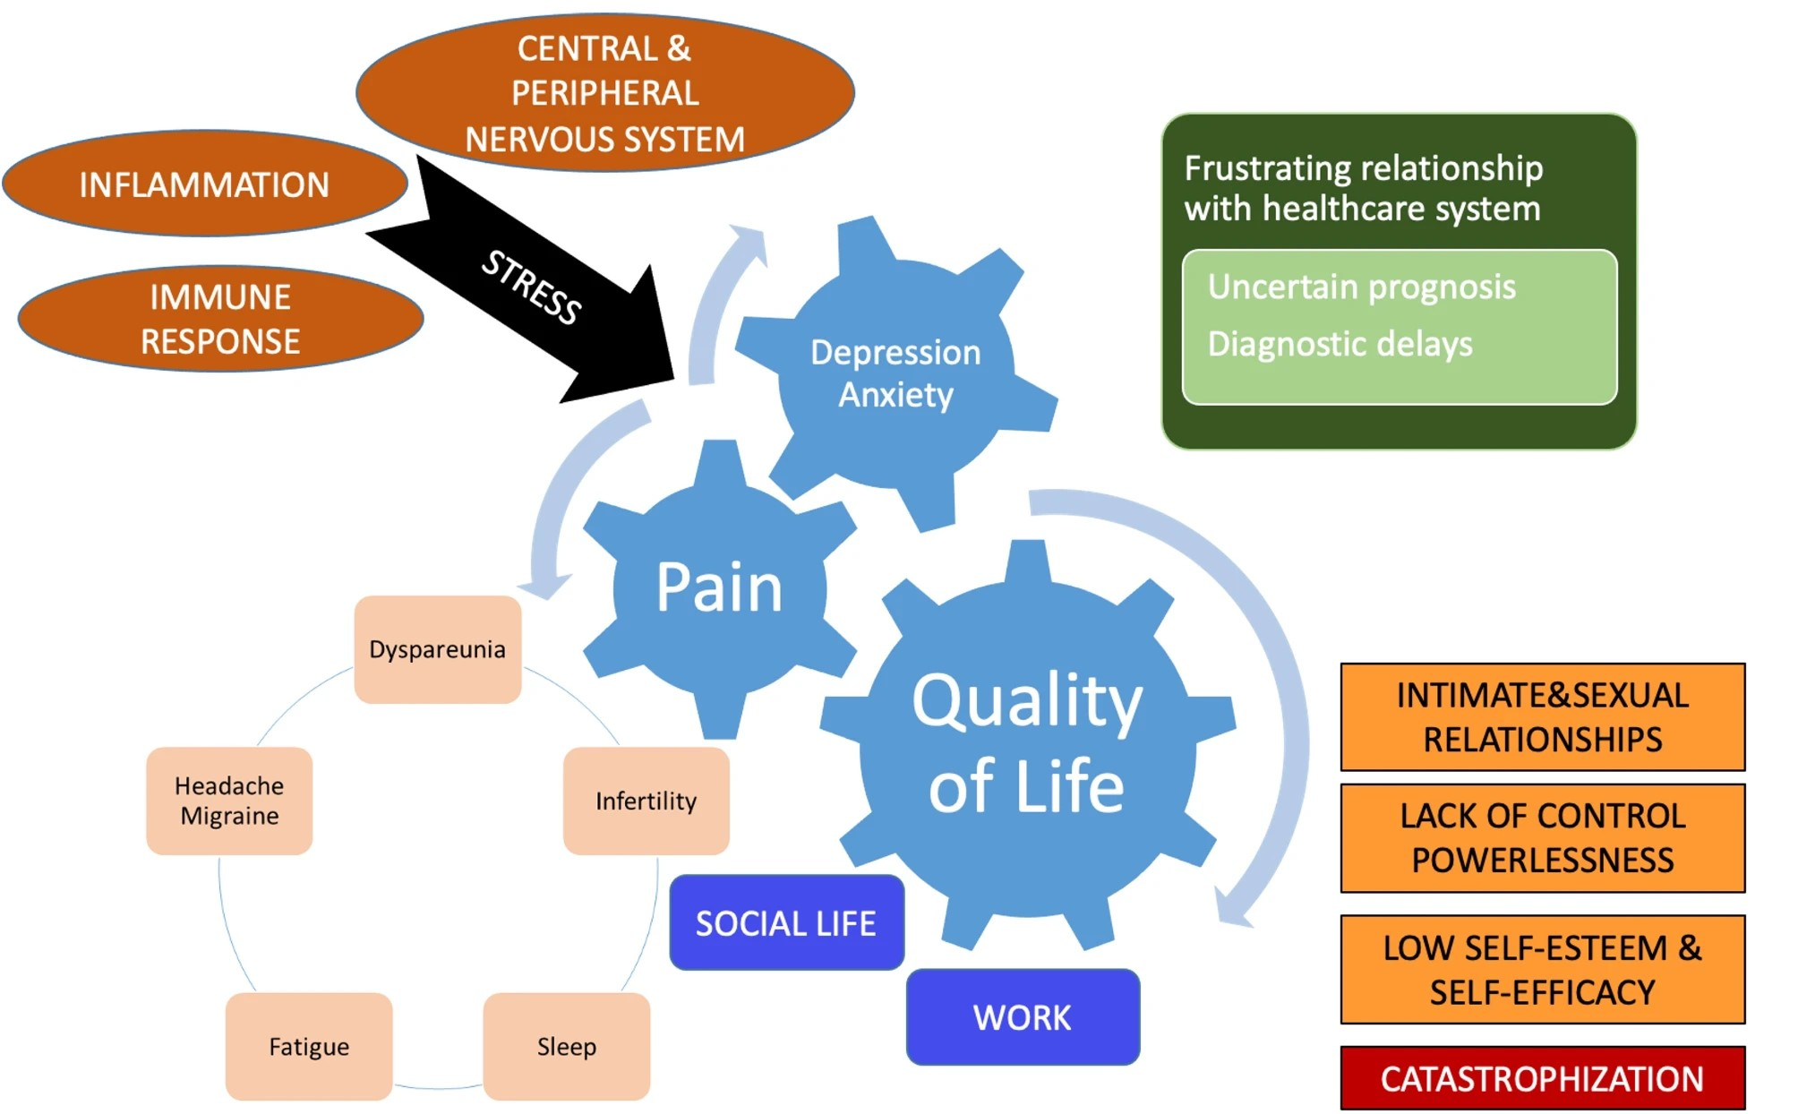

Slide 22
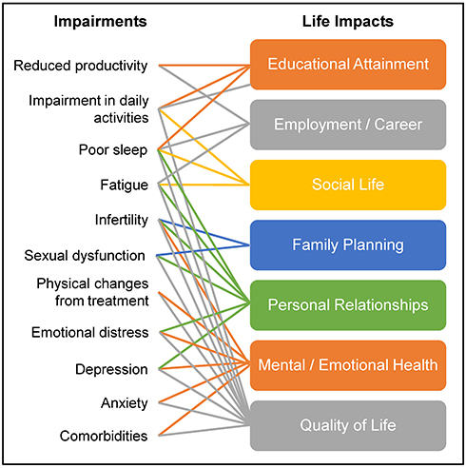

Slide 23
Kirsty
Pain may not be typical, can affect musculoskeletal system.
Long term.
Pain- Central sensitisation and wind up.
Pain treatment may need various medication
Surgery may be needed, not only to excise the endometriosis but to treat complications such as adhesions.
Psychological issues.

Slide 24
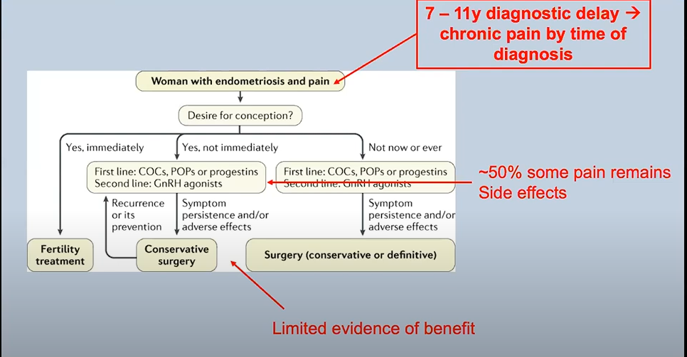

Slide 25
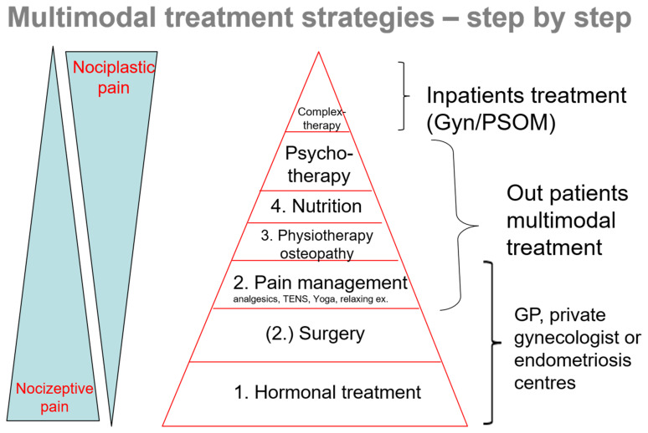

Slide 26
Treatment options
Surgical
Conservative:
Medications
Physiotherapy: Pelvic floor, exercise
Psychological: CBT, pacing, mindfulness
Healthy Lifestyle: Exercise, yoga, no alcohol, diet.
TENS Machine
Acupuncture

Slide 27
Multidisciplinary management
Nurse
Dietician
Physiotherapist
Patient
Gynaecologist
Psychology
Pain Doctor

Slide 28
Multidisciplinary management
Dietician and gastro: treatment of IBS symptoms, dietary modifications, Laxatives, stool bulkers. Alcohol.
Urology: Bladder. Instillations of LA/ Hyalase
Gynae: heavy menstrual bleed.
Physio: Pelvic floor exercise
Pelvic pain Psychology: Group therapy, Aim is self management to improve quality of life rather than reduction in pain.

Slide 29
Medications
Simple pain killers: Paracetamol
NASIDs: Ibuprofen, Naproxen
Harmonal
Neuropathic pain medicines
Opioids

Slide 30
Neuropathic Pain Medicines
Amitriptyline/Nortriptyline
Duloxetine
Gabapentin
Pregabalin
OPIOIDS: Morphine, Codeine, Tramadol,Oxycodone, Tapentadol

Slide 31


