Slide 1


Slide 2
History of Respite
The Respite Ministry was started under the Committee of Health and Welfare at First United Methodist Church in the spring of 2012.
The church saw a need in the River Region for a program that would not only serve people who suffer from any form of dementia, but also their family and caregivers.
There are roughly over 7,000 people diagnosed with dementia each year in the city of Montgomery. Until the development of this program, there was no program to serve the mental, physical and spiritual needs of both a caregiver and participant.
The program began with two participants and has served over 185 participants in four years.

Slide 3
Theory of Respite
Often times our participants have been great volunteers in our community and have lost their ability to give back to others due to memory loss.
At Respite, we pair people with someone they can help giving our friends a sense of accomplishment.
The relationships are so personal and strong between volunteers and participants you cannot tell who is a volunteer and who is a participant.
There are many 1:1 activities and conversations that stimulate and motivate everyone involved. Our trained volunteers are flexible and coached on building self-esteem amongst our friends thus developing a sense of meaning, purpose and hope.

Slide 4
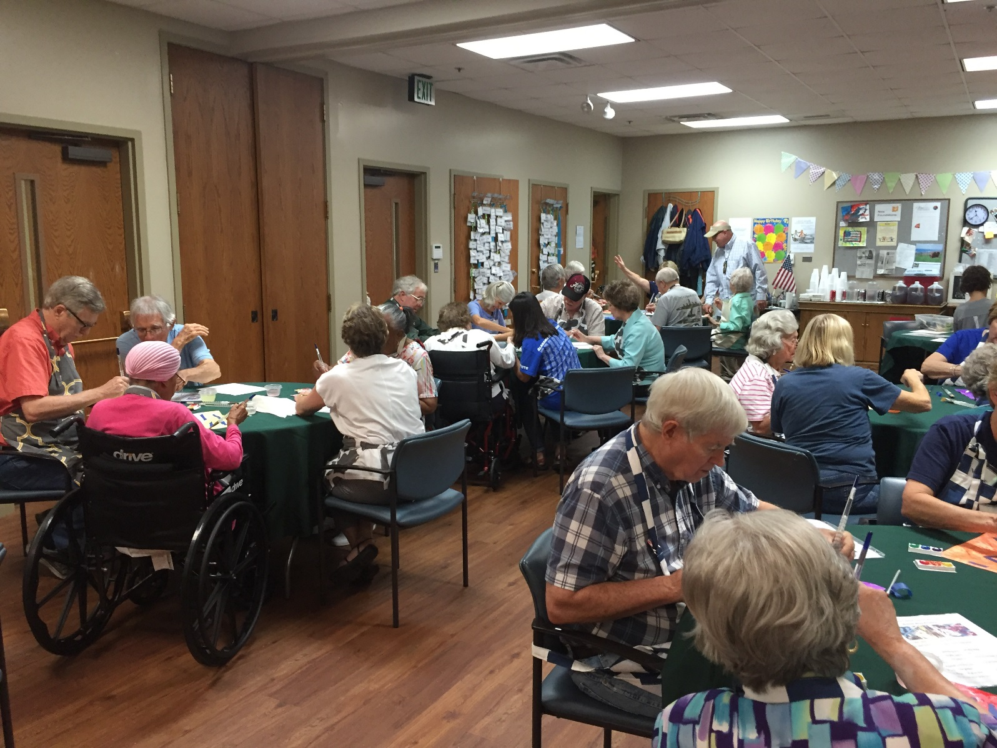
You Cannot Tell Who is Who!

Slide 5

Theory of Respite
Society has built ramps, access and accommodations for people with physical abilities. The Respite Ministry provides cognitive ramps, access and accommodations for those living with memory loss by providing:
Identity
Connection
Security
Autonomy
Meaning
Growth
Joy

Slide 6
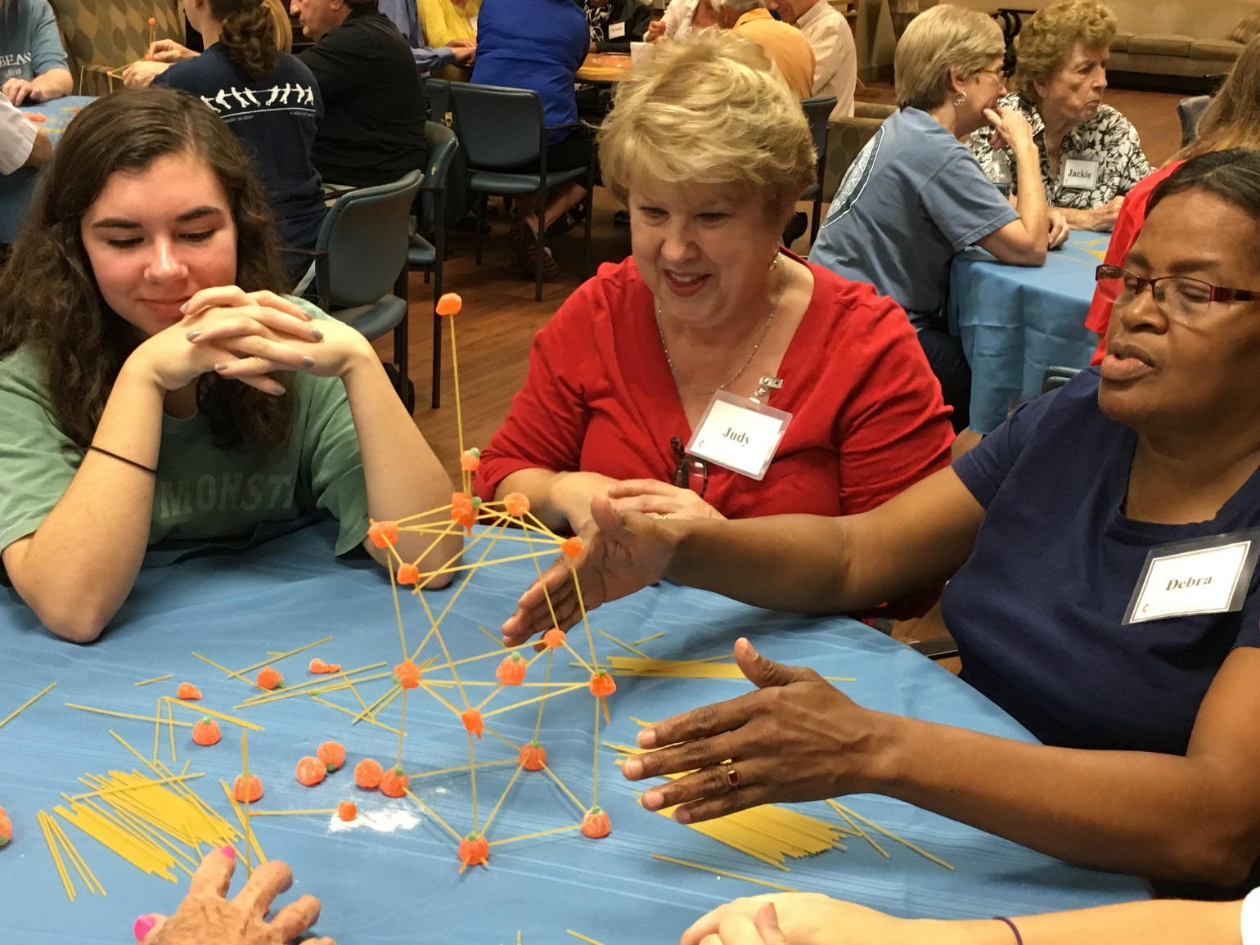

Slide 7
Typical Day of Respite
10-10:15am – Arrival, coffee, socialization
10:15am -11:15am – Brain fitness (trivia, brainstorming, creative writing) followed by physical fitness
11:15am-12noon – Music, Art, or hand-eye coordination activities
12noon-12:45pm – Family style meal: lunch and dessert
12:45pm- 1:15pm- Physical activities
1:15pm- 2:00pm Brain stimulation followed by music

Slide 8
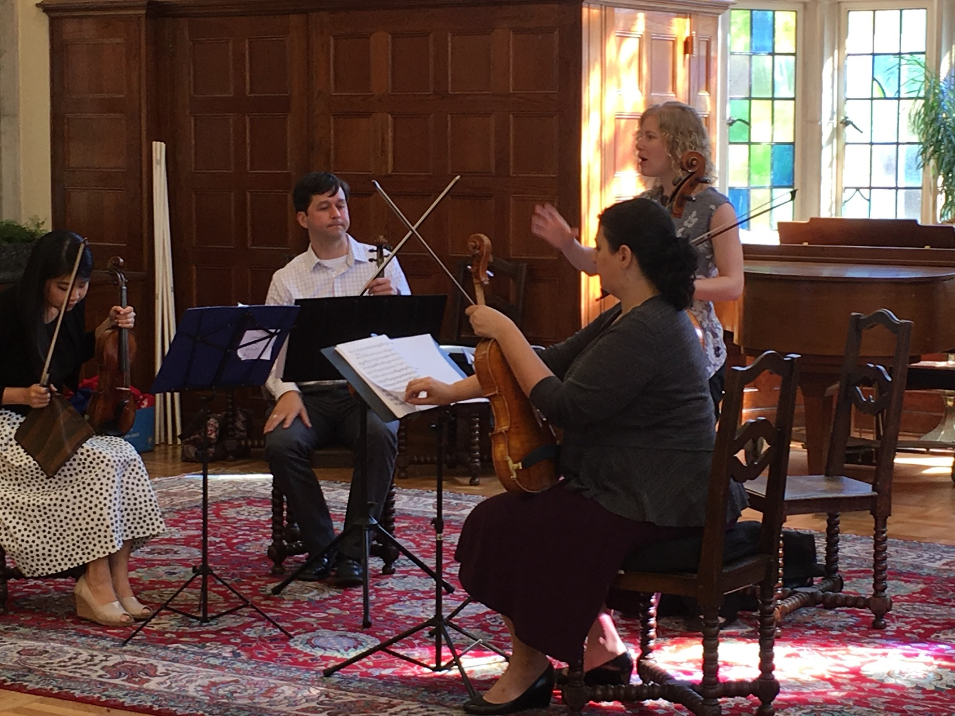

Slide 9
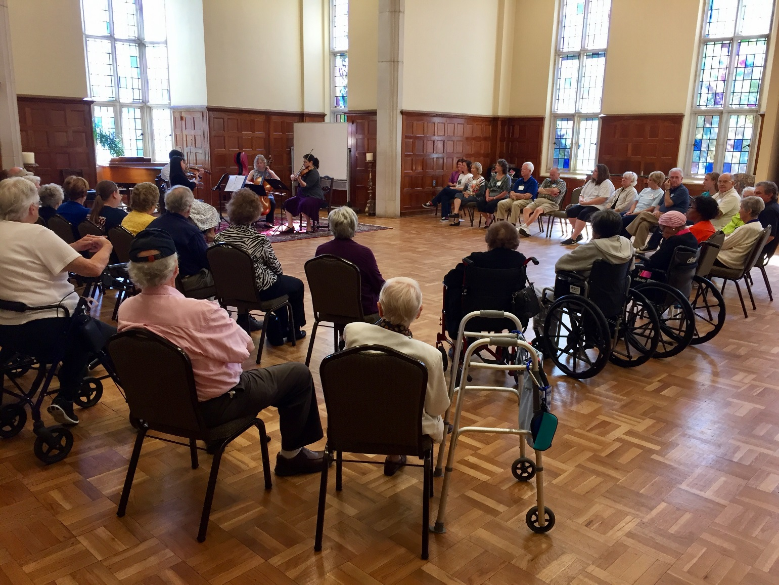
Bring the Symphony to Them…

Slide 10
Elements of Respite
Respite is open to all faith backgrounds with cognitive memory disorders such as Alzheimer’s, Dementia, Parkinson’s or stroke and will provide a safe haven of activities to include social, intellectual, and physical stimulation.
Respite will be run daily by one trained professional and 10-15 trained volunteers who provide supervision, lead activities and serve a nutritious lunch with love and compassion.
Participants must be mobile (assisted devices acceptable), attend their own bathroom needs, participate in social activities and eat on their own.
Respite is offered Monday-Thursday from 10am-2pm with a cost of $30 a day including lunch

Slide 11
Cognitive Stimulation
Respite provides a wide variety of group programming that enhances:
1. Speed of processing
2. Comprehension
3. Reasoning
4. HUMOR
5. Self Confidence
6. Sense of belonging

Slide 12
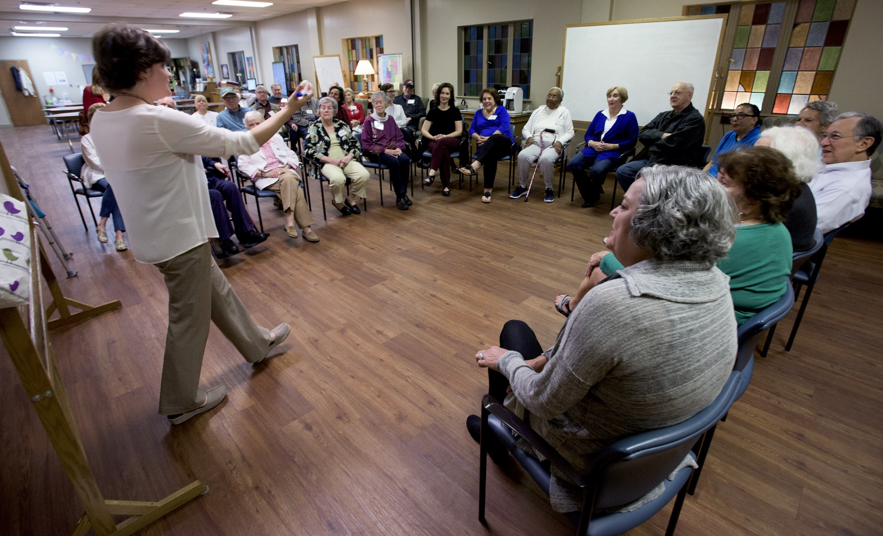
Group Discussions

Slide 13
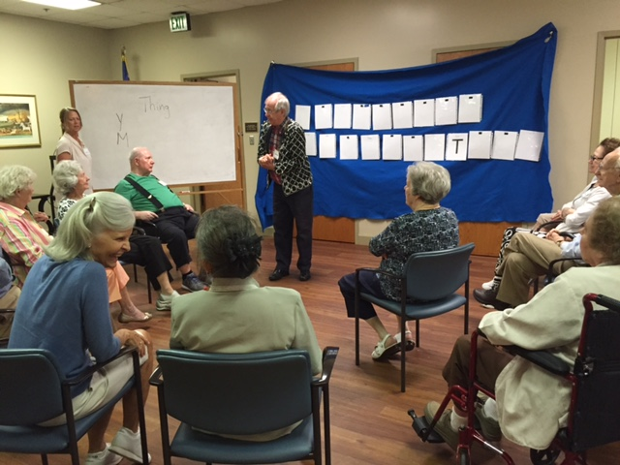
Cognitive Activities

Slide 14
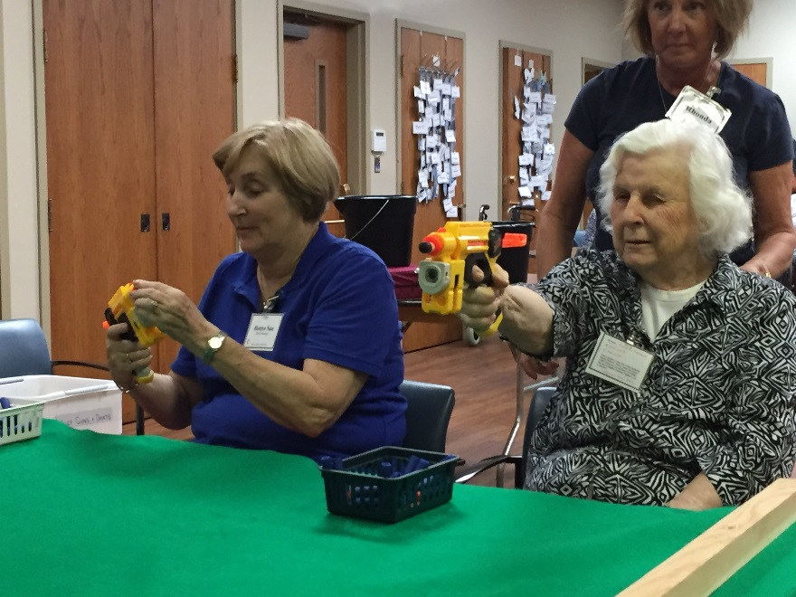
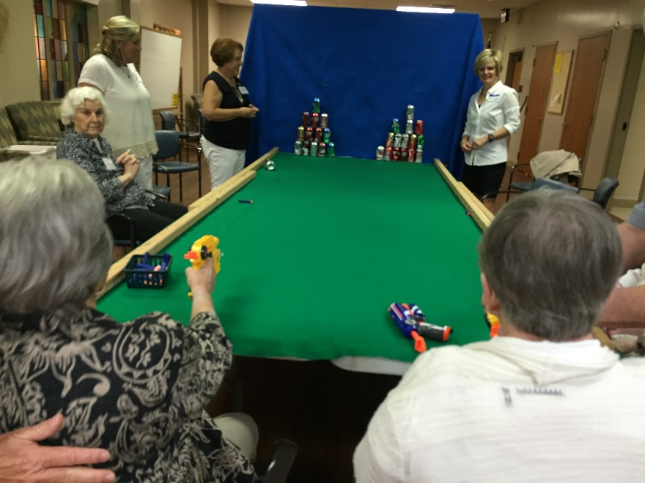
Hand Eye Fun

Slide 15
Benefits of Respite Ministry
The care partner of a person with memory loss experiences levels of fatigue and distress that eventually leaves both persons feeling mentally, physically, emotionally and even spiritually bankrupt.
The Respite Ministry is an intervention to prevent such a level of exhaustion and restores a sense of purpose and meaning to the lives of both the patient and their caregiver.
It improves the quality of life for the patient, the primary care giver and even for the extended family, by seeing joy and meaning return to the day of the person with dementia.
Such a service assists families in being able to care for their loved one in the home for a longer time, often without the need for hired in-home care givers.

Slide 16
Importance of Care Team
The sense of purpose and belonging that one can achieve through joining a Respite program is beyond what the care partner can accomplish alone at home, no matter how much they love, and how much time they devote to care giving.
A Team approach to Respite includes several sub-teams of volunteers simultaneously preparing an activity, performing an activity, cleaning up from previous activity, preparing meals so there is a seamless flow from one activity to another throughout the day.
One person cannot accomplish this at home for a sustained period, nor is it realistic to attempt to do so. The care team in effect is serving as an external source of motivation and initiative for the person who is memory impaired, and since the volunteers rotate, participating once or twice monthly, they bring fresh energy and enthusiasm daily which a sole care giver in the home cannot possibly provide.

Slide 17
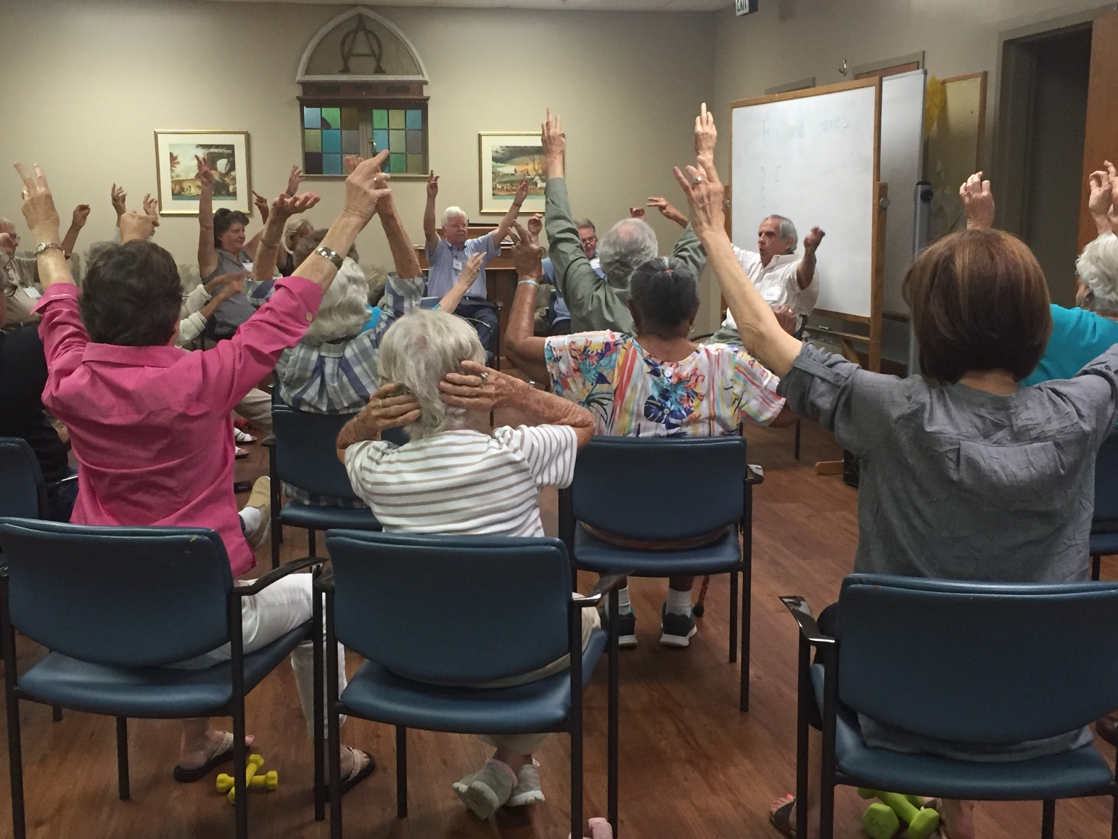

Slide 18
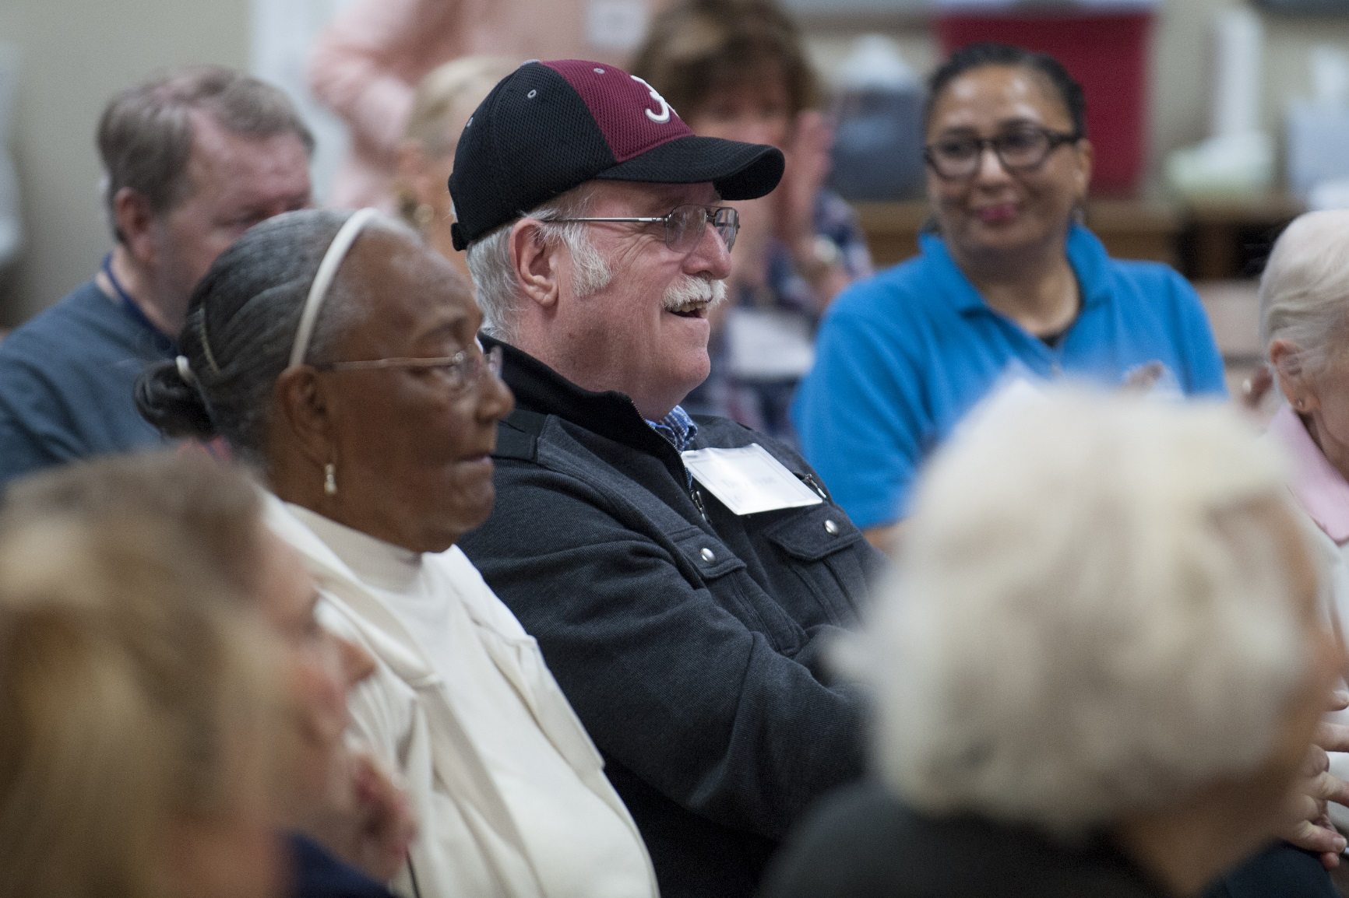
Ages range from 55-95

Slide 19
Church and Organization
Respite was started under the Church and Society Committee of First United Methodist Church, Montgomery. A part-time director was hired to develop and run the program.
Respite saw the vision to recruit other churches to be involved in this ministry. Two Episcopal churches and a Jewish Temple supply scholarship money along with volunteers. There are eight churches that provide volunteers along with two synagogues.
First Methodist hired director for 35K and used 15K for supplies and marketing material.
The program started with two participants and has served over 185 participants in four years. That is 185 care partners as well. There are currently 50 people that come weekly averaging 20 participants daily.

Slide 20
Respite Design
Volunteers
Logistics
The volunteers are the heart of the program.
Volunteer time commitment is flexible, work 4 times a year or 4 times a month or weekly, no commitment.
Program to allow close to 1.5 ratio of volunteer per participant.
Volunteers and Participants will wear the same name tags so not to differentiate.
Participant attendance is recorded daily.
Invoices will be sent at the end of the month.
$30.00 a day for participants
Sample revenue:
$30.00 a day, 2 days a week =$3,000 a year per person

Slide 21
REVENUE
Revenue is based on $40 per person:
Revenue is based on $30 per person:
• 10 people, 2 days a week, 50 weeks = $40,000
$30,000
• 15 people, 2 days week, 50 weeks= $60,000
$45,000
• 15 people, 3 days a week, 50 weeks= $90,000
$67,500
• 15 people, 4 days a week, 50 weeks= $120,000
$90,000
• 20 people, 4 days a week, 50 weeks= $160,000
$120,000

Slide 22
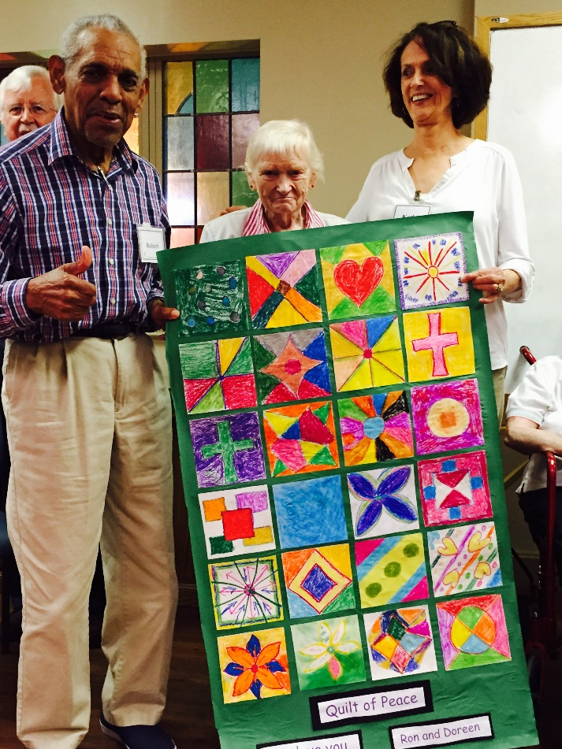
Art Projects
Participants often make art projects to send sick members of the group to brighten their day.
Volunteers and participants do everything together so there is no “us and them” mentality

Slide 23
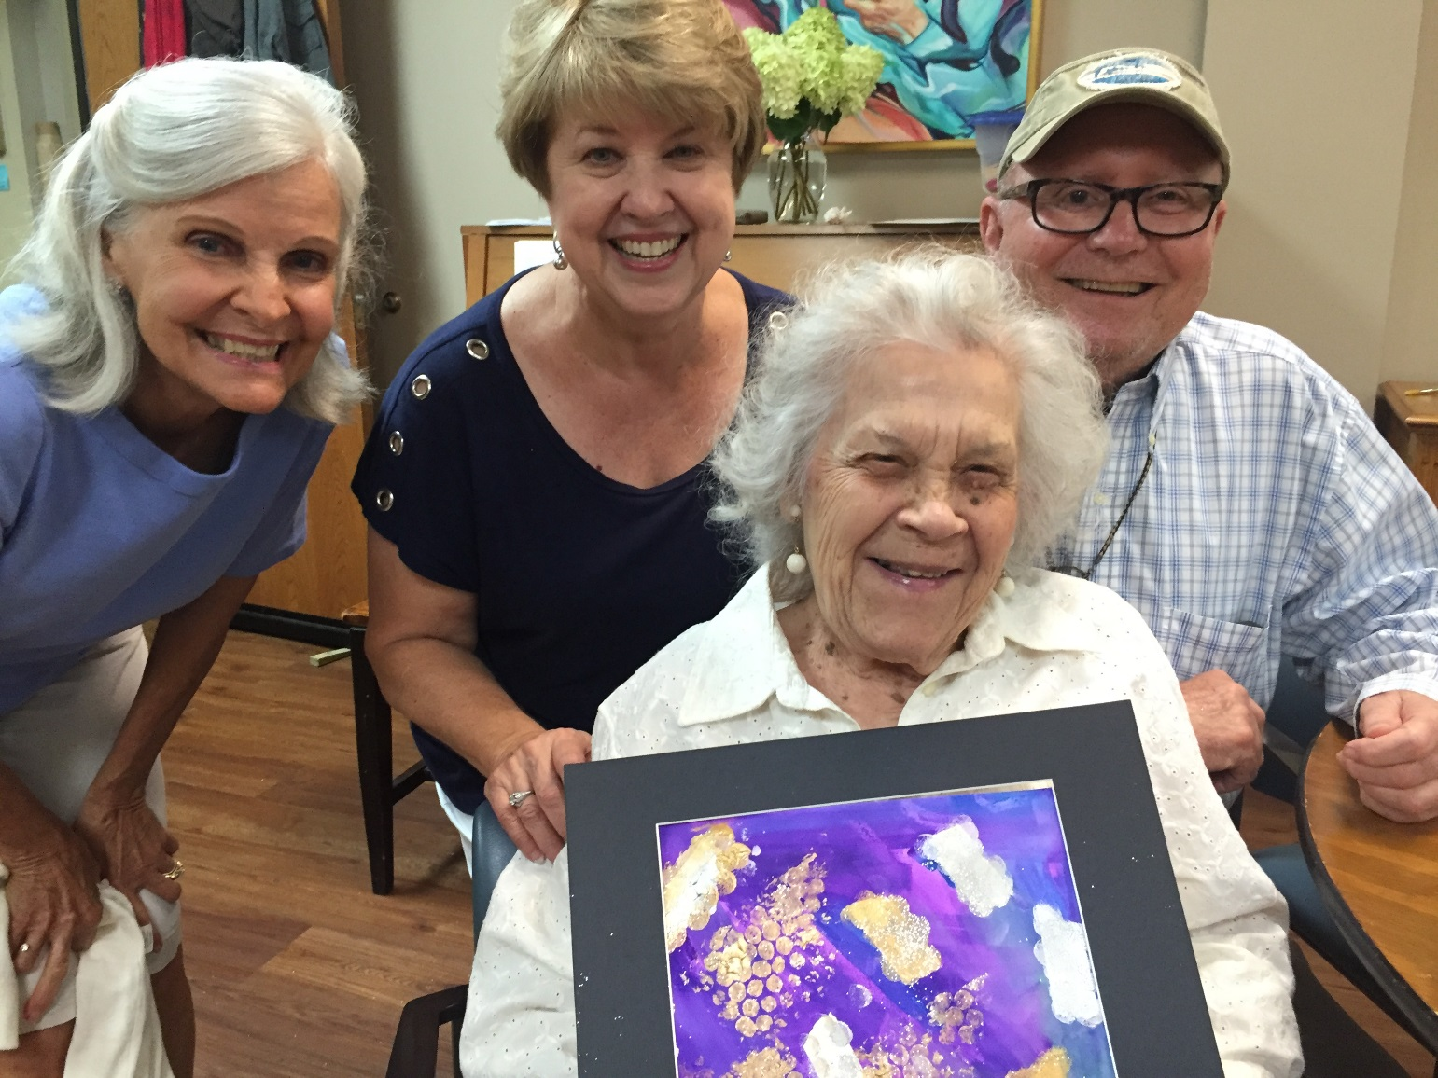
Abstract Art with Opening Minds thru Art process

Slide 24
Job Descriptions
Encore will initially hire 2 employees (salaries TBD)
Program Director
Volunteer/Family Coordinator
Qualifications:
Great love for older adults, strong interpersonal skills, good rapport with families and caregivers. Strong knowledge of characteristics of Alzheimer’s and dementia related diseases.
College degree, preferably in Nursing or geriatric care
Skills in creative arts are desirable (music, art, etc.)
CPR certified
Awareness of symptoms of abuse and mistreatment
General Responsibilities
Plan fun filled and cognitive enhancing curriculum for respite classes and activities.
Implement daily, structured program to include mental, physical, spiritual and creative programming assistance of VFC and volunteers.
Maintain orderly environment of classroom to promote sense of calm and well-being
Keep classroom, storage and work areas neat and orderly.
Produce monthly calendar and newsletter to be sent to the home of each client.
Work with Director of Senior Adults for programming and operation of this ministry.
Qualifications
Great love for older adults, strong interpersonal skills, good families and caregivers. Strong knowledge of characteristics of Alzheimer’s and dementia related diseases.
College degree, preferably in Nursing or geriatric care
CPR certified
Awareness of symptoms of abuse and mistreatment
General Responsibilities
Work with PD to carry out daily schedule of activities.
Recruit volunteers for program and train properly.
Counsel families and assist with new participant paperwork.
Maintain enthusiasm and high energy level amongst the volunteers and caregivers.
Present program to other churches and organizations in Birmingham Community.
Conduct individual conferences with caregivers to discuss progress of each client.

Slide 25
Initial Set Up Costs
Salary, cell phone plan and laptop $42K-45K
Activity Supplies and Storage Bins $4,000
Marketing: 1K-3K depending on size of church
Food Cost per person $7.00 a meal x number of
participants and volunteers for day
Cost of Director and food are largest financial commitments
Participants meals will be covered in the daily cost and volunteers will pay $5 for their own meal.
Respite ran a 50K budget for two years and on year four, we now have a 125K budget

Slide 26
Supplies
Puzzles (10)
Markers (10 packs)
Glue sticks (10 packs)
Scissors (10)
Tape (15)
Paper plates 5 packs
Construction paper
Pipe cleaners
Yarn
Paints
Paint brushes
Coloring books
Small canvases
Volleyball net
Balloons
Noodles
Dominos
Board games
White board
Dry erase markers
Decks of cards
Wheel of fortune
20 study chairs with arms
Computer
Nametags
Bulletin board
Piano or keyboard
(4) 4ft round tables
Storage closet
Storage bins

Slide 27
Why?
“Ours is an aging society, and as the number of older adults in our congregations and communities increases, the church will be called to new practices and new ministries, particularly with the growing numbers of persons living with dementia.”
“If we should forget God, God does not forget us. Our community of faith can help us remember and bring God’s presence to all His children through means that do not require us to grasp that presence cognitively.”
“Respite permits the dementia journey to be shared in community with others, rather than undertaken as it too often is in our culture as a private and personal “tragedy” marked by stigma and isolation.”
Quotes from:
Aging, Dementia, and the Faith Community
Continuing the Journey of Friendship
John T. McFadden, M.Div

Slide 28
Brenne Brown:
“In the absence of love and belonging, there will always be suffering. All of us long for connection; it’s not negotiable. We are neurobiologically hard wired for connection, love and belonging, it is in our DNA.”
“

Slide 29
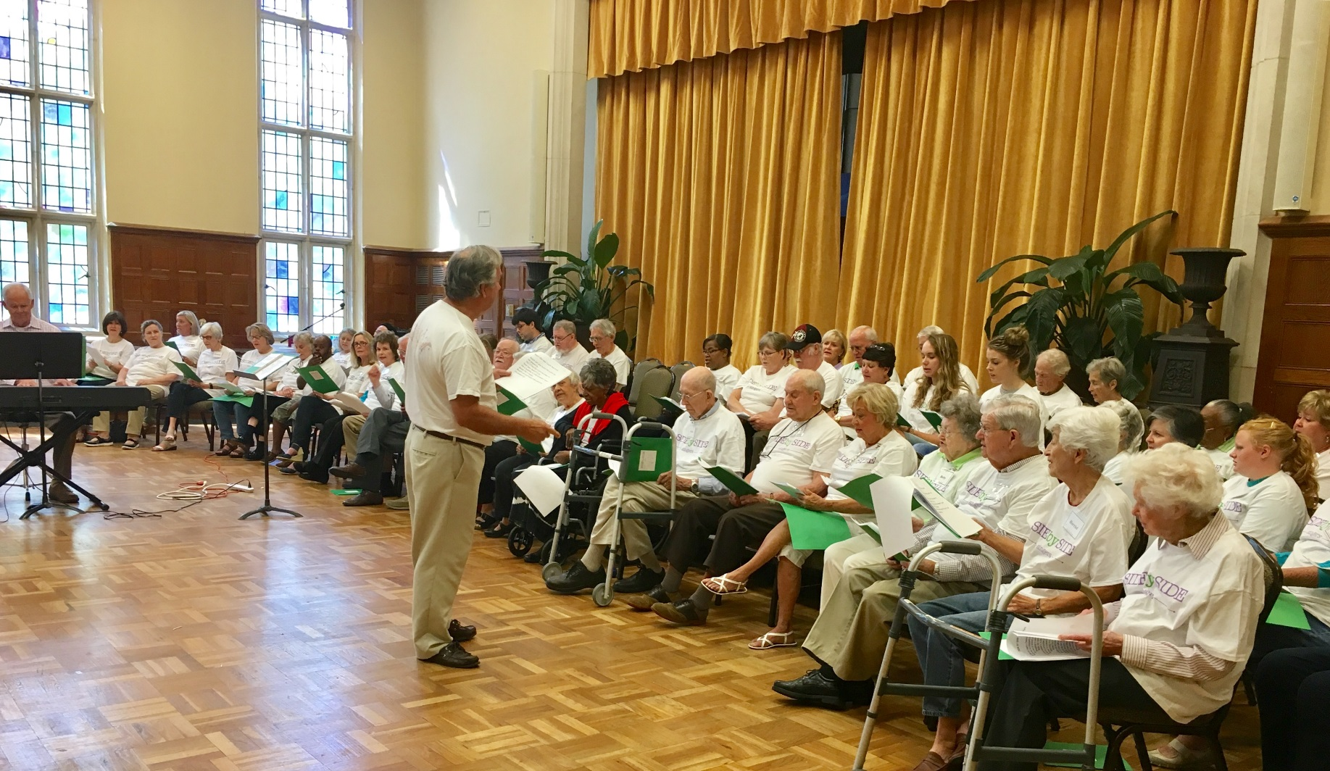
Choir Concerts All Over Town!

