Slide 1

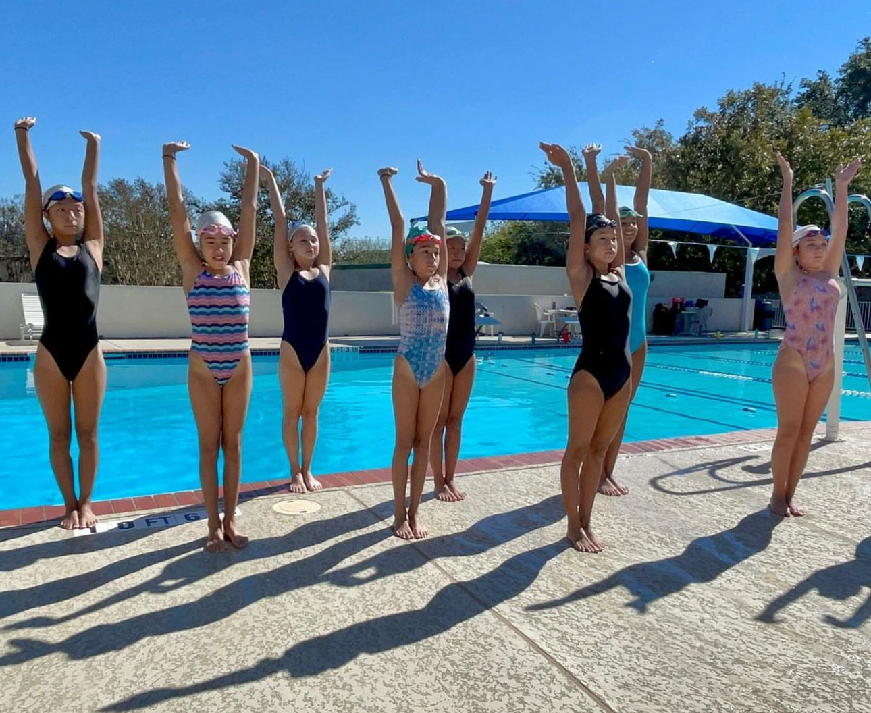
Splash Bash Toolkit

Slide 2
What The Foundation can/will provide to all clubs who register:
How to maximize fundraising toolkit
Event Logo
Payment platform with link to website
What clubs will provide:
Tagging USAASF and USAAS in all posts/ stories from the event
Counters and an Accurate count of laps per participant
*Clubs with 50% participation will receive a Splash Bash gift!

Slide 3
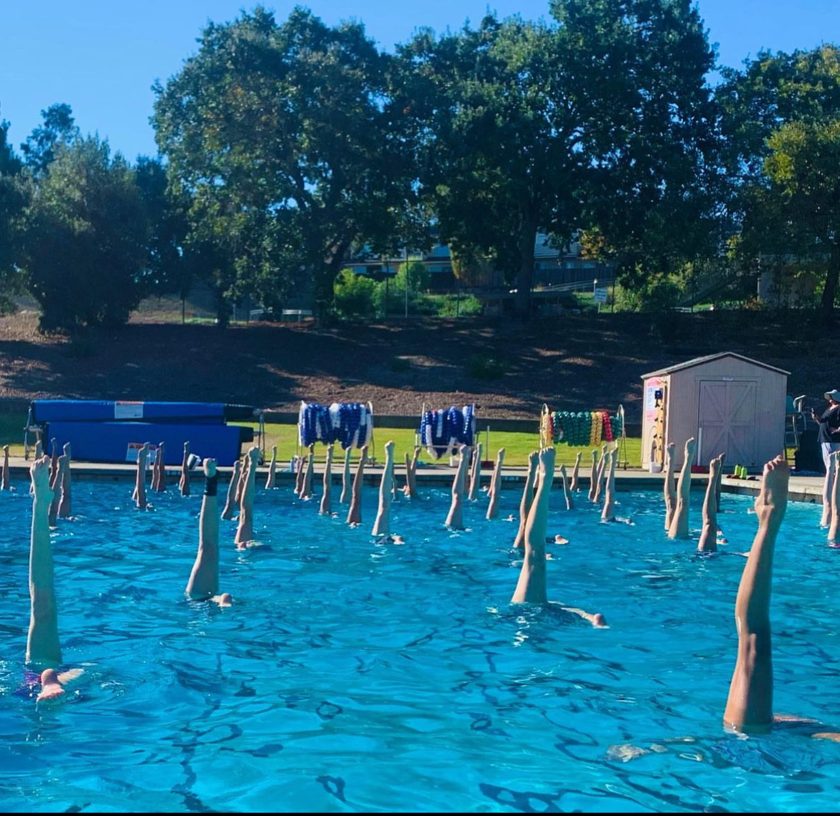
How to…

Slide 4
How to…
SET EVENT FUNDRAISING GOALS
What are you raising money for? Supporting your clubs competition goals, funding education for athletes, coaches, and officials, or funding your club’s necessities of pool time, travel, ect.
What is your target fundraising goal? Select the amount you think is achievable/ desired goal for your club’s needs.
What is the best way to reach your audience? Do your donors like to be called on the phone, sent emails, or do they follow your social media pages? Promote the event however your audience likes to be reached!
Decide on the fundraising strategies - listed above

Slide 5
How to…
Map out logistics
What activity will your club be doing for the event? – Swim, Scull, Eggbeater, laps, ect.
When will you be doing the activity? – Are you doing this event during one practice in February or are you doing it weekly for the whole month?
How are you promoting the event? - Send your donors a link to your club’s donation page, promote on social media, have each swimmer on your team make their own page to promote, live stream day of, or send emails to parents and donors about the event.
Who will be your counters and how will you ensure the accuracy?

Slide 6
Tips & Tricks
FOR EMAIL COMMUNICATION TO YOUR NETWORK
Customize/individualize each email in your organization’s tone/style/brand if you’d like to edit further
Insert a First Name into your mail merge to make it feel personal -Dear XXXX(NAME)
Push out the event on social media to your internal network and ask your team to post according to the same schedule and tag your organization in order to extend the reach!
Have questions about the event? Contact the below individuals for questions!
Sandra Mahoney: sandra.mahoney@usaartisticswimmingfoundation.org
Amanda Styninger: astyninger@usaartisticswimmingfoundation.org

