Slide 1
Grant Applications & Procedures
2025
Webinar

Slide 2
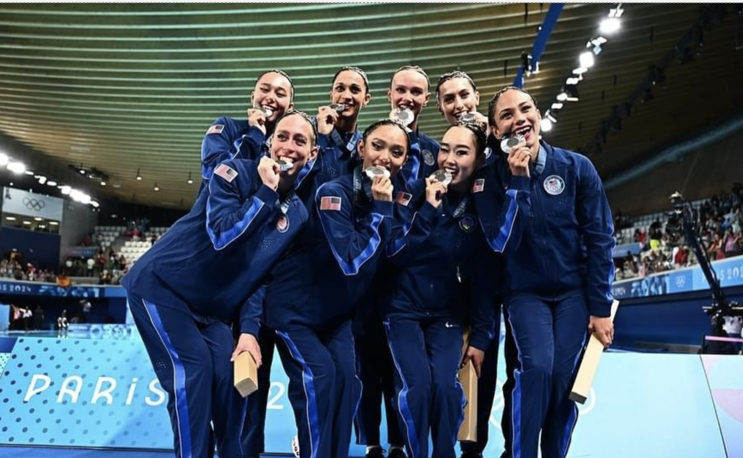
Introductions
usaartisticswimmingfoundation.org

Slide 3
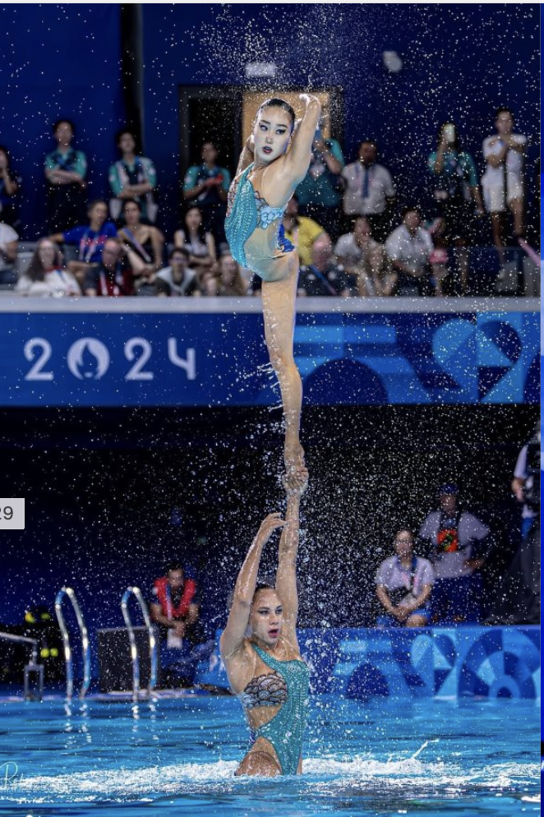
USA Artistic Swimming Foundation
Mission
Committed to funding the growth of the sport and preparing today's artistic swimmers to become tomorrow's champions and leaders.
USA Artistic Swimming (NGB)
Mission
Lead in the advancement of artistic swimming by empowering athletes to achieve competitive success, uniting our community & inspiring our membership to pursue lifelong excellence & involvement in the sport.

Slide 4
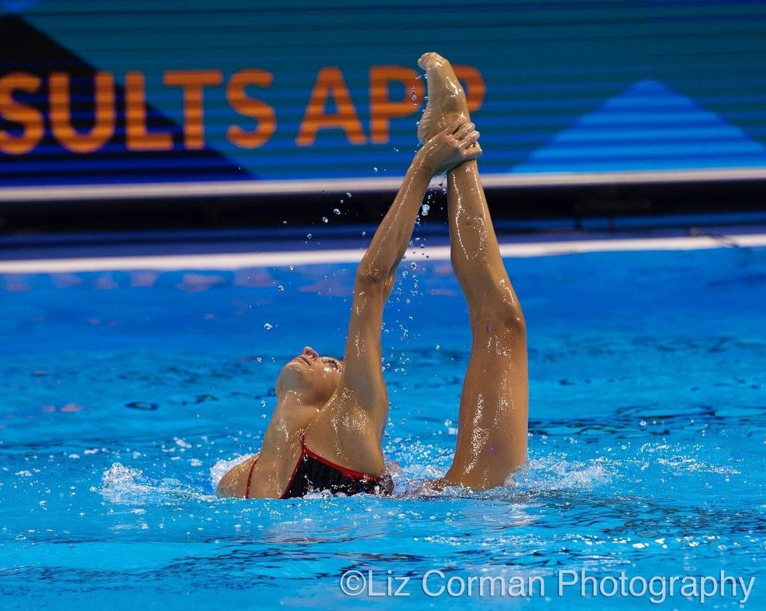
What The Foundation Does
The U.S. Government does not financially support amateur athletics (NGBS) or send our athletes to the Olympic Games - Americans do.
The USA Artistic Swimming Foundation is a 501c3 that supports the sport of Artistic Swimming, including athletes, coaches and officials who participate at Youth, Collegiate, Masters and National Team and Olympic levels. Together with USA Artistic Swimming, we are igniting interest, attracting new athletes, and raising funds to guarantee a bright future.

Slide 5
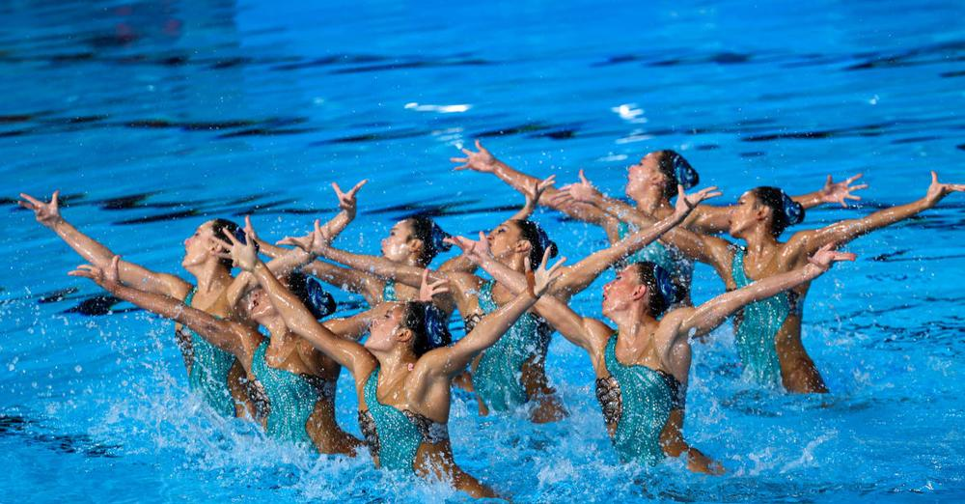
USAASF Grant Cycle Timeline
If applying for both a Traditional & and Education Grant they MUST be separate applications
May 6 – July 11th
  Grant applications are accepted via the USAASF website
    usaartisticswimmingfoundation.org
August
  USAASF’s Grants Committee reviews applications and makes award decisions.
September
  Grantees are notified of grant awards
October - November
  Grant Agreements sent to Grantees

Slide 6
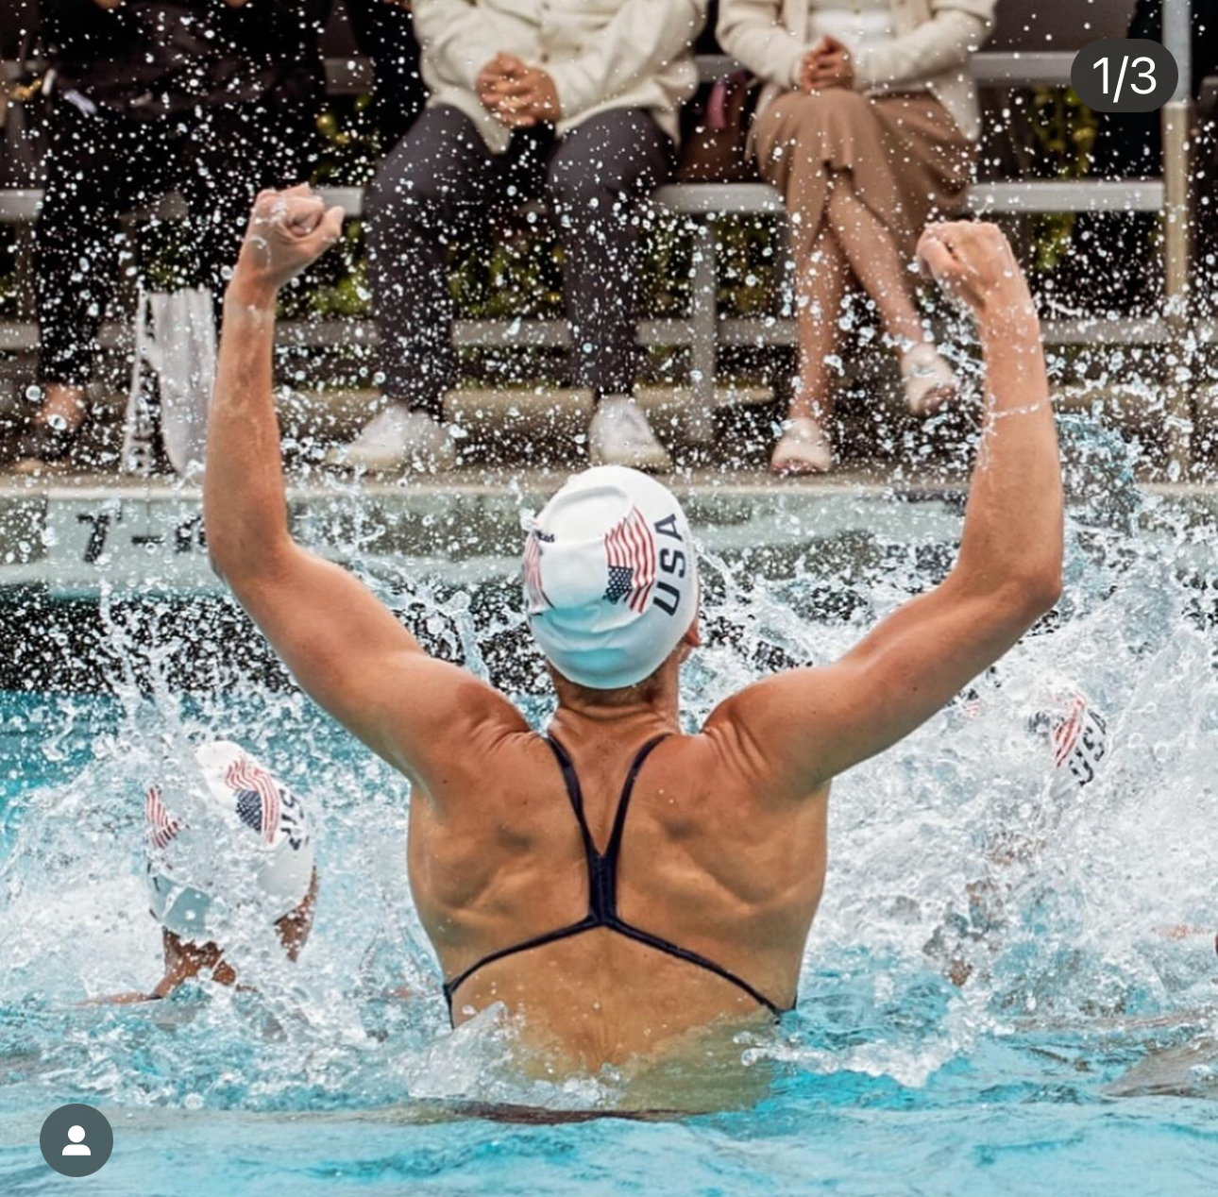
Grant Categories
Traditional Grants
  Sport and Club Growth of Artistic Swimming
    Try it Clinics
    Exposing the Sport to more people
  Athlete Development
    Camps & Clinics that are open to more than one club
    Programs that help develop the greatest number of athletes, clubs and or areas
  Diversity
    Grants to help develop underserved communities
    AWD Exposure
    Development of an AWD program to become a club of excellence

Slide 7
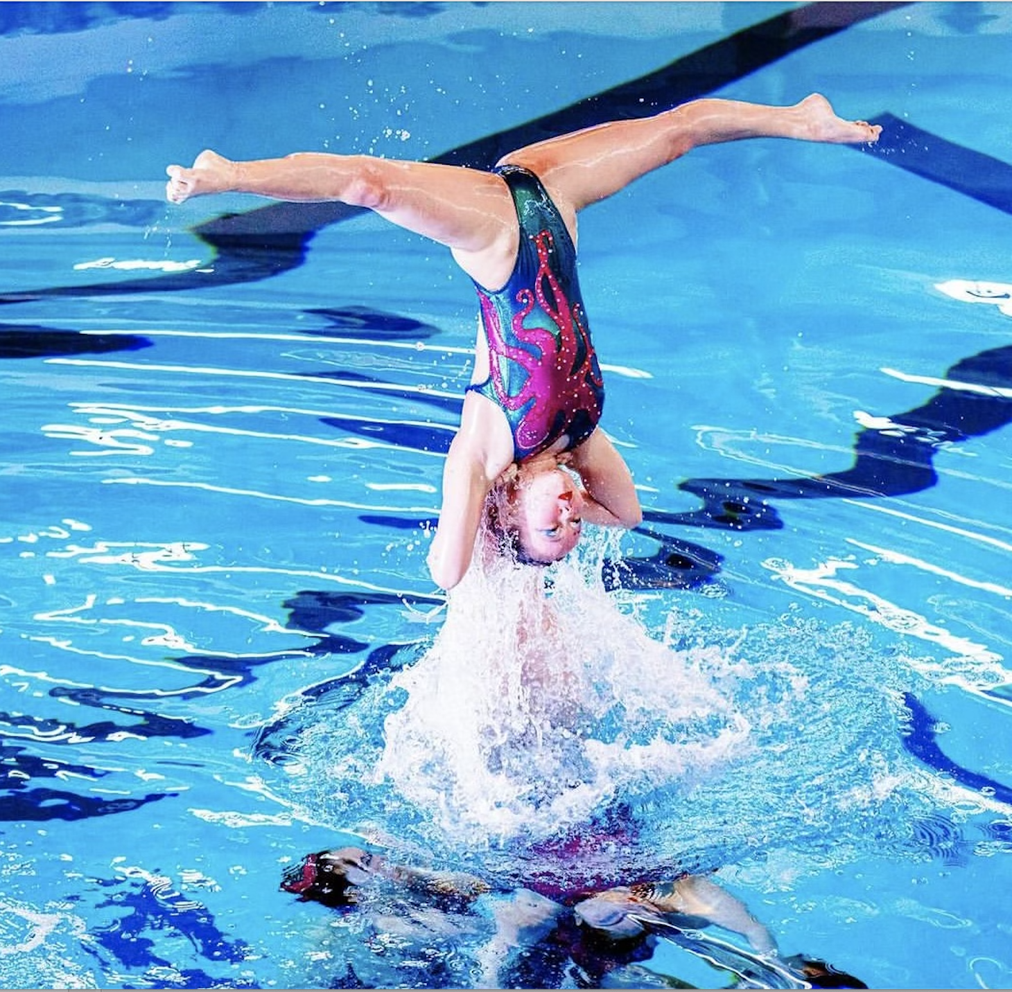
Grant Categories
Education Grants
  Coaches College
  Coaches Certification
  Additional Education opportunities
    Judging school
    Specific education Training (DOES NOT include First aid, CPR, lifeguarding)

Slide 8
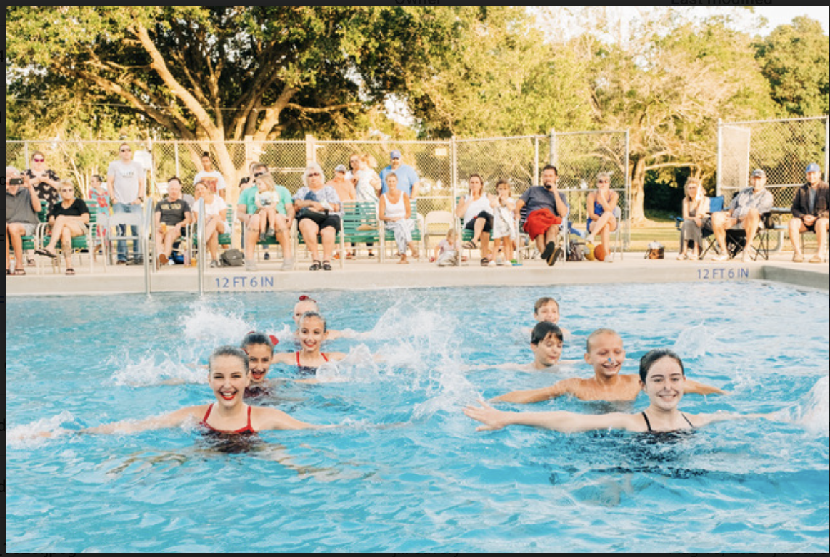
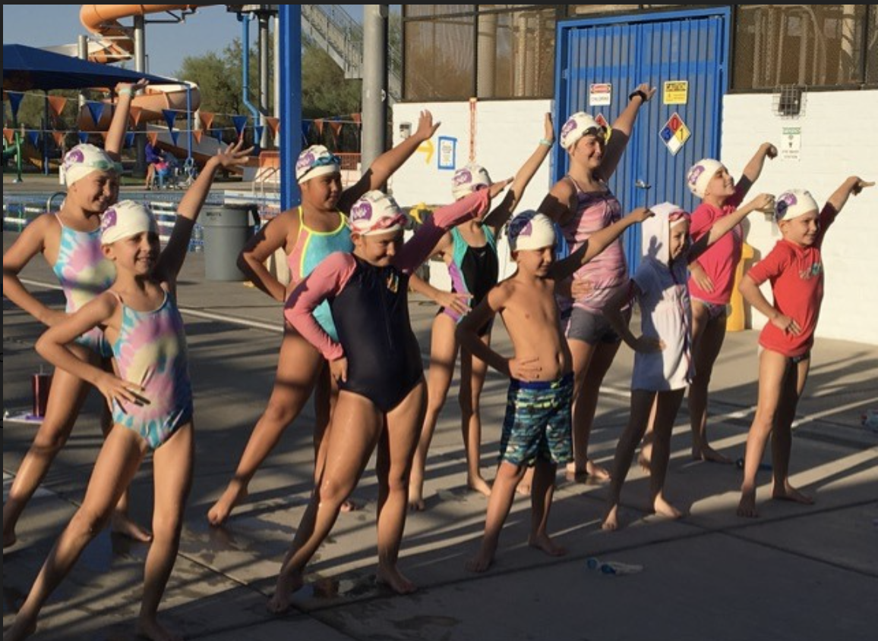
Grant Categories, Cont.
The Foundation MAY consider special grant requests that are off-cycle.
In some situations, the USAASF may offer a matching grant as an incentive to the fundraising by the grantee organization.
Grants may be for a single-year or multi-year program/project.
  Multi-year programs shall be subject to review each year by the Grants Committee to assure annual goals and objectives are being met and that funding should be continued.
Projects should lead to ongoing self-sustaining programs or growth.

Slide 9
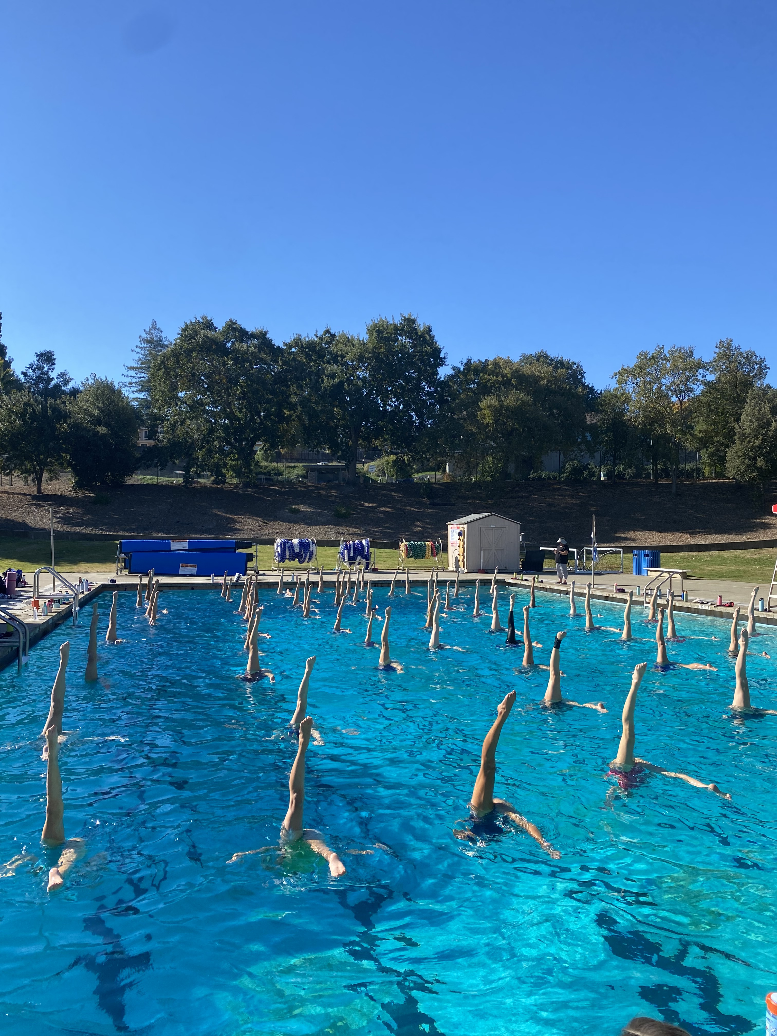
Grant Categories, Cont.
USAASF does NOT award grants in the following
categories:
  Travel to competitions, hotels/meals
  Club equipment or equipment replacement
  Regular Salaries
  Overhead, normal or operating expenses
  Regular club expenses or expenses for a member individual
  Certifications outside of USAAS
    Such as CPR, First Aid, Lifeguarding, etc.
  Repeat programs (programs awarded monies should be self-sustaining)
  Membership fees

Slide 10
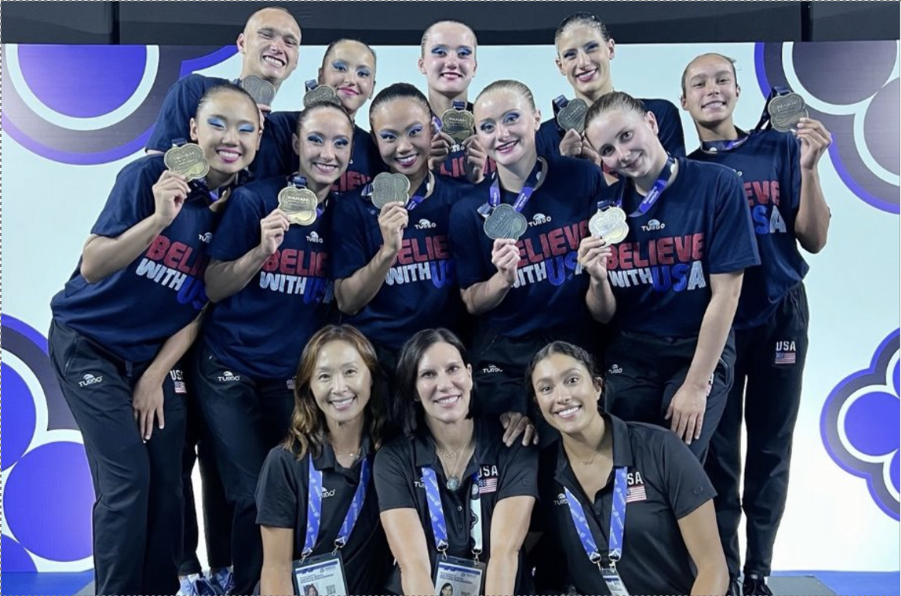
USAASF Grants Timeline
Traditional Grants:
  30 days after return of signed Grant Agreement, proof of Certificate of Insurance and complete W-9: 1st grant payment (75%)
  July 31 – Final Report due
  After acceptance of Final Report: 2nd grant payment (25%)

Slide 11
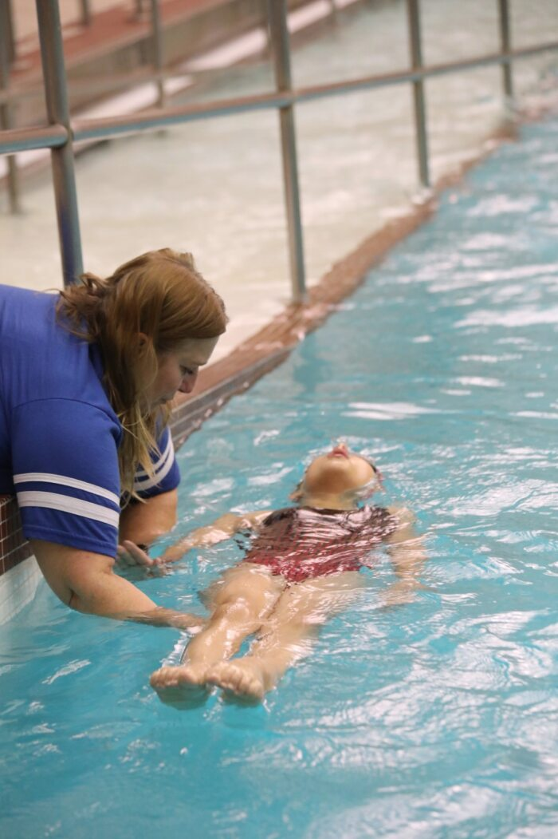
Writing a Successful Grant Proposal
Think outside the box.
Where and what are your problem areas?
Impact a large group of people.
Be thorough in explanations.
Consider costs carefully. Do not apply for money to cover areas that the Foundation does not fund.
Include at least two contacts that will be available to manage your grant with your liaison.
Make sure the email you use on your application is the email we should use to communicate with you.
Ensure that you have 501c3 status, Fill in your W-9 completely, including date/signature
Include your non-profit IRS letter.

Slide 12
Reporting Back to the Foundation
WE NEED YOU!
You are our greatest ambassadors to help the Foundation continue to raise more funds which allows us to provide more grant monies to you. That is why the Final Report is so important for us.
We use the information submitted by grantees to:
Create marketing materials that tell the Foundation's story and inspire potential donors.
Promote our grantees in our Newsletter; we want to share the exciting things our grants have allowed you to do.
Increase our social media exposure. #usaasfoundation
Help us raise more money to give out more grants!

Slide 13
Grantee Process - Traditional Grants
Grantees must READ, SIGN and RETURN the Grant Agreement. The grant agreement will be an Adobesign electronic document sent by email.
  All instructions for receiving your grant monies are included in the Grant Agreement.
  Traditional Grants are a 2-step process.
  Return of Grant Agreement,W9, non- profit status letter & COI
  Like and Follow our social media platforms
Final Report
  10 High Quality digital images of the event/grant program.
  At least 3 social media posts at least 1 prior to the event and 1 after. Tagging with #USAASFoundation, Report back with what worked, what didn’t work, and what you learned or were able to achieve with your grant. What was the impact.
  Success failure what you learned. Any quantifiable matrix: ex: we held a try it clinic, 30 people participated and 6 joined the team.
  Impact statement (written or video)

Slide 14
Grantee Process - Education Grants
Grantees must READ, SIGN and RETURN the Grant Agreement. The grant agreement will be an Adobesign electronic document sent by email.
  All instructions for receiving your grant monies are included in the Grant Agreement.
  Education Grants are a 2-step process.
  Return of Grant Agreement,W9, non- profit status letter & COI
  Like and Follow our social media platforms
Final Report Items required for grant payment:
  Receipts from USAAS Courses Taken & certificate of completion.
  5-10 High Quality Photo and/or Video demonstrating what you learned or how you have applied your new knowledge.
  At least 3 social media posts at least 1 prior to the event and 1 after. Tagging with #USAASFoundation
  Final Report: Report back with what worked, what didn’t work, and what you learned or were able to achieve with your grant. What was the impact. Any quantifiable matrix: How you applied what you learned and what were the outcomes. How did your grant help the sport improve and grow?

Slide 15
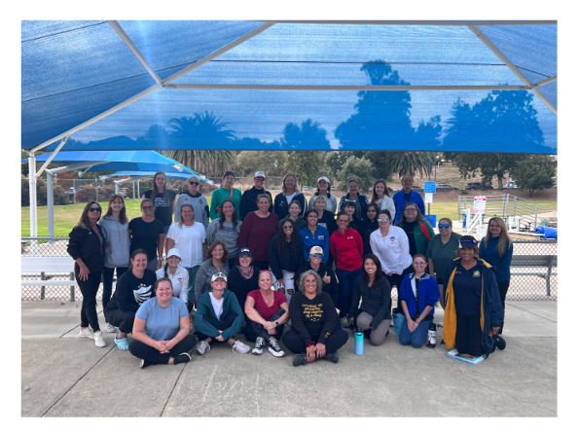
Grantee Liaisons
Each Grantee will be assigned a Liaison from the Foundation's Grants Committee.
This Liaison will be your contact person regarding questions or problems about the grant. They are there to help keep you on track and answer questions along the way.
We’re a Team and we are here to help make your grant a success!

Slide 16
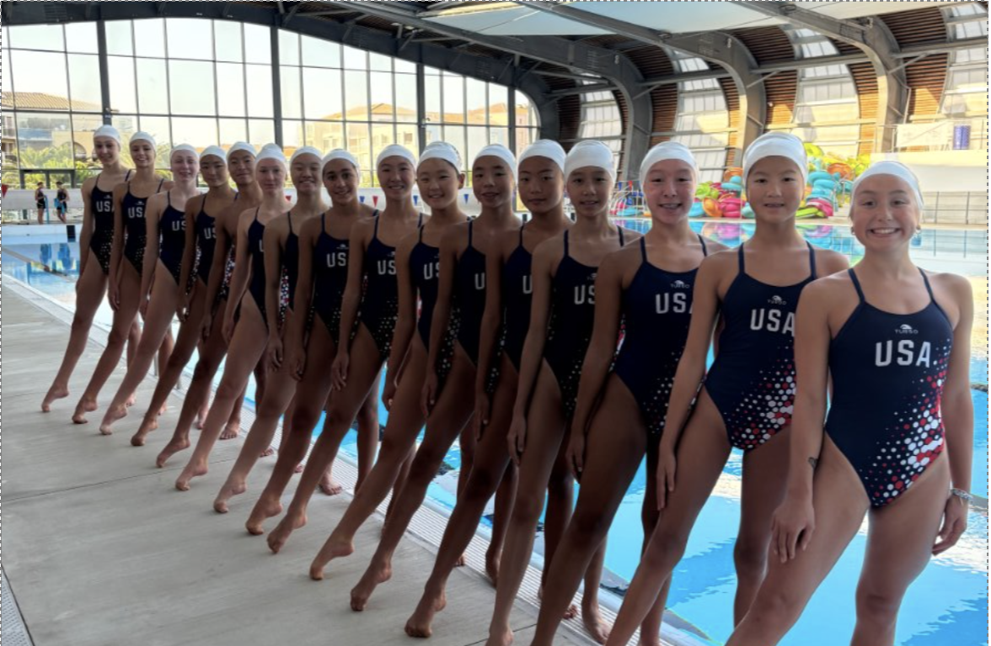
Commonly Asked Questions
How much information needs to be in my application?
Can I put a Traditional and Education Grant on the same application?
Is it possible to only be awarded part of a grant request?
What if something changes after I have submitted my application?
Who do I contact if I have questions about my application?
Where do I find an IRS W-9 Form and non profit status?
How do I know if I have a Certificate of Insurance?

Slide 17

Thank You

