Slide 1

SponSorship Opportunities
September 4th, 2026

Slide 2


Mission Statement
Our mission is to fund the growth of the sport and to prepare today's artistic swimmers to become tomorrow's champions and leaders.​
We work together with USA Artistic Swimming to raise funds to support the athletes, coaches, and officials at all levels.
The Foundation is a 501(c)(3).

Slide 3
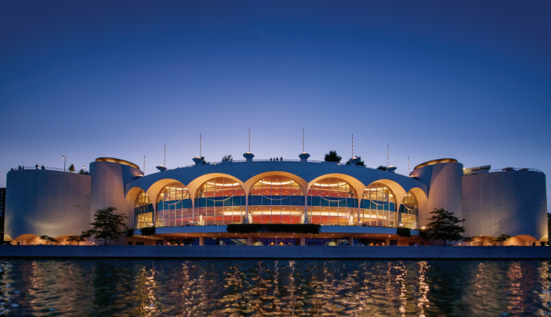
Monona terrace community & convention center
USAASF Champion of Dreams, Paving the way to la Convention Reception will be held at MONONA TERRACE COMMUNITY & CONVENTION CENTER IN MADISON, WI on September 4th from 6-10pm.
Join us for a night filled with honor and celebration from this past year. NOT TO MENTION AMAZING food, drinks, and prizes to win! We will have special guests from our 2026 USA Artistic Swimming National Team.
You won’t want to miss this opportunity!

Slide 4



Sponsorship
Opportunity Levels

Slide 5
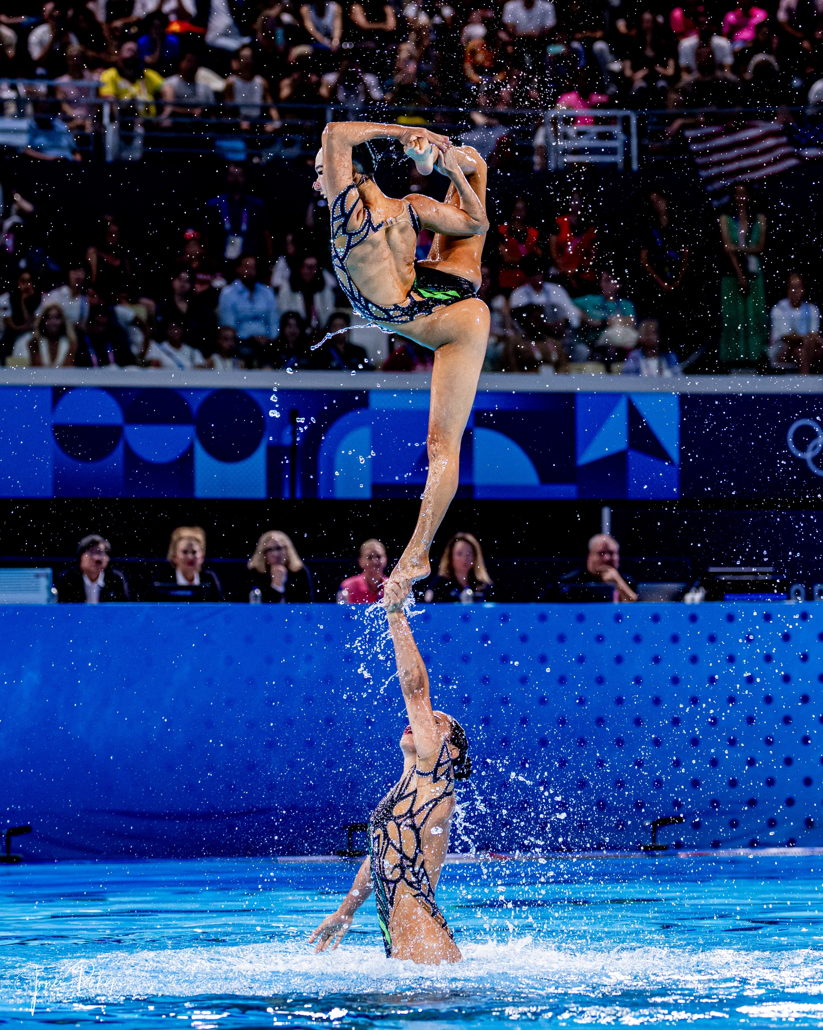

Title Sponsor-
In Honor of Judy McGowan $6,000
MARKETING BENEFITS:​
Corporate Name/Brand attached to title of event​
Logo/Name on Signage at event​
Logo/Name on Website​
One (1) Social Media Post regarding the sponsorship​
On Stage Recognition​ at event
EVENT BENEFITS:​
Ten (10) Event Tickets​
Prime Seating during the event
Exclusive access during the event

Slide 6
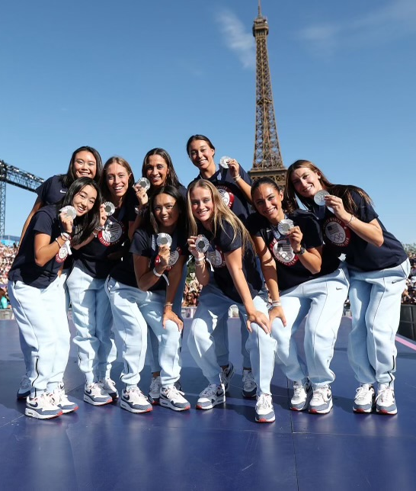
LA 2028 Sponsor Level $4,000
MARKETING BENEFITS:​
Logo/Name on Signage at event​
Logo/Name on Website​
One (1) Social Media Post regarding the sponsorship​
On Stage Recognition at event
EVENT BENEFITS:​
Six (6) Event Ticket
Prime Seating during event

Slide 7
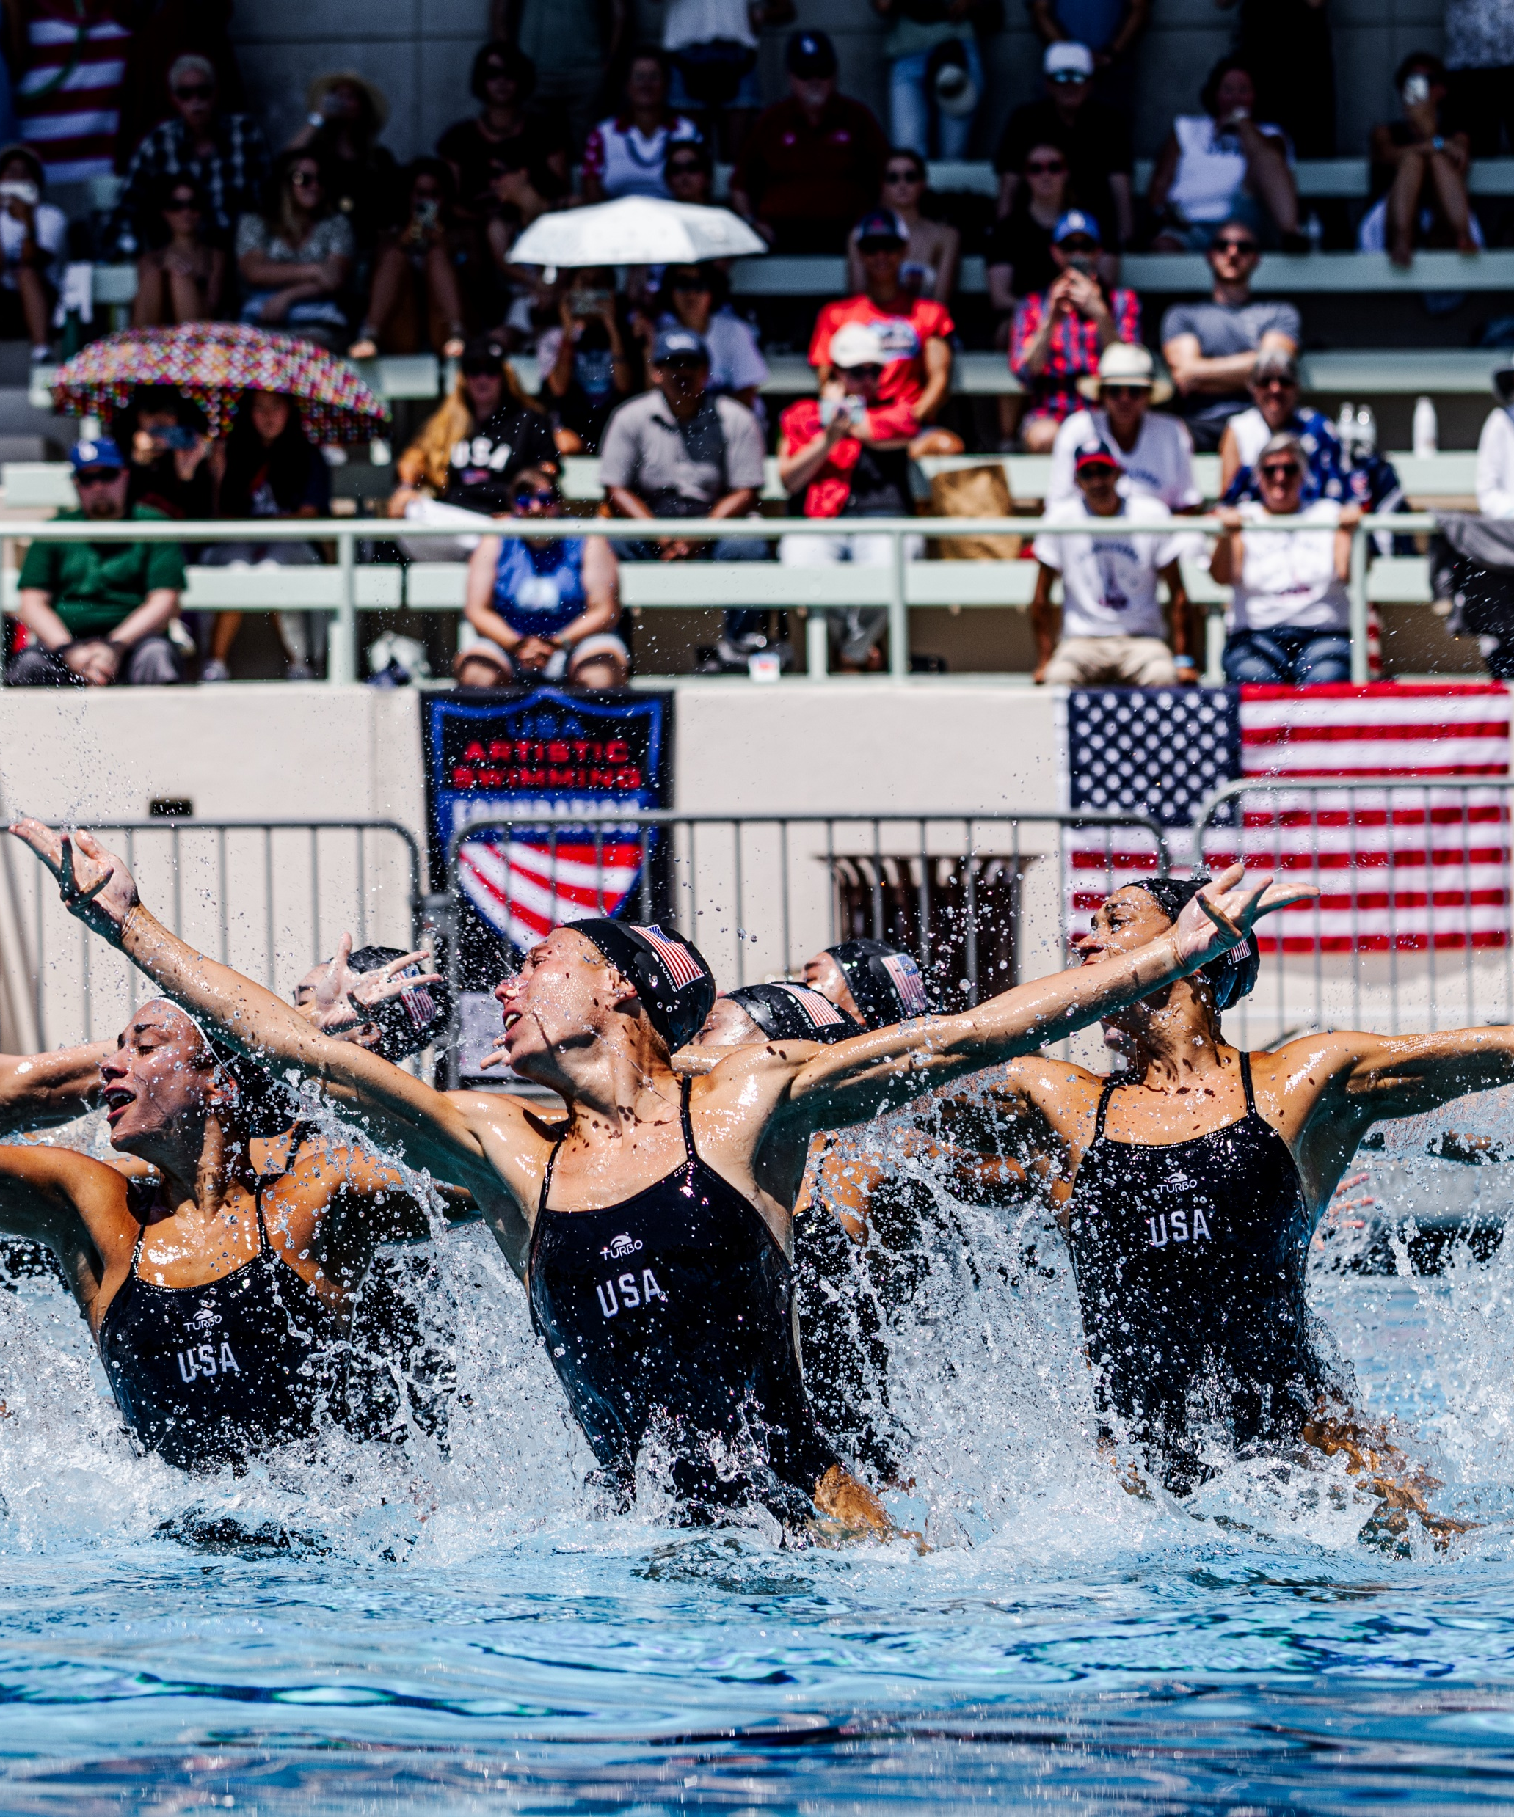
Paris 2024 Sponsor Level
$2,500
MARKETING BENEFITS:​
Logo/Name on Signage at event​
Logo/Name on Website​
One (1) Social Media Post regarding the sponsorship
EVENT BENEFITS:​
Four (4) Event Tickets
Prime Seating at event

Slide 8
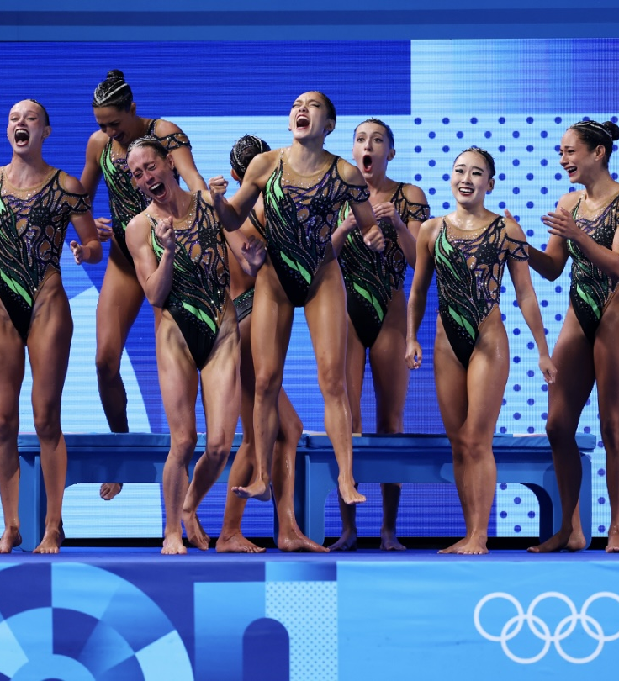
Atlanta 1996 Sponsor Level
$1,000
MARKETING BENEFITS:​
Logo/Name on Website​
One (1) Social Media Post regarding the sponsorship
EVENT BENEFITS:​
Two (2) Event Tickets
Prime Seating during event

Slide 9
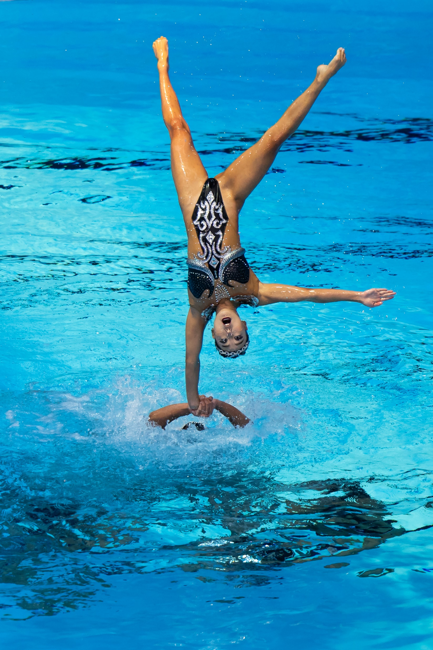
LA 1984 Sponsor Level
$500
MARKETING BENEFITS:​
One (1) Social Media Post regarding the sponsorship
EVENT BENEFITS:​
oNE (1) Event Tickets
Prime Seating during event

Slide 10
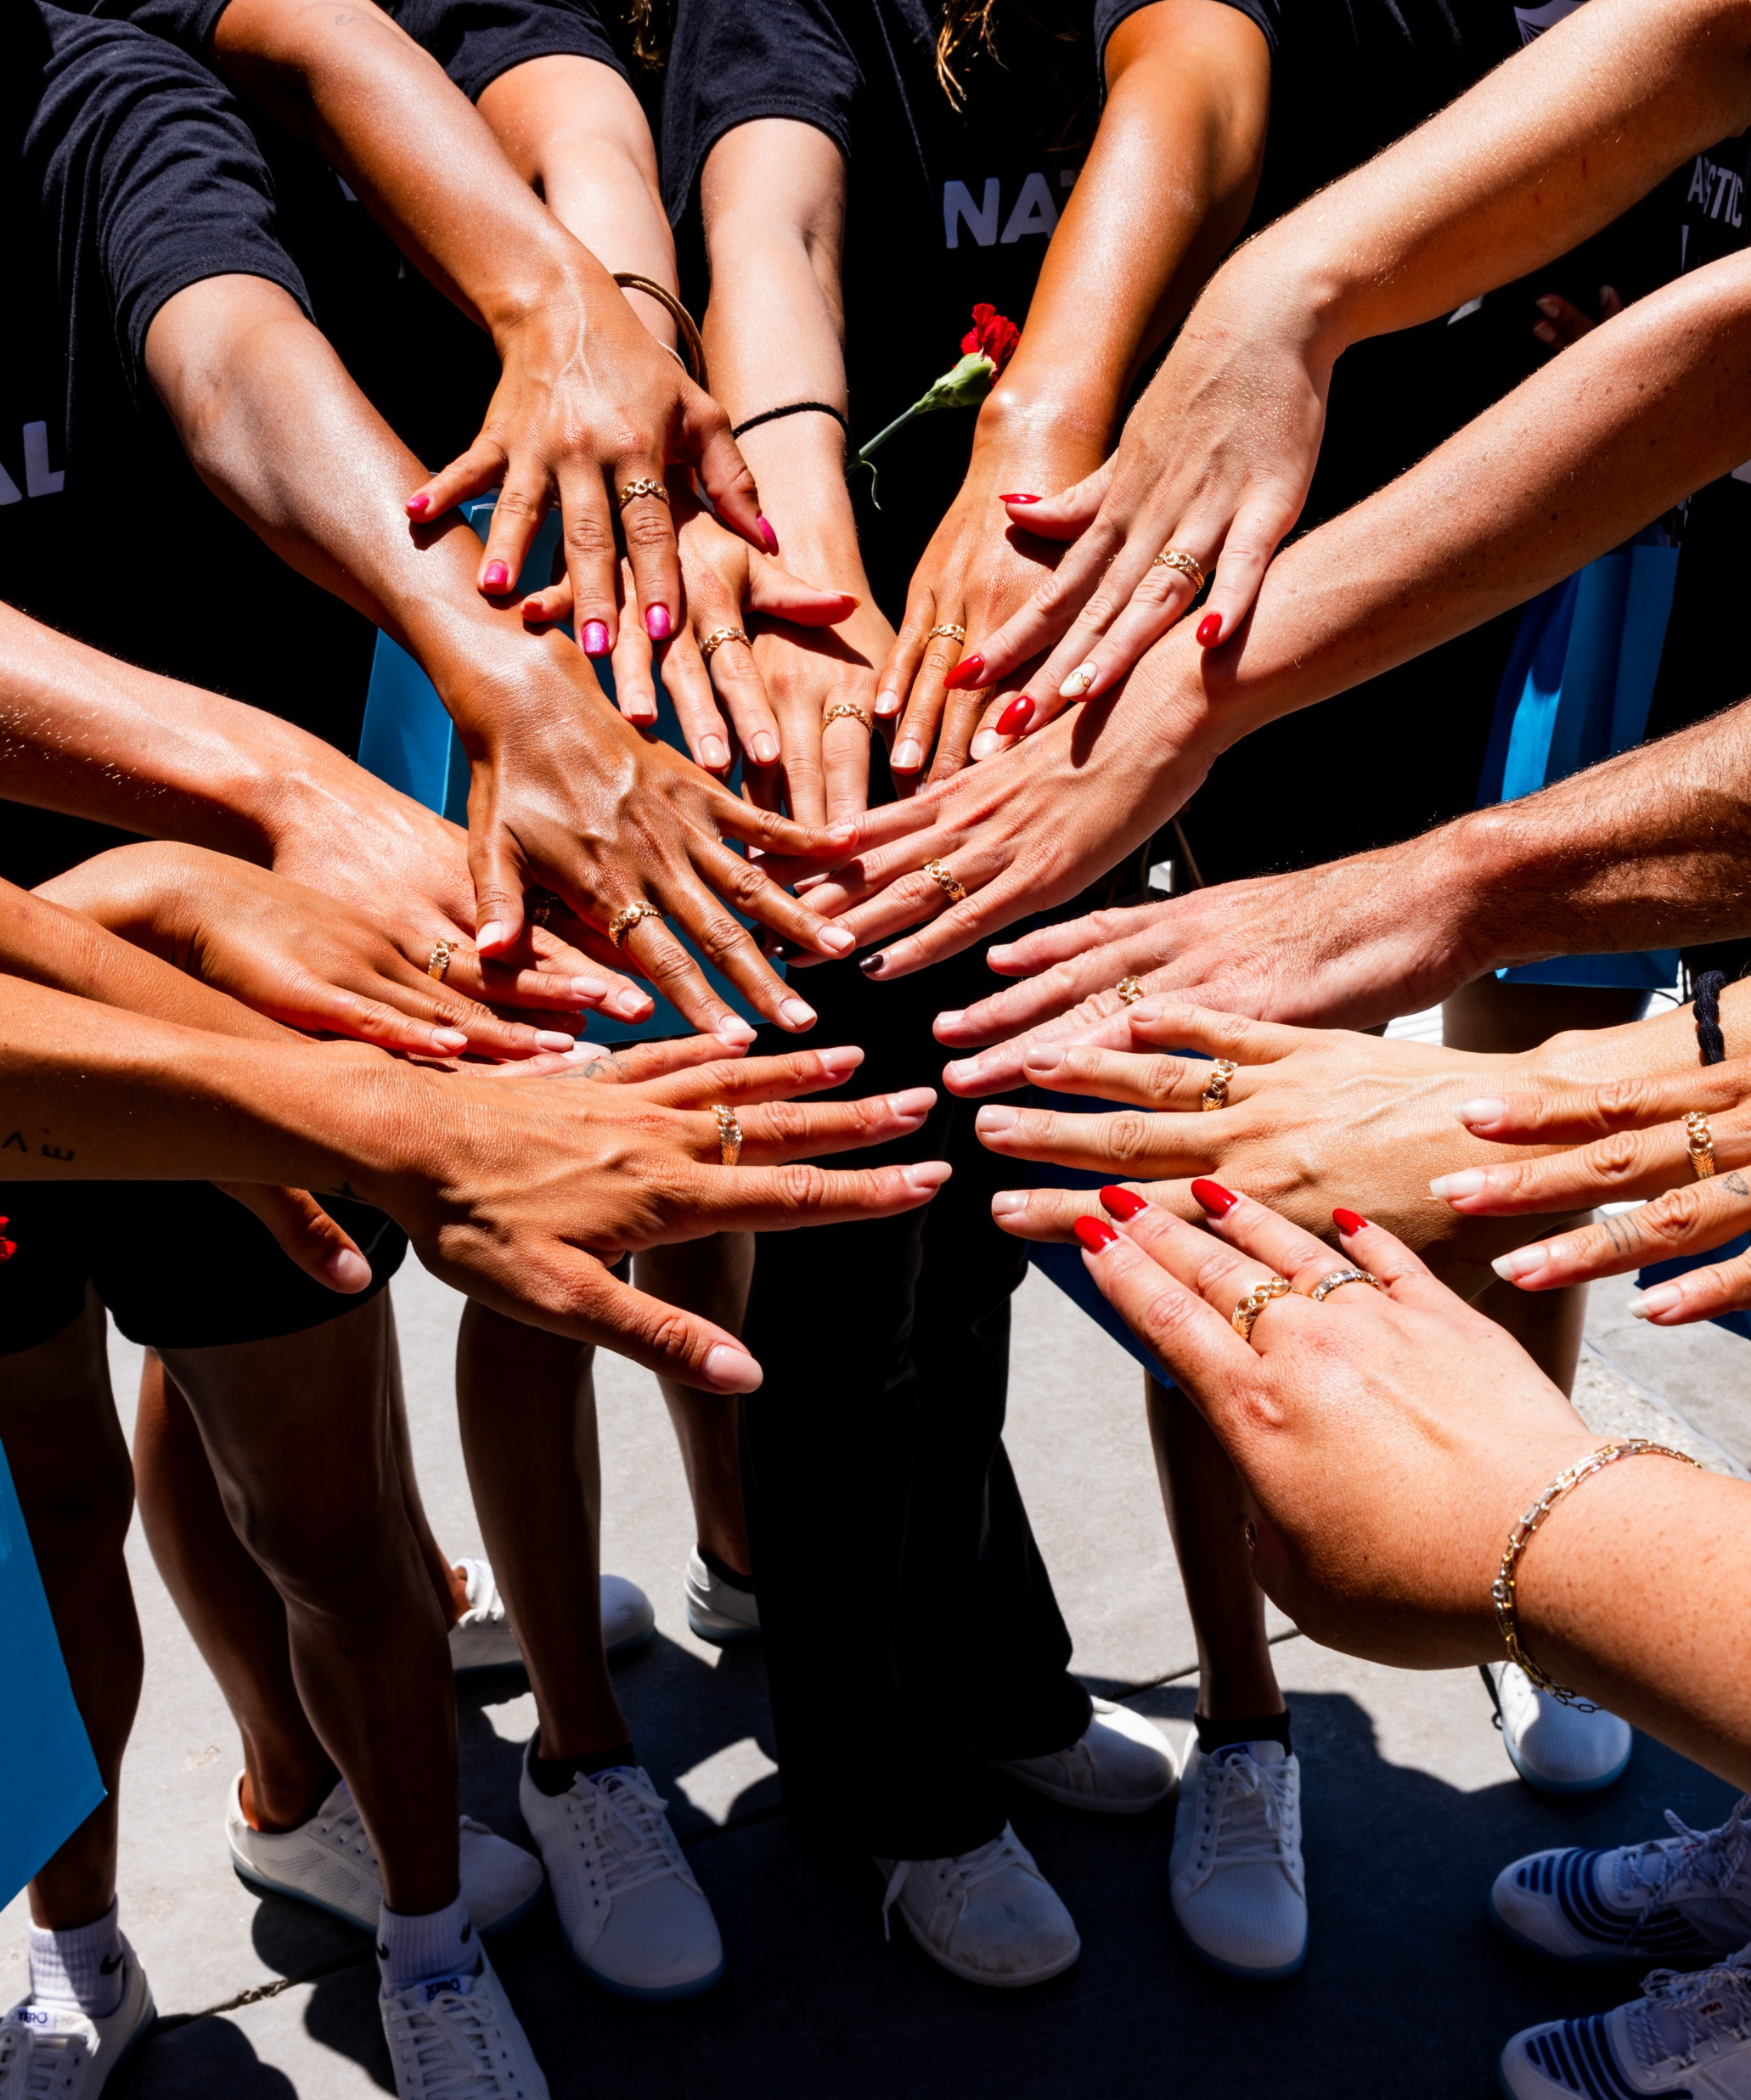
We Appreciate You!
Thank you in advance for considering being a sponsor for our event. Your support makes our athletes stronger.​
We look forward to seeing you there!
If you are interested in being a sponsor for the 2026 USAASF Champion of Dreams Convention Reception, please contact:
Amanda Styninger astyninger@usaartisticswimmingfoundation.org

