Slide 1
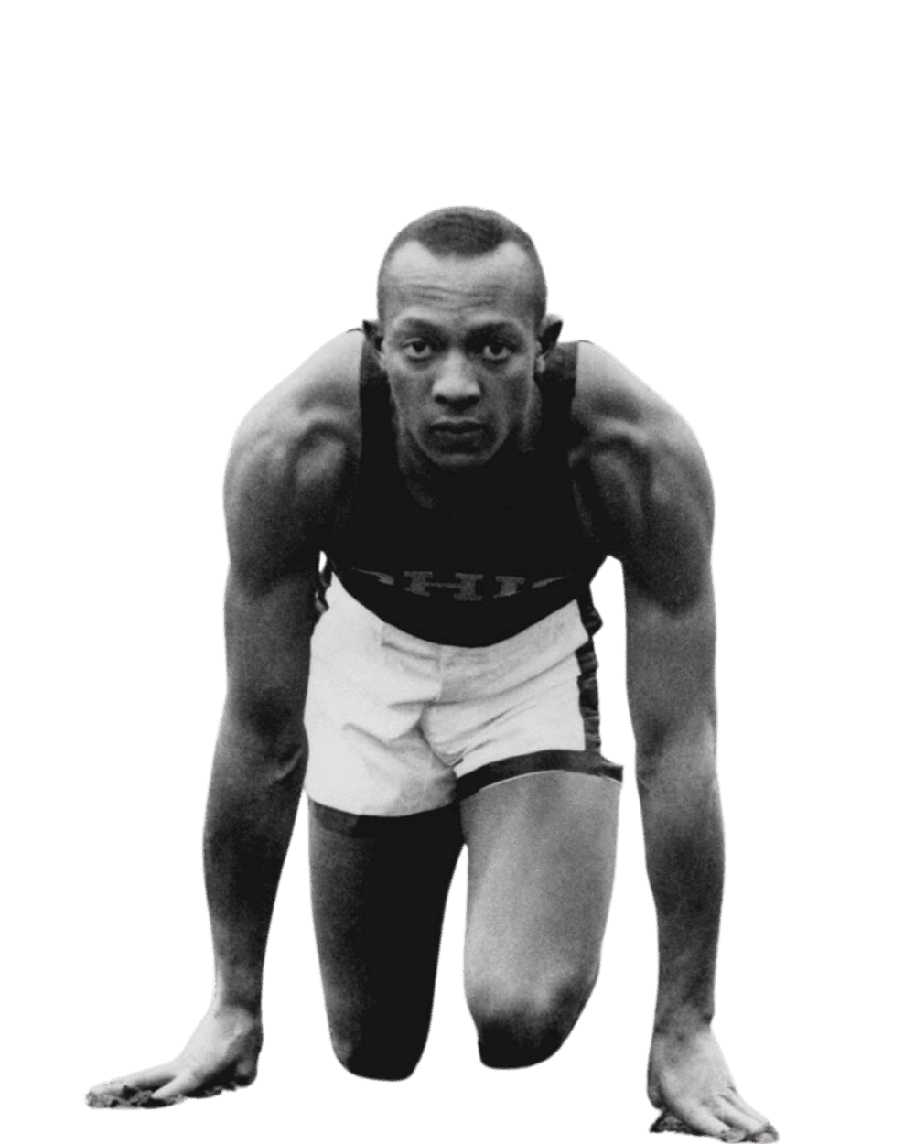
IMPACT504
Running the Race.

Slide 2
IMPACT504
Running the Race.
Your presence has already made an IMPACT.
In less than 1 week the IMPACT504
Board of Directors Announcement Posts have generated:
Views | Reactions | Comments | Shares
13,366 | 672 | 248 | 20

Slide 3
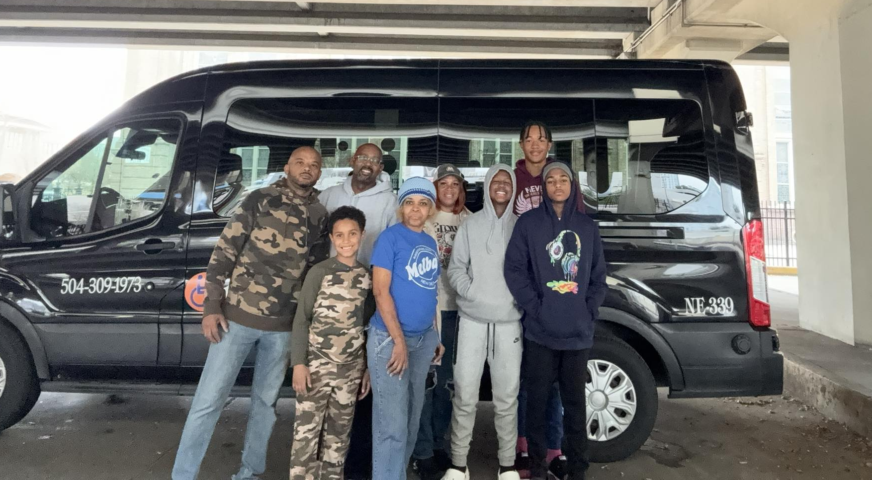
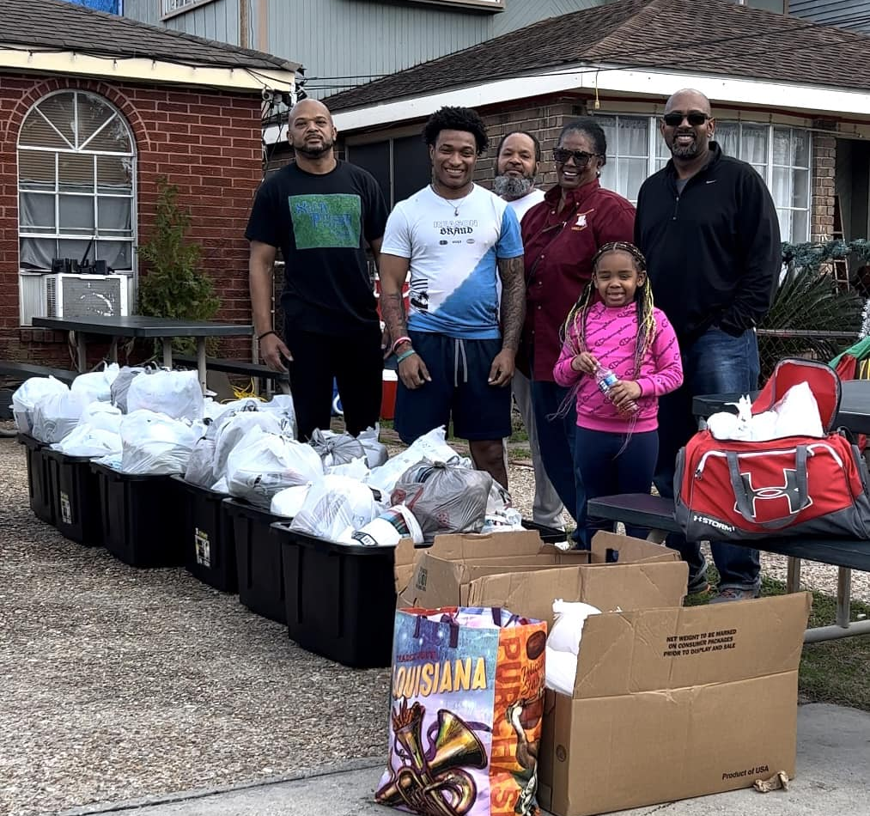
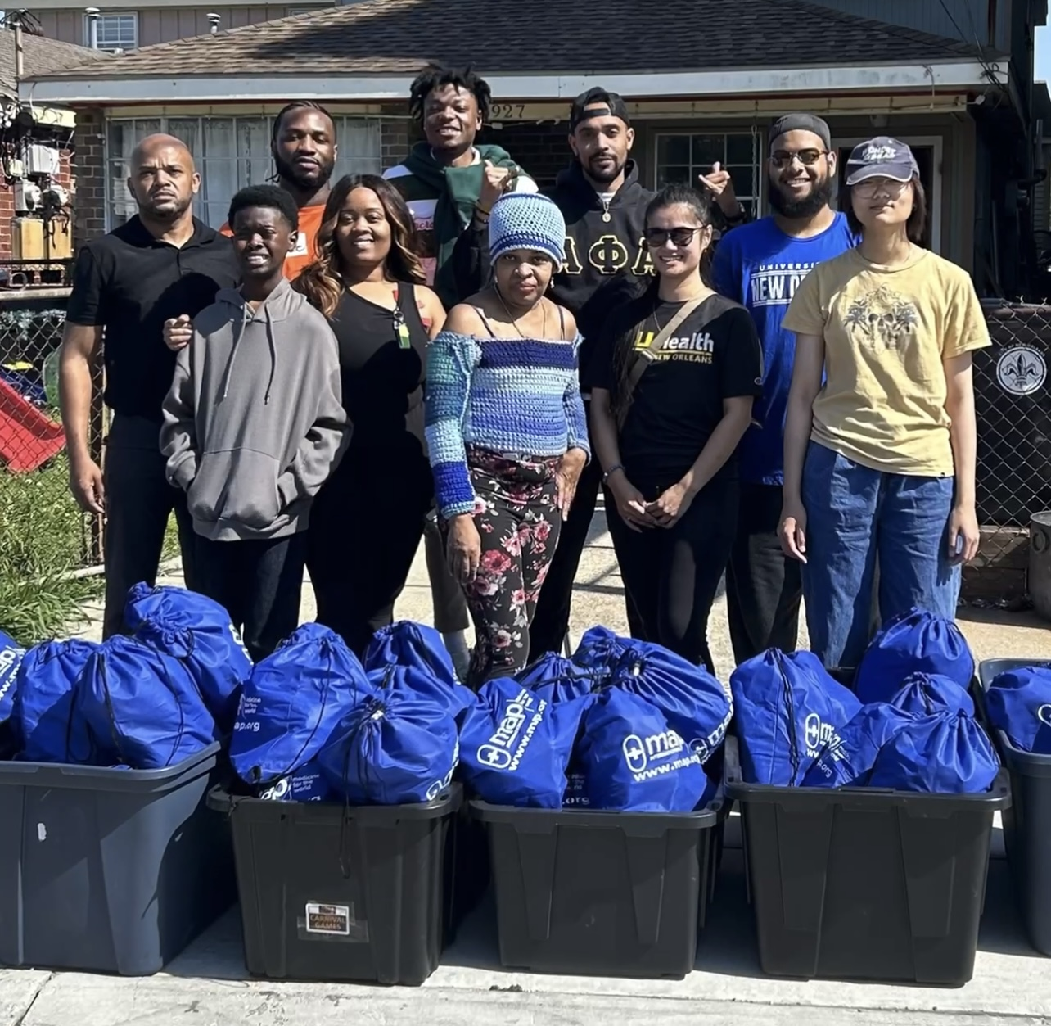
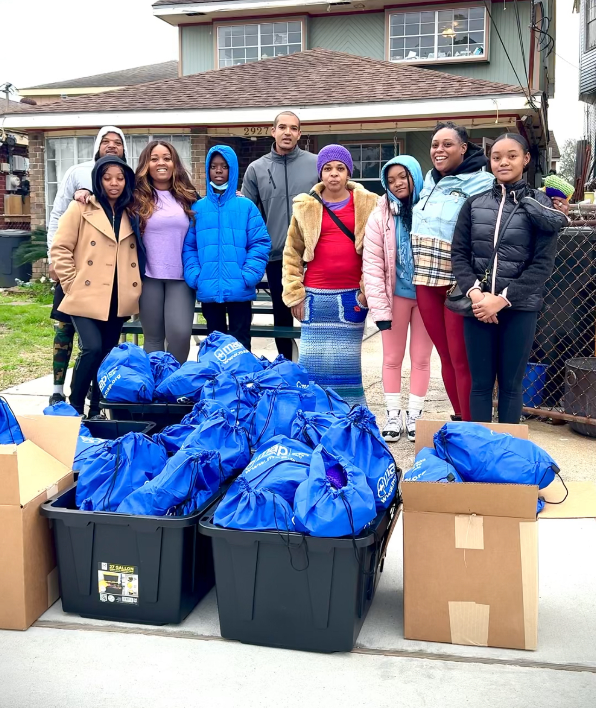
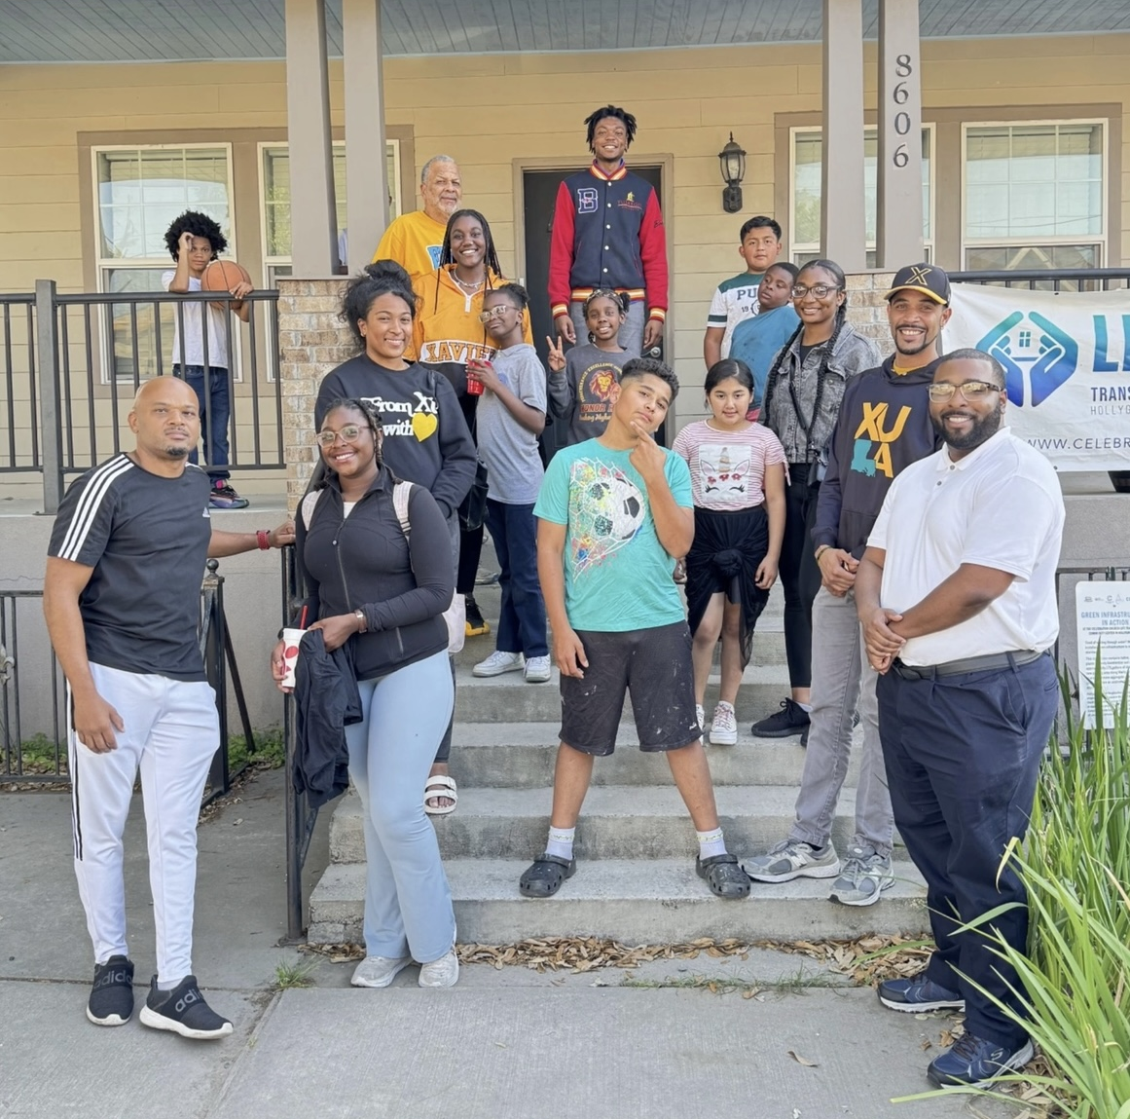
IMPACT504
Running the Race.
Running the First Leg: 2024’s IMPACT
Krewe de Charite’
• Distributed over 800 personal hygiene kits
• Distributed over 200 hats and throws
• Held 4 on-site distributions throughout the city
• Over 60 Volunteer service opportunities filled
• Over $2,500 was contributed by donors
• Collaborated with the Hollygrove / Dixon Life Transformation Center Youth Program to sort through donated clothing
Krewe de Charité
Caring for the Underserved

Slide 4

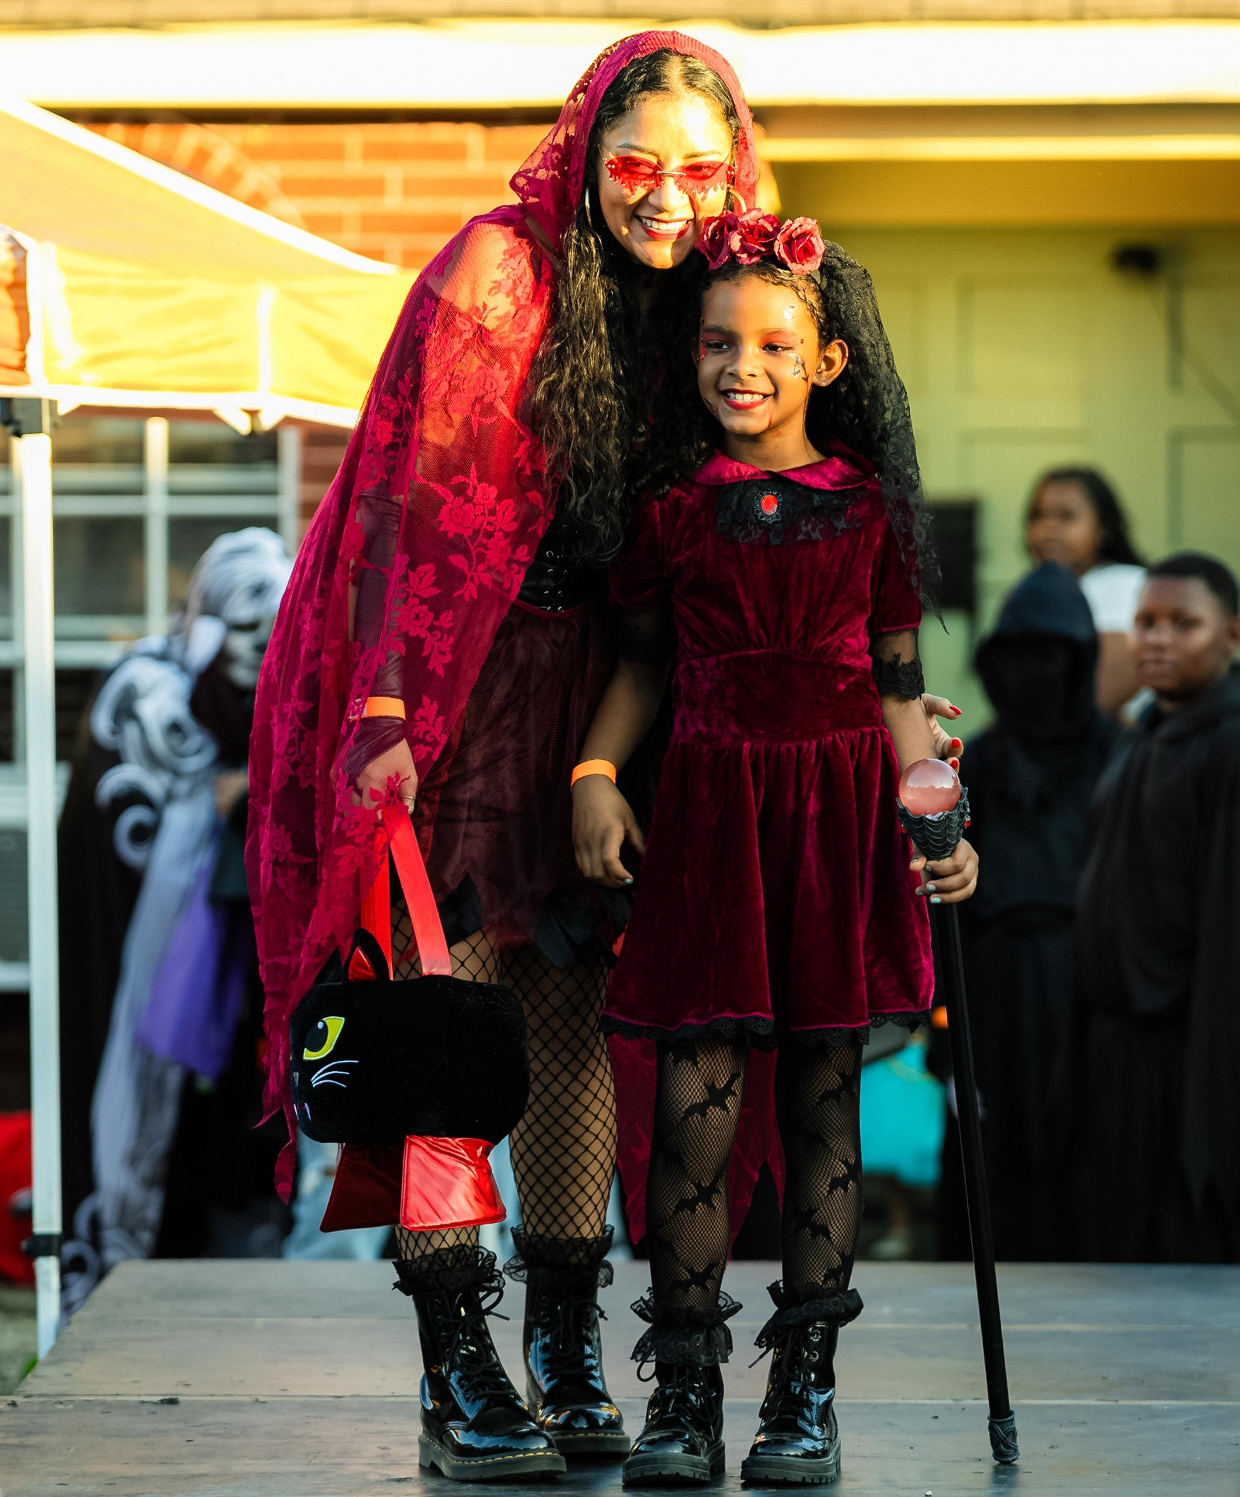
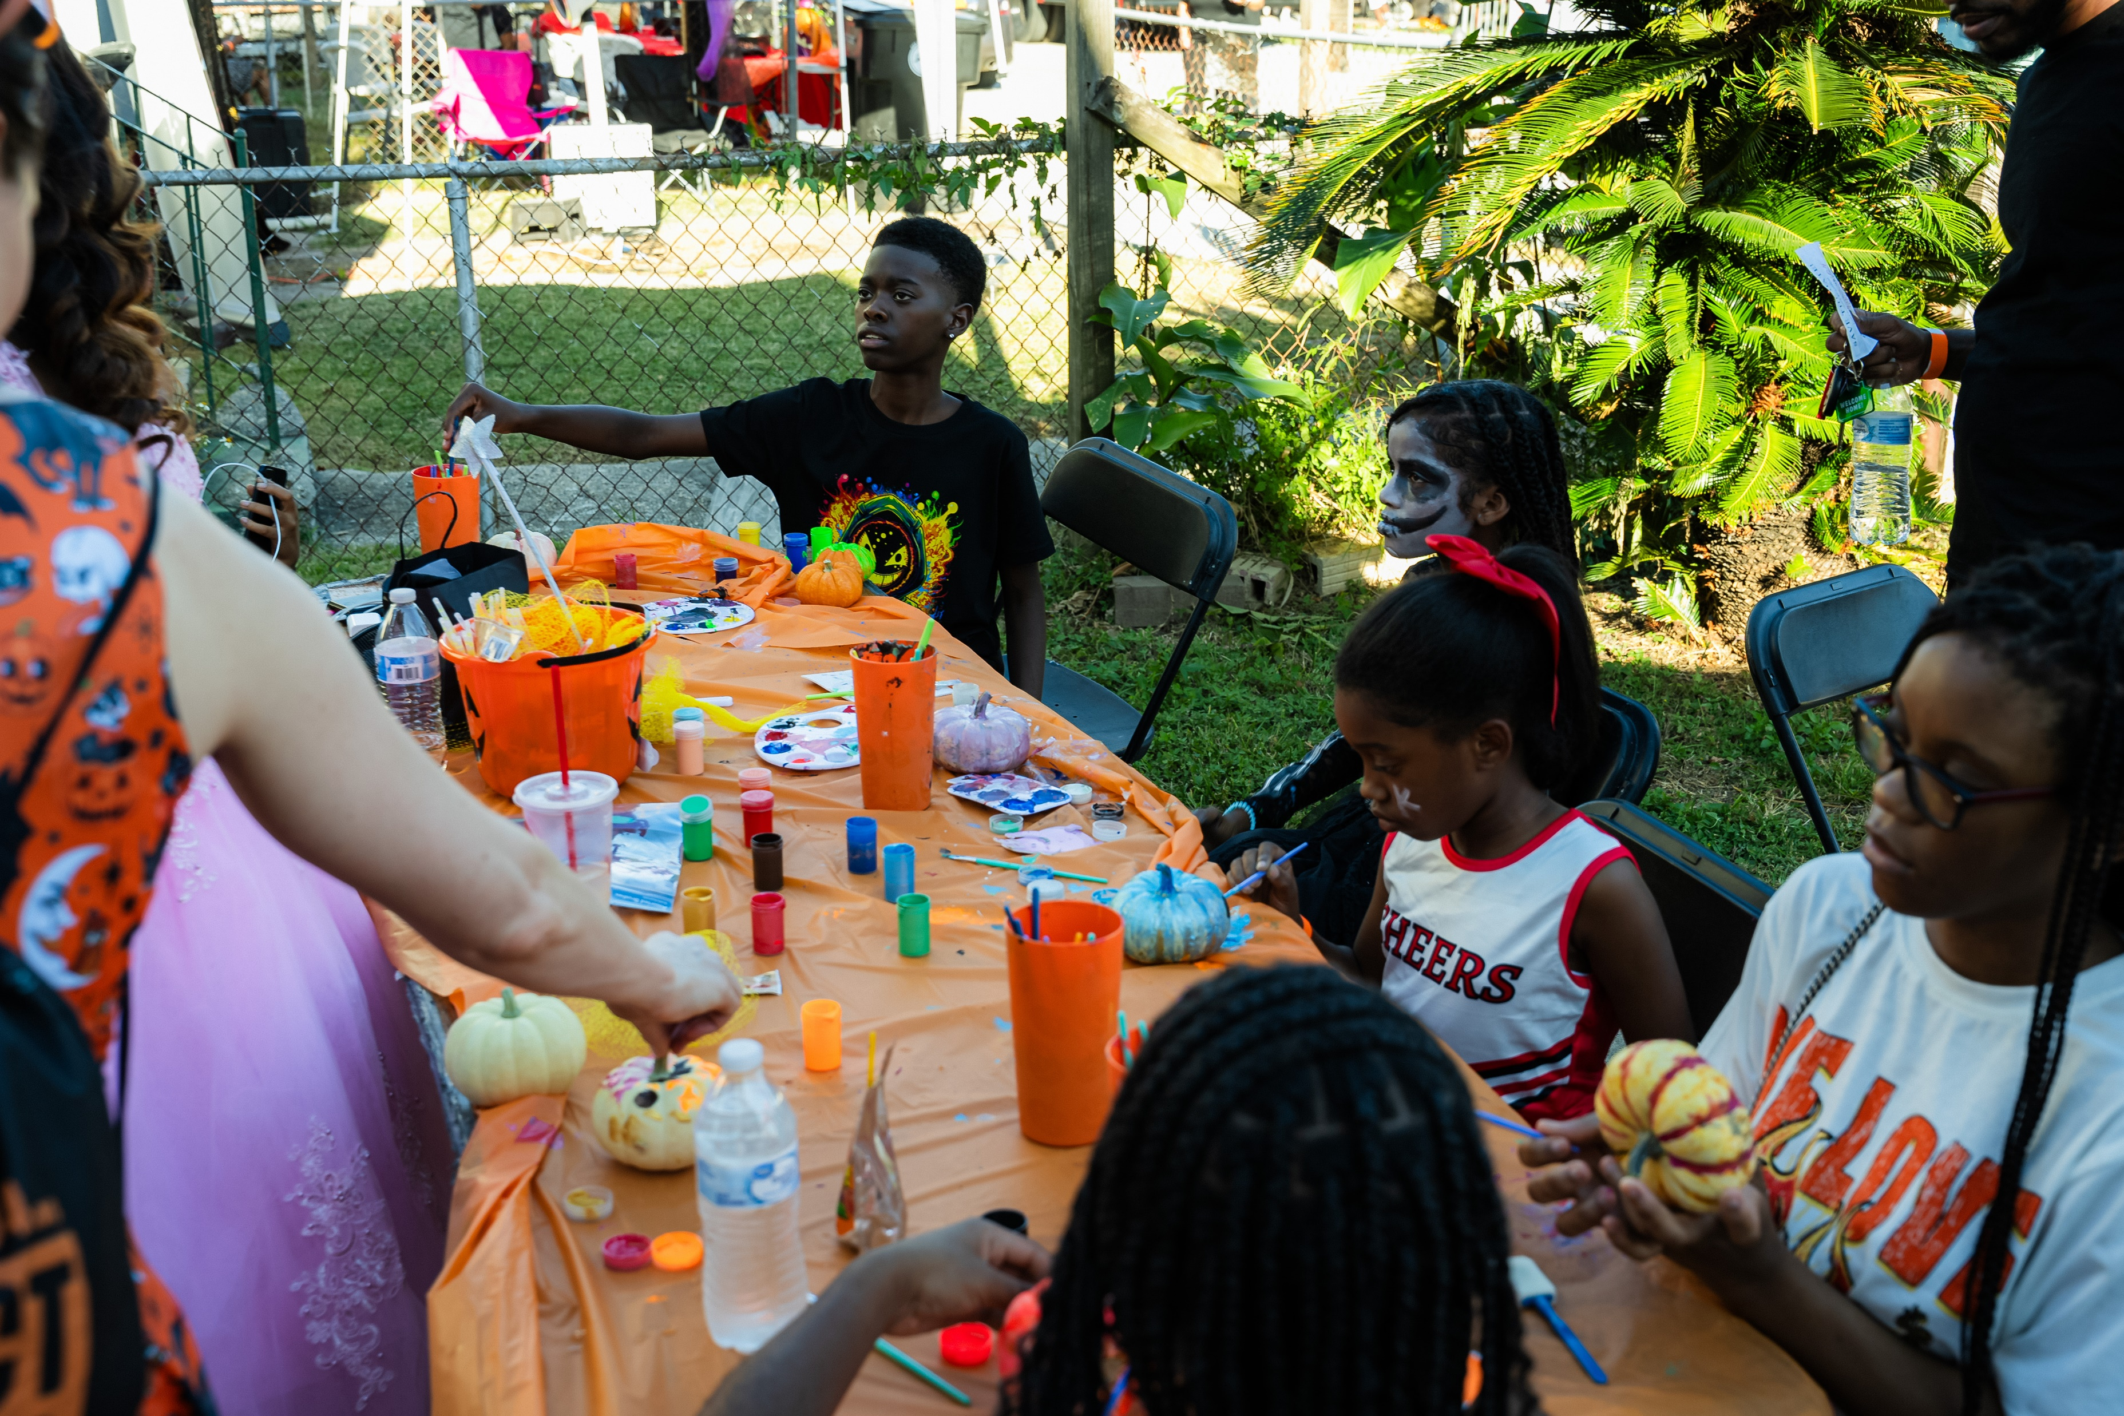
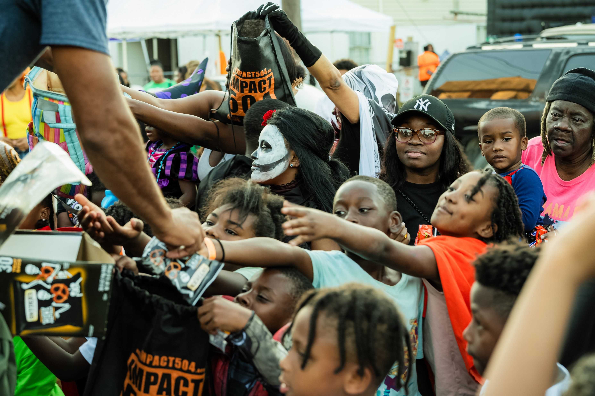
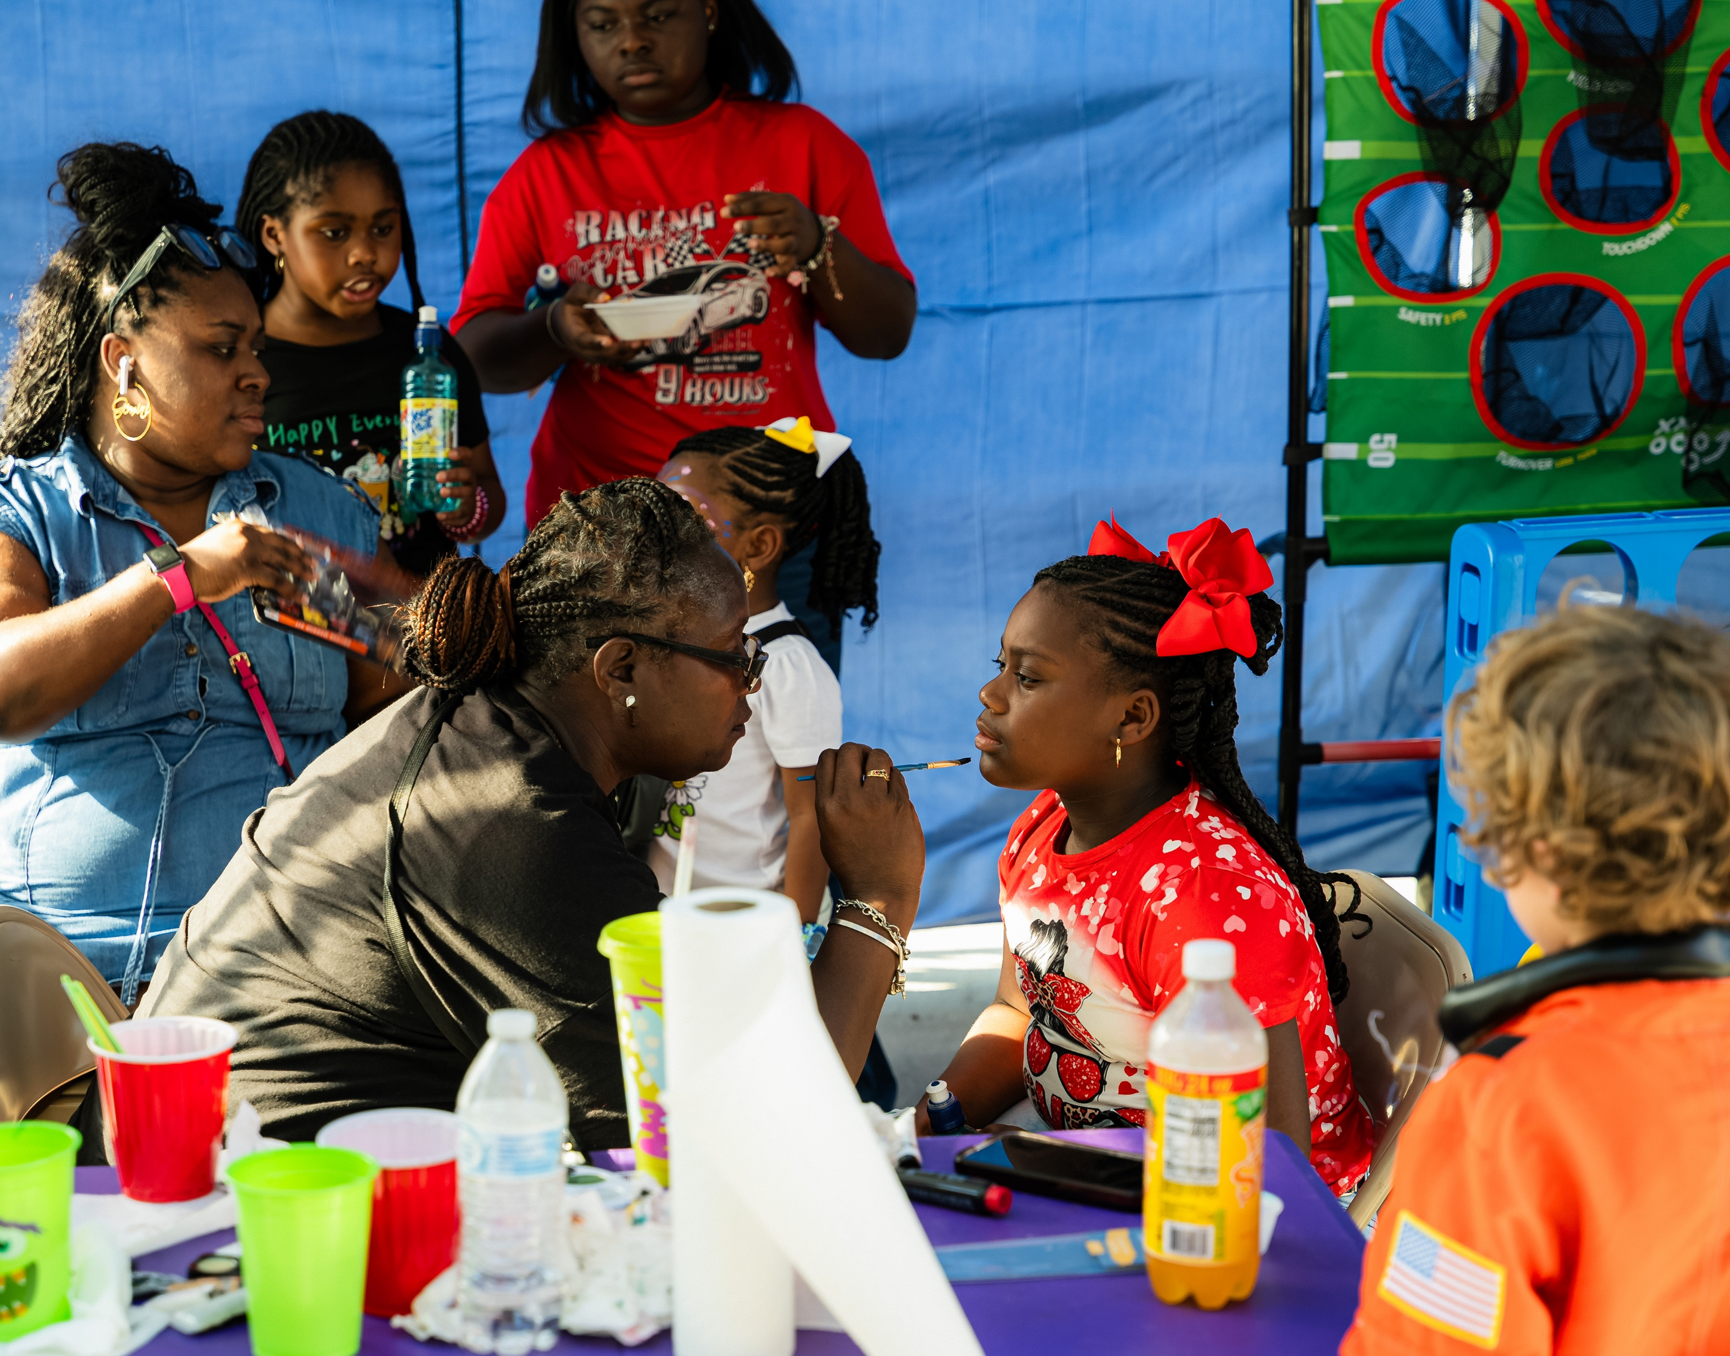
IMPACT504
Running the Race.
Running the First Leg: 2024’s IMPACT
The Fourth Annual BOO!Dat504 – Saturday, October 26, 2024
• Over 500 attendees
• 250 IMPACT504 Bags distributed
• Over 50 volunteers (30 from Xavier University)
• Over 30 entities supported
• Sponsorship funds more than doubled
• Over 60 individual donors
• Substantial media coverage: WWL, WDSU, WVUE, WGNO, The Advocate, and WBOK
• Over 3,000 brochures distributed in Gert Town and surrounding communities
• Over 2,350 people visited BOODat.com in October
• City/State Officials in attendance: Lesli Harris, Royce Duplessis, Shaun Mena, and Mandie Landry

Slide 5

IMPACT504
Running the Race.
The Next Leg: Future IMPACT

Slide 6

IMPACT504
Running the Race.
The Next Leg: Future IMPACT

Slide 7

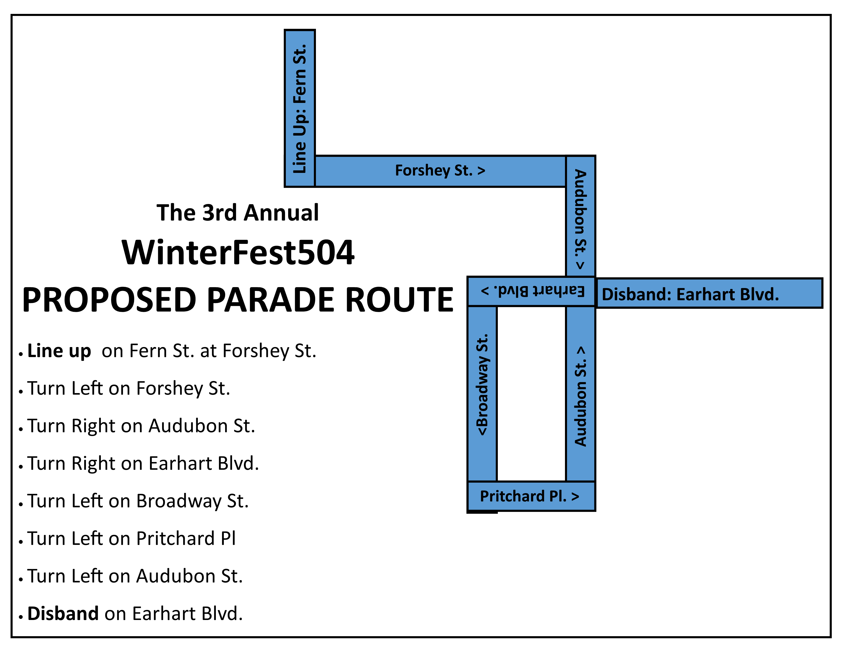
IMPACT504
Running the Race.
The Next Leg: Future IMPACT

Slide 8
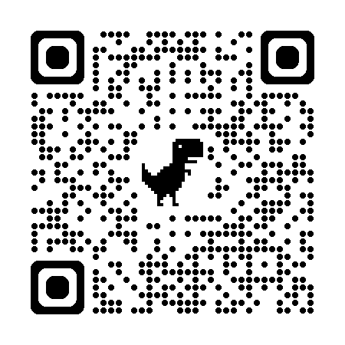


IMPACT504
Running the Race.
How you can help increase our IMPACT.
SCAN TO GIVE!
Contribute
  Volunteer for our projects, activities, and events
  Donate goods / supplies for our giveaways and activities
  Recommend programs, activities, collaborations, and service opportunities
  Make tax-deductible financial donations to support our efforts (and ask your friends, family, co-workers, employers to also!)
Be our cheerleaders
  Follow IMPACT504 on Social Media
  Share our posts adding your personal experiences
  Show up to our programs (and bring friends)
Online Donations: pay.boodat.com
OR Cash App: $ReachTheGoal

Slide 9
IMPACT504
Running the Race.
How you can help increase our IMPACT.
The team only wins the relay race when we all run our best.
Let’s make the win be for
our communities…
our youth…
our elders…
and each other.

