Slide 1
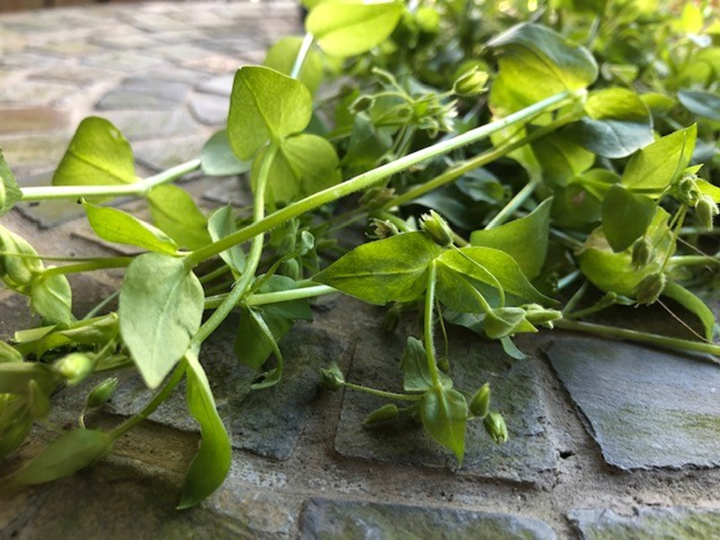
Herbal Allies
the well being program
Herbal Medicine making workshops

Slide 2
OUR MISSION
Provide affordable access to complementary and alternative medical services that
integrate and promote the holistic health and wellness of the mind, body and spirit
COACHING SERVICES
Wellness • Mindset
Mindfulness • Meditation
Stress Management
MENTAL HEALTH SERVICES
Depression • Anxiety
PTSD • Domestic Abuse • Addictions
Substance Abuse Support
HEALTH SERVICES
Ayurveda • Herbal Consultations
Herbal & Wellness Education
Reiki• Chakra Balancing
Traditional Chinese Medicine

Slide 3
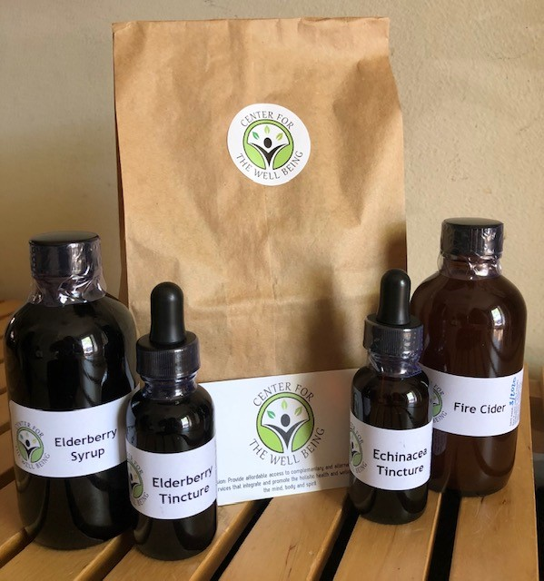
FROM THE COMMUNITY APOTHECARY
Our new initiative to serve the local community during the COVID-19 pandemic
FREE Herbal Care Packages are available for those in our local communities in the Washington, DC area who are in financial need due to COVID-19 or are in our
Affordable Access Program
All donations for this event will go towards this initiative
Please make donations through our PayPal Giving Fund,
an IRS-registered 501(c)(3) public charity, and receive a charitable tax write-off. Suggested donation: $25

Slide 4
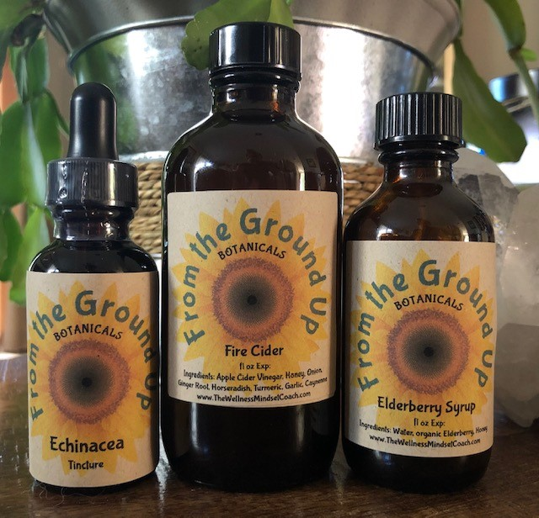
$25 DONATION
Immune Support Kit
FALL SPECIAL
IMMUNE SUPPORT KIT includes:
• 4oz bottle of FIRE CIDER
• 2oz bottle of ELDERBERRY SYRUP
• 1oz ECHINACEA TINCTURE
BOOST THE IMMUNE SYSTEM DAILY
FIRE CIDER - Take 1-2 tablespoons every morning to keep the immune system strong! Use it all year long!
ELDERBERRY SYRUP - Take a teaspoon every morning to build the immune system.
TAKE CARE OF THE COLD AT THE FIRST SIGN
If you feel a cold coming on, take a teaspoon of ELDERBERRY SYRUP and a dropperful of
ECHINACEA TINCTURE 3-4 times a day until you feel better.
This herbal combination significantly shortens the duration and severity of colds.

Slide 5
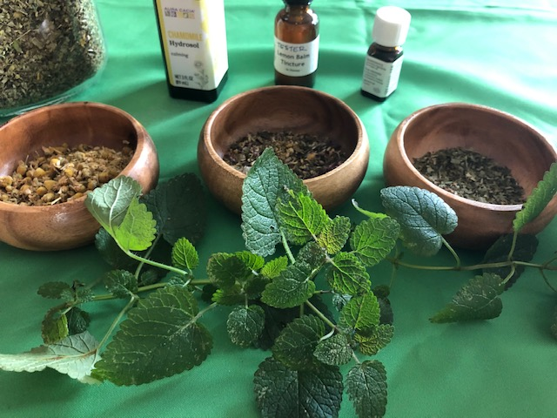
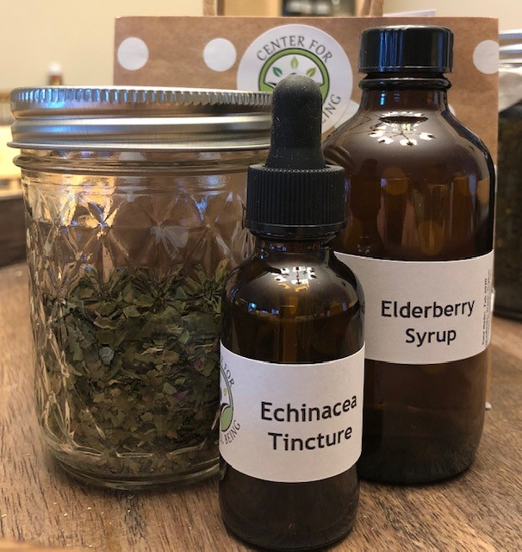
THE WELL BEING
Herbal Allies Workshop Series
1st Saturday of Every Month
9:00 - 10:30AM
An educational resource to discover ways we can empower ourselves through using complementary and alternative approaches to holistic health and wellness as well as the healing and nourishing benefits and uses of herbs in our daily lives
Herbal Medicine Making Workshops
2nd Saturday of Alternating Months
9:00 - 11:00AM
Consists of 2-3 hour long hands-on workshops alternating monthly where guests can learn how easy and economical it is to make herbal preparations at home and take home what they make at the workshop

Slide 6
THE WELL MIND
Wounded to Well:
Healing Through the Chakras™
Last Saturday of Every Month
9:00 - 10:30AM
A series of seven monthly 1 ½ hour in-person workshops held on the last Saturday of each month where we explore a chakra and its energies, understand how our unhealed traumas can manifest as illnesses and imbalances, and learn ways we can work with each of the chakras to heal ourselves
Mindset Matters: Manage Your Mind™ Workshops
2nd Saturday of Each Quarter
9:00 - 10:00AM
A series of one-hour in-person group coaching sessions alternating monthly to provide attendees with tools and strategies to help rewire the mindset, allowing us to fulfill our goals, reach our full potential, and become our best, healthiest and happiest

Slide 7
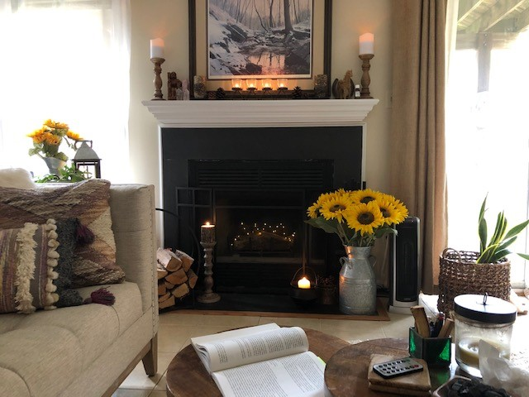
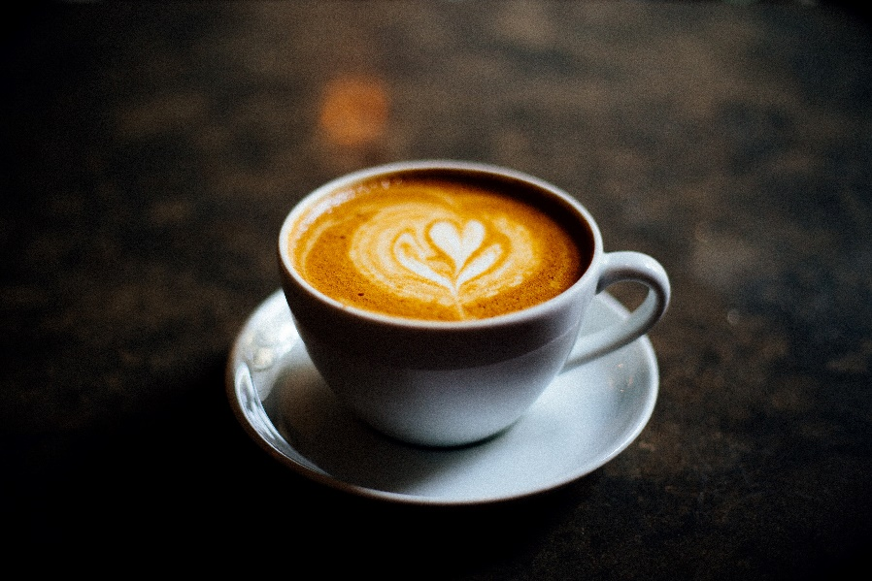
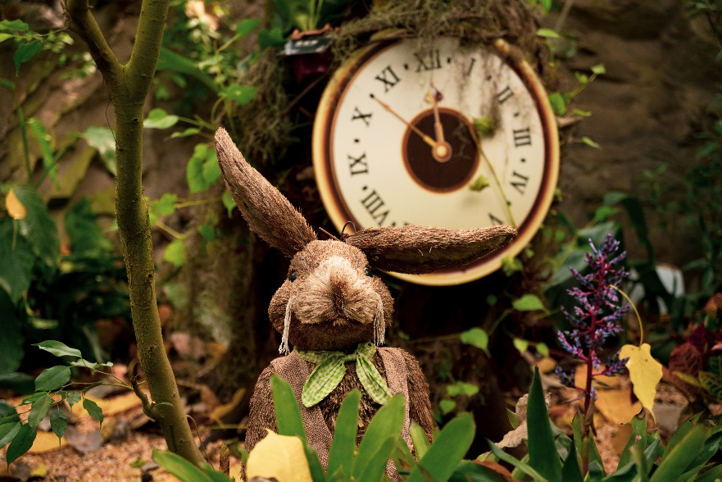
STAYING WELL
Staying Well
Fireside Chats
Select Weekdays at 7:00 - 8:00PM
Fireside Chats are one-hour VIRTUAL events held in the evening where we talk about ways we can help ourselves with staying well - wellness lifestyle, mindset, spirituality, herbs...and whatever else is on our minds
Spiritual Chats
at the Kindred Spirit Café
2nd Wednesdays at 5:00 - 6:00PM
Spiritual Chats are 60-minute VIRTUAL events held monthly where we talk about everything spiritual. We all have a spirit to nurture and have been brought together for community, clarity and purpose
All Things Herbal
Happy Hours
3rd Thursdays at 5:00 - 6:00PM
Herbal Happy Hours are 60-minute VIRTUAL casual discussions held monthly where we talk about All Things Herbal - from growing and purchasing herbs to using them in homemade medicinal elixirs and beauty recipes or a simple tea

Slide 8
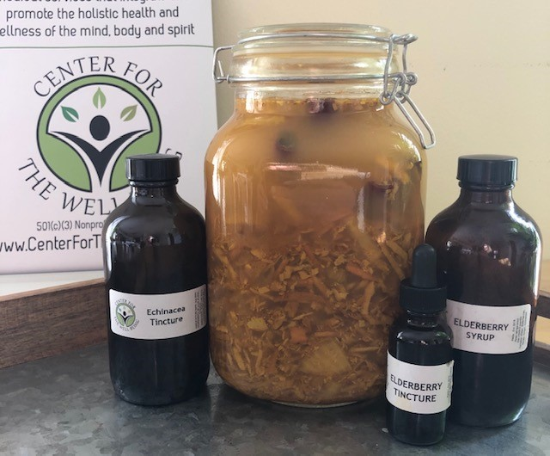
Herbal Allies
Herbal Medicine Making: Immunity boosters – Part 2
Elderberry syrup
Echinacea Tincture

Slide 9
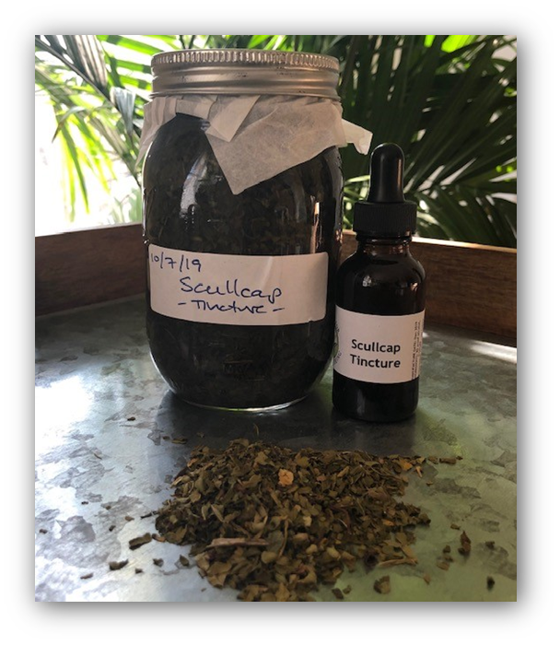
Herbal Tinctures: What They Are and How to Use Them
HERBAL TINCTURES
WHAT ARE HERBAL TINCTURES?
Tinctures can be made with fresh or dried flowers, leaves, roots, barks, or berries.
Tinctures are concentrated herbal extracts that have alcohol as the solvent.
Alcohol must be the solvent used to extract the herbal properties.
If you are using vinegar, glycerin, only water (water used to dilute alcohol is fine), or any menstruum (solvent) other than alcohol, your preparation is an extract, but it is not a tincture.
HOW AND WHY TO USE HERBAL TINCTURES?
Tinctures easily stored for long periods of time in a concentrated and liquid form.
The effects will depend upon the herb or herbs tinctured, the amount and frequency taken, and the individual ingesting them.
Tinctures can be taken straight by the dropper under the tongue, diluted in tea or other beverage, or dried over night to evaporate the alcohol and rehydrated in the morning.
Tinctures are concentrated herbal extracts that have alcohol as the solvent

Slide 10
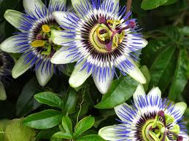
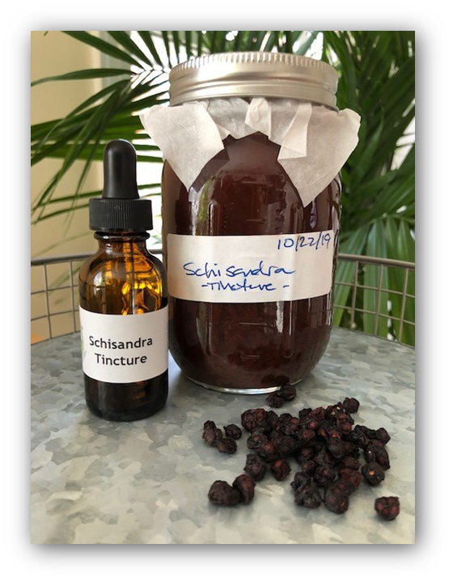
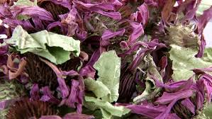
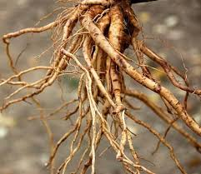
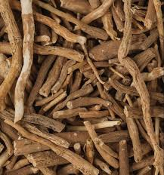
Plant Material: Fresh vs. Dried
PROPORTION GUIDELINES
FRESH LEAVES AND FLOWERS
Finely chop or grind clean herb to release juice and expose surface area.
Only fill jar 2/3 to 3/4 with herb.
Pour alcohol to the very top of the jar. Cover plants completely.
Jar should appear full of herb, but herb should move freely when shaken.
DRIED LEAVES AND FLOWERS
Use finely cut herbal material.
Only fill jar 1/2 to 3/4 with herb.
Pour alcohol to the very top of the jar. Cover plants completely.
FRESH ROOTS, BARKS AND BERRIES
Finely chop or grind clean plants to release juice and expose surface area.
Only fill jar 1/3 to 1/2 with fresh roots, barks, or berries.
Pour alcohol to the very top of the jar. Cover plants completely.
Jar should appear full of herb, but herb should move freely when shaken.
DRIED ROOTS, BARKS AND BERRIES
Use finely cut herbal material.
Only fill jar 1/4 to 1/3 with dried roots, barks, or berries.
Pour alcohol to the very top of the jar. Cover plants completely.
Roots and berries will double in size when reconstituted.
Guidelines for the correct amount of herb to alcohol

Slide 11
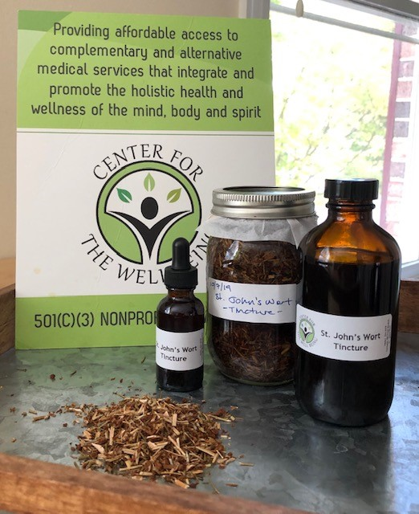
Ratios: Alcohol by Volume to Herb
ALCOHOL BY VOLUME GUIDELINES
40% - 50% ALCOHOL BY VOLUME
(80- TO 90-PROOF VODKA)
"Standard" percentage range for tinctures
Good for most dried herbs and fresh herbs that are not super juicy
Good for extraction of water-soluble properties
67.5% - 70% ALCOHOL BY VOLUME
(HALF 80-PROOF VODKA AND HALF 190-PROOF GRAIN ALCOHOL)
Extracts the most volatile aromatic properties
Good for fresh, high-moisture herbs like lemon balm, berries, and aromatic roots
The higher alcohol percentage will draw out more of the plant juices
85% - 95% ALCOHOL BY VOLUME
(190-PROOF GRAIN ALCOHOL)
Good for dissolving gums and resins but not necessary for most plant material
Extracts the aromatics and essential oils bound in a plant that don't dissipate easily
This alcohol strength can produce a tincture that's not easy to take and will also dehydrate the herbs if used for botanicals beyond gums and resins
Guidelines for using the correct alcohol by volume ratios

Slide 12
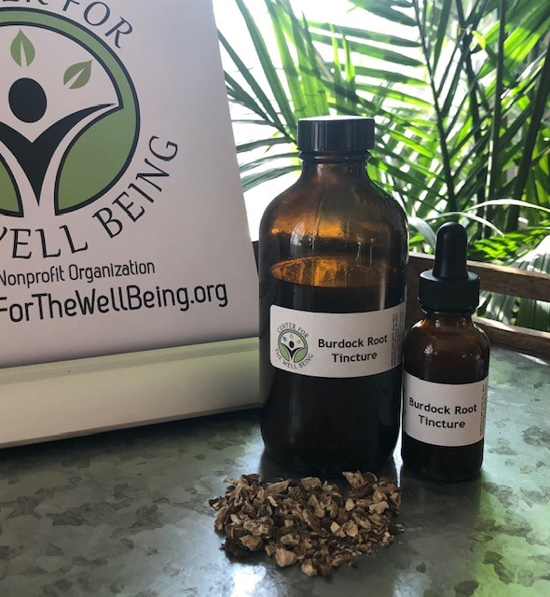
Last Steps: Finishing the Process
EXTRACTION, BOTTLING AND LABELING
HOW TO EXTRACT YOUR TINCTURES
Use a standard metal canning jar lid with metal rim and place a layer of parchment paper underneath the lid before securing the rim.
Leave as little air space between the liquid and lid as possible, as too much air plus the parchment may cause tinctures of insufficient alcohol content to develop rot.
Store your tincture in a cool, dark, dry place.
Shake several times a week, and check your alcohol levels. If the alcohol has evaporated a bit and the herb is not totally submerged, be sure to top off the jar with more alcohol. Herbs exposed to air can introduce mold and bacteria into your tincture.
Allow the mixture to extract for 6 to 8 weeks.
HOW TO BOTTLE YOUR TINCTURES
Drape a damp cheesecloth over a funnel and place into an amber glass bottle.
Pour tincture into funnel and allow to drip.
Squeeze and twist the mass in the cheesecloth until you can twist no more.
Store in a cool, dark place and your tincture may last for many years.
HOW TO LABEL YOUR TINCTURES
Once you've strained and bottled your tincture, be sure to label each bottle with as much detail as possible: date made, herb used and alcohol content.
Don’t forget to label all tinctures with date made, herb used and alcohol content!

Slide 13
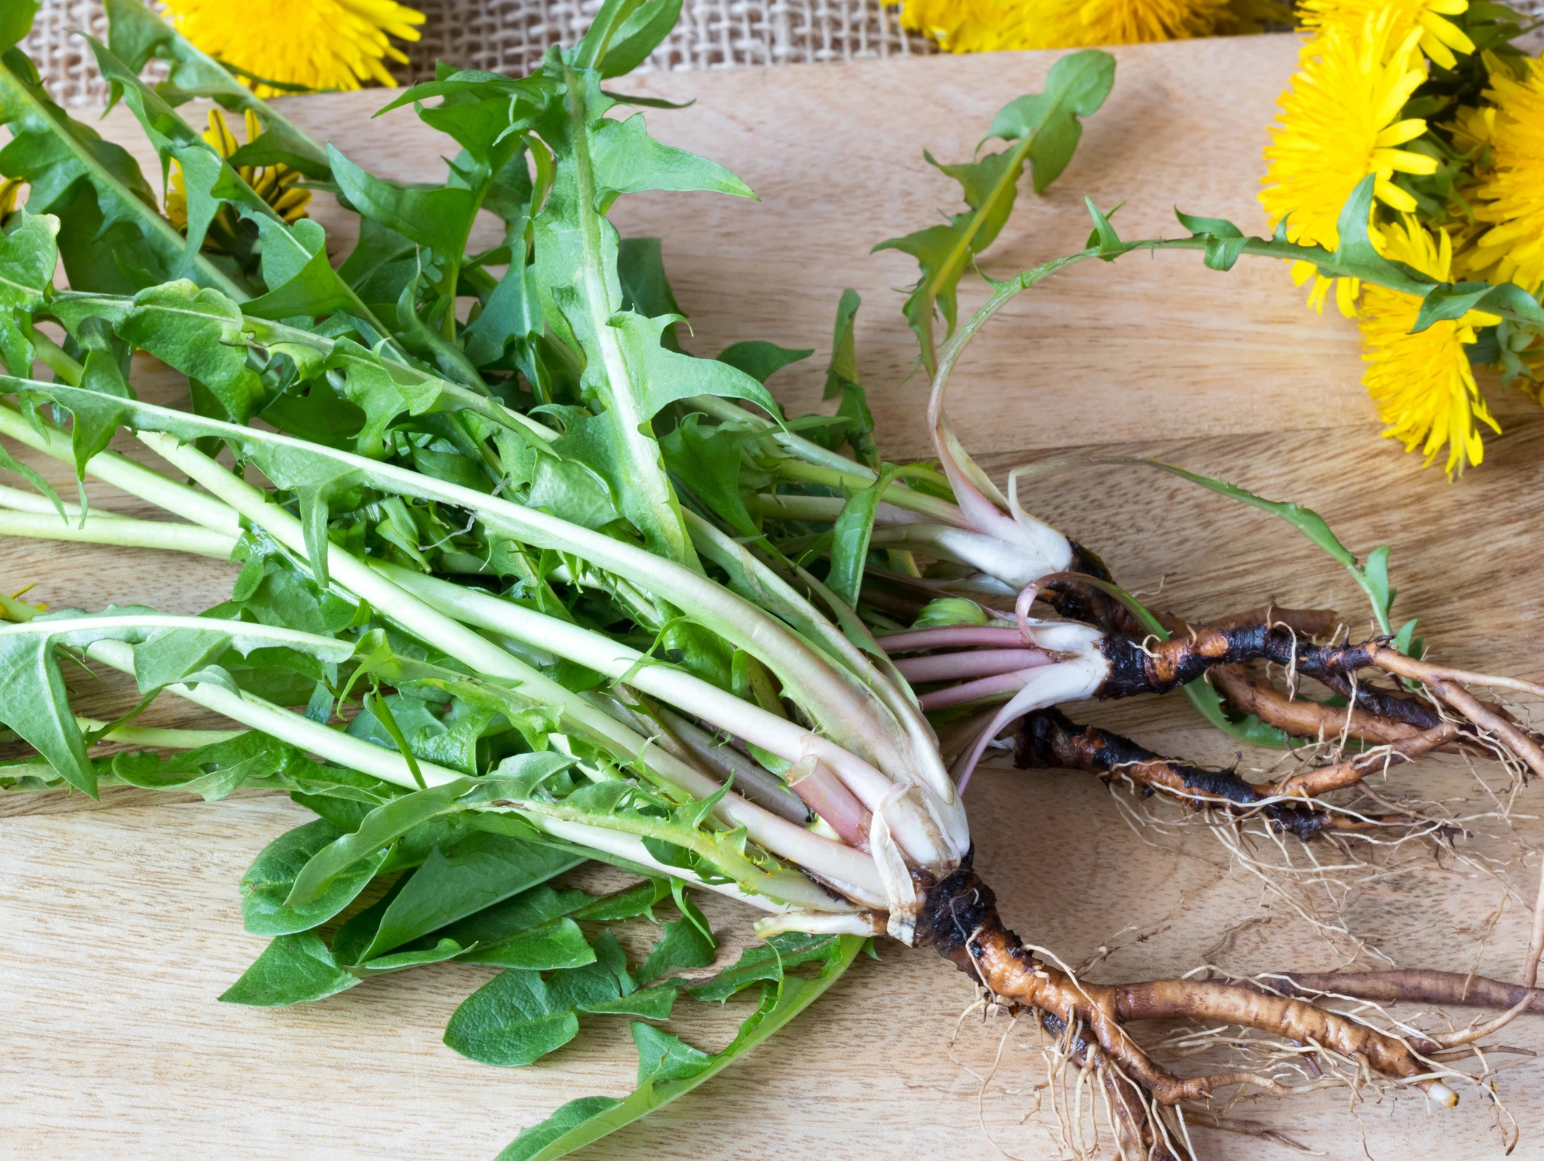
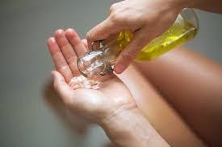
WAYS TO SUPPORT THE IMMUNE SYSTEM
Ways to maintain Wellness during the Fall
NOURISH THE IMMUNE SYSTEM
One of the best ways to directly support the immune system is through food. Incorporate herbs and mushrooms like astragalus, elderberries, rose hips, shiitake, lion’s mane, and maitake into meals.
FEED YOUR MICROBIOME
Eat seasonally available roots and tubers which are rich in probiotic starches to support a healthy digestive system. Warm the body with roots and grounding vegetables such as Dandelion and Burdock.
MOISTURIZE FROM THE INSIDE
Herbs that help moisturize, sooth and support the respiratory tract are Marshmallow Root, Slippery Elm Bark and Licorice Root.
MOISTURIZE FROM THE OUTSIDE
Apply warm oil to the skin through to help stimulate the lymphatic system - an integral component of the immune system. This daily act is a traditional Ayurvedic practice performed with raw sesame oil with a few drops of essential oils for additional benefits.

Slide 14
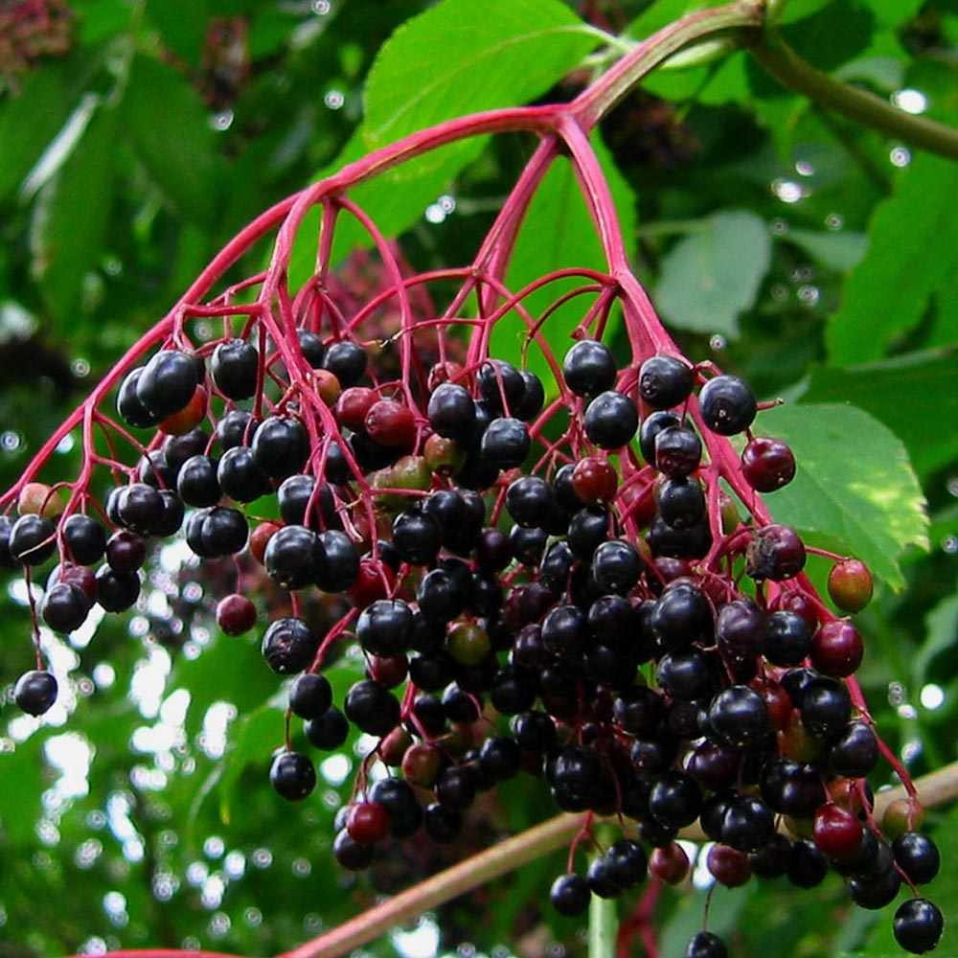
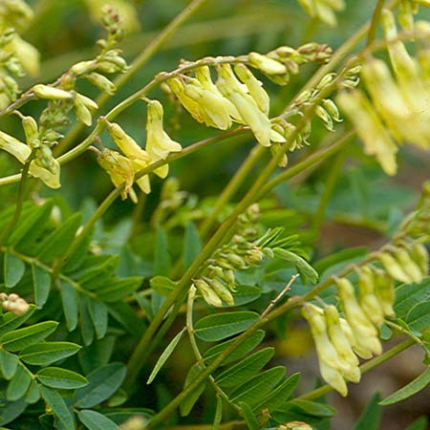
HERBS FOR IMMUNE SYSTEM SUPPORT
Immunity: The ability of an organism to resist a particular infection or toxin by the action of specific antibodies or sensitized white blood cells. – Oxford English Dictionary
Echinacea (Echinacea purpurea)
General tonic, immuno-modulator & immuno-stimulator, lymphatic, antimicrobial (antibacterial & antiviral), anti-inflammatory, anti-allergic, diaphoretic, anti-catarrhal, detoxifier, alterative, peripheral vasodilator, bitter, vulnerary
Treatment for the common cold, coughs, bronchitis, upper respiratory infections, and some inflammatory conditions
Elderberry (Sambucus nigra)
Anti-viral, anti-phlegm, respiratory tonic; antioxidant; anti-inflammatory
Reduces duration of colds, flu and infections; prevents flu virus; acute immune and respiratory support
Astragalus (Astragalus membranaceus)
Mild adaptogen, immune tonic, anti-bacterial, heart tonic, liver protectant
Used to defend against pathogens (viruses and bacteria) and support a healthy immune system; can be taken long term as a tonic herb for fibromyalgia, diabetes; common cold and upper respiratory infections
Echinacea
Elderberry
Astragalus

Slide 15
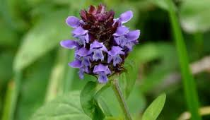
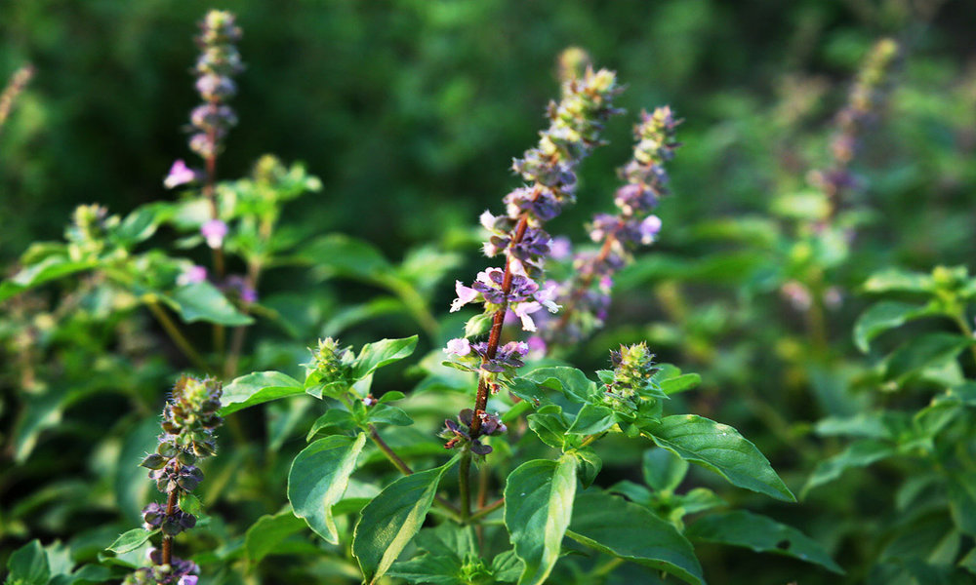
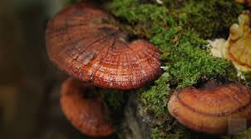
MORE HERBS FOR IMMUNE SYSTEM SUPPORT
Self-Heal (Prunella vulgaris)
General tonic, antimicrobial (antibacterial and antiviral), anti-inflammatory
Treats chronic viral Infections, inhibits ability of viruses to replicate; upper respiratory infections, sore throats, allergy inflammation, reduces an excessive immune system response with seasonal allergies
Tulsi or Holy Basil (Ocimum sanctum)
Adaptogen, immune tonic, anti-viral, heart tonic, respiratory tonic, diaphoretic
Relieves symptoms of asthma, bronchitis, colds, congestion, coughs, flu, sinusitis, sore throat
Ashwagandha (Withania somnifera)
General tonic, adaptogen
Treats brain fog, increases focus, balances moods; connects the brain with the rest of the body to maintain a balance between one’s physical and mental health; a stress-tolerant herb that helps regulate metabolic activities in the body, especially helpful when feeling overworked and overwhelmed
Reishi (Ganoderma lucidum)
Adaptogen, antioxidant; anti-inflammatory
Contains polysaccharides, antioxidant properties, and beta-glucans that help with immune function; used to treat coronary artery disease, arthritis, hepatitis, hypertension, AIDS, cancer
Self-Heal
Tulsi
Ashwagandha
Reishi

Slide 16
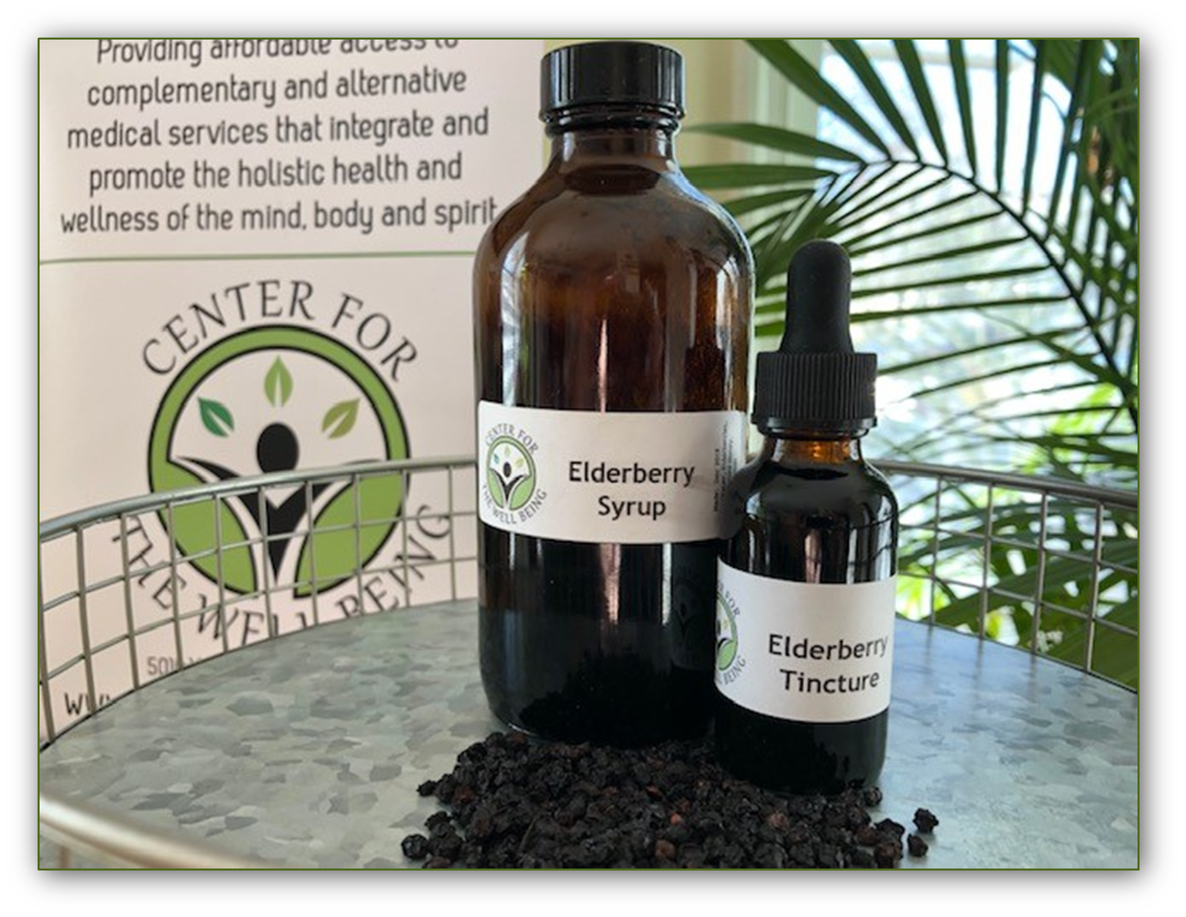
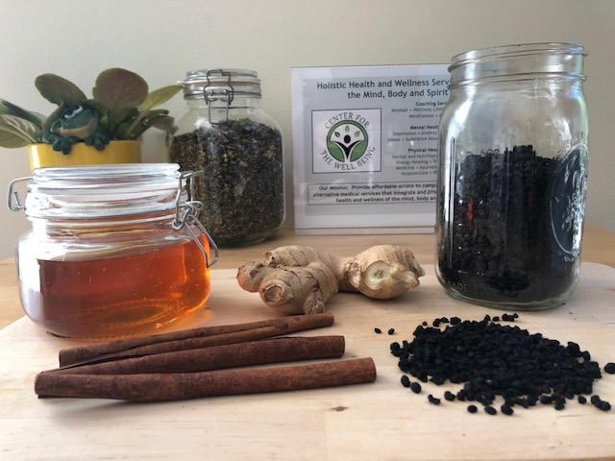
ELDERBERRY IMMUNITY BOOSTERS

Slide 17
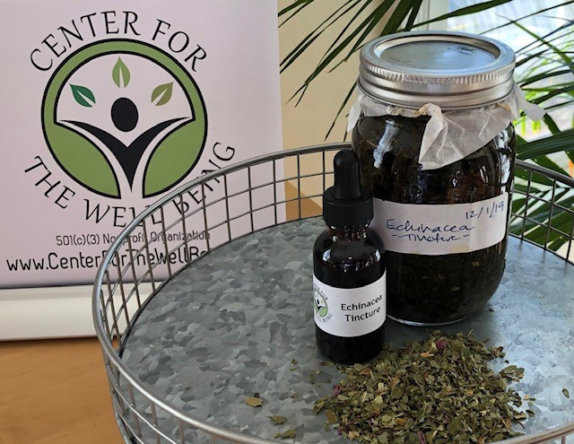
ECHINACEA TINCTURE
DIRECTIONS TO MAKE
Fill a Mason jar halfway with dried Echinacea leaf and flower.
Pour vodka (or any other 40 proof alcohol) until the 8 oz mark.
Place a piece of wax paper over the mouth of the jar and twist the lid on tightly.
Shake well to ensure all of the herb is covered with the alcohol.
Place in a dark area away from sunlight.
Shake daily.
Let tincture sit for at least 4-6 weeks.
Strain and bottle.
Shelf life is long – up to 5 years or more.
DIRECTIONS FOR USE
Take ½ - 1 dropper full as necessary.

Slide 18
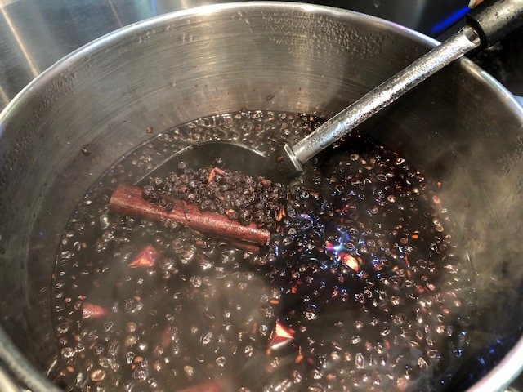
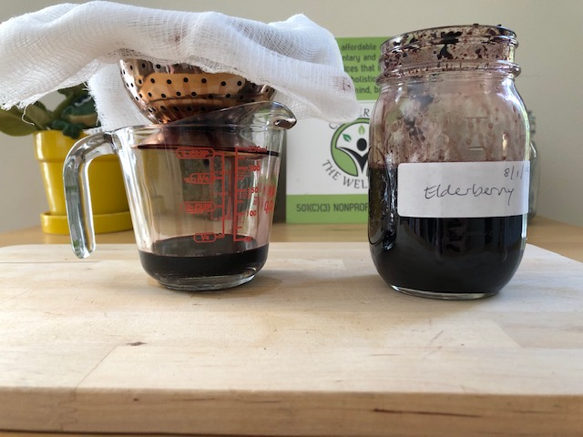
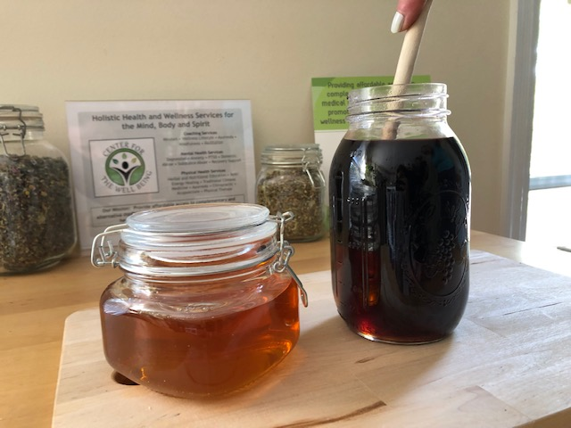
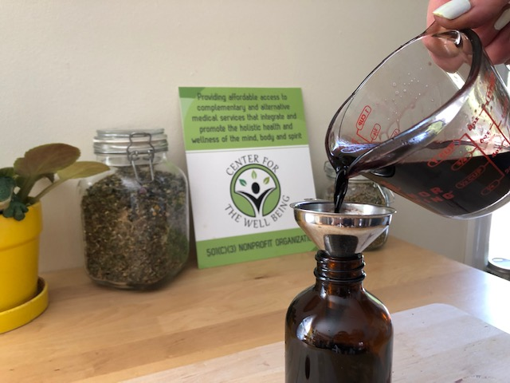
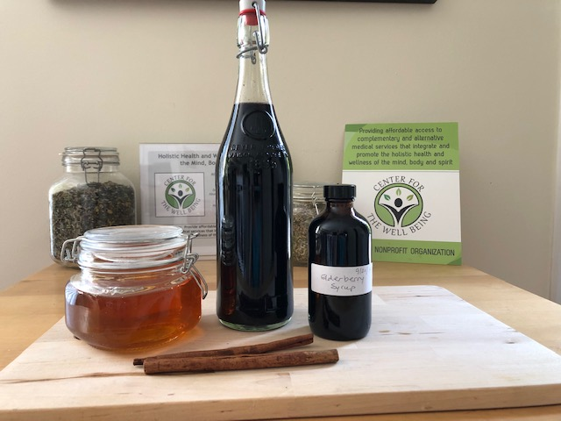
ELDERBERRY SYRUP: STEP-BY-STEP
Step 1
Step 2
Step 3
Step 4
Step 5
Step 6

Slide 19
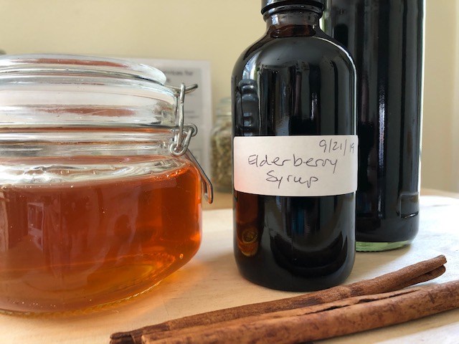
ELDERBERRY SYRUP
TIME: 1 ½ hours ● YIELD: 24 ounces ● COST: $7.00
MATERIALS
large pot
large bowl
strainer
cheese cloth
liquid measuring cup
bottles
labels
INGREDIENTS
2 cups water
1 cup dried Elderberries
1 cup Honey
1 large thumb of fresh sliced Ginger root
1 Cinnamon stick
Optional: 1/8 cup of high proof alcohol
DIRECTIONS TO MAKE
Add water, ginger, dried elderberries and cinnamon to large pot.
Bring mixture to a boil; then reduce to a simmer until desired thickness, approximately 30-45 minutes.
Strain mixture using strainer lined with cheese cloth.
Once berries have cooled, wring extra juice out from the berries using the cheese cloth.
Measure Elderberry liquid and add it to large bowel. While still hot, add equal part honey and mix.
Pour mixture slowly into bottle(s); label with date and ingredients. Store in the fridge and use within 3 months.
DIRECTIONS FOR USE
Adults: Use 1-2 tablespoons several times a day when needing a immunity boost.
Children: Ages 1-3: ¼ teaspoon daily - Ages 4 and up: 1 teaspoon daily
WARNING: Do not give honey products to children under 12 months old.

Slide 20
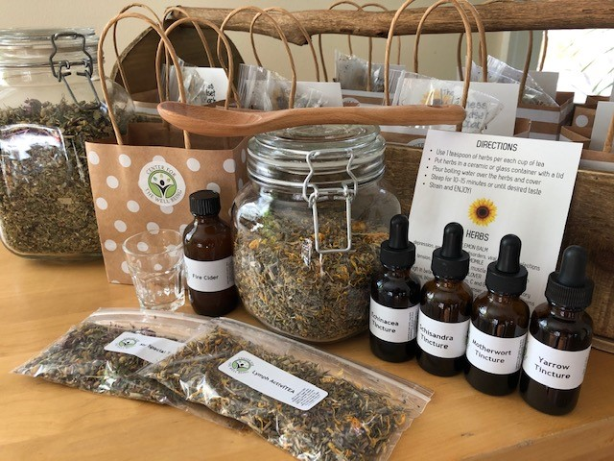
DONATIONS: Find our PayPal Giving Fund at www.paypal.com/us/fundraiser/charity/3705770
$5 1 package HERBAL TEA ($5/oz)
$10 1 - 1 oz HERBAL TINCTURE
$25 1 - bottle HERBAL CAPSULES (60 ct)
$25 DONATION
Popular Combination Options
2 HERBAL TINCTURES and 2 HERBAL TEAS
3 HERBAL TINCTURES
1 HERBAL CAPSULES and 1 HERBAL TEA
Included in all build-your-own gift bags:
4 - packets Aura Cacia Oils
Rosehip • Argan • Tulsi • Turmeric
Herbal Reference Cards

Slide 21
THANK YOU FOR COMING
WE APPRECIATE YOUR DONATIONS!
They help us continue to deliver
these workshops and charitable services
to the community
JOIN US NEXT TIME

