Slide 1
Build Contacts to Set Appointments

Slide 2
Build Contacts to Set Appointments
New recruit contact lists are easy to build using Sprint to District!
Top 25
Qualify
Add details
Set Appointment

Slide 3
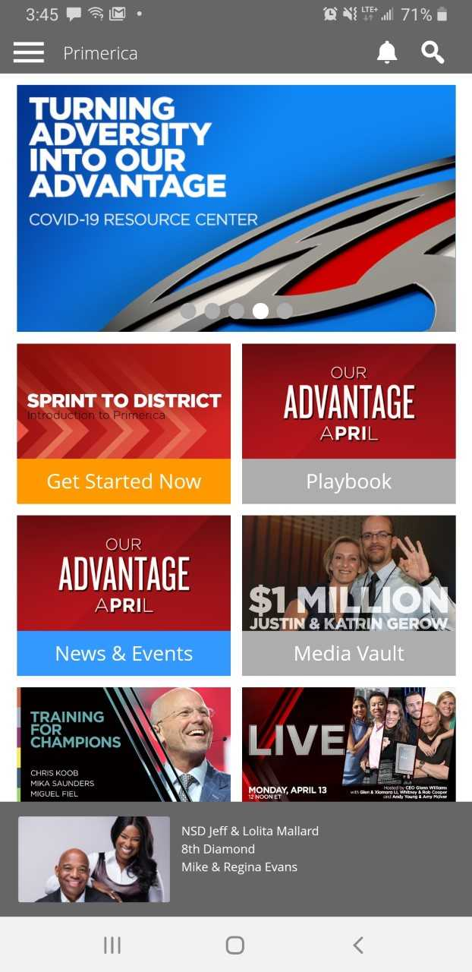
Build Contacts to Set Appointments
TOUCH
the hamburger
to get started

Slide 4
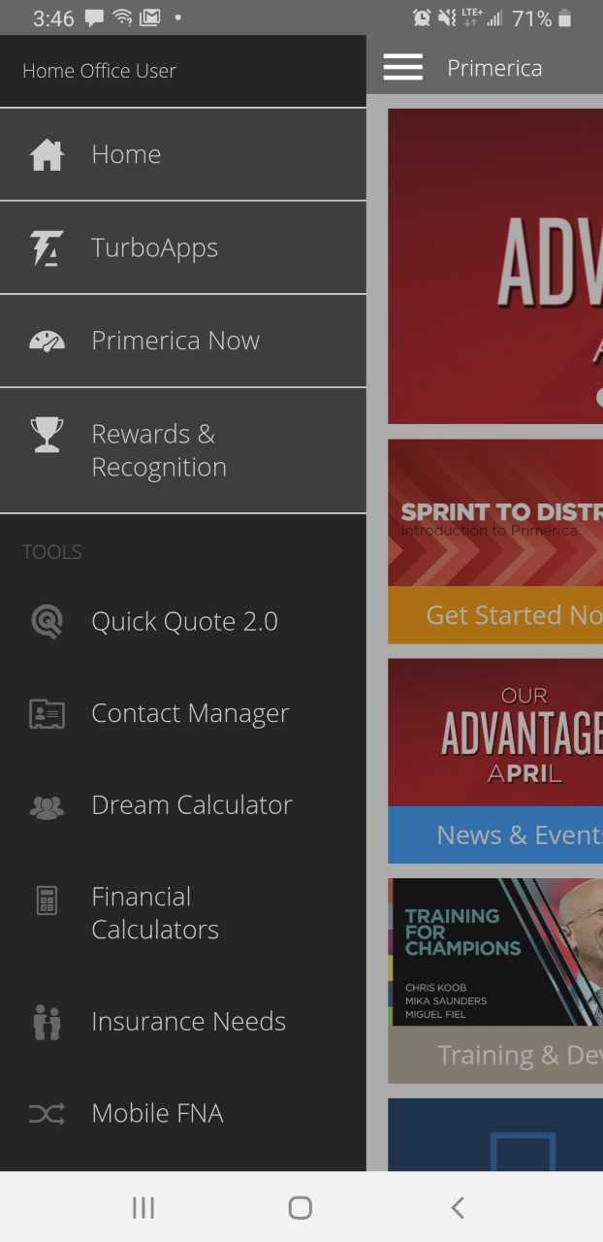

Build Contacts to Set Appointments
Select
Contact Manager
HERE

Slide 5
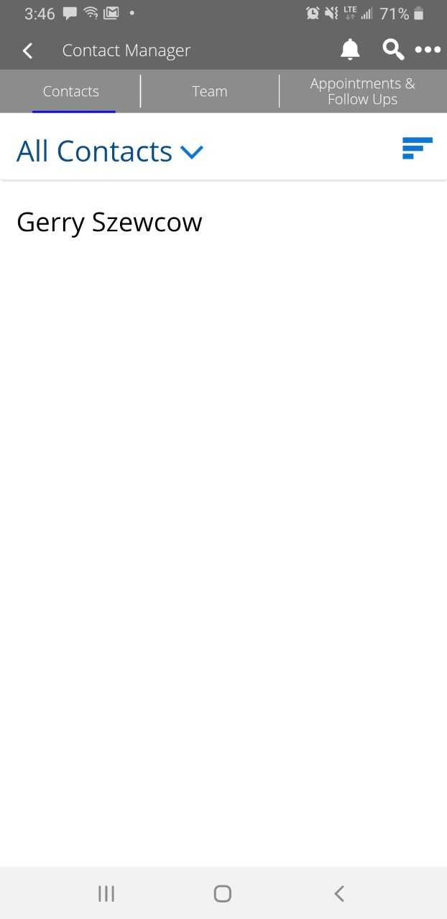


Build Contacts to Set Appointments
TOUCH
the 3 dot menu to begin building a top 25 list from a new recruits phone contacts

Slide 6
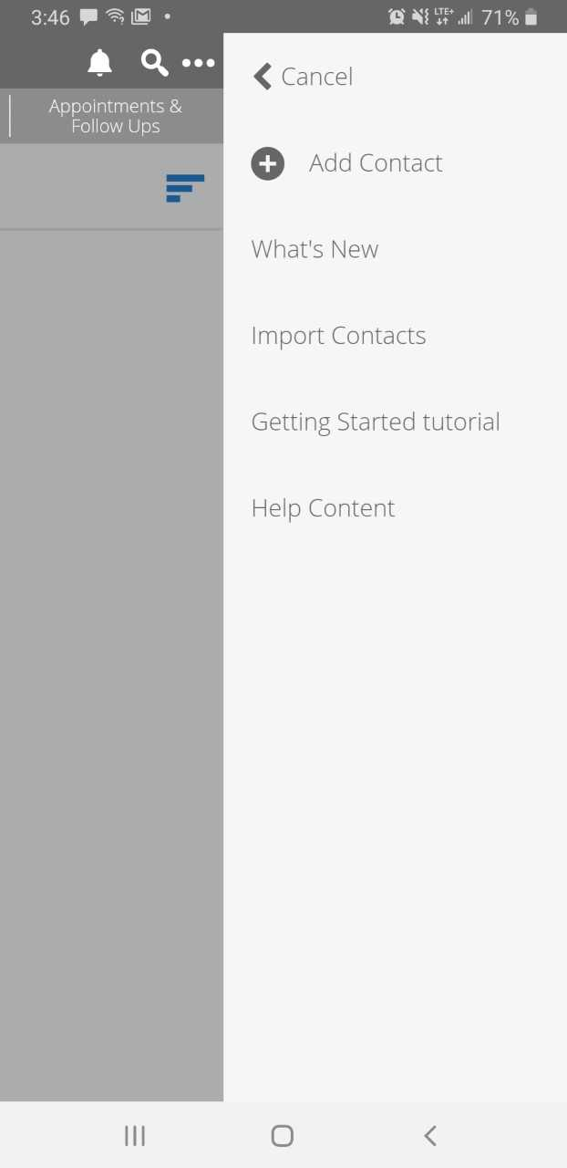
Build Contacts to Set Appointments
Select
Import Contacts
HERE

Slide 7
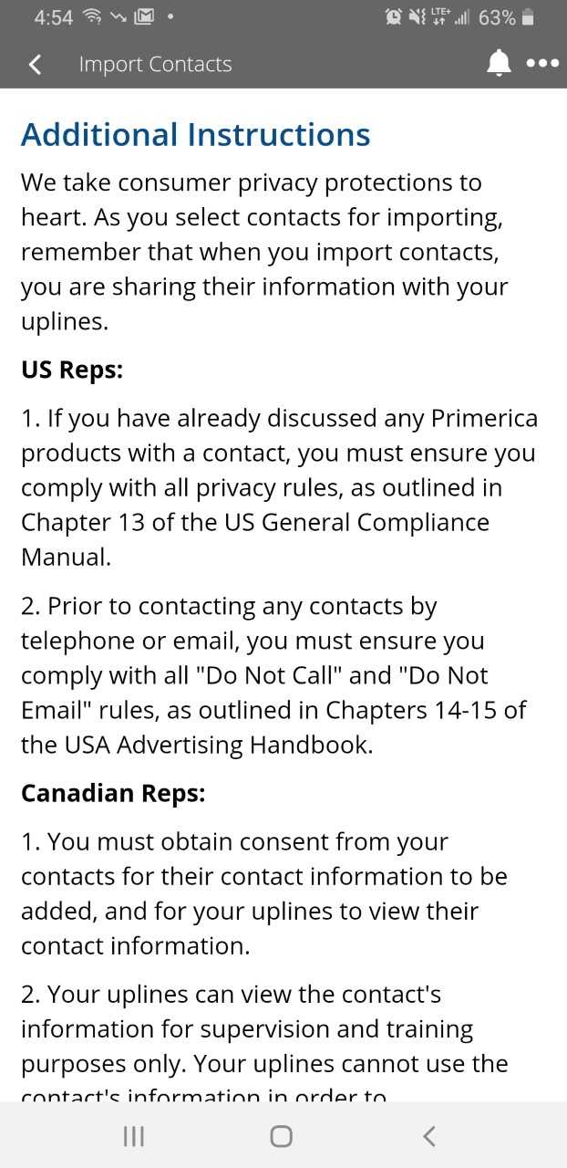
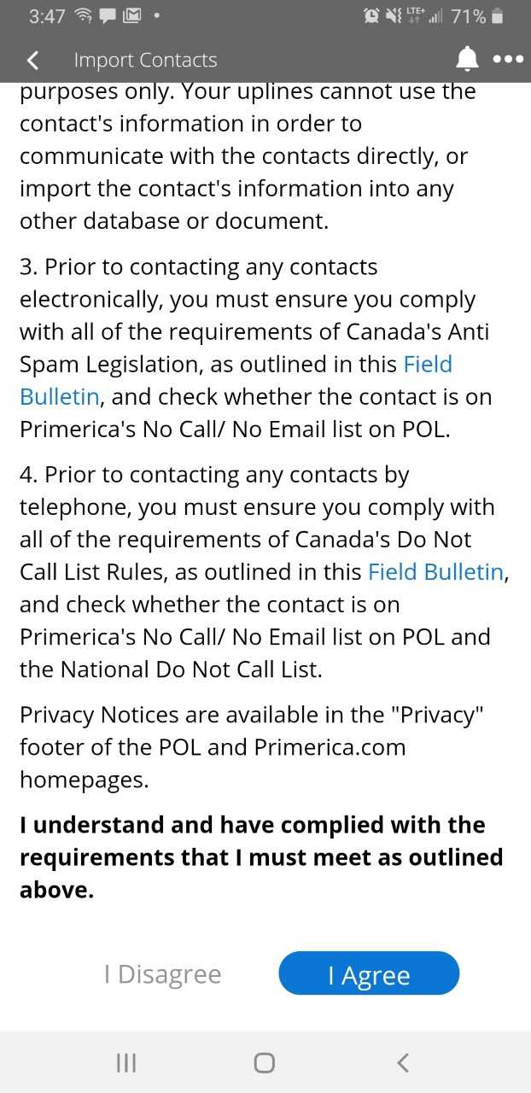

Build Contacts to Set Appointments
Read
the consumer privacy instructions and comply with the requirements
HERE

Slide 8
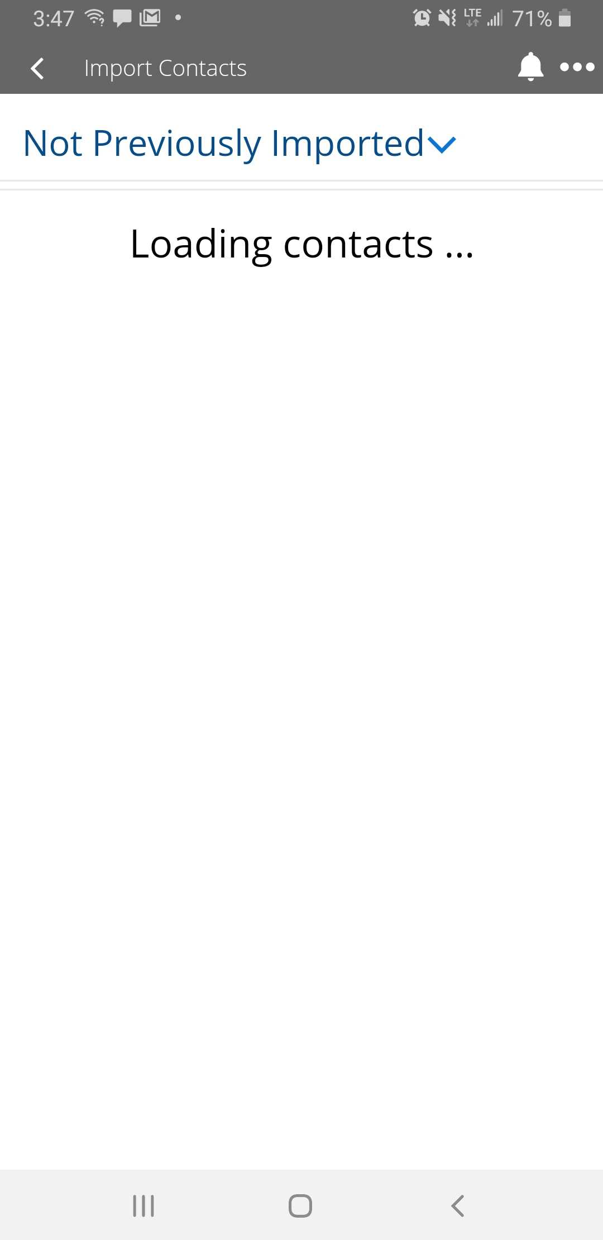
Build Contacts to Set Appointments
Hang on, it takes a few seconds to load those contacts into the PRI App

Slide 9
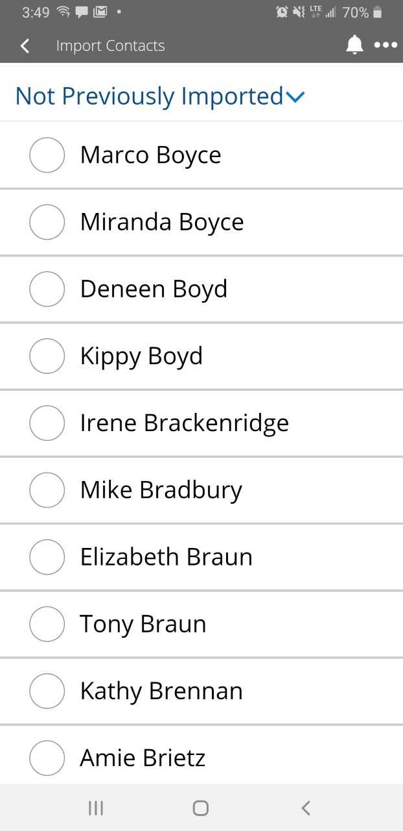
Build Contacts to Set Appointments
And there they are!
Hundreds of phone contacts to choose from

Slide 10
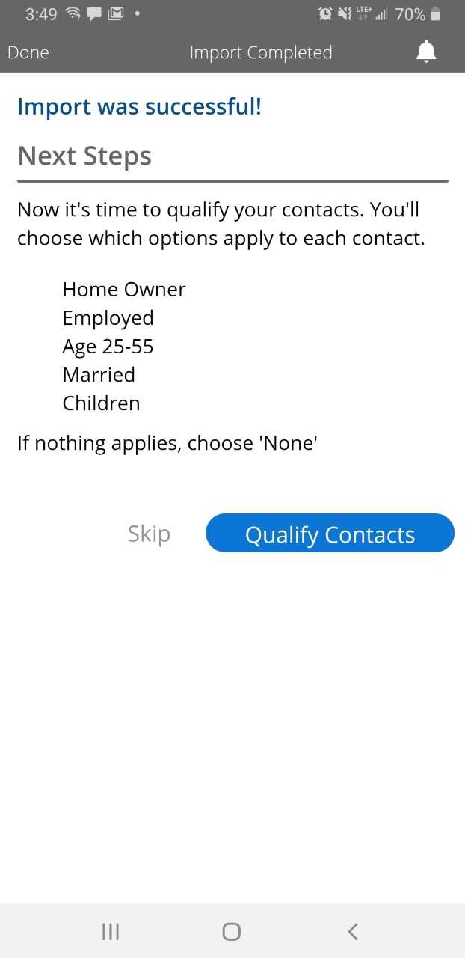

Build Contacts to Set Appointments
SUCCESS!
Next, let’s qualify

Slide 11
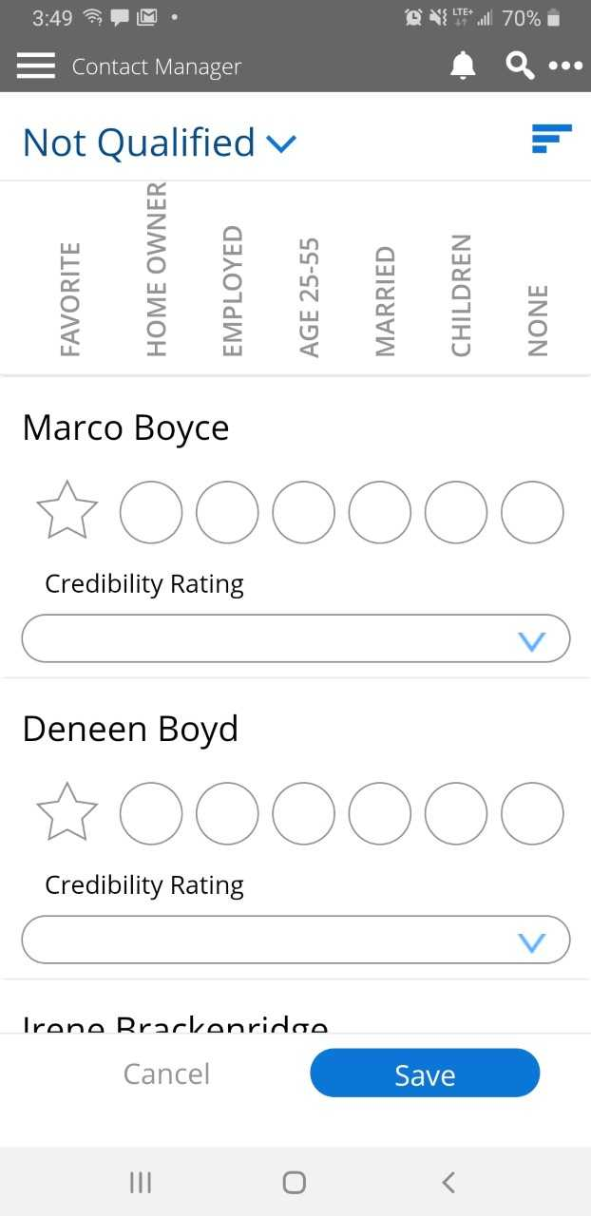
Build Contacts to Set Appointments
Learn more by qualifying:
Favorite
Home owner
Employed
Age 25-55
Married
Children
None

Slide 12
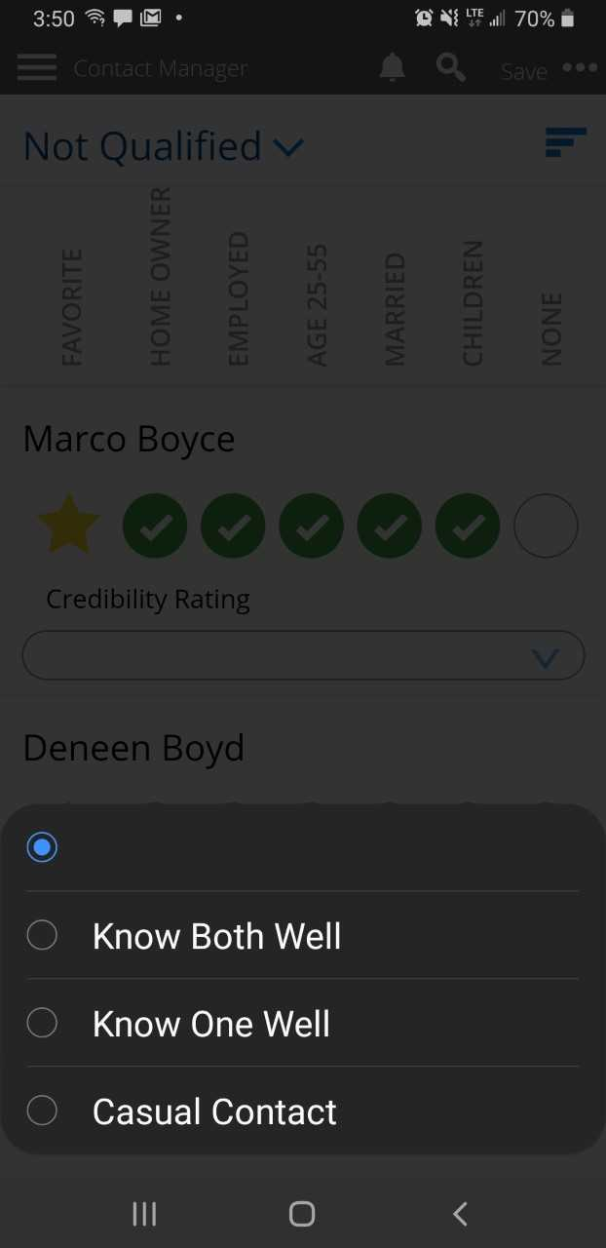

Build Contacts to Set Appointments
“How well do you know your contact?”
Find out
HERE

Slide 13
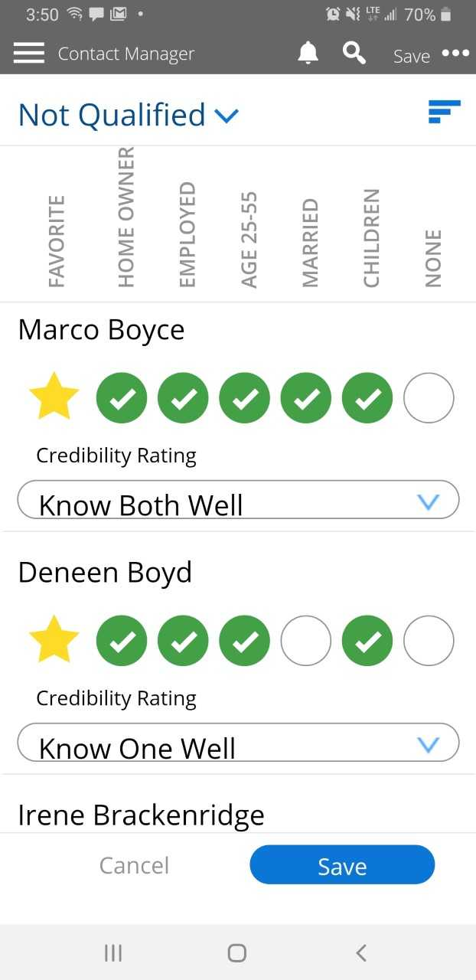

Build Contacts to Set Appointments
Be sure to
save to build a list
touch HERE

Slide 14
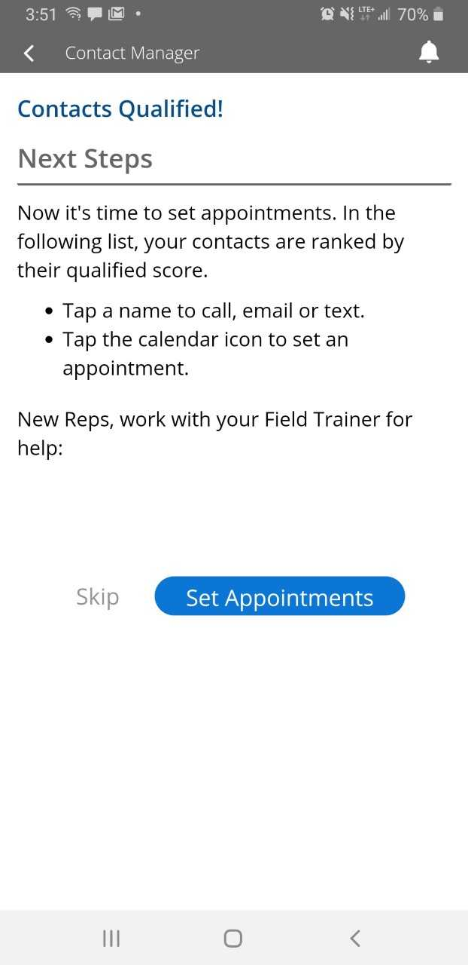

Build Contacts to Set Appointments
Set appointments to Field Train and earn FTB credits HERE

Slide 15
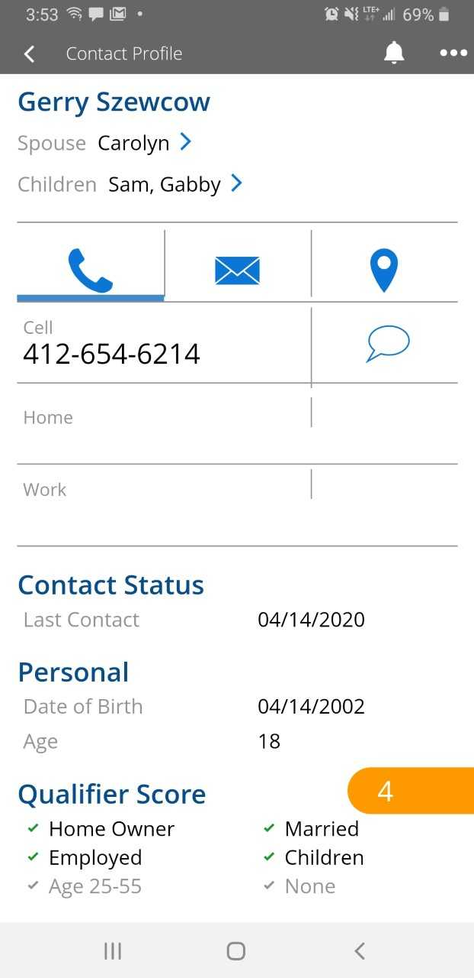
Build Contacts to Set Appointments
Click on a contact and
add more information
  Spouse name
  Kid’s names
  Additional phone numbers
  AND MORE
CALL
EMAIL
TEXT
DIRECTIONS

Slide 16
YOUR FIRST/NEXT 30-90 DAYS
Build a HUGE list in Contact Manager in your Primerica App NOW and text your field trainer when it’s done!
Launch Your Business! Send the video out to your Top 25 list NOW and then follow up with setting appointments for your field trainer to meet with the “Hot Prospects” who Pick a Path.
3. Sprint to District with 2x2,000 in your first 30 days & Bank FTBs - $200 for every 1x1,000 during your first 90 days before licensed.
4. Show Up to Training – Tuesdays 7-7:45pm & Saturdays 9:30-10:30am Log onto learngrowandearn.com for the Zoom Training Schedule Meeting IDs and passwords. (email lisa.a.dobie@gmail.com with your name, email address, and RVP name just saying you’d like access to the website)
Get Licensed – complete Pre-Licensing in first 60 days & pass test in first 90 days.
Get a $100 bonus if you complete Pre-Licensing in your first 30 days!

Slide 17
How to send a text with the 18 minute video:
Hi ____. Hey will you do me a favor… I started working with a new company, we’re expanding and I’m trying to get the word out on what I’m doing. Will you help me out and just watch an 18 minute video?
Get an answer back and then say: Great, I’ll text you a link to the video, when will you have time to watch it and I’ll send it over then?
Get an answer back and then say: Ok, I will send it at that time and then I’ll follow up with you after. Thanks for your help!
Text with video: Here’s the video, like I said it’s just 18 min, please watch
it all the way to the end and click on Path 1, 2 or 3 so I know you finished,
and then I’ll follow up with you after. Thanks again for your help!
What is it?
We’re a financial company, we teach people how to make and save money. I’m really excited about what I’m learning, I just need help getting the word out on what I’m doing. You’ll help me out and just watch this video right?

Slide 18
End Notes
You must always comply with Primerica's Telephone Solicitation Policy. Remember to check Primerica's Telephone Solicitation Policies in Section 14 (U.S.) or Section 13 (Canada) of the Advertising Handbook on POL before placing any calls or texts for your business.
In Canada, prior to uploading contacts, representatives must ensure they comply with all applicable privacy legislation, including obtaining consent from each contact for the transmission of their personal information into Contact Manager to be used for business purposes.
© 2020 Primerica / 58044 / 4.20 / 1162178

