Slide 1


FAST START PLANNER
A step by step guide to getting your business and income off to a fast start

Slide 2
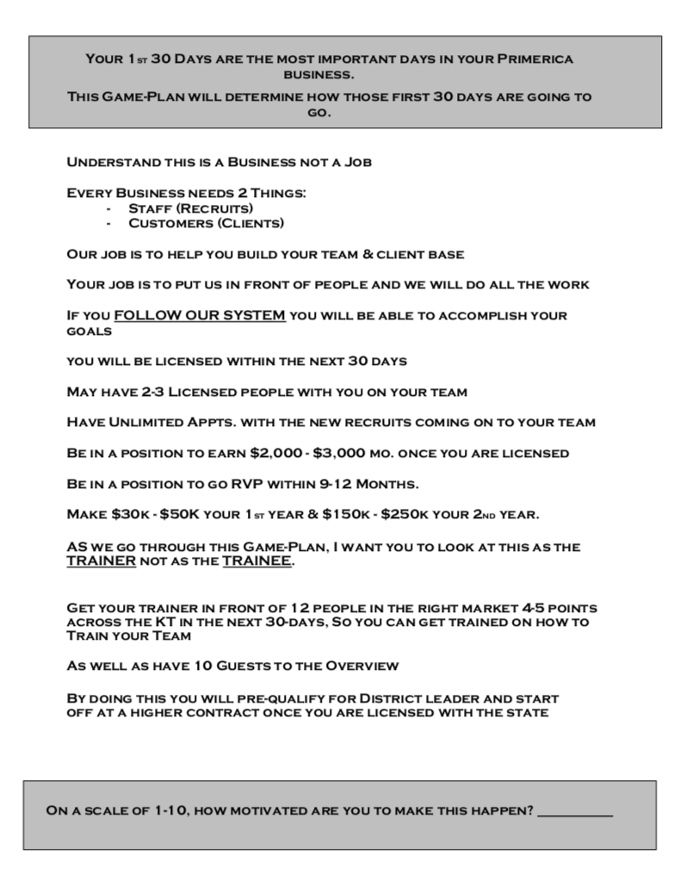

Slide 3
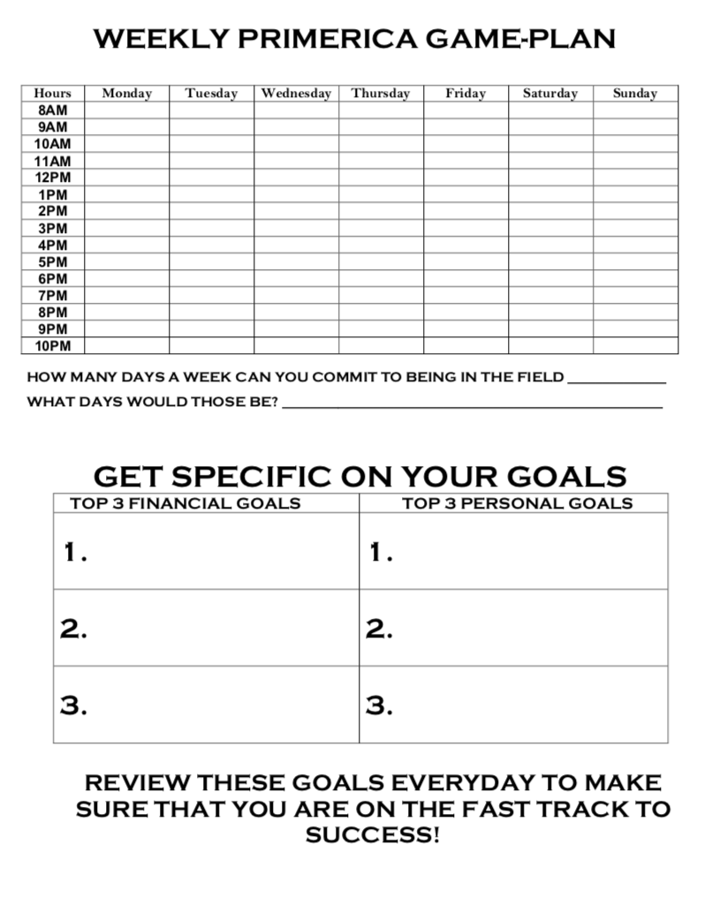

Slide 4
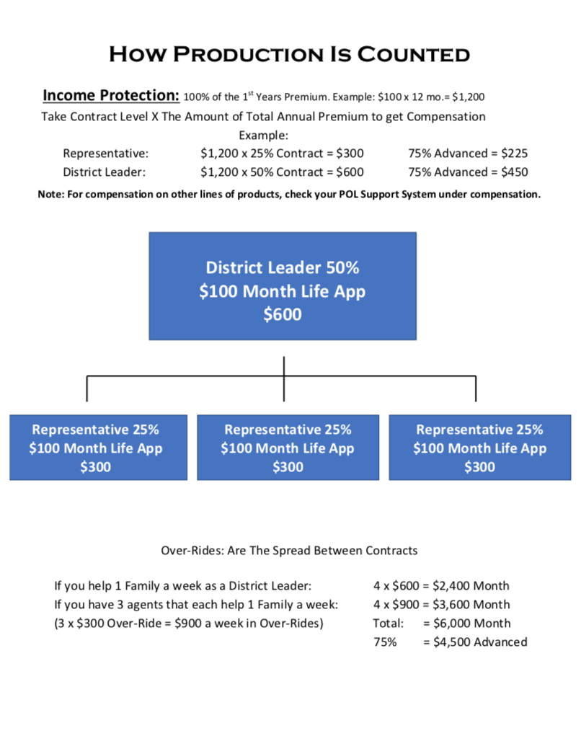

Slide 5
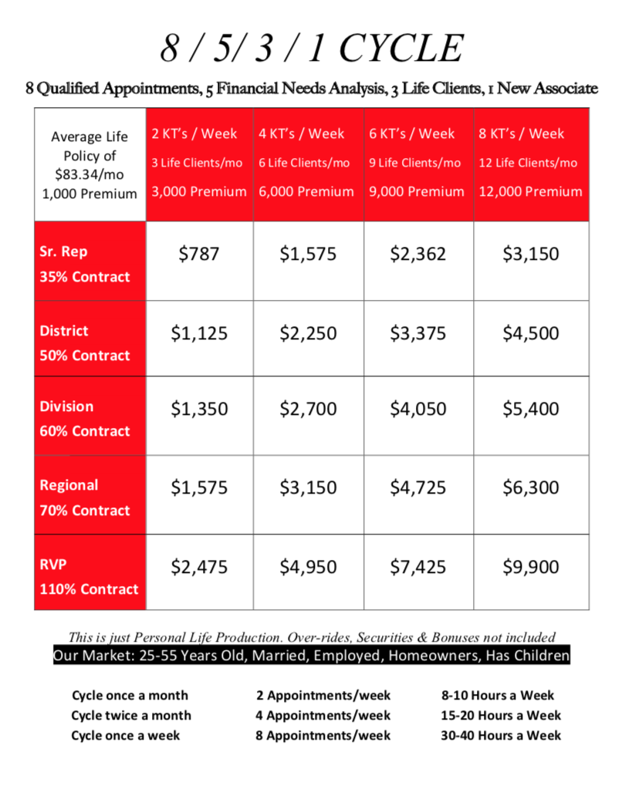

Slide 6
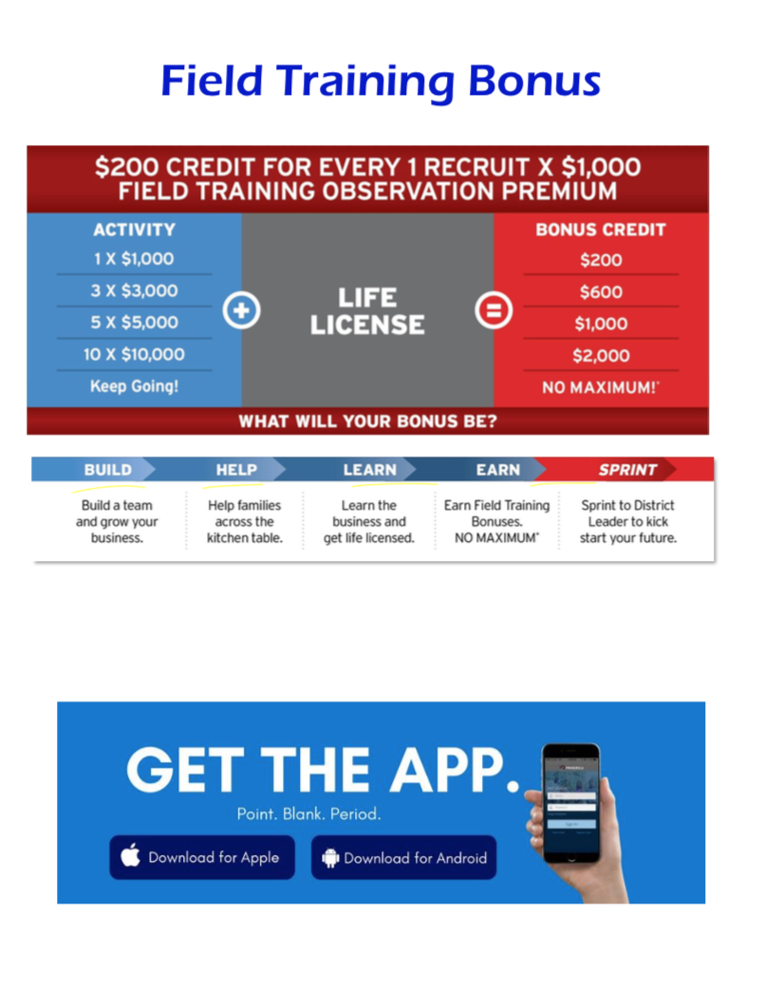

Slide 7

Get Paid During Training or just for Referring Client Solutions Services
Auto / Home $50 / $25
ID Theft Defense $40
Legal Protection $50
Home Security $250
Small Business $50
38

Slide 8
KITCHEN TABLE TRAINING LIST
NAME | TELEPHONE | RELATIONSHIP | MARRIED | KIDS UNDER 18 YRS | HOMEOWNER | EMPLOYED | AGE 25-55 | PTS | CALLED

Slide 9
Name | Number | What they do or How you know them
C
H
AM
P
Who do you know that is Competitive, Hard working, Ambitious, Motivated, Has good People skills or has a job but you know they wouldn’t mind earning extra income.

Slide 10
Hot Market Training Appointment – setting appt first, then sending video before meeting
Homeowner, Employed, age 25-55, Married, Children
Hi , this is , how are things going? (short conversation)
Hey _______, will you do me a FAVOR?
I started working with a new COMPANY.
We’re EXPANDING and I’m trying to get the word out on what I’m doing.
Will you (and ______) HELP me out and meet on zoom for 30 min?
Set appointment
Do you (and ______) have any time later today or would tomorrow be better?
What time would work best for both of you? Great! I’ll text you the meeting ID and password.
If I send you a 20 minute video to give you a little background info before we meet, would you both watch it? Great!
[We had very good growth this year and this video is a big part of that. We are using it to interview people to work with us and to expand our client base.]
I’ll text you both a link to the video – please watch it all the way to the end and click on Path 1, 2 or 3 so I know you finished.
Text with video - Here’s the video, like I said it’s just 20 min, please watch it all the way to the end and click on
Path 1, 2 or 3 so I know you finished. Look forward to meeting then on ____ at ____. Thanks again for your help!
What is it?
We’re a financial company, we teach people how to make and save money, I’m really excited about what I’m learning, I just need help getting the word out on what I’m doing. My trainer will explain everything and answer questions, you don’t have to do anything, you’ll help me out by just meeting on zoom for 30 min, right?

Slide 11
How to send a text with the 18 minute video:
Hi ____. Hey will you do me a favor… I started working with a new company, we’re expanding and I’m trying to get the word out on what I’m doing. Will you help me out and just watch an 20 minute video?
Get an answer back and then say: Great, I’ll text you a link to the video, when will you have time to watch it and I’ll send it over then?
Get an answer back and then say: Ok, I will send it at that time and then I’ll follow up with you after. Thanks for your help!
Text with video:
Here’s the video, like I said it’s just 18 min, please watch
it all the way to the end and click on Path 1, 2 or 3 so I know you finished,
and then I’ll follow up with you after. Thanks again for your help!
What is it?
We’re a financial company, we teach people how to make and save money. I’m really excited about what I’m learning, I just need help getting the word out on what I’m doing. You’ll help me out and just watch this video right?

Slide 12
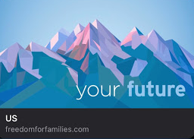
Watch Video -
VIDEO LINK: https://freedomforfamilies.com/us/?f=RVP or field trainer name

Slide 13
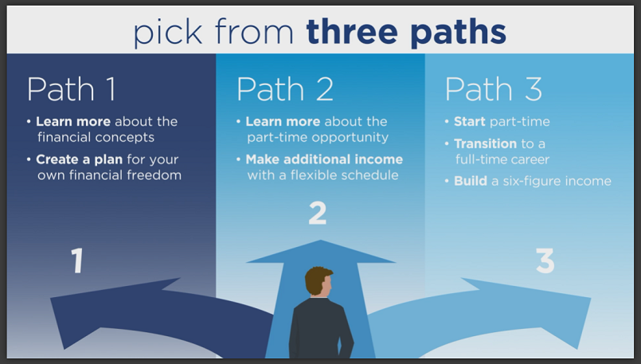

Slide 14
After they’ve watched the video…
Text:
I saw that you finished the video and picked path ___.
Our next step is to meet up on zoom with my trainer who can answer
your questions, and this will help me with my training.
Do you have time today or is tomorrow better?

Slide 15
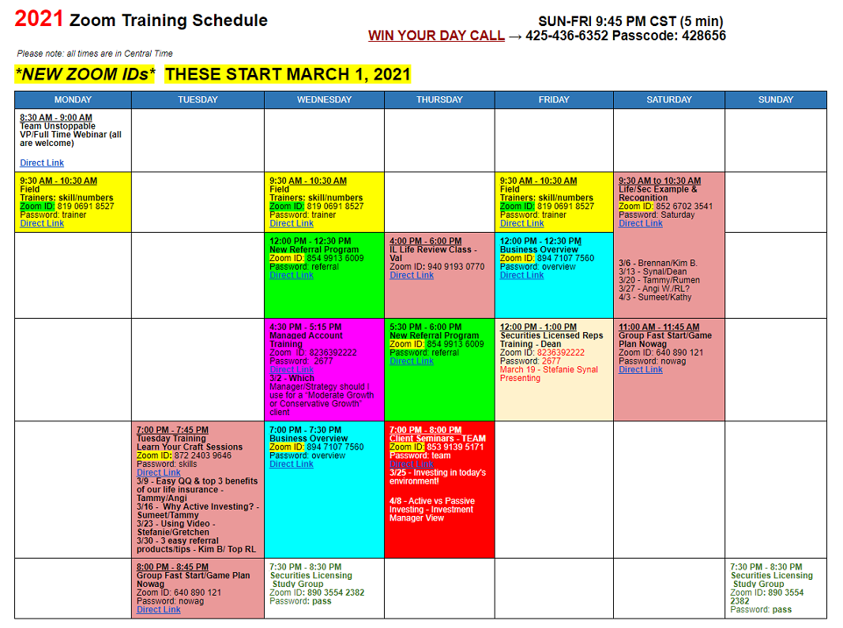

Slide 16
YOUR FIRST/NEXT 30-90 DAYS
Build a HUGE list in Contact Manager in your Primerica App NOW and text your field trainer when it’s done!
2. Launch Your Business! Send the video out to your Top 25 list NOW and then follow up with setting appointments for your field trainer to meet with the “Hot Prospects” who Pick a Path.
3. Sprint to District with 2x2,000 in your first 30 days & Bank FTBs - $200 for every 1x1,000 during your first 90 days before licensed.
Show Up to Training – Tuesdays 7-7:45pm & Saturdays 9:30-10:30am
Log onto learngrowandearn.com for the Zoom Training Schedule Meeting IDs and passwords. (email lisa.a.dobie@gmail.com with your name, email address, and RVP name just saying you’d like access to the website)
Get Licensed – complete Pre-Licensing in first 60 days & pass test in first 90 days.
Get a $100 bonus if you complete Pre-Licensing in your first 30 days!

