Slide 1
$
Time
$600,000
8%
x
Job
Investing
$48K/year
$4,000/month
Education
Coach
Game Plan
$1500-$2K
$0
  Debt Elimination
  Work with us
  Introduce us
  Asset Protection
  Taxes & Investments

Slide 2
Protect
Assets
Life Now to Retirement
Retirement
Age 60+

Slide 3
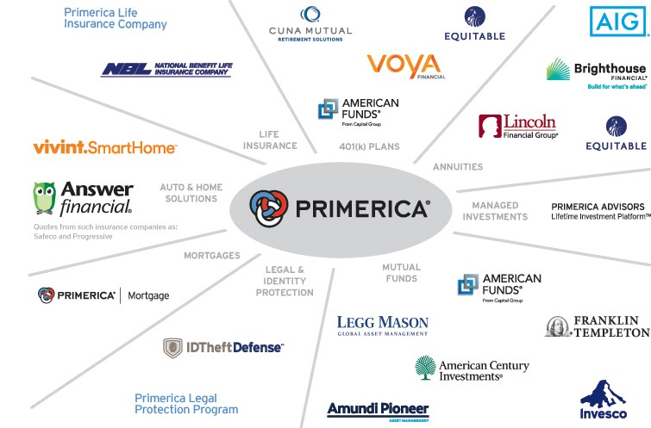
Not all products and services are available in all states, territories, or the District of Columbia. A representative's ability to offer products from the companies listed is subject to state and federal licensing and certification requirements. Please refer to the Important End Notes for additional details about the contractual arrangements and company affiliations detailed above.

Slide 4
2 Paths Working With Us
Refer
Talk us up
~$40-200 successful referral
$300-500/mo
Coach/Leadership-RVP
Education
Training
Licenses
Part-time or Full-time
$2-3k/mo $5-6k/mo
  RVP $100k+
can move back and forth between the two paths
Referral Rep Zoom
Business Overview Zoom or Video

Slide 5



Independent Business Application (IBA)
$99
The Ultimate Business Support System
$25
ONE TIME
MONTH
(Do not Delete Box)
Box = action button
— mouse-over hyperlink
to slide 4 position:
“you can start part time”
  Application Value Includes:
  State Application
  Exam Fee
  Processing Fees
  Appointment Fee
  Fingerprint
  Typical Cost to Become Life Licensed: $500*
Technology Support Package Value Includes:
Cell phone discount: up to 25%/yr.
Your own website and business reports: $50/mo.
Live and on-demand video training: $55/mo.
Total Value: $105+/month
Additional Potential Value Includes:
  Exam Fee: $450
  Exam Prep Course: $150 to $200
  Securities License Total: Approximately $850*
  Morningstar financial analysis software: $625/mo.**
*Costs vary by state. Average licensing costs are $193. Average costs for pre-licensing education are $206 for life only and $248 for life and health.
*Reimbursement of securities licensing costs is subject to meeting program requirements, including a full-service POL subscription and pre-study and licensing requirements. Not all licensing fees are covered. Please refer to the Securities Licensing tab on POL for additional information.
**Must be securities licensed.

Slide 6
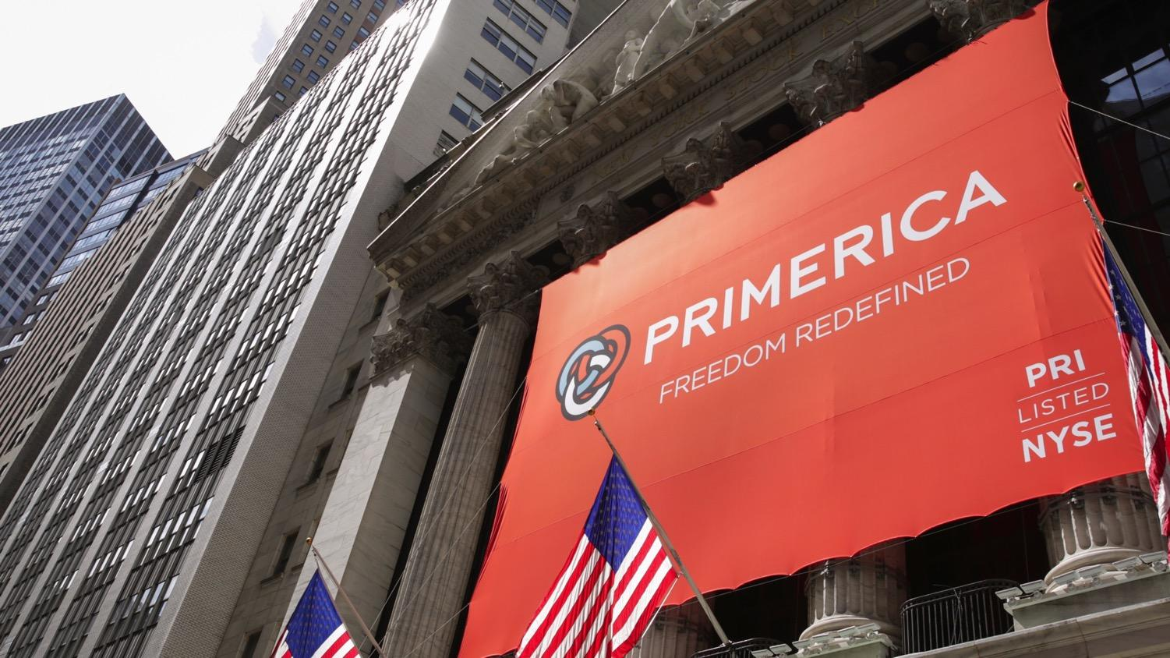
The largest independent financial services marketing company in North America
Listed on the New York Stock Exchange (PRI)
In business since 1977
Approximately 5 million lives insured and approximately 2.5 million investment clients
Investment clients have more than $70 billion in asset values in their Primerica investment accounts
Named one of America’s 50 Most Trustworthy Financial Companies (Forbes, August 3, 2015)
Primerica Named to FORTUNE 1000 June 2020
As of December 31, 2019
Primerica representatives market term life insurance underwritten by National Benefit Life Insurance Company (Home Office: Long Island City, NY) in New York and Primerica Life Insurance Company (Executive Offices: Duluth, GA) in all other U.S. jurisdictions. In the U.S., securities are offered through PFS Investments Inc.,
1 Primerica Parkway, Duluth, Georgia 30099-0001. PFS Investments Inc. is a member of FINRA and SIPC.
6

