Slide 1
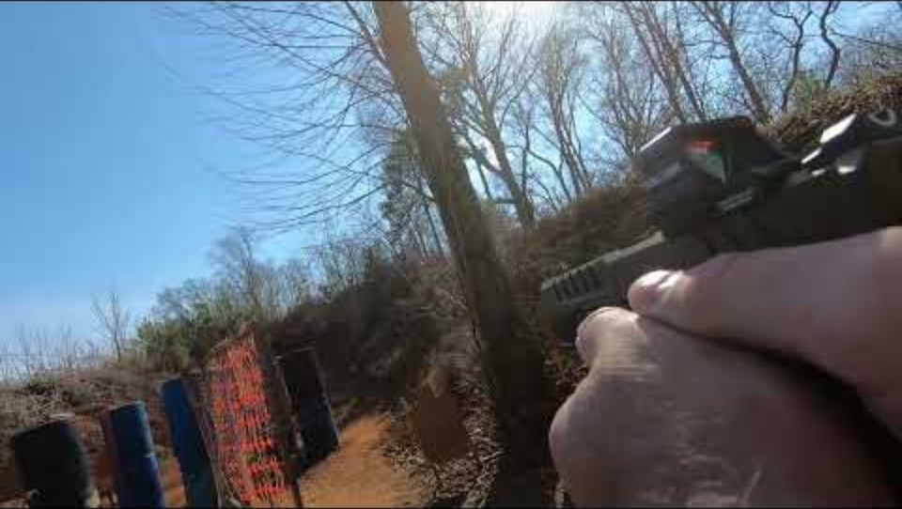

Slide 2
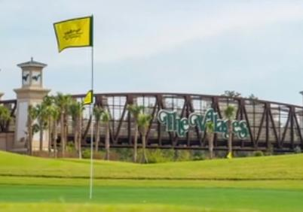
Competitive Shooting Opportunities
Near The Villages

Slide 3

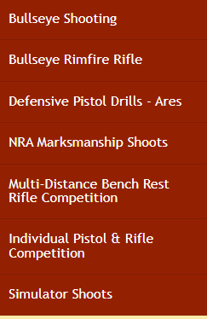
The Villages Straight Shooters Club
Link to Website
The Villages Straight Shooters Gun Safety, Education, Marksmanship - Home
The club offers some great shooting opportunities for all skill levels. Plus, monthly meetings that offer raffles of cash, gun gear and a gun.

Slide 4
Competitive Shooting
A few of our members have taken their shooting skills to the competitive arena.
This might sound intimidating, but we have found these “competitions” to be fun and rewarding. The people are friendly and helpful. No one really pays attention to how accurate you are, how fast you are, or what your final score is.
Finding this information is not easy, so these pages will give you the info you need to get started.

Slide 5
4 Rules of Gun Safety
Treat all firearms as if they are loaded.
01
Keep the muzzle pointed in a safe direction.
02
Keep your finger off the trigger until you are ready to fire.
03
Be sure of your target and what’s beyond it.
04

Slide 6
Safety
Safety is number one.
All competitions are handled under the premise that no guns are loaded until you are on the firing line, under the command of a Range Officer.
If the range is clear, you will hear “The range is hot”
Command “Load and make ready”
“Are you ready?” “Stand by” “beep” from the timer.
After shooting is compete, “Unload and show clear”
You put the empty gun in your holster or back to the bag.

Slide 7

USPSA United States Pistol Shooters Association
Link to Website
www.uspsa.org
YouTube example of USPSA stages
This is a great resource to get started!
Most places don’t require you to be a USPSA member, but being a member allows your results to be tracked.
USPSA and Steel Challenge are formats under this umbrella.

Slide 8
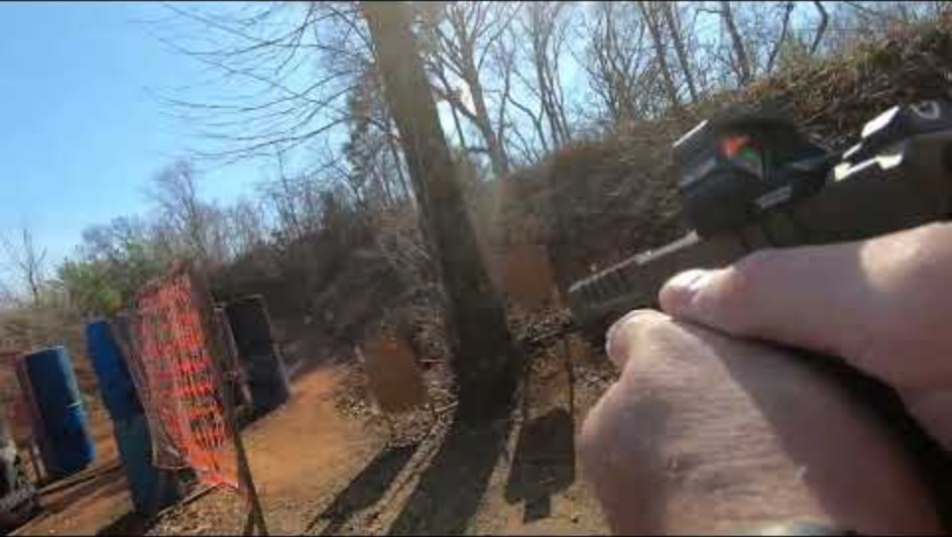

Slide 9

Steel Challenge
Link to Website
www.scsa.org
YouTube example of Steel Challenge
Part of USPSA, so no new membership required.
Hit 5 targets as fast as you can. You get 5 tries and your best 4 times are added up.
No running, .22 caliber guns are allowed. It is just fun!

Slide 10
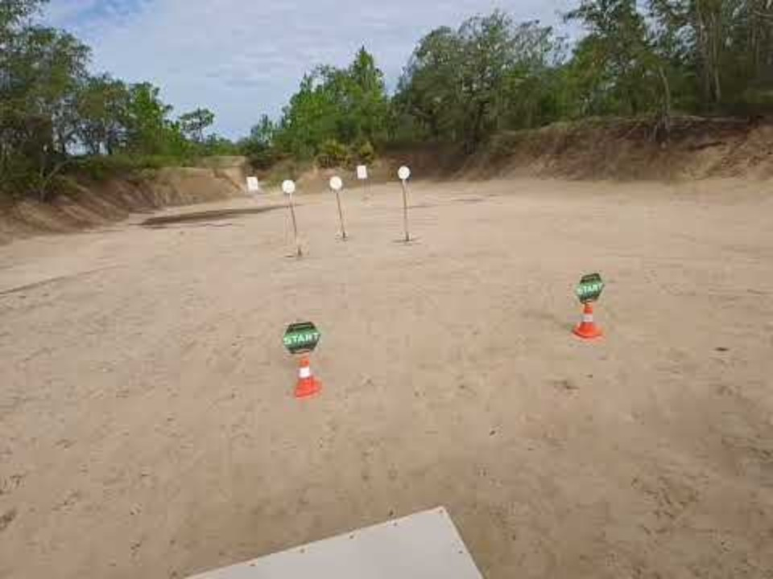

Slide 11
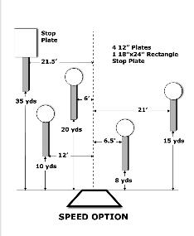
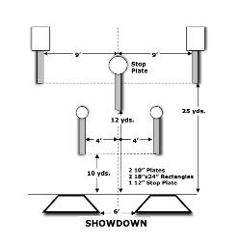
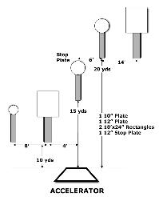
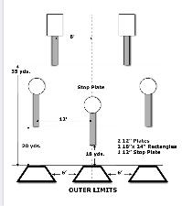
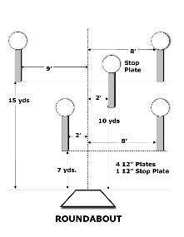
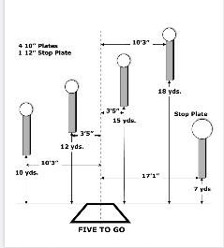
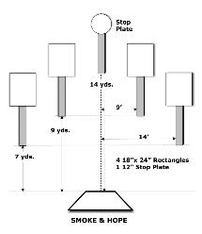
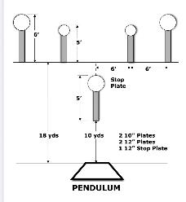
The Steel Challenge Stages

Slide 12

Manny’s Action Steel
Link to Website
www.mannybragg.com
www.volusiacountygunclub.com
YouTube example of Manny's action Steel
Weekday and weekend events.
Find these events in Practiscore undern the club name “Extreme GM.”

Slide 13
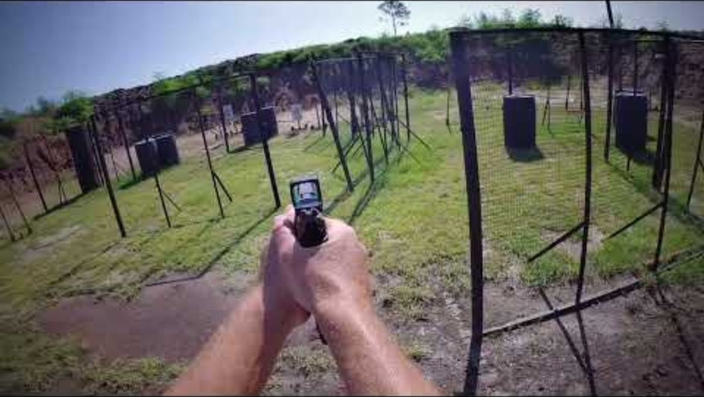

Slide 14

Galactic Pistol Alliance
Link to Website
www.galacticpistolalliance.com
YouTube example of GPA
Relaxed rules on equipment and some procedures in the effort to make it more fun.
GPA does require a membership, but at this time you can sign up for a 1-year free trial.

Slide 15
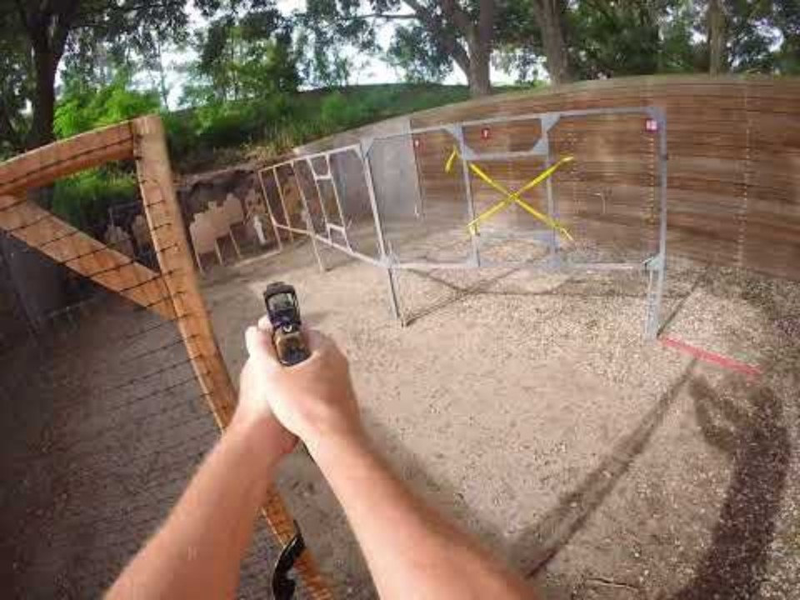

Slide 16

IDPA
Link to Website
www.idpa.com
YouTube example of IDPA
Practice how you carry!
IDPA is more geared toward concealed carry gear and there are tighter rules around managing the equipment you have.

Slide 17

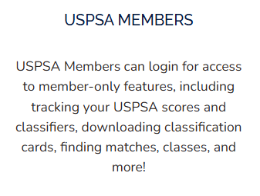
Join USPSA
Link to the Website
www.uspsa.org
Why Join USPSA?
Membership cover USPSA and Steel Challenge.

Slide 18
Practiscore
Link to Web Site
www.practiscore.com
A Practiscore account is a must have!
Here you will find:
Find clubs and events near you.
Sign up for events.
See the scoring results of the events.

Slide 19
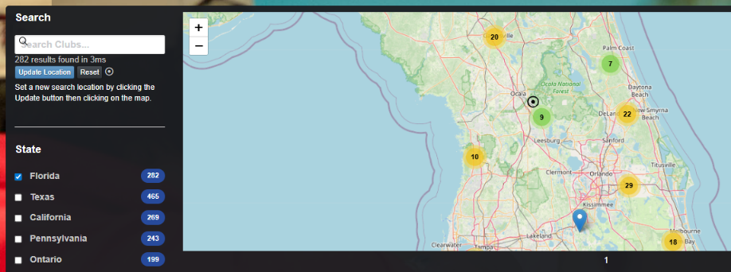
Practiscore search
Link to Web Site
Clubs Search | PractiScore
The “Clubs’ Tab is where you can search gun clubs in the area. To search for matches, select the “Matches” tab.

Slide 20
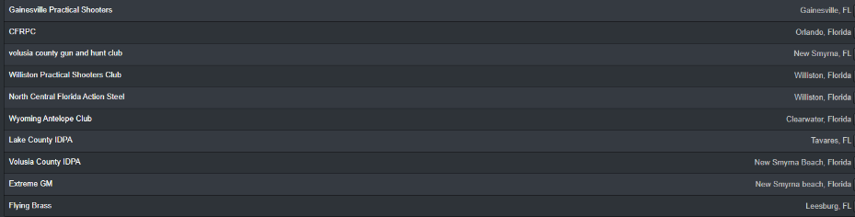
Practiscore, follow your clubs!
Once you have an account, you can select “My Dashboard” to see all your data.
I would suggest when you find a club near you, hit the “follow” button and that club will show up under “My Clubs”
I am currently the following Florida clubs. I would suggest following all the clubs shown.
This can be cumbersome, and this is the main reason I am sharing this information.
I want it to be easy for you to find.

Slide 21
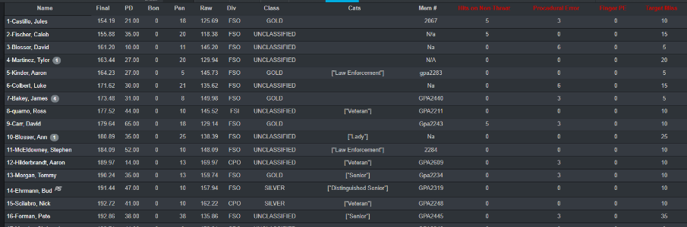
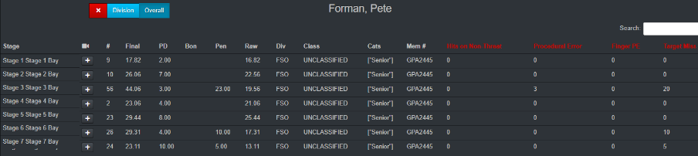
See how you stack up!

Slide 22
Links to Ranges
Hernando Sportsman's Club
Shoot GTR - Gainesville Target Range
Volusia County Gun Club
Manny Bragg – Pro Shooting Sports
Eustis Gun Club
Ares Training Facility
Wyoming Antelope Shooting Range
Port Malabar IDPA Website
Central Florida Rifle and Pistol
Shooters World
Outpost Shooting Range Florida

Slide 23
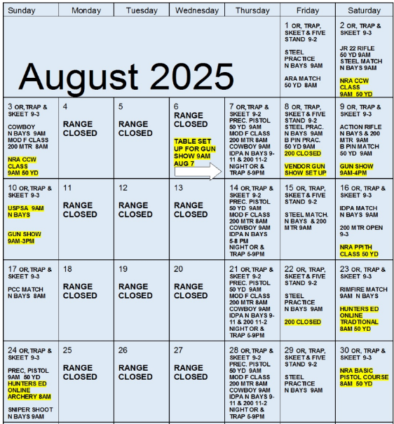
Hernando
Sportsman’s
Club
Hernando Sportsman's Club
Monitor the Event Calendar for Steel Challenge practice and matches, as well as other shooting disciplines

