Slide 1


Slide 2



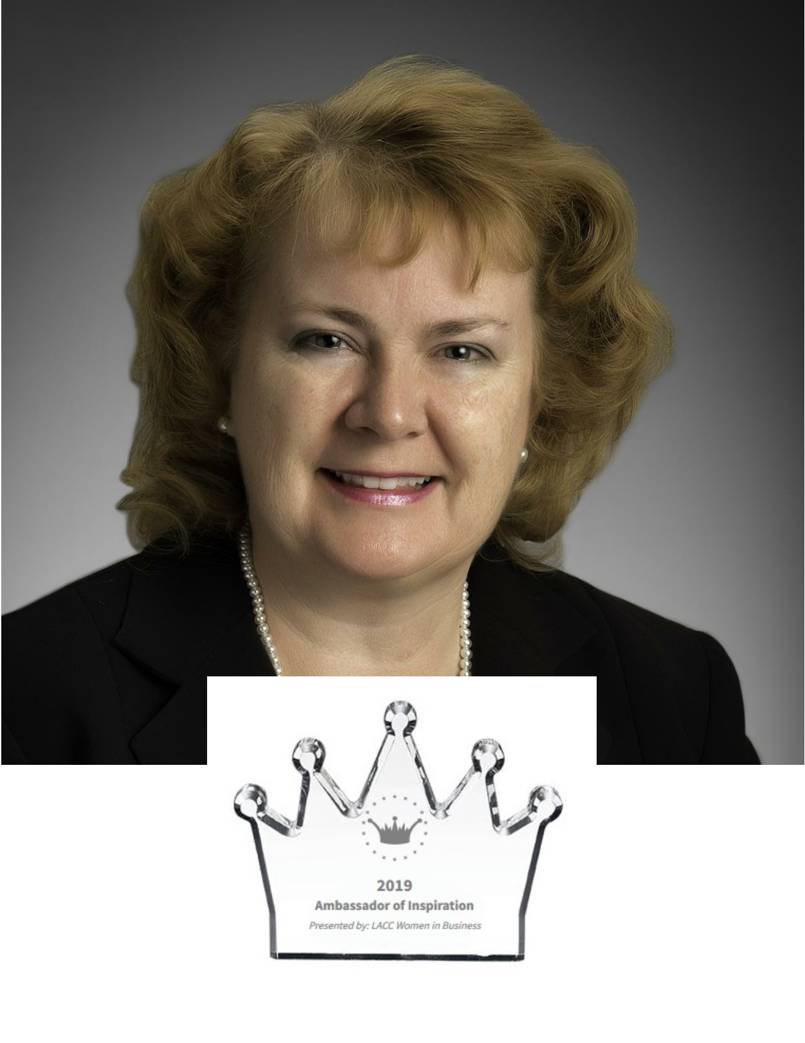


2019
January
Jan. 1st: John Bruso, Erie County Legislator approved $5000 worth of 2018 funding for the Coalition to utilize towards their development and promised $10,000 for the year of 2019
Jan. 5th: Depew/Lancaster Schools Surveyed 8th, 10th, and 12th graders with PNA Survey
Jan. 17th: Director Gwendolyn A. Bork was nominated as an “Agent of Change” at the Lancaster Area Chamber of Commerce Women in Business Awards Dinner for her work in the community with the coalition and their strategic partners
Jan. 17th: WNY PRC Training-DFC GRANT TRAINING
Notes:
https://docs.google.com/presentation/d/e/2PACX-1vTe7zPBzKwajr9KOWpMLU7V73q_qwfgmXhKpsDp5tww4VDCX02XX9HEJfBVlFglkFSzwa00bpaQuWGc/pub?start=true&loop=true&delayms=30000

Slide 3
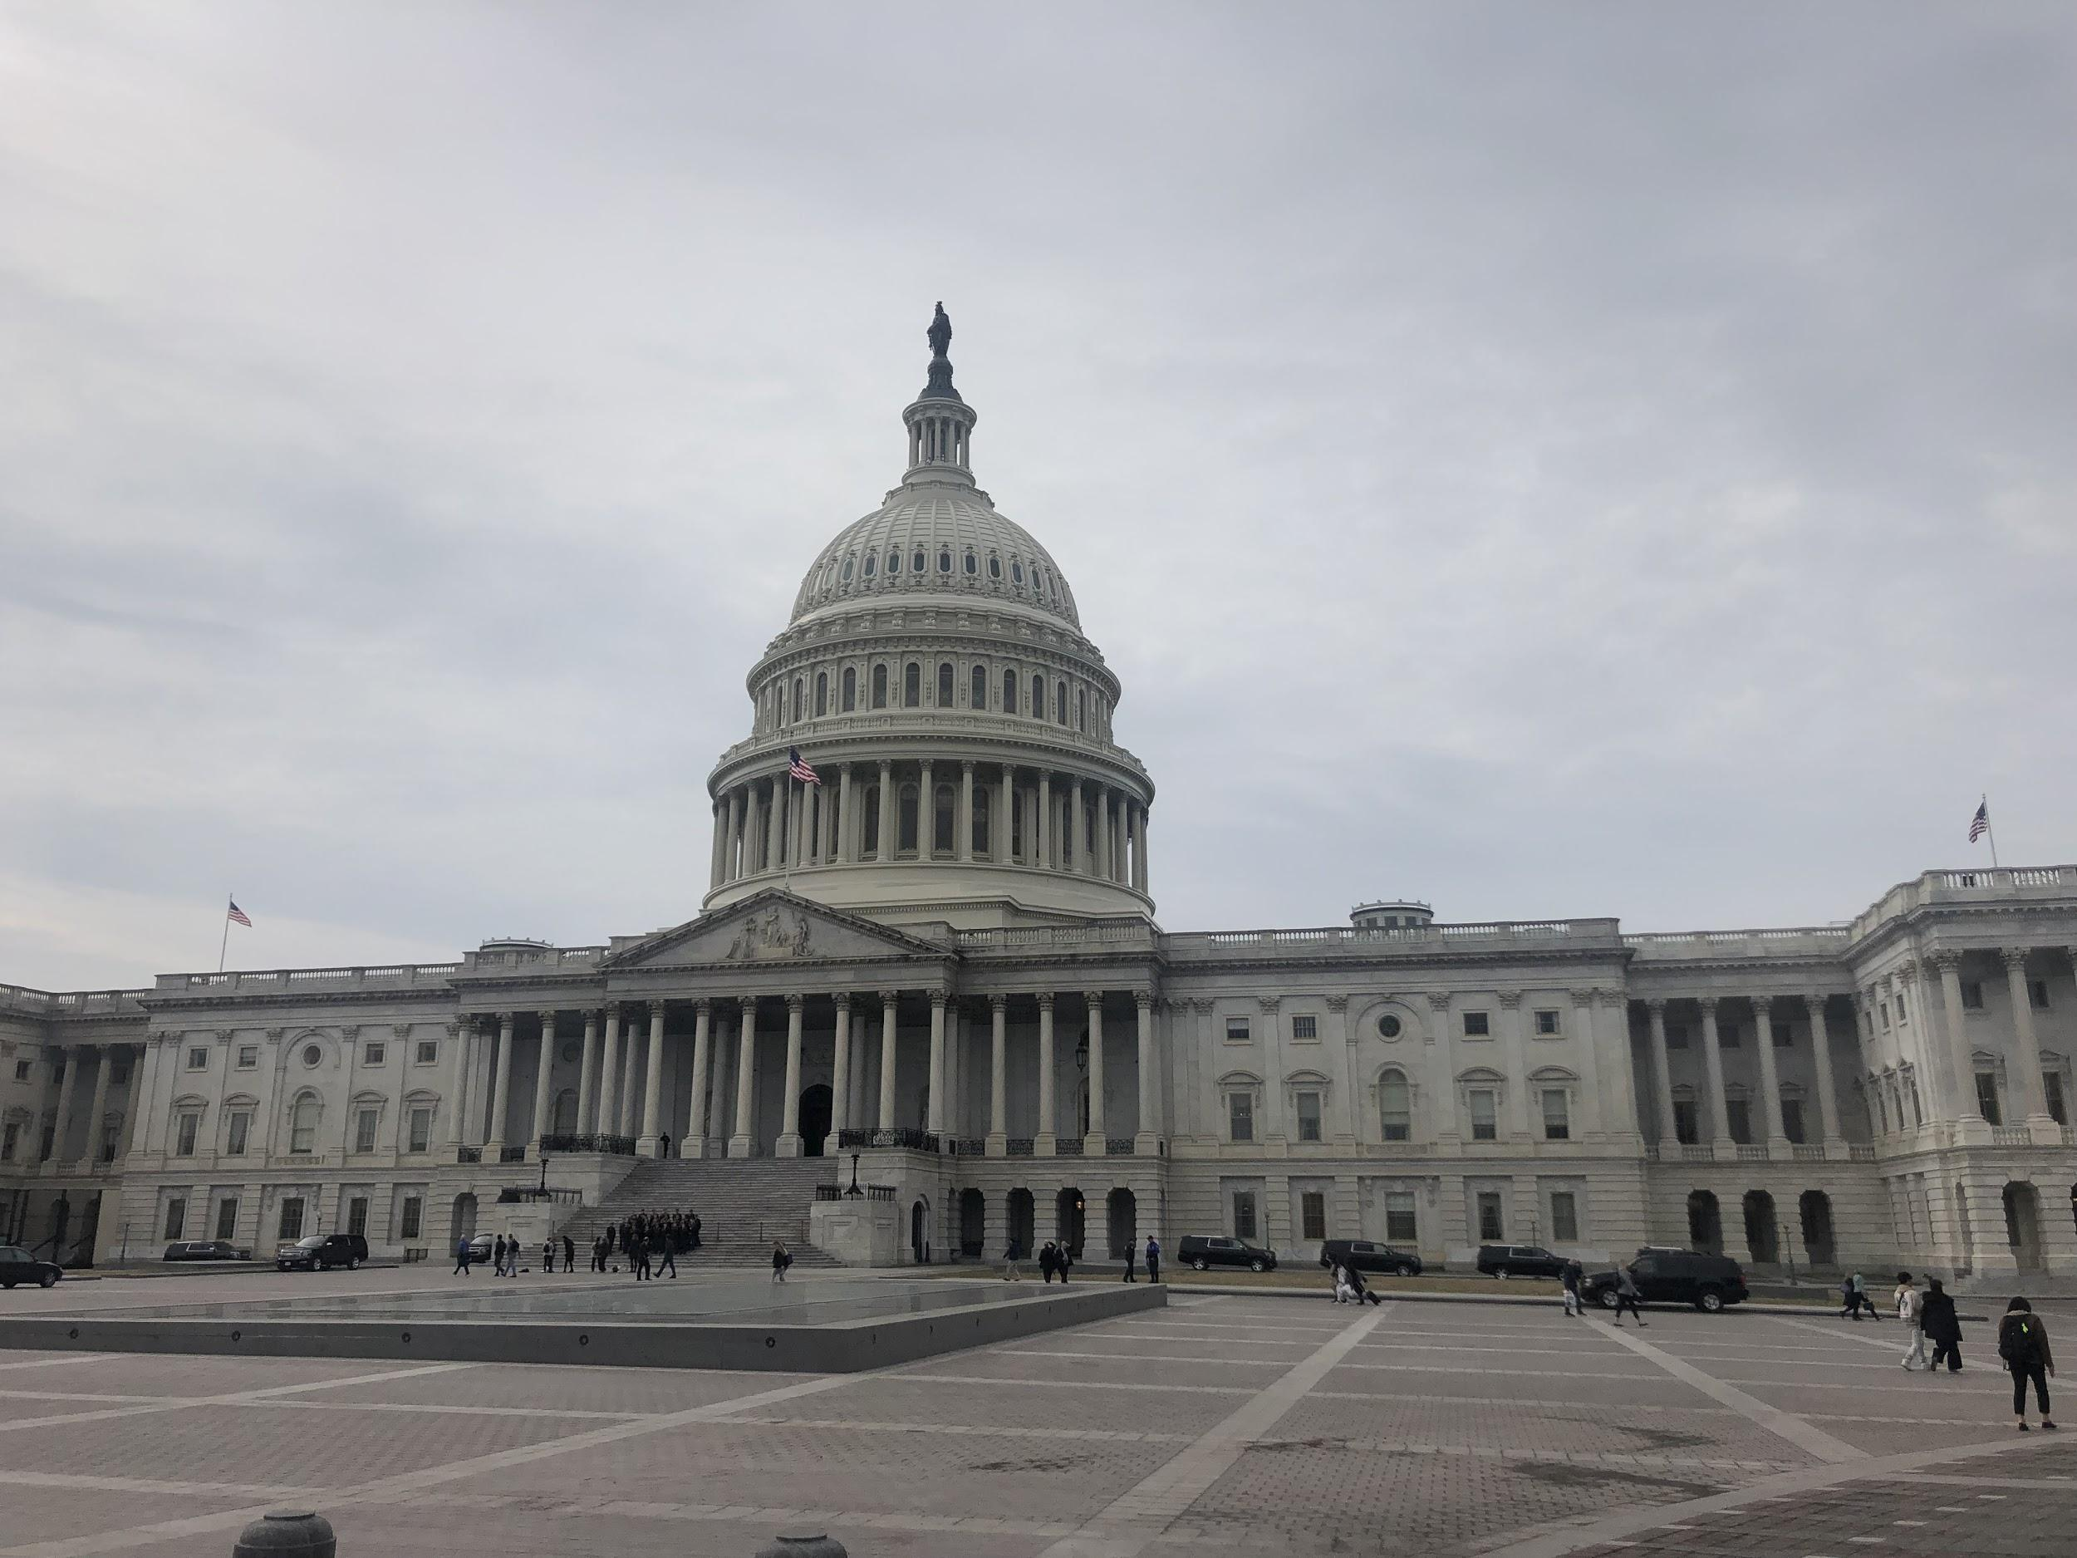
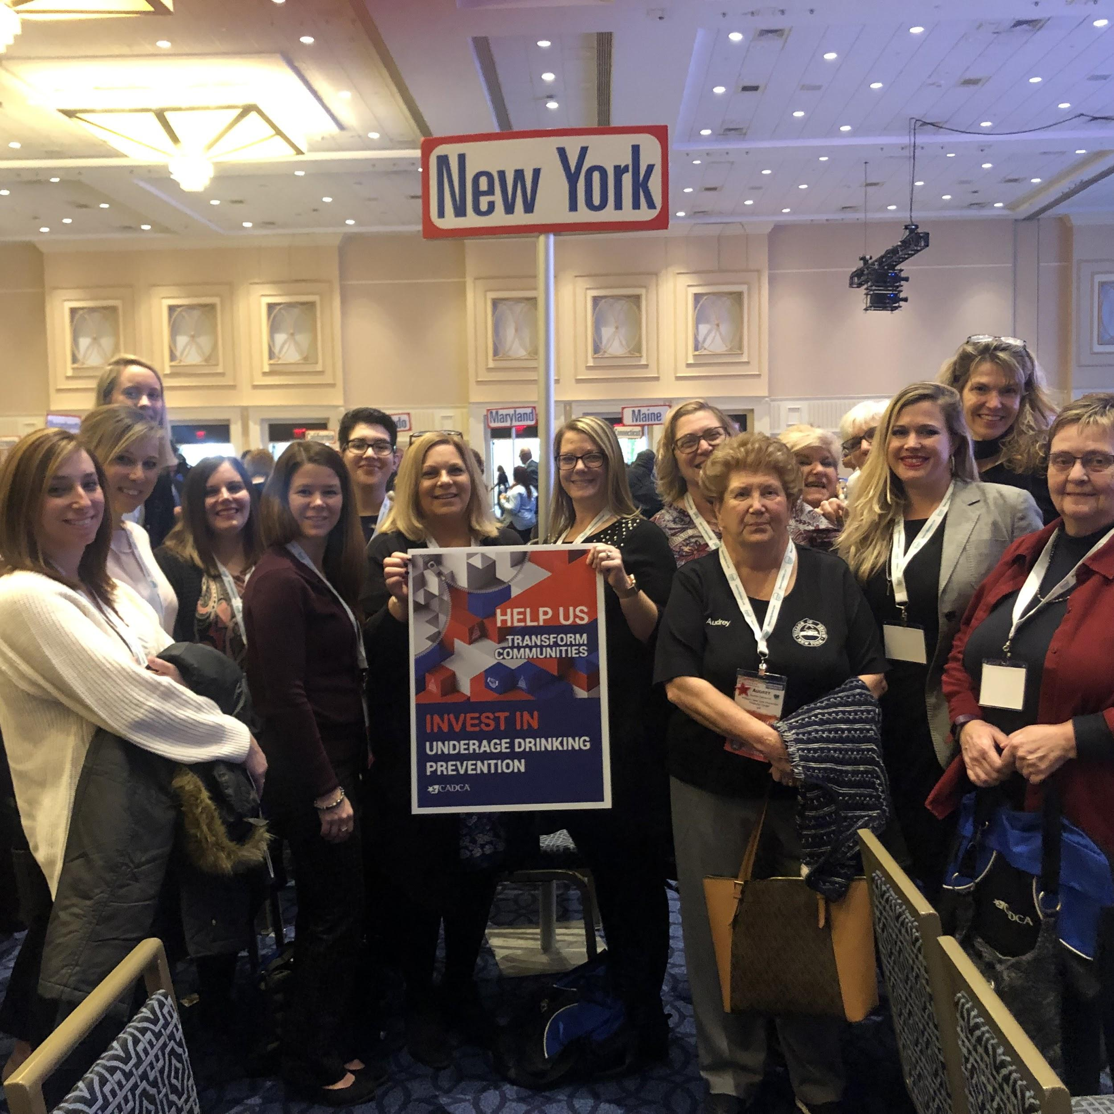
February
Feb.4-8th: Audrey Hamernik (Treasurer) and Gwendolyn Bork (Director) report to Washington DC to attend the Annual CADCA Leadership Conference to meet with public officials and acquire key training
Feb. 11th: FOCUS was officially registered on the DUNNS Site and SAMS in order to start the process for Federal Grants

Slide 4
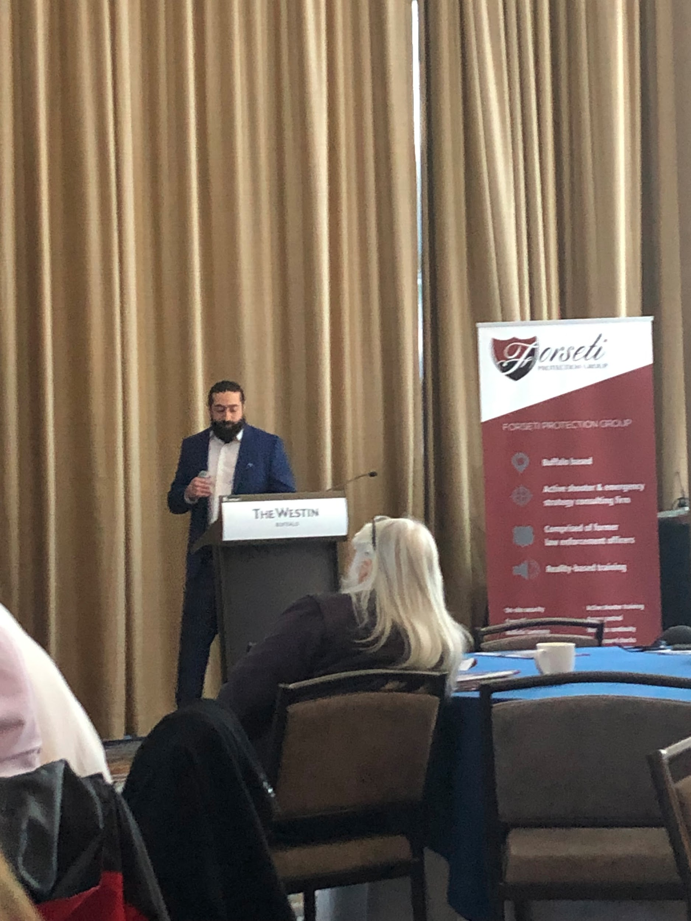
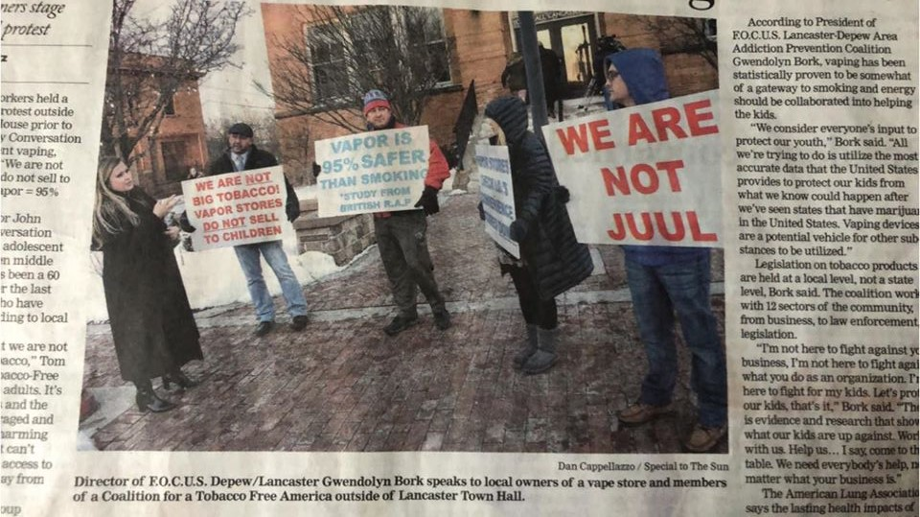
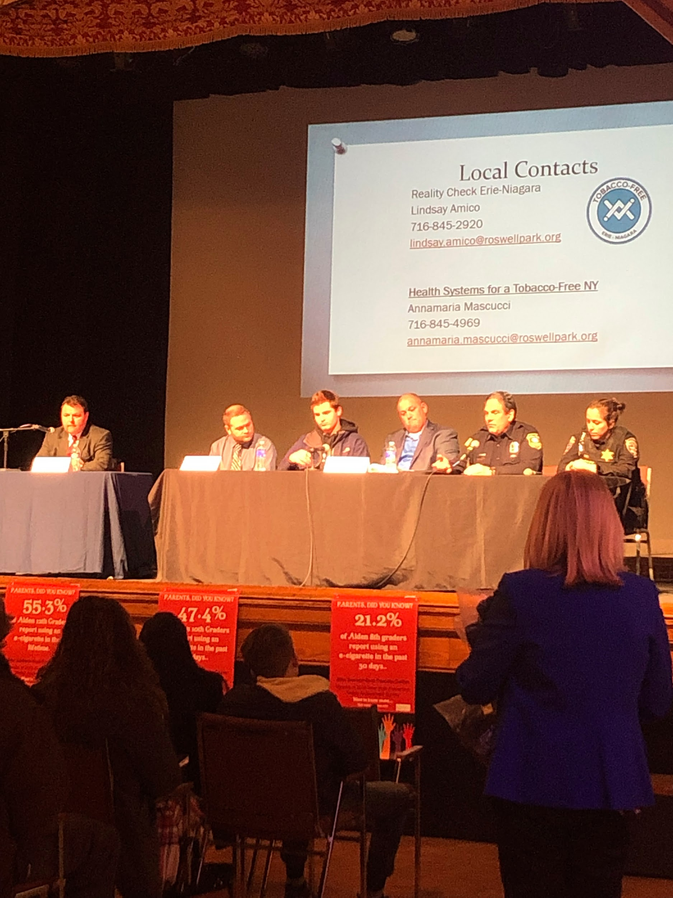
March
Mar. 6th: Forseti Protection Seminar at Westin with FBI, Army, Vegas Shooter Survivor: speaking on how to protect our schools, businesses, and each other in the community
Mar. 6th: Town Hall Event-Former Legislator Bruso/FOCUS/Alden Coalition: Vaping Event at Lancaster Opera House to discuss trends in vaping paraphernalia, meet school SRO’s, panel with experts, surveyed attendees on vaping traits
Mar. 6th: T21 was passed in the House to raise the age of buying tobacco products.FOCUS Sector partners, Tobacco Free WNY, John Bruso County Legislator, Etc. Approx. 100 attended, 34 Vaping Surveys collected just for Lancaster/Depew
Mar. 13th: Taste of Education Event @ Salvatore’s to benefit Pro-Start Youth Culinary School, guest judge

Slide 5

April & May
April 6th: ITAC Health & Wellness Fair (neighboring Addiction Prevention Coalition) Vendor Table
May 9th: WNY PRC Coalition Celebrations Event

Slide 6
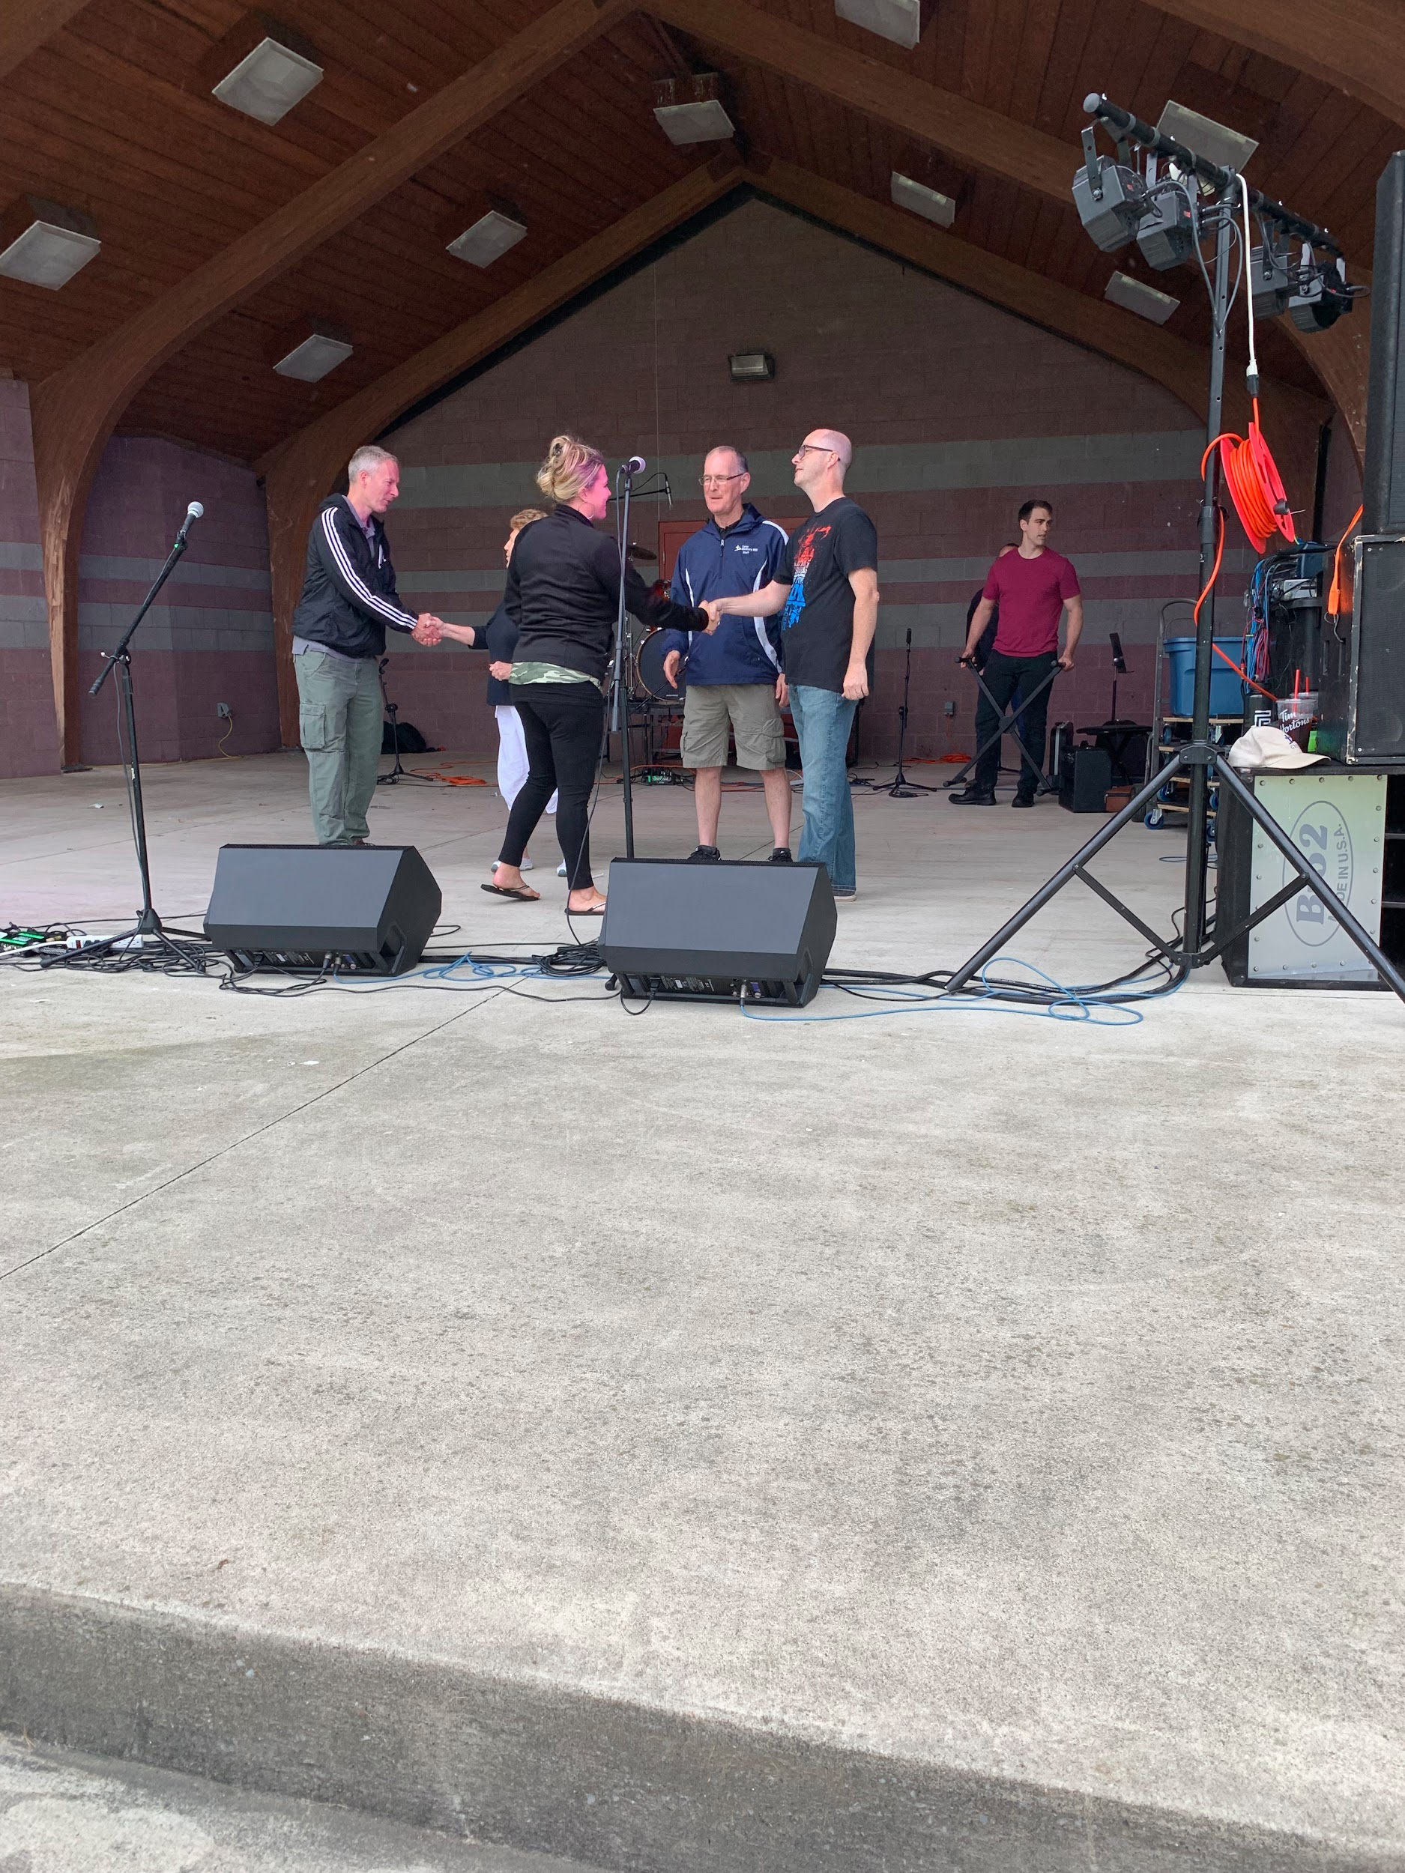
June & July
June 15th: Rock the Ark Music Fest, officially donated $1533 to Camp Hickory Hill through BB&G Charities, marketed Coalition at event with Vendor table
July 27th: Founder’s Day Parade and Vendor table, Nichol City Realty walked in Parade on our behalf
July 4th: Lancaster Parade and PSA campaign with lawn signs and mobile marketing
July 7th: Submitted DFC Grant on behalf of Coalition-$125,000 for 5 years, $625,000 total

Slide 7
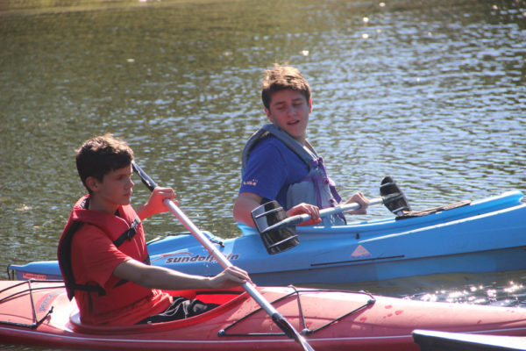
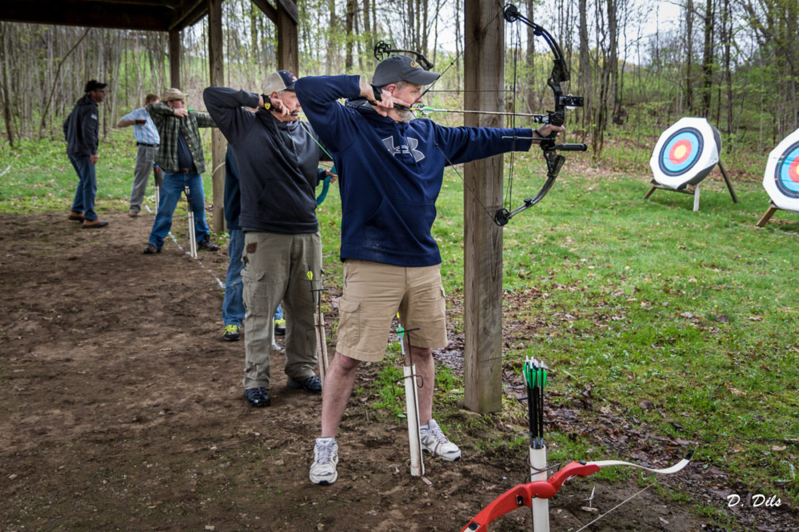
FOCUS GRANTS $1,500 to
"BB&G Charities-Camp Hickory Hill"

Slide 8
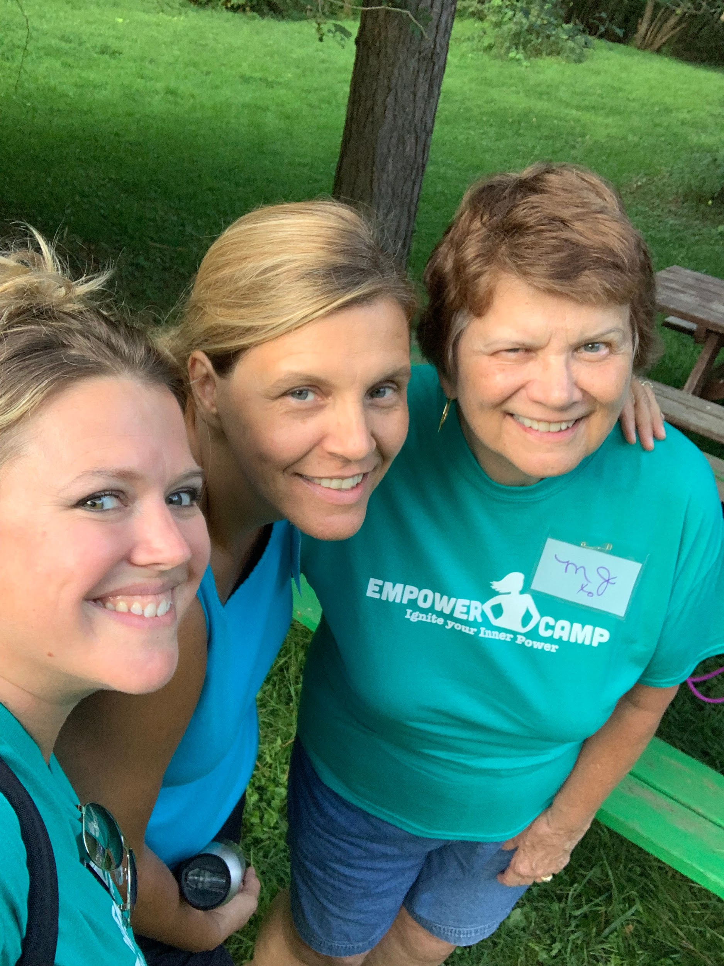
FOCUS GRANTS $1,500 to
"Empower Camp"
5 girls sent to Camp from the Depew/Lancaster area free of charge
5 recruited from community who obtained scholarships
10 total girls from Depew/Lan sent
Empower Camp Mission:
Empower Camp 's mission it to ignite the inner power of young women, ages 13-18, and Empower the lady leaders of tomorrow.

Slide 9
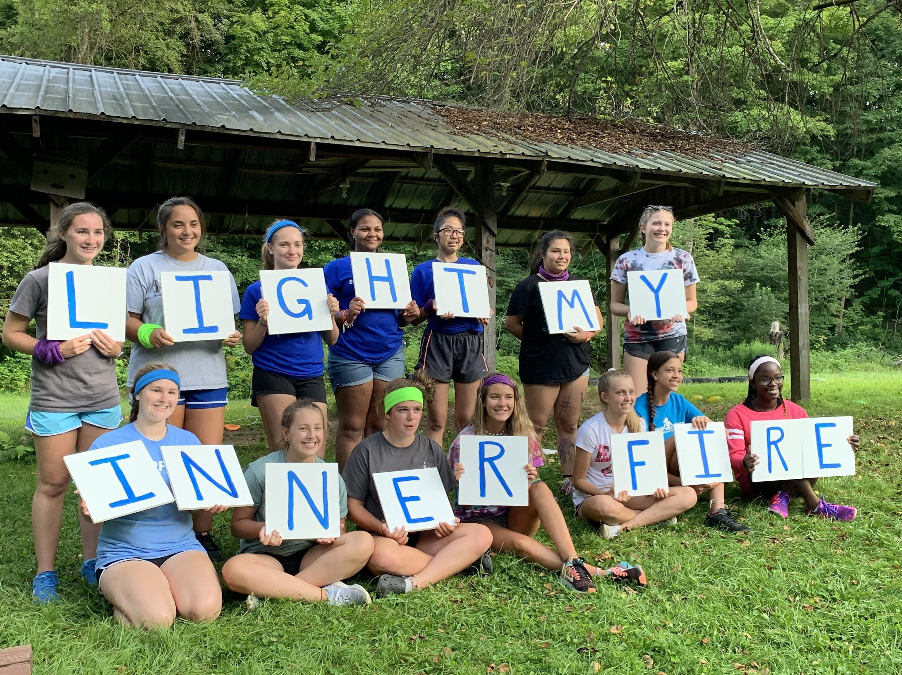
FOCUS GRANTS $1,500 to
"Empower Camp"
Testimonial:
“Empower Camp meant a lot to me because normally kids aren’t the nicest to me. When I went to this camp, it made me feel welcomed and it made me feel like I had another place to be my true self. I learned that no one judges or leaves you out of anything. It was nice to make some true friends that I can trust and talk to anytime. The camp counselors are like moms and it made me feel very safe and welcomed. I can’t put it in any better way than I loved this camp. They are like another family and I will come again! Thank you so much for great memories, amazing friends and a new home away from home”.
- Isis
Notes:
Testimonials:
"Empower Camp was one of the greatest experiences of my life. I was wary about attending at first because I knew only one other girl that would be going, but once at camp I truly felt welcome. Everyone was very energetic and inclusive, and I found myself making new friends almost immediately. From the songs to the games to eating in the dining hall, I was always meeting new people and making memories. One of my fondest memories of Empower Camp was our final campfire. Everyone was singing and dancing with each other and it was astounding to see how fast we all had bonded. By the end of camp we all knew each other by name and felt comfortable confiding in each other. There is truly no other experience like that of Empower Camp, and I'm so glad that I had the opportunity to attend."
- Marcianna

Slide 10
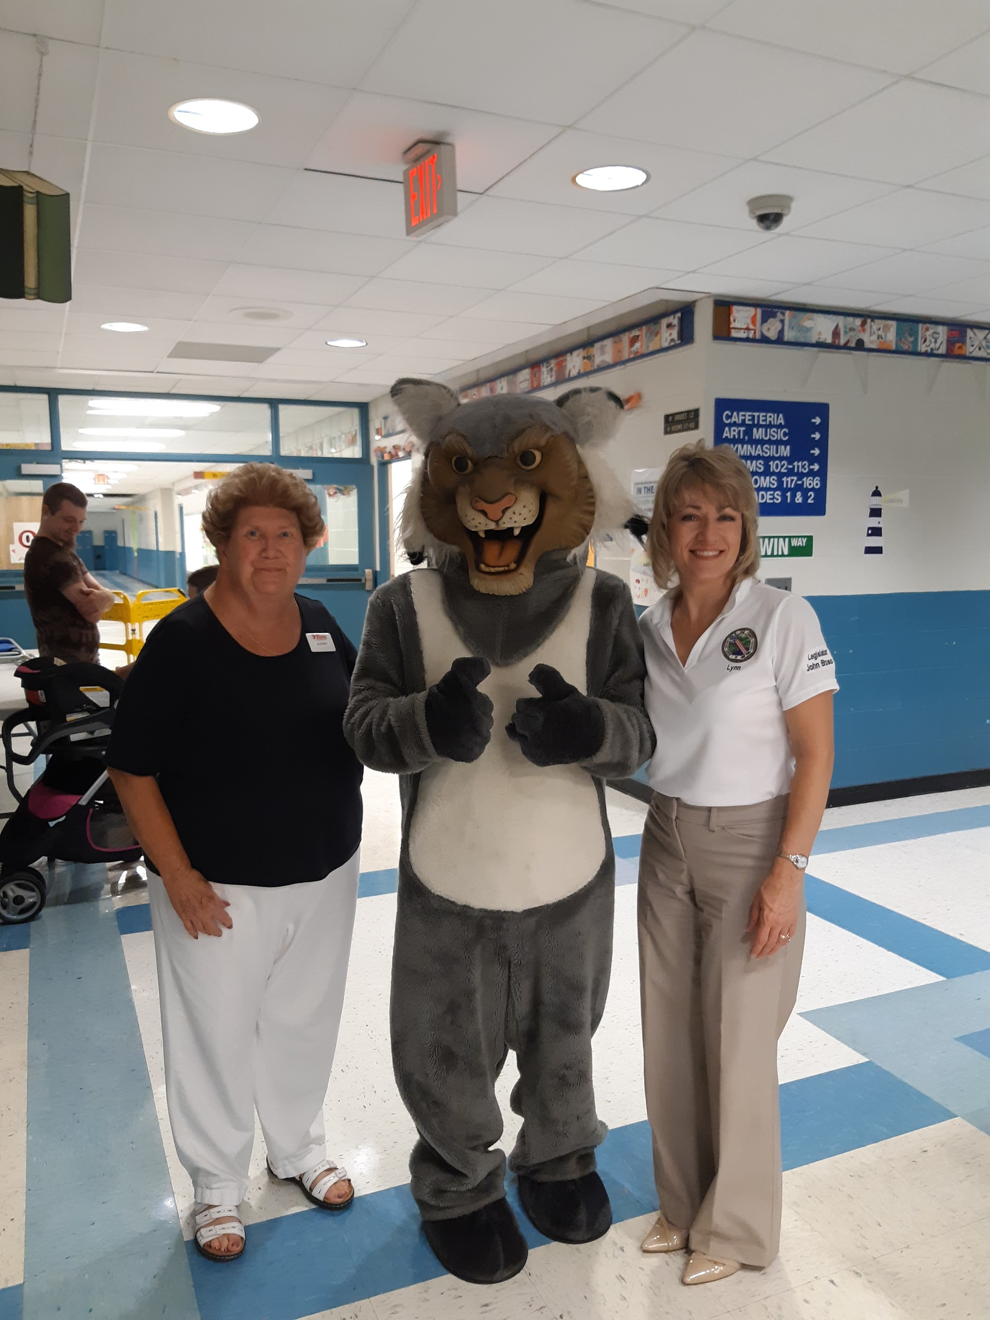
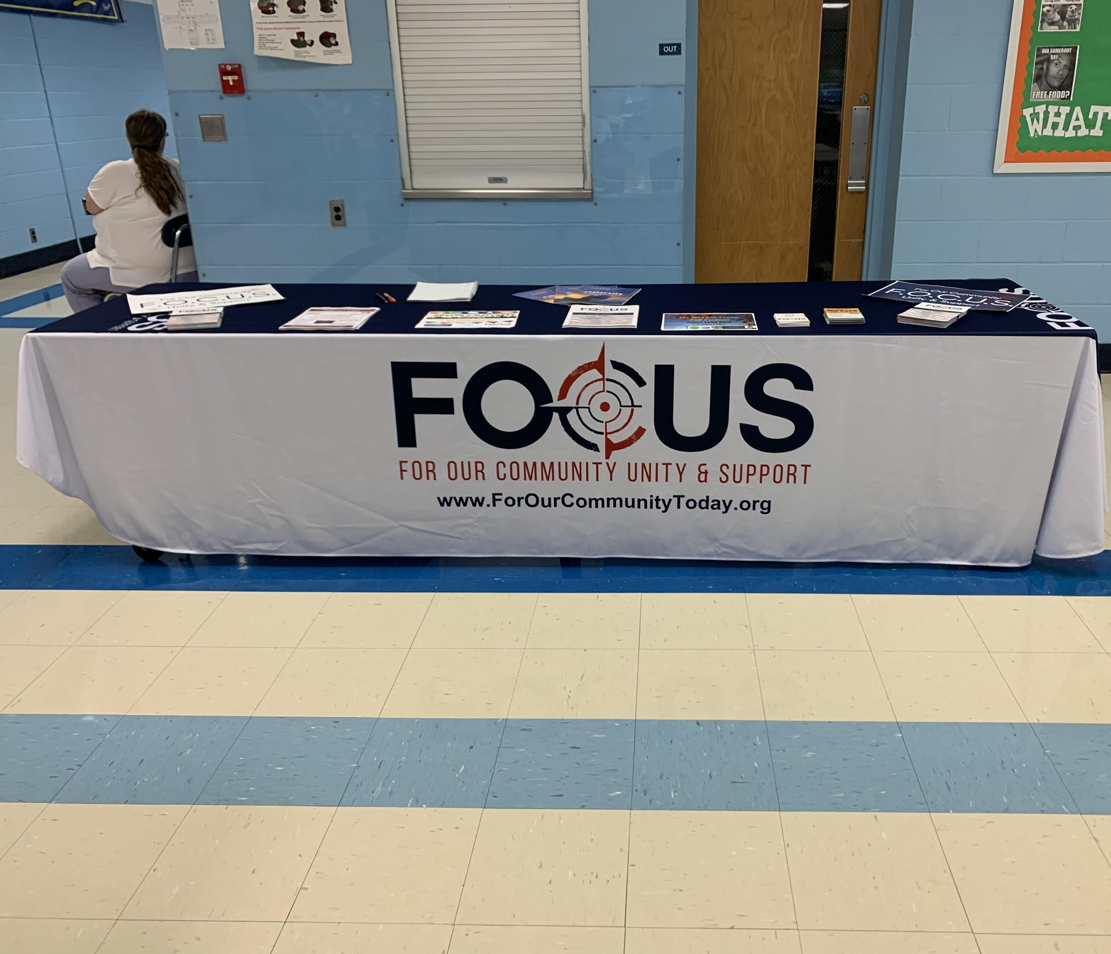
August & September
Vendor Tables at all Open Houses for all schools in Lancaster CSD and Depew UFSD (six locations)
September 8th: Kids Escaping Drugs “Rise for Awareness” Walk

Slide 11
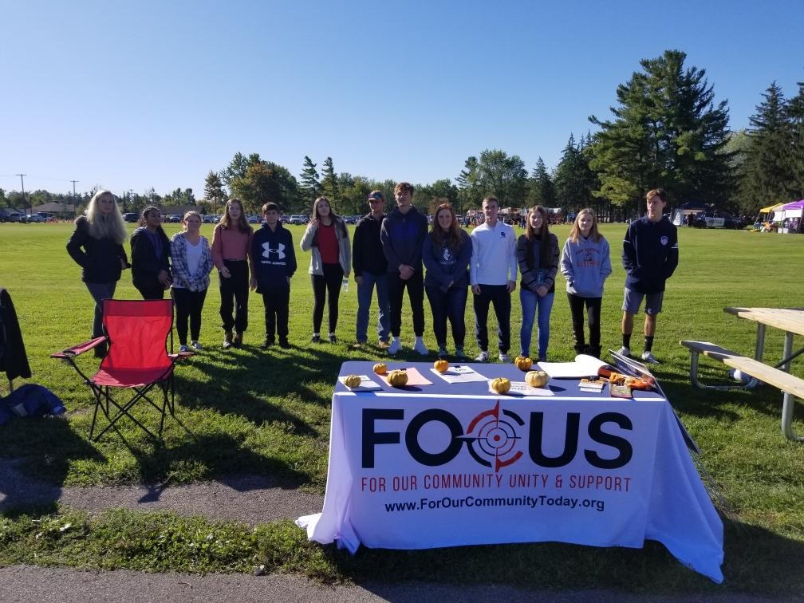
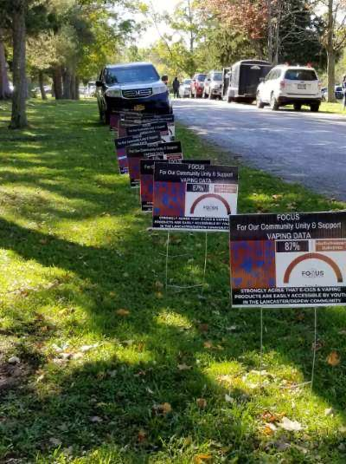
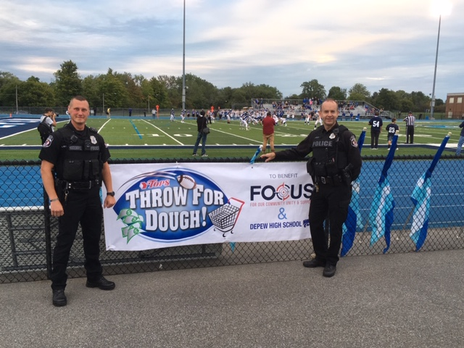
October
October 5th: Erie County Fall Fest-Scavenger Hunt for Youth ages 9-15, youth volunteers ran the activity
Month of October: Tops Throw for the Dough Contest at Football games, raised over $500

Slide 12
October
October 19th: Health & Wellness Fair, Cayuga Heights Elementary School, over 250 people attended
October 23rd: Town Hall Event: Release 2018-2019 8th, 10th, 12th grade PNA Data, various speakers on Alcohol and Vaping trends, SRO’s, New Laws (T21) Social Host updates and Red Ribbon Day

Slide 13
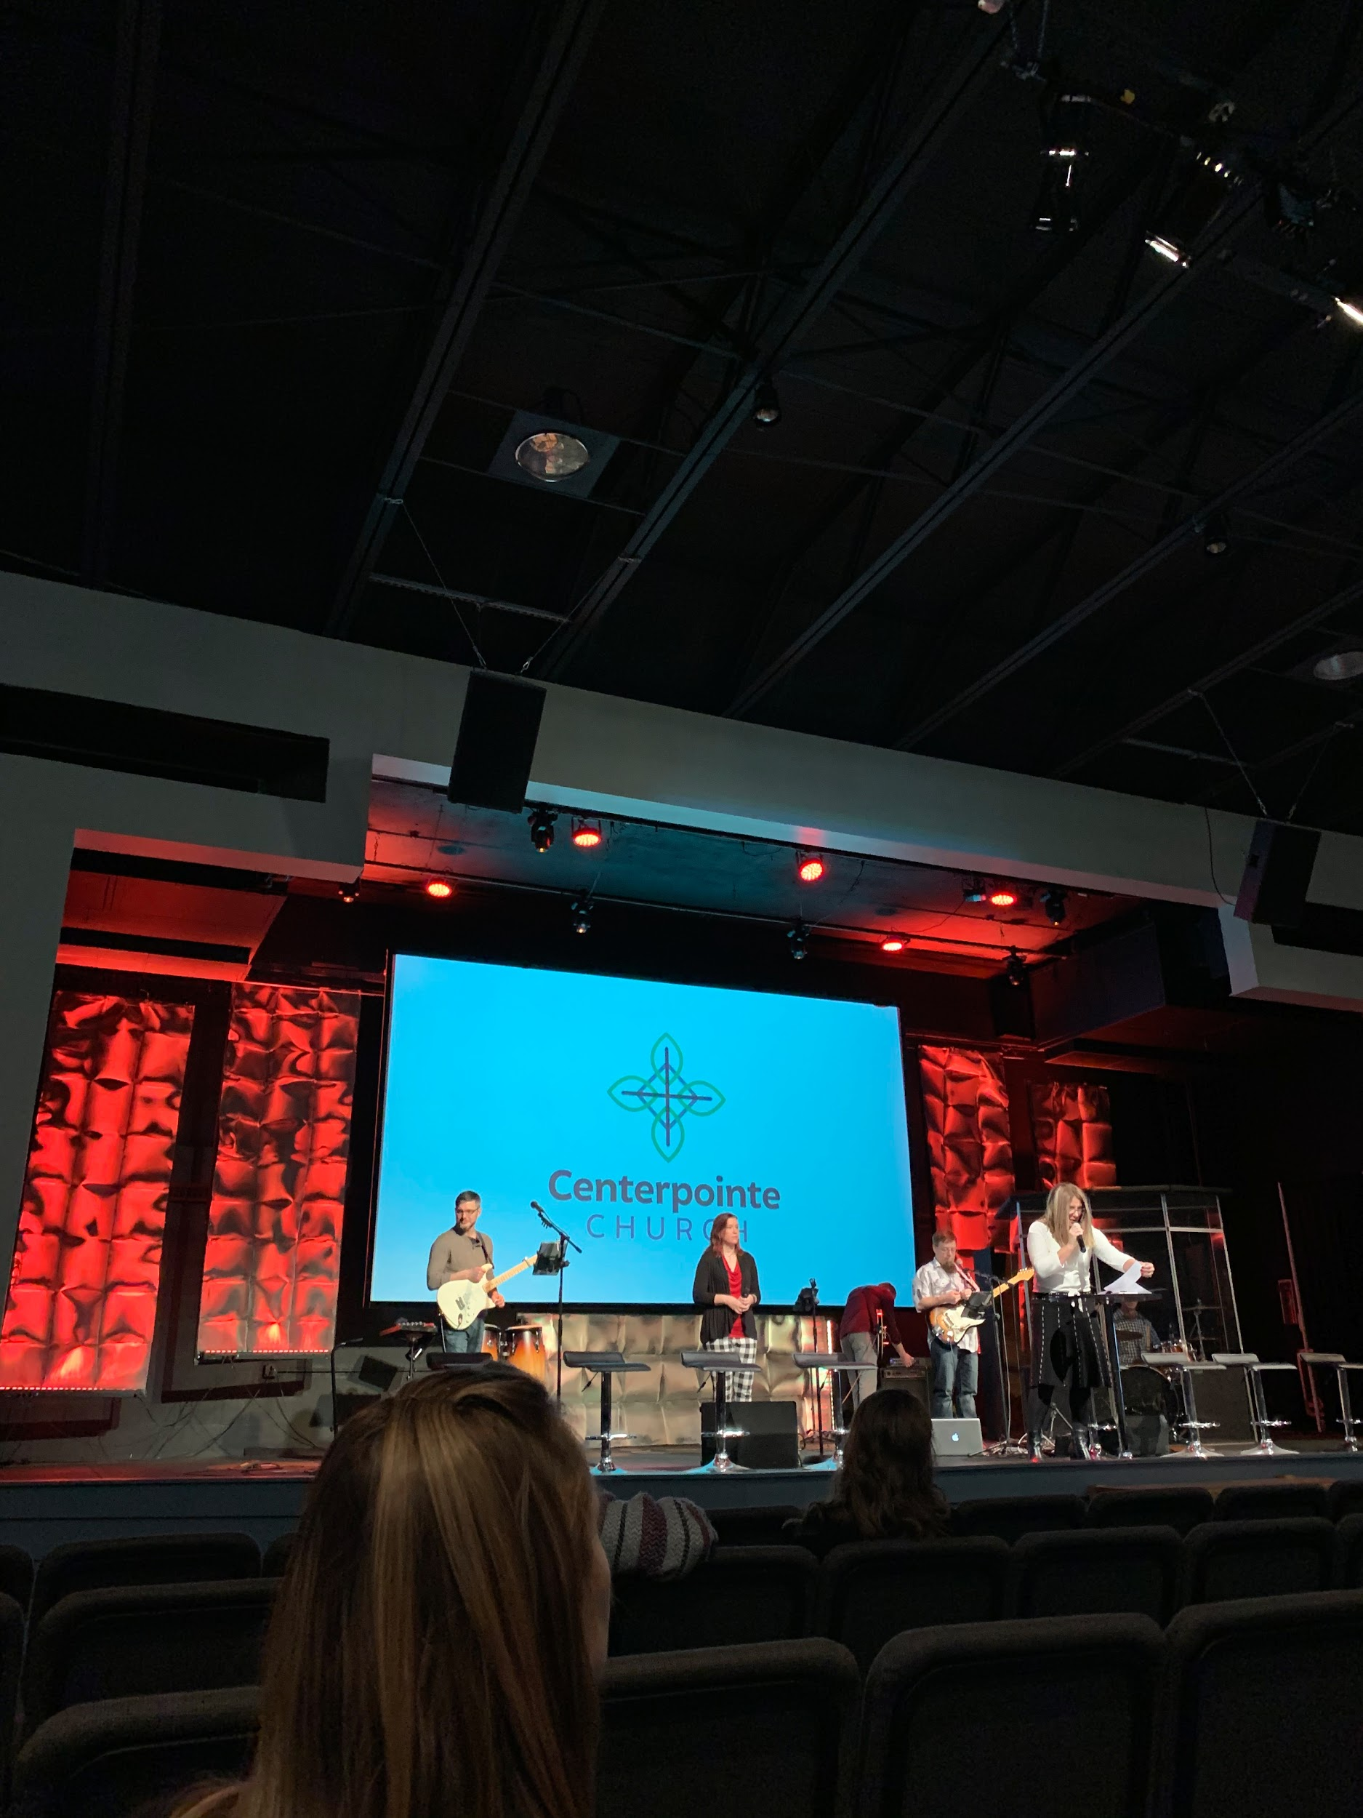
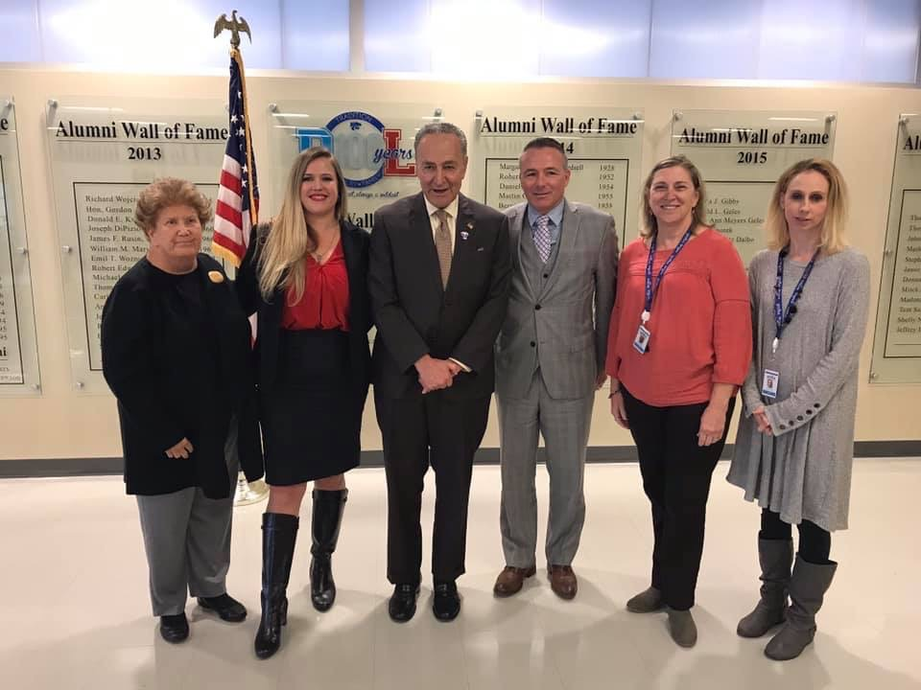
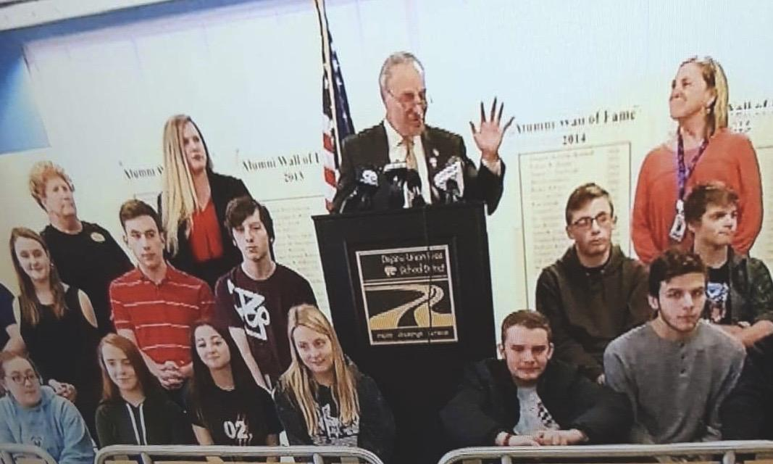
November
Nov. 7th: “Environmental Strategies-Social Norms, Part 1” Michaels, Hamburg (WNY PRC)
Nov. 17th: Missional Experiences Community Forum @ Centerpointe Church, Depew. 1 of 5 nonprofits presented for an opportunity to be supported. Gained five more Volunteers, Faith-Based Sector Partner, Secretary for the Board and new meeting space starting January 2020
Nov. 18th: Press Conference with Senator Schumer on Vaping at Depew High School

Slide 14
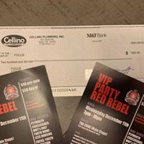

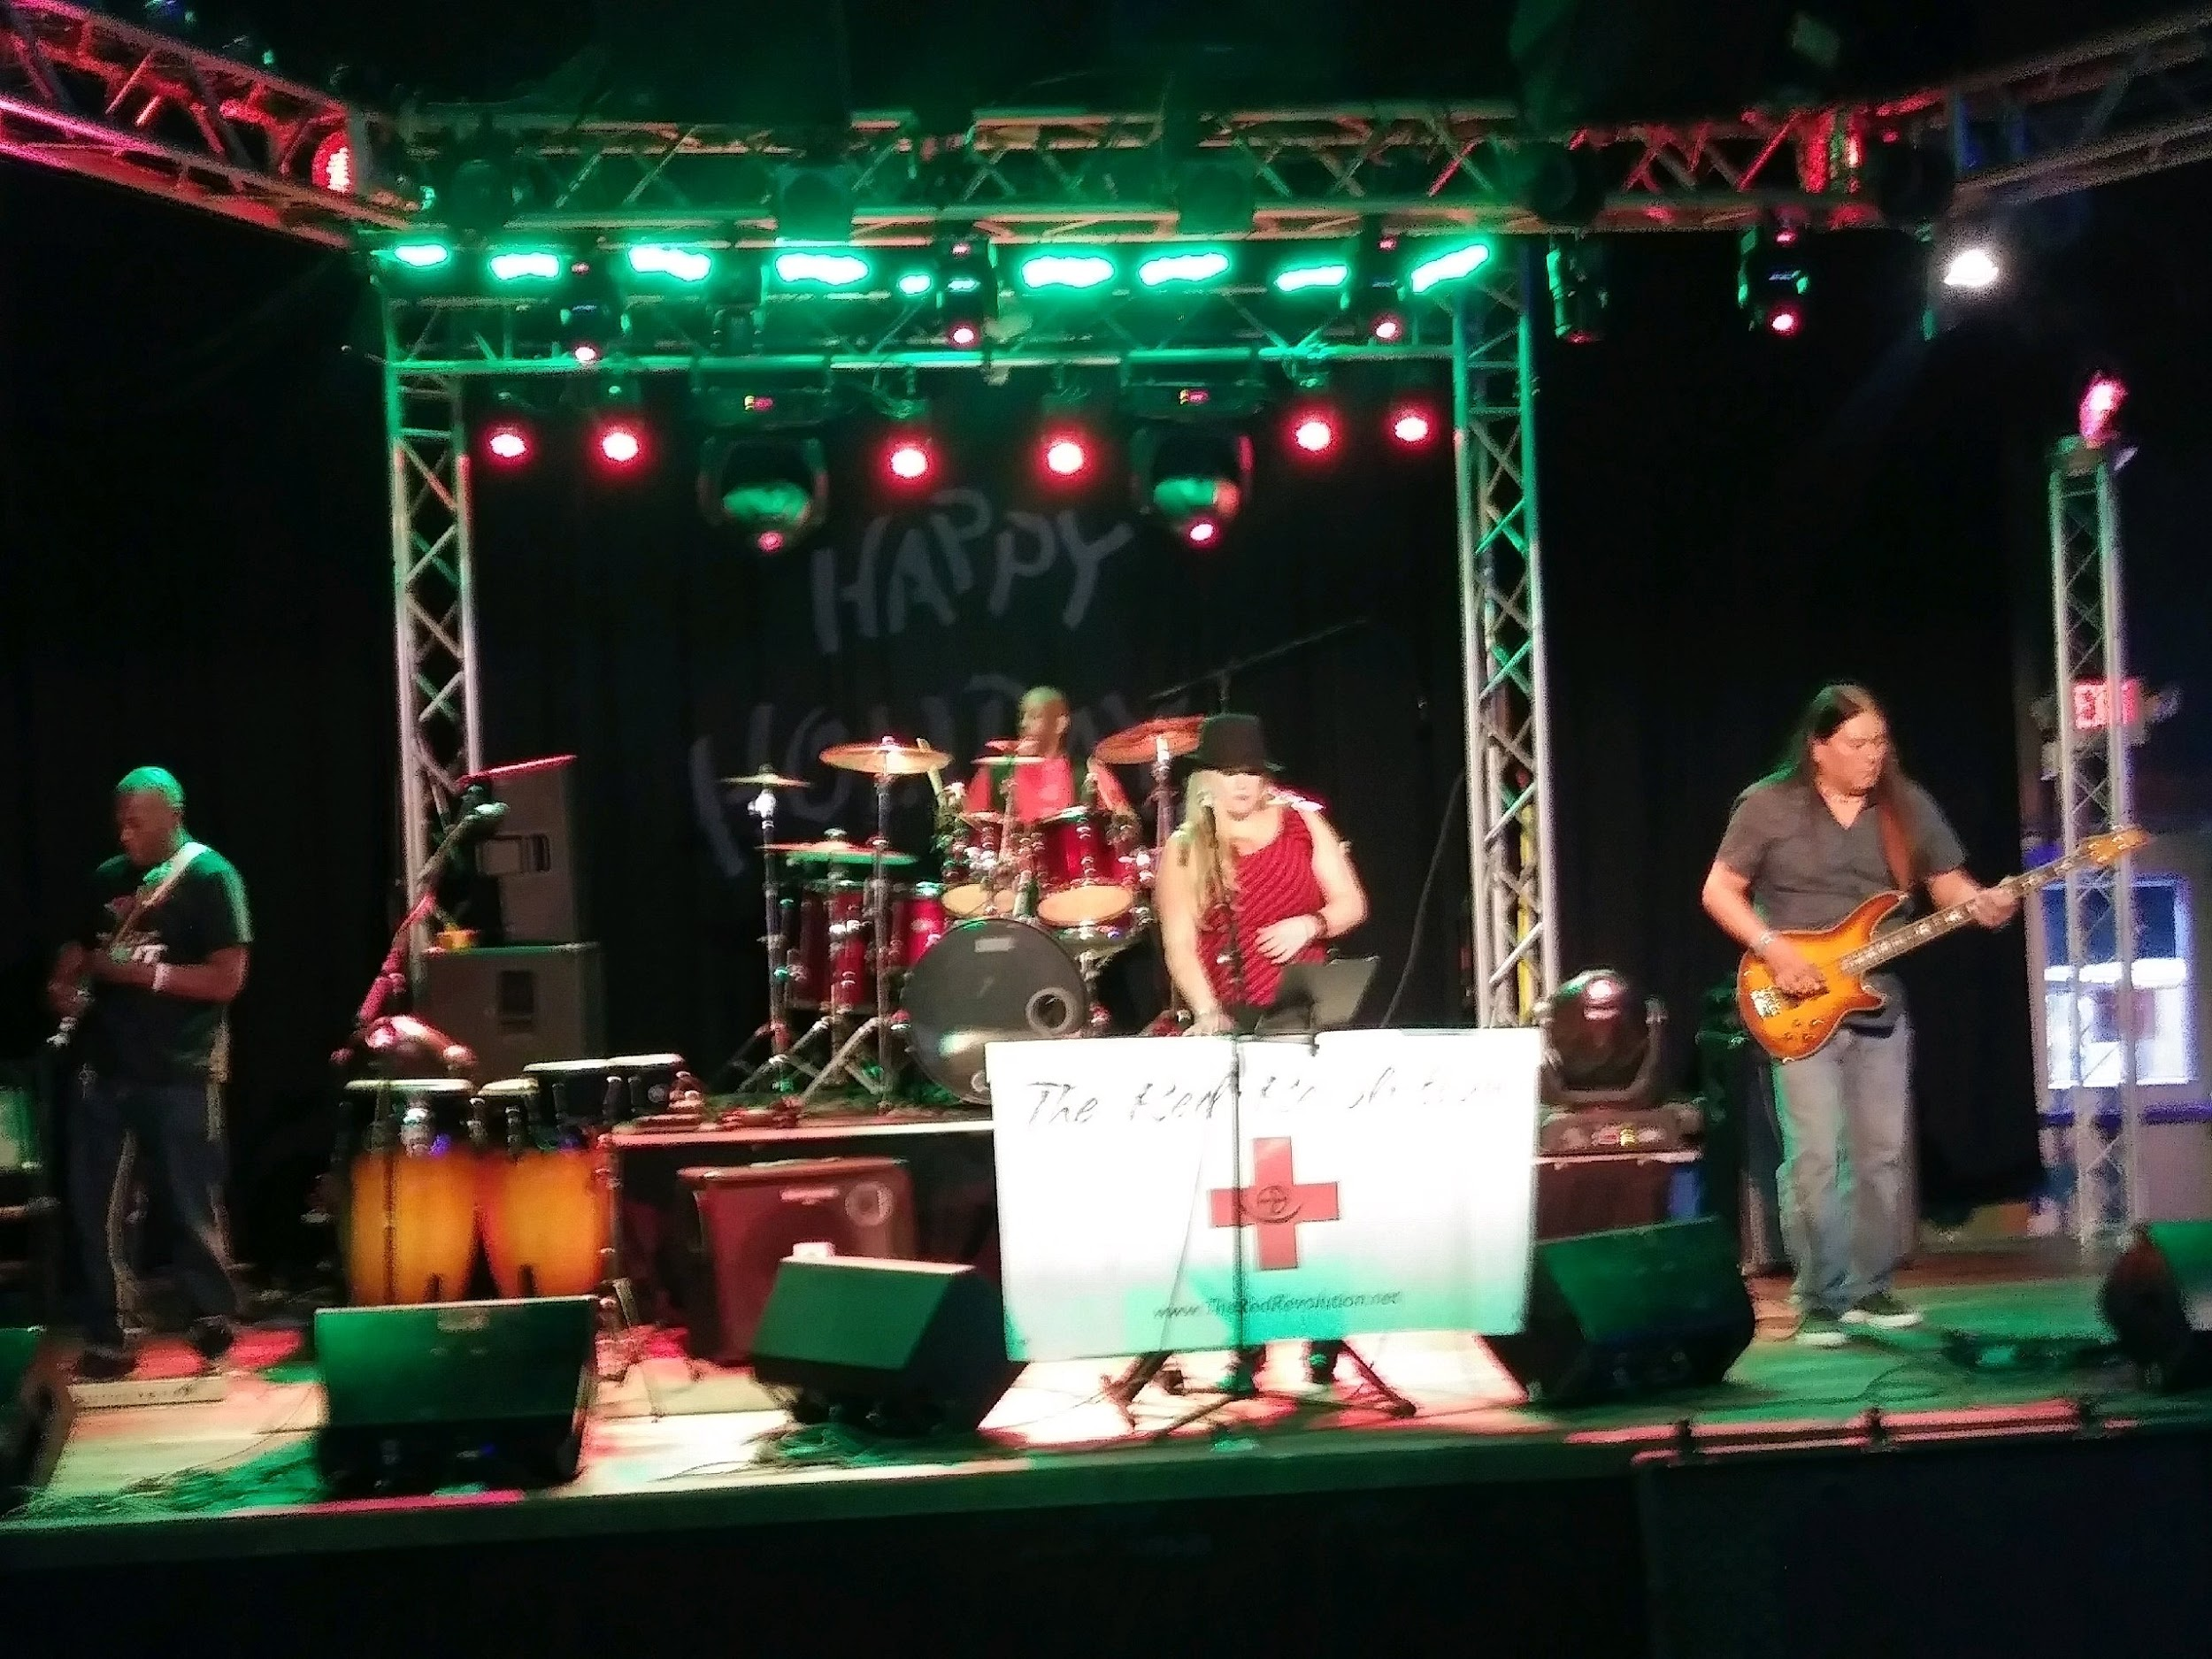
December
December 11th: Red Rebel VIP Charity Party to benefit FOCUS & Plymouth Crossroads from Queen City Collaborative: Received $200 Donation from Cellino Plumbing, $100 Lancaster/Depew Rotary. Silent Auction Items from Buffalo Sabres, a Private Sailing Excursion, Diamonds from Airport Jewelers, B&B Giveaway Oscars Buffalo. Raised over $5,000, with half benefiting FOCUS and half to Plymouth Crossroads

Slide 15

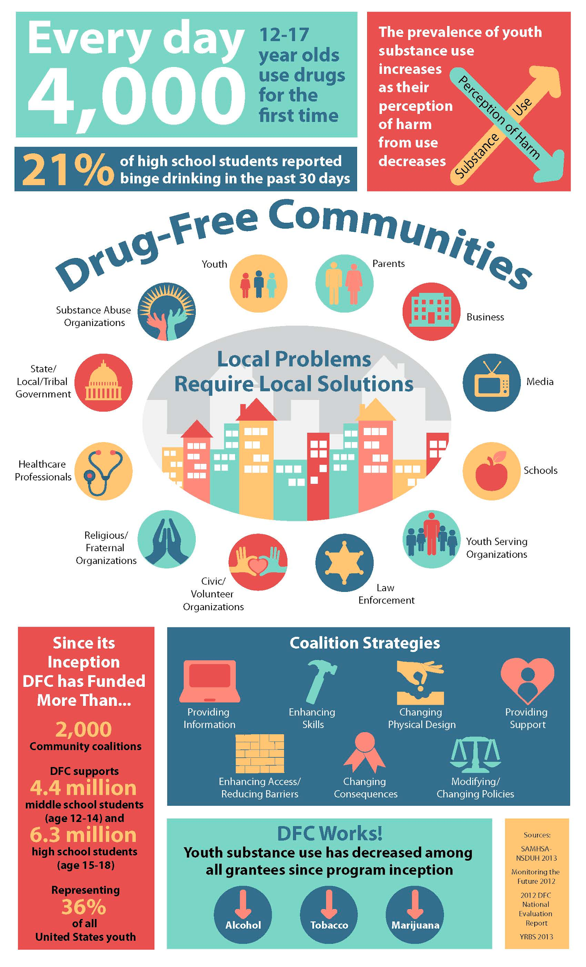

December
December 27th: FOCUS RECEIVES FEDERAL ANNOUNCEMENT FROM WHITE HOUSE OFFICE OF DRUG CONTROL POLICY IT HAS BEEN AWARDED $125,000 PER YEAR FOR FIVE YEARS! ($625,000 TOTAL)

Slide 16










Thank You to Our Partners
Prince of Peace Lutheran Church

