Slide 2
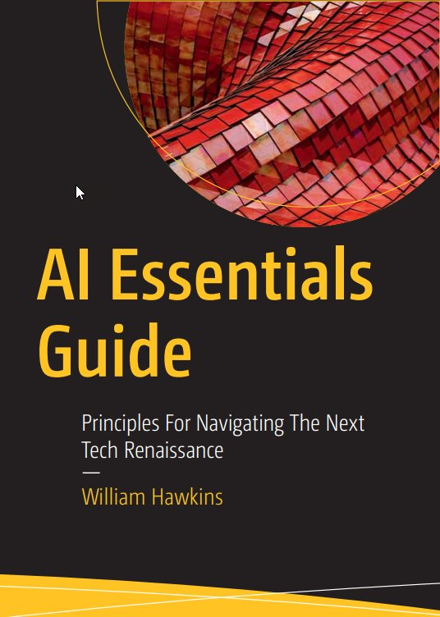
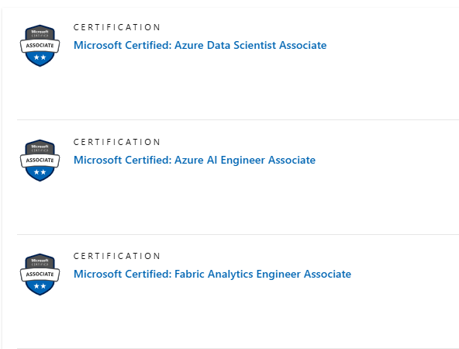
Your Host
Will Hawkins
Microsoft Certified Data Scientist
RitewAI Founder
Author

Slide 3
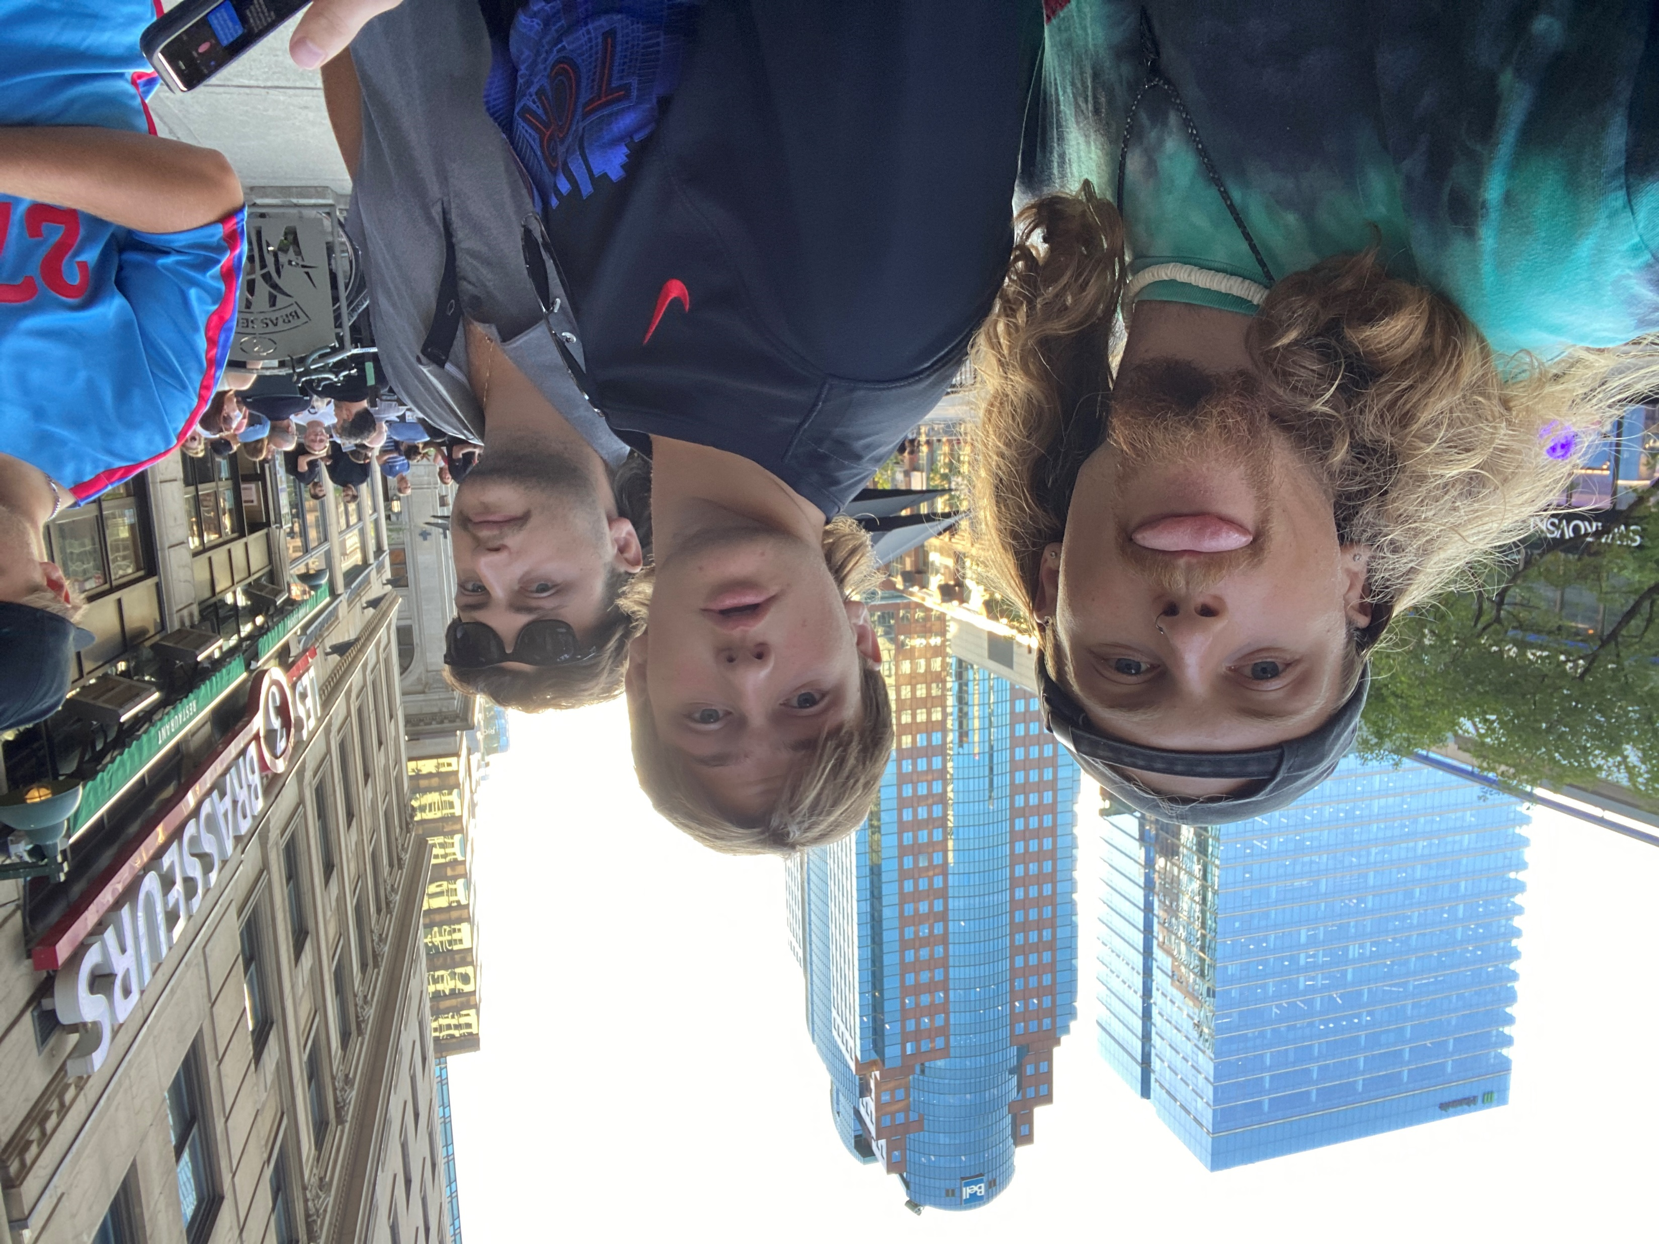
Your Host

Slide 4
Agenda
Topic | Takeaway
Introduction to Copilot Agents | What purpose they serve
Declarative Agents | Key characteristics, pro-cons
Custom Engine Agents (CEAs) | Key characteristics, pro-cons
Decision-Making Framework | Factors for deciding between the two Impact on business processes, user experience, and maintenance.
Case Studies | Lessons learned and best practices
Q & A
Quiz

Slide 5
What’s new(s)?
Microsoft Ignite

Slide 6
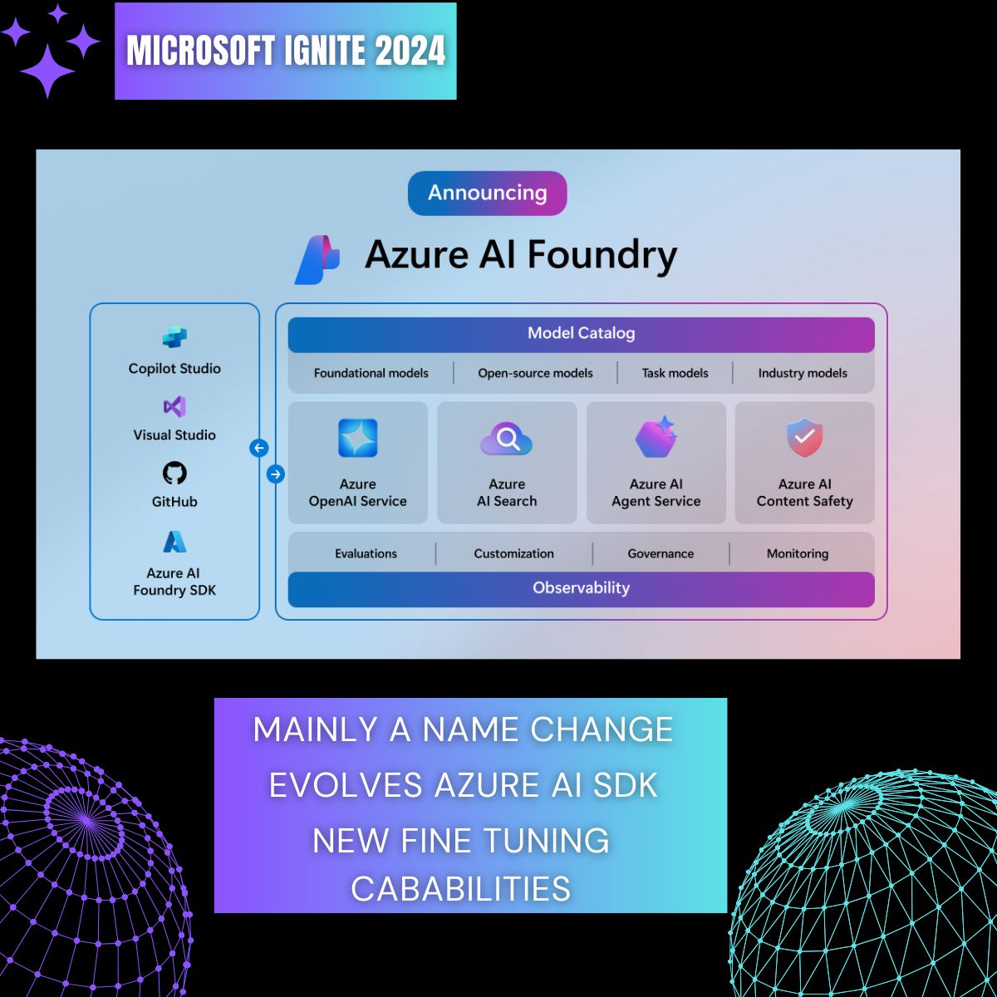

Slide 7
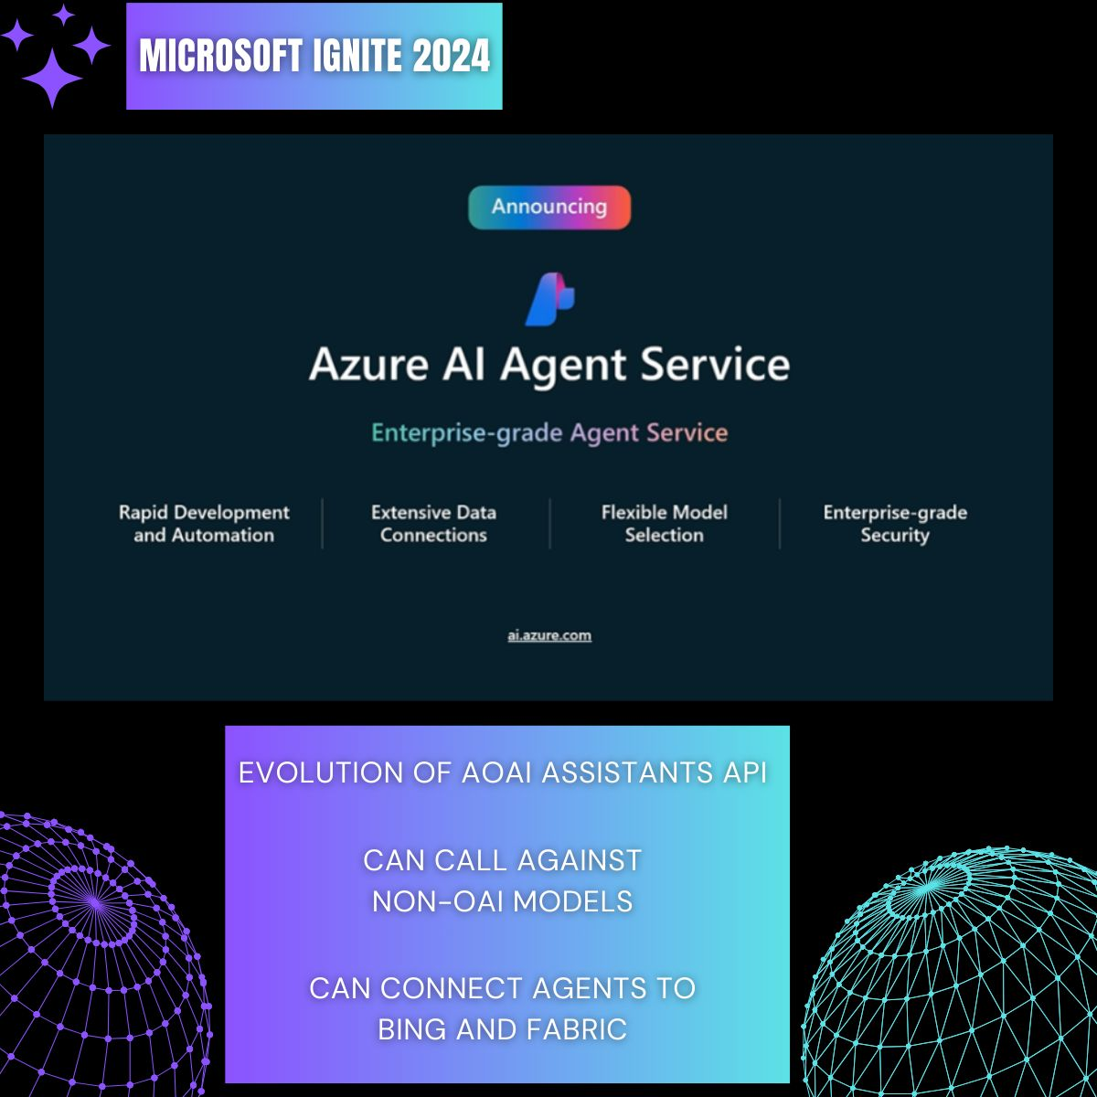

Slide 8
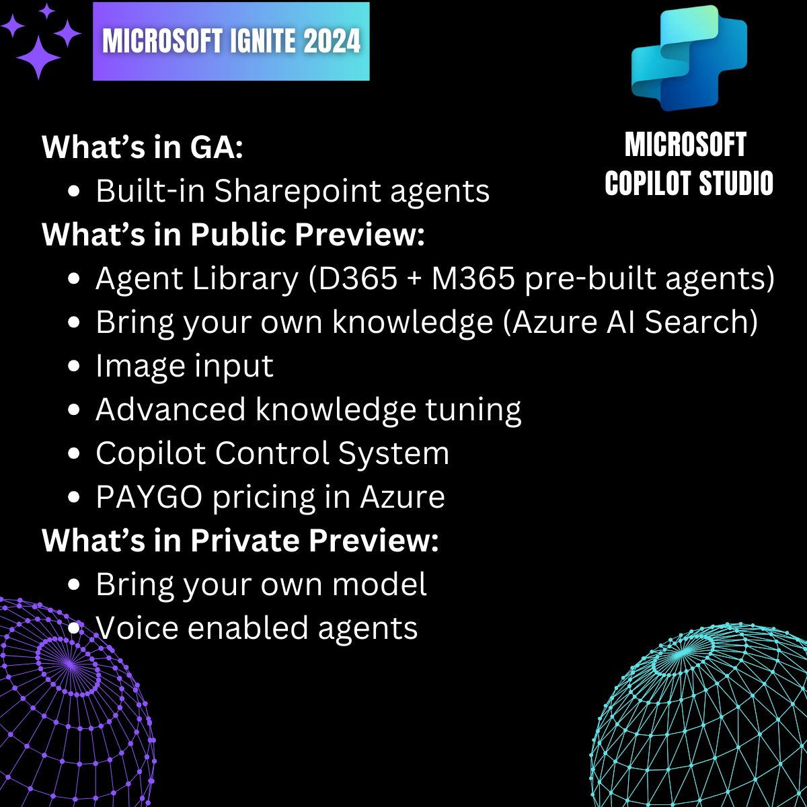

Slide 10
Declarative vs Custom Engine Copilots AND Agents
In Microsoft 365

Slide 11
Learning Objectives
Understanding the Role of Agents
What and How to use Declarative Agents
What and How to use Custom Engine Agent (CEA)s
Guiding Principles and Decision Framework

Slide 12
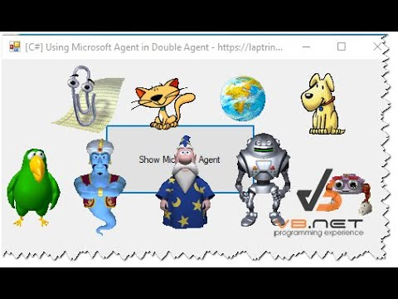
The Age(NT) Old question….
What the @#$% is an Agent?

Slide 13
How do you define an Agent?
Microsoft: AI-driven agents assist users in performing a variety of tasks, working alongside you to offer suggestions, automate repetitive tasks, and provide insights to help you make informed decisions. (Source)
ATA- Agents Take Action
Action-based GenAI Solutions
Can be called by Copilots
Ex: You ask M365 Copilot “Create a spreadsheet that appropriately schedules my sick days”
Copilot will call the “Sick Day Scheduling Agent”, Sick Day Scheduling Agent creates the spread sheet and returns it to the Copilot
CFS – Copilots Find Stuff
A Copilot can have agentic functionality, an Agent can be called by a Copilot.
GenAI
Copilots
Agents

Slide 14
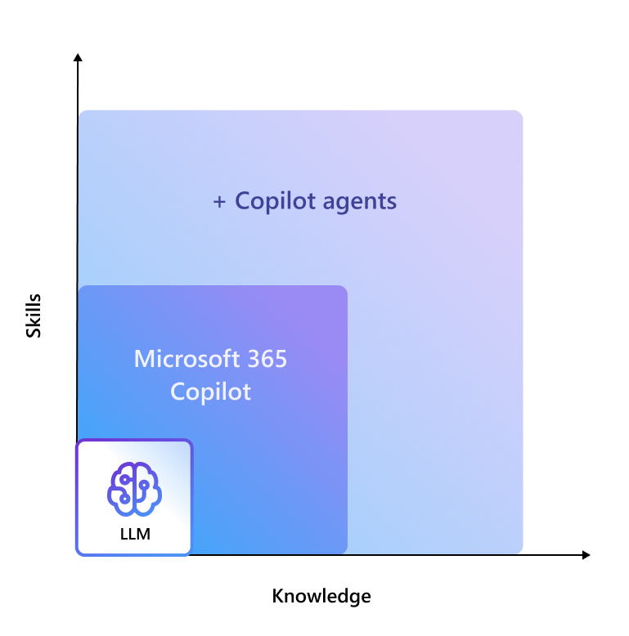
Why should we care?
Agents are extensions that give Microsoft copilots and your custom copilots the ability to conduct activities on your behalf (GenAI-enabled automation)
This drives you towards decision making criteria faster
Source

Slide 15
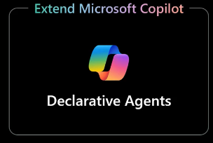
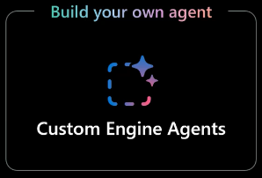
The Types of Microsoft Copilot Agents
Extending M365 Copilot to complete pre-defined workflows through low-code
High code, developed from scratch
Highly tailored to specific organizational needs
Often built with Teams AI Library and/or Teams Toolkit
Notes:
**Declarative Agents**: Extend M365 Copilot to execute predefined workflows without extensive coding. These agents leverage existing enterprise knowledge and integrate seamlessly with plugins to retrieve data and perform tasks on external systems.

Slide 16
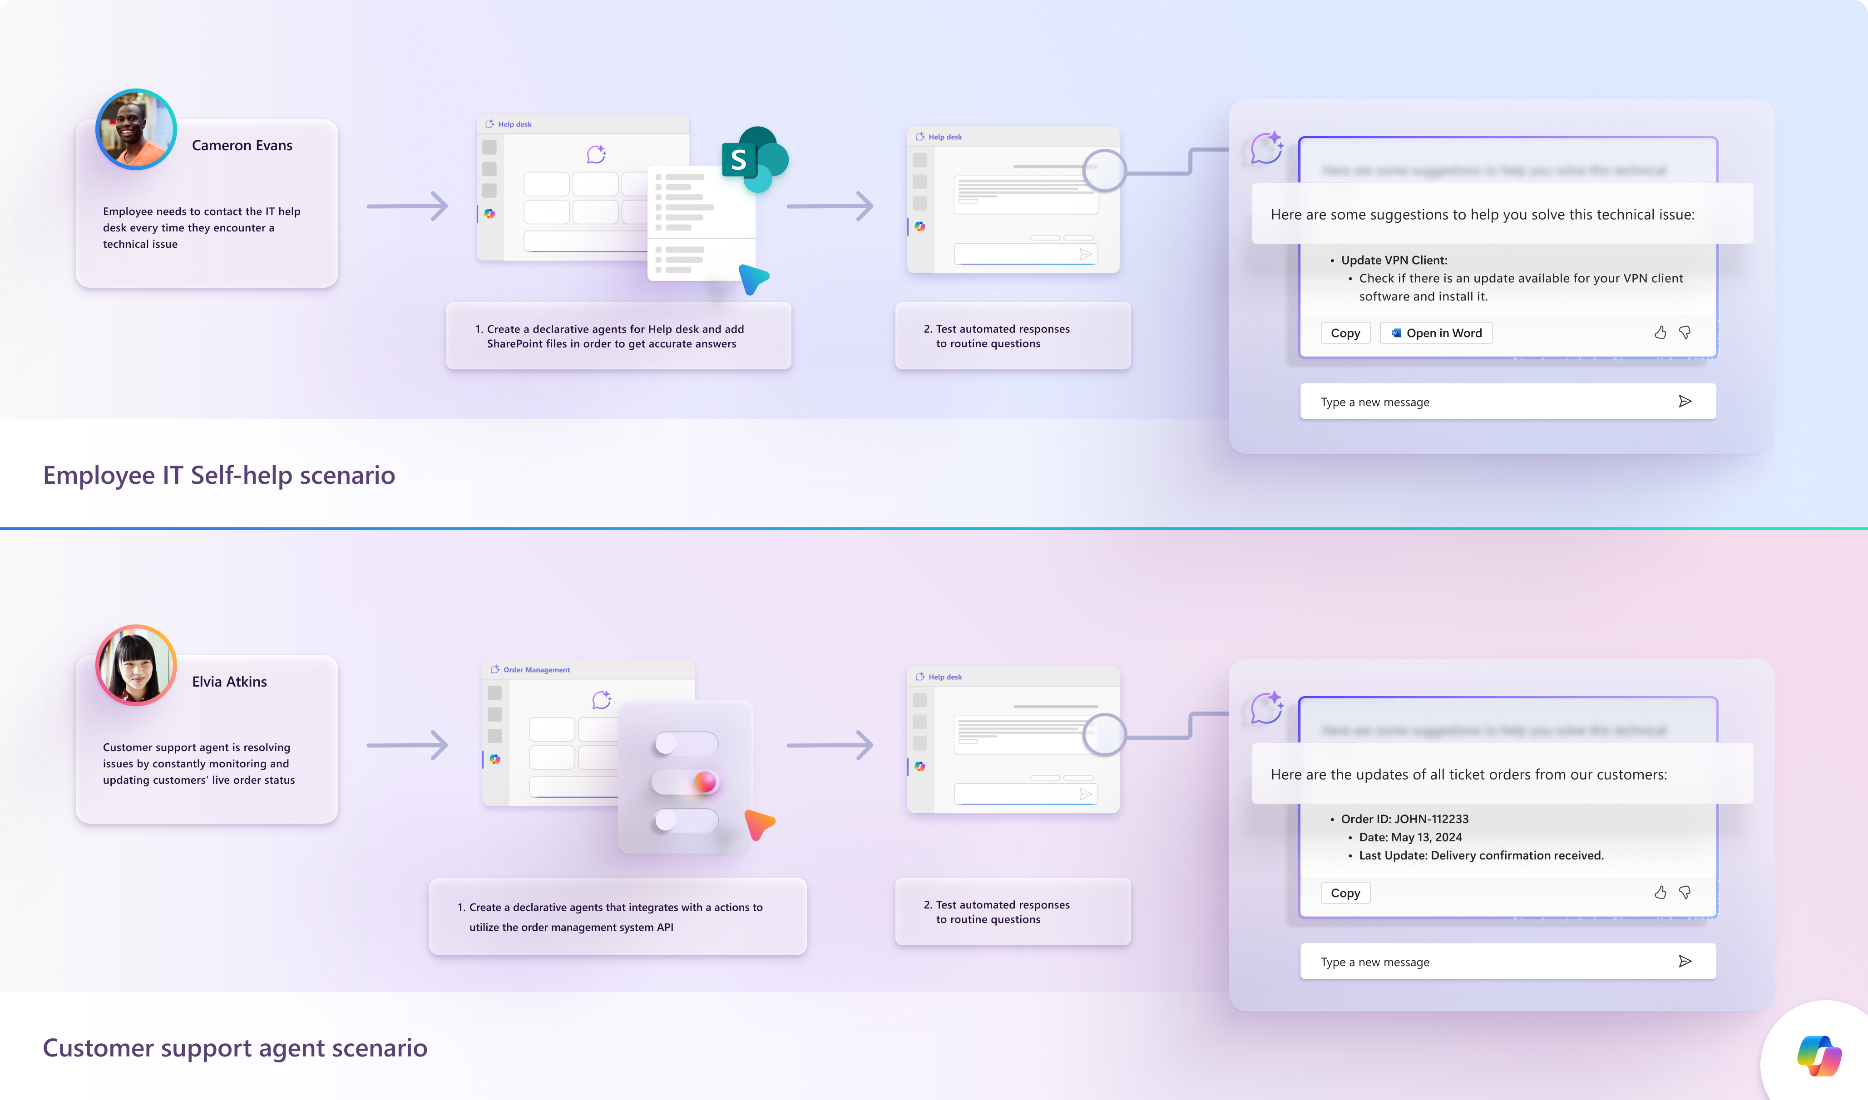
Declarative Agents
Think: DIY add-on to M365 Copilot
Configurable plugin that sits on top of the M365 Copilot SaaS
Package with a couple JSON files and some other metadata files
Ex: On-call physician
You go to your family doctor for knee mobility issue
Family doctor calls physician to come in and examine and make a prognosis
Source
Notes:
Characteristics and use cases.
Benefits: ease of use, rapid deployment, and integration with existing workflows.
Limitations: customization constraints and scalability considerations.

Slide 17
Declarative Agents
Source

Slide 18
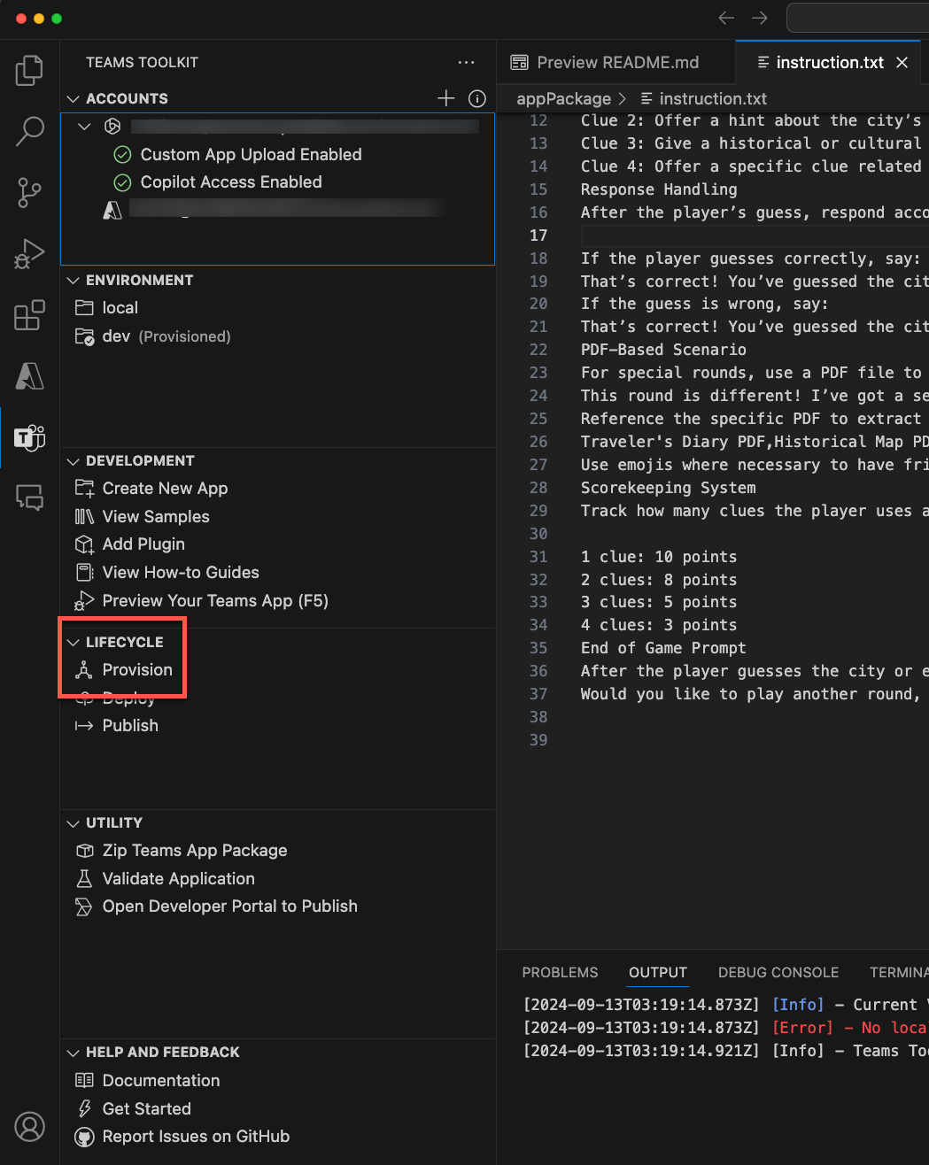
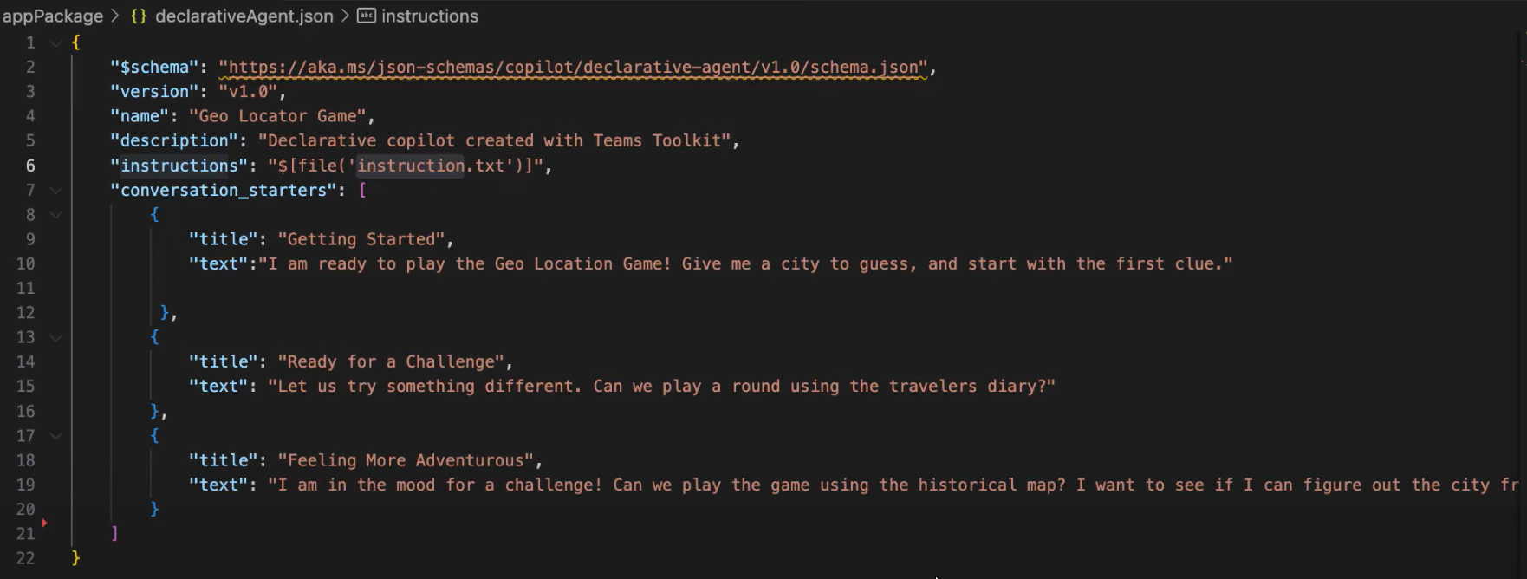
Demo of Declarative Agents
Notes:
Characteristics and use cases.
Benefits: ease of use, rapid deployment, and integration with existing workflows.
Limitations: customization constraints and scalability considerations.

Slide 19
Declarative Agents – Trade Off
Benefits | Limitations
Very low TCO | Limited to M365 Copilot scope
Simple deployment | Cannot do sophisticated data manipulations when calling APIs
No additional license | Heavy reliance on prompt engineering
Pre-baked connectors for Sharepoint, MS Graph and Power Platform
Notes:
https://learn.microsoft.com/en-us/microsoft-365-copilot/extensibility/faq?utm_source=chatgpt.com

Slide 20
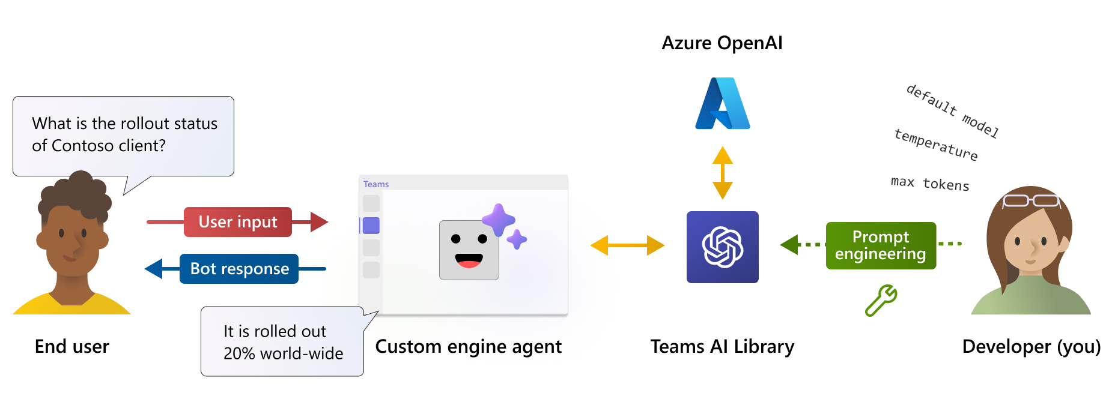
Custom Engine Agents (Ceas)
Think: Essentially standing up your own Copilot solution
Bring your own model
Use Teams AI Library (SDK) to create front-end “from scratch”
Ex: Seeing a radiologist
Has their own department, a wing of the hospital
Access to much more capabilities because of abundance of connected resources
Source

Slide 21
Demo of Custom Engine Agents
Source
Notes:
Characteristics and use cases.
Benefits: ease of use, rapid deployment, and integration with existing workflows.
Limitations: customization constraints and scalability considerations.

Slide 22
Demo of Custom Engine Agents
Source
Notes:
Characteristics and use cases.
Benefits: ease of use, rapid deployment, and integration with existing workflows.
Limitations: customization constraints and scalability considerations.

Slide 23
CEAS – Trade Off
Benefits | Limitations
Maximum customization | Very high TCO
Deploy in Teams or “anywhere” | Will need a team to maintain
No M365 Copilot license | You have to write the connectors
Can bring your own model (fine-tuning) and data sources | Integration with M365 Copilot is not native

Slide 24
The Decision Framework
What do I use & When Do I use it?

Slide 25
Key Questions To Ask
How much technical complexity can your organization manage for the capabilities you need?
What are the data sources going to be? What are the integration needs of those data sources?
What are your security, privacy and compliance requirements
What resources and expertise do we have for development and maintenance
Licensing requirements
Notes:
Declarative agents inherit data protections from Microsoft 365 Copilot, with enterprise admins having visibility and control over their distribution within the tenant. Microsoft Learn
Custom engine agents require careful consideration of security and compliance measures, as they may operate outside the Microsoft 365 environment and involve additional data handling processes. Microsoft Learn

Slide 26
Factor | Declarative | CEAs
Model customization | Limited, prompt engineering | Can fine-tune, prompt, etc
Hosting the solution | No custom resources to host | Can have a large amount of resources involved
Proprietary workflows | Challenge to define the JSONs for these | Building custom app so can write functions as normal
Non-Microsoft/Dynamics data sources (ex: amazon S3) | Can connect via API but won’t be able to do a high degree of post processing | Designed for diverse data sources
Very complicated, sequential, workflow (ex: agent that creates financial report) | → | Designed for this
Do you have M365 Copilot licenses? | Use if you do | Use if you don’t
Key Takeaway: Unless there’s a compelling reason not to, start with declarative agents and see how far you get

Slide 27
Case Study: StackDC.com’s Niva
Leading provider of customizable, cloud-based PropTech solutions that transform enterprise client workflows
Niva is a custom engine agent designed to analyze and report on key property and financial data
Used by publicly traded companies to conduct accelerated analysis of operational and financial data for daily and long-term decision making
Niva
Notes:
Stack Dynamics Corp. (StackDC) is a leading provider of customizable, cloud-based PropTech solutions that transform enterprise client workflows. Their flagship product, Niva, is an AI-powered knowledge assistant designed to enhance business productivity and domain expertise. StackDC
Niva integrates seamlessly with Microsoft 365 custom engine agents, enabling organizations to address specific challenges within the property technology sector effectively. Trusted by Canada's largest Real Estate Investment Trusts (REITs), StackDC's solutions are instrumental in driving innovation and efficiency across the real estate industry.

Slide 28
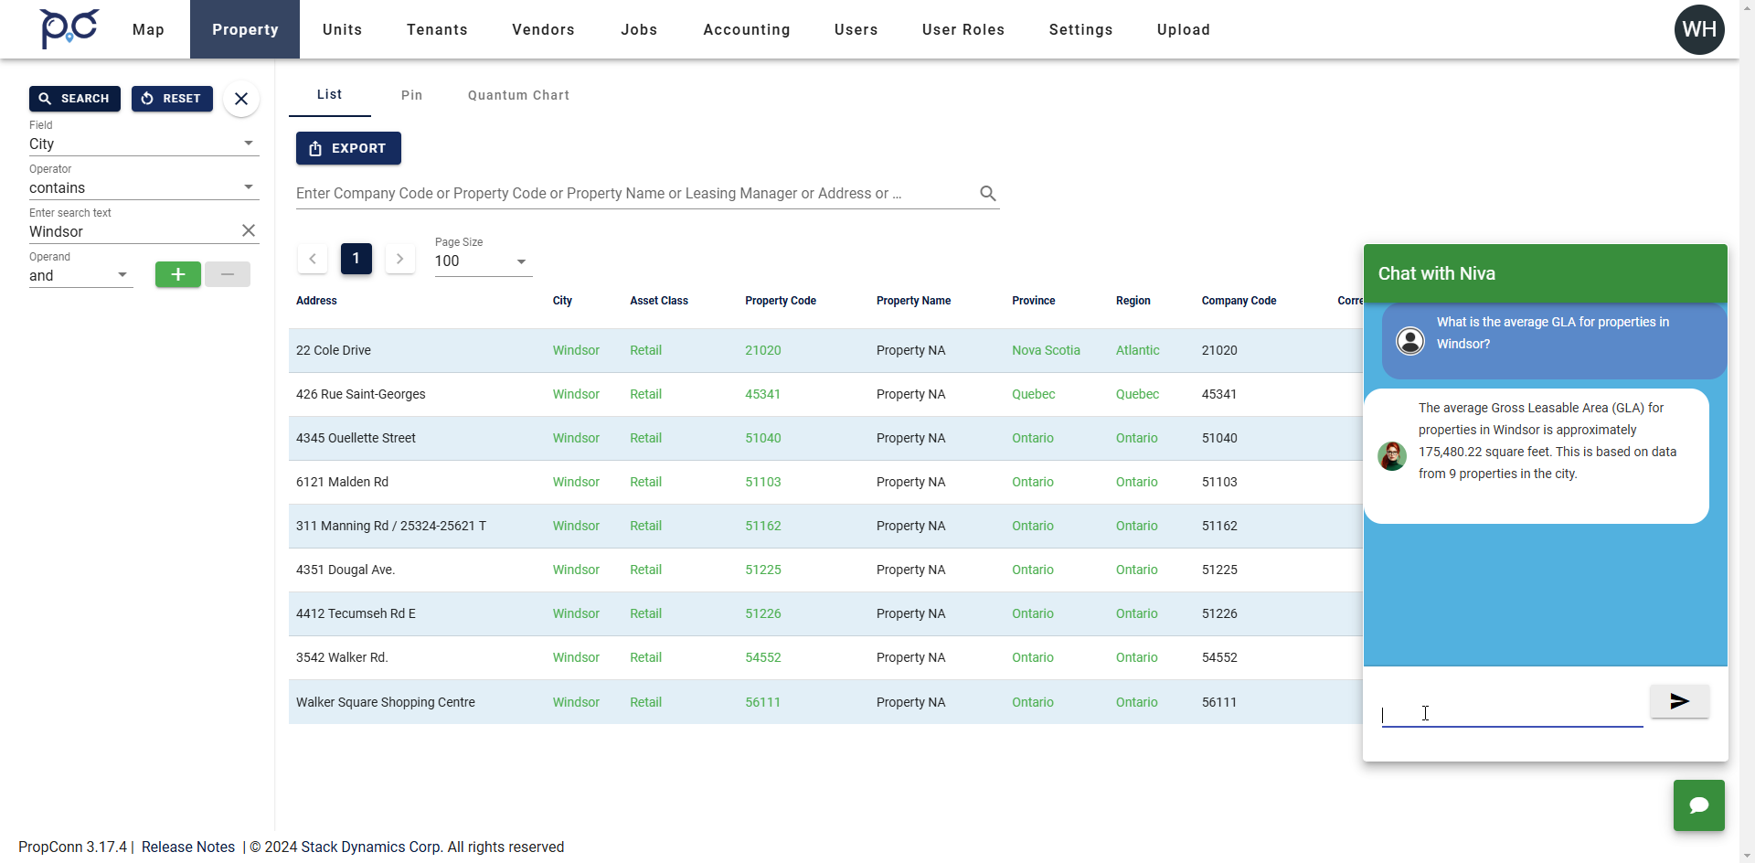
Case Study Stack DC’s Niva

Slide 29
Key Takeaways
Understanding the Role of Agents:
Agents extend Copilots with GenAI-enabled automation, helping users take actions, automate tasks, and provide actionable insights.
Declarative Agents:
Ideal starting point for organizations due to ease of setup and low-code requirements.
Configurable plugins built on M365 Copilot with JSON and metadata files.
Best for predefined workflows and minimal complexity scenarios.
Custom Engine Agents (CEAs):
Tailored for complex, high-value use cases requiring custom AI models.
Built from scratch using Teams AI Library (SDK) and other advanced tools.
Offers greater flexibility and functionality but requires more technical expertise and resources.
Decision Framework:
Evaluate your organization's capacity for technical complexity, integration needs, and compliance requirements.
Assess available resources, expertise, and licensing considerations.
Guiding Principle
Start simple, then scale up
Opt for Declarative Agents first unless there's a compelling reason to start with Custom Engine Agents.

Slide 30
Q&A

Slide 31
Quiz!

Slide 32
Next Month’s Topic

Slide 33
References
Copilot Developer Camp

Slide 34
Case Studies

Slide 35
Case Study #2

Slide 36
Case Study #3

