Slide 1


Welcome!

Slide 2
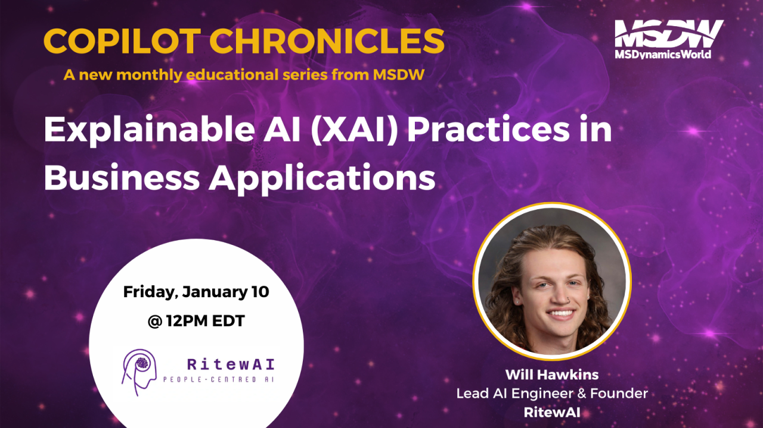

Slide 3

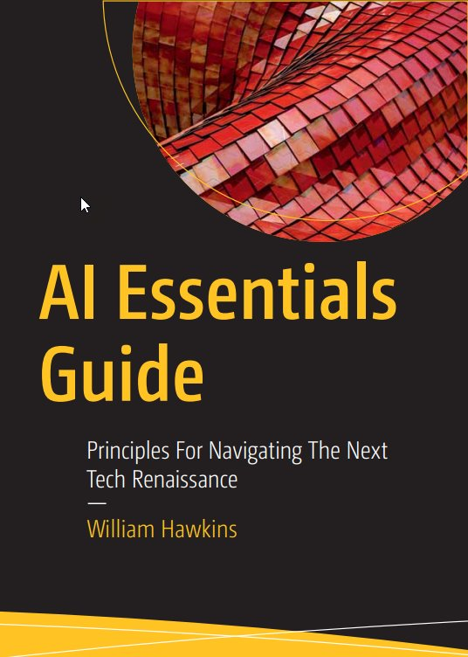

Your Host
Will Hawkins
Microsoft Certified Data Scientist
RitewAI Founder
Author

Slide 4




Your Host

Slide 5
Agenda
Topic | Takeaway
Introduction to Explainable AI (XAI) | High-level overview
The Importance of XAI in Business Applications | Key considerations
Common Challenges in Achieving Explainability | Usual suspects to watch out for
Best Practices for XAI | Key strategies and approaches
Implementing XAI in Dynamics 365 and the Power Platform | Main tools for success and how to solution them
Case Studies | Real world examples of XAI in action
Q & A
Quiz

Slide 6
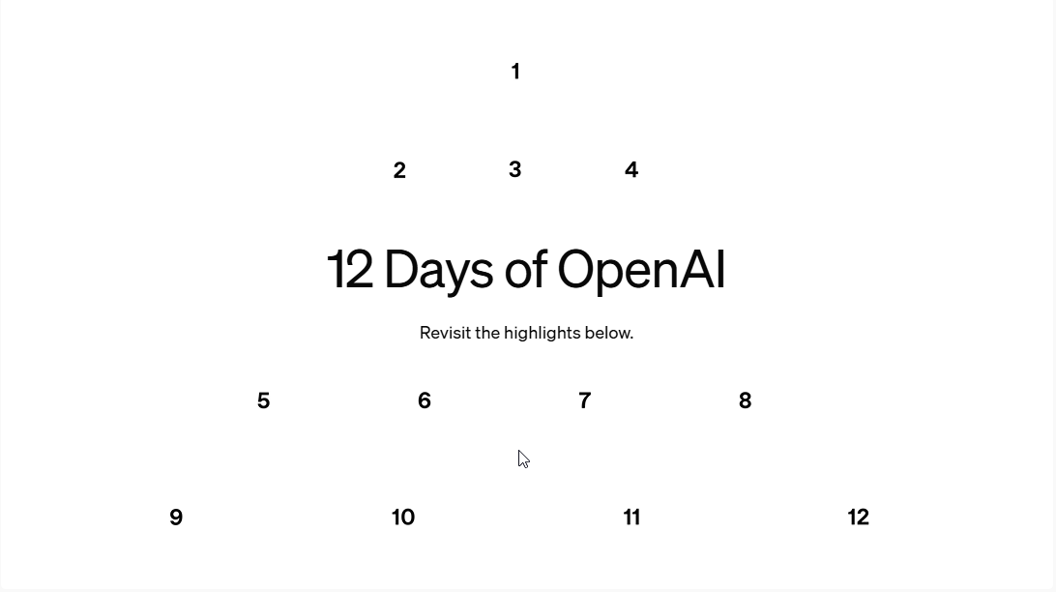
What’s new(s)?
12 days of OpenAi

Slide 7

O1 goes GA!
Advanced problem-solving model
Uses chain of thought so you can follow how it got to its answer
Best used for strategic, deep-thinking questions
Available on Azure

Slide 8

Sora goes live!
Creates videos from text
Can generate videos up to 1080p resolution, up to 20 sec long, and in widescreen, vertical or square aspect ratios
Can upload an image and make a video from it

Slide 9

Advanced Voice takes on a new look

Slide 10

Finally, I can organize!

Slide 11
Explainable AI (XAI) Practices
In Business Applications

Slide 12
Learning Objectives
Solid understanding of Explainable AI (XAI)
Why its important in Business Applications
How to implement it in D365 and PP
XAI Best Practices For Your Organization

Slide 13
Let’s poke the elephant in the room….
What is Explainable AI (XAI)?
A set of techniques/approaches designed to make the decision-making processes of AI systems more transparent and understandable to humans

Slide 14
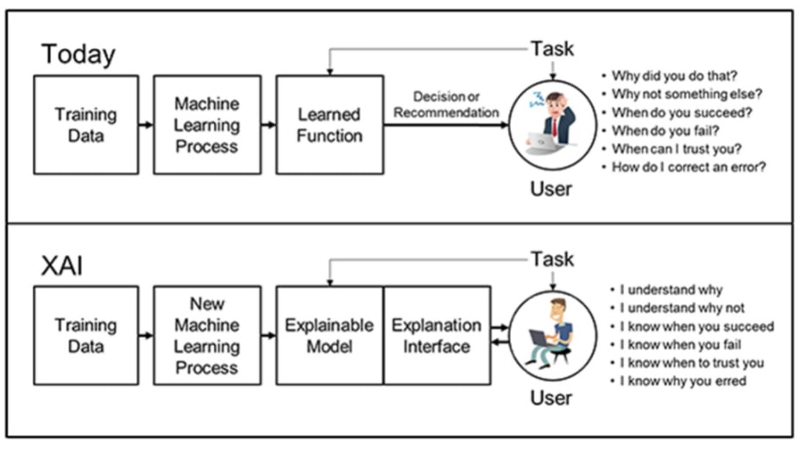
Why should we care?
Enables humans to build confidence in AI-generated output
Bridges the gap between “black box” nature of AI algorithms and the need for users to trust, interpret, and validate AI-generated outcomes
Source

Slide 15
Why is this important in Business Applications?

Slide 16

Trust & Accountability
Need to build reliability with users, customers and regulators
#1 problem with AI adoption isn’t lack of enthusiasm, lack of understanding
When people understand how AI arrives at conclusions, they are more likely to accept and rely on those decisions.
Having XAI ensures decision accountability
  Power Automate workflows can include human approval steps for high-stakes decisions, reducing the risk of errors.
Notes:
Mention building reports, there’s a period of learning to trust the report

Slide 17


Compliance
This will become a legal requirement
EU AI Act:
  High-Risk Systems: mandatory documentation of algorithms and data used in training to ensure traceable and explainable output
US Secure AI Act:
  Organizations must demonstrate compliance with federal anti-discrimination laws
Canada’s AIDA:
  Organizations must maintain detailed logs of AI outputs and their explanations for regulatory reviews
GDPR Article 22
  Individuals have the right to an explanation when decisions are made solely by automated systems
Notes:
Legal requirement especially if system is deemed in ‘high risk’ situation

Slide 18

Risk mitigation
Clear chain of thought or decision criteria makes it easier to debug, identify biases or other unintended consequences
Ex: In CI-J, XAI can identify if customer segmentation models disproportionately favor high-income groups
Unexplainable models can produce unpredictable results, posing risks to operational efficiency.
Example: XAI ensures that lead scoring logic in Sales 365 reduces false positives.
Notes:
By understanding why a model produces certain outcomes, businesses can fine-tune their systems to achieve more reliable performance.

Slide 19

Business Growth
Organizations that establish digital trust among consumers through XAI are more likely to see their annual revenue and EBIT grow at rates of 10 percent or more
Companies that attributed at least 20 percent of EBIT to their use of AI—are more likely than others to follow best practices that enable explainability.
Builds confidence in and outside of the organization
  D365 Customer Service Copilot provides reasons for recommendations, increases agent confidence which improves customer service
Digital trust equals accelerated AI adoption because users know the why
Notes:
Example: Power BI visuals can illustrate factors behind customer churn predictions, making it easier for marketing teams to act on insights.

Slide 20
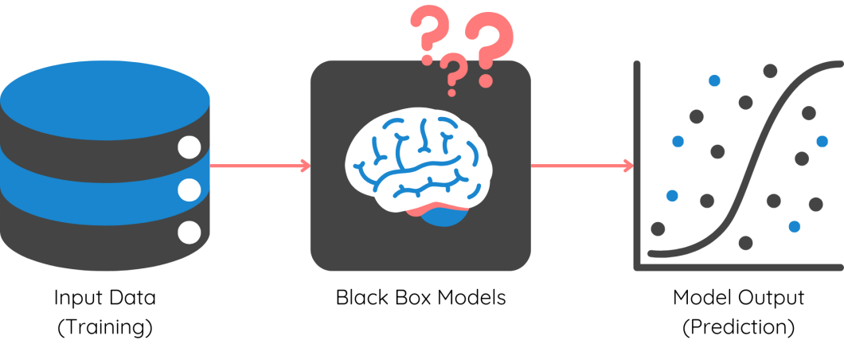
In Short…
XAI is about maximizing benefit of new tech while acknowledging and respecting risks involved
Knowing how models come to conclusions, being able to explain their thought process and being clear on what data it used is how trust is built
Notes:
Talk about patient discrimination case in the US and how that wasn’t the developer’s fault

Slide 21
Common Challenges

Slide 22

Model Complexity
Algorithms like neural networks extremely statistical
  Complex models use millions, billions and trillions of parameters making tracing impossible
Results in often functioning as a ‘black box’ to humans
Advanced models are capturing nonlinear relationships which are difficult for humans to conceptualize
  A CNN used for image recognition identifies patterns that may not correspond to human logic, such as minor pixel variations indicating critical features.
Try to use simpler models if possible
  Ex: decision tree or linear regression
Balance accuracy with interpretability
  If you can’t explain your 99.9% accurate model, how do you know its not overfitted?
Notes:
Discuss how these challenges impact the adoption of AI in Dynamics 365 and Power Platform.

Slide 23

Data volume
Models evolve over time as they process more data
Decision paths become moving targets
  Example: A recommendation system updates based on user interactions, making it harder to reproduce and explain past decisions.
Data drift
  Continuous learning can lead to overfitting on recent data
  If this is drastically different then what model was trained on, you have a new model
  A sales forecasting model in Dynamics 365 may overemphasize recent spikes in demand, skewing future predictions.
Model versioning
  Track changes between model version to retain ability to reproduce past decisions
Periodic revalidation
  Regularly validate updated models against a baseline to ensure explainability is not compromised.
Notes:
Example: Use Azure Machine Learning’s model registry to archive versions of models, ensuring previous outputs can be explained even after updates.
Example: Conduct quarterly reviews of Power Automate AI workflows to verify they meet business requirements.

Slide 24

Diverse Stakeholder Needs
Customers have one definition of ‘explainable’
Technical teams have another definition of ‘explainable’
Regulators need tailored explanations
Varied levels of technical expertise
Varied industry and/or regional expectations of AI explainability
  Example:
    In healthcare, explainability must focus on patient safety and clinical decision support
    In finance, focus may be on bias mitigation and regulatory compliance.
Tailored explanations
  PowerBI report with dashboard for biz leaders, a dashboard for regulators, technical teams and end-users
Notes:
Everyone’s got a different definition of explainable

Slide 25
XAI Best Practices

Slide 26

Feature Importance
Identify and weight which factors most influence AI output
Does the model base its response to the user on location information?
Does it rely on specific user information like permissions, company role?
Improves auditability
Identify bias early
Real-time insights into model performance
Notes:
Everyone’s got a different definition of explainable

Slide 27

Local Explanations
Use specific interactions to isolate variables
Allows you to explain the cause and effect relationship of inputs and AI model outputs
Focus on why AI is designed to return the output it returns so you can identify these major factors and find their relationships to the model output.
Notes:
For example, say you have a junior and senior analyst using an AI-insight tool, do they receive the same output? Is there censored data that only the senior analyst can see?

Slide 28

Visualizations
Create visuals that help interpret model output
  Graphs of document references made by an LLM
    How many times it referenced a document
    Which sections of the document
    Correlate this with user feedback
Simplifies relationships between contributing variables
  Makes AI processing of multiple variables and interactions comprehensible
Enables interaction
  Allow users to explore how changing inputs affect outputs
Reduces ‘black box’ perception
  Visuals increase confidence in how AI made its choices
Notes:
Everyone’s got a different definition of explainable

Slide 29

Rule based systems
Pre-check models with simplified, transparent decision conditions
Rules that guide AI decisions
  Ex: if you are using a CNN to identify whether someone has access to a building, you might have an algorithm that is run first to check if the user is wearing glasses and if they are, asks the user to remove them to ensure a higher accuracy when making the access scan
RBS act as controls to simplify the build up or follow up steps after the execution of an AI model
Makes decision path of model transparent
Notes:
LIME (Local Interpretable Model-agnostic Explanations): This is essentially an algorithm for automating local explanations. It is a model that provides interpretable explanations for individual predictions made by any machine learning model. It is an AI that simplifies the output of a more complex AI to understand its decision process. Kind of cool or weird, whatever you prefer!
SHAP (Shapley Additive Explanations): An algorithm that automates feature importance mathematically. Another AI helping AI situation, so cool, or weird!

Slide 30
Implementing XAI
In Dynamics 365 and Power Platform

Slide 31

AI Builder
Create prompts that describe model output
Runs as part of a flow to create a description for how the model arrived at its conclusion
Notes:
Everyone’s got a different definition of explainable

Slide 32

PowerBI
Create decomposition trees to break down outputs into factors
  Ex: For customer churn, you can show how "average time on hold" or "support satisfaction scores" influenced the churn likelihood.
Notes:
Everyone’s got a different definition of explainable

Slide 33

Power Automate
Use human approval action to require human sign off on AI output
Action you add to a flow that requires a reviewer to approve AI-generated output before flow completes
Use flow run history to maintain logs of AI model output, output explanations and user feedback to improve future output
Notes:
Everyone’s got a different definition of explainable

Slide 34



Power pages, Dynamics 365 & Power apps
Embed descriptions or PowerBI visuals in portals, D365 dashboards or app interfaces to explain model predicted values
  Ex: A sales dashboard shows a lead’s score of 87/100. Next to the score, an explanation reads: "This lead's high score is due to high engagement with email campaigns, recent product inquiries, and a large potential deal size."
Notes:
Everyone’s got a different definition of explainable

Slide 35

Expert mode – azure ai
Azure Machine Learning Responsible AI Dashboard:
  Error analysis
  Feature importance
  Counterfactual what-if
  Causal analysis
Fairlearn Toolkit:
  Improve fairness using dashboards and mitigation algorithms.
Responsible AI Scorecard:
  Monitor model performance against business-defined targets.
Notes:
Provide resources or links to Azure’s Responsible AI documentation.Include a quick example of counterfactual analysis for understanding decision alternatives.
Azure Machine Learning Responsible AI Dashboard:
Error Analysis:
Pinpoints patterns in incorrect predictions to identify and address model weaknesses.
Example: Detects that errors disproportionately affect a specific customer segment, highlighting potential bias.
Feature Importance:
Reveals which features contribute most to AI decisions, improving transparency.
Example: Shows that "email engagement" and "purchase history" heavily influence churn predictions.
Counterfactual What-If:
Simulates how changing input variables would alter model predictions.
Example: Tests whether improving "support satisfaction scores" by 10% reduces churn risk.
Causal Analysis:
Analyzes cause-and-effect relationships to understand the impact of interventions.
Example: Determines if increasing "website visit frequency" directly improves lead conversion rates.
Fairlearn Toolkit:
Fairness Assessment:
Evaluates model outputs for biases against specific groups using dashboards.
Example: Highlights disparities in loan approvals based on demographic features.
Mitigation Algorithms:
Applies techniques to reduce unfair outcomes while balancing accuracy.
Example: Adjusts model weights to ensure fair treatment of underrepresented groups.
Responsible AI Scorecard:
Performance Monitoring:
Tracks metrics like accuracy, fairness, and bias over time, comparing them to predefined business targets.
Example: Ensures a fraud detection model consistently meets a 90% accuracy target without introducing bias.
Decision-Making Support:
Provides stakeholders with a clear view of whether models are ready for deployment or need further refinement.
Example: Alerts the team if a model fails to meet fairness benchmarks, delaying its release.

Slide 36

Case Study: Customer Service Chatbot
Model was failing to answer questions with the right information
Was pulling the wrong sources
Used an LLM to describe how the chatbot was recognizing the user’s intent (what they were asking for)
Description broke down why chatbot thought the user was asking for live agent when they just wanted help understanding documentation
Used this description to hypertune the model to better recognize the intent

Slide 37

Case Study: Analytics Agent
Agent was being used to make on the fly analytics
Ex: “Tell me the average GLA across properties in the Greater Toronto Area”
Users were skeptic of LLM calculations, would end up doing the data validation themselves, this created more work
Added in a module that would output the code the LLM was writing to make its calculation to ‘show its work’
Allowed user to verify the numbers without having to manually calculate everything
Established a new level of trust and adoption skyrocketed

Slide 38
Key Questions To Ask
How are we tracking XAI today?
Are we leveraging Microsoft XAI tools in our workflows?
Do we have mechanisms to monitor and mitigate biases in our AI models?
Notes:
Declarative agents inherit data protections from Microsoft 365 Copilot, with enterprise admins having visibility and control over their distribution within the tenant. Microsoft Learn
Custom engine agents require careful consideration of security and compliance measures, as they may operate outside the Microsoft 365 environment and involve additional data handling processes. Microsoft Learn

Slide 39
Key Takeaways
XAI Builds Trust
  Providing transparency into AI decision-making processes builds trust with users, stakeholders and regulators
Essential For Regulatory Compliance
  Regulatory frameworks like the EU AI Act and GDPR mandate transparency in AI
Drives Business Growth
  Organizations implementing XAI see higher AI adoption, better decision making and measurable revenue growth
Microsoft’s Got Lots Of Tools!
  AI Builder Prompts
  PowerBI
  Power Automate human approval action
  Azure Machine Learning Responsible AI Dashboard
  Responsible AI Scorecard
Tailored Explanations Matter
  Different stakeholders need different levels of detail
  Not everyone knows statistics
Start Simple and Scale
  Work with simple models to build out your XAI framework and use these learnings to design your more complex model flows

Slide 40
Q&A

Slide 41
Quiz!

Slide 42
Question 1
Why is Explainable AI (XAI) critical for regulatory compliance?
A
B
Helps organizations avoid fines by making AI outputs traceable and transparent.
Replaces the need for human oversight in AI decisions.
C
D
It ensures models are always accurate, even without monitoring
It reduces the cost of deploying AI models

Slide 43
Answer 1
Why is Explainable AI (XAI) critical for regulatory compliance?
A
B
Helps organizations avoid fines by making AI outputs traceable and transparent.
Replaces the need for human oversight in AI decisions.
C
D
It ensures models are always accurate, even without monitoring
It reduces the cost of deploying AI models

Slide 44
Question 2
Which tool in the Power Platform can be used to visualize prediction factors and break down AI outputs?
A
B
Power Automate
Power Apps
C
D
Power BI
AI Builder

Slide 45
Answer 2
Which tool in the Power Platform can be used to visualize prediction factors and break down AI outputs?
A
B
Power Automate
Power Apps
C
D
Power BI
AI Builder

Slide 46
Question 3
What is a practical way to ensure diverse stakeholders understand AI outputs?
A
B
Use a single, detailed technical report for all stakeholders
Tailor explanations and visualizations based on the audience’s needs and expertise
C
D
Avoid explaining outputs to minimize confusion
Focus only on technical teams for explainability

Slide 47
Answer 3
Why is Explainable AI (XAI) critical for regulatory compliance?
A
B
Use a single, detailed technical report for all stakeholders
Tailor explanations and visualizations based on the audience’s needs and expertise
C
D
Avoid explaining outputs to minimize confusion
Focus only on technical teams for explainability.

Slide 48
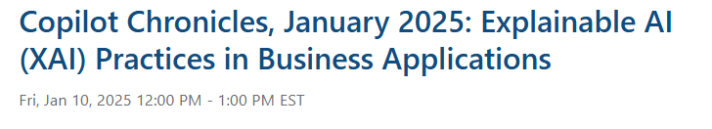
Next Month’s Topic

Slide 49
References
12 Days of OpenAI
How to use ChatGPT Projects: Your Ultimate Guide
Azure Machine Learning Studio Responsible AI Dashboard
Responsible AI Text Dashboard (Preview)
Responsible AI Image Dashboard
Responsible AI Scorecard
Model Interpretability
Fairlearn SDK
Why businesses need explainable AI—and how to deliver it

Slide 51
Case Studies

Slide 52
Case Study #2

Slide 53
Case Study #3

