Slide 1
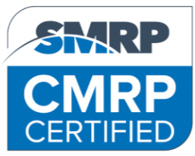
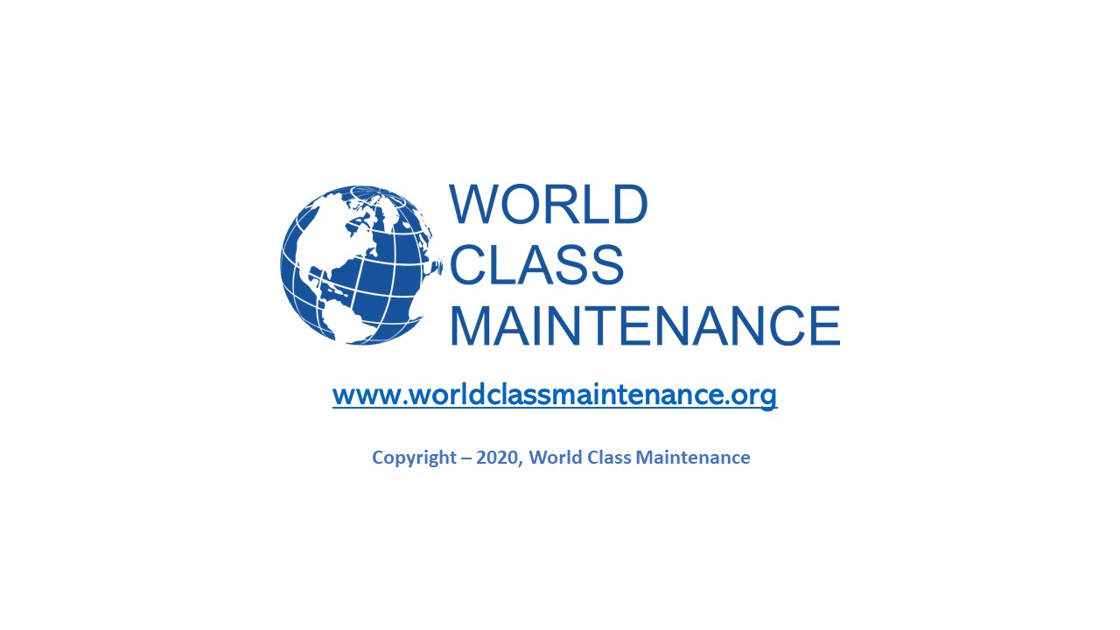
What you need to know to prepare for the CMRP exam
SMRP – Society for Maintenance and Reliability Professionals
By Ricky Smith CMRP

Slide 2

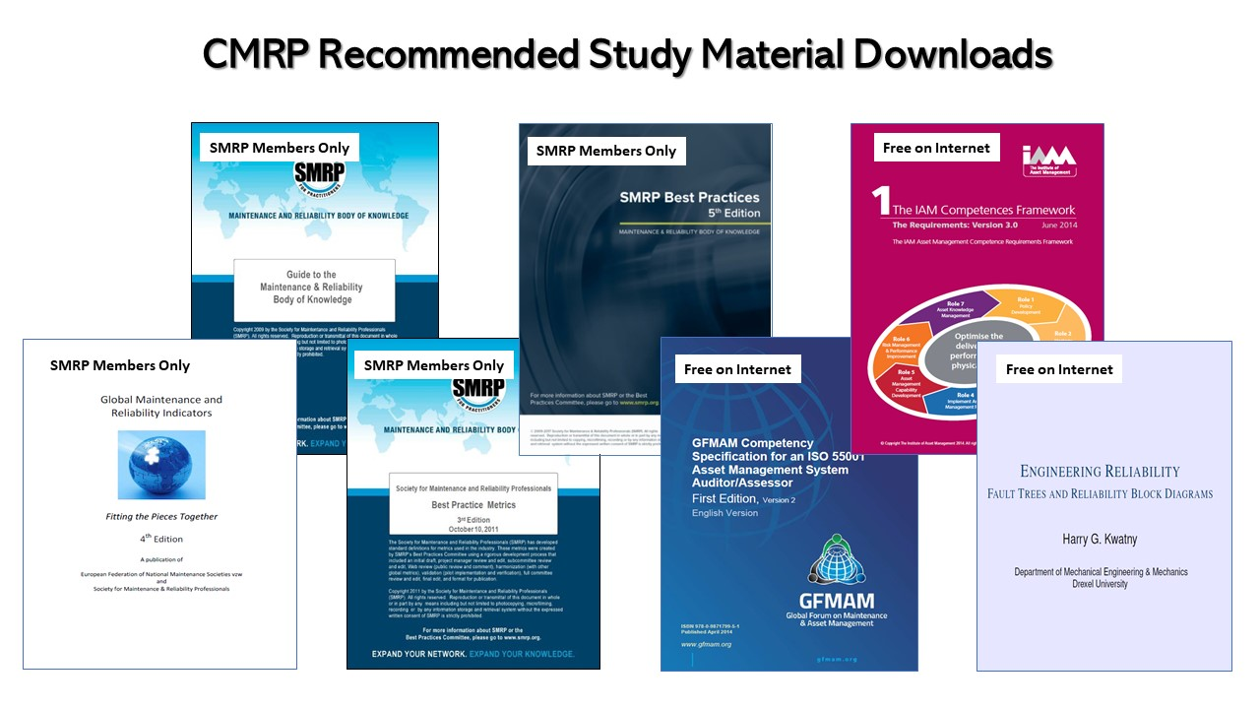
Facts about the CMRP Exam?
The CMRP Exam is 2-1/2 Hours
There are 110 Multiple Choice Question
Which averages out to 1.7 minutes per question
1.7
minutes?

Slide 3
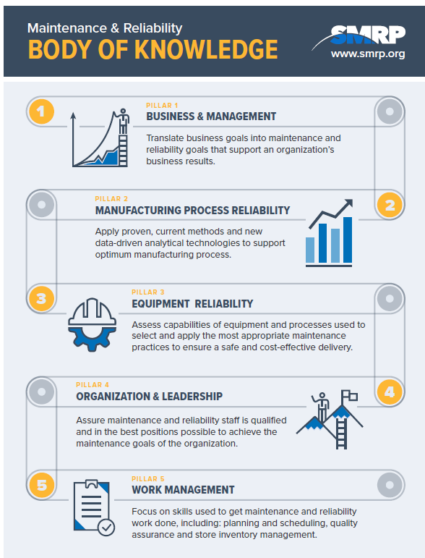
What does the CMRP Encompass?
The exam assesses an individual’s aptitude within the five pillars of the SMRP Body of Knowledge (BoK):
Business & Management
Equipment Reliability
Manufacturing Process Reliability
Organization & Leadership
Work Management
Each pillar details an area of maintenance, reliability and physical asset management that individuals should be proficient in to improve their careers.
Several of the pillars also address technical and “people” skills that help individuals better manage relationships with colleagues.

Slide 4

Answers for Questions Concerning the CMRP Exam?
What is the first step I need to take if I want to take and pass the CMRP Exam?
Go to www.smrp.org and join SMRP
Where do I sign up for the CMRP Exam?
You must apply and pay for the CMRP Exam online at SMRP Website (www.smrp.org)
How much time do I have to complete the CMRP Exam?
2-12 Hours
How many questions are on the CMRP Exam?
There are 110 Multiple Choice Question
How much time is that per question?
You have 1.7 minutes per question
Where can take the CMRP Exam?
After you register for the exam you will be provided a time and location that meets your needs
How long does it take to get the results?
Within 5 minutes as to “pass or fail”

Slide 5
My Recommendations for CMRP, Part 1
One “Must” have knowledge concerning the following in order of priority:
  Known Maintenance and Reliability Best Practices (see “CMRP Study Recommendations step 3 below”)
  SMRP Body of Knowledge
  SMRP Metrics Definitions
  Global Maintenance and Reliability Indicators (SMRP)
  The Global Forum on Maintenance and Asset Management (GFMAM) (low priority but important)
  Institute of Asset Management Competency Framework (IAM) (low priority but important)
  Engineering Reliability – Fault Trees and Reliability Block Diagrams by Harry Kwatny
CMRP Study Recommendations:
  Step 1 - Join SMRP (www.smrp.org) IMPORTANT FIRST STEP
  Step 2 – Join one of the SMRP Chapters or Special Interest Groups and Participate, meet others and learn from each other
  Step 3 – Purchase “Maintenance Best Practices” by Ramesh Gulati and “Rules of Thumb for Maintenance and Reliability
  Engineers” by Ricky Smith and Keith Mobley
  Step 4 – Take training in “SMRP Body of Knowledge” or Maintenance and Reliability Best Practices (not a requirement)
  Step 5 – Download and Study the following from SMRP Website as a member. (SMRP Body of Knowledge, SMRP Metrics, and SMRP Best Practices, Global Maintenance and Reliability Indicators )
  Step 6 – Download these free documents from internet at no charge and study
    The Global Forum on Maintenance and Asset Management (GFMAM)
    Institute of Asset Management Competency Framework (IAM)
    CMRP Candidate Guide for Certification and Recertification (Free on SMRP Website, you do not have to be a member to download), CMRP example questions are in this document
    Reliability Block Diagrams by Harry G. Kwatny (search on internet – free)

Slide 6
My Recommendations for CMRP, Part 2
Learn and Have Knowledge of:
SMRP Body of Knowledge (5 Pillars) - Think about how you could use these Pillars in your organization to optimize asset reliability and maintainability.
  Pillar 1: Business & Management
  This subject area describes the skills used to translate an organization’s business goals into appropriate maintenance and reliability goals that support and contribute to the organization’s business results.
  Pillar 2: Manufacturing Process Reliability
  This subject area relates maintenance and reliability activities to the manufacturing process of the organization to ensure that maintenance and reliability activities improve the manufacturing process.
  Pillar 3: Equipment Reliability
  This subject area describes two kinds of activities that apply to the equipment and processes for which the maintenance and reliability professional is accountable.
  First are those activities used to assess the current capabilities of the equipment and processes in terms of reliability, availability, maintainability, and criticality.
  Second are the activities used to select and apply the most appropriate maintenance practices so that the equipment and processes continue to deliver their intended capabilities in the safest and most cost-effective manner.

Slide 7

My Recommendations for CMRP, Part 2 continues
Learn and Have Knowledge of SMRP Body of Knowledge (continues):
  Pillar 4: Organization & Leadership
  This subject area describes processes for assuring that the maintenance and reliability staff is the most qualified and best assigned to achieve the maintenance and reliability organization goals.
  Pillar 5: Work Management
  This subject area focuses on the skills used to get the maintenance and reliability work done. It includes scheduling and planning activities, quality assurance of maintenance activities, stores and inventory management.
  Side Note: Think about how you could use the 5 Pillars to Optimize/Reshape your current Maintenance and Reliability organization.

Slide 8
My Recommendations for CMRP, Part 3
Remember this:
Leading Metrics lead to results
Lagging Metrics are the results
Learn and be able to answer questions regarding the SMRP Metrics
SMRP Metrics – Review the definitions found in each metric along with how they are measured and think about how one could use these metrics to optimize your current maintenance / reliability program.
The SMRP Metrics provides the maintenance and reliability professional the ability to do the following:
Identify the standardization of how our maintenance and reliability practices are measured and “forms the foundation for these goals” through;
  Measure performance consistently
  Make valid comparison
  Realistic expectations
  Establish achievable goals and objectives

Slide 9
My Recommendations for CMRP, Part 4
Study SMRP Best Practices
SMRP Best Practices is a comprehensive publication of world-class metrics, guidelines and a glossary of terms for the maintenance, reliability and physical asset management profession.
This publication is designed to help practitioners run safe, cost-efficient and effective maintenance and reliability programs that align with strategic, operational and tactical best practices of an organization.
The 70+ metrics and guidelines in this new edition provide standardization and benchmarks to measure the success of maintenance and reliability programs.
Each metric is broken down by definition, objective(s), formula, component definitions and qualifications, and includes a sample calculation, best-in-class target values, cautions and notes for harmonization.
The guidelines provide additional information and further clarification of component terms used in SMRP's metrics.

Slide 10
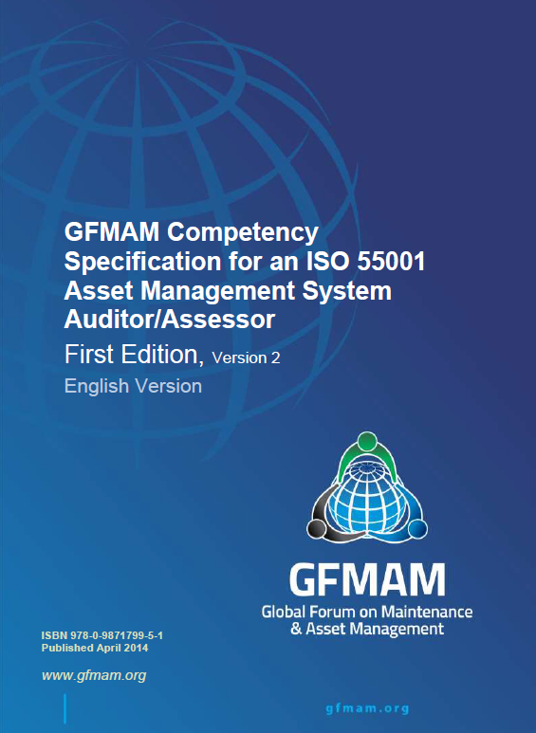
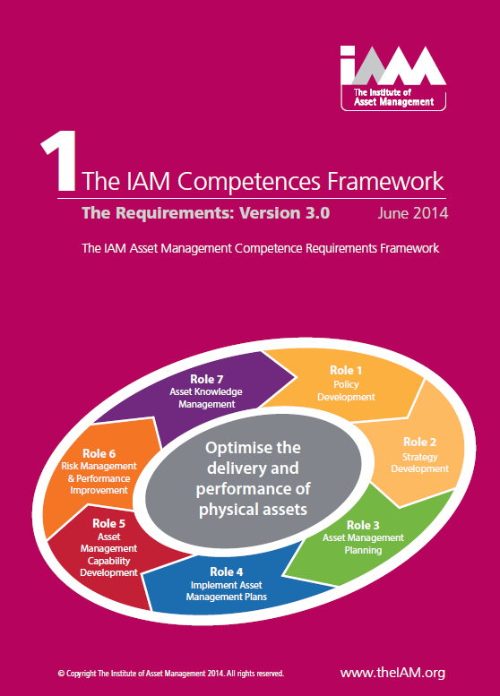
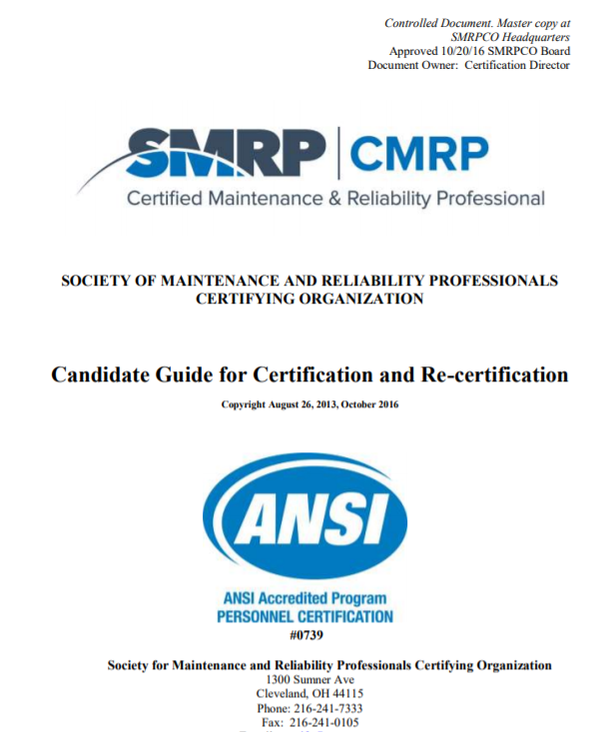
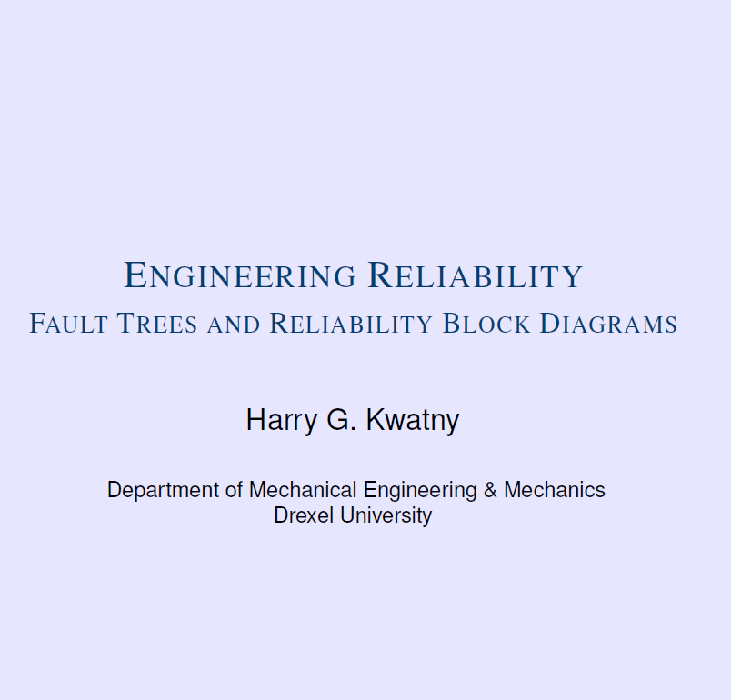
My Recommendations for CMRP, Part 5
Study These Addition Documents
    The Global Forum on Maintenance and Asset Management (GFMAM)
    Institute of Asset Management Competency Framework (IAM)
    CMRP Candidate Guide for Certification and Recertification (Free on SMRP Website, you do not have to be a member to download), CMRP example questions are in this document
    Reliability Block Diagrams by Harry G. Kwatny (search on internet – free)

Slide 11


My Recommendations for CMRP, Part 5
Starting the week prior to the CMRP Exam:
  Study 2-4 hours every other day using the material recommended previously
  Take a 15-minute break every hour, walk around outside and clear your head, no TV while studying.
  Study with someone else is good but you will need time alone studying as well
  Get plenty of uninterrupted sleep the night prior and minimize alcohol intake (minimum of 6 hours sleep)
  Morning of the exam, eat breakfast, minimize sugar intake, take a short walk to clear your head before exam.

Slide 12
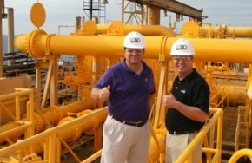
Wishing you the Best
If you have questions email me.
Please contact me when you find out the results of your exam
rsmith@worldclassmaintenance.org

