Slide 1
Planning & Scheduling
Made Simple
By: Ricky Smith CMRP

Slide 2
Maintenance Planning And Scheduling is critical to Optimizing…
Increase “Maintenance Wrench-Time”
- and “Reducing Human Error”

Slide 3
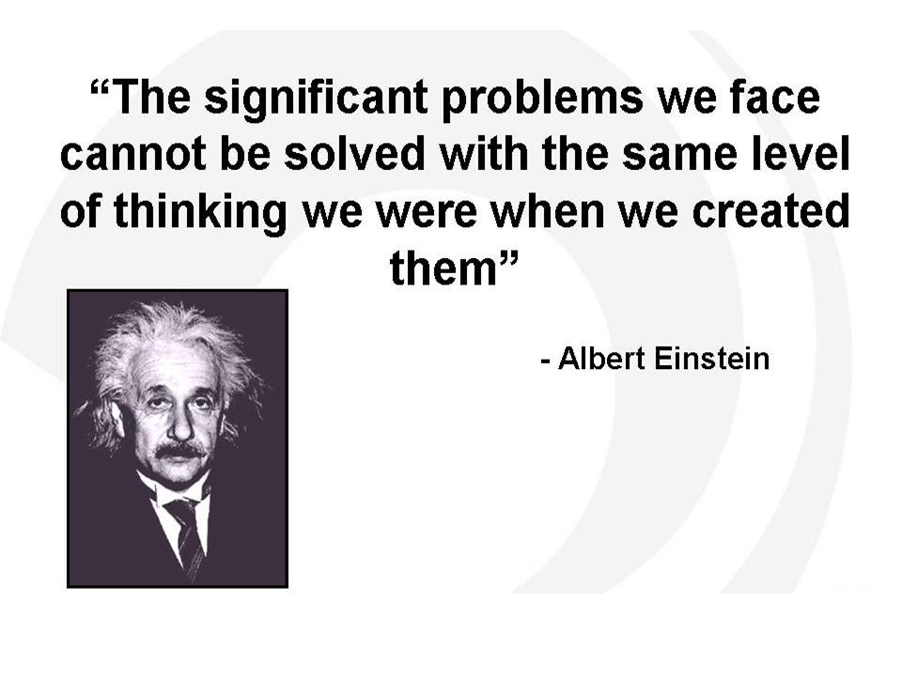

Slide 4
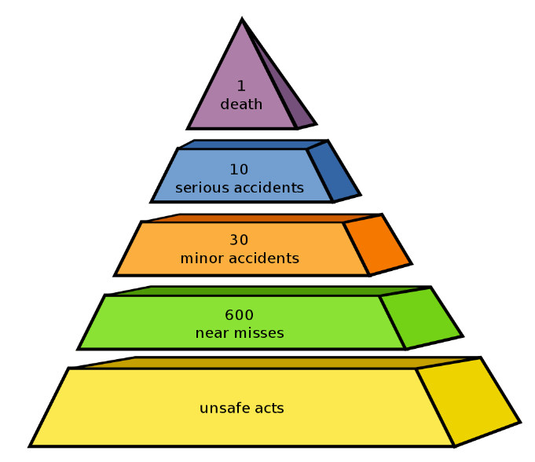
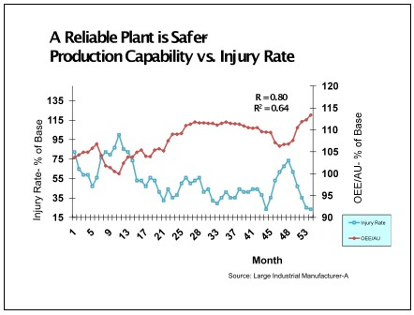
Safety and Reliability
Safety requires attention to detail
Following Procedures mitigates failures
Not rushing a job
Effective Planning and Scheduling increases wrench-time and mitigates human error which results in equipment and personnel failures

Slide 5

Day in the life a Proactive Maintenance Planner

Slide 6
Day in the life a Proactive Maintenance Planner
Maintenance Planners (planner/scheduler) are one of the most misused resources in the maintenance organization. We must always remember that the Maintenance Planner represents that single resource in the organization who is strictly dedicated on preparing for the future.

Slide 7
Day in the life a Proactive Maintenance Planner
Sources of Maintenance Wastes:
Waiting for Instructions or Drawings
Winging it Without Instructions or Drawings
Waiting for Parts
Looking for Supervisors for Instructions
Making Multiple Trips to the Job Site
Looking for the Right Tools
Making the Wrong Tools Work
Waiting for Approval/Permits
Waiting for the Equipment to be released
Shutdown, Cooled Down, Drained, etc.
Waiting on a Crane Lift
Having too many/ too few craft-workers per job
Not placing the right craft I skill for the job
Repeat Repairs and Rework

Slide 8
Day in the life a Proactive Maintenance Planner
Without this focus, we fall victim to the typical maintenance wastes associated with a reactive organization.
Reactive Maintenance Organizations have a "Low Wrench-Time" because of all the sources of Maintenance Waste.

Slide 9
Day in the life a Proactive Maintenance Planner
The only method to achieve optimal and stable wrench-time is through Maintenance Planning and Scheduling. Maintenance Planning and Scheduling are two different functions which are dependent on each other.
If an organization increases by wrench-time by 10% it could make a serious impact of equipment reliability.

Slide 10
Day in the life a Proactive Maintenance Planner
DEFINITIONS:
Without definitions we are dependent on everyone's opinion.
Maintenance Planning - the process of future maintenance work which the job has been scoped, parts and material identified, # and type of maintenance craft, downtime required (if required).
Maintenance Scheduling - the process of scheduling maintenance resources with productions by day by hour.

Slide 11
Day in the life a Proactive Maintenance Planner
DEFINITIONS CONTINUED:
  Weekly Maintenance Scheduling Meeting - a weekly scheduled meeting with production, maintenance, engineering (if required) to ensure all stakeholders are in agreement with the preliminary schedule which was created with Production and Maintenance Leadership based on the needs of the site.

Slide 12
Day in the life a Proactive Maintenance Planner
DEFINITIONS CONTINUED:
  Parts Kitting - the process to identify and stage parts required for upcoming Maintenance Scheduled Work Maintenance
  Rework - Rework is Corrective Work completed on previously maintained equipment that has prematurely failed due to maintenance operations, or material problems.

Slide 13
MAINTENANCE PLANNING AND SCHEDULING ROLES AND RESPONSIBILITIES
Maintenance Planning and Scheduling Roles and Responsibilities is critical to success to ensure all stakeholders understand their role and responsibilities in this process. See example below of a Maintenance Planning and Scheduling RACI.

Slide 14
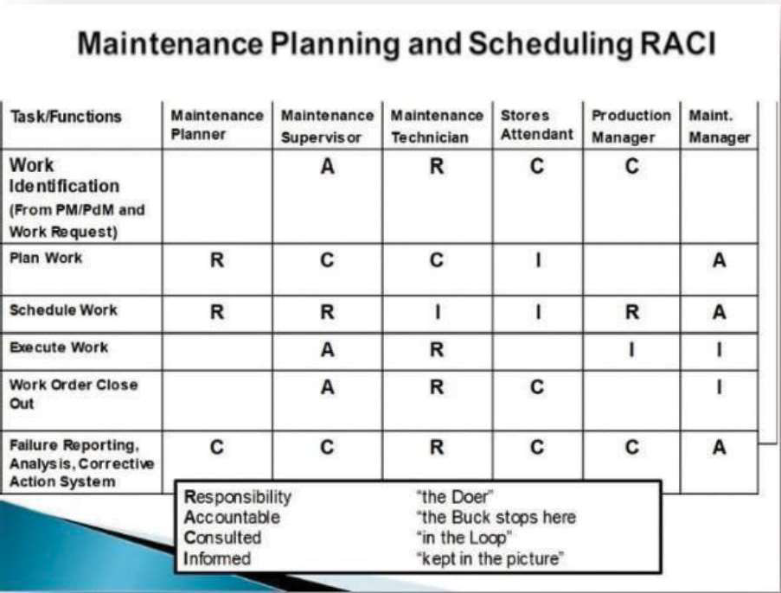
Day in the life a Proactive Maintenance Planner

Slide 15

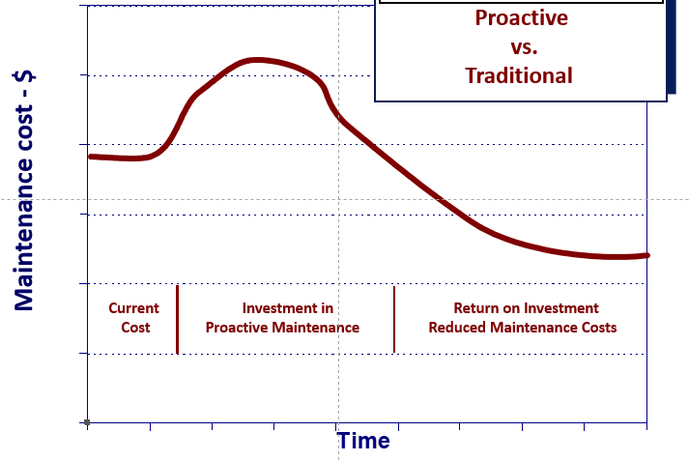
Your thoughts on the topic of how to reduce Maintenance Cost?
International Standard: “Maintenance Cost as a % of Asset Replacement Value
World Class – 1.6 to 3.4%
Worst in Class – 16 to 24%
“Moving to a different state in Maintenance Planning requires everyone pulling on the rope equally”

Slide 16

Computerized Maintenance Management System (CMMS)

Slide 17
What is CMMS
CMMS stands for computerized maintenance management system.
Maintenance CMMS software help maintenance teams optimize their activities by allowing them to Easley track work orders, maintenance assets, and schedule preventative maintenance. It is important

Slide 18
CMMS Question
How accurate is the data in your CMMS/EAM?
How effective is your current system at managing failure on like components / parts?
How effective is your current system at identifying repeat failures on like equipment?
Do you use this data to make the right decisions at the right time?
“Many times, it is what we don’t know that causes the biggest problems”

Slide 19
Effectively Utilizing Work Management Technology - CMMS/EAM systems
All work captured by a work order/notification
All work orders/notifications must have the following:
  Asset Type/Number
  Component
  Estimated labor hours
  Type labor
  Estimate downtime
  Actual downtime
  Asset as found
  Asset as left
  Any items needed further investigation or repair
  Parts used by part number

Slide 20
CMMS Data Flow
A CMMS ties together records of the Assets, and the work needed to keep them in operation.
All work done to an asset should be recorded onto a Work Order, and every work order should be assigned to an asset.

Slide 21
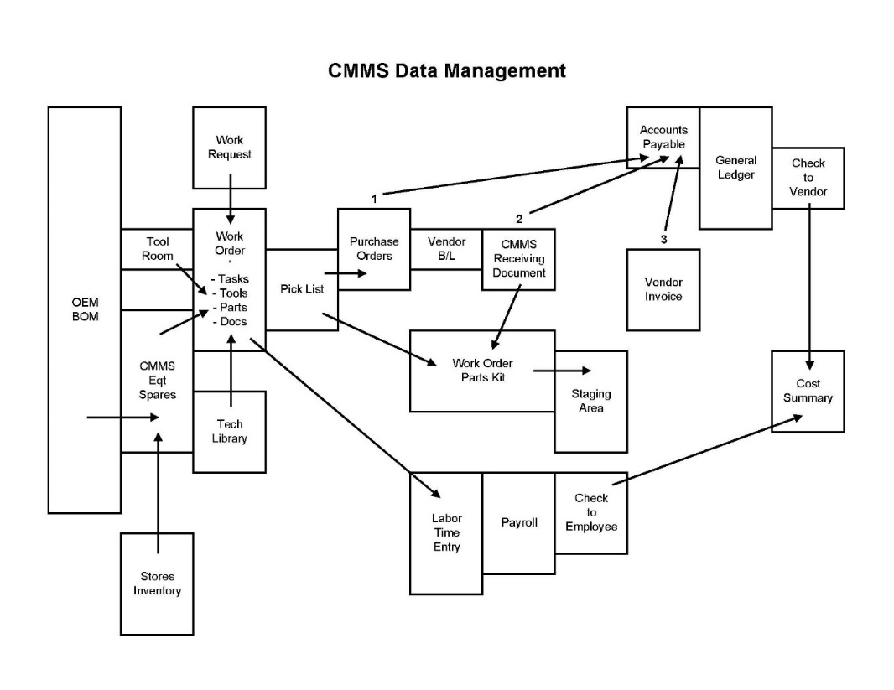
CMMS Data Flow

Slide 22
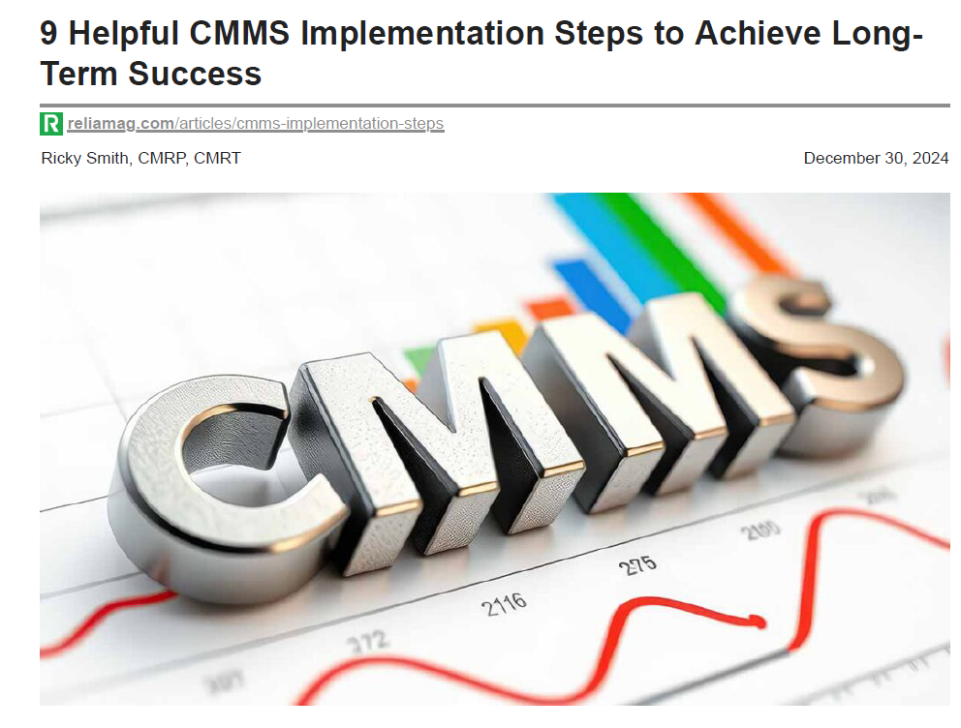
9 Helpful CMMS Implementations Steps to Achieve Long term Success

Slide 23
What Should a Work Request includes?
Mandatory Minimum
Who is submitting the request
Correct Asset Number / Location
Reference to the equipment / component that is showing a negative symptom
What symptom was found
Date of request
Strongly suggested
A prioritization rating for the work request, following standard documented, and trained, guidelines
How the problem was discovered
  Regular inspection
  Ad-hoc

Slide 24
Work Management Mesurement
Metrics to assess Work Management Processes
  Planning Accuracy
  Backlog Size
  Schedule Compliance Metrics
  Origin of Corrective Maintenance
  Feedback Recording
Let’s go through these
Are there others?
Are these leading or lagging?

Slide 25


Slide 26
Work Order
Work Orders tool is a tool managing what needs to be done, how we will do it, when and by whom.
They capture history and record costs.
Work Order that need to be planned, scheduled, executed, get feedback recorded, and then analyzed for improvements.

Slide 27
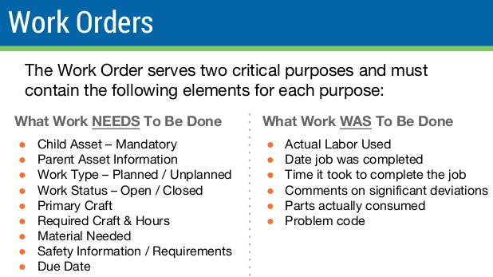

Slide 28
Work Order (WO) Requirements
All work must have a Work Order and must be charged to an asset
Standing Work Orders should only be used for time paid meetings, ie. Safety, Corporate, Site, etc., however time must be charge to these specific work orders in case we need to retrieve this information in the future.
All work orders must review before close of business each day by Maintenance Supervisor.
All work orders must be closed out by the Maintenance Planner to ensure all information is accurate.
“Without Good Data we are Lost”

Slide 29
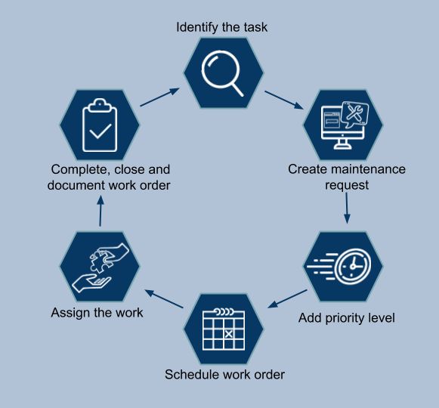
Work Order(WO) Requirements
A Work Order is a document that provides all the information about a maintenance task and outlines a process for completing that task.
Work Orders can include details on who authorized the job, the scope, who it's assigned to, and what is expected.

Slide 30
Work Order Priority
5 | Emergency – Respond Now
4 | Urgent – Needed within 2 days
3 | Need Soon – Needed within 5 days
2 | Normal – Need 2 weeks to plan
1 | Outage – Scheduled for next shutdown

Slide 31

Work Identification

Slide 32
Work identify

Slide 33
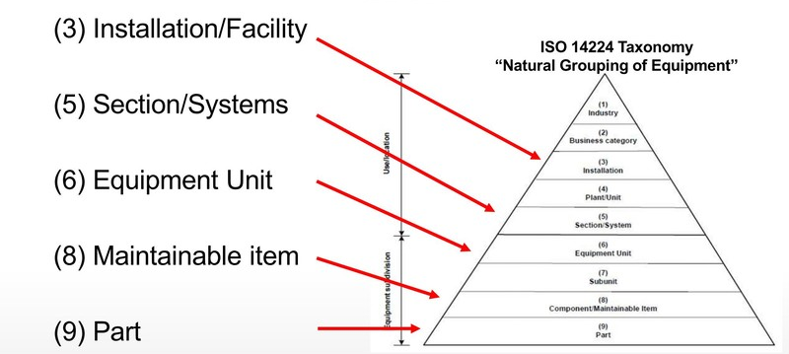
ISO 14224 – Equipment Taxonomy
International Standard for the:
“Collection and exchange of reliability and maintenance data for equipment”
“Measure what you manage” – Dr Deming

Slide 34
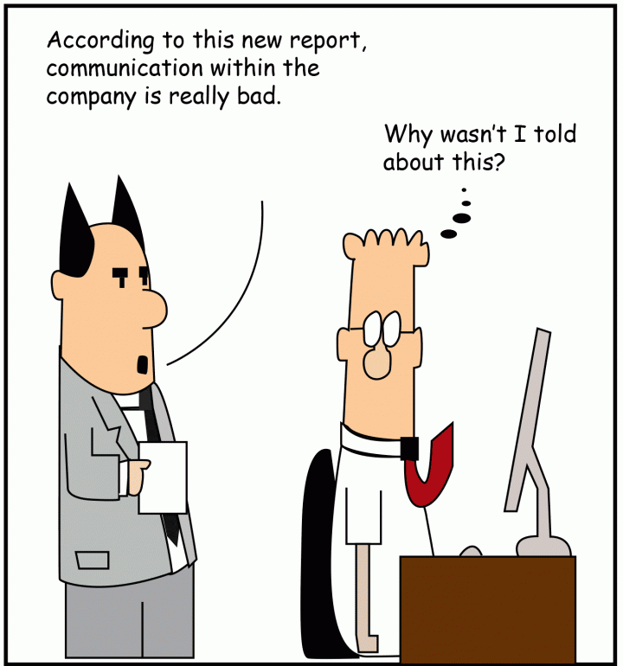
“Without definitions we all have difficulty communicating with each other”

Slide 35
Maintenance Strategics
Preventive Maintenance (PM)
Preventive maintenance is the act of performing regularly scheduled maintenance activities to help prevent unexpected failures in the future.
Scheduled restoration and replacement tasks are examples of preventive maintenance.
Source: SMRP Best Practices
SMRP = Society for Maintenance & Reliability Professionals

Slide 36
Maintenance Strategies
Predictive Maintenance (PdM) is an equipment maintenance strategy based on assessing the condition of an asset to determine the likelihood of failure and taking appropriate action to avoid failure.
The condition of equipment can be measured using condition monitoring technologies, statistical process control, equipment performance indicators or through the use of human senses.
Source: SMRP Best Practices

Slide 37
Predictive Maintenance (PdM) Benefits
Predictive maintenance techniques are designed to help determine the condition of in-service equipment in order to estimate when maintenance should be performed.
This approach promises cost savings over routine or time-based preventive maintenance, because tasks are performed only when warranted.
Predictive Maintenance allows the most time (dependent on a specific failure mode) to Plan and Schedule Work.
Source: SMRP Best Practices

Slide 38
Condition- Based Maintenance (CBM)
An Equipment Maintenance strategy based on measuring the condition of equipment against known standards in order to assess whether it will fail during some future period and taking appropriate action to avoid the consequences of that failure.
- The Condition of the Equipment could be measured using condition monitoring, statistical process control, equipment performance or through the use of human senses.
The term Condition Based Maintenance (CBM), On-Condition Maintenance and Predictive Maintenance (PdM) can be used interchangeably.
Source: SMRP Best Practices

Slide 39
Maintenance Strategies
Corrective Work is work that is identified through preventive and/or predictive maintenance tasks and completed prior to failure in order to restore the function of an asset.
Source: SMRP Best Practices

Slide 40
Preventive Maintenance Attributes
A group of preventive maintenance tasks, which include failure-finding tasks, scheduled to be accomplished at specified intervals, or based on condition.
The objective of these tasks is to identify and prevent deterioration below inherent safety and reliability levels by one or more of the following means:
  Lubrication/servicing;
  Operational/visual/automated check;
  Inspection/functional test/condition monitoring;
  Restoration
  Source : SMRP Best Practices

Slide 41
Operator Care
Operator Care is a simple process that engages all of the personnel working within the organization towards a common goal of increased throughput and decreased equipment delays.
ELEMENT 1 - Focus on Abnormalities, not Failures: Point "P" (the onset of failure) differs greatly from point "F" (the loss of function) on the P-F curve. Many operators do not understand this relationship and are not conditioned to report equipment abnormalities.
ELEMENT 2 - Formal Routine Inspection Forms: Simple, clear, and concise, the Routine Inspection Form defines the expectations of the operators in the area and facilitates standardization
ELEMENT 3 – Ensure Inspections are Quantitative:
ELEMENT 4 - Liberal use of Visual Controls

Slide 42
Planning and Scheduling
Two Different Functions which are dependent on
each other

Slide 43
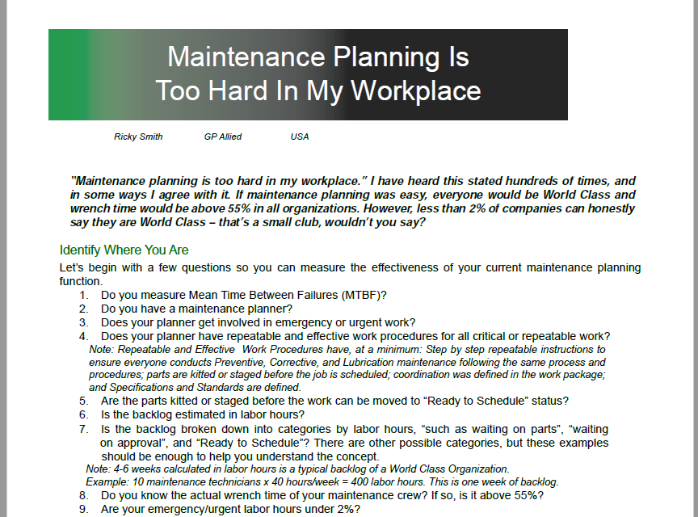
“Maintenance Planning Is Too Hard in my Workplace”

Slide 44
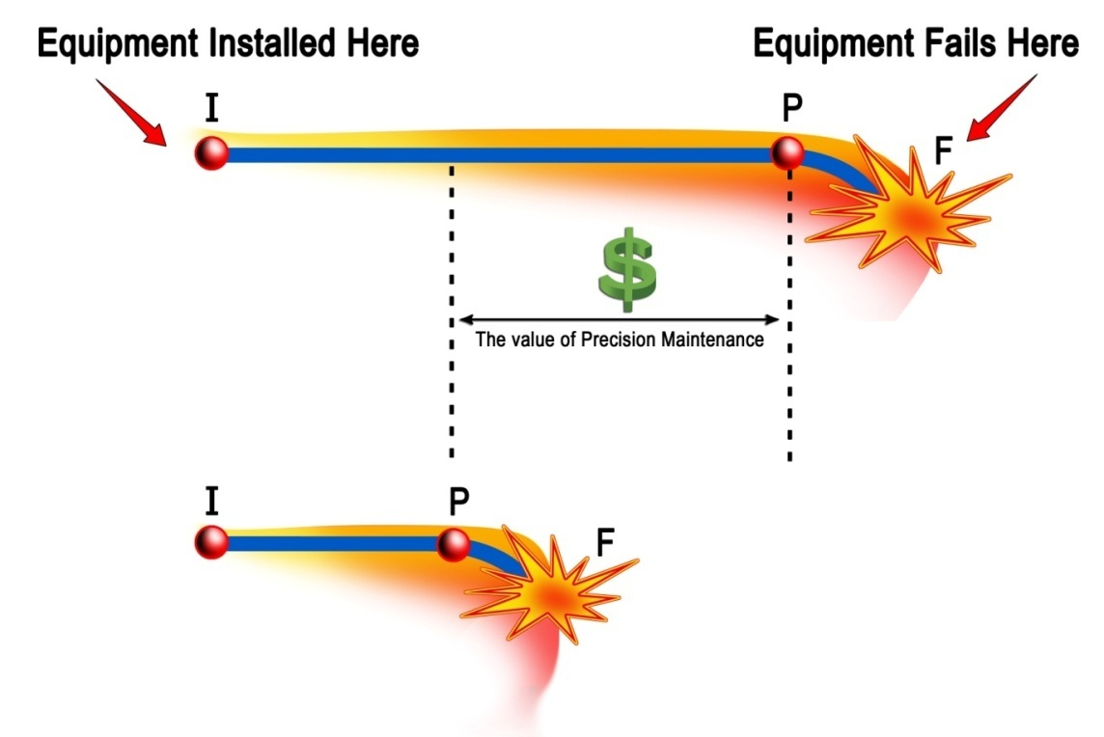
Maintenance Planning:
Identifying the parts, tools, procedures, standards, and specifications required for effective maintenance work, increasing wrench time.
“Planning is key to the success of Precision Maintenance”

Slide 45
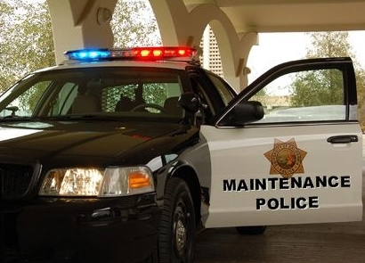
Maintenance Scheduling:
Scheduling of maintenance, operations, contractors, engineering , safety personnel to be at the right time for the right work synchronized together which is intended to minimize interruption to operations and production
“Performing the right work at the right time”

Slide 46

Why Wrench Time is critical

Slide 47
What is Wrench Time?
Wrench time is a measure of crafts personnel at work, using tools, in front of jobs.
Wrench time does not include obtaining parts, tools or instructions, or the travel associated with those tasks. It does not include traveling to or from jobs.
It does not include time spent obtaining work assignments.

Slide 48
Maintenance Wrench-Time

Slide 49
Facts About Maintenance Wrench-Time
1: World-class wrench time is 55-65%; most companies have a wrench time between 18-30%.
2: It is not uncommon for the effectiveness of planned and scheduled jobs to be 25%
or more than the same job without planning and scheduling (P&S).
3: The term “wrench time” refers to a unit of measure for the time maintenance personnel spend doing the actual work for which they are responsible for. It does not include the time a technician spends:
  Looking for parts
  Looking for their supervisor
  Waiting on production

Slide 50
Facts About Maintenance Wrench-Time, cont’d
4: Wrench time is usually expressed as a percentage, and national studies typically put this number between 25-50% for North American Industrie As an example, the time a maintenance mechanic takes to replace a mechanical seal and do a laser alignment on a pump would count as wrench time.
However, the time spent leaving the job to get the seal from the storeroom, and the time spent away from the job site to obtain additional shims for aligning the pump, would not count as wrench time.

Slide 51
Facts About Maintenance Wrench-Time, cont’d
5: The goal is to eliminate all delays and nonproductive work so that maintenance personnel can work effectively and efficiently by never having to leave a job once they start, except for regularly-scheduled breaks, mealtimes, and the end of the working day.
However, the only time that would not be counted as wrench time would be things like safety and other critical meetings, break and lunch times, and travel time to and from the job.
While this measure is somewhat idealistic, it does provide a clear way to assess overall effectiveness.

Slide 52
Facts About Maintenance Wrench-Time, cont’d
6: P&S is the most effective way to improve an organization’s wrench time.
The power in improving wrench time is considerable.
For example, if you have a crew of ten people that have a wrench time of 30% and it is improved to 40%, one mechanic effectively will have been added, and this mechanic has a wrench time of 100%.
7: The only way to optimize maintenance wrench time is to have an effective maintenance planning and scheduling process with a highly trained maintenance planner or planner / scheduler.

Slide 53
Sources of Maintenance Wastes
Waiting for Instructions or Drawings
Winging it Without Instructions or Drawings
Waiting for Parts
Looking for Supervisors for Instructions
Making Multiple Trips to the Job Site
Looking for the Right Tools
Making the Wrong Tools Work
Waiting for Approval/Permits
Waiting for the Equipment to be Prepared; i.e. Shutdown, Cooled Down, Drained, etc.
Waiting on a Crane Lift
Having too many/too few craft-workers per job
Not placing the right craft/skill for the job
Repeat Repairs and Rework

Slide 54
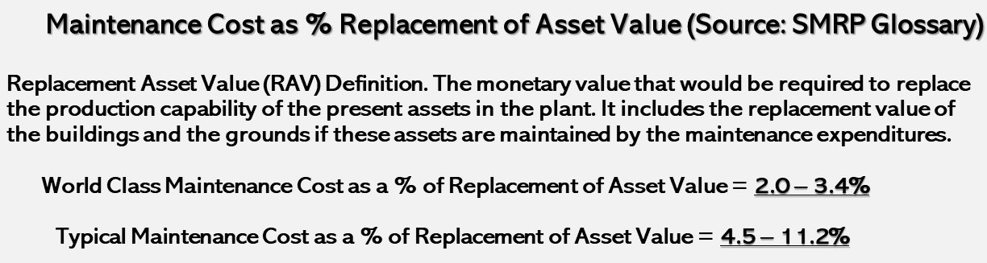
How to Control Waste
Perform Maintenance Planning and Scheduling to World Class Maintenance Standards
Focus on Reducing Maintenance Rework through use executing maintenance work to specifications

Slide 55
Wrench-Time is… (or utilization time)
“The time a Maintenance Person actually has their hand on a tool”
Typical Wrench-Time – 6-35%
World Class – 55-65%

Slide 56
Current Labor Utilization in “good or typical” maintenance organizations
Breaks/Relief
10%
Coordination
Delay
8%
Direct Work
Personal Time
35%
5%
Idle at Job Site
5%
Travel
Receiving Inst
15%
5%
Late/Early
Obtain
5%
Tools/Mat
12%

Slide 57
Impact of Planning & Scheduling on
Labor Resource Utilization
If this were your current state where would you want to be? | Percent of Day Spent
 | Typical Current | Target
Receiving Instructions*
Obtaining Tools and Material*
Travel*
Coordination Delays*
Idle at Job Site
Late Starts and Early Quits
Authorized Breaks and Relief
Excessive Personal Time
Subtotal
Direct Work
5
12
15
8
5
5
10
5
65
35

Slide 58
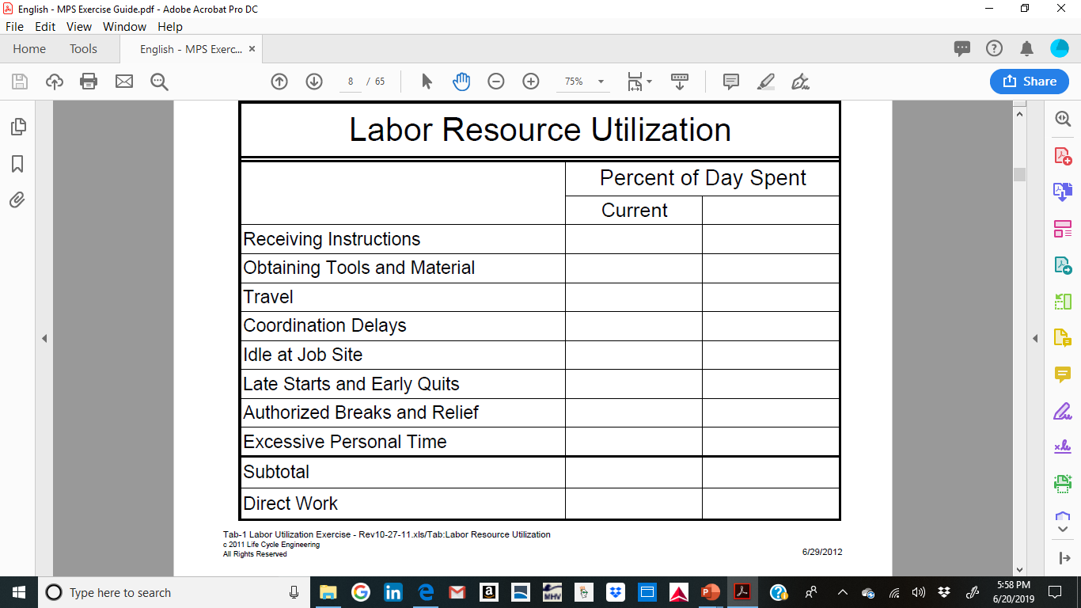
Wrench Time Utilization
Exercise: Currently, How much of a Maintenance Techs time is spent and what is your goal.
Goal

Slide 59
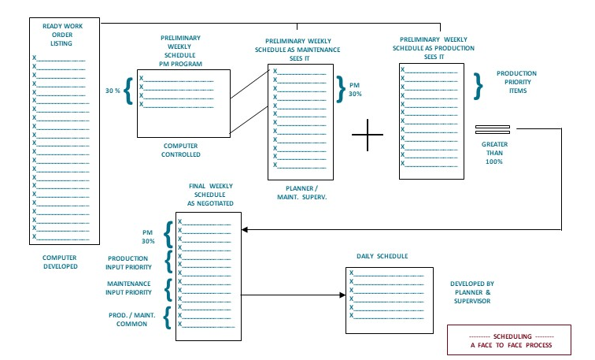
Maintenance Scheduling Illustration
Step 1
Step 2
Step 3
Step 4
Step 5
Step 6
Understand in this phase all work planned and future work

Slide 60
What is a Failure?
They further define two types of failures.
“A functional failure is the inability of an item (or the equipment containing it) to meet a specified performance standard.”
“A potential failure is an identifiable physical condition which indicates a functional failure is imminent.”
    - F. Stanley Nowlan and Howard F. Heap, Reliability-Centered Maintenance, Department of Defense Report Number AD-A066-579, December 1978

Slide 61
Maintenance Issues
Most maintenance staff actually work 2-4 hours a day
  Effective Direct work is low
  Caused by Lack of effective Planning
  Caused by Lack of effective Scheduling
70-80 % of equipment failures are Human-INDUCED
  Not using a Torque Wrench
  Not knowing specifications
  Not having the right part at the right time
  Improperly handling and installing bearings (parts)
  No Repeatable, Effective PM, Corrective, Lube Procedures
Notes:
61

Slide 62
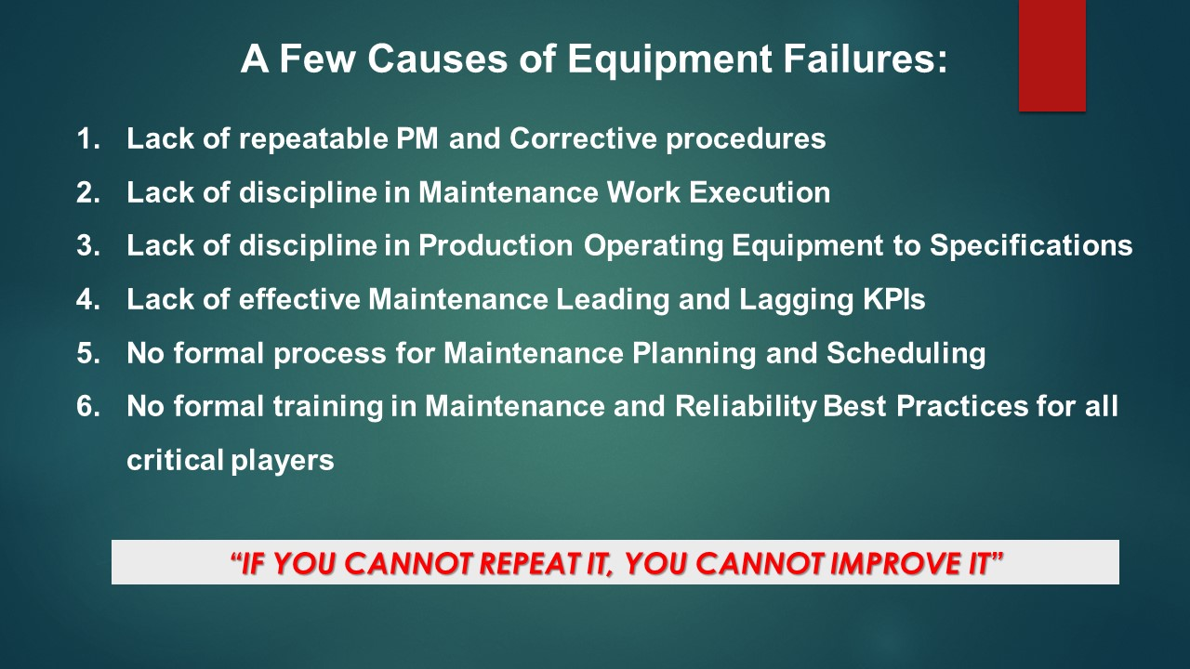
Your thoughts

Slide 63
A Few Known Facts
Schedule Compliance 80-90%
% of Planned Work 90%
PM Execution – 15%
Results from PM Execution – 15%
PdM Execution – 15%
Results from PdM – 35%
Wrench Time typical company – 18-30%
World Class Company – 55% +
Maintenance Cost (Reactive) 19% / RAV
Maintenance Cost (World Class) 1.7% / RAV

Slide 64
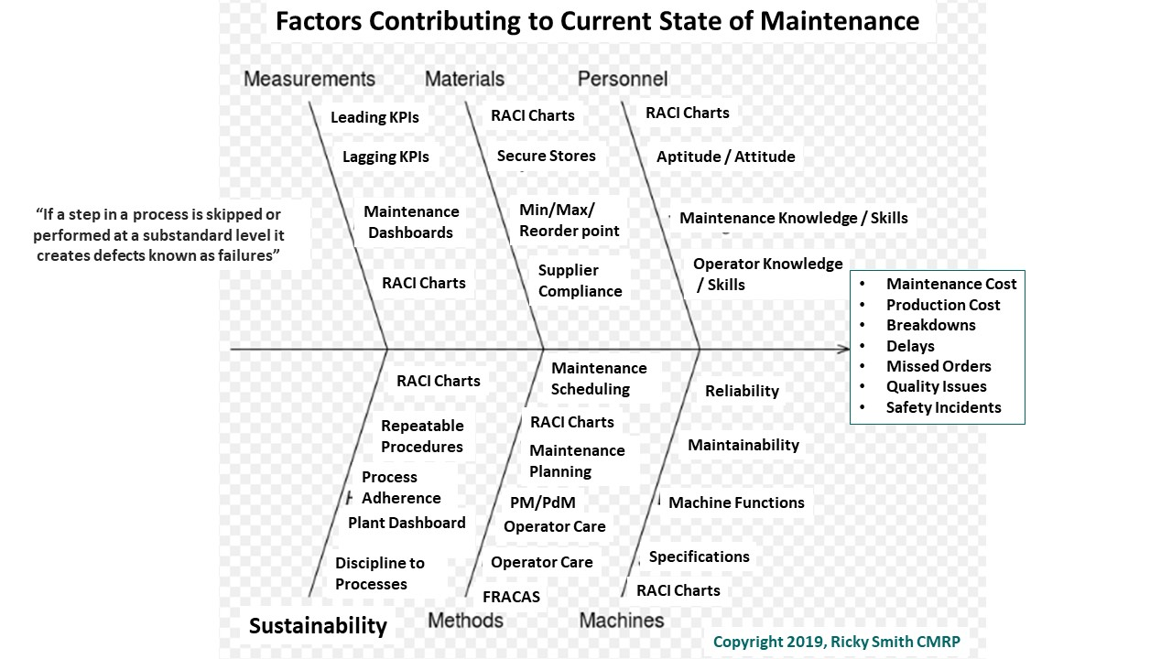


Slide 65


Slide 66

A Maintenance Planner’s primary responsibility is to planned and scheduled future maintenance activities

Slide 67

Process Mapping/ Work Flow

Slide 68
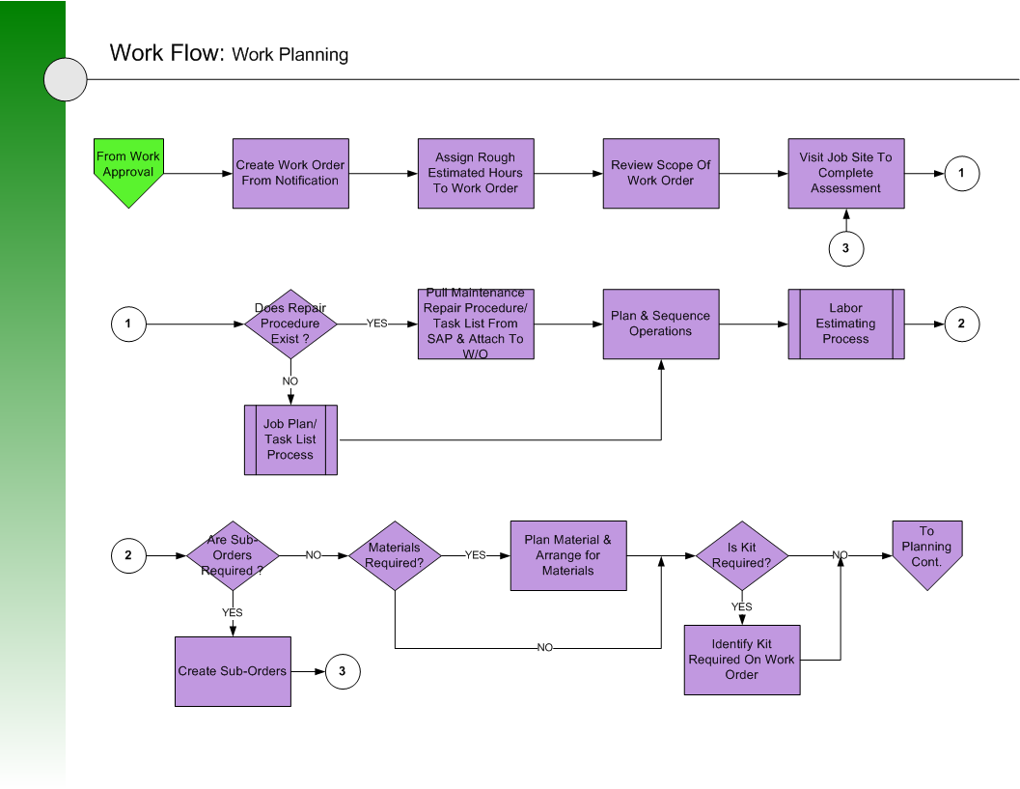

Slide 69
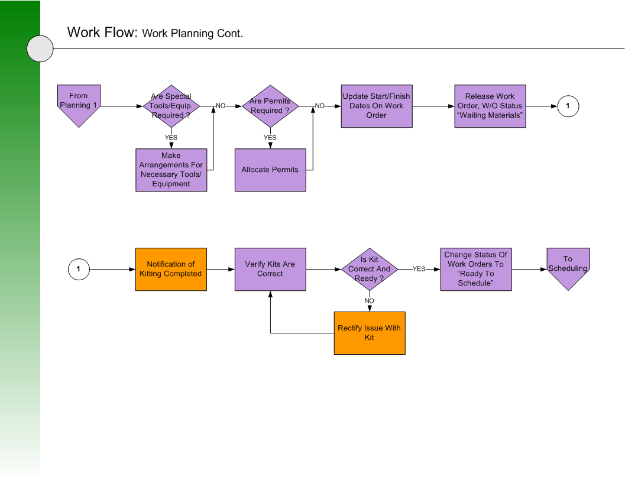
Appendix V-4

Slide 70
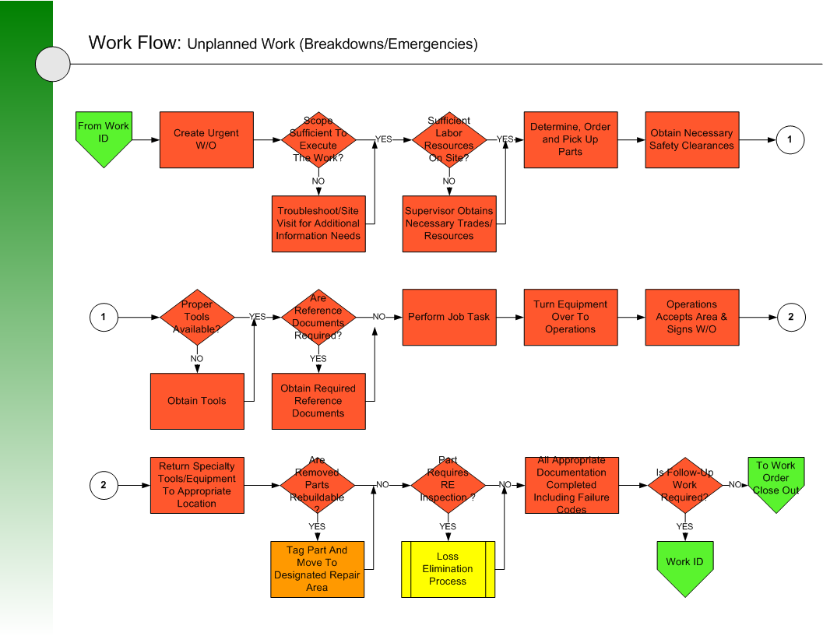
Appendix V-6

Slide 71
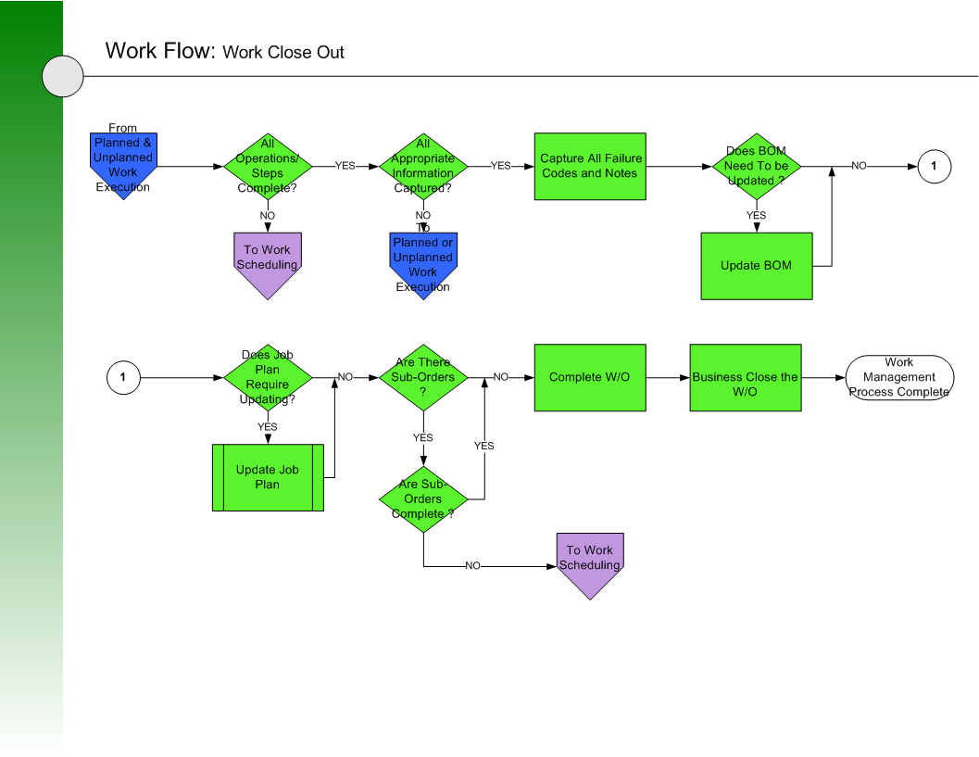
Appendix V-6

Slide 72
Maintenance Scheduling Workflow
Step 1
Step 2
Step 3
Step 4
Step 5
Step 6
Understand in this phase all work planned and future work

Slide 73
Identify why Process Maps are Important
Answer the following as a group and be prepared to brief your findings:
1. How close is the previous process maps to your Maintenance Planning and Scheduling Process?
2. How would you improve your Maintenance Planning based on what you see on the previous Planning and Scheduling flowcharts?

Slide 74

Where do you start planning and scheduling optimization?

Slide 75
Step 1: Identify External Distracters
Poor spare parts and inventory controls
Conflicting ideas of what planning is
Planners taken off job, put on tools, or involved in daily activities (parts chaser, facilitating daily work)
Maintenance and Production not acting as a team
No planning process, unclear expectations, unclear roles and responsibilities
Maintenance leadership not following the plan
Emergency / Urgent Work too High
Lack of Discipline
The CULTURE

Slide 76
Step 2: Education of the Team
“Coaching is not just for Planners Anymore”
Plant / Operations Leadership
Frontline Production Leadership
Maintenance and Reliability Leadership (all levels)
Planners
Maintenance Personnel
Operators

Slide 77
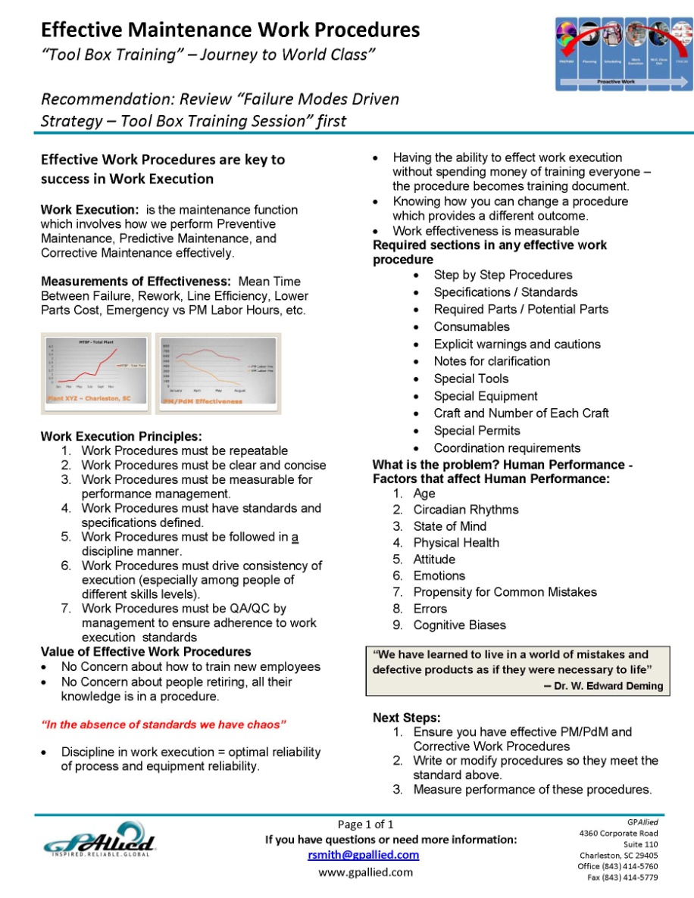
Tool-Box Talk – Education is Critical to Success

Slide 78
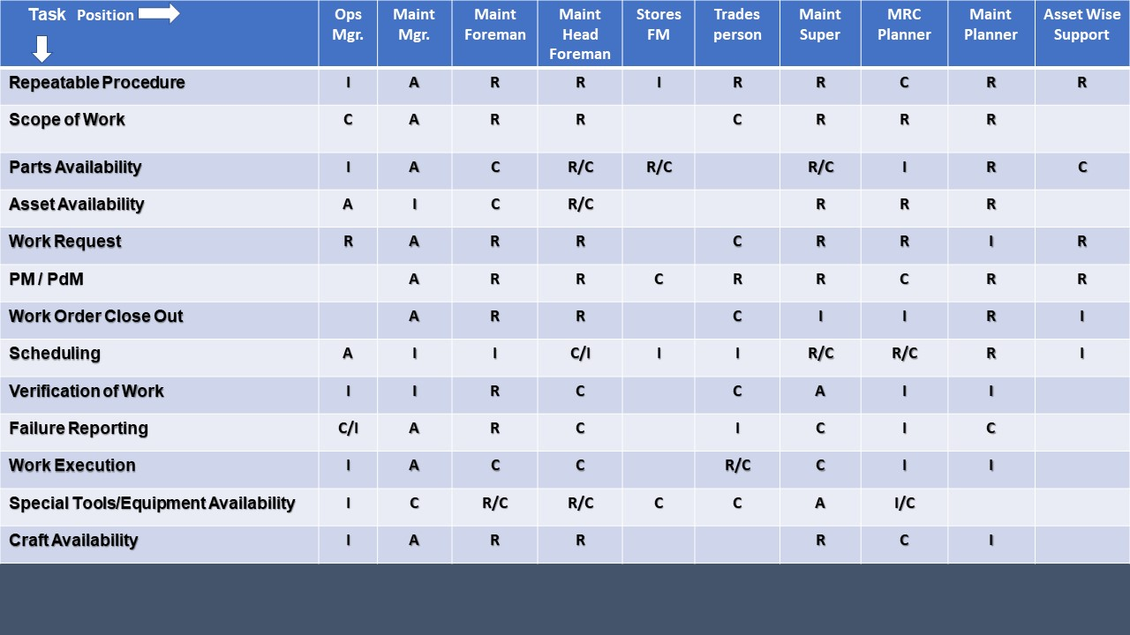
Step 3: Develop RACI Chart for
Maintenance Planning and Scheduling

Slide 79
Step 4: Develop Guiding Principles for Planning and Scheduling
The planners focus on future work and maintain at least two weeks of work backlog that is planned, approved, and ready to schedule / execute.
Planners Do Not Chase Parts for Jobs in Progress
Supervisors and Crew Leads Handle the Current Day’s Work and Problems - Coordination
Scheduling Does Not Occur Until Parts are Kitted
We will maintain a stable / no fluid Criticality Index

Slide 80
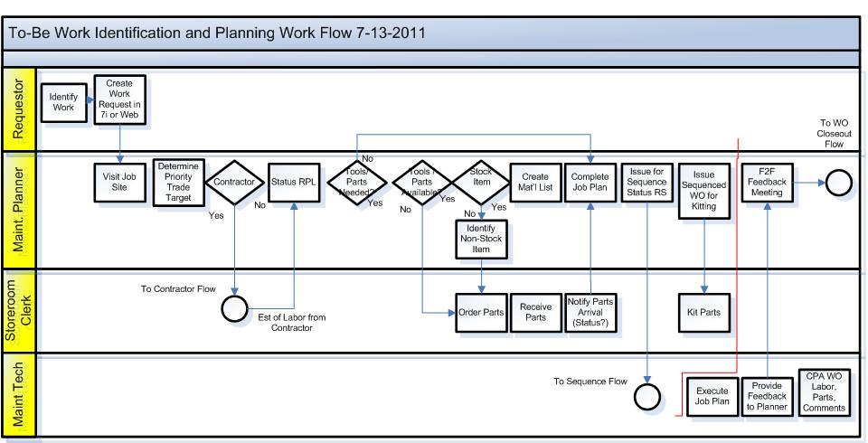
Step 5: Define the Planning Process

Slide 81
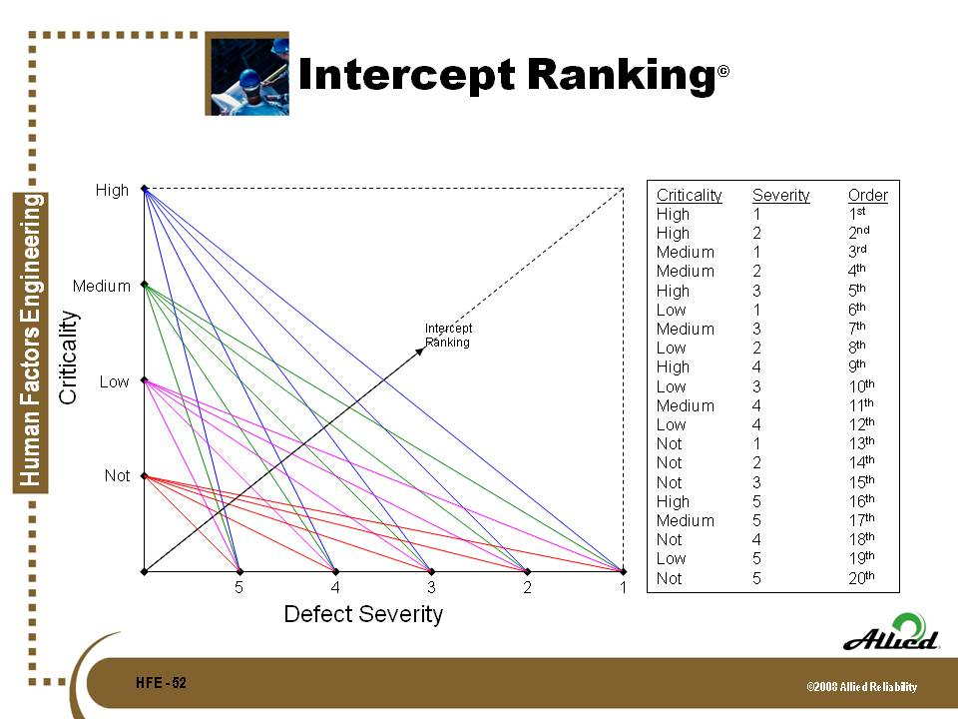
Step 6: Prioritize Work to be Planned

Slide 82
Step 7:
Develop Effective / Repeatable Procedures
Repeatable Process
Capture Knowledge
Train New Employees
Reduce Human Induced Failures

Slide 83
Step 8: Measure Effectiveness of Planning and Scheduling
% of Work Orders Planned (Trending Up)
% of Planned Work (90%)
    Proactive (90%
    Reactive (2%)
    Requires no Planning (8%)
% of Work Orders with Estimated to Actual Labor Hours (+/- 10%)
Backlog - measured in labor hours by week
  Ready to Schedule (2-4 Weeks)
  Total Backlog (6-8 Weeks)
% of WOs with Comments/Recommendations
PM Compliance (Critical Assets – 100%)
PdM Compliance (Critical Assets – 100%)
Mean Time Between Failure (MTBF)

Slide 84
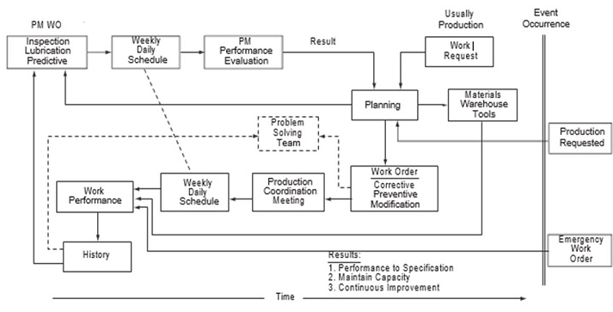
Step 9: Discipline to the Process
“If a step in a Process is skipped or performed at a substandard level it creates defects known as failures”

Slide 85
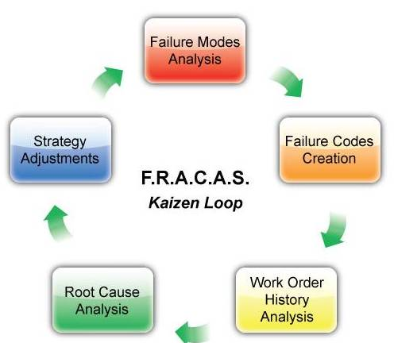
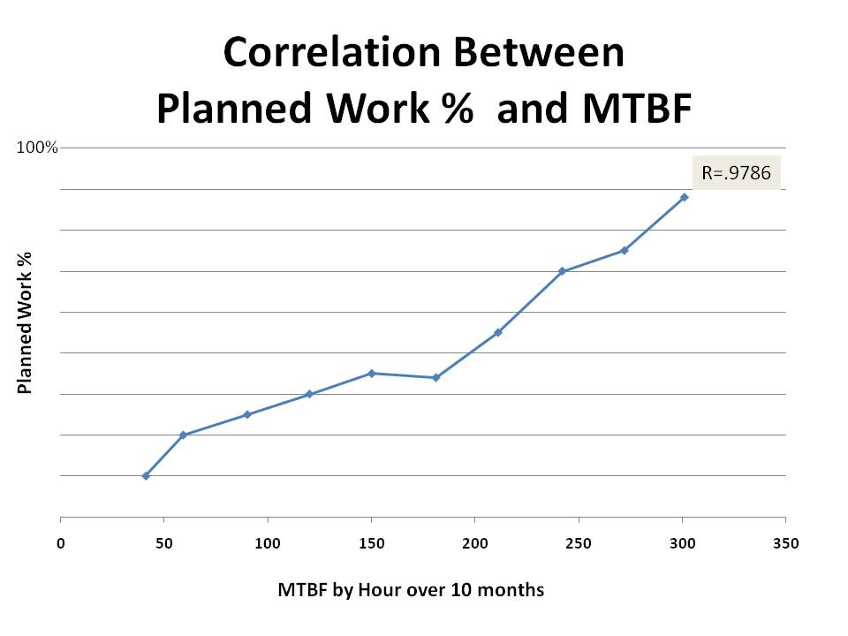
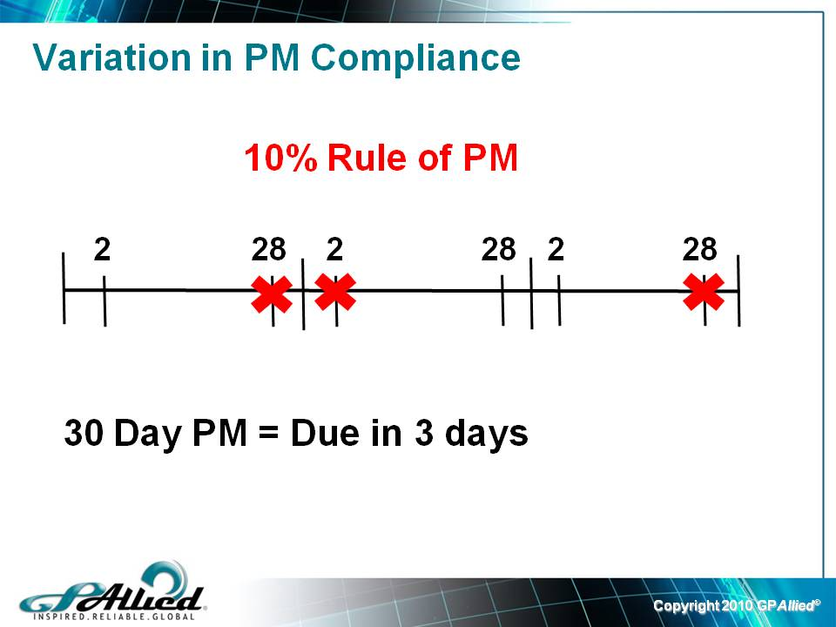
Step 10: Continuous Improvement
Failure Mode Driven Strategy (Failure Mode – How something Fails)
Manage and make adjustment using Metrics
  Repeatable / Effective Procedures
  Process Map of Planning
  Education
Identify a solution to a problem using Root Cause Analysis (RCA)

Slide 86
Step 11: Kitting Parts is Critical to Optimizing Wrench-time
Kitting/Staging is defined as the having all parts, prints, and repair / PM /
rebuild instructions are together in a kit.
Kitting area is critical to eliminate “wait” time for parts, prints, and
instructions.
Special tools may be placed in the Kit to again improve maintenance
productivity.

Slide 87
General Rules which must be followed for Maintenance Planning / Scheduling
Work orders for Kits are not to be scheduled until there all parts, material, drawings, procedures, etc. are on site and kitted.
No issue of partial Kits to the storeroom for picking (unless management approves per incoming stock due dates or other circumstances).
Kits kept in a secured area
Each Kit has separate containers, and are marked (For example 1 of 3, 2 of 3, 3 of 3 along with the work order that is visible)

Slide 88
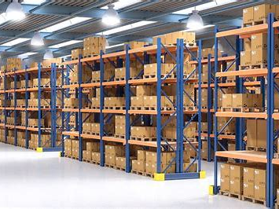
What is Kitting/ Why is so important?

Slide 89
What is Kitting and why it is so important?
Kitting is defined as components pulled from stock and readied for delivery.
The Kits are set up, picked, and completed in a secured area to prevent parts from being taken to supply other kits.
Once the kit is completed, it is staged in secure kitting area or delivered to the job site.
This eliminates the waiting time and searching time for parts, information, etc. and decreases downtime of equipment.

Slide 90
Guiding Principles for Parts Kitting
Planner/Scheduler issues work orders for kits
Provide a secure area to set up a kitting operation
Storeroom fills kits for each work order requiring parts for a planned job.
Work order placed on the empty container where kit is filled
Storeroom begins picking kits, checking it off
Stores completes kit and delivers
Work Order cannot be scheduled until a kit is complete.

Slide 91
Parts Kitting/ Staging
Kitting is defined as components/parts which are pulled from stock secured for Scheduled Maintenance Work. The Kits are set up, picked, and completed in a secured area to prevent parts from being taken to supply other kits
Once the kit is completed, it is staged in -secure kitting car.ea or delivered to the job site. This eliminates the waiting time and searching time for parts, information, etc. and decreases downtime of equipment.

Slide 92
Parts Kitting/ Staging
General Rules which must be followed:
Work orders for Kits are not to be scheduled until all parts, material, drawings, procedures, on site and kitted.
No issue of partial Kits to the storeroom for picking (unless management approves per incoming stock due dates or other circumstances).

Slide 93
Parts Kitting/ Staging, cont’d
General Rules which must be followed:
Kits kept in a secured area, Each Kit has separate containers and are marked with a work order attached to the kit (For example 1 of 3, 2 of 3, 3 of 3 along with the work order that is visible) Kits are developed per individual work order, with a start date and a due date.
Kits are to include all pertinent information, including tools, job instructions, and prints/drawings. Work orders with the parts showing description, quantity, and location, and other related installation instructions as necessary. Special tools may be included in the kit.

Slide 94
Parts Kitting/ Staging, Cont’d
Kits are mobilized, for easier transportation to the job site or work site if at a remote site
Planners and the storeroom keep in communication during the entire process, notification to maintenance when parts or material is in the secure kitted area at the job site.
Visible methods are done at each stage of the operation.
Bulk items are identified by location, so that small parts can be attached to the larger parts when completed and delivered.
Material handlers are to ensure that Kits are handled properly and adhere to the rules.

Slide 95
Guiding Principles for Maintenance Part Kitting:
  Provide a secure area to set up a kitting operation
  Planner/Scheduler issues work orders for kits
  Storeroom fills kits for each work order requiring parts for a planned job.
  Work order placed on the empty container where kit is filled
  Storeroom begins picking kits, checking it off
  Stores completes kit and delivers to kitted area
  Work Order cannot be scheduled until a kit is complete
  Parts kitting increase "Maintenance Wrench-Time" by having the right part on site when the work is scheduled

Slide 96
Maintenance Iceberg

Slide 97
Why does an organization need Effective Maintenance Planning and Scheduling?
To optimize wrench-time
To reduce human induced failures - 80% of equipment failures are human induced
To ensure repeatability in maintenance work
To ensure maintenance work is accomplished to specification
To ensure maintenance work meets the intent of operations or production in terms of reliability and maintainability
Lessons learned from previous work is recorded and be used to improve procedure
If a problem occurs the first step in RCA may be to determine was…
  the procedure accurate
  the procedure followed
  was the work completed to specifications

Slide 98
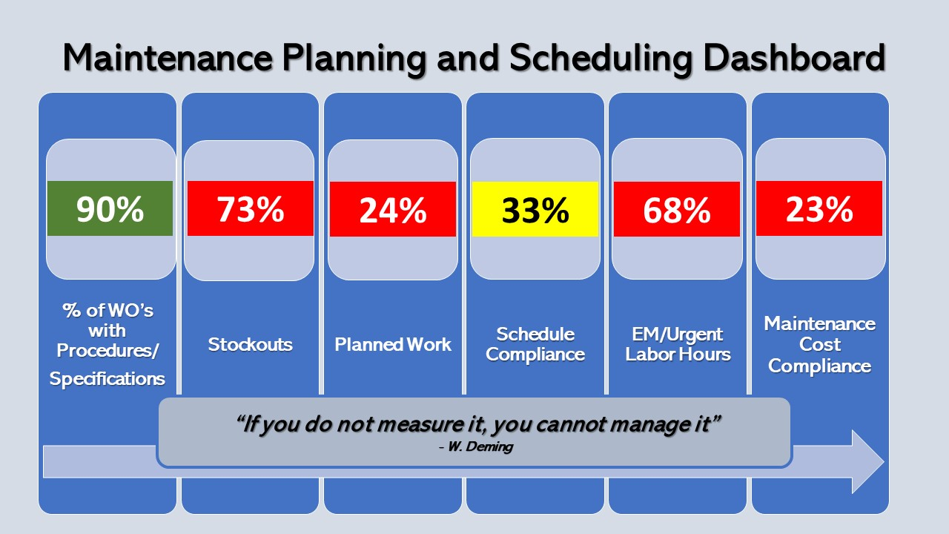
Do you need Dashboard?

Slide 99
Objective of Maintenance Planning and Scheduling
Objective of Maintenance Planning and Scheduling:
“To increase and optimize wrench-time”
Wrench-time Definition: “Hands on tool time”
World Class Wrench-time = 55-65%
Typical Wrench-time = 5-25%

Slide 100
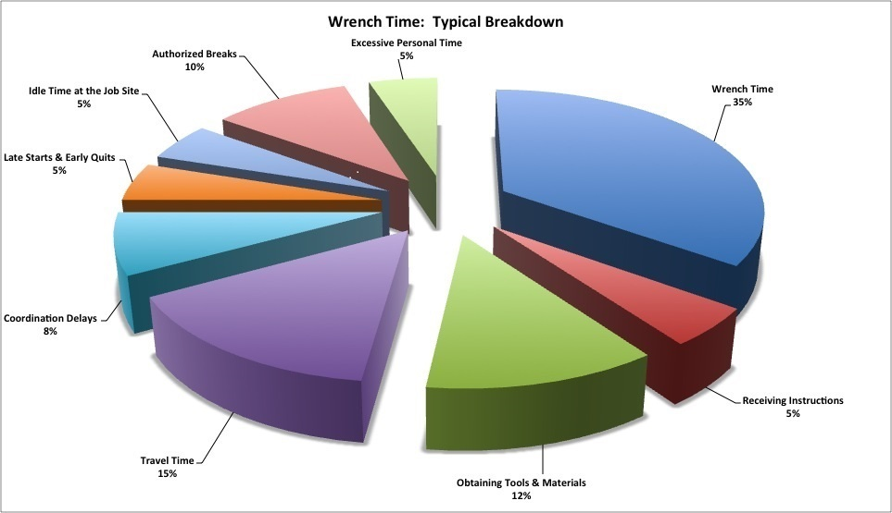
Planning and Scheduling Impact on
Wrench-Time “Hands on Tool Time”

Slide 101
Think about things that Impact Wrench-Time…
Late starts because:
  Equipment not available
  Maintenance techs looking for tools
  Maintenance Techs receiving instruction
  Maintenance Techs looking for parts
Equipment breaks down prematurely because:
  Could not complete all work scheduled
  No time to validate defect eliminated on equipment
  Did not have the right part as planned
Maintenance Techs frustrated because of:
  Lack of time to complete work complete work accurately
  Lack of Parts

Slide 102

What is your current Wrench-time?

Slide 103
Key Terms/ Definitions
Preventive maintenance (PM) - an equipment maintenance strategy based on replacing or restoring an asset on a fixed interval regardless of its condition.
Scheduled restoration and replacement tasks are examples of preventive maintenance.
Source: SMRP Best Practice

Slide 104
Key terms and Definitions
Preventive Maintenance (PM) are actions performed on a time- or machine-run-based schedule that detect, preclude or mitigate degradation of a component or system with the aim of sustaining or extending its useful life through controlling degradation to an acceptable level.
Predictive Maintenance (PdM) is an equipment maintenance strategy base on measuring the condition of equipment against known standards in order to assess whether it will fail during some future period and taking appropriate
action to avoid the consequences of that failure.
Also called Condition Based Maintenance (CBM)
Source: SMRP Best Practices

Slide 105
Key Terms and Definitions
Wrench-time – Wrench time is a maintenance metric used to measure how much time maintenance technicians spend doing actual work assignments
Maintenance Planning - what, how and time estimate for a job.
Maintenance Scheduling - Scheduling decides when and who will do the job.
Specification - "to state explicitly or in detail" or "to be specific". ... the conditions of a system or object after years of operation, including the effects of wear and maintenance

Slide 106
PLANT RELIABILITY
AS A RESULT OF
PROACTIVE MAINTENANCE
Notes:
`

Slide 107
Is your organization?
REACTIVE
VS
PROACTIVE

Slide 108
Why Did Proactive Maintenance Planning and Scheduling Come from?

Slide 109
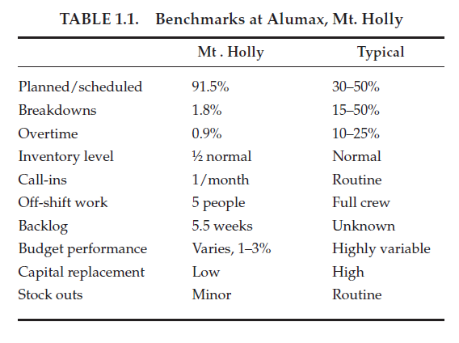
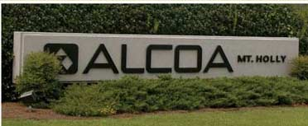
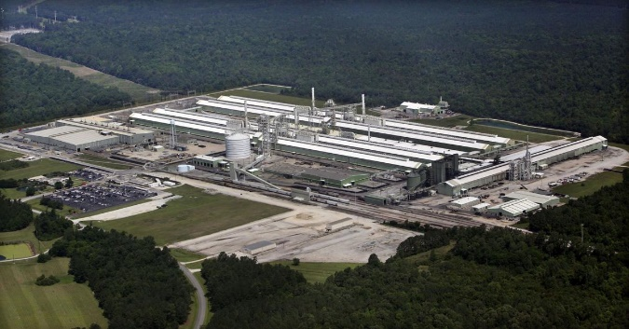
Founder of “Maintenance Planning and Scheduling” was John Day PE, Engineering/Maintenance Manager at Alumax Mt Holly
(purchased by Alcoa Mt. Holly in 2014 and spread this process worldwide)
John Day created Maintenance Planning and Scheduling to: “Minimize Human Induced Failure”, “Increase Hands on Tool Time (Wrench-Time)”, and to “ensure the right work was performed at the right time to specifications”
“World Class Wrench-Time is 55-65%, Typical Wrench-Time is 15-30%”

Slide 110
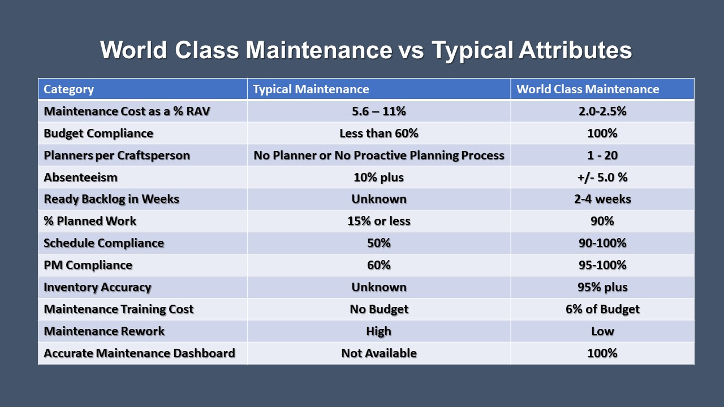
World Class Maintenance vs Typical Attributes

Slide 111
Attributes of
Maintenance Planning / Scheduling
Proactive
Reactive
90% of maintenance techs work in planned and scheduled
Schedule compliance is high, by day by week
Wrench-time is high
Planned work has defined parts and are kitted and prepared to execute
Planned and Scheduled work is adhoc at best
No parts kitting
Parts are expediated a lot
Stores is out of critical parts often
Wrench-time is low
Equipment manages itself

Slide 112
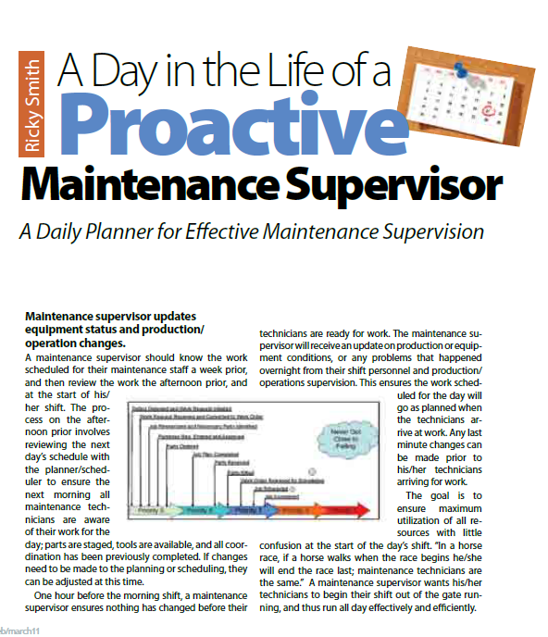
“Day in the Life of a Proactive Maintenance Supervisor”

Slide 113
“Day in the Life of a Proactive Maintenance Supervisor”

Slide 114
Proactive Maintenance
vs.
Continuous Improvement
Inherent Continuous Improvement
Implementation
Proactive Maintenance
Aggressive Continuous Improvement
Maintenance Performance Index
Current Performance

Slide 115
Maintenance Vision
The Maintenance Vision for the smelter is to provide an efficient continuous operating facility at all times through minimizing unscheduled / scheduled downtime and by approaching maintenance as an investment with a goal of minimizing the cost over the long run.

Slide 116

Maintenance Mission
The Maintenance Mission is to perform all proactive work to specifications (planned and scheduled) in order to ensure production has minimize losses.
SourceL:
Source: Alumax Mt Holly

Slide 117
MAINTENANCE STRATEGY
The Maintenance Vision
will be achieved through a
Total Proactive approach to
maintenance based on
CENTRALIZED,
PROACTIVE MAINTENANCE PLANNING
and
DECENTRALIZED EXECUTION
of the work.

Slide 118
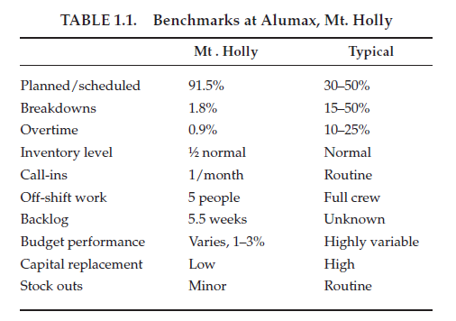
MAINTENANCE STRATEGY
The Maintenance Strategy will be achieved through a Total Proactive approach to maintenance based on “CENTRALIZED, PROACTIVE MAINTENANCE PLANNING and DECENTRALIZED EXECUTION” of the work.

Slide 119
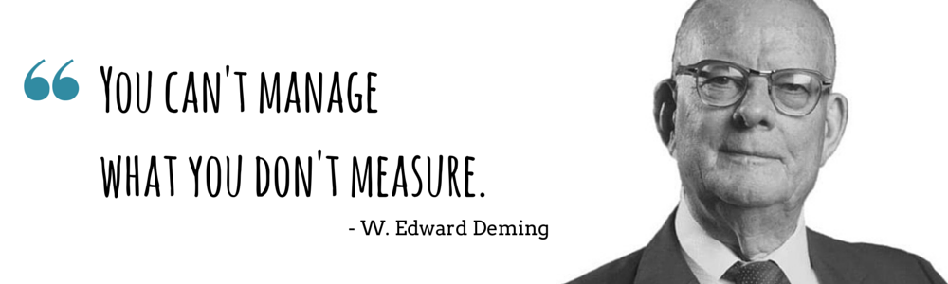
A MAINTENANCE MANAGEMENT SYSTEM (EAM/CMMS)
  Philosophy
  System
  Investment
    System Support Equipment
    Training
    Preparation
    Acceptable Facility
  Management Support

Slide 120
Maintenance PHILOSOPHY
Planned / Managed
Cost as Investment vs. Burden
Managed vs. Supervised
Decisions / Actions at Lowest Organizational Level
Supervisor as a Manager

Slide 121
Maintenance Function
  Maintenance Organization Responsible & Accountable
  Single Point Accountability for Costs, Uptime, Budget
  Frequency and Level of Maintenance
  Reporting Level for Maintenance
  Credibility
  Equal Partner

Slide 122
DEFINITION
DISCIPLINE

Slide 123
RESPONSIBILITY
AUTHORITY
ACCOUNTABILITY

Slide 124
MAINTENANCE INDUCED FAILURE
70%
SKILLS
MEMORY
SPECIFICATION
PLAN

Slide 125
REPAIR
To RESTORE by REPLACING a part or
putting together what is torn or broken: FIX
  Fix
  Restore
  Replace
  Recondition
  Patch
  Rebuild
  Rejuvenate

Slide 126
MAINTENANCE
The act of MAINTAINING.
MAINTAIN
KEEP in an existing state.
PRESERVE from failure or decline.
Keep
Preserve
Protect

Slide 127
THE EVENT LINE
EVENT
MOVING IN
THE
PRESENT
FUTURE
TIME
Figure #1

Slide 128
CULTURE = FILTER
CULTURE - Customary beliefs, social forms and material traits of a group.
FILTER - Separates out matter from stream that passes through.
C
U
L
T
U
R
E
F
I
L
T
E
R
Planned
Proactive
Maintenance
?

Slide 129
Cost of Maintenance
Proactive
vs.
Traditional
Maintenance cost - $
Current
Cost
Investment in
Proactive Maintenance
Return on Investment
Reduced Maintenance Costs

Slide 130
MAINTENANCE
PROCESS
IS A

Slide 131
THE
MAINTENANCE
PROCESS
CAPACITY
P R O D U C E S

Slide 132
THE
MAINTENANCE
PROCESS
AN
INFORMATION
DRIVEN
PROCESS
IS

Slide 133
MAINTENANCE
A SERVICES
ORGANIZATION
IS NOT
SERVICES = REACTIONARY

Slide 134
RESULTS
PROACTIVE
TYPICAL
Planned / Scheduled
91.5%
30-50%
Breakdowns
1.8%
15-50%
Overtime
0.9%
10-25%
Inventory Level
1/2 Normal
Normal
Call-Ins
1/Month
Routine
Off-Shift Work
5 People
Full Crew
Backlog
5.5 Weeks
Unknown
Budget Performance
Var. 1-3%
High Var.
Capital Replacement
Low
High
Stock outs
Minor
Routine
FIGURE #7

Slide 135
CAPACITY
ASSURANCE
(MAINTENANCE)

Slide 136
MAINTENANCE CONCEPT
CUSTOMER SERVICE( FUNCTIONAL)
CAPACITY SUPPLIER( PROCESS)
REACTIVE (BREAKDOWN)
PROACTIVE (PLANNED)
1. Planned product - quality, cost, service,
delivery, productivity.
2. Proactive - must anticipate customer needs.
3. Must develop plan & budget to provide capacity.
4. Must provide a specification product.
5. The product (capacity) must be considered and planned for as a whole.
6. Planning horizon is continuous from the present into the foreseeable future.
7. Anticipates future requirements based on
product (capacity) and equipment history.
8. Material Support is routine- near JIT
9. Provides an environment for good management practices.
10. Responsible for own credibility and reputation.
CHARACTERISTICS
1. Manageable maintenance backlog (float)
2. Capable of continuous product (capacity)
improvement.
3. Low breakdowns / trouble calls.
4. Controlled and lower costs.
5. Planned & negotiated work schedules.
6. Low stress working environment.
7. Must know all aspects of requirements to
produce the product (capacity).
1. Responds to needs, request, breakdowns.
2. Budget dependent on service request of customer.
3. Customer specifies requirements and schedule
4. Key - skilled people & tools available at required
time to do required work.
5. Customer limits investment in service capability.
6. Planning horizon begins with the service request.
7. Rapid response is essential.
8. Requests for service comes after the need exists -
no prior warning.
9. Material support usually difficult.
CHARACTERISTICS
1. May have excessive backlog - backlog difficult to
manage.
2. Service is usually breakdown / trouble calls
driven.
3. High cost - related to breakdowns and
rapid response.
4. Management is usually by urgent priority.
5. High stress working environment.

Slide 137



How many believe in Proactive
Planning and Scheduling?

Slide 138
Key Term and Definitions
Maintenance Planning:
Identifying the parts, tools, procedures, and standards, specifications required for effective maintenance work, increasing wrench time.
Maintenance Scheduling:
Scheduling of maintenance, operations, contractors, engineering , safety personnel to be at the right place at right time and conduct the right work synchronized together which is intended to minimize interruption to operations and production
Source :SMRP Best Practices

Slide 139
Planned Work
Planned work is the amount of planned maintenance work that was completed versus the total maintenance labor hours, expressed as a percentage.
Planning adds value for the craft worker through preparation and an understanding of work request prior to the commencement of work.
Maintenance planning is a highly skilled function that requires a basic knowledge of the maintenance work process, operations, project management, maintenance management system (MMS) and related systems, as well as a practical understanding of the work to be performed.
Planning is the “what’s required” and “how to” part of any maintenance job.
Source: SMRP Best practices

Slide 140
Planned Work Metric
This metric is designed to measure the amount of planned work that is being executed.
Planned work available for execution is identified by the planner. Any completed work done that was not planned is defined as unplanned work.
This is a measure of the effectiveness of the routine maintenance planning process.
It is a secondary indicator of craft utilization and can provide insight into wrench time improvement potential.

Slide 141
Planned Work Metric
Planned Work (%) =
[Planned Work Executed (hrs) ÷ Total Maintenance Labor Hours (hrs.)] × 100 The result is expressed as a percent (%).
Example: If a company spends 80 hours of Planned Maintenance and a total of 100 hours on all maintenance activities in a month then the Planned work % is 80%

Slide 142
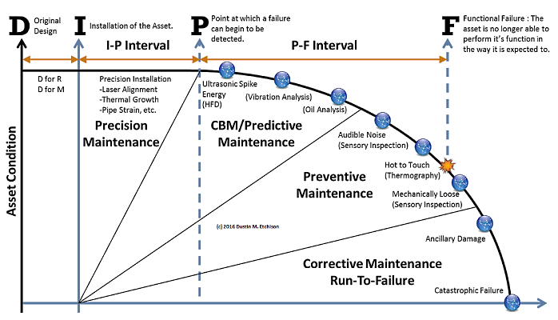
Preventive maintenance or Preventative Maintenance (PM) … is maintenance that is regularly performed on a piece of equipment to lessen the likelihood of it failing. It is performed while the equipment is still working so that it does not break down unexpectedly.
Predictive maintenance (PdM) techniques or Condition Monitoring (CM)
…are designed to help determine the condition of in-service equipment in order to estimate when maintenance should be performed

Slide 143
Traditional Maintenance
(Reactive Work Flow)
EVENT
ENGINEERING
FILE CABINET
TOOL BOX
“JOE”
SUPERVISOR
PRODUCTION
COMPLETE
WAREHOUSE
VENDOR
FABRICATE
IDENTIFY
INFORMATION
PARTS
NOTIFICATION
MECHANIC
FIX
TEST
CLEAN
DISASSEMBLE
MEASURE
PLAN
GENERAL PURPOSE
SPECIAL PURPOSE
PERSONAL
TOOL CRIB
CONTRACTOR
ASSESS
JOB
TOOLS
TIME
Notes:
143

Slide 144
Proactive Maintenance

Slide 145
Traditional Maintenance (Reactive Work) is 60-70% less efficient than Proactive Maintenance

Slide 146
Proactive Maintenance is Lower Cost than Reactive Work

Slide 147
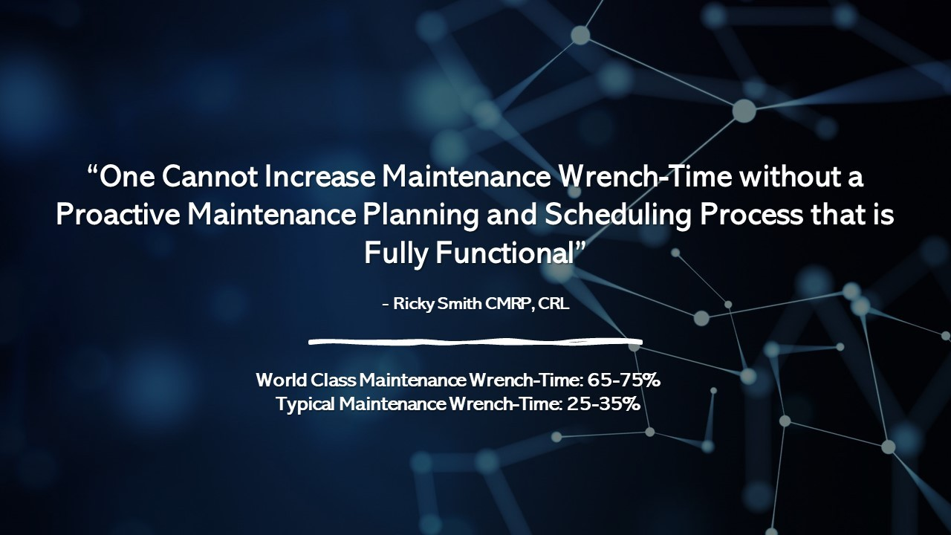

Slide 148
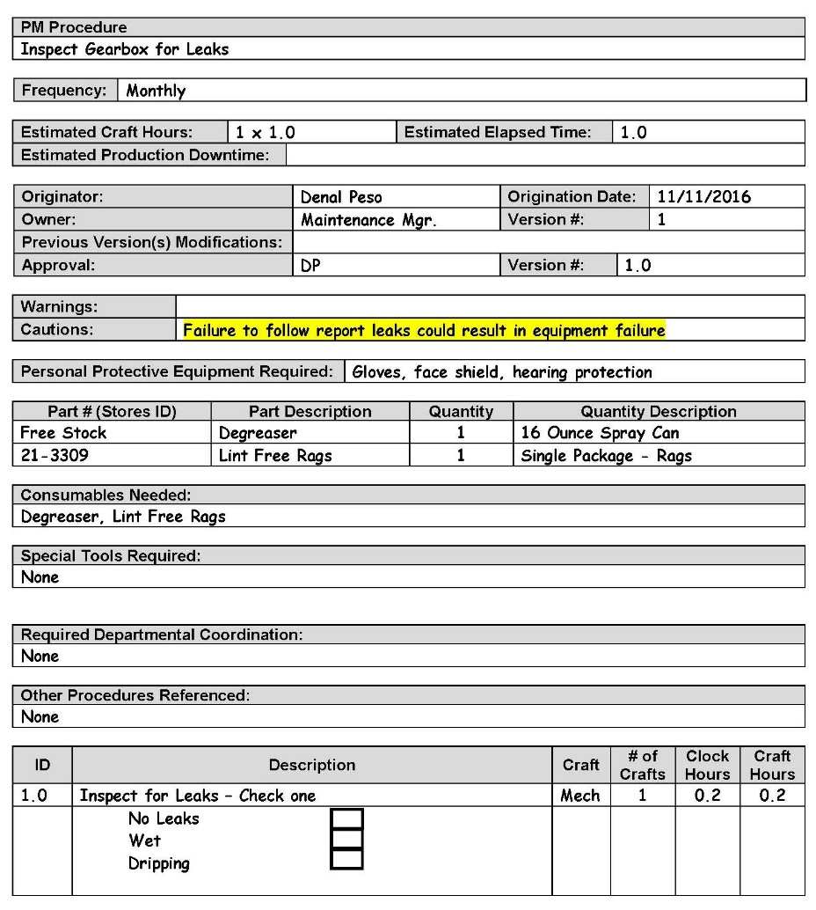
Repeatable Procedures are a Requirement
Why?
To reduced human induced failures
To continuously improve reliability of assets
If a failure occurs it is easier to change a procedure
“If you cannot repeat it, you cannot improve it”

Slide 149
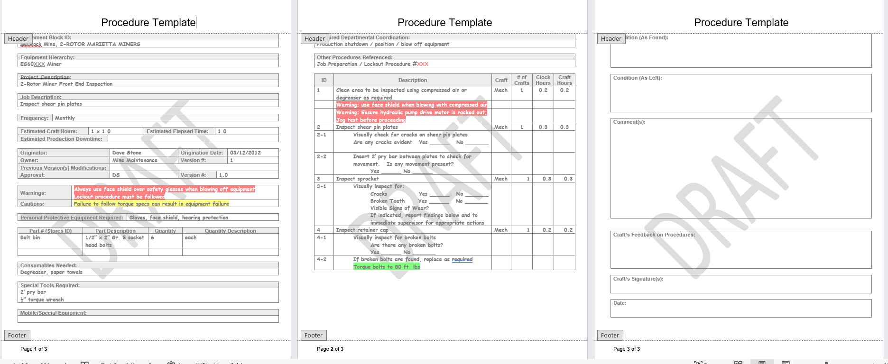
Procedure Template Example

Slide 150
Effectively Utilizing Work Management Technology - CMMS/EAM systems
All work captured by a work order/notification
All work orders/notifications must have the following:
  Asset Type/Number
  Component
  Estimated labor hours
  Type labor
  Estimate downtime
  Actual downtime
  Asset as found
  Asset as left
  Any items needed further investigation or repair
  Parts used by part number

Slide 151
ISO 14224 – Equipment Taxonomy
International Standard for the:
“Collection and exchange of reliability and maintenance data for equipment”
“Measure what you manage” – Dr Deming

Slide 152
Test - answer each question, be prepare to discuss
What is the definition of Maintenance?
What does operations expect from Maintenance?
What is the definition of Maintenance Planning?
What is the definition of Maintenance Scheduling?
From a scale from 1 -10 (1 – worst in class, 10 – world class) where is your current maintenance planning and scheduling?

Slide 153

Results from:
INCORRECTLY PRIORITIZED WORK
Work not accomplished at all
Work not accomplished on time
Work not accomplished to specification
Resulting in not meeting the intent of the end user
Notes:
14:57 – 15:00 3 Minutes
Based on the presenter’s experience, work prioritization is more emotional than risk based. Based on the presenter’s experience, the primary reason it is emotional is that production does not have confidence in either their backup equipment because their experience shows that the backup pumps often do not work. Or, fail soon after startup. The main focus is on means to produce and not on saving maintenance work and maintenance costs.
Paul Barringer stated that too much emphasis is placed on repairing pumps when a backup pump is running.
Another reason for emotion is the belief, backed up by experience, that maintenance will not take a request serious unless it is urgent or a priority. This is typical for reactive organizations with high break-in work levels. The larger the backlog of high priority items, the worse the chances are of any work, with a lower priority getting done.

Slide 154
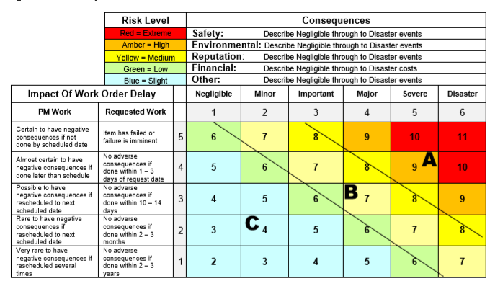
Developing a Work Prioritization System
“All work is not equal”
Source: Lifetime Reliability

Slide 155
Priorities, in most plants are often emotional NOT BASED ON FACTS
Source of conflict?
What is the Solution?
Have a consistent
Should be based on:
    Asset Criticality
    Defect Severity
    Time on Backlog
Notes:
15:04 – 15:07 3 Minutes
Requesters of maintenance work often only have the needs of their own production area in mind.
While their maintenance priority might be high for their area, it might be low when compared to production risks in other areas.
These jobs are often performed at the cost of other jobs that have more importance.

Slide 156
4-Way Prioritization Model
Asset Criticality | Defect Severity | Time on Backlog | Work Order Type
500 – Highest Criticality | 5 – Priority 1 (Most Severe) | 4 – Greater than 120 Days | 10 - Emergency
 | 4 – Priority 2 | 3 – Greater than 90 Days | 9 – Quality Compliance
1 – Lowest Criticality | 3 – Priority 3 | 2 – Greater than 60 Days | 8 – Results of PdM Inspection
 | 4 – Priority 4 | 1 – Less than 60 Days | 7 – Preventive Maintenance Inspections
 | 1 – Priority 5 (Least Severe) |  | 6 – Working Conditions/Safety
 |  |  | 5 – Planned Work Outage
 |  |  | 4 – Normal Maintenance
 |  |  | 3 – Projects and Experiments
 |  |  | 2 – Cost Reductions
 |  |  | 1 – Spares Equipment
Is this something you need to use in your organization?

Slide 157

Maintenance Backlog

Slide 158
Backlog Management
1.Work prioritizations also allows making sense out of their maintenance backlog
2. Maintenance backlog is very simple
The essential maintenance tasks to repair or prevent equipment failures that have not been completed yet
3. Maintenance backlogs can be developed from overall organizational perspective within smaller organizational groups or within categories

Slide 159
Maintenance Backlog
Maintenance Backlog is a list of maintenance work that have been approved but are not yet planned or scheduled for completion.
Formula for calculating maintenance backlog:
The formula for calculating maintenance backlog is: Backlog (in time units) = Total Estimated Hours of Work / Available Maintenance Hours Per Time Unit.
For example, if you have 1200 hours of backlogged work and your maintenance team can work 120 hours per week, your backlog would be 10 weeks (1200 / 120 = 10).

Slide 160
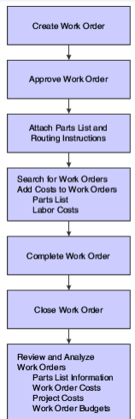
Effectively planning work –
Backlog management
Types of Backlog
  Ready Backlog – Ready to Schedule
    Measured by week via labor hours
    Example: 1 week backlog = Total Maintenance Labor Hrs. / # of technicians
  Total Backlog – measured in weeks
Backlog Status:
  Waiting Parts
  Waiting downtime
  Waiting contractor
  ??
Notes:
15:10 – 15:15 5 Minutes

Slide 161
Effectively Planning Work –Kitting
Kitting of parts typically are for future planned and scheduled work
Parts are kitting in secure area and is controlled by the Maintenance Planner
Storeroom personnel move parts for scheduled work from storeroom to kitting area
Parts and Material are staged in kitted area in specific number/letter designated areas which correspond to a specific work order

Slide 162
Effectively Planning Work – Kitting Cont.
Maintenance Planner has the only key – these parts are removed from stores inventory and can only be released by planner
All parts/material must be assigned to a specific work order
Canceled kits should be the exception not the rule
The supervisors in both operations and maintenance play a key role in a successful kitting process
All the points in the are vital; however, the final element for success is maintenance leadership
After each week lessons learned should be posted for all to see using the 2 up and 2 down rule

Slide 163
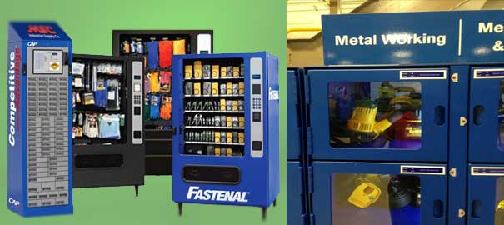
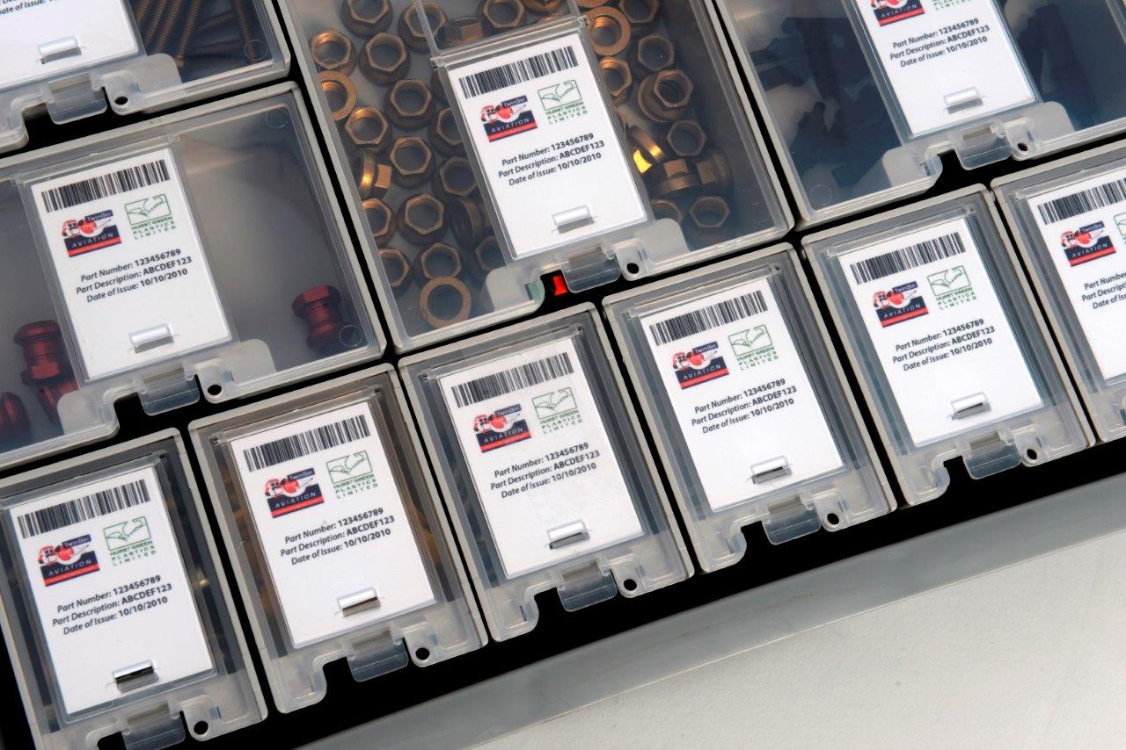
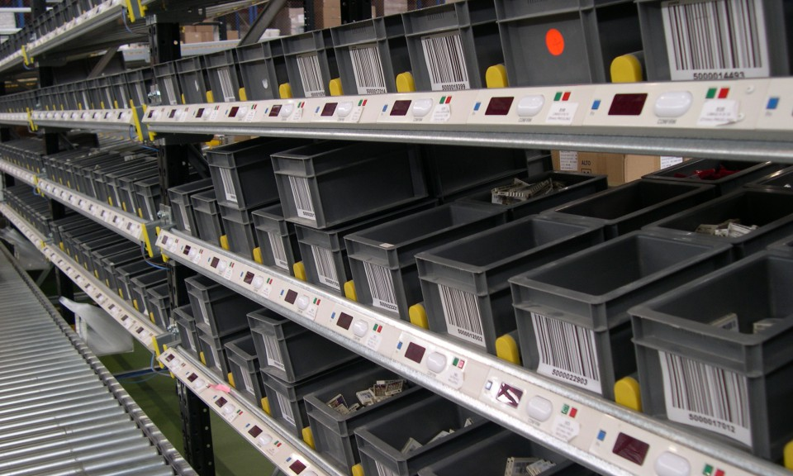
Examples of “Kitting”

Slide 164
Shutdown and Turnaround
The planed shutdown of equipment, production line, or process until to clean, change catalyst, and make repairs, etc. after a normal run.
Durations is usually in days or weeks; it is the elapsed time between shutting down the unit and putting the unit onstream/ online again

Slide 165
Effectively Planning Work for Shutdown Turnaround
1. Jobs must be identified via work order and charged to an asset/s
2. Each job must be scoped for labor, material, labor hours, parts,
coordination and outage duration.
Contractors must be identified, and coordination conducted with enough time to ensure the outage is completed on time and to specifications
4. All parts must be secured and stored in locked areas
Contractor meetings with maintenance, engineering and production at least X amount of months out for preliminary and final meeting 4 weeks before outage, with continued communication until outage
6. After the outage a “lessons learned” meeting should be held to
  Identify work that was accomplished correctly (make it repeatable)
  Identify work that did not go according to plan (must change/adjust before next outage) (POST TURNAROUND Mtg)
Notes:
15:25 – 15:30 5 Minutes

Slide 166


Currently, How do you measure Effectiveness?
Preventive Maintenance (PM)
Maintenance Planning
Maintenance Scheduling
Maintenance Execution
Equipment Reliability
MTBF, EM vs PM Labor Hrs
% of Planned Work
MTBF, Capacity, Compliance
MTBF, Rework, Maintenance Cost
MTBF, MTBR, Cost by Asset Type

Slide 167
Maintenance Storeroom

Slide 168
What is a Maintenance Storeroom?
A maintenance storeroom is a storage area for maintenance parts, repair parts, and operating supplies (known as MRO).
It stores parts and supplies for future use to avoid prolonged downtime, which could ultimately lead to a plant shutdown.

Slide 169

Proactive Maintenance and Spare Parts
Job Scoped
Parts In Stock
Parts Kitted
Job Scheduled
Job Completed to Specification
Possible Results with
  Reduced Cost
  Increase in Production Capacity
  Safety and Reliability is Optimized
  Stress is low
  Maintenance Rework is controlled

Slide 170

Reactive Maintenance and Spare Parts

Slide 171
Storeroom Clerk
STOREROOM CLERK:
Any employee who has responsibility for the day-to-day activities in the storeroom, measured as a full-time equivalent (FTE).
Also known by other titles, such as storekeeper, storeroom attendant, etc.

Slide 172
Storeroom Clerk
The storeroom clerk’s typical duties include, but are not limited to, the following:
  Issuing parts
  Stocking and labeling parts
  Organizing inventories
  Shipping equipment and materials (e.g. vendor returns, repairable spares, etc.)
  Picking, kitting, staging, delivering and related activities
  Counting inventory (e.g. cycle counting)
  Housekeeping
  Receiving activities (e.g. opening boxes, checking packing slips, noting discrepancies, etc.)

Slide 173
Materials Management Tracking of Parts
Keeping track of spare parts is a daunting task. A CMMS helps you get and stay organized by automating inventory purchasing, so you can have the correct parts when you need them, in the correct amount.
Many CMMS systems let you log all spare parts and note where they are stored, when they were purchased, how to use them and their availability at all sites across the organization.
Cont.

Slide 174
Materials Management Tracking of Parts cont.
This way, technicians know what parts they'll need for a repair or preventive maintenance task, where those parts are and how to use them.
Finally, a CMMS helps you maintain an optimal inventory through tracking inventory costs, referencing order history, cycle counts, usage data and first-in/first-out details.

Slide 175
Maintenance Spare Parts, cont.
A spare part, spare, service part, repair part, or replacement part, is an interchangeable part that is kept in an inventory and used for the repair or refurbishment of failed units/equipment.
Spare parts are an important feature of logistics engineering and supply chain management, often comprising dedicated spare parts management systems.
In an industrial environment, spare parts are described in several manner to distinguish key features of various spare parts.
The following describes spare part types and their typically functionality.
              Cont.

Slide 176
Maintenance Spare Parts, Cont.
Capital Parts are spare parts which, although acknowledged to have a long life or a small chance of failure, would cause a long shutdown of equipment because it would take a long time to get a replacement for them.
Capital Parts are typically repaired or replaced during planned overhauls/scheduled inspections. As description implies, these Capital Parts are typically expensive and are depreciated over time.
An example of Capital Part could be a pump and motor set used in industrial plant, or impeller or a rotor required for a pump or motor.
This “spare” requirement would be determined by redundancy of equipment used in the industrial processes.

Slide 177
Safety and Reliability
Safety requires attention to detail
Following Procedures mitigates failures
Not rushing a job or looking for Parts or Material
Effective Planning and Scheduling increases wrench-time and mitigates human error which results in equipment and personnel failures

Slide 178
Maintenance Materials Management Best Practices
Maintenance Materials Management is Critical to Success of any Organization and makes an impact on cost
Example of Cost Differences between WCM and Typical Organizations $220,000 ------ $48,0000

Slide 179

The Objective of a Maintenance Storeroom
“To Provide the Right Part/Material at the Right Time in like new condition to Maintenance”

Slide 180

Individual Exercise: ID Why Equipment Criticality Analysis is Important using This Document
“20 Minutes”

Slide 181
Impact of Planning & Scheduling on
Labor Resource Utilization
If this were your current state where would you want to be? | Percent of Day Spent
 | Typical Current | Target
Receiving Instructions* |  | 5
Obtaining Tools and Material* |  | 5
Travel* |  | 10
Coordination Delays* |  | 4
Idle at Job Site |  | 1
Late Starts and Early Quits |  | 10
Authorized Breaks and Relief |  | 5
Excessive Personal Time |  | 5
Subtotal |  | 35
Direct Work |  | 65%
5
12
15
8
5
5
10
5
65
35%

Slide 182

Maintenance/Reliability Process
“if a step in a process is skipped or performed at a substandard level it creates defects known as failures, the output of a health reliability process is optimal reliability at optimal cost”

Slide 183
Class Discussion:
What metrics do you use to measure…
The EFFECTIVENESS of your PM Program
The EFFECTIVENESS of Maintenance Planning
The EFFECTIVENESS of Maintenance Scheduling
The EFFECTIVENESS of the Maintenance Storeroom
The EFFECTIVENESS of Maintenance Work Execution

Slide 184

Planning’s Goal:
Identifying the parts, tools, procedures, and standards/specifications required for effective maintenance work, increasing wrench time.
“Planning is key to the success of Precision Maintenance”

Slide 185
You must have an effective plan
One must Must have: Repeatable Effective Procedure Tools Identified Parts identified and order or reserved in stores Parts must be kitted at least 2 weeks out Standards and Specifications Know Safety / Environment Hazards ID and Risk Assessed Coordination identified etc. % of Planned Work (90% Plus)

Slide 186

Scheduling Goal:
Scheduling maintenance personnel at the right time to minimize interruption to operations and production
“Performing the right work at the right time”

Slide 187
Maintenance Planning Metrics
% of Planned Work
% of Planned Work with Parts and Material Identified
% of Planned Work with Parts kitted

Slide 188


Do Not Fix What is Not Broke!
What is your current Wrench Time?
Do you see the same failures over and over?

Slide 189
Maintenance Issues
Most maintenance staff actually work 2-4 hours a day
  - Effective Direct work is low
  Lack of effective Planning
  Lack of effective Scheduling
70-80 % of equipment failures are Human-INDUCED
  Not using a Torque Wrench
  Not knowing specifications
  Not having the right part at the right time
  Improperly handling and installing bearings
  No Repeatable, Effective PM, Corrective, Lube Procedures
Notes:
189

Slide 190

A few Known Facts
PM Execution – 15%
Results from PM Execution – 15%
PdM Execution – 15%
Results from PdM – 35%
Wrench Time typical company – 10 to 30%
World Class Company – 55% +
Maintenance Cost (Reactive) 19%/RAV
Maintenance Cost (World Class) 1.7% RAV

Slide 191

Individual Exercise –
One thing you learned so far?
“one person at a time”
Simple Rule – if someone has stated “one thing”, you must come up with another one

Slide 192

“Your system is perfectly designed to give you the results you get”
            W. Deming PhD

Slide 193
What is Maintenance Planner?
Planning=What & How
What should be done& Understanding the definition of the work.
- Scope of work may require talking to requester and visiting job site.
Better able to identify tools, steps, procedures, specification, etc.,
- May break job into sub-tasks if job too large or complicated

Slide 194

Exercise: ID 2 things you learned from this document – 15 Minutes

Slide 195

Attributes of a proactive maintenance planner
Attribute: a quality or feature regarded as a characteristic or inherent part of someone or something.
Maintenance Planner is fully trained in Proactive Maintenance
Focuses on Future Work Only (supervisor handles todays problems)
Understands the impact of Maintenance Wrench-Time because of their efforts
Ensures parts/material are kitted before the work is scheduled
Works with Maintenance Supervisors and Production to ensure the schedule meets everyone’s needs
Manages the Scheduling meeting which is 30 minutes max, all parties agreed upon the schedule before the scheduling meet occurs
Publishes the Maintenance Schedule on Friday so Maintenance Supervisors can review the next week’s schedule with his/her team

Slide 196


Slide 197
Maintenance Delays and Losses
Non-planned and inadequate job plans
Getting parts and tools
Getting drawings
Waiting on availability, next job, coordination issues
Repeat repairs and rework encountering “unexpected” requirements
Failing to capture equipment history

Slide 198
8 Reasons why Maintenance Planning Fails
Bureaucratic use of work orders
Clerk-type tasks crowd out value added time
Poor spare parts and inventory controls
Conflicting ideas of what planning is
Not enough time given to planning
Planners taken off job, put on tools, or involved in daily activities (parts chaser, facilitating daily work)
Maintenance and Production not acting as a team
No system, unclear expectations, unclear roles and responsibilities

Slide 199

Exercise: 2 Things you Learned from this Document – 20 Minutes

Slide 200

Making Improvements in
Planning and Scheduling

Slide 201
Simple Rules for Maintenance Planners
Planners only focus on future work (next week, etc.)
Planners are not parts chasers
Planners must be disciplined in following the process to Plan and Schedule Maintenance Work
Planners must be respectful and patient
Planners require good and accurate information from Maintenance Technicians
It is the Maintenance Supervisors role to ensure accuracy of maintenance work order close out information

Slide 202
Planner Responsibilities
Identify all parts and material required for all scheduled work
Identify specifications for all work
Provide Necessary Drawings For Jobs
Ensure Drawings Are Revised & Current
Arrange For Special Tools & Equipment
Coordinate Equipment Downtime With Production
Provide Cost Information From Equipment History
Assist With Development Of Annual Overhaul Schedule
Publish Negotiated Weekly Maintenance Schedule

Slide 203
Planner Qualities
Experienced Craftsman And Well Respected
Understands The ”Maintenance Process”
Comfortable With Engineering Drawings & Simple Sketches
Self Motivated And A Visionary Type Person
Able To Express Self Well With All People
Good Administrative Skills
Is A Leader

Slide 204
Test – Text in your answers
What is the definition for Maintenance Scheduling?
What one metric do you use to measure “Maintenance Work Effectiveness”?
Schedule Compliance is measured using what formula?
Maintenance Rework is what?
If you were to perform PM on equipment that continues to break down what is your recommendation?

Slide 205

Roles and Responsibilities using RACI
A responsibility assignment matrix, also known as RACI matrix or linear responsibility chart, describes the participation by various roles in completing tasks or deliverables for a project or business process. Wikipedia
RACI is used to ensure everyone is aligned

Slide 206

Exercise:
Create a RACI Chart for the Maintenance Planning / Scheduling Process
Steps
See RACI Chart Exercise Handout
20 Minutes

Slide 207
Guiding Principles
"Guiding Principles" are a broad philosophy that encompass your personal beliefs and values and guide an organization throughout its life in all circumstances, irrespective of changes in its goals, strategies or type of work.
They create a company culture where everyone understands what's important.
“What would be an example of a Guiding Principle for Maintenance Planning?”
What would be an example of a Guiding Principle for Maintenance Scheduling?

Slide 208
Guiding Principles
Planner | Scheduler | Stores Manager | Maintenance Supervisor | Production Supervisor
Ensures Plan meets the intent of end users | Ensures schedule can be obtained. | Ensures parts are on time and placed in Kitted area Notify planner on parts status | Ensures resources are available to execute the plan to standard | Coordinates and Cooperates with Planner for Coordination of work

Slide 209
Scheduling Guiding Principles
Planned Jobs must have all parts on site and kitted before being schedule.
Availability of equipment must be communicated to maintenance at least 7 days advance.
Perform an after-action review on any shutdown over 4 hours.

Slide 210
Management Guiding Principles
Planners focus on work not yet started
Deliverable: one week of work backlog that is planned, approved, and ready to execute
No crew work
No parts chasing for jobs in progress
Supervisors and crew leads handle the current day’s work and problems

Slide 211
Individual Exercise
Identify one guiding principles for Maintenance Planning and one guiding principle for Maintenance Scheduling

Slide 212
The Challenge of Sustaining Improvements
Two-thirds of improvement initiatives fail to meet expectations
Only 3% report great results
Out of over 1000 are either trying or have tried to implement Planning and Scheduling with only 3 are operating to standard.
“Are you up for a challenge?”
“The rewards are awesome!”

Slide 213
Planning and Scheduling Improvements
Understanding concepts is simple
Application is tough
  Tyranny of the urgent moment
  Too much on the plate?
  Combating one issue after another
  Not making this a priority locally
  Waiting for someone from above to force it to happen
  Not giving the planner enough time

Slide 214

Planning and Scheduling: Best Practices
Planning function requires:
  Effective Work Procedures
  Backlog Measured
  Work cannot be scheduled until planned and parts kitted
Defined roles and responsibilities
Management framework with training, audits, and metrics
Guiding Principles Defined

Slide 215
Planning and Scheduling Standards
Hallmark of world class
Consciously developed, best demonstrated practice
What they do:
  Enable consistency
  Reduce variation
  Provide basis for improvement
  Enable accountability
Standardization is not documentation
However, documentation enables standardization

Slide 216
End of Day 2
One thing you learn today

Slide 217

Day 3
Maintenance Planning and Scheduling

Slide 218

Planning

Slide 219
Planning’s Efficiency and Effectiveness Depend On:
Scope
Specifications / Repeatable Procedures
Skills required
Specific safety hazards
Special tools and equipment
Estimated duration and crew size
Parts Kitted (Eyes on the Parts)
Getting real feedback
Identify potential waste / losses and eliminate
Metrics / KPIs

Slide 220

A Place for Everything?
Everything in its Place?

Slide 221

Organized for Efficiency
Everything has an identified place where things are put back after use
Everyone knows the system and follows it
Finding tools and equipment is much faster
People are more productive instead of spending so much time on non-value-added “looking” for what they need

Slide 222
Maintenance Planning and Scheduling Metrics
Leading KPIs Lagging KPIs
  Schedule Compliance Production Cost
  % of Planned Work Rework
Schedule Compliance
The metric is a measure of adherence to the maintenance schedule expressed as a percent of total time available to schedule.
Rework
A rework is any piece of equipment that fails within 60 days or less after completion of a repair work order.
Several factors can cause a rework: Poor operating procedures. Improper maintenance procedures. Subpar materials and parts.

Slide 223
Individual Exercise – Text me One thing you learned so far?
“one person at a time”
Simple Rule – if someone has stated “one thing”, you must come up with another one

Slide 224




It isn’t what you know that will kill you, it is what you don’t know that will

Slide 225





“Your system is perfectly designed to give you the results you get”
            W. Deming PhD

Slide 226

Exercise: Assess the Current Utilization of your Maintenance Staff – 15 Minutes

Slide 227


Slide 228

Reliability
Meeting the functional requirements of the end user

Slide 229

Safety and Reliability
Injury Rate (% of Base)
OEE (% of Base)
Month
OEE
Injury Rate
Source: The RM Group, Knoxville, TN

Slide 230

Cost Comparison of Maintenance Programs
Maintenance Cost per Horsepower
Run-to-
Failure
Preventive
Predictive
Precision
Source: EPRI Power Generation Study

Slide 231

A Few Ideas

Slide 232
World Class Standards
PM Execution – 15%
PM Results – 15%
PdM Execution – 15%
PdM Results – 35%
Total Work “Planned” – 90%
Reactive Work – Less than 2%
Stock-outs – less than 2%
Scheduled compliance by day/week – 85 to 90%
Failure Reporting, Analysis, Corrective Action System in place and eliminating failures by changing maintenance strategy and equipment modifications
Work orders are closed out with ALL Codes ID

Slide 233

World Class Standards

Slide 234
Dr. Deming:
“Your system is perfectly designed to give you the results you are getting.”

Slide 235


Nowlan and Heap Study further stated…
“…A failure is an unsatisfactory condition. In other words, a failure is an identifiable deviation from the original condition which is unsatisfactory to a particular user.”

Slide 236


What is a Failure?
“A functional failure is the inability of an item (or the equipment containing it) to meet a specified performance standard and is usually identified by an operator”.

Slide 237



What is a Failure?
“A potential failure is an identifiable physical condition which indicates a functional failure is imminent and is usually identified by a Maintenance Technician using predictive or quantitative preventive maintenance”

Slide 238
Reactive Maintenance Attributes
Ineffective or No Planning and Scheduling
PM Compliance has a wide variance
Performing PM on Equipment that continues to breakdown
Overnight deliveries sit for weeks, months
Everyone works as hard as they can with little if any movement seen toward proactive
Storeroom is Chaos (people standing in line at 7:00am waiting on parts)
Contractor replacing equipment with no one validating if the defect was eliminated or work was completed accurately

Slide 239
Variation is Your Enemy - Causes
Lack of Discipline in maintenance execution
The wrong maintenance approach to reliability
Production not operating the equipment to standard
PM Compliance is Too Wide
Doing Too Much PM
No standards or specifications

Slide 240

Problems
  Maintenance – Most Companies
    Direct work is low (wrench time is less than 25%)
    Lack of effective Planning – Planning is not defined
    Lack of effective Scheduling – Delays are common
    Storeroom is dysfunctional
Notes:
240

Slide 241

70-80 % of equipment failures are
“Human-Induced”
Putting hydraulic fluid into a reservoir without filtering
Welding on equipment without grounding properly
Running Equipment to Failure when it is not part of your maintenance strategy
Aligning couplings without using a laser
Improperly lubricating electric motors
Not using PdM Technology Effectively
No effective, repeatable work procedures with specifications.
Electricians not using a Torque Wrench

Slide 242

Number 1 – Awareness of a Problem (baby steps)
Track Self/Human Induced Failures
Set up a chart listing these failures and causes / No names or blaming
Establish an atmosphere of calmness but focused
Use Tool Box Training Sessions
Apply the “D” Word (Discipline)
“You cannot change an environment overnight”

Slide 243

Exercise: ID How your KPIs Match Up with this document
“30 Minutes”

Slide 244

Exercise (15 Minutes): Steps to Optimize Maintenance Planning and Scheduling

Slide 245
Maintenance Process
The Maintenance Process is like a supply chain, if a step is skipped or performed at a substandard level it creates defects known as failures. The output of a healthy maintenance process is optimal asset reliability at optimal cost.
- Ron Thomas
Former Reliability Manager
Dofasco Steel
Hamilton, Ontario

Slide 246

Where does Maintenance Planning Begin?

Slide 247

Our Goal
Failure Elimination
Failure Management

Slide 248

PF Curve with Priorities
Identify defect, Plan and Schedule Work Zone
100% Reactive Work

Slide 249

PF Curve and Managing Proactive Maintenance
Ultrasound Detected a Defect
Point P
Point F

Slide 250
Proactive Maintenance

Slide 251

Work Priority Distribution
Priority 1 and 2 Work is Reactive
Priority 3, 4, and 5 Work is Proactive

Slide 252

Work Priority Distribution – a Few Simple Rules
EMERGENT work is anything
that is done as a Priority 1 or 2
CORRECTIVE work is
anything done as a result of an inspection
CORRECTIVE work should never be done as a P1 or P2
ROUTINE work is anything
done as a PRIORITY 3
CORRECTIVE work should be
done as a Priority 4 and 5
Most CORRECTIVE work
should be done as P4 or P5 if
you embrace P-F mentality

Slide 253
PF Curve - Planning and Scheduling

Slide 254
What are Work Procedures?
Preventive Maintenance
Corrective Maintenance
Operator Care
Lubrication

Slide 255


World Class–Effective/Repeatable Work Procedures
Standards/Specification
Step by Step Procedures
Coordination
Safety/Environmental warnings and cautions
Used on all work which a failure could occur
Use Subject Matter Expert to write a procedure
Develop a Process Map for Procedure Approval

Slide 256

PM Execution

Slide 257
Variation in PM Execution – 30 Day PM
58 Days
3 Days
28 Days
1
28
2
28
1
28
June
July
August
High Variation in Your PM Program
“Apply the 10% Rule of PM”
30 day PM = 3 Days or out of compliance

Slide 258
Sounds Easy – The Issues
Variation – a serious problem causing planning and scheduling to fail
  Human-Induced Failures, 80% plus
  PM Variation is a killer
  PMs not focused on Failure Modes
  No repeatable maintenance procedures with specifications and standards
  Metrics, no performance metrics which impact asset health
  Operators not operating equipment to specification
  Management not managing consistently (using wrong KPIs)

Slide 259


Group Exercise 14
Situation: scope the changeout of the electric motor shown using the “Scoping Checklist”
30 minutes

Slide 260
What did you learn from this exercise?

Slide 261
4 Steps to Optimization Planning and Scheduling

Slide 262
Step 1: Established a Proactive Maintenance Philosophy
Established the Maintenance Vision will be achieved through a Capacity on Demand approach.
The Maintenance Strategy is to execute planning and scheduling proactively Optimizing asset reliability at optimal cost.

Slide 263
Step 2: We defined “Maintenance”
MAINTENANCE
The act of MAINTAINING.
MAINTAIN
KEEP in an existing state.
PRESERVE from failure or decline.
Keep
Preserve
Protect

Slide 264
“The significant problems we face cannot be solved with the same level of thinking we were at when we created them.”
“Albert Einstein”
Step 3 – We began to change the culture

Slide 265
Maintenance Planning and Scheduling
Planned work is work that has gone through a formal planning process to identify labor, materials, tools and safety requirements.
This information is assembled into a job plan package and communicated to craft workers prior to the start of the work.
Scheduled maintenance is a list of predetermined maintenance actions carried out at regular time intervals that are aimed at the prevention of breakdowns. ...
“The primary goal of scheduled maintenance is to prevent equipment failure before it actually occurs”

Slide 266
Individual Exercise – One thing you learned so far?
“one person at a time”
Simple Rule – if someone has stated “one thing”, you must produce another one

Slide 267
Planning’s & Maintenance Relationship
Key Element:
Communications

Slide 268
Planner / Supervisor Communications
Meet Twice Daily
Morning
  - Review Previous Day’s Work & Future Work
Afternoon
  - Deliver Next Day’s Work Orders
  - Scope Future Work For Plan, Materials, Equipment

Slide 269
Planner - Crew Supervisor Communications
Planner & Crew Supervisor Work As A Team.
Both Share Common Goals
Maintain Equipment At Capacity
Meet Crew Budget Requirements
Identify Recurring Problems To Reduce Equipment & Increase Reliability

Slide 270
Planner / Maintenance Crew Relationship
Communication Major Factor
Feedback from PM’s Provides 85 - 90% Of Repair Work Orders
Input To Maintenance Equipment B.O.M.’s
Revision Suggestions To PM Text
Repair / Process Improvement Suggestions

Slide 271
Work Order (WO)Development
Communication and Types of Feedback
  Repair Work/Corrective Maintenance
  Job Estimate Recommendations
  PM Frequency Changes
  Work Order Text Revisions
  Bill of Materials Additions / Deletions

Slide 272
Work Order Development
Identified Work is Communicated By:
  Completed Inspection/Lube W/O’s
  CMMS Electronic Request
  Mail
  E-Mail - Interoffice
  Telephone
  Face-to-Face

Slide 273
Work Orders –
Ready for Schedule
Work Order Reports and Parts Complete Report Reflect When Work Orders Are Ready to Schedule. (all parts are on hand)
Proposed Schedule Reviewed With Supervisor Prior to Production - Maintenance Planning Meeting.
- W/O’s With Schedule Date - Automatically on Weekly Schedule
- W/O’s With-out Schedule Date - Manually Listed on Weekly
Schedule as Potential Work.

Slide 274
Development Of Weekly Maintenance Schedule
Open Work Order Report
Preliminary Schedule, 30% (Computer Controlled) Inspections & Lubes
Maintenance Recommended Work Items
Overhaul Schedule
Production Priority Items
WEEKLY SCHEDULE

Slide 275
Production / Maintenance Weekly
Planning Meeting
PLANNERS - Host the meeting
SUPERVISOR - Maintenance
PRODUCTION - Area Production Liaison
ENVIRONMENTAL - Representative
ENGINEERING – Any Engineers with Projects to be Planned or Scheduled
-Scheduling-
A Face - to - Face Process

Slide 276
Planning and Scheduling Workflow
READY WORK
ORDER
LISTING
PRELIMINARY
WEEKLY
SCHEDULE
PM PROGRAM
PRELIMINARY WEEKLY
SCHEDULE AS MAINTENANCE
SEES IT
PRELIMINARY WEEKLY
SCHEDULE AS PRODUCTION
SEES IT
X_______________
X_______________
X_______________
X_______________
X_______________
X________________
X________________
X________________
X________________
X________________
X________________
X________________
X________________
X________________
X________________
X________________
X________________
X________________
X________________
X________________
X________________
X________________
{
X_____________________
X_____________________
X_____________________
X_____________________
X_______________
X_______________
X_______________
X_______________
X_______________
X_______________
X_______________
X_______________
X_______________
X_______________
X_______________
X_______________
}
X________________
X________________
X________________
X________________
X________________
X________________
X________________
X________________
X________________
X________________
X________________
X________________
}
PRODUCTION
PRIORITY
ITEMS
30 %
PM
30%
COMPUTER
CONTROLLED
GREATER
THAN
100%
FINAL WEEKLY
SCHEDULE
AS NEGOTIATED
PLANNER /
MAINT. SUPERV.
{
X_______________
X_______________
X_______________
X_______________
X_______________
X_______________
X_______________
X_______________
X_______________
X_______________
X_______________
X_______________
X________________
PM
30%
COMPUTER
DEVELOPED
PRODUCTION
INPUT PRIORITY
{
DAILY SCHEDULE
MAINTENANCE
INPUT PRIORITY
{
X_____________________
X_____________________
X_____________________
X_____________________
X_____________________
X_____________________
DEVELOPED BY
PLANNER &
SUPERVISOR
{
PROD. / MAINT.
COMMON
--------- SCHEDULING --------
A FACE TO FACE PROCESS

Slide 277
Successful Planning Meeting Factors
TEAMWORK
- “Equal Partnership”
HONESTY
- Open Communication
- Straight Forward
- Trust
CREDIBILITY
- Meeting Commitment
- Continuous Improvement

Slide 278
Final Weekly Schedule Negotiated
Maintenance
Production
30% Maintenance Work - Inspection & Lubes
Production Input Priorities
Maintenance Input Priorities
Routine Work Not Affecting Production

Slide 279
The Results
“Actual Real Case Study”
Capacity increase 50% in the first month
Cost increase for 6 months and then production and maintenance cost dropped to the lowest level ever with capacity exceeding Plant “Name Plate”
Cancelled multi-million dollars plant expansion

Slide 280

Exercise (30 Minutes): Day in the Life of a Proactive Maintenance Technician

Slide 281
Individual Exercise : 30 Minutes
What did you learn from the class this week?
Be Prepared to discuss your lessons learned and how these problems could be handled.

Slide 282

Exercise: Identify Why Work Orders should be closed Properly - 15 Minutes

Slide 283

Final Exercise – 30 Minutes
Create Master Plan so you can make a difference in your department

