Slide 1


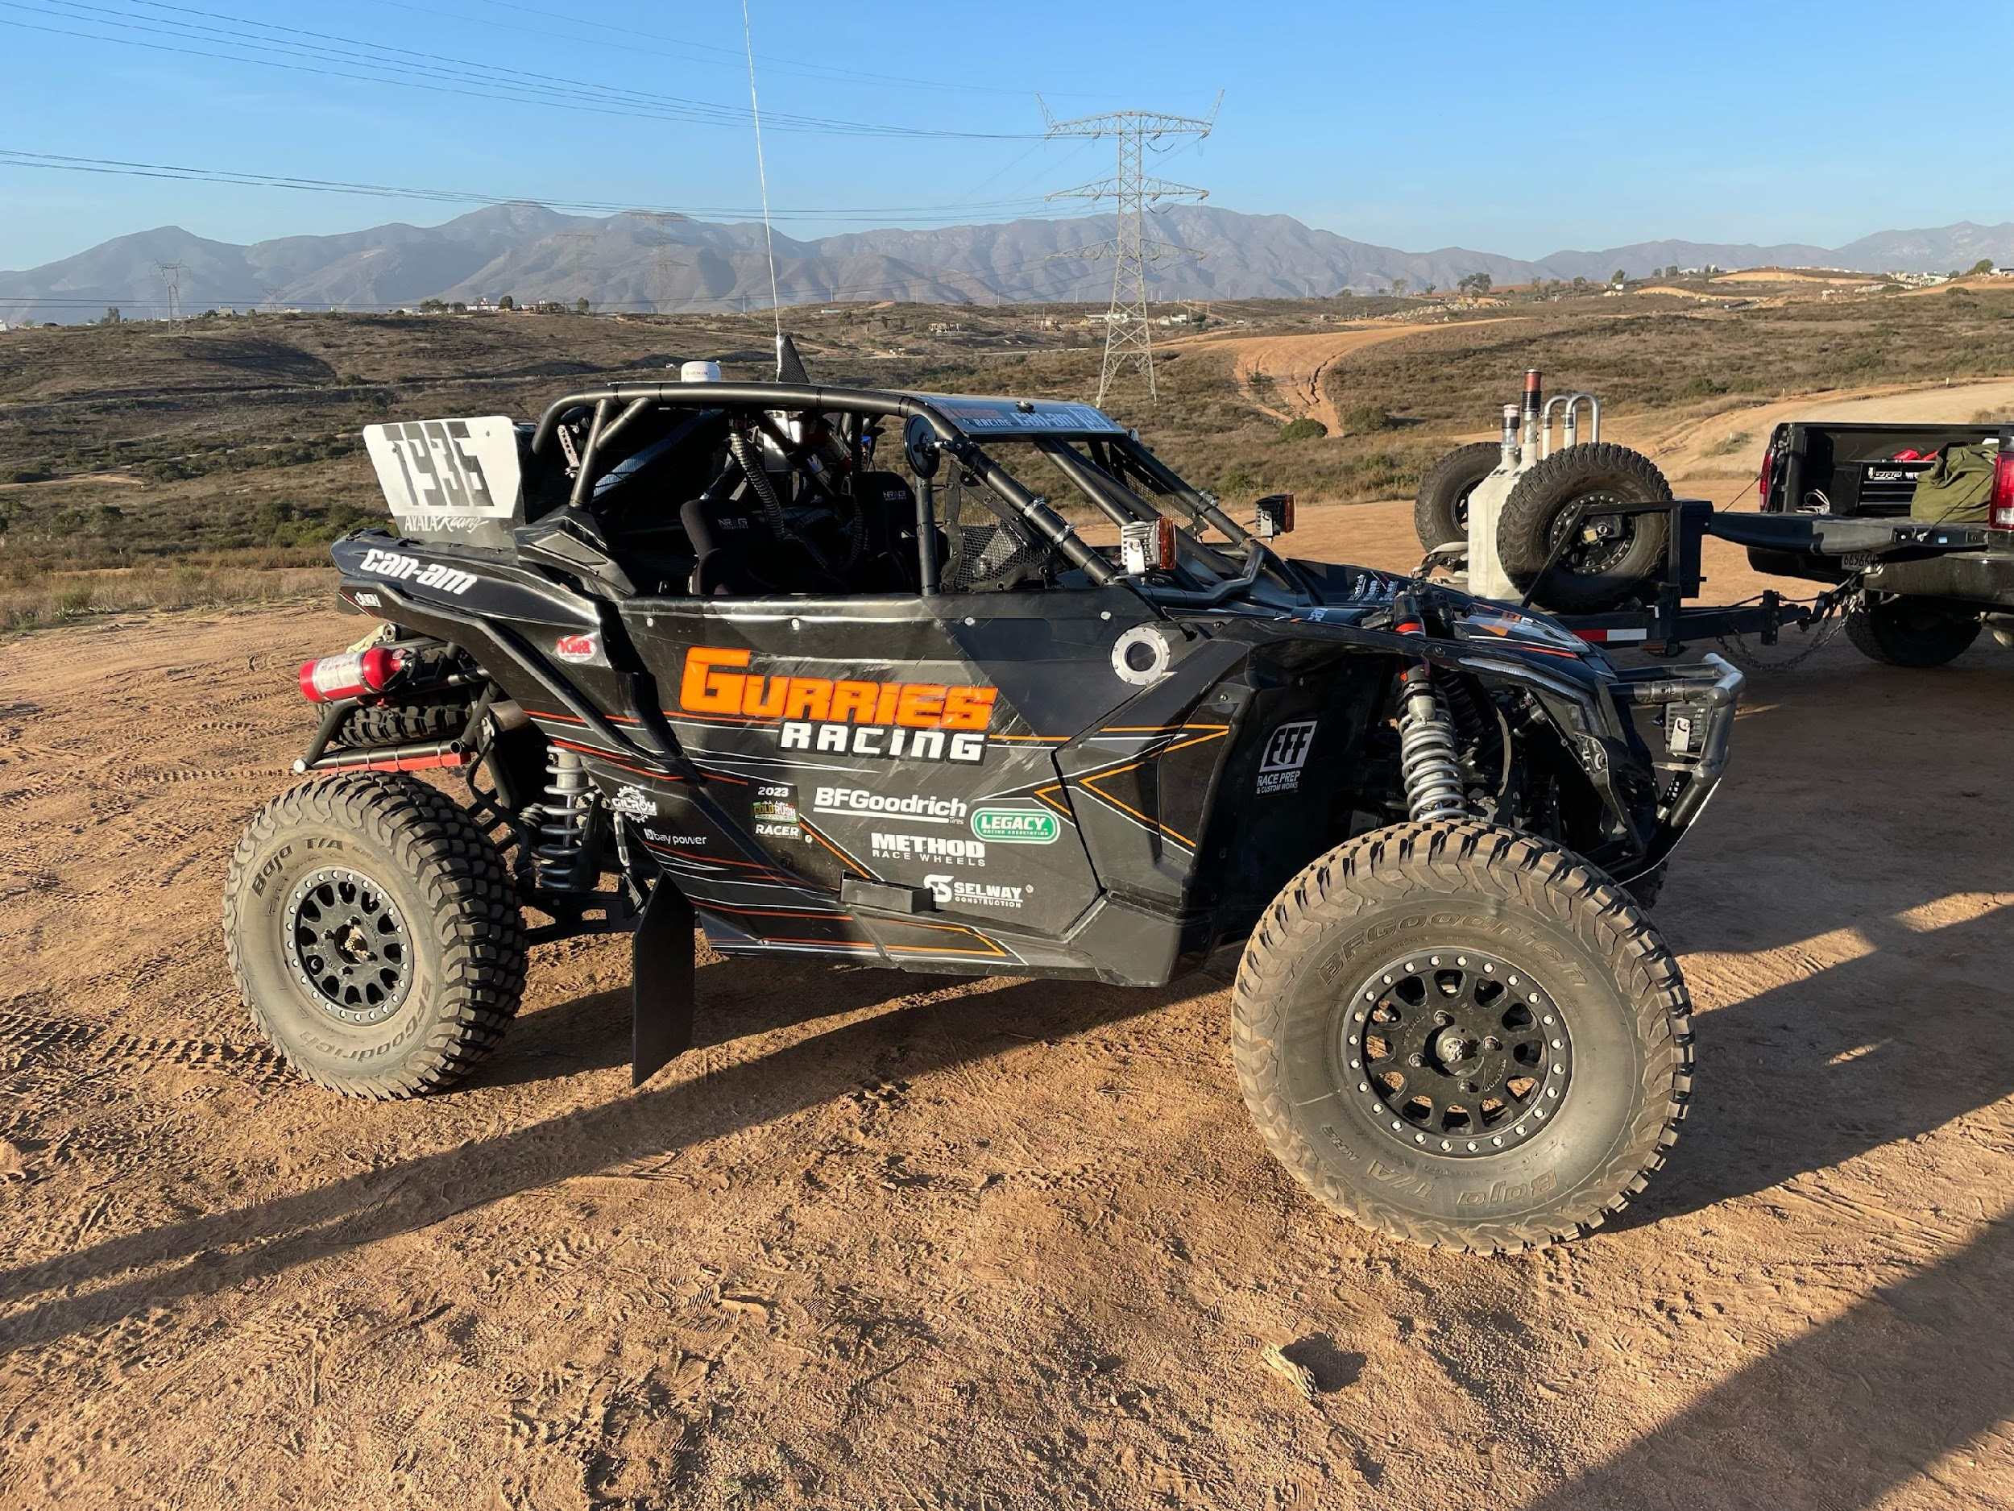
Sponsorship Proposal

Slide 2
About Gurries Racing
Our team is comprised of business owners, mechanics, and speed feens. We are a group of friends who have been going together to the SCORE races in San Felipe for over 10 years. We formed a team in 2018 and have never looked back. We have built two race-cars together, as well as multiple pre-runner race-cars and chase trucks. Our driver and team manager, Nicholas Gurries, is dedicated and hard-working. He manages a successful electrical contracting business, Gurries Electric, in the Bay Area.

Slide 3
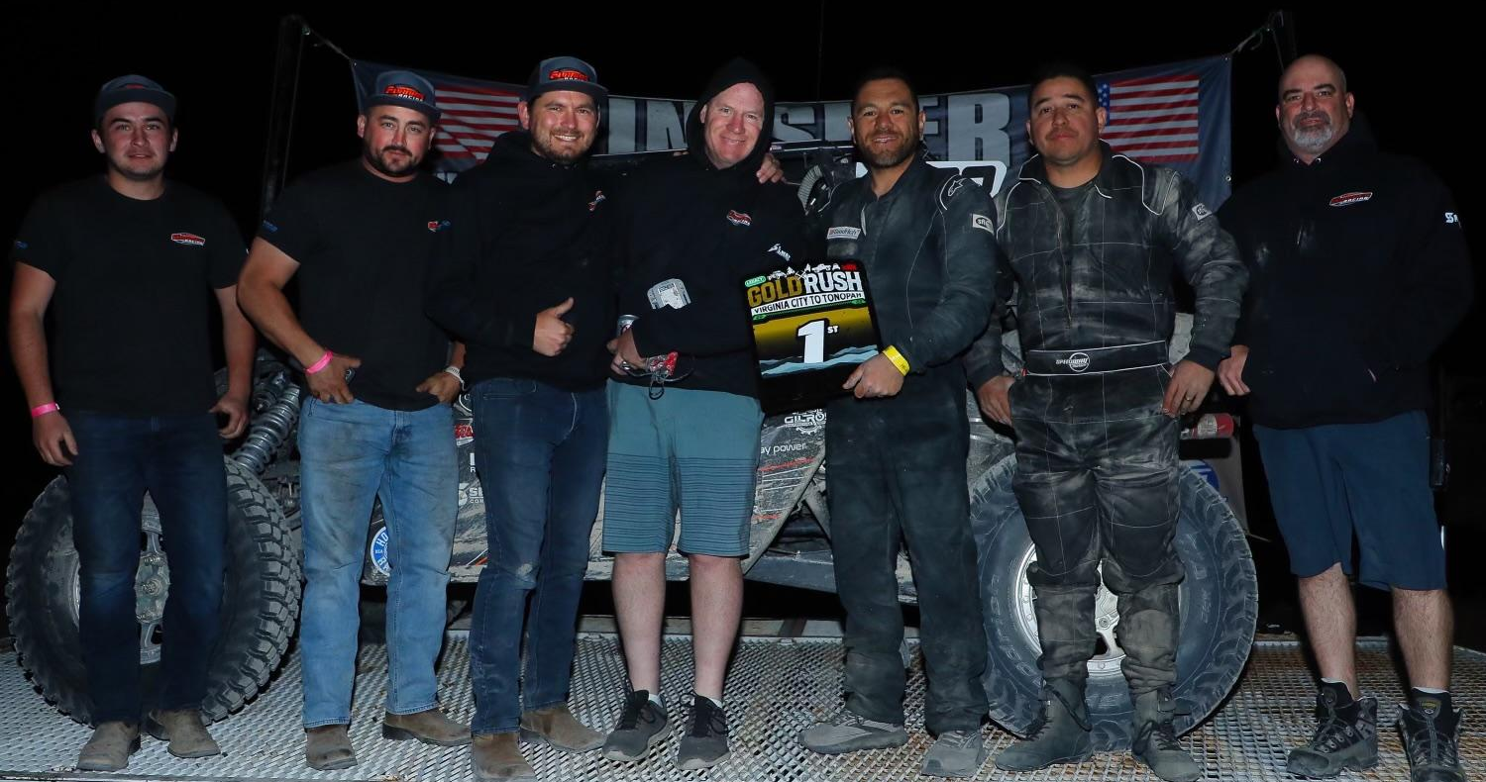
Meet Our Team
Drivers:
Nicholas Gurries
Fito Ayala
Co-drivers/Navigators:
Marcos Galdamez
Richard Boomer
Pitman:
Tyson Lewis
Chris
Anthony Sipe

Slide 4
2023 Gurries Racing Successes
Race | Date | Placing
Legacy Baja Nevada | May 10 | First Place (Day 2)
Vera Stomping Grounds, 300 | September 13 | First Place
Legacy Gold Rush | October 19 | First Place
Legacy Stateline Shootout | November 30 | First Place

Slide 5
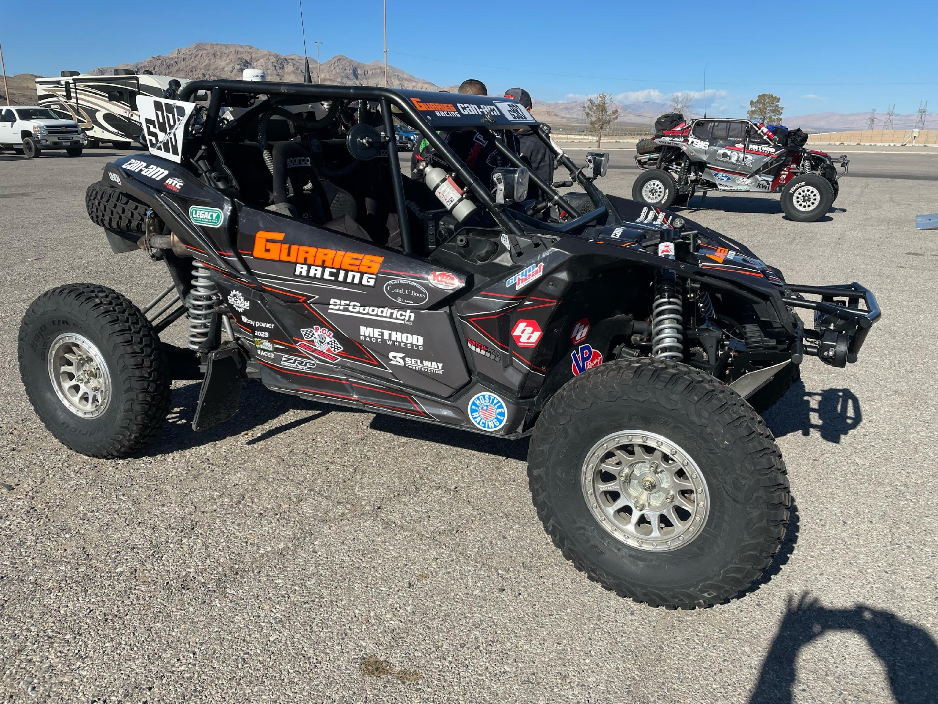
2023 CAN-AM X3

Slide 6




Upcoming 2024 Races
Event | Location | Date
Parker Dam 500 | Parker, AZ | February 21-25
Frontier 500 | Pahrump to Dayton, NV | April 18-21
Baja Nevada | Nevada | June 26-30
Dirt Rebelution | Cedar City, UT | August 2-3

Slide 7


Upcoming 2024 Races
Event | Location | Date
UTV Freedom Ride | TBA | September 19-21
Gold Rush | Virginia City to Tonopah, NV | October 10-13
4WP Desert Showdown | Pahrump, NV | December 5-8

Slide 8
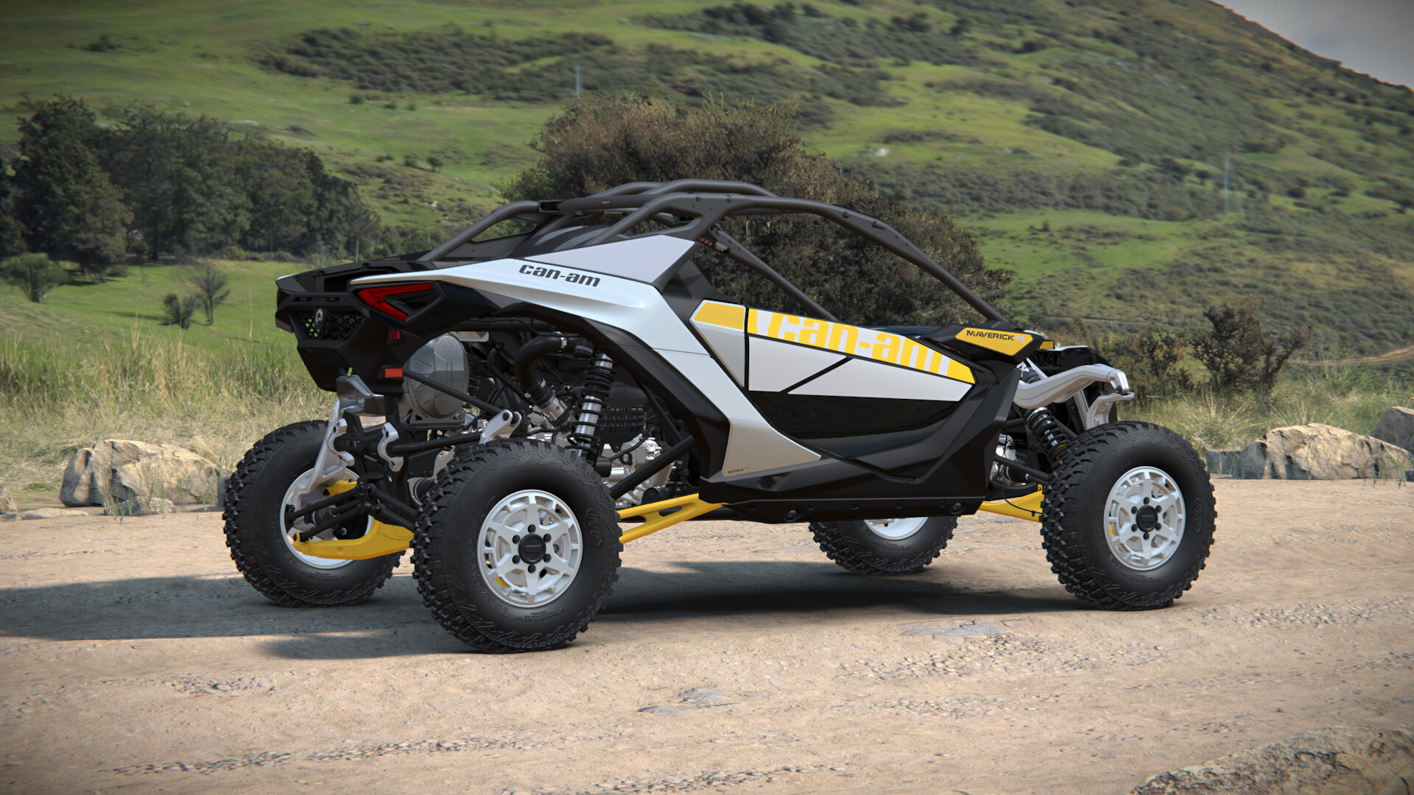
CAN-AM – Maverick R Coming 2024
Engine: 999T DCT
Suspension: NoLimit
Shocks: Fox
Wheels: Raceline
Tires: BF Goodrich
Lights: Baja Designs
Battery: Optima
Builder: NoLimit

Slide 9







Current Sponsors

Slide 10
Marketing Opportunities
your logo on the car
website promotion
Promotional events
social media promotion
your logo on our racing gear

Slide 11
Sponsor Levels
Level | What You Receive | Price
SILVER | Small (4X6) logo on both sides; 10 team branded hats, once a quarter business shoutout on our Instagram. Podium shout-out to your business. | $5k
GOLD | Medium (8X16) logo on both sides; 15 team branded hats and shirts; once a month business promotion on our Instagram. Podium shout-out to your business. | $10k
PLATINUM | Large (16X24) logo on both sides; 20 team branded hats and sweatshirts; twice a month business promotion on our Instagram; our Can-Am race car at your business for photoshoot/meet & greet plus Taco Party Lunch for up to 50 employees. Podium shout-out to your business. | $20k

Slide 12
Connect With Gurries Racing
Website: https://gurriesracing.com/
Instagram: https://www.instagram.com/gurries_racing/?hl=en
See us in action: https://www.youtube.com/watch?v=rYQvW4uL4FI&ab_channel=josedelarosa
Email: gurriesracing@gmail.com

