Slide 1

Leases,
Insurance, and Fraud
Jeffrey C. Smith, Esq.
Jeffrey Smith Law, LLC.
Jeff@jeffreysmithllc.com
205-225-9798

Slide 2
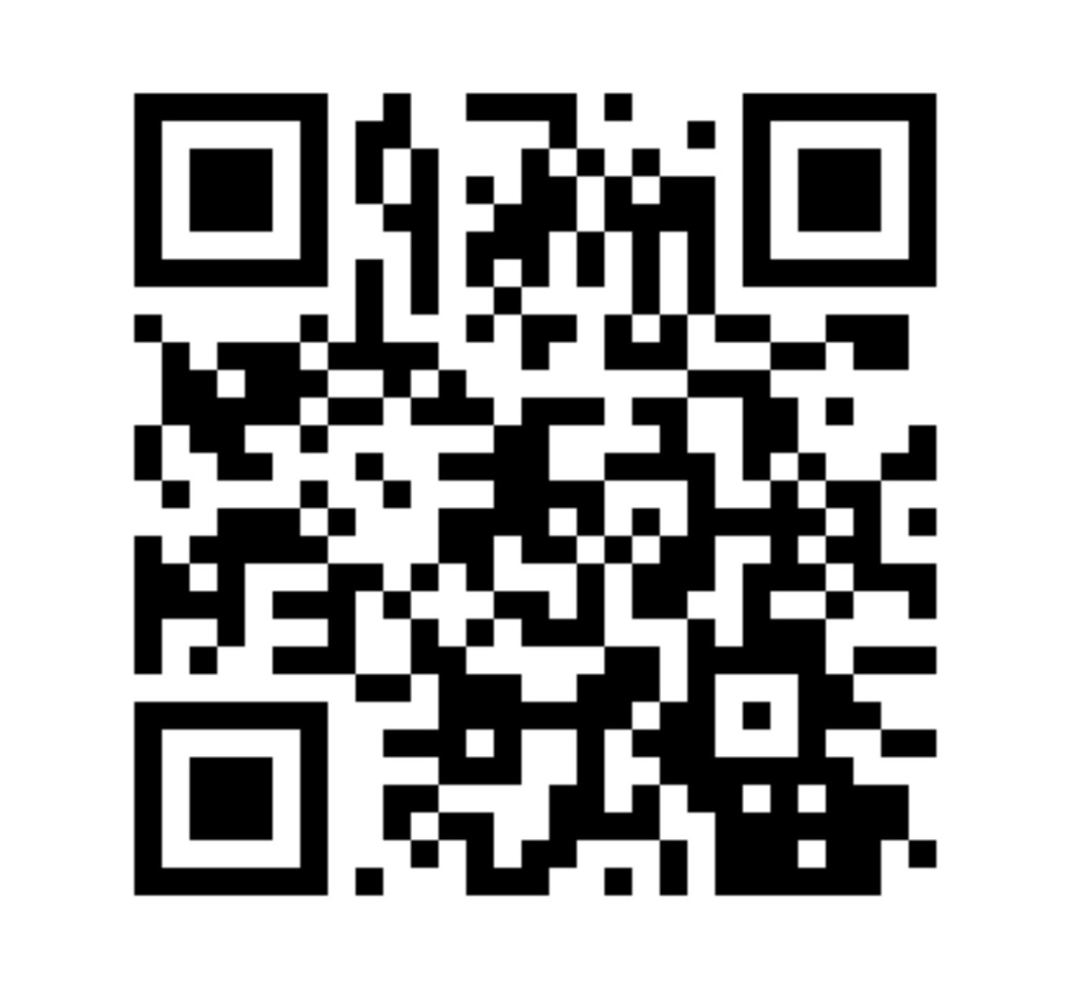

Slide 3
Tenant Screening & Fair Housing Compliance in Alabama
Why it’s a major issue:
Improper screening can lead to problem tenants, but landlords must avoid discrimination claims under the federal Fair Housing Act (FHA) and the Alabama Fair Housing Law (Ala. Code §§ 24-8-1 et seq.).
Key Alabama considerations:
  Protected classes: race, color, religion, sex, national origin, disability, familial status (FHA) and additional state-specific provisions.
  Service & assistance animals: Under Alabama law, landlords must accommodate properly documented assistance animals, even if the property has a “no pets” policy (Ala. Code § 24-8-10).
Case example: Hunt v. Aimco Props., L.P., 814 F.3d 1213 (11th Cir. 2016) – failure to accommodate disability requests can result in significant damages.
Screening practices must be applied uniformly: same credit criteria, same background check procedures for all applicants.

Slide 4
Rent Collection & Delinquencies (Alabama Uniform Residential Landlord and Tenant Act – URLTA)
Why it’s a major issue:
Alabama landlords are often constrained by the Uniform Residential Landlord and Tenant Act (Ala. Code §§ 35-9A-101 et seq.).
Key Alabama considerations:
  Late fees: Allowed only if reasonable; Ala. Code § 35-9A-421.
  Nonpayment notice: 7-day written notice before filing eviction for nonpayment (Ala. Code § 35-9A-421(b)).
  Self-help prohibited: Landlords cannot change locks or shut off utilities; must use court process (Mabry v. Norris, 409 So. 2d 823 (Ala. 1982)).

Slide 5
Maintenance, Repairs & Habitability Issues
Why it’s a major issue:
Under Ala. Code § 35-9A-204, landlords must maintain the property in a habitable condition. Failure to do so can allow tenants to terminate the lease or seek damages.
Key Alabama considerations:
  Required to comply with building and housing codes affecting health and safety.
  Must make all repairs and keep premises “fit and habitable” (Ala. Code § 35-9A-204).
  Tenants must give 14 days written notice to repair before they can terminate (Ala. Code § 35-9A-401).
Case example: Ex parte Housing Auth. of Talladega, 13 So.3d 957 (Ala. 2008) – property managers can face liability if failing to maintain common areas.

Slide 6
Lease Enforcement & Evictions
Why it’s a major issue:
Eviction mistakes can cost time and lead to liability.
Key Alabama considerations:
  Notice requirements:
    7-day notice for nonpayment or material breach (Ala. Code § 35-9A-421 & § 35-9A-422).
    Immediate termination possible for certain criminal activity (Ala. Code § 35-9A-421(c)).
  Court process: Only District Court can issue writ of possession; cannot forcibly remove a tenant without sheriff involvement.
Case example: Mabry v. Norris, 409 So. 2d 823 (Ala. 1982) – “self-help” eviction can result in damages.

Slide 7
Liability & Risk Management
Why it’s a major issue:
Alabama law exposes landlords to premises liability claims and contractual disputes.
Key Alabama considerations:
  Premises liability: Landlords owe a duty to keep common areas reasonably safe (Campbell v. Valley Garden Apartments, 600 So. 2d 240 (Ala. 1992)).
  Criminal acts: Can be liable if they knew of prior similar crimes and failed to take reasonable security measures.
  Insurance: Emphasize the importance of CGL and EPLI coverage; ensure off-premises coverage is included.
  Vendors/contractors must have proper licenses and insurance to avoid vicarious liability.

Slide 8
Essential Insurance Coverage for Alabama
Property Managers and Real Estate Agents

Slide 9

Introduction
Real estate agents and property managers are exposed to significant legal and financial risks as they manage client properties, handle tenant issues, and oversee day-to-day operations. Alabama courts have consistently held agents and managers accountable for professional mistakes, premises-related injuries, employee actions, and even theft of client funds.

Slide 10
Errors & Omissions (E&O)/ Professional Liability Insurance
Protects against claims of professional negligence, misrepresentation and failure to disclose important information.
  Covers claims for failing to disclose property defects.
  Provides defense for tenant screening errors and Fair Housing violations.
  Addresses financial mismanagement allegations, such as mishandling security deposits.
  Recommendation: Maintain at least $1 million per claim/$1 million aggregate. Verify coverage includes property management and brokerage activities and does not exclude Fair Housing claims.

Slide 11
Alabama Case Law Example
Fennell Realty Co., Inc. v. Martin, 529 So. 2d 1003 (Ala. 1988):
  Facts: An agent knowingly misrepresented the condition of a heating system with a cracked heat exchanger and undersized vent to buyers.
  Issues: Whether the agent breached the duty to disclose known material defects and whether misrepresentation justified a fraud verdict.
  Ruling: The Alabama Supreme Court upheld a fraud verdict against the agent, ruling that real estate professionals have a duty to disclose material defects affecting health and safety when asked or when the defects are known and not easily observable.

Slide 12
Commercial General Liability (CGL)
CGL policies cover third-party bodily injury, property damage, and personal injury claims occurring on properties you manage, even if you do not own them.
Alabama Case Law Examples
Taylor v. Leedy & Co., Inc., 412 So. 2d 763 (Ala. 1982):
  Facts: A tenant’s child was injured when a defective stove collapsed in a leased apartment. The tenant sued the landlord’s rental agent.
  Issues: Whether the rental agent could avoid liability by relying on an exculpatory clause in the lease and whether there was a duty to inspect for latent defects.
  Ruling: The court allowed the claim to proceed, holding that the exculpatory clause did not shield the agent from liability for concealed defects.
Gentle v. Pine Valley Apartments & Evans Realty Co., 631 So. 2d 928 (Ala. 1994):
  Facts: Tenants brought suit after being injured due to hazardous conditions in common areas managed by a property management company.
  Issues: Whether the property managers had a duty to maintain safe conditions in common areas.
  Ruling: The Alabama Supreme Court ruled that property managers could be held liable for failing to maintain common areas in a reasonably safe condition.
Daniels v. Hawthorne-Midway Lily Flagg, LLC, 314 So. 3d 1213 (Ala. 2020):
  Facts: A tenant sued the apartment owner, property manager, and on-site manager for injuries sustained from a fall on the premises.
  Issues: Whether the hazard was open and obvious and whether the property manager could be held liable.
  Ruling: The court affirmed summary judgment for the defendants, holding that the hazard was open and obvious. The case illustrates the defense costs even when defendants prevail.

Slide 13
Off-Premises Coverage Limitation Case (Outside Alabama)
Nationwide Mut. Fire Ins. Co. v. Wilbon, 960 F. Supp. 2d 263 (D.D.C. 2013):
  Facts: A property manager was sued after a fire at an apartment building. The property manager sought coverage under a CGL policy that included a “Limitation of Coverage to Designated Premises” endorsement, and the building where the fire occurred was not listed on the declarations page.
  Issues: Whether the insurer had a duty to defend or indemnify when the alleged injury occurred at a property not scheduled on the policy.
  Ruling: The court held that the endorsement unambiguously limited coverage to the listed premises and that Nationwide had no duty to defend or indemnify the property manager for off-premises claims. This case highlights the importance of confirming off-premises coverage or ensuring all managed properties are listed on the policy.

Slide 14
Why is GCL Critical?
Protects against tenant injury claims and visitor accidents.
Covers libel, slander, or advertising injury claims.
Defense costs alone can be financially crippling without CGL.
Recommendation: Maintain at least $1 million per occurrence/$2 million aggregate. Confirm there is no “real estate operations” or “designated premises” exclusion that limits coverage for management activities or off-premises incidents.

Slide 15
Additional Insured Status and Property Manager Endorsements
Being named as an Additional Insured on the property owner’s CGL policy ensures that you are covered under the owner’s liability policy for incidents occurring at managed properties.
Alabama Case Law Example
Pennsylvania Nat’l Mut. Cas. Ins. Co. v. Roberts Brothers, Inc., No. 07-0085-WS-M, 2008 WL 686952 (S.D. Ala. Mar. 11, 2008):
  Facts: A property management firm sought coverage under its CGL policy for a tenant injury claim, but the policy contained a “real estate operations” exclusion.
  Issues: Whether the exclusion applied and whether the insurer had a duty to defend.
  Ruling: The court ruled the exclusion applied and the insurer had no duty to defend. This highlights the need for Additional Insured status on the owner’s policy to fill coverage gaps.

Slide 16
Why It’s Critical for You
Ensures the owner’s insurer defends and indemnifies you.
Reduces the likelihood of out-of-pocket legal costs.
Recommendation: Require owners to name you as Additional Insured using ISO forms CG 20 11 or CG 20 26 and request Property Managed endorsements (CG 22 75). Confirm primary and non-contributory wording and waiver of subrogation.

Slide 17

Umbrella / Excess Liability
Umbrella policies provide additional liability limits above your CGL, E&O, and auto policies.
Why It’s Critical
  Major injury or death claims can exceed primary policy limits.
  Legal defense costs can rapidly erode policy limits.
Recommendation: Maintain at least $1–5 million in umbrella coverage. Confirm it follows form over your primary policies and does not exclude property management activities.

Slide 18
Employment Practices Liability Insurance (EPLI)
EPLI covers claims by employees and third parties alleging harassment, discrimination, or wrongful termination. For property managers, third-party coverage (claims by tenants or vendors) is especially important.
Why It’s Critical
  Tenants and applicants can bring Fair Housing discrimination claims.
  Employees may allege retaliation or harassment.
  EPLI provides defense and settlement costs.
Recommendation: Maintain EPLI with at least $500,000–$1 million per claim. Ensure it includes third-party coverage and aligns with your E&O policy.

Slide 19
Third-Party EPLI & Fair Housing
Third-party EPLI coverage extends protection beyond employee-related claims to include allegations by non-employees, such as tenants, applicants, or vendors. This is critical for Fair Housing Act (FHA) discrimination claims, which are most often brought by tenants or rental applicants.
Standard EPLI policies cover only employee claims. Third-party endorsements are required to cover claims by tenants or other third parties.
FHA allegations involving discrimination based on race, religion, disability, familial status, or other protected classes can lead to costly lawsuits and regulatory enforcement actions.
Coverage must be broad enough to cover defense and settlement costs for these non-employee claims.

Slide 20
Industry Practice
While no widely cited Alabama case addresses third-party EPLI coverage specifically, industry authorities consistently emphasize the need for a third-party endorsement to cover Fair Housing claims. Without this coverage, property managers could be left without any defense.
Recommendation: Confirm that your EPLI policy includes third-party coverage and review the definition of "wrongful act" to ensure it encompasses Fair Housing discrimination claims. Coordinate EPLI with your E&O policy to avoid gaps.

Slide 21
Crime Insurance / Employee Dishonesty Coverage
Crime insurance protects against employee theft of funds, including client (owner) money.
Alabama Case Law Example
Cincinnati Ins. Co. v. Tuscaloosa Parking Auth., 827 So. 2d 765 (Ala. 2002):
  Facts: Employees of the Tuscaloosa Parking Authority embezzled funds over several years.
  Issues: Whether the fidelity bond covered the embezzlement and the scope of coverage for employee dishonesty.
  Ruling: The Alabama Supreme Court analyzed the terms of the fidelity bond and its definitions, underscoring the importance of clear employee dishonesty coverage.
Why It’s Critical
  Property managers often collect rent and deposits on behalf of owners.
  Owners will look to you for reimbursement if funds are stolen.
Recommendation: Maintain commercial crime coverage with an Employee Dishonesty endorsement that covers theft of client funds. Implement strong internal controls, including dual authorization for disbursements and monthly reconciliations.

Slide 22
Summary of Coverage Recommendations
E&O: $1M per claim
CGL: $1M per occurrence / $2M aggregate
Umbrella: $1–5M
EPLI: $500K–$1M (with third-party)
Crime: Include Employee Dishonesty
Require Additional Insured + Property Manager endorsements

Slide 23
Why It Matters
• A single uncovered claim can devastate your business.
• Coverage gaps can leave you personally liable.
• Legal defense costs alone are substantial, even if you win.

Slide 24
Insurance Conclusion
Alabama property managers and real estate agents face a broad array of legal risks. A single uncovered claim can put your business and personal assets in jeopardy. The coverages outlined are not optional; they are essential safeguards that protect you, your clients, and your livelihood.

Slide 25
Fraud and Fraudulent Suppression in Residential Real Estate Sales
Let's discuss the standards of liability for Fraud and Fraudulent Suppression in the sale of residential real estate under Alabama law. I will discuss the doctrine of caveat emptor, the seller’s duty to disclose, the impact of 'as-is' clauses, and key Alabama cases interpreting these principles.

Slide 26
Fraud and Fraudulent Suppression Claims
Under Alabama law:
Fraudulent Misrepresentation occurs when a seller makes a false statement of material fact intending the buyer to rely on it, and the buyer reasonably relies on it to their detriment.
Fraudulent Suppression occurs when a seller conceals or fails to disclose a material fact they have a duty to disclose, causing harm to the buyer.
Both claims require the buyer to establish reasonable reliance on the misrepresentation or omission.

Slide 27
Doctrine of Caveat Emptor
(Buyer Beware)
In Alabama, the doctrine of caveat emptor applies to the sale of used residential property, generally placing the burden on the buyer to inspect the property for defects. There are three narrow exceptions:
1. A fiduciary relationship exists between the buyer and seller.
2. The defect affects health or safety and is not readily observable by the buyer.
3. The buyer makes a direct inquiry about a material condition, which the seller must answer truthfully.

Slide 28
Impact of “As-Is” Clauses
Alabama courts have consistently enforced “as-is” clauses in purchase agreements. These clauses generally negate the element of reliance necessary for fraud and fraudulent suppression claims by placing the risk of defects on the buyer.

Slide 29
Key Case Summaries: Facts, Issues, and Rulings
Nesbitt v. Frederick, 941 So. 2d 950 (Ala. 2006)
Facts: Buyers purchased a used home and later discovered latent defects. They alleged the seller failed to disclose these defects. The buyers had the opportunity to inspect the property before closing but did not.
Issues: Whether caveat emptor barred fraud-based claims and when exceptions apply.
Ruling: The Court reaffirmed that caveat emptor applies unless one of three exceptions exists. None applied, so the fraud claims were barred.
Teer v. Johnston, 60 So. 3d 253 (Ala. 2010)
Facts: The buyers purchased a home with an “as-is” clause and later discovered defects.
Issues: Whether the “as-is” clause barred fraud-based claims.
Ruling: The Court held that the “as-is” clause negated the element of reliance, barring fraud and suppression claims.
Rosenthal v. JRHBW Realty, Inc., 303 So. 3d 1172 (Ala. 2020)
Facts: Buyers discovered defects after closing. The purchase agreement contained broad disclaimers.
Issues: Whether disclaimers and “as-is” clauses barred fraud claims.
Ruling: The Court enforced the disclaimers, holding that buyers must preserve representations in the purchase agreement.
Leatherwood, Inc. v. Baker, 619 So. 2d 1273 (Ala. 1993)
Facts: Buyers purchased a home with an “as-is” clause and sued for fraud after discovering defects.
Ruling: The Court reaffirmed that “as-is” clauses preclude fraud claims by defeating reliance.
Haygood v. Burl Pounders Realty, Inc., 571 So. 2d 1086 (Ala. 1990)
Facts: Buyers purchased a home from a seller who was also a real estate agent. The seller repeatedly assured the buyers that there were no water issues in the basement, even though they had previously patched and attempted to repair leaks. Buyers signed an “as-is” clause.
Issues: Whether the seller’s false assurances and suppression of the prior water problem allowed the buyers’ fraud claims to proceed despite the “as-is” clause.
Ruling: The Court held that the “as-is” clause and entire agreement provisions barred reliance and dismissed the fraud claims, even though the seller’s conduct was troubling. The case illustrates the strong protection “as-is” clauses provide sellers.

Slide 30
Practical Guidance
Alabama law strongly favors enforcing “as-is” clauses in used residential property transactions. Fraud and fraudulent suppression claims often fail because these clauses negate the element of reliance. Buyers must protect themselves through thorough inspections and by ensuring any representations are incorporated into the purchase agreement. Sellers should include clear “as-is” and non-reliance language in their contracts to limit liability.

Slide 31
Protecting Purchasers Through Direct Questions and Contract Addendums
One of the most effective ways for purchasers to protect themselves from the strict application of caveat emptor and 'as-is' clauses is to make **specific direct inquiries** regarding latent defects and then incorporate the seller's responses into the written agreement. Under Alabama law, the doctrine of caveat emptor does not apply where the seller fails to truthfully answer direct inquiries about a material defect. However, to preserve these protections, buyers should go beyond oral questions and ensure the responses are memorialized in the contract.
Purchasers should:
1. Ask direct, written questions about any latent or non-obvious defects in critical systems (roof, foundation, plumbing, electrical, water intrusion, etc.).
2. Request that the seller certify their responses in writing.
3. Use a contract addendum that creates an exception to the 'as-is' clause for those specific representations.

Slide 32

Sample Contract Addendum
ADDENDUM TO RESIDENTIAL REAL ESTATE PURCHASE AGREEMENT
This Addendum is made part of and incorporated into the Residential Real Estate Purchase Agreement dated [DATE] between [BUYER] and [SELLER] for the property located at [ADDRESS] ('Agreement').
1. **Seller Representations Regarding Latent Defects:** In response to Buyer’s specific inquiries, Seller represents and warrants that:
- There are no known water intrusion issues in the basement, crawlspace, or attic.
- There are no known foundation cracks or structural defects.
- There are no known plumbing leaks or defects.
- [Insert any other responses to Buyer’s specific inquiries].
2. **Exception to 'As-Is' Clause:** The parties agree that the 'as-is' provisions of the Agreement and the doctrine of caveat emptor shall not apply to the specific representations stated above. Buyer may rely upon these representations and shall have all remedies available at law or in equity if any representation is false or incomplete.
3. **No Waiver:** All other terms and conditions of the Agreement, including the 'as-is' clause, remain in full force and effect.
IN WITNESS WHEREOF, the parties have executed this Addendum as of the date set forth below:
___________________________ ______________________________
Buyer (Print Name and Sign) Seller (Print Name and Sign)
Date: ______________________ Date: _______________________

Slide 33

Seller-Friendly Template for Responding to Buyer Inquiries
General Seller Response Template
This Response is provided in connection with the Buyer’s direct inquiries about the condition of the property located at [Property Address]. Seller makes the following statements based solely on their actual knowledge as of the date below:
1. Seller’s responses are based only on Seller’s current actual knowledge and recollection. Seller has not conducted any independent investigation, inspection, or testing.
2. Seller makes no warranties or guarantees, express or implied, as to the current or future condition of the Property.
3. Buyer is strongly encouraged to obtain, at Buyer’s sole expense, any surveys, inspections, testing, or other investigations Buyer deems necessary.
4. Responses to Buyer’s inquiries:
- [Question] – To the best of Seller’s actual knowledge, Seller is not aware of any [defect] in the area or system identified.
5. Buyer acknowledges that these responses do not modify or waive any other terms of the Purchase Agreement, including the 'as-is' provisions, except as expressly stated.

Slide 34

Model Response: Previously Known Issues That Have Been Repaired
To the best of Seller’s actual knowledge, the Property previously experienced [describe issue briefly]. However, Seller represents that the issue was addressed and repaired prior to placing the Property on the market.
- Details of Repairs: [Insert brief summary: who performed the repair, approximate date, and whether documentation is available. For example: 'The repair was completed by [licensed contractor] in [month/year]. Copies of invoices and any available warranties are attached for Buyer’s review.’]
- No Further Known Issues: Seller is not aware of any recurrence of this issue since the repair was completed. Seller makes no warranties or guarantees regarding the continued performance of the repair or the future condition of the Property.
- Buyer is strongly encouraged to conduct any independent inspections, testing, or investigations Buyer deems necessary to satisfy themselves as to the condition of the Property and the adequacy of any prior repairs.

Slide 35
Jeffrey C. Smith, Esq.
Jeffrey Smith Law, LLC.
Jeff@jeffreysmithllc.com
205-225-9798

