Slide 1

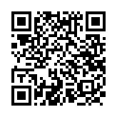
Free music for English teachers
More free resources at:
leighdwyer.com

Slide 2

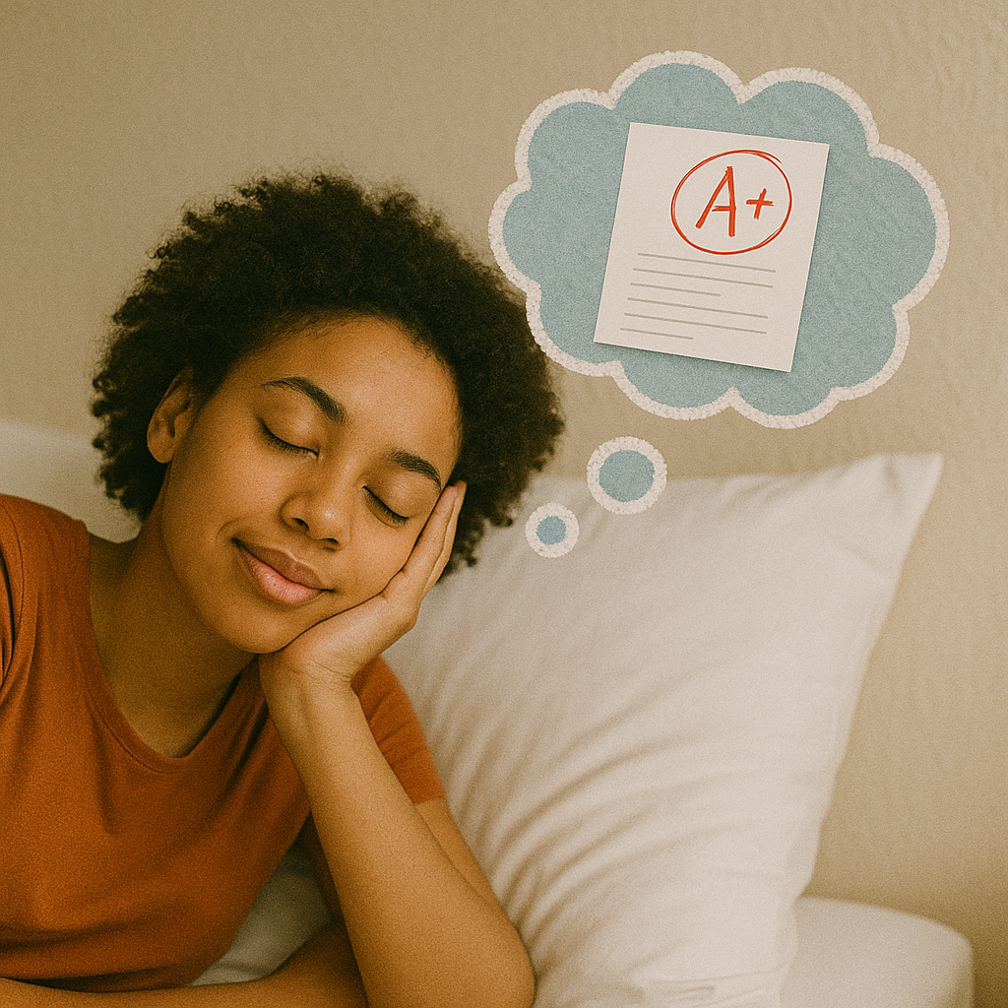
FOR
I studied hard, for I wanted to pass.

Slide 3

AND
I studied hard and I danced all night.

Slide 4
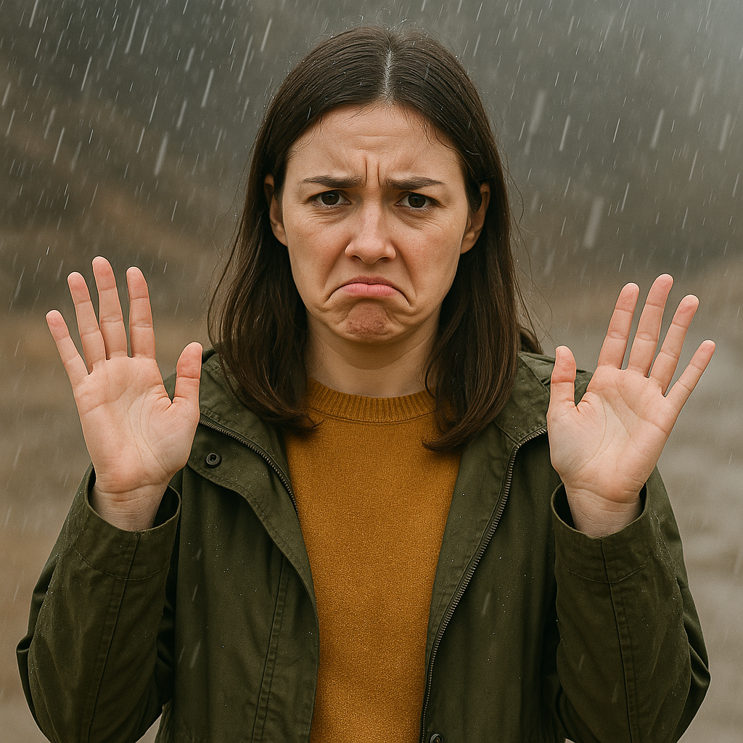
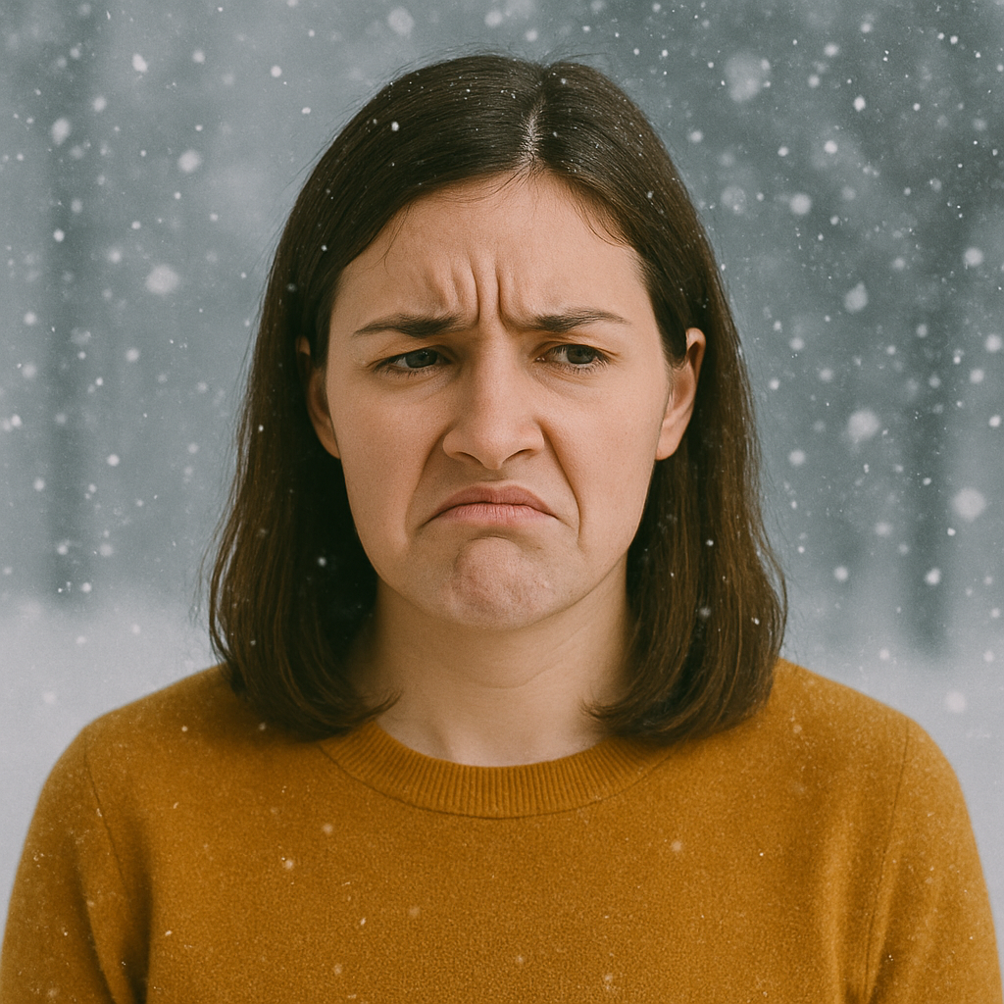
NOR
I don’t like rain, nor do I like snow.

Slide 5
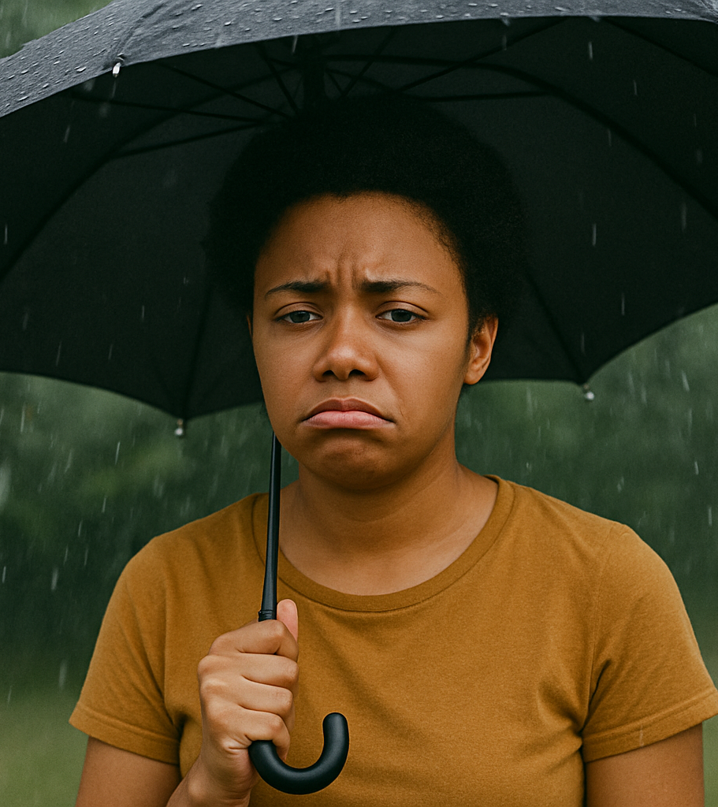
BUT
I don’t like the rain, but I love to dance.

Slide 6
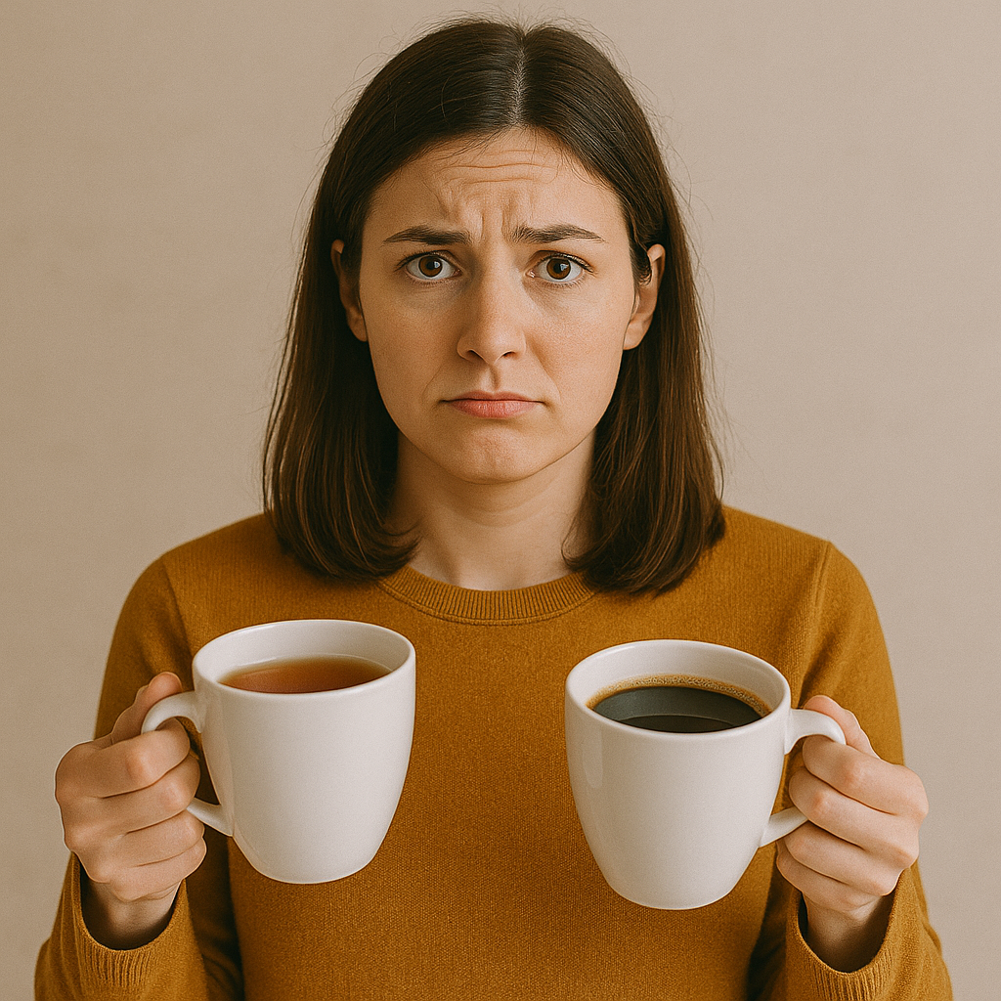
OR
Tea or coffee?

Slide 7
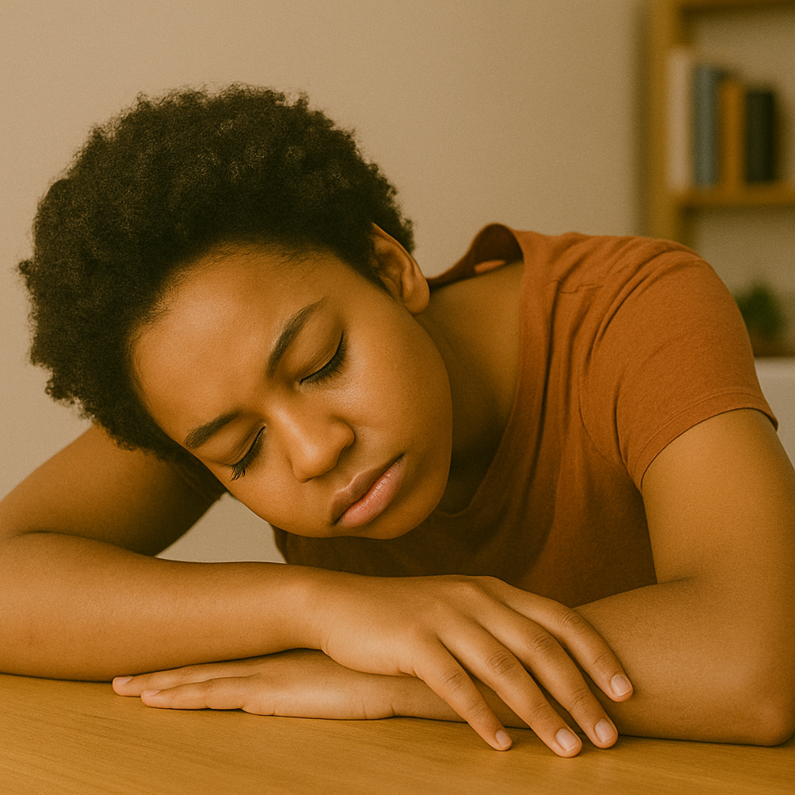
YET
I’m tired, yet I’ll study.

Slide 8


SO
I practiced all day, so I passed the test.

Slide 9
Coordinating conjunctions
F - for
A - and
N - nor
B - but
O - or
Y - yet
S - so

Slide 10


Free resources leighdwyer.com

Slide 11
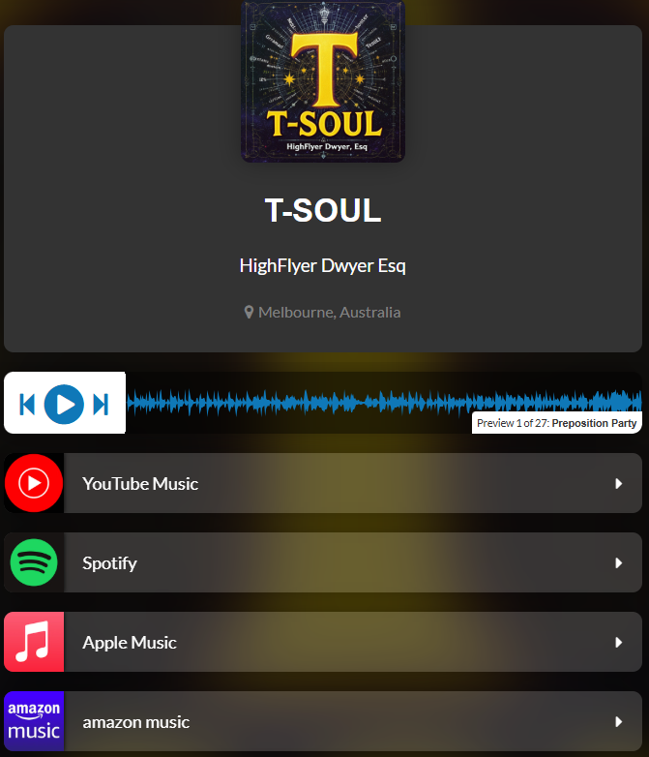
Free resources leighdwyer.com

Slide 12
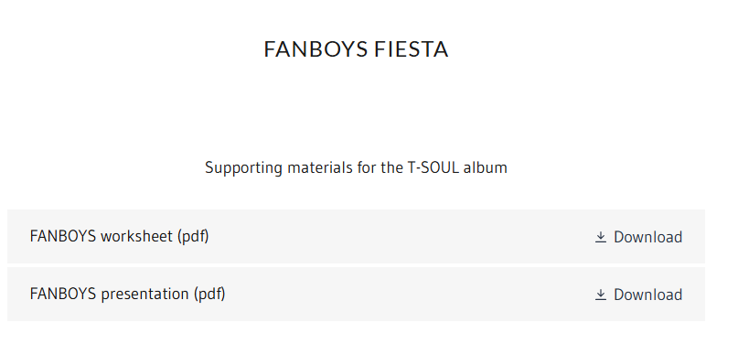
Free resources leighdwyer.com

Slide 13
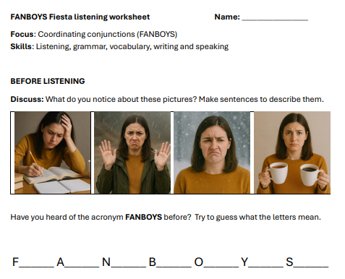
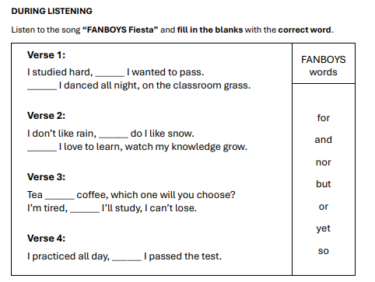
Free resources leighdwyer.com

Slide 14

for
1: I studied hard, ______ I wanted to pass.
______ I danced all night, on the classroom grass.
Chorus
F-A-N-B-O-Y-S, join the fiesta, oh yes!
For, And, Nor, But, Or, Yet, So,
Link your ideas, let the sentences flow!
FANBOYS fiesta, sing it loud and free!
And
nor
2: I don’t like rain, ______ do I like snow.
______ I love to learn, watch my knowledge grow.
But
or
3: Tea ______ coffee, which one will you choose?
I’m tired, ______ I’ll study, I can’t lose.
yet
so
4: I practiced all day, ______ I passed the test.
For
and
5. ___I’m learning, ____ I’m having fun,
____ rain ____ wind, can stop my run.
Nor
nor

Slide 15


Additional resources at:
leighdwyer.com

