Slide 1
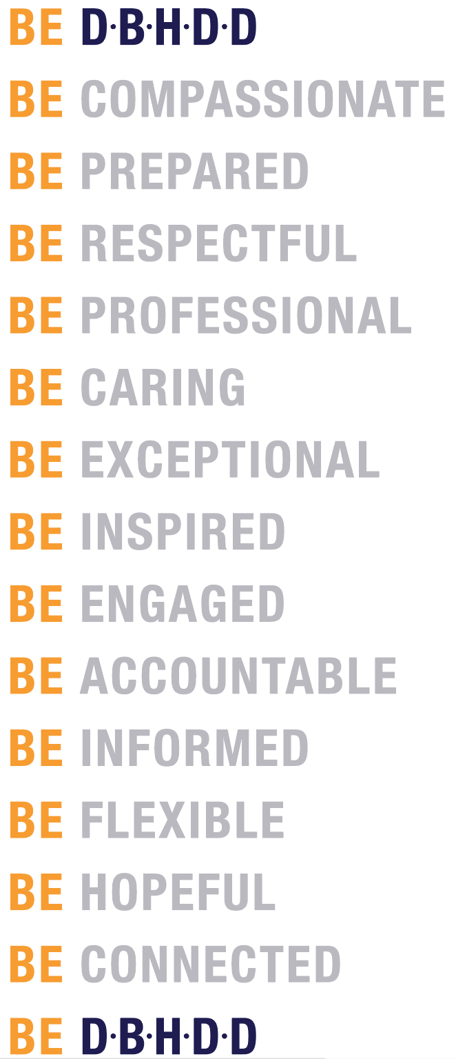


Slide 2


DBHDD: Who are we, and who do we serve?
Georgia Department of Behavioral Health & Developmental Disabilities
Michael Link,
Region 1, CYF Specialist

Slide 3
Vision
Easy access to high-quality care that leads to a life of recovery and independence for the people we serve

Slide 4
Mission
Leading an accountable and effective continuum of care to support Georgians with behavioral health challenges, and intellectual and developmental disabilities in a dynamic health care environment

Slide 5
DBHDD: Georgia’s Public Safety Net
State agency created in 2009
Provides treatment and support services for
  Mental health
  Substance use disorders
  Intellectual and developmental disabilities
  Target population:
people who are uninsured, underinsured, or on Medicaid

Slide 6
Community Behavioral Health Services
Core and Specialty Services
  Assessment
  Medication
  Crisis Intervention
  Individual, Family, and Group Support
  Case Management
  Intensive Case Management
  Psychosocial Rehabilitation
  Substance Use Treatment
  Medicaid assisted Treatment Programs
  Peer Support
  Assertive Community Treatment
  Community Support Teams
  Residential Support
  Supported Employment
  Peer Respite/Recovery Centers
Crisis Services
  Mobile Crisis Response
  Behavioral Health Crisis Centers
  Crisis Stabilization Units
  Crisis Respite Apartments

Slide 7
Community Service Boards (CSBs)
Part of Georgia’s public system of care for behavioral health
Georgia’s public “safety net” for behavioral health (providing coverage for all 159 counties)
Boards appointed by county commissions in their catchment area

Slide 8
Community Service Boards
Advantage Behavioral Health Systems
Aspire Behavioral Health & Developmental Disability Services
Avita Community Partners
Clayton Center CSB
Cobb-CSB
Douglas CSB
CSB of Middle Georgia
DeKalb CSB
Fulton County Behavioral Health
Gateway BHS
Georgia Pines CSB
Haralson BHS
Highland Rivers Health
Lookout Mountain Community Services
McIntosh Trail CSB
Middle Flint BHC
New Horizons Behavioral Health
Oconee Center CSB
Pathways CSB
Phoenix Center CSB
Pineland BHDD
River Edge Behavioral Health Center
Serenity Behavioral Health System
BHS of South Georgia
Unison Behavioral Health
View Point Health

Slide 9
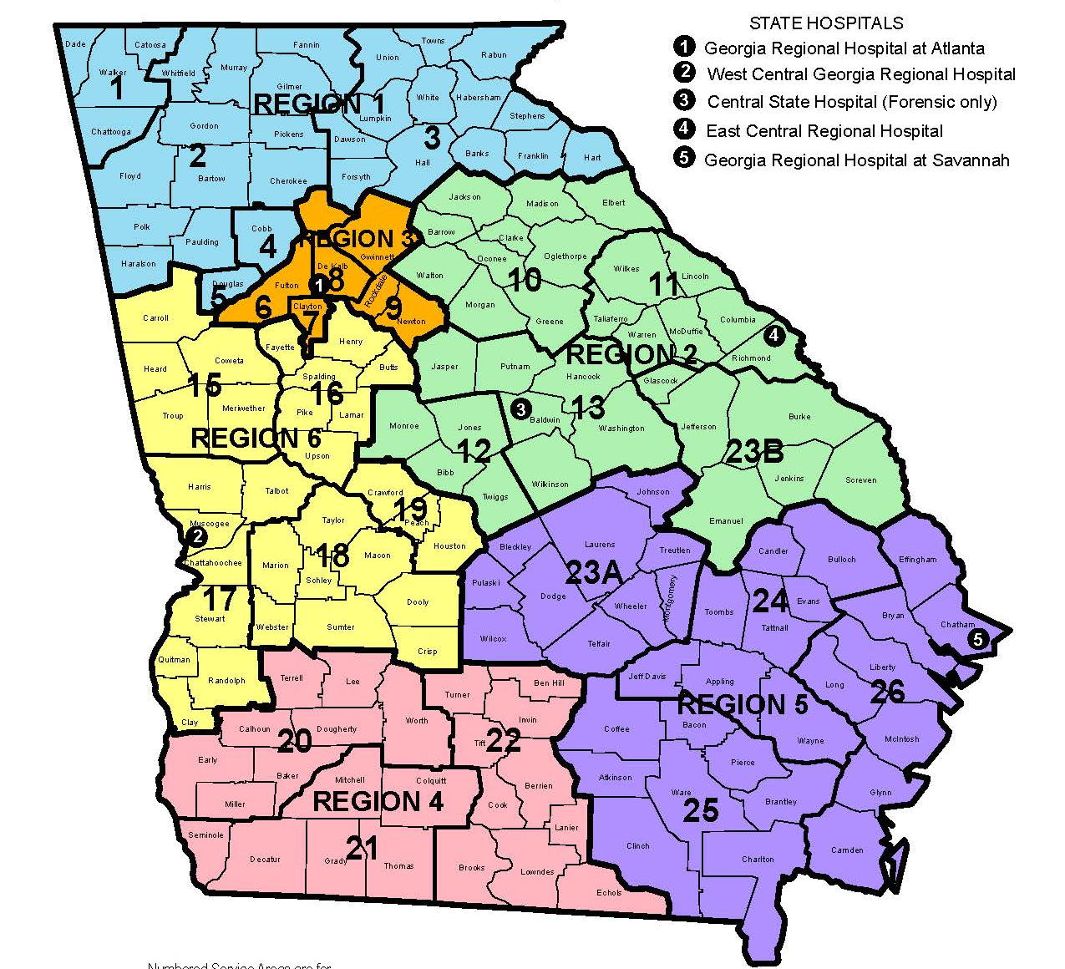
Providers by DBHDD Region 1
Region 1 (Blue)
Avita Community Partners
Cobb CSB
Douglas CSB
Haralson Board of Health
Highland Rivers Health
Lookout Mountain Community Services
Notes:
DBHDD manages a three-tiered provider network (not to be confused with the three tiers that I mentioned in the last slide).
Apex is anchored to the first two tiers of the DBHDD provider network.
Tier 1 consists of community service boards (CSBs for short). It is our safety net. Tier 2 includes what community Medicaid providers.
Additionally, DBHDD is organized into six geographical regions.
We launched the program with six providers in Region 1…represented in Blue on the map.

Slide 10
Contacts:
Highland Rivers Health 800-729-5700
Lookout Mountain Community Services 706-806-1222
Cobb CSB 770-422-0202
Avita Community Partners 800-525-8751
Douglas Community Service Board 770-949-8082
Haralson Behavioral Health Services 770-537-2367

Slide 11
C&A Fee For Services Providers
Advantage Counseling Services, Inc
Alliance for Change Through Treatment , LLC
Comprehensive Counseling Solutions, Inc
Cornerstones Counseling Center, Inc
Families United Services, Inc.
Family & Children First, dbs Georgia H.O.P.E.
Family Ties, Inc.
Focus Counseling & Training, Inc.
Georgia Health Partners, LLC
Northside Psychological Services, Inc
Positive Growth, Inc
Royal Treatment Health Systems, LLC
The Ark Family Counseling Center, Inc.
The AUC Institute for Career Studies, Inc
The Children and Teenagers Foundation, Inc.
Transitional Family Services
Trinity Social Services, LLC
Underdue Social Services

Slide 12
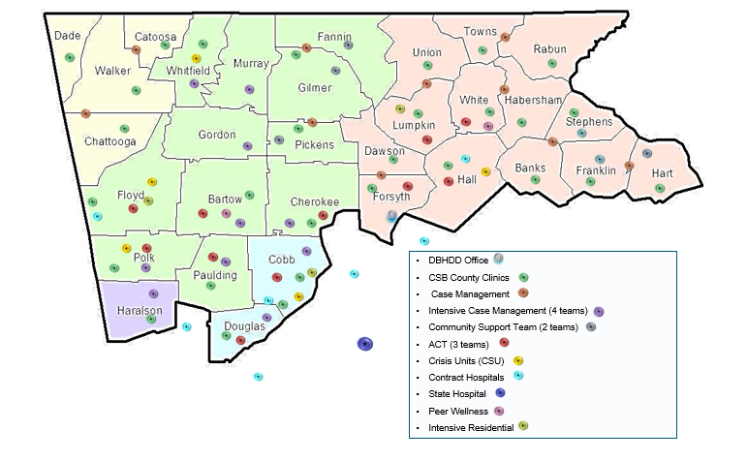
Region 1 Adult Continuum of Care September 2014

Slide 13
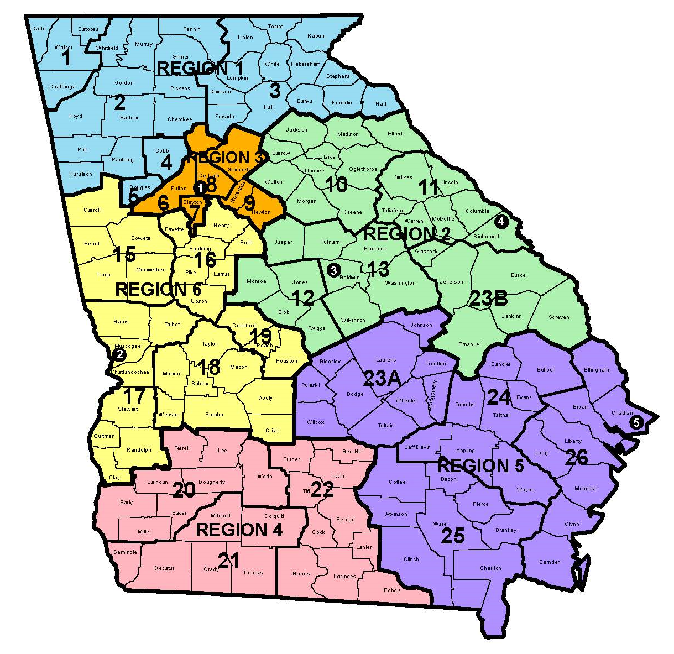

Public Safety Net
STATE OFFICE
2 Peachtree St, Atlanta
25 Community
Service Boards
6 REGIONS
Regions contain field offices with resources serving the community (i.e., integration homes and providers)
REGIONAL HOSPITALS
Georgia Regional Hospital at Savannah
Georgia Regional Hospital at Atlanta
East Central Regional Hospital
West Central Georgia Regional Hospital
Central
State Hospital
SAVANNAH
ATLANTA
AUGUSTA
COLUMBUS
MILLEDGEVILLE
Notes:
Speaker: RHA
The purpose of this slide is to set up the structure of the state office, regions, hospitals. Then, ultimately, where the staff member fits into this structure.
You may want to mention which region your hospital is located.

Slide 14
Child & Adolescent Crisis Stabilization Programs:
Viewpoint 678-209-2710
2591 Candler Road 404-856-3605 Fax
Decatur, GA 30032
27 Beds
Accepts ages 14 to age 18 yrs.
_____________________________________________________________
Hope’s Corner – Pathways CSB 706-775-0544
756 Woodbury Drive, Building B 706-672-3306 Fax
Greenville, GA 30222
12 Beds
Accepts ages 5 to age 18 yrs.
_____________________________________________________________
Lakeside Center (SRH) 912-330-8335
600 DOT Barn Road 912-330-8340 Fax
Blommingdale, GA. 31302
14 Beds
Accepts ages 5 to age 18 yrs.
_____________________________________________________________
River Edge 478-803-8605
3575 Fulton Mill Road 478-471-5700 Fax
Macon, Ga. 31206
16 Beds
Accepts ages 5 to 14 yrs.
_____________________________________________________________

Slide 15
PRTFs
Devereux – (Kennesaw)
Hillside – (Atlanta)
Laurel Heights - (Atlanta)
Youth Villages –(Douglasville)
Costal Harbor – (Savannah)
Lake Bridge –(Macon)
Light House – (Augusta)

Slide 16
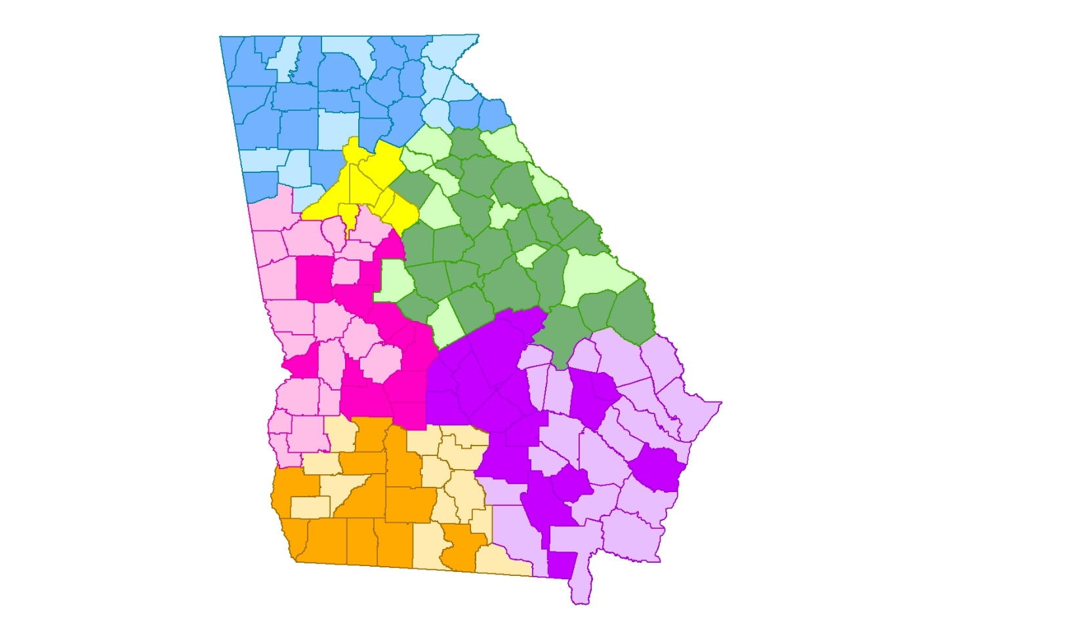
GEORGIA APEX PROGRAM REACH, YEAR 3
As of June 2018, the Georgia Apex Program is in
87 counties (55%)
101 school districts* (56%)
396 schools (17%)
Region 1
Region 3
*Includes two alternative, military, and state charter schools
Region 2
School Type | Number of Schools
Elementary | 180
Middle | 102
High | 78
Alternative | 36
Positive Behavioral Interventions and Supports (PBIS) | 159
Region 6
Region 5
Region 4
Darker shaded counties contain at least one Apex school.
Notes:
Read info at top on GA Apex Program in…..
Schools are defined as having the Apex Program if they have been implementing Apex for at least 3 months.
Note: All Region 3 counties have at least one Apex school.
Apex has been somewhat more highly concentrated in elementary schools, supporting the goal of early detection of mental health issues and prevention and early intervention as important in effectively promoting children’s mental health.
Apex is currently in 134 schools with co-existing PBIS programs, at various stages of implementation.
DBHDD has partnered with the Center of Excellence for Children’s Behavioral Health at Georgia State University to provide technical assistance in the areas of program implementation and sustainability to the community-based MH providers, and for program monitoring and evaluation support.

Slide 17
Autism Spectrum Disorder Providers for R1
Autism & Behavior Services | http://autismbehaviorservices.org/
Building Bridges Therapy | https://www.buildingbridgestherapy.com/
Children & Family Programs at KSU | https://chss.kennesaw.edu/ccm/children-family-programs/index.php
Dreamworks Children's Therapy | https://dmyf.info/dreamworks/
Elite Behavior Analysis | http://www.elitebehavior.com/
Georgia Neurobehavioral Associates | https://www.georgianeurobehavioral.com/BehavioralServices.en.html
Southern Behavior Consultants | N/A
Emory Autism Center | http://psychiatry.emory.edu/programs/autism/index.html
Integrated Behavioral Solutions | www.ibs.cc

Slide 18
Autism Spectrum Disorder Providers for R1
Comprehensive Early Autism Sevices | https://earlyautismservices.com/
Trusty Behavioral Services, Inc. | http://trustybehavioral.com/
Autism Center for Children | https://www.autismcenterga.com/
Children's Therapy Works | http://childrenstherapyworks.com/
Creative Pieces Behavior Associates | http://creativepiecesbehaviorassociates.com/
Footprints Therapy | www.footprintstherapy.org
Peachtree Autism Services | http://www.peachtreeautism.com/
Positive Behavior Services | www.positivebehaviorfl.com
Rainbow Steps | http://www.rainbowstepsaba.com/

Slide 19
Autism Spectrum Disorder Providers for R1
Village Autism Center | https://villageautism.com/
Appleseeds Behavioral Center | https://www.abatherapyga.com/
Positive Behavior Supports Corp | www.teampbs.com
Key Autism Services | https://www.keyautismservices.com/autism-and-aba-therapy-in-georgia/
Thrive Autism Consulting, LLC

Slide 20
Addiction Recovery Support Center (Adults)
The Mosaic Place | 321 West Ave Cedartown, GA 30125 | Lydia Goodson | lydiagoodson@highlandrivers.org | 404-989-9163
Living Proof Recovery | 408 Shorter Avenue NW, Rome, GA 30165 | Claudia Hamilton | claudia@livingproofrecovery.org | 706-204-8710
RCFF - The Connection | 608 Veterans Memorial Boulevard Cumming, Georgia 30040 | Bill Whitney | bill@theconnection | 470-253-8564
J's Place Recovery Center | 1362 Juanita Ave, Gainesville, GA 30501 | Jordan Hussey | executive.director@jsplacerecovery.org | 678-316-0403

Slide 21
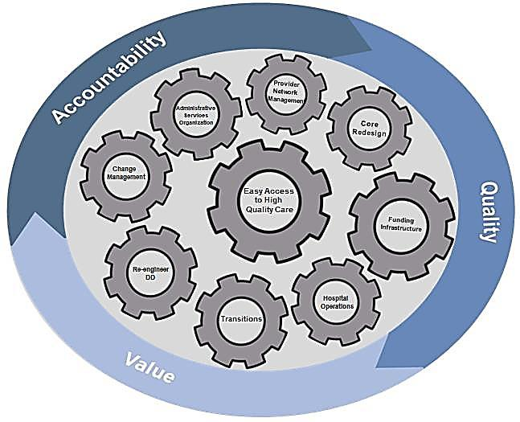
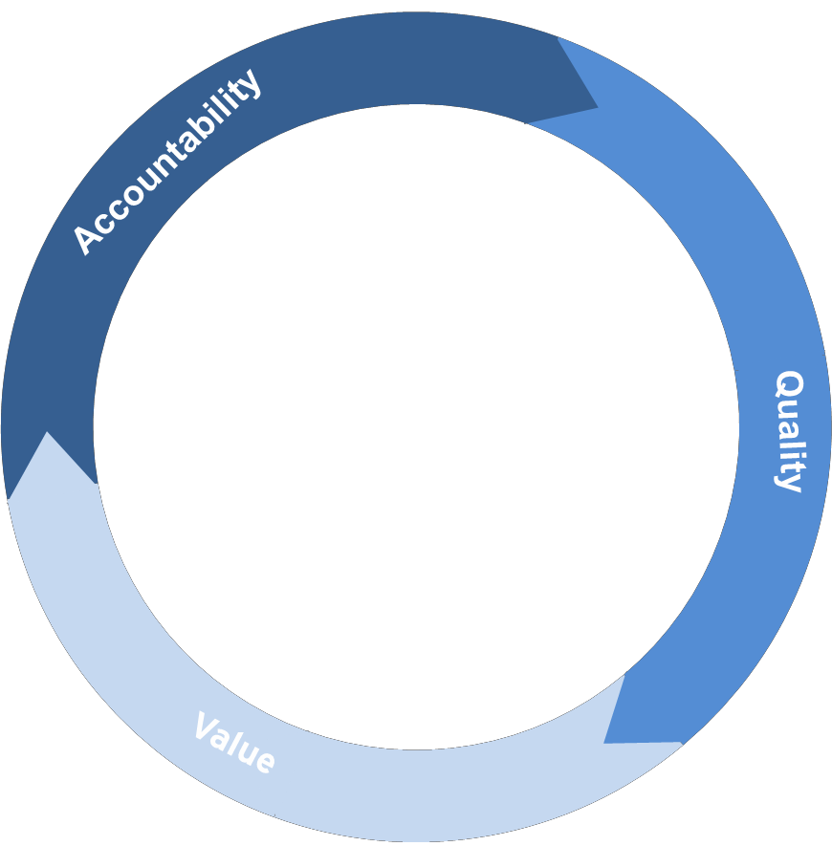
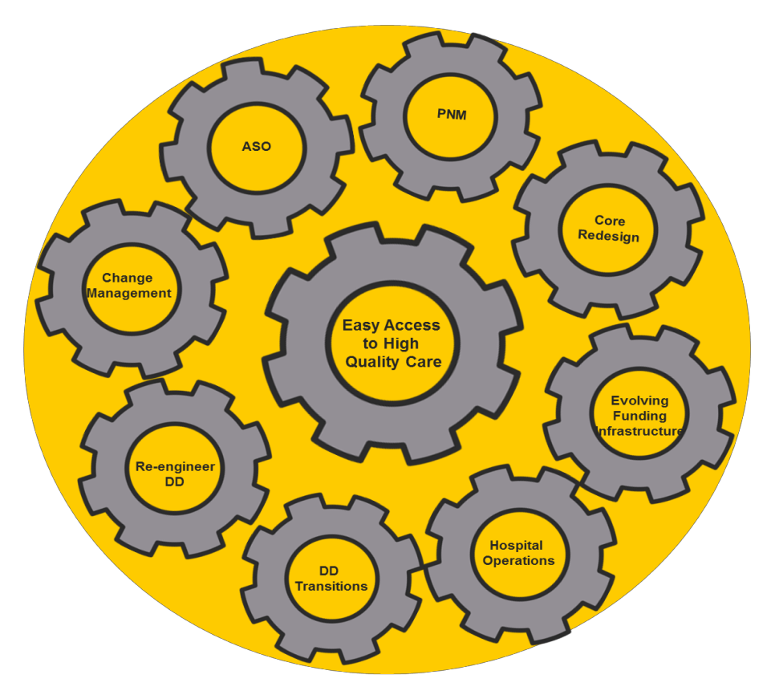
Focus
Creating a Comprehensive Continuum of Care
dd
Clarifying Roles and Responsibilities
Notes:
All of these initiatives have there own workgroups that include all levels of staff as well as provider partner input.

Slide 22
there were few options for a person to connect with until recently:
Individual
Family
Advocates
Hospitals/ ED
Faith Based Community
Judges
Law Enforcement
State Agencies
individuals
CORE BH Services
Crisis Units
State Psychiatric Hospital

Slide 23
Community Based System of Care
Individual
Family
Advocates
CORE
BH
Housing Supports
Supported Employment/ Vocational
Judges
CM/ICM Services/ ACT/ CST
Peer Centers
Crisis Stabilization
Programs
Hospitals/ED
Contract Psychiatric Hospital
Law Enforcement
FQHC's
Faith Based Community
State Agencies
Mobile Crisis

Slide 24

Georgia Crisis and Access Line
24 hours a day, 7 days a week
Text capabilities
Statewide (159 counties)
Mobile crisis response
Behavioral health crisis centers
Provider referrals
Free and confidential

Slide 25

Emotional Support Line

Slide 26
2x2 Series: Self-Care Tips and Support for Managing Life
WebEx events designed to provide self-care tips and support for managing life during these unprecedented times
Held live twice weekly, on Tuesdays and Thursdays at 2:00 p.m.
Mental health tips about managing stress, grief, work/life balance, and wellness
Sessions are recorded and available for review on the DBHDD website: https://dbhdd.georgia.gov/2x2-series

Slide 27
So as you leave today:
We hope you are more informed on what is available and how to access it.
We hope that you will share this information with other community partners
KNOW WHO TO CALL

Slide 28
Region 1 contact
Region 1 Field Office Contact Behavioral Health
Services | Staff | Email | Office | Cell
Services for Children, Youth and Family | Michael Link | Michael.Link@dbhdd.ga.gov | 770-781-6852 | 404-353-6342
Crisis Services (CSUs/BHCC/SCB) | Nakita Robinson | Nakita.Robinson@dbhdd.ga.gov | 770-781-6849 | 404-295-6820
GHVP and PATH | Scarlett Freelin | Scarlett.Freelin@dbhdd.ga.gov | 678-947-2814 | 706-728-0412
Community Bases Services (ACT/CST/ICM/CM/SE) Residential Services in the Community (CRR) | Renee Funk-Barbacone | renee.barbacone-funk@dbhdd.ga.gov | 678-947-2811 | 404-360-2757
Services in the state hospitals and transitions Intensive Treatment Residential (ITR) | Deborah Fujan-Pinney | deborah.fujan-pinney@dbhdd.ga.gov | 770-781-6848 | 404-293-2062
All issues | Hetal Patel | hetal.patel@dbhdd.ga.gov | 770-781-6802 | 404-327-2310

Slide 29
Questions?
Georgia Department of Behavioral Health & Developmental Disabilities
Notes:
USE AS END SLIDE if needed

