Slide 1
Region 1 Caregiver Recruitment and Retention Unit

Slide 2
Vision
Stronger Families for a Stronger Georgia

Slide 3
Mission
Strengthen Georgia by providing Individuals and Families access to services that promote self-sufficiency, independence, and protect Georgia’s vulnerable children and adults

Slide 4
Goals of Georgia’s Foster Care System
1: Ensure Safety
2: Enhance Birth Families’ Parenting Capabilities
3: Promote and Expedite Permanency
4: Preserve Birth Families Connections

Slide 5
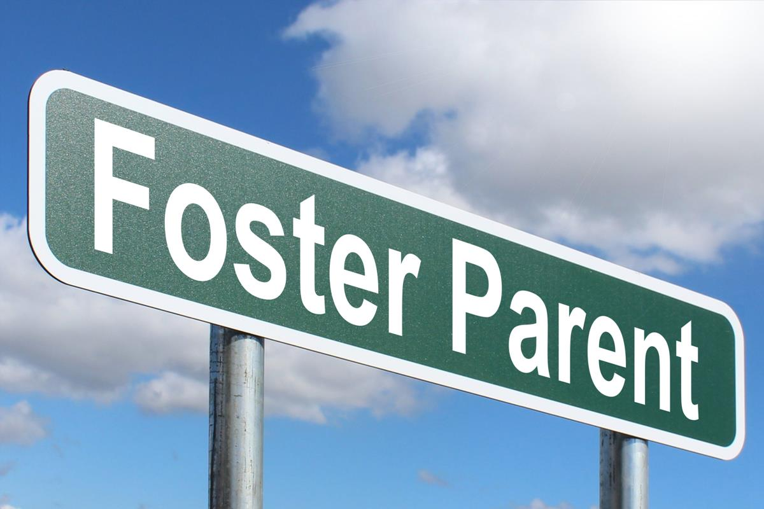
Caregiver Types
Partnership Parents **
Resource Parents **
Adoptive Parents
Adopt Legal Risk
Relative Partnership Parent (Fictive Kin)
Respite Family
Volunteer Only
Receiving Homes
** Majority of Fannin County homes

Slide 6
As of March 2022, there were 31 children in Fannin County in care.
Partnership Homes: There are currently on 6 Partnership homes in Fannin County.
Those homes have 15 beds in total. They currently have 22 beds in use.
Resource Homes: There are currently 2 Resource Parent homes in Fannin County.
Those homes have 4 beds in total. They are also over capacity.
Fannin County does have 2 Kinship Partnership Parent and 2 Kinship Resource Parent homes along with 1 ICPC Partnership home. These homes only take relatives into their homes and more than likely will close after permanency is reached for the child(ren).

Slide 7
Our Need
We need Foster parents!
We need Partnership Parents
We need Partnership Parents who are willing to take sibling groups of 3 or more.
We need families to take in youth (13-17)
We need Respite Families
We need Receiving Homes
These homes will allow Fannin County children to remain in their local community, to hopefully remain in their school and allow them to continue some normalcy.

Slide 8
The Why
“Being a partnership parent means fostering the entire family unit, not just the children; we are teaching and coaching the parents just as much as we are their kids.”
“I wanted to help not only children in crisis, but their families in crisis as well”
“Engaging with the families sharing stories, parenting strategies and strategies for navigating life situations. Sharing for success”
“The ability to change your life and someone else’s life. Taking a leap of faith. A forever family. Will it be easy? Nope. Will it be worth it? Absolutely!”

Slide 9
Fostering “means patience, understanding, unconditional love and devotion. It’s understanding that these children are imperfectly perfect. It’s about offering a light when the world seems dark to them and the willingness to walk beside in support and encouragement. It’s not easy, but worth every stumble when you hear them laugh and see happiness in their smile and hearts.”
“Partnership parenting to me is standing in the gap for families who need help getting back on their feet. My goal is to try to partner with the biological parents to be an extension of their family and to extend empathy and grace.”

Slide 10
“Expect dark skies and rough seas but remember after all storms there is sunshine and rainbows.”
The world may not change if you foster a child, but for that child their world will change.
Are you a starfish thrower?

Slide 11
Contact Information
Amberle Dillard
Caregiver Recruitment and Retention Unit
Region 1
Cell: (706) 618-8746
Email: Amberle.dillard@dhs.ga.gov

