Slide 1
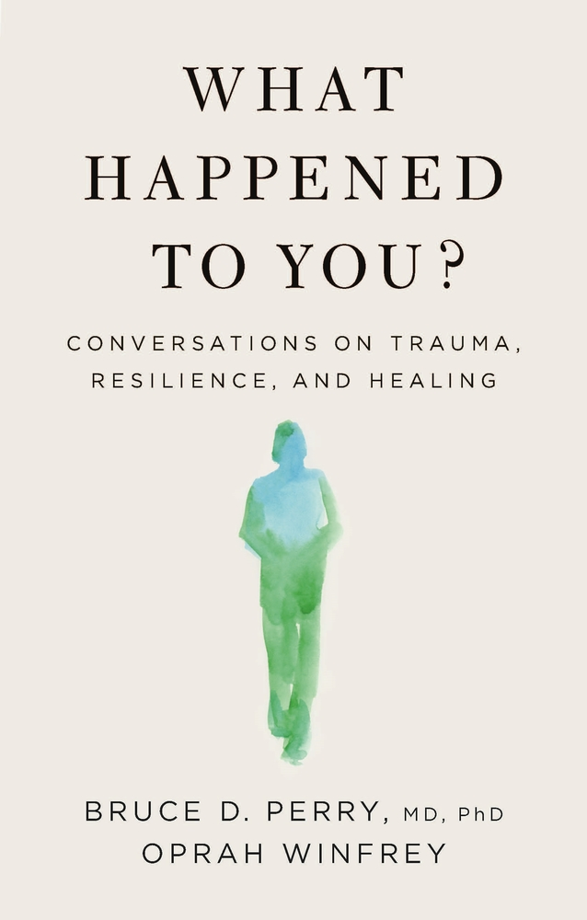
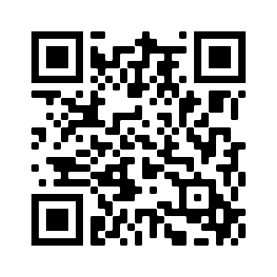
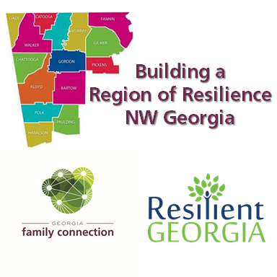
You’re Invited!
Be a part of the Building a Region of Resilience Book Club, a discussion of
Bruce D. Perry, MD, PhD and Oprah Winfrey's book, “What Happened to You?”
Building a Region of Resilience is inviting you to be a part of an important conversation on trauma, resilience and healing in our community and across our state. Join us as we walk through our Georgia-specific discussion guide and debrief the key concepts in this book. We will explore the difference between the questions “What’s wrong with you?” and “What happened to you?” and how that key question changes our perspective, approach and outcomes.
When: The 2nd, 3rd and 4th Wed. in April from 3:30 – 5 PM (4/14/22, 4/21/22 and 4/28/22)
Where: Discussions will be facilitated via Zoom and credentials emailed with the invite upon registration.
Registration: https://forms.gle/dnU9r8Ey8BeGvXG28
Georgia’s Essentials for Childhood
This book discussion is a part of Georgia’s Essentials for Childhood Initiative, Georgia Reads and sponsored by Resilient Georgia’s grant to the Building a Region of Resilience in NW Georgia. In addition to joining our book study, we hope you will attend the kickoff event, a virtual, statewide opportunity to learn more about the book and how our state is working to address trauma, build resilience, and offer healing in our communities.
You can get more information about trauma and resources available in NW Georgia on our website: www.ResilientNWGA.org
Notes:
https://gwinnettpl.libnet.info/event/5550654
Link to host registration form: https://tinyurl.com/WH2Uhost

