Slide 1

Handcrafted & Artisinal Gifts

Slide 2
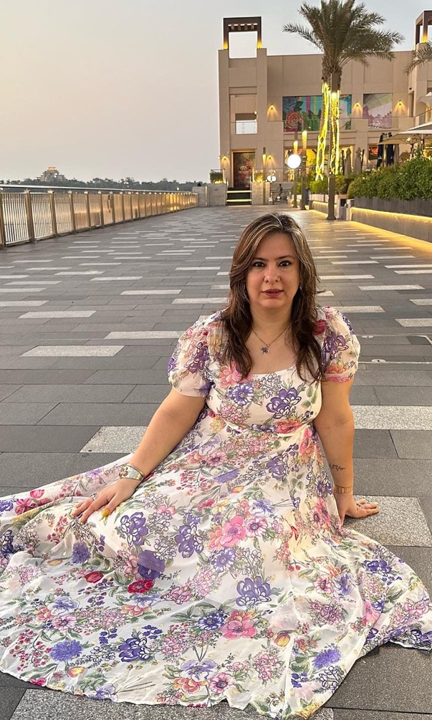
The Artist
Allow me to introduce Aditi, a mixed media artist whose very essence resonates with creativity. For the past 20 years, I have immersed myself in the world of artistic expression, crafting captivating projects that push the boundaries of imagination. Creativity runs through my veins, becoming an integral part of who I am. With each passing year, my passion for art only deepens, driving me to explore new techniques, experiment with different mediums, and bring my unique vision to life. Step into my world and witness the culmination of two decades' worth of artistic exploration and innovation. Welcome to the realm where creativity thrives, and my name is synonymous with limitless possibilities.

Slide 3

Sustainability Story
Wood Products
Crafted from scrap wood, each piece gives new life to what would have been waste, turning leftover fragments into timeless keepsakes.
Colour Use
We believe in using colour mindfully, keeping tones rich yet minimal so nothing goes to waste and every stroke counts.
Wax Bars
Our wax bars are infused with discarded coffee beans, fallen flowers, and leftover spices, capturing beauty from what nature has already given.
Glassware
Our glassware collection breathes new life into old discarded bottles, transforming them into stylish glasses, jugs, mugs, and platters for your home or cafes

Slide 4
Paintings

Slide 5
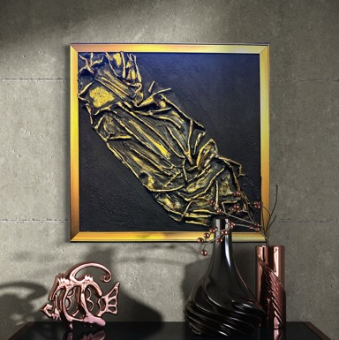
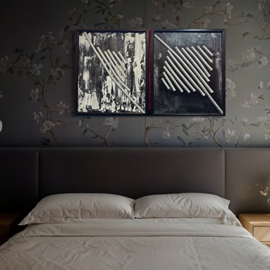
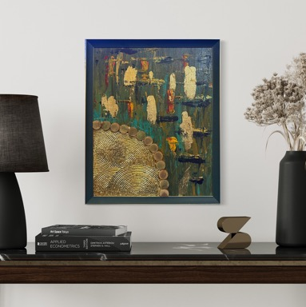
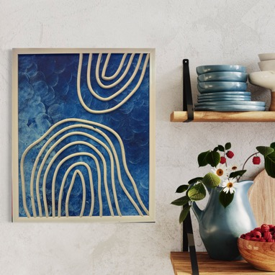
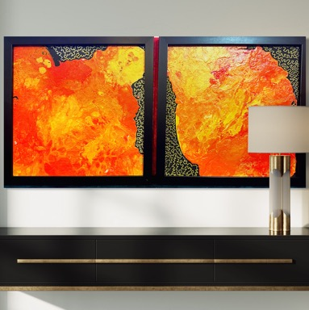
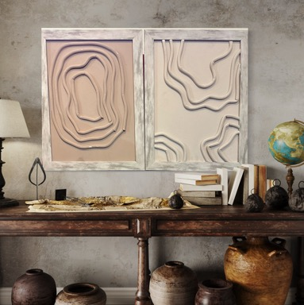
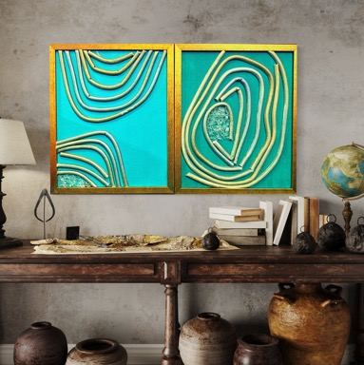
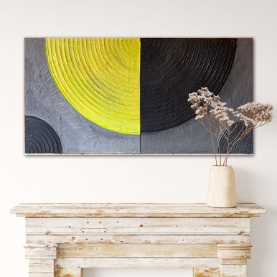

Slide 6
Hand Made Wall Clocks

Slide 7
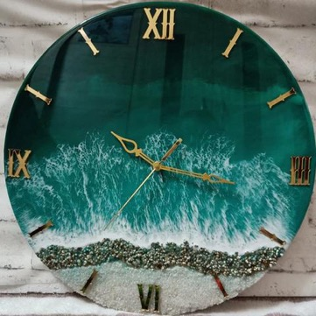
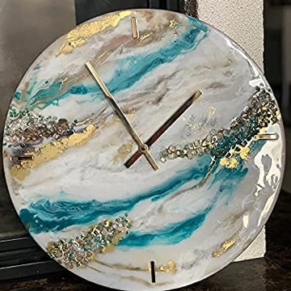
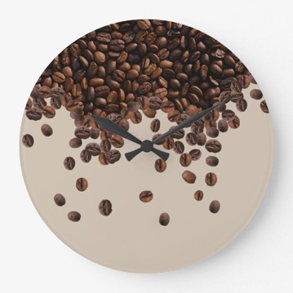
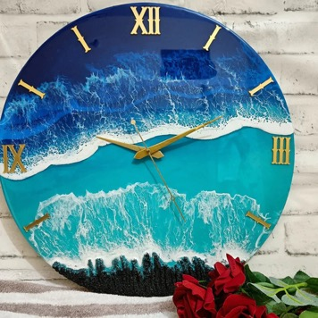
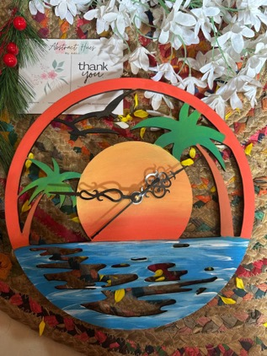
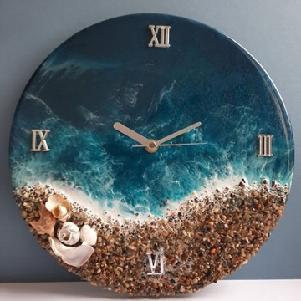
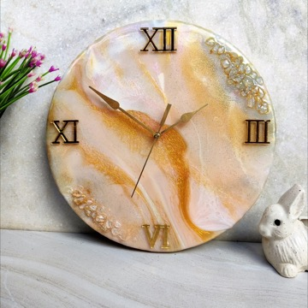

Slide 8
Trays, Coasters &
Cheese Boards

Slide 9
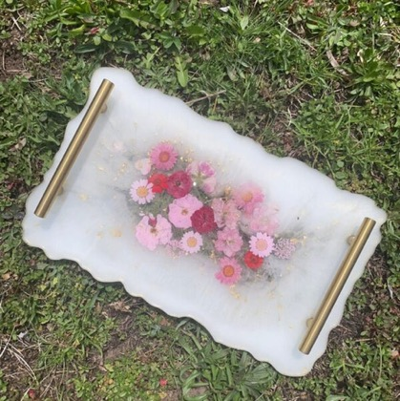
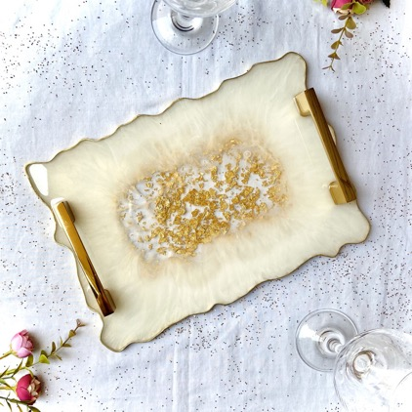
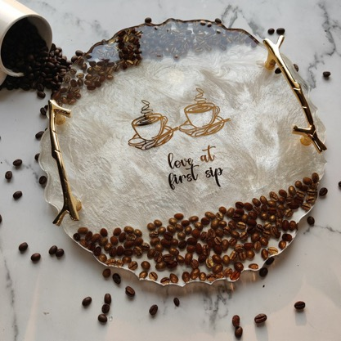

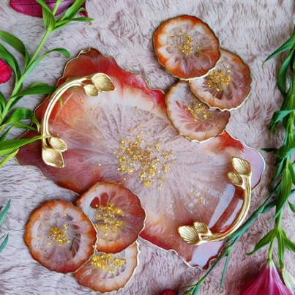
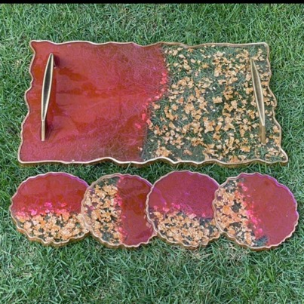

Slide 10
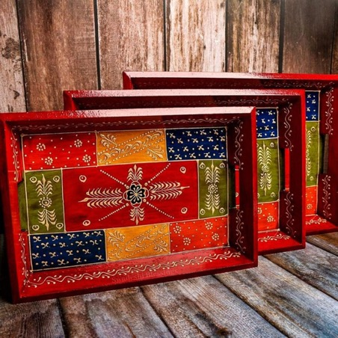
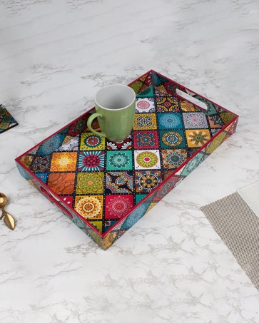
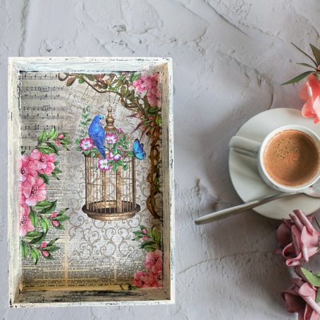
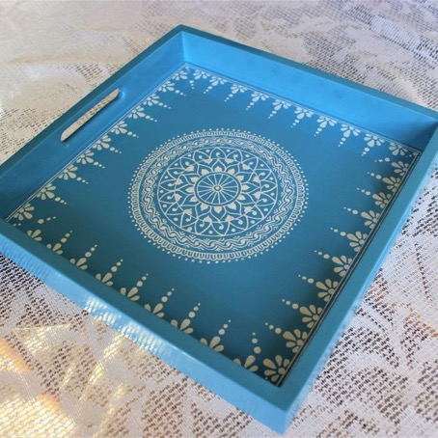
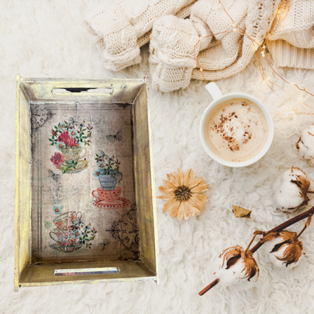
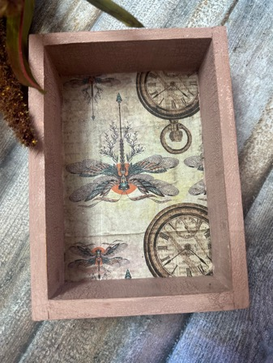
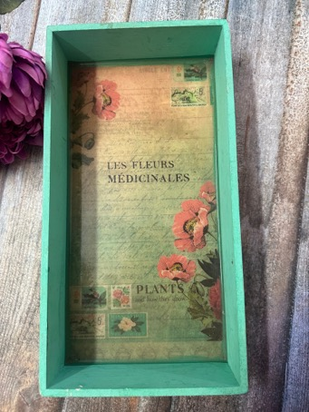

Slide 11
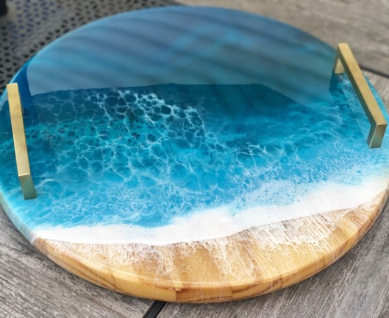
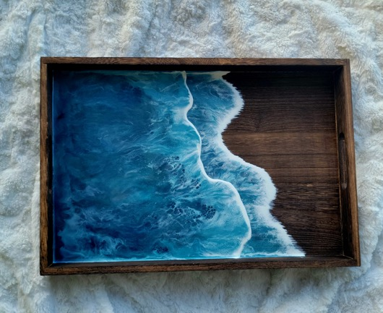
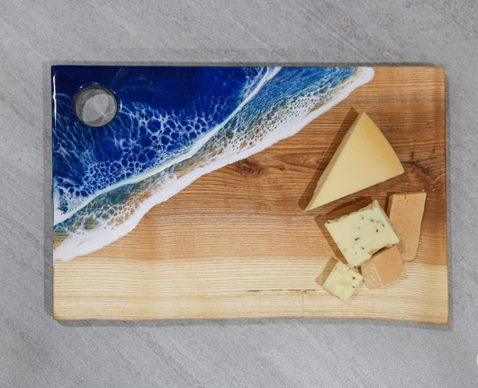
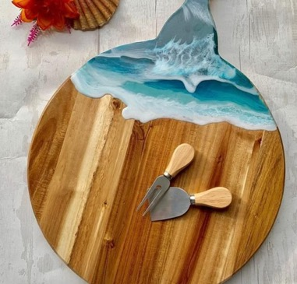
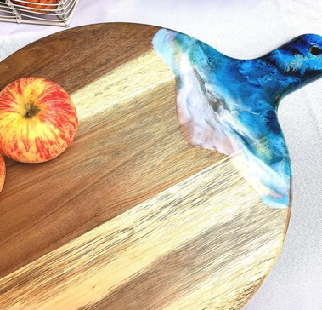
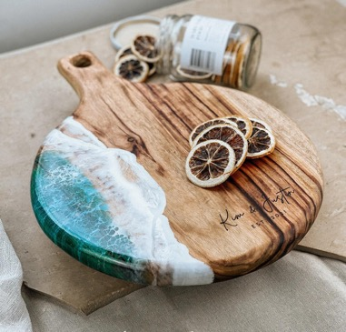
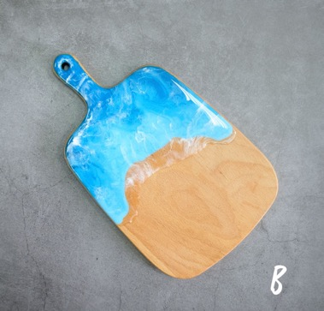

Slide 12
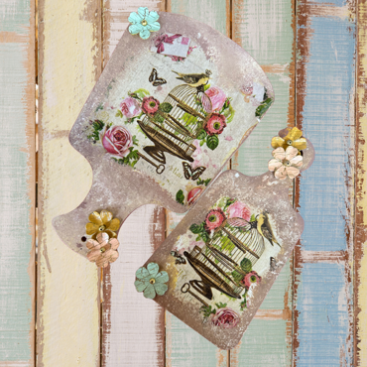
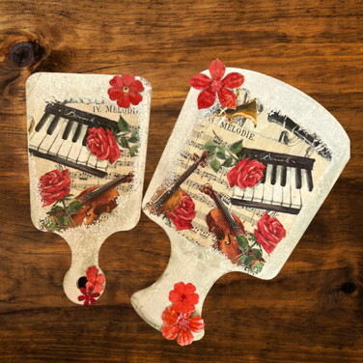
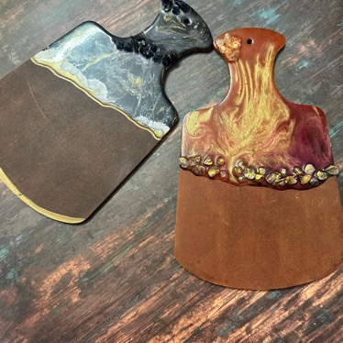
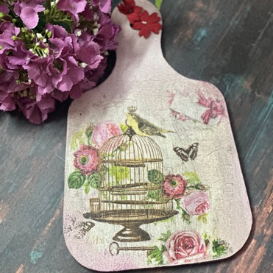
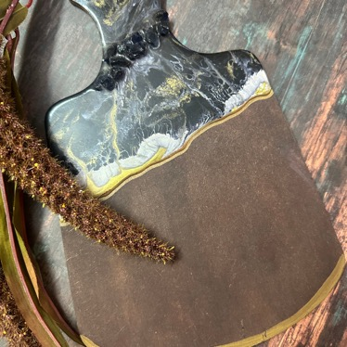
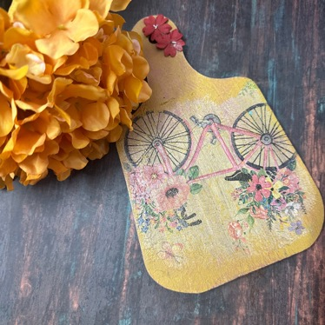
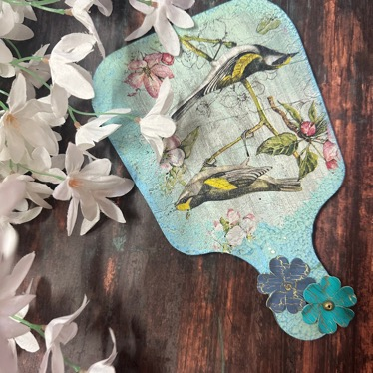
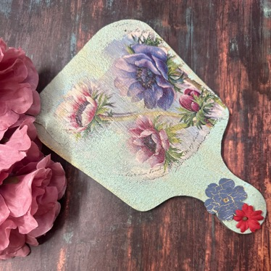

Slide 13
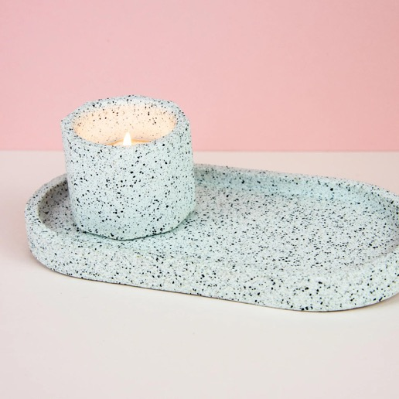
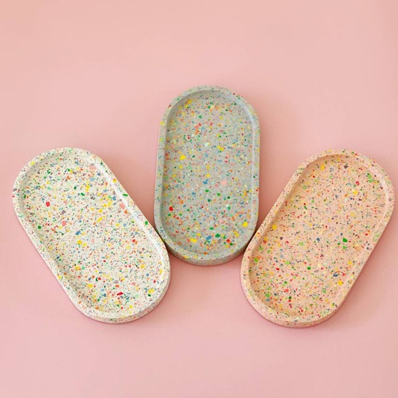
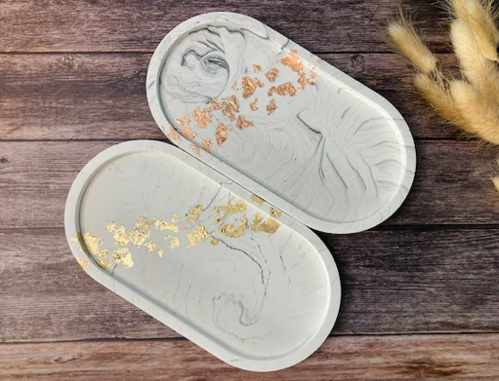
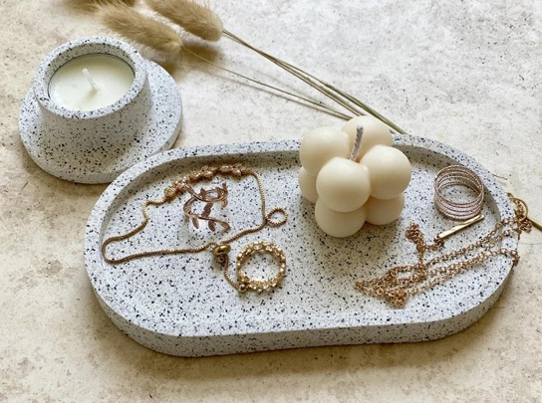

Slide 14
Quirky Wall Art

Slide 15
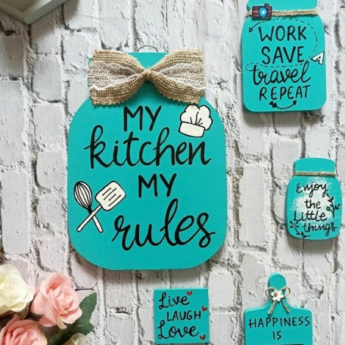
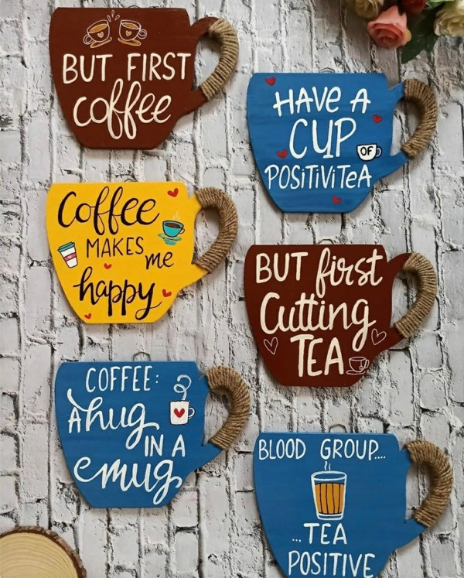
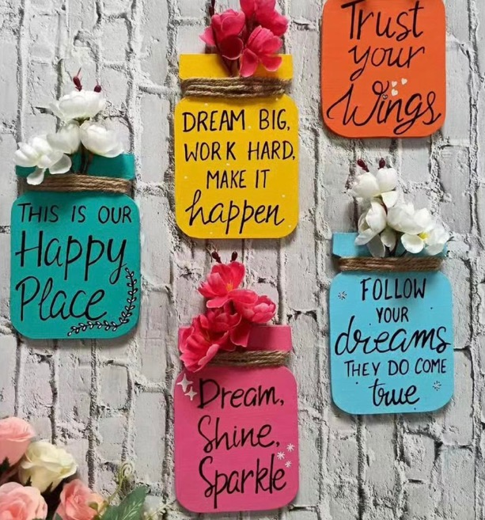


Slide 16
Pooja Thalis

Slide 17









Slide 18
Diwali Specials

Slide 19










Tee Light Candle Holders
Rs 150/- to Rs 250/-

Slide 20






Coasters &
Table Mats
Coasters(2)
Rs 200/-
Table Mats 8 inches with mirror work
Rs 300/-
without mirror work
Rs 250/-

Slide 21
Hamper Boxes

Slide 22







Slide 23
Christmas Specials

Slide 24




Fridge Magnets
Rs 125/-

Slide 25



Fridge Magnet
(8 inches) Rs 250/-
Name Plate- 175/-

Slide 26



Cheese Boards/Hangings
8 inches- Rs 250/-

Slide 27



Tee Light Holders & Coasters
Tee Light Holders- Rs 175/
Coasters (Set of 2)- Rs 125/- (without Resin)
Coasters (Set of 2- Rs 175/- with Resin

Slide 28



Photo Frames
5X3.5 inches- Rs 200/-
8X5.5 inches- Rs 300/-

Slide 29
Candles & More..

Slide 30



Wax Fragrance Bars
Rs 125/-

Slide 31



Candles
Rs 150/- onwards

Slide 32
Exclusive Collaborations

Slide 33

Lotus Bottle Art
Glassware
Our glassware collection breathes new life into old discarded bottles, transforming them into stylish glasses, jugs, mugs, and platters for your home or cafes

Slide 34









Slide 35

Latin Quarter Coffee
Coffee
Latin Quarter is a Goan brand of top-quality single-estate coffee roasters, founded in 2019. With a vision to provide an exclusive coffee range that feels like a hug in a mug, they established their roastery to complement their iconic coffee shop, Caravela Café—the first café in Goa to serve brews made with their own in-house roasted beans.
The overwhelming love and appreciation from coffee lovers encouraged Latin Quarter to extend beyond the café, offering their range of beans for customers to enjoy at home. Today, their carefully curated variants feature among India’s Top 10 coffee beans, bringing the café experience straight to every kitchen.

Slide 36



Slide 37
Let's Collaborate
+91 9811643530
aditi@thesavvystrategists.in

