Slide 1
Exosome and the Future of Application in Cosmetics
Presented by
SkinGenomix International ™

Slide 2
Why Exosomes Are the Future of Beauty
1. Precision Skin Communication
Exosomes act as messengers that speak the skin’s natural language, delivering instructions to repair, regenerate, and restore at a cellular level.
2. Non-Invasive Yet Potent
Exosome-based treatments offer injectable or topical alternatives to lasers and fillers, with less downtime and more holistic outcomes.
3. Superior to Growth Factors Alone
Unlike isolated growth factors, exosomes deliver a comprehensive regenerative payload, enabling a synchronized healing and anti-aging process.
4. Ideal for Sensitive and Compromised Skin
With low immunogenicity and high biocompatibility, exosomes are safe for all skin types, including post-procedure, acne-prone, or aging skin.
5. Growing Clinical and Consumer Demand
The global exosome cosmetic market is rapidly expanding, with increasing adoption in:
Luxury skincare lines
Medical spas and aesthetic clinics
Post-treatment recovery products
Personalized anti-aging regimens

Slide 3
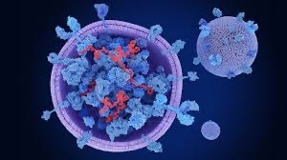
What are Exosomes?
- Nano-sized vesicles secreted by cells
- Size range: 30–150 nm
- Involved in intercellular communication
- Carry a diverse range of bioactive molecules:
Proteins: Tetraspanins, heat shock proteins, MHC molecules, integrins.
Lipids: Sphingomyelin, cholesterol, phosphatidylserine.
Nucleic Acids: mRNA, miRNA, lncRNA, DNA fragments.
Surface markers: CD9, CD63, CD81 (commonly used for exosome identification)

Slide 4
Exosome Biogenesis and Function
1. Intercellular Communication
Transfer of cargo (RNA, proteins) to recipient cells alters gene expression and function. Crucial in processes like immune modulation, tissue repair, and tumor progression.
2. Immune Regulation
Antigen presentation via MHC I/II molecules.
Can suppress or activate immune responses depending on cellular origin.
Used by tumors to create immunosuppressive microenvironments.
3. Regenerative Medicine
Stem cell-derived exosomes promote:
Angiogenesis
Wound healing
Anti-inflammation
Neural and cardiac regeneration
4. Disease Progression
In cancer, exosomes:
Promote metastasis
Modify tumor microenvironment
Confer drug resistance
In neurodegenerative diseases, exosomes may propagate misfolded proteins like tau or alpha-synuclein.
5. Biomarkers for Diagnostics
Exosomes in bodily fluids (blood, urine, saliva) carry disease-specific signatures.
Non-invasive "liquid biopsies" using exosomes are being developed for:
Cancer
Neurodegenerative diseases
Cardiovascular conditions

Slide 5
Exosome Isolation
The choice of exosome isolation method should be guided by the application, sample volume, and required purity. For therapeutic use, TFF or SEC are preferred for their scalability and integrity preservation. For research or diagnostics, Immunoaffinity and gradient centrifugation offer precision. Combining methods is often beneficial to improve both purity and yield.

Slide 6
Lyophilization: Why Freeze-Dry Exosomes?
1. Extended Shelf Life
Prevents degradation of exosomes by removing water, which limits hydrolytic and enzymatic activity.
Enables long-term storage (months to years) at ambient or refrigerated temperatures without significant loss of bioactivity.
2. Enhanced Stability
Protects exosomes from thermal and mechanical stress.
Maintains structural integrity and preserves cargo (proteins, miRNA, lipids) over time.
Reduces the need for continuous cold chain logistics.
3. Simplified Storage and Transport
Room temperature storage is possible post-lyophilization, which is crucial for distribution in global or remote areas.
Makes it easier to ship in dry form, reducing logistical costs and complexity.
4. Facilitates Formulation Development
Lyophilized exosomes can be easily incorporated into powders, creams, injectables, or capsules.
Enables precise dosing and mixing into pharmaceutical or cosmetic formulations without destabilizing the vesicles.
5. Reduces Risk of Microbial Contamination
Water-free environment reduces potential microbial growth, enhancing safety and purity.
Ideal for clinical and sterile therapeutic applications.
6. Preserves Functionality
With optimized cryoprotectants (e.g., trehalose, mannitol), lyophilization can maintain:
Exosome size and shape
Membrane markers (CD9, CD63, CD81)
Bioactivity such as tissue regeneration, immunomodulation, or anti-inflammatory effects
7. Enables Reconstitution on Demand
Lyophilized exosomes can be reconstituted in sterile water, saline, or buffers right before use.
Supports customized dosing for injectable or topical use based on patient or product needs.
8. Suitable for Regulatory and GMP Environments
Freeze-drying supports standardization and batch consistency, essential for clinical trials and eventual FDA/EMA approval.
Easier to comply with Good Manufacturing Practice (GMP) requirements when producing stable, dry formulations.

Slide 7
Generations of Exosomes
First-generation exosomes are naturally secreted extracellular vesicles harvested directly from primary, unmodified stem cells or donor cells under physiological, unengineered conditions. They retain the native biological content and communication potential intended by nature.
In contrast:
Second-generation exosomes may be derived from genetically modified cells or immortalized lines.
Third-generation exosomes are often engineered nanoparticles or synthetic vesicles mimicking exosomes.

Slide 8
Benefits of First Generation Exosomes
1. Natural Bioactivity
First-generation exosomes carry endogenous proteins, miRNAs, cytokines, and growth factors optimized by nature for cell-to-cell signaling.
Their biological content is physiologically balanced, enabling multi-targeted action (anti-inflammatory, regenerative, immunomodulatory).
→ Outcome: Higher efficacy in tissue repair, anti-aging, and immunoregulation without artificial enhancement.
2. Superior Safety Profile
Sourced from non-genetically modified, primary stem cells, first-generation exosomes carry minimal risk of immunogenicity or oncogenic mutations.
Free from synthetic additives or engineered payloads.
→ Outcome: Clinically safer for human use in cosmetic, aesthetic, and therapeutic applications.
3. Integrity of Native Membrane Markers
Preserve CD9, CD63, CD81, and other natural tetraspanins, essential for cellular uptake and target specificity.
Retain the lipid bilayer structure that ensures stability and targeted delivery.
→ Outcome: Higher uptake efficiency and biological relevance in regenerative medicine and targeted therapies.
4. Enhanced Communication Capacity
Maintain their natural ability to:
Modulate inflammation
Promote angiogenesis
Stimulate fibroblast and keratinocyte activity
Signal tissue-specific repair
→ Outcome: First-generation exosomes act as true messengers, not just carriers.
5. Non-Toxic and Biocompatible
Unlike engineered or synthetic alternatives, first-generation exosomes are fully biocompatible, with low cytotoxicity and no need for immunosuppressive co-treatments.
→ Outcome: Ideal for use in injectables, topical serums, and IV formulations.
6. Ethical and Transparent Sourcing
Derived from human umbilical cord, placenta, or adipose-derived MSCs using ethical, traceable, and GMP-compliant methods.
→ Outcome: Supports regulatory approval, clinical acceptance, and consumer trust.
7. Consistency with Clinical Research
Most clinical and preclinical studies on exosome therapies use first-generation exosomes, making them the best validated in literature.
→ Outcome: Easier to align with existing research and accelerate development pipelines.

Slide 9
Supporting Studies
Clinical applications of stem cell-derived exosomes Detailed review of MSC- and dendritic cell-derived exosomes in clinical trials, covering inflammation, regeneration, cancer vaccines, and drug delivery—highlighting their safety and translational progresswired.com+15biosignaling.biomedcentral.com+15frontiersin.org+15nature.com.
Stem cell‑derived exosomes as therapeutic alternative to cell therapy (Nature) Demonstrates that MSC-derived exosomes offer immunomodulatory, regenerative, and non-tumorigenic effects—positioning them as safer, more practical surrogates to stem cell therapies mdpi.com+2nature.com+2nature.com+2.
MSC‑derived exosomes in clinical and preclinical trials Summarizes ongoing/completed clinical trials using MSC exosomes, examining isolation, characterization, dosage, and administration routes for immunomodulation and regenerationsciencedirect.com+15stemcellres.biomedcentral.com+15mdpi.com+15.
MSC‑EVs for tissue repair and immune regulation (Nature Communications) Reviews molecular mechanisms of exosomes in treating osteoarthritis, spinal cord injury, skin injury, fibrosis, and T1DM—showing direct tissue effects from natural exosome cargo nature.com.
Preclinical exosome therapies in cardiovascular and ischemic injury Evidence that BM- and ESC-MSC exosomes reduce infarct size and improve cardiac function via natural signaling pathways sciencedirect.com+15link.springer.com+15bpspubs.onlinelibrary.wiley.com+15.
Comprehensive review: biologic function and clinical applications A broad survey of exosome biology, diagnostics, and drug delivery—including isolation techniques consistent with first-gen processing pmc.ncbi.nlm.nih.gov.
MSC-exosomes as bio‑inspired nanomedicines Discusses the intrinsic advantages of natural MSC-derived exosomes (e.g., biocompatibility, therapeutic efficacy) over synthetic alternatives mdpi.com+2sciencedirect.com+2frontiersin.org+2.

Slide 10
Supporting Studies
Why These References Matter
Validated Biological Potency: Multiple sources confirm that MSC-derived, naturally secreted exosomes carry functional proteins, miRNAs, and cytokines critical for regeneration and immunomodulation.
Proven Safety in Clinical Contexts: Reviews and trials repeatedly underscore their low immunogenicity, non-tumorigenicity, and non-cell-based therapeutic advantages.
Translational Readiness: Ongoing Phase I/II clinical trials (e.g., in stroke, T1DM, lung injury, skin conditions) demonstrate real-world application .
Therapeutic Breadth: Works range from cardiovascular repair to fibrosis, arthritis, dermatology, and beyond, showing wide-reaching biological relevance.

Slide 11
SkinGenomix™ Exosomes Why our Exosomes are better?
1. Superior Source Material
Derived from Wharton's Jelly or other clinically validated sources.
Cells are cultured in xeno-free, serum-free, GMP-compliant conditions to ensure maximum bioactivity and safety.
2. Advanced Biogenesis Optimization
We leverage first-generation exosome harvesting, preserving the most potent and naturally secreted vesicles.
Exosomes are isolated at peak bioactivity, retaining high concentrations of growth factors, miRNAs, cytokines, and anti-inflammatory molecules.
3. Industry-Leading Isolation & Purification
Proprietary multi-step isolation process combining tangential flow filtration (TFF) and size exclusion chromatography (SEC) ensures:
Ultra-high purity (free from proteins, DNA, and cell debris)
Intact membrane markers (CD9, CD63, CD81)
Reproducibility across batches
4. Lyophilization for Stability and Global Reach
Our exosomes are lyophilized with pharmaceutical-grade cryoprotectants, ensuring:
Shelf stability at room temperature
No loss of structure or biofunction upon reconstitution
Easier transport and integration into topical or injectable products
5. Validated Efficacy
Skin rejuvenation and anti-aging formulations
Hair regeneration, scar remodeling, and wound healing
Immune modulation and inflammation control backed by preclinical data, in vitro potency assays, and ongoing clinical collaborations.
6. Scalable & GMP-Compliant Production
State-of-the-art manufacturing facility with GMP, ISO 13485, and FDA-aligned protocols.
Scalable production capacity for both boutique formulations and large-scale biotech or cosmetic OEM partnerships.
7. Trusted by Professionals
Our exosomes are used by leading dermatologists, regenerative medicine clinics, and luxury skincare brands in the U.S., Europe, and Asia.

Slide 12
Bio-Reactor Results

Slide 13
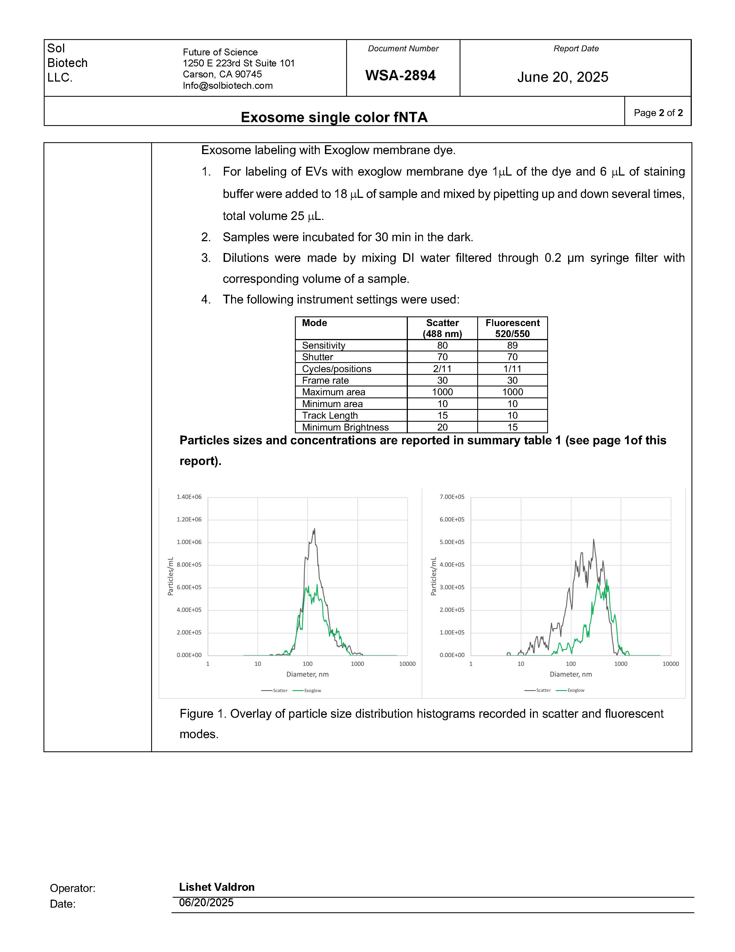
Bio-Reactor Results

Slide 14
SkinGenomix™ vs. Competitors
✅ Unmatched Particle Density
SkinGenomix™ exosomes deliver an impressive 4.4 × 10¹⁰ particles/mL—over three times the concentration found in others formulation. This translates to more active vesicles per dose, ensuring superior clinical and cosmetic outcomes for end users.
✅ Enhanced Payload Capacity
With a larger average particle size (169.3 nm), SkinGenomix™ exosomes are better equipped to carry vital bioactive molecules like proteins, growth factors, and miRNAs. This enables more effective tissue signaling and regenerative response.
✅ High Functional Quality
Skin Genomix’s exosomes show a greater absolute count of labeled particles (5.0 × 10⁹/mL), confirming high levels of CD9, CD63, and CD81 markers. These are essential for targeted cell communication and therapeutic impact—meaning every vial delivers real, measurable results.
✅ Superior Formulation Stability
Each batch is lyophilized for shelf-stable storage, maintaining bioactivity without the need for cold chain logistics—ideal for distributors seeking efficient, global fulfillment.

Slide 15
Breakdown of Bio-Reactor Results
📊 What This Means in Simple Terms
✅ 1. SkinGenomix™ Has a Higher Particle Count
SkinGenomix's exosome sample had over 3x more particles than competitors.
This suggests a denser and more potent formulation.
✅ 2. Larger, More Robust Exosomes
SkinGenomix™ exosomes are larger on average, which may indicate greater cargo capacity (more growth factors, RNA, proteins).
✅ 3. Surface Marker Presence is Comparable
Both brands have similar levels of surface markers (CD9, CD63, CD81), important for targeting and cell uptake.
The compared sample had a slightly higher percentage (12.31%) than SkinGenomix™ (11.36%), but both are within strong, active ranges.
✅ 4. Higher Functional Particle Count in SkinGenomix™
The number of labeled, functional exosomes (those confirmed by fluorescent antibodies) was much higher in SkinGenomix™.
This supports the biological relevance and activity of SkinGenomix’s product.

Slide 16
Who is SkinGenomix™ International?
SkinGenomix™ International LLC is a cutting-edge skincare manufacturing company specializing in exosome- and Peptide formulations designed for advanced dermatological and aesthetic applications. Headquartered in Los Angeles, California, with global operations extending to Dubai and India, the company is driven by a commitment to merging biotechnology with beauty—delivering next-generation products that are both clinically effective and scientifically validated.

Slide 17

SkinGenomix Founders
Dr. Naina Sachdev, founder of NAINA MD™ Beverly Hills, is a highly respected physician Board Certified in Anti-Aging and Regenerative Medicine. With a strong commitment to advancing the science of longevity and wellness, she has completed an intensive fellowship in Functional, Aesthetic, and Stem Cell Medicine through the prestigious A4M Academy of Anti-Aging and Regenerative Medicine. Dr. Naina’s expertise spans a wide range of cutting-edge medical disciplines, positioning her at the forefront of integrative and personalized healthcare. Her clinical approach bridges the gap between science and beauty, empowering patients to achieve optimal health, vitality, and confidence at any stage of life.

Slide 18
Summary
Exosomes represent the intersection of biotechnology and beauty. Their ability to biologically instruct skin cells to regenerate sets a new standard in cosmetic science. For brands, clinics, and distributors seeking to lead the next era of skincare, exosomes offer not just a product—but a paradigm shift. SkinGenomix formulates high-performance skincare and regenerative products powered by first-generation, lyophilized exosomes. These exosomes are derived from ethically sourced, GMP-grade, and preserved using advanced lyophilization techniques to ensure long-term stability, potency, and shelf life. Every batch is rigorously tested for particle concentration, purity, and surface marker expression (CD9, CD63, CD81), making SkinGenomix products some of the most potent and therapeutically relevant in the market. By offering Skin Genomix exosomes, distributors gain access to a scientifically validated, clinically relevant, and commercially scalable product. This not only elevates your portfolio but also builds long-term trust with clients seeking next-generation regenerative solutions.

