Slide 1
THE BUSINESS CASE FOR BREASTFEEDING
Building a Lactation Support Program

Slide 2
Breastfeeding Recommendations
American Academy of Pediatrics
Babies be fed nothing but breast milk for the first 6 months and continue for at least 1 year
World Health Organization
Babies be fed nothing but breast milk for the first 6 months and continue for at least 2 years

Slide 3
Vision – Create a culture in Collier County that genuinely promotes exclusive breastfeeding by healthy mothers to healthy newborns
Mission – Improve breastfeeding exclusivity rates in Collier County for mothers who face cultural, institutional and financial obstacles

Slide 4
About Us
Members include clinicians, lactation specialists, employers and childcare providers
Focused on increasing breastfeeding rates in Collier County

Slide 5
Outreach
Work with community healthcare providers, businesses and employers
Provide services that promote breastfeeding by increasing access to environments that support breastfeeding

Slide 6
Department of Health WIC Breastfeeding Data
% of Infants Ever Breastfed 0-24 Months
 | Naples | Immokalee | Golden Gate | Overall
Sept-2016 | 90.85 | 79.86 | 80.81 | 84.08
Sept-2015 | 90.50 | 79.60 | 83.50 | 85.0
Sept-2014 | 89.40 | 84.50 | 85.10 | 86.5
% of Infants Currently Breastfeeding 26-52 Weeks
 | Naples | Immokalee | Golden Gate | Overall
Sept-2016 | 48.06 | 36.38 | 41.63 | 42.5
Sept-2015 | 42.90 | 30.20 | 36.80 | 37.6
Sept-2014 | 44.80 | 33.50 | 26.40 | 35
% of Infants Exclusively Breastfed 26-52 Weeks
 | Naples | Immokalee | Golden Gate | Overall
Sept-2016 | 20.28 | 19.68 | 21.30 | 20.51
Sept-2015 | 19.50 | 14.50 | 18.20 | 17.9
Sept-2014 | 22.80 | 10.00 | 15.50 | 16.90

Slide 7
Benefits of Breastfeeding
Recommendations
Financial Benefits
Mom & Baby Benefits
Statistics
Community Engagement

Slide 8
Breastfeeding saves money.
The United States would save $2.2 billion per year.
Medical costs are lower for fully breastfed infants than never-breastfed infants
Breastfed infants usually need fewer sick visits, prescriptions and hospitalizations

Slide 9
Breastfeeding saves lives.
Recent research shows that if 90% of families breastfed exclusively for 6 months, nearly 1,000 deaths among infants could be prevented.

Slide 10
How Lactation Support Programs Benefit Public Health
For every 1,000 babies not breastfed, there is an excess of 2,033 physician visits, 212 days in the hospital, and 609 prescriptions.
“Breastfeeding is a very important economic and public health issue.”
-Dr. Melissa Batrick, Harvard Medical School

Slide 11
Benefits to Mothers
Lowers risk of:
Breast Cancer
Ovarian Cancer
Osteoporosis
Prevents postpartum depression and Type 2 diabetes
Reduces stress

Slide 12
Benefits to Children
First line of defense against:
Obesity
Diabetes
Allergies
Cuts risk of Sudden Infant Death Syndrome
Prevents infections and illnesses including:
Ear infections
Respiratory Infections
Dermatitis
Asthma

Slide 13
Breastfeeding is better for the environment.
The production of artificial milk, baby bottles and other feeding accessories require energy to produce.
Manufacturing of packaging for artificial baby milk creates toxins and uses paper, plastic and aluminum.
Each cow used to produce formula needs 2.4 acres of land, which leads to deforestation and soil erosion.
Lactation Supportive Environments, UC San Diego Center

Slide 14
Breastfeeding Support
NCH BirthPlace is committed to giving quality family centered maternity care
Only birthing center in Collier County
Offers education for maternity patients and their expanding families
Breastfeeding Class
Certified Lactation Consultants

Slide 15
Breastfeeding Support
The NCH Birth Place Advocates Exclusive Breastfeeding
Golden Hour
First Bath
Quiet Time
Pacifiers

Slide 16
Babies today…
…your future employees!

Slide 17
Business Benefits of a Lactation Support Program
Improve Retention
Mitigate Lost Productivity
Lower Healthcare Costs
Recognition

Slide 18
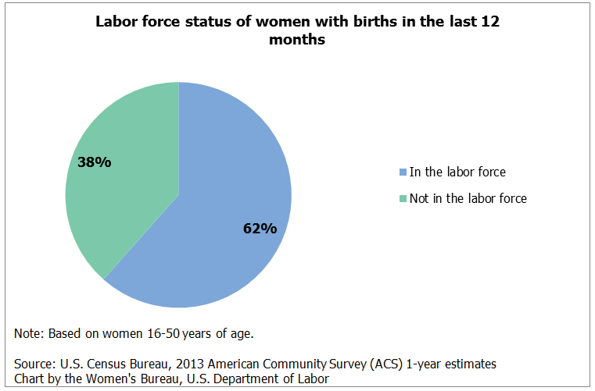
Women In The Workforce
Did you know?
Mothers are the fastest growing segment of the US workforce
70% of women with children participate in the labor force

Slide 19
https://www.youtube.com/watch?v=aqD5PuXPYmg
“I feel more loyal to my employer because they support me and my personal choices. It also gives me the ability to be the best worker I can be while still providing for my family.”
- Katie Greenberg
Working Mom, Naples, FL

Slide 20
Improve Retention
Employees are more likely to return to work after childbirth when their workplace provides a supportive environment for continued breastfeeding.
The Business Case for Breastfeeding, US Dept of Health and Human Services

Slide 21
Reduce Absenteeism
Breastfeeding employees miss work less often
Breast fed infants are healthier! One-day absences to care for sick children occur more than twice as often as formula-fed infants.
The Business Case for Breastfeeding, US Dept of Health and Human Services

Slide 22
Lower Healthcare Costs
Lower risk of illness for babies and mothers translates into lower medical insurance claims
CIGNA conduced a 2-year study of 343 employees who participated in a lactation program and found annual savings of:
$240,000 IN HEALTHCARE EXPENSES
&
62% FEWER PRESCRIPTIONS
The Business Case for Breastfeeding, US Dept of Health and Human Services

Slide 23
Receive Recognition
Florida Breastfeeding Friendly Employer Award
Join the growing list of recipients!
Gold, Silver and Bronze level awards
Local Gold Star Recipients

Slide 24
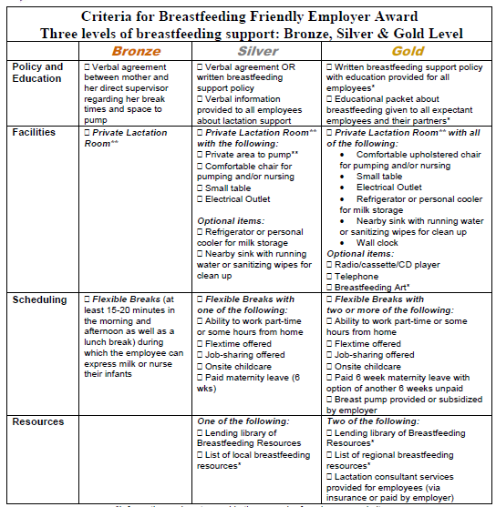
Complete your Application
Decide which level you want to obtain
Evaluate your current Lactation Program
Make any required improvements
Complete the online application
www.flbreastfeeding.org

Slide 25
Florida Department of Health in Collier County Community Health Improvement Plan
Goal: Increase the initiation, duration and exclusivity of breastfeeding
Double the number of Breastfeeding Friendly workplaces as defined by the Florida Breastfeeding Coalition

Slide 26
Become a Certified Worksite
One of the 46 Best Practices in the Blue Zones Project ®
14. Adopt a policy that provides space and time for breastfeeding during work hours.
Contact Bree Fung to get started
239-231-8084
Bree.fung@healthways.com

Slide 27
Adopt a lactation accommodation policy!
Providing a breastfeeding-friendly workplace doesn't only make sense for babies and moms, it also makes business sense.
IT ROCKS!

Slide 28
Create a Lactation Accommodation Program
Define Your Policy
Provide a Space
Supplies
Support & Communication

Slide 29
Lactation Accommodation Program
A Model For Success
Communication
Facilities
Policy
Education & Resources

Slide 30
It’s the Law
Patient Protection and Affordable Care Act
Section 4207 requires employees to
provide reasonable break time
and
a place, other than a bathroom, that is shielded from view and free from intrusion

Slide 31
Create a Policy
Key Elements to a Lactation Policy
Break Times
Available Lactation Areas
Breastfeeding Equipment
Employee Responsibilities
Staff Support

Slide 32
Allow Time
What is reasonable?
Typically every 2-3 hours, for about 15-20 minutes
2-3 times per 8 hour shift
3-4 times per 12 hour shift
Work together to coordinate times that work for both mom and business

Slide 33
“Coming back to work after maternity leave and having a place that I can pump and be comfortable is definitely encouraging. I am very appreciative to my employer for providing this space.”
- Katie Greenberg
Working Mom, Naples, FL

Slide 34
Provide a Space
Basic needs are minimal
Private space with locked door
Chair and table
Electrical outlet
Anti-microbial wipes
Access Sink
Place to store milk (personal cooler or supplied refrigerator)

Slide 35
Provide a Space

Slide 36
Provide a Space

Slide 37
Provide a Space

Slide 38
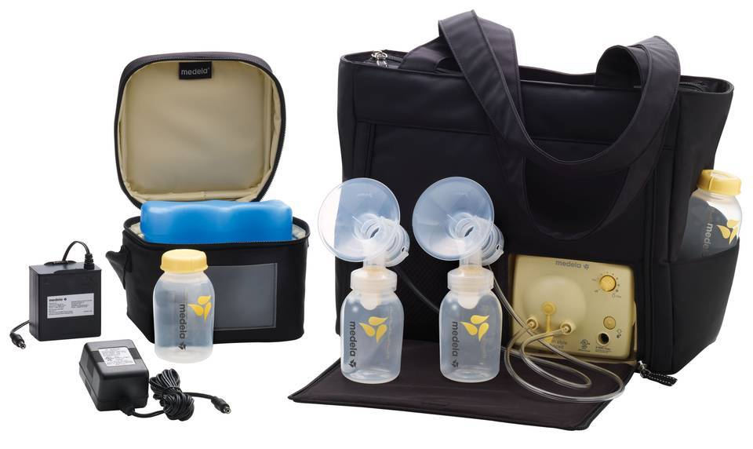
Equipment
Pumps & supplies offered through company insurance
Direct reimbursement from the company
$1 Invested = $3 Return

Slide 39
“As a new mom, it was scary going back to work. I have no complaints, my employer did such a great job and accommodated everything I could possibly could need.”
- Kristin Elze
Working Mom & Branch Manager, Chase, Naples, FL

Slide 40
Offer Support
Create a Culture of Support
Educate management on laws and benefits of breastfeeding
Work with mothers to schedule milk expression breaks
Offer for breastfeeding resources through community referrals
Cover Lactation Consultation through insurance

Slide 41
“The lactation policy and education has helped our associates and managers recognize the importance of accommodating breastfeeding employees. This program helped us stay in compliance with the law and keep our new mothers in the workforce”
– Shaun Stout, Pinnacle Hotels

Slide 42
Communication
Develop an Employee Maternity Leave Packet
Provide a copy of your location policy
Insurance Benefits Coverage for breast pumps & lactation consultation
Review break/PTO policy-offer a sample pumping schedule
Designate a place to pump or discuss lactation room operations

Slide 43
You Play a Key Role in Continuing Breastfeeding After Returning to work

Slide 44
Employer Resources
Florida Breastfeeding Coalition
www.flbreastfeeding.org
Office of Women’s Health, US Department of Health and Human Services
www.womenshealth.gov/breastfeeding/employer-solutions
United States Breastfeeding Committee
www.usbreastfeeding.org
United States Department of Labor
www.dol.gov/whd/nursingmothers

Slide 45
www.SafeHealthyChildren.org
239.624.4033
info@SafeHealthyChildren.org

