Slide 1

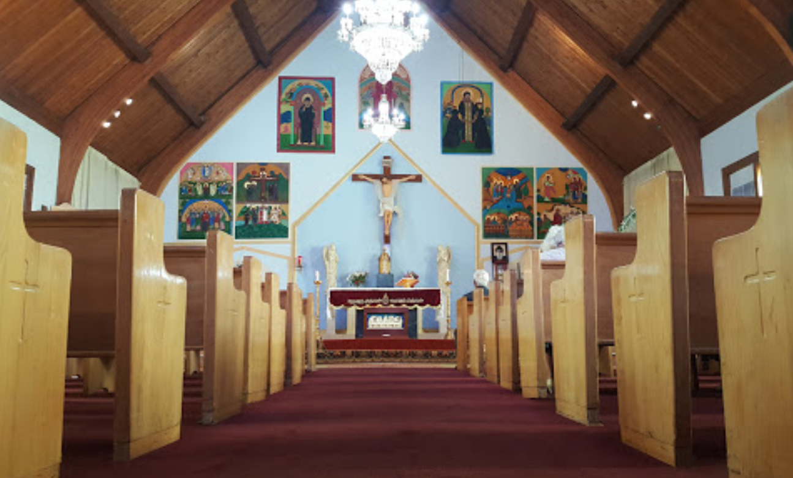
Saint Sharbel Maronite Church
2019 Town Hall
1/19/19
Reverend Simon El Hajj

Slide 2
Key Topics
3-year Strategic Plan
Annual Financial Highlights
New Building Planning

Slide 3
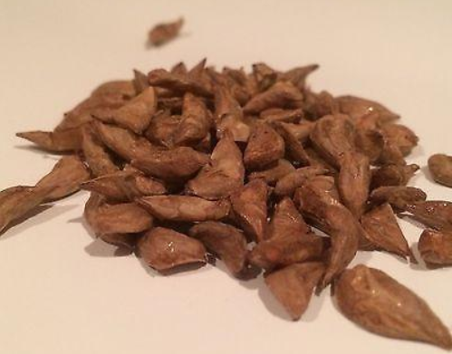
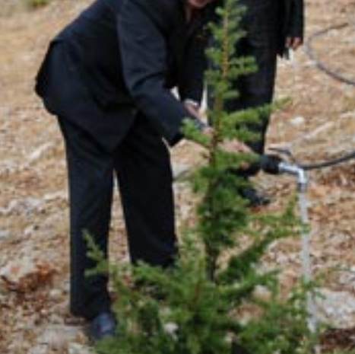
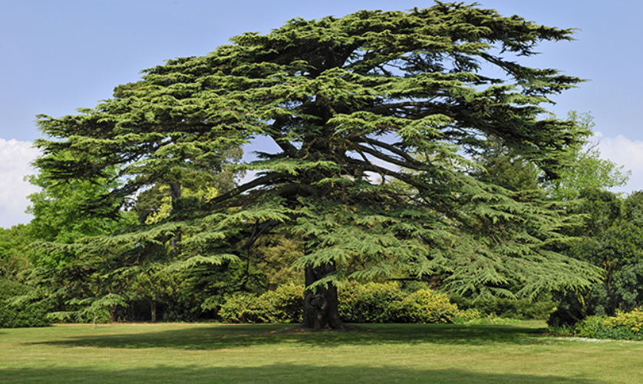
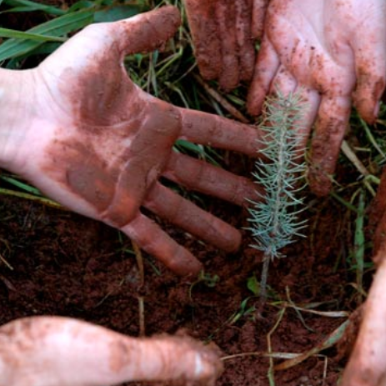
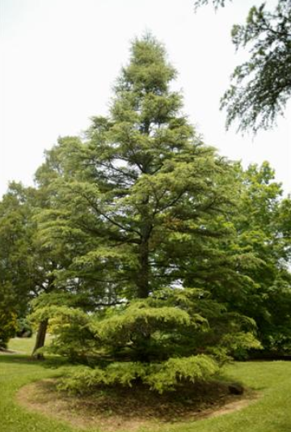
Notes:
Seed of an idea – to start church
Work together to plant and grow
Nurture, water, care for to bring health & growth
And while our tree is a mid-size, 30+ years old, we have much more growth ahead of us to achieve our full potential
Live 150 – 300 years, Cedar of Lebanon some cited up to a 1000 years
Our Church 39 years vs 1000 years = 3.9% of our lifespan but truly our life-span is infinitely until the end of time

Slide 4
Our Journey

Slide 5


Growing
Together

Slide 6
Objective
- St Sharbel Church - 2018 Steering Committee
2018 Steering Committee
Develop long-term strategic plan, considering input from the parish community, to realize our aspirations in spiritual needs, sense of fellowship, outreach, social justice, personal growth, culture and connection to Lebanon.
Key Deliverables
Execution of Parish-wide survey
Development of strategic fundamentals
    Vision
    Mission
    Core Values
    Parish Organizational design
    5 Pastoral Priorities
    3-year Strategic Plan

Slide 7
- St Sharbel Church - 2018 Steering Committee
2018 Survey Overview
200 + Respondents
Broad Demographics
47%
Satisfaction
Themes & Focus Areas Identified
Sense of Change generating excitement
Notes:
208 respondents, with 80% having been Parish members for 10+ years, with 85% living within 30 minutes of the church and over 65% saying they attend Church multiple times a month
Demographic of respondents includes: 60/40 female to male ratio with 75% between the ages of 25-54. 65% are married, 73% have a college / post-graduate degree, 60% employed (FT/PT) & 20% self-employed, 60% have kids and very heavy bilingualism in ability to speak but not read/write Arabic
Overall Satisfaction: 15% of the Parish indicated a level of Dissatisfaction. Approximately 47% of the Parish indicated some level of Satisfaction and 39% are Neutral (Satisfied = 38.6%, Very Satisfied = 7.9% = 46.5%)
Parishioners are sensing change and excited to see what the outcome of this potential change may be

Slide 8
- St Sharbel Church - 2018 Steering Committee
2018 Survey Highlights
Top 3 Themes
Top 3 Area’s of Focus
Facilities: bigger, better, more enabling of a community life
Building a stronger sense of Community & Inclusion
Increased Spiritual life (Bible studies, evening prayers, etc…)
Children Religious Education
Providing opportunities to help the needy
Developing a sense of Parish Community

Slide 9
Strategic Fundamentals
- St Sharbel Church - 2018 Steering Committee
Vision
We will be an active, growing, and welcoming community living the faith, values, and traditions of the Maronite Church of Antioch.
Mission
To preserve our Antiochene Aramaic heritage and practice our Maronite Catholic Faith as Disciples of Christ in the local community and beyond.
Six Core Values
Liturgical Worship: strongest anchor enabling us to receive God’s grace
Fellowship: caring community towards others
Discipleship: emulate Jesus in our lives
Apostleship: servants of evangelization
Stewardship: cultivate and share our God given time, talent & treasures
Communionship: with our Eparchy and other Maronites around the world
Notes:
Vision: Our Aspiration – what we want to be
Mission: what we want to achieve
Values: defines who we are
Our Core Values define who we are, what we believe in, and how we live. These values distinguish us as an ancient Church with contemporary relevance, give us a sense of purpose as a faith community, and guide our behavior in proclaiming Christ’s message in words and deeds.

Slide 10
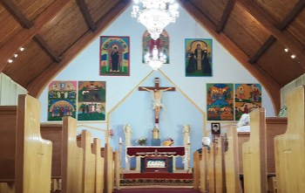
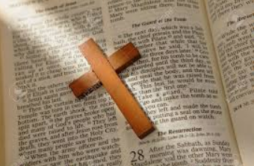



NEW! 5 Foundational Ministries
- St Sharbel Church - 2018 Steering Committee
Liturgy & Mystery
Prepare, celebrate & live the liturgy & mysteries (Liturgy, Novena, Choir, Alter Boys, Decorations, Retreats)
Formation & Development
Identify, teach & assess the Antiochene Aramaic Faith (MCF, Adult / Family Enrichment, Languages, Social Catholic Teachings)
Pastoral Outreach
Create & implement an inclusive parish-wide ministry (inactive / new parishioners, Christian services, Pastoral care)
Parish Life
Offer & promote religious, social & cultural experiences (Parish unity, culture & identity, social / sport / trips, Parish communication strategy & annual calendar)
Evangelization & Vocations
Mentor & support those who have a calling from God to answer & inspire those who do know the Gospel to accept Jesus (Discernment workshops, external missions)
Notes:
Organizational structure delivering LEADERSHIP & GOVERNANCE
Pastoral Outreach:
Christian services (caring for the poor families, homeless dinners, scholarships)
Pastoral care (visit elders, sick and homebound)

Slide 11
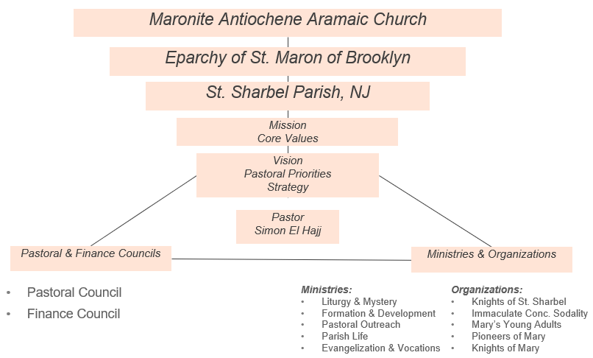
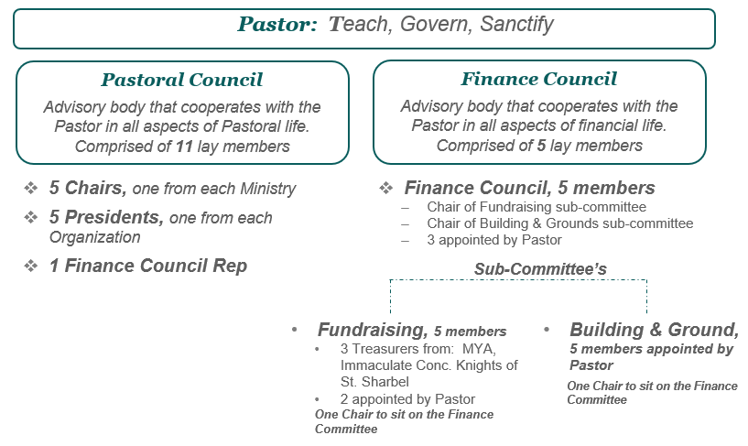
- St Sharbel Church - 2018 Steering Committee
Structure & Leadership
Organizational Design
Leadership & Governance

Slide 12
Saint Sharbel Church 3-Year Strategic Plan
- St Sharbel Church - 2018 Steering Committee
We will be an active, growing, and welcoming community living the faith, values, and traditions of the Maronite Church of Antioch.
VISION
Expand Faith-Based Initiatives +50%
Increase Parish satisfaction rating by +12pts to 50% by 2021
Improve functionality of Parish campus
Grow net income +15%
Strengthen Community Leadership & Engagement
GOALS
5 PASTORAL PRIORITIES
FAITH FORMATION & SPIRITUAL LIFE
COMMUNICATION & COMMUNITY
FACILITIES AND INFASTRUCTURE
FINANCIAL DEVELOPMENT
LEADING WITH PURPOSE
TASKS
  Strengthen our Christian faith:
    Implement Monthly Bible Study meetings by Dec 2019
    Host 1 Catholic Social Teaching Seminar by 2020
  Grow spiritual engagement:
    Maintain paraliturgical prayers throughout 2019
    Assess impact of dedicated English Liturgy by November 2019
    Plan a Parish Retreat for implementation in 2020
    Form small Faith Communities program for implementation in 2021
  Launch evangelization and vocation programs:
    Conduct speaker series on vocations to the Priesthood and Consecrated Life by October 2019
    Conduct training programs for evangelization by June 2020
  Develop & execute Parish Townhall annually with the first by January 2019 including financial transparency
  Strengthen consistent communication & awareness of Parish initiatives:
    Publish annual events calendar by December 2019 for 2020
    Increase followership & optimize FB / App and assess entering Instagram by Dec 2019
  Reinvigorate key organizations and drive active enrollment to increase participation by +10% by December 2021
  Complete a Parish registration drive & database by December 2019
  Identify & connect with new and non-participating parishioners to re-engage 5+ families by 2020
    Build awareness of our Parish in NJ
    Outreach to inactive/new Parishioners
  Increase Parish charity work:
    Create elders support program by December 2019
    Locally-based charity programs by December 2020
    Lebanon-specific charity work by December 2021
  Develop a maintenance plan for the Parish campus by June 2019
    Develop & implement a consistent approach to ensure restrooms across the campus are clean & fully stocked every weekend
  Continue to identify short-term facility update opportunities and implement optimization solutions
  For new Church construction:
    Create a capital-campaign team by June 2019
    Complete the model of the new complex by October 2019
    Break ground by March 2021
Optimize & enhance Church festival to increase income for 2019 festival by +20%
Identify 2 new, innovative ‘big ideas’ to deliver 100% incremental income by December 2019
Implement digital payment programs by December 2020
Implement new Pastoral Council structure including a team-building event by March 2019
Execute & ensure compliance of relevant training for key volunteer roles by June 2019
Develop educational & mentorship initiatives for youth and young adults to inspire internal / external leadership and personal development by December 2020
Define & nurture an environment of inclusion by December 2021
Notes:
Faith Formation and Spiritual Life (spiritual engagement, bible studies, evening prayers, etc.)
Communication and Community (stronger sense of community, inclusion, new parishioners, etc.)
Facilities and Infrastructure (facility update, maintenance, new church more enabling of a community life, etc.)
Financial Development (innovative ideas for increasing income, digital payment, etc.)
Leading with Purpose (team building, mentorship, and personal development programs, etc.)
Execute & ensure compliance of relevant training for key roles (ie. MCF Teachers digital module)
Mentorship: assistants with MCF teachers, industry mentorship, match young high school / college kids with people working in area’s of interest for shadowing / mentoring / development opportunities

Slide 13
St. Sharbel Church 3 Year Plan
- St Sharbel Church - 2018 Steering Committee
Timeline View
2019 |  |  |  | 2020 |  |  |  | 2021
Q1 | Q2 | Q3 | Q4 | Q1 | Q2 | Q3 | Q4 | Q1 | Q2 | Q3 | Q4
Para Liturgical Prayers
Bible Study
Catholic Social Teaching
Spiritual Life & Development
English Liturgy
Vocation Speaker Series
Small Faith Communities
Parish Retreat
Youth Mentorship
Evangelization Training
Events Calendar
St. Sharbel Church Awareness
Organization Enrollment
Communication & Community
Social Media Optimization
Elders Support
Re-engage Parishioners
Lebanon based Charity
Locally based Charity
Parish Registration
Events Calendar
Events Calendar
Facilities & Infrastructure
Facility Updates
Maintenance Plan
New Church Model
Facility Updates
Break ground New Church
Financial Development
Festival Income
Income Big Ideas
Digital Payments
Capital Campaign Team
Leadership
New Parish Council
Promote Inclusion
Volunteer Training

Slide 14

St. Sharbel Church
Financial Update

Slide 15
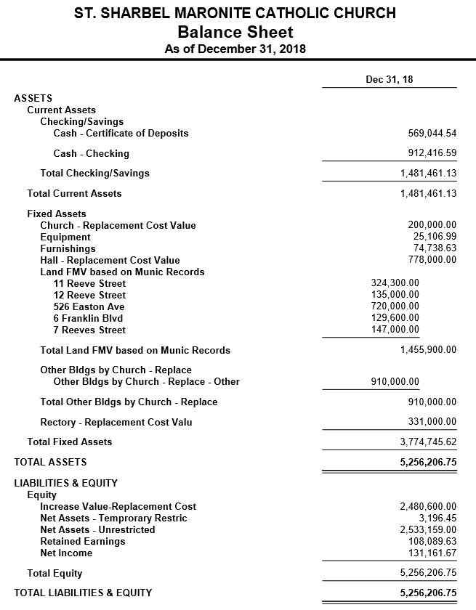
2018 Balance Sheet
Recap of the total value we possess
Current Assets $1.48MM
Fixed Assets $3.77MM
Total Assets: $5.26MM
Total Liability: $0
TOTAL EQUITY: $5.26MM

Slide 16
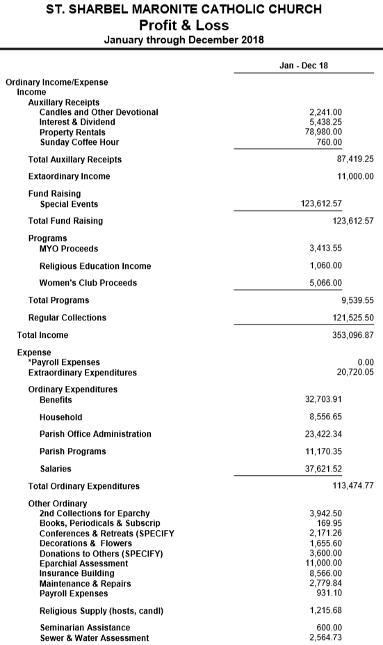
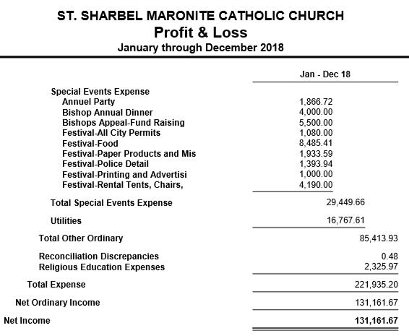
2018 Profit & Loss Statement
Recap of the total income, expenses and profit we transacted in 2018
Total Income: $353,097
Total Expenses: $221,935
TOTAL PROFIT: $131,162

Slide 17
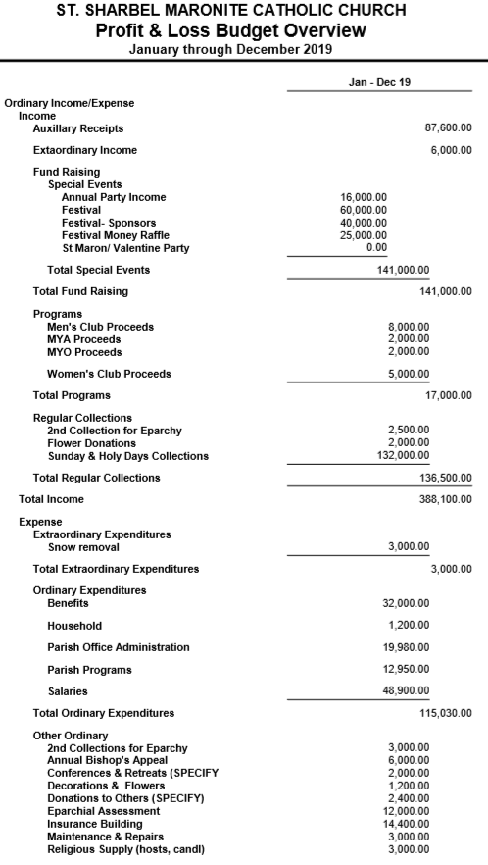
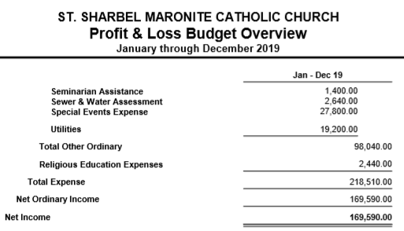
2019 Budget
Recap of the total income, expenses and profit we are projecting for 2019
Total Income: $388,100
  +$35,003; +10%
  Primarily driven by: $14K Festival, $15K Collection, $6K Knights of St. Sharbel
Total Expenses: $218,510
  -$3,425; -1.5%
  Primarily driven by cost efficiencies
TOTAL PROFIT: $169,590
  +$38,428; +29%

Slide 18

St. Sharbel Church
New Building Planning

Slide 19
New Building Process & Approach
Abouna Tony created a team lead the New Building Development Plan
  Milestone achieved was external view of the new building
Abouna Simon working with same Building development team to progress the project
  Have developed internal drawings

Slide 20
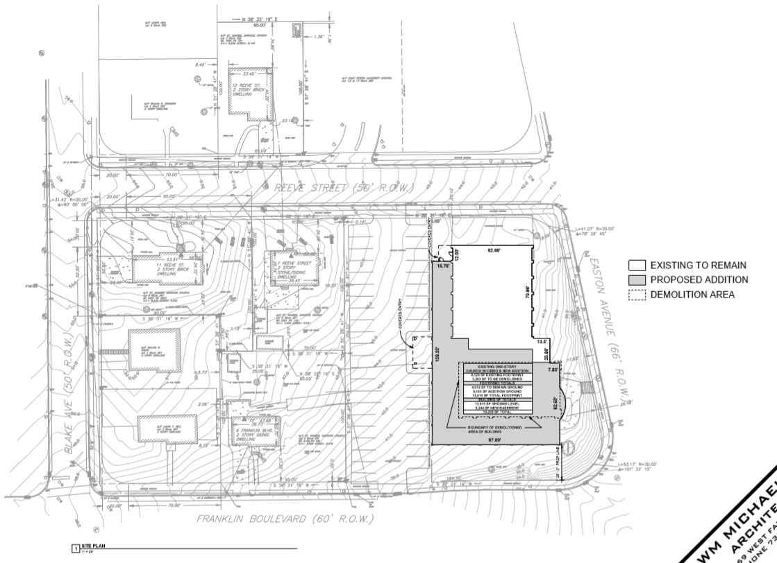
Building Plan
Site Plan

Slide 21
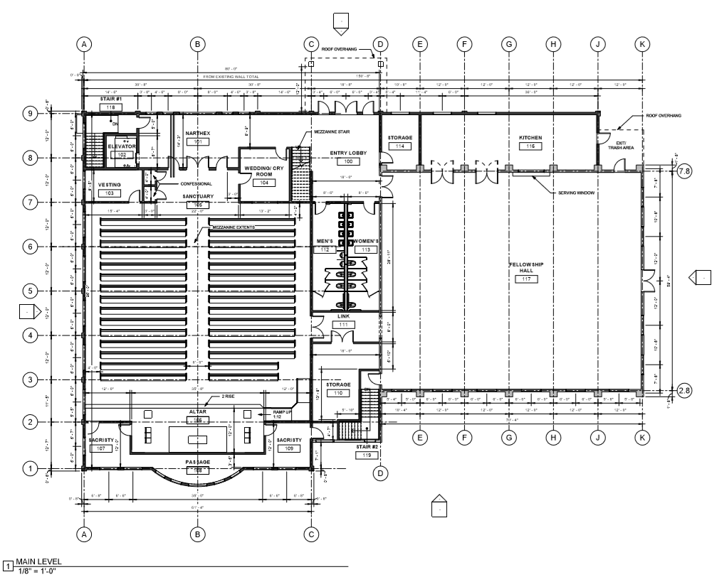
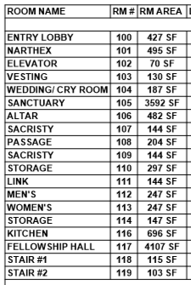
Building Plan
Main Level

Slide 22
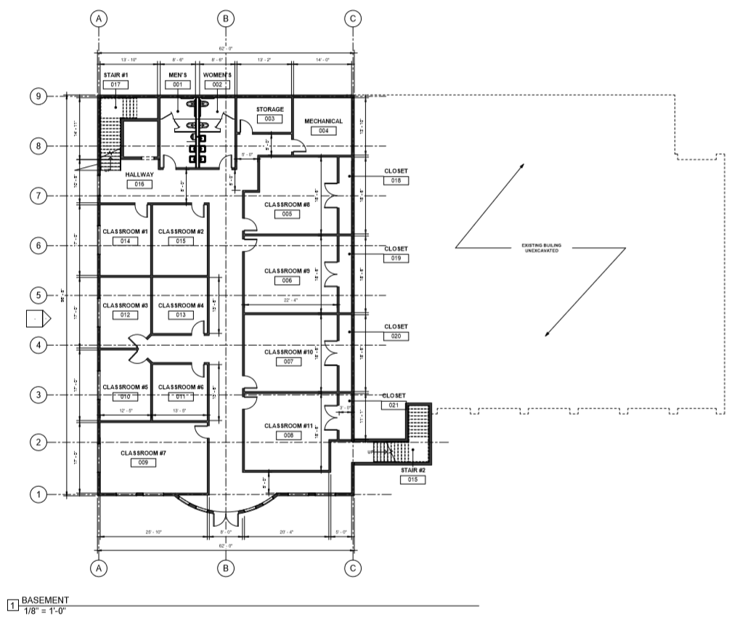
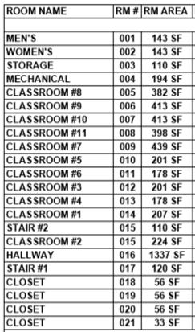
Building Plan
Basement

Slide 23
New Building Development Next Steps
Begin Zoning Board process by April 2019
Create capital-campaign team by June 2019
Complete the model of the new complex by October 2019

Slide 24

Questions
Comments

Slide 25
Growing
Together

Slide 26
- St Sharbel Church - 2018 Steering Committee
Appendix

Slide 27
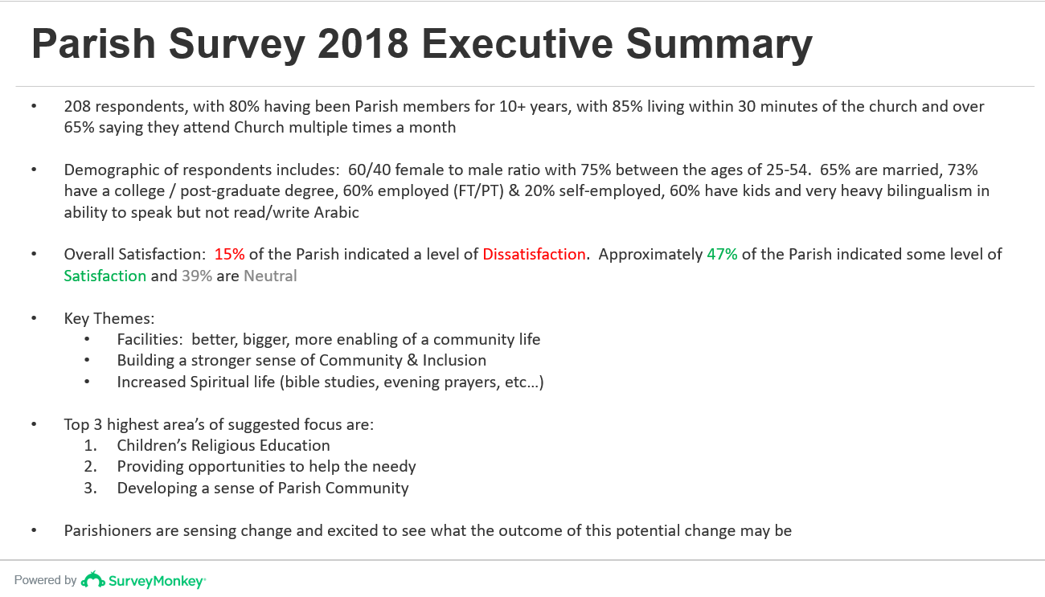
Parish Survey
- St Sharbel Church - 2018 Steering Committee
Comprehensive survey with 200+ participants & +49% completion rate
Emergence of key demographics, parish sentiment and theme’s

Slide 28
Organizational Design
- St Sharbel Church - 2018 Steering Committee
Maronite Antiochene Aramaic Church
Eparchy of St. Maron of Brooklyn
St. Sharbel Parish, NJ
Mission
Core Values
Vision
Pastoral Priorities
Strategy
Pastor
Simon El Hajj
Pastoral & Finance Councils
Ministries & Organizations
Pastoral Council
Finance Council
Ministries:
Liturgy & Mystery
Formation & Development
Pastoral Outreach
Parish Life
Evangelization & Vocations
Organizations:
Knights of St. Sharbel
Immaculate Conc. Sodality
Mary’s Young Adults
Pioneers of Mary
Knights of Mary
Notes:
Organizational structure delivering LEADERSHIP & GOVERNANCE
Office of Ministry

Slide 29
Leadership & Governance
- St Sharbel Church - 2018 Steering Committee
Pastor: Teach, Govern, Sanctify
Pastoral Council
Advisory body that cooperates with the Pastor in all aspects of Pastoral life. Comprised of 11 lay members
Finance Council
Advisory body that cooperates with the Pastor in all aspects of financial life. Comprised of 5 lay members
5 Chairs, one from each Ministry
5 Presidents, one from each Organization
1 Finance Council Rep
Finance Council, 5 members
  Chair of Fundraising sub-committee
  Chair of Building & Grounds sub-committee
  3 appointed by Pastor
Sub-Committee’s
Fundraising, 5 members
  3 Treasurers from: MYA, Immaculate Conc. Knights of St. Sharbel
  2 appointed by Pastor
  One Chair to sit on the Finance Committee
Building & Ground, 5 members appointed by Pastor
  One Chair to sit on the Finance Committee
* Chairs to be re-elected every 2 years; Capital Committee additional short-term team to aid in the new construction project
Notes:
Our Core Values define who we are, what we believe in, and how we live. These values distinguish us as an ancient Church with contemporary relevance, give us a sense of purpose as a faith community, and guide our behavior in proclaiming Christ’s message in words and deeds.

Slide 30
Leadership & Governance
- St Sharbel Church - 2018 Steering Committee
Pastor: Teach, Govern, Sanctify
Pastoral Council
Advisory body that cooperates with the Pastor in all aspects of Pastoral life. Comprised of 11 lay members
Finance Council
Advisory body that cooperates with the Pastor in all aspects of financial life. Comprised of 5 lay members
5 Chairs, one from each
  Liturgy & Mystery
  Formation & Development
  Pastoral Outreach
  Parish Life
  Evangelization & Vocations
5 Presidents, one from each
  Knights of St. Sharbel
  Immaculate Conception Sodality
  Mary’s Young Adults
  Pioneers of Mary
  Knights of Mary
1 Finance Council Rep
Finance Council, 5 members
  Chair of Fundraising sub-committee
  Chair of Building & Grounds sub-committee
  3 appointed by Pastor
Fundraising sub-committee, 5 members
  One Chair to sit on the Finance Committee
  MYA Treasurer
  Immaculate Conc. Treasurer
  Knights of St. Sharbel Treasurer
  2 appointed by Pastor
Building & Grounds sub-committee, 5 members
  One Chair to sit on the Finance Committee
  5 appointed by Pastor
* Chairs to be re-elected every 2 years; Capital Committee additional short-term team to aid in the new construction project
Notes:
Our Core Values define who we are, what we believe in, and how we live. These values distinguish us as an ancient Church with contemporary relevance, give us a sense of purpose as a faith community, and guide our behavior in proclaiming Christ’s message in words and deeds.

