Slide 1


De-Mazifying Medicare
LIS
Formulary
Part B
Part A
AEP
SEP
HMO
PPO
  Supplement
Part D
Medicare Educational Event

Slide 2


Presentation Agenda
Medicare Overview – A B D & C
The 3 Medicare paths
Case Study
AEP/ MA-OEP
Next Steps
HMO
AEP
IEP
PPO
Notes:
Medicare paths – each person’s situation is different
There is no “one size fits all” with Medicare
Poll Audience here – Who is on Medicare/ Who is not?

Slide 3
Medicare Overview
A B D & C
When to Enroll
How to Enroll
How much will it cost
HMO
AEP
IEP
PPO
Notes:
Also known as the A B D & C’s of Medicare
Why out of order?

Slide 4

Why out of order?? A, B, D & C
We’ll explain our funny alphabet shortly
HMO
AEP
IEP
PPO
Notes:
Remember Mary Shelley’s monster?
Bits and parts cobbled together over time… Medicare is the same way. From 1960s to today, it’s been pieced together.

Slide 5












Medicare Parts A & B
Inpatient Hospital Care
Skilled Nursing
Facility Care
Home Healthcare
Hospice
Doctor Visits &
Preventative Care
Ambulance
Medical Testing
& Lab Services
Outpatient
Services
Durable Medical Equipment
Notes:
Walk through Medicare A vs B coverage
This infographic is available – fill out the PTC

Slide 6
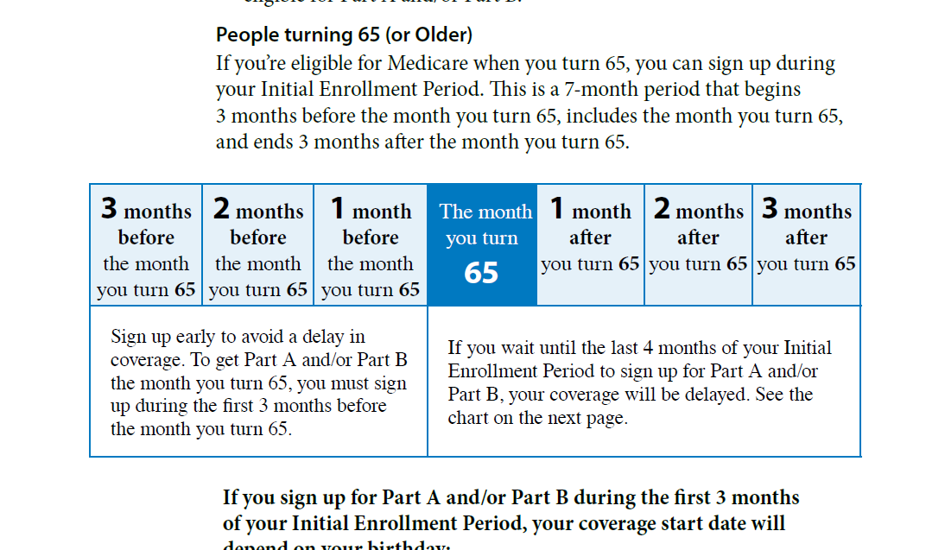

When to enroll in Medicare Parts A&B?
HMO
AEP
IEP
PPO
Notes:
Auto enrolled into Medicare Parts A and B if you are receiving Social Security Income
Can delay Medicare enrollment if you are covered by CURRENT Group Employment insurance
Must enroll in Medicare A and B if you are going to use Tricare for life

Slide 7
When to enroll in Medicare Parts A&B?
What if I’m still working?
As long as you have credible Current Group EMPLOYMENT insurance coverage, you will have an 8 month SEP (Special Enrollment Period) to sign up for Medicare Part B with no penalty.
→8 month SEP does not apply to Part D
COBRA and RETIREE coverage do NOT qualify for the Part B SEP but in most cases still count as creditable coverage for Part D. You may pay a late enrollment penalty for Part B if you do not enroll when first eligible. This includes a LEP for VA and retiree coverage if you enroll at a later date.
HMO
AEP
IEP
PPO
Notes:
Auto enrolled into Medicare Parts A and B if you are receiving Social Security Income
Can delay Medicare enrollment if you are covered by CURRENT Group Employment insurance
Must enroll in Medicare A and B if you are going to use Tricare for life

Slide 8

How to Sign Up?
You can enroll in Medicare Part A and/or Medicare Part B in the following ways:
Online at www.SocialSecurity.gov.
      Create your account online NOW
By calling Social Security at 1-800-772-1213 Monday through Friday, from 7AM to 7PM.
In-person at your local Social Security office.
HMO
AEP
IEP
PPO
Notes:
Walk through time-line

Slide 9
How much is the late enrollment Penalty
Part B late penalties are calculated as an extra 10 percent for each full 12-month period when you should have had Part B but didn't. If you should have signed up at age 65, the penalty calculation is made on the time that elapsed between the end of your IEP and the end of the GEP in which you finally sign up.
This is a lifetime penalty!
Usually, you don't pay a late enrollment penalty if you meet certain conditions such as credible group EMPLOYMENT Insurance.
HMO
AEP
IEP
PPO
Notes:
Walk through time-line

Slide 10

What About Paying for Medicare Part B?
Currently Drawing Social Security Income?
Payment comes out of your check automatically
NOT Drawing Social Security Income?
Quarterly Bill $185.00 x 3 = $555.00
Direct Debit Monthly out of Checking for $185.00
HMO
AEP
IEP
PPO
Notes:
Walk through time-line

Slide 11
Medicare Parts A & B
Inpatient Hospital Care
Skilled Nursing
Facility Care
Home Healthcare
Hospice
Doctor Visits &
Preventative Care
Ambulance
Medical Testing
& Lab Services
Outpatient
Services
Durable Medical Equipment
Notes:
Walk through Medicare A vs B coverage
This infographic is available – fill out the PTC

Slide 12

Medicare Part D
(Yes we skipped C on purpose… more on that in a moment…)
HMO
AEP
IEP
PPO
Notes:
When you think of Medicare Part D → Drug plan
Fortunately it starts with D for Drug Plan

Slide 13
Medicare Part D Enrollment period
Begins at age 65 along with your entitlement to Medicare Part A
Can be purchased as a stand alone product from a private carrier or integrated into a Medicare Advantage plan
The late enrollment penalty is an amount added to your Medicare Part D monthly premium if you go without Creditable prescription drug coverage for a continuous period of 63 days or more after your Initial Enrollment Period is over.
The penalty is 1% of the national average times the number of months you should have had credible coverage but didn’t. ie 12 months without coverage equals a 12% lifetime penalty added to your monthly premium.
HMO
AEP
IEP
PPO
Notes:
When you think of Medicare Part D → Drug plan
Fortunately it starts with D for Drug Plan

Slide 14

Part D = Prescription Drug Plan
Standards for every Drug Plan
Deductible $590.00
Initial Coverage Limit – 75%/25%
Max out of pocket $2000.00
NO Catastrophic
Formulary Varies By Plan
Amounts change every year
HMO
AEP
IEP
PPO

Slide 15

Medicare Part C (Finally!)
Also known as Medicare Advantage (MA)
D
A
B
C
HMO
AEP
IEP
PPO
Notes:
Medicare Part C – Thought up by Insurance companies –
Approached the government and said, “We think we can do it better! Fund us…”
Funding from Government explains why so many rules to protect against fraud, waste, or abuse of system
We will define and get in depth shortly

Slide 16

3 Paths To Medicare Coverage
Original Medicare
Original Medicare + MediGap + Rx
Medicare Advantage
HMO
AEP
IEP
PPO

Slide 17

Path 1: Original Medicare
Part A
Hospital Insurance
Part B
Medical Insurance
+
HMO
AEP
IEP
PPO

Slide 18
Path 1: Original Medicare
Part A -Usually no premium
Hospital $1632 deductible
Skilled Nursing Days 1-20 $0 Days 21-100 $209.50/day
Part B – 2022 premium is $185.00 $257 annual deductible
Doctor 80% / 20%
Lab Work 80% / 20%
X-rays 80% / 20%
Other Services 80% / 20%
HMO
AEP
IEP
PPO

Slide 19

Path 2: Medicare Supp + Rx
Original Medicare
Part A
Hospital Insurance
Part B
Medical Insurance
You can add
Medicare Supplement Insurance (Medigap) Policy
Part D
Prescription Drug Coverage
(PDP)
HMO
AEP
IEP
PPO

Slide 20
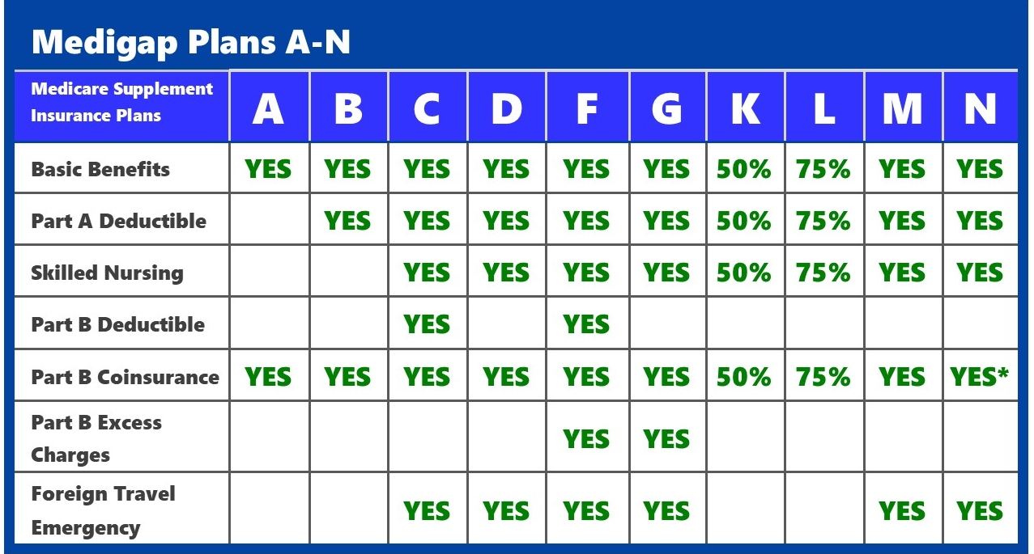

Path 2: Medicare Supp + Rx
HMO
AEP
IEP
PPO

Slide 21

Path 2: Rx = PDP
Monthly Premium on Part D Plans
Deductible $590.00
Initial Coverage Limit – 75%/25%
Max out of pocket $2000.00
No Catastrophic
HMO
AEP
IEP
PPO

Slide 22


Path 2: Prescription Drug Plan
Initial Coverage Limit Formulary Tiers
Tier 1
Inexpensive Drugs
Tier 5
Expensive Drugs
HMO
AEP
IEP
PPO

Slide 23

Path 3: Medicare Advantage
Part C
Combines
Part A and Part B
May include, or you may be able to add
Part D
Prescription Drug Coverage
(98% of Part C plans cover prescription drugs. You may be able to add drug coverage to some plan types if not already included.)
HMO
AEP
IEP
PPO

Slide 24

Path 3: Medicare Advantage
How MA plans work
Medicare pays plan for each member every month
Amount varies by county
HMO
AEP
IEP
PPO
Notes:
CMS Pays insurance company month/member
Amount varies by county - Denver Metro average in 2018 - $813/ month/ member

Slide 25

Path 3: Medicare Advantage
Additional Options - HMO
Health Maintenance Organization - You pick one primary care physician. All your health care services go through that doctor. That means that you need a referral before you can see any other health care professional, except in an emergency. Visits to health care professionals outside of your network typically aren’t covered by your insurance.
HMO
AEP
IEP
PPO
Notes:
I am not typically a fan of reading slides, these two are exceptions: HMO & PPO understanding
THINK: HMO = More restrictive, most cost effective

Slide 26

Path 3: Medicare Advantage
Additional Options - PPO
Preferred Provider Organization - plans give you flexibility, no primary care physician. You can go to any health care professional you want without a referral—in/out of your network, as long as they agree to bill your insurance.
Staying inside your network means smaller copays and full coverage. If you choose to go outside your network, you'll have higher out-of-pocket costs, and not all services may be covered.
HMO
AEP
IEP
PPO
Notes:
Again, sorry to read the slide, but let’s be clear on our understanding
THINK: PPO = Generally more expensive, less restrictive

Slide 27


3 Paths In Review
Original Medicare
Medicare Advantage Plan
Part A
Hospital Insurance
Part B
Medical Insurance
Part C
Combines
Part A and Part B
May include, or you may be able to add
You can add
Part D
Prescription Drug Coverage
(Most Part C plans cover prescription drugs. You may be able to add drug coverage to some plan types if not already included.)
Medicare Supplement Insurance (Medigap) Policy
Part D
Prescription Drug Coverage
(PDP)
HMO
AEP
IEP
PPO
Notes:
Graphically shown here are all three options side by side
Remember there are only 3 ways to get coverage

Slide 28

Medicare Case Study
Meet Bernice…
HMO
AEP
IEP
PPO
Notes:
We will examine Bernice’s health situation through all 3 options
This is based on real client’s experience
Name has been changed to protect guilty…

Slide 29

Medicare Case Study
2 ER Visits (Feb – 3 days, April – intensive care 2 weeks, moved to skilled nursing, dialysis) Multiple chronic conditions
2 Hospital Deductibles
Chemotherapy
42 days Skilled Nursing - Dialysis
6 PCP visits
Total of 42 different bills, doctor visits, chemo treatment
6 visits to Cardiologist
2 Ambulance rides
1 Urgent care visit
8 visits to audiologist
Tier 5 Part D Drug ($16k/ month)
Hearing Aids $5,300
HMO
AEP
IEP
PPO
Notes:
We will examine Bernice’s health situation through all 3 options
Remember our Medicare View resident expert Charlie from earlier? This is an actual patient situation, name changed to protect the unfortunate

Slide 30
Medicare Case Study
Chemotherapy - $61,000 allowable charges,
$61,000 * 20% = $12,200
2 Hospital Deductibles
$1676 * 2 = $3352
2 Ambulance rides
$2600 for both, times 20% = $520
Original Medicare
HMO
AEP
IEP
PPO
Notes:
Bernice’s story costs with Original Medicare

Slide 31
Medicare Case Study
2 Emergency Room visits - ~$10,000 total charges
Skilled Nursing – 42 days total
Days 1-20 – No charge
Days 21-42 - $209.50 * 21 = $4399.50
Doctor Visits
$22,000
Hearing Aids - $5,300
Original Medicare
HMO
AEP
IEP
PPO
Notes:
Bernice’s story costs with Original Medicare… Part 2

Slide 32


Medicare Case Study
Bernice says…
Original Medicare
HMO
AEP
IEP
PPO
Notes:
Bernice says “No Way, José!”

Slide 33
Medicare Case Study
Premium - Plan F - $265/ month
$3,180 annual
Premium – Part D Plan $30/ month
$360 annual
Hearing Aids - $5,300
Total $8,840 for 1 year
Original Medicare +
MediGap + Rx
HMO
AEP
IEP
PPO
Notes:
Bernice’s story costs with a Medicare Supplement

Slide 34

Medicare Case Study
Bernice says…
Original Medicare +
MediGap + Rx
HMO
AEP
IEP
PPO
Notes:
Bernice says “It’s good coverage, but could I have done it differently?”

Slide 35
Medicare Case Study
$0 premium Medicare Advantage -
MOOP $3,000 (Multiple plans currently)
(Can be as high as $8,300)
Premium – Part D Plan – Included with plan
Hearing Aids - $5,300 Discounted to $1,400
Max Total $4,400 for 1 year
Medicare Advantage
HMO
AEP
IEP
PPO
Notes:
Bernice’s story costs with Medicare Advantage

Slide 36

Medicare Case Study
Bernice says…
Medicare Advantage
HMO
AEP
IEP
PPO
Notes:
Bernice says “Ah, peace of mind… I feel good about my coverage!”

Slide 37

The Choice Is Yours
Path 3: Medicare Advantage
Path 1: Original Medicare
Path 2: Medicare Supplement
Path 1: Original Medicare –
No coverage for the 20%
No MOOP
Path 2: Medicare Supplement –
Maximum coverage – for an Additional premium
Drug Plan purchase separately
Path 3: Medicare Advantage –
Affordable Coverage – MOOP
Premiums range from $0 – 160/month
Drug Plan included
Some have Hearing, Dental, Vision, Gym
HMO
AEP
IEP
PPO
Notes:
Nationally:
14 Million Supplement
21 million Medicare Advantage

Slide 38

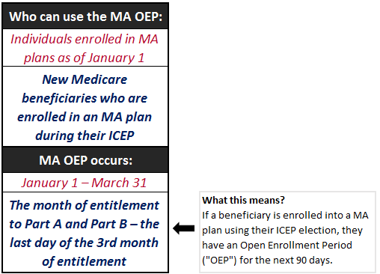

MA-OEP: One time change
HMO
AEP
IEP
PPO
Notes:
OEP – January 1 – March 31
A new election period to change (one time) MA plan if the fit isn’t quite right – Justin’s story from 2017, problems with carrier & couldn’t switch
ICEP (Initial Coverage Election Period) refers to the period during which people who are newly eligible for Medicare can enroll in a Medicare Advantage plan

Slide 39

The importance of Annual Review
AEP – October (1) 15th – December 7th
Does your current plan continue to meet your needs in the coming year?
HMO
AEP
IEP
PPO
Notes:
AEP – October 15 – December 7 each year
October 1 – can start discussing, cannot make any changes before October 15
AEP – Annual Election Period, also unofficially known as Open Enrollment for Medicare
The importance of getting time on the calendar to meet and discuss any changes to plan or your medical condition (Underwriting Carolyn story)

Slide 40

Do You Have Questions?
HMO
AEP
IEP
PPO
Notes:
…Or is your path unclear?

Slide 41
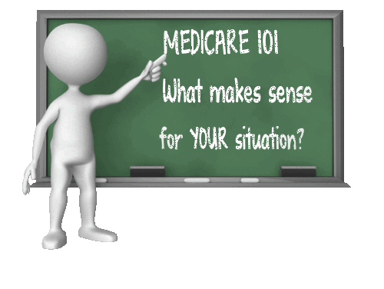

Medicare Education – Why do We do This?
Sheri Younker
(602) 960-8974 Call
(602) 397-8480 Text
stressfreemedicare@hotmail.com
HMO
AEP
IEP
PPO
Notes:
Background –
Have many friends and family aging into Medicare – all are confused and need just the basic understanding of Medicare

Slide 42



Broker vs. Captive Agent
HMO
AEP
IEP
PPO
Notes:
Remember this presentation is not plan specific
Difference between captive agent for 1 carrier and a broker who will shop all plans in market – Someone who represents multiple plans

Slide 43

Everyone’s Situation is Different
Let’s set a time to talk. Which Medicare scenario will work for you?
HMO
AEP
IEP
PPO
Notes:
…Or is your path unclear?

