Slide 1
SPEAK UP! A Royalty-free Educational Tool

Slide 2
Join the movement to improve the social, emotional and mental health of our students

Slide 3
SPEAK UP! A Royalty-free Educational Tool

Slide 4
SPEAK UP!
A Royalty-free Educational Tool

Slide 5
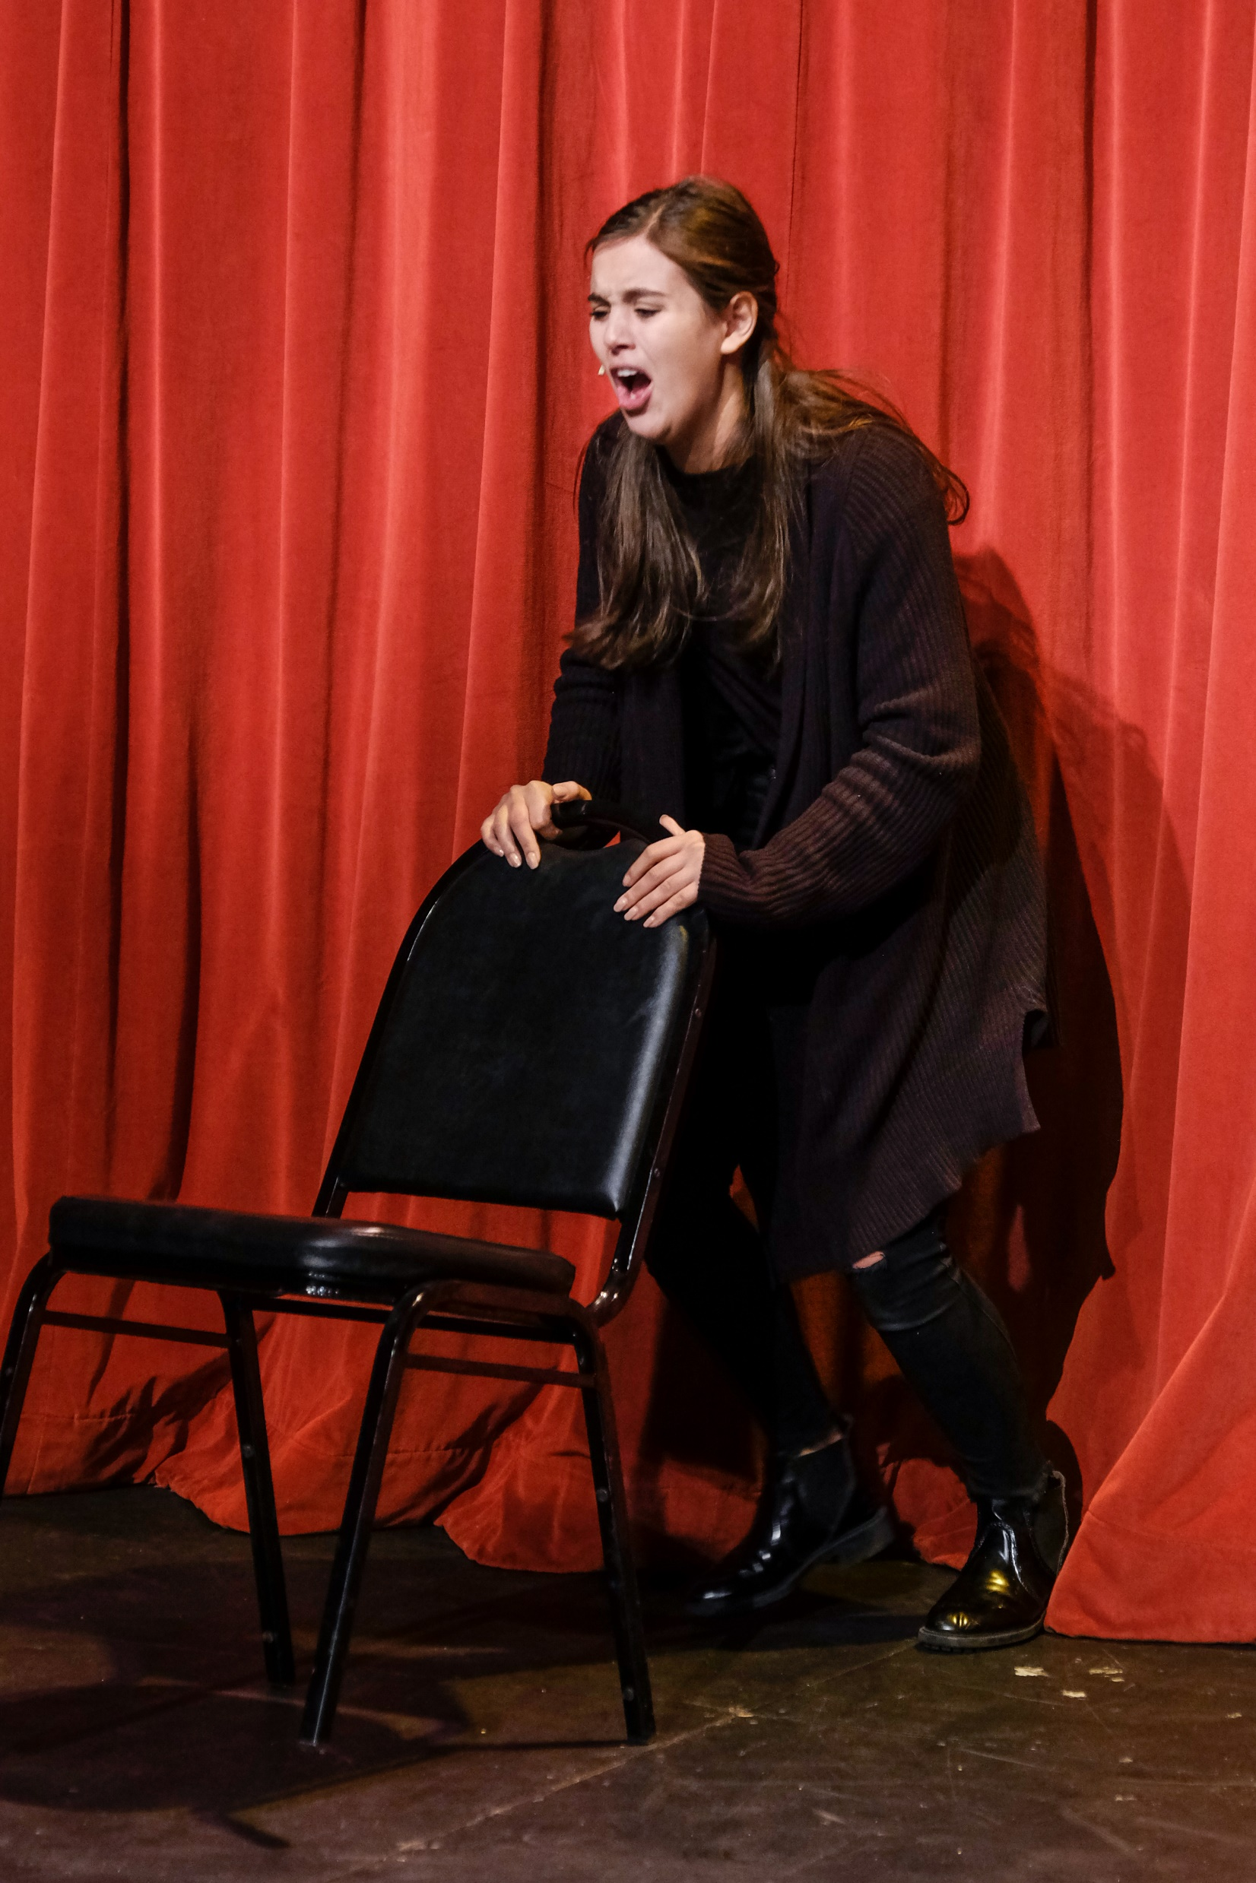
SPEAK UP!
A Royalty-free Educational Tool

Slide 6
SPEAK UP!
A Royalty-free Educational Tool

Slide 7
SPEAK UP! A Royalty-free Educational Tool
The Play and Took Kit are available free of charge to schools and agencies that sign a Memorandum of Agreement about its responsible use as a catalyst for potentially life-saving conversation.

Slide 8
SPEAK UP! is a Call to Action. A Call to Save a Life.
Speak Up!, a Royalty-free Educational Tool, is distributed by Theatre on Purpose (T.O.P.)
If you are interested in bringing this tool to your school, please contact:
Amy Luskey-Barth
Executive Artistic Director, T.O.P.
alb@theatreonpurpose.org
www.theatreonpurpose.org

