Slide 1
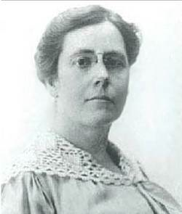
The Beginning
The year is 1919
My name is Marion de Forest
I would like to join the Rotary Club because I want to help others- but- the year is 1919 and I am not allowed to join because I am a woman.
Are there any other women in the same situation?

Slide 2
These women, in 1919, founded Zonta to
Improve
Women’s
Lives
But why do we still need this mission today?

Slide 3
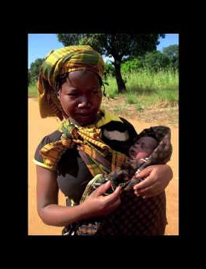
Millions of women live with obstetric fistula
It was preventable
It cost less than $500 to repair a fistula
And the project was a success!
With Zonta’s help, women were able to get medical care; and re-start lives as tailors, bakers…

Slide 4
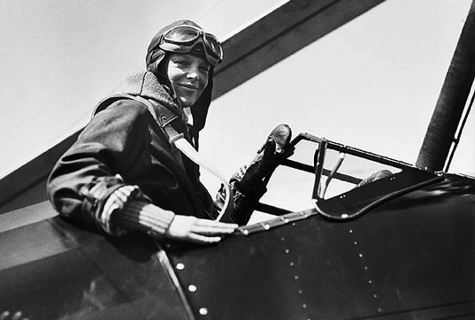
We need to ensure that opportunities are equally available for women and for men to pursue various career paths
Amelia Earhart Fellowships- for women pursuing post graduate studies in aerospace science and engineering

Slide 5
35 per cent of women worldwide have experienced either physical and/or sexual intimate partner violence or non-partner sexual violence -
up to 70 per cent of women have experienced physical and/or sexual violence in their lifetime from an intimate partner
Approximately 140 million girls and women in the world have suffered female genital mutilation/cutting

Slide 6
Zonta thanks our donors

Slide 7
In times of crisis, adolescent girls are the first ones to suffer. They are often taken out of school and married off to help their families during droughts and food shortages.
End Child Marriage

Slide 8
1968- Zonta comes to Victoria

Slide 9
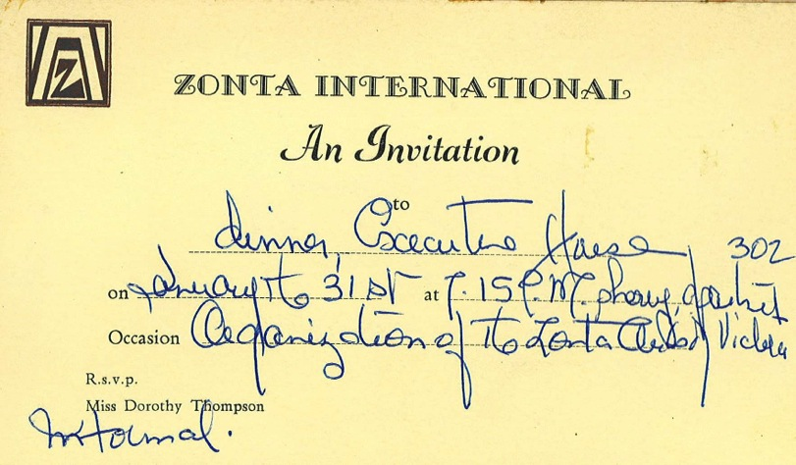

Slide 10
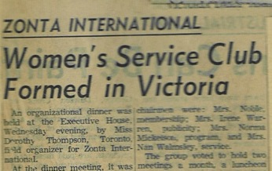
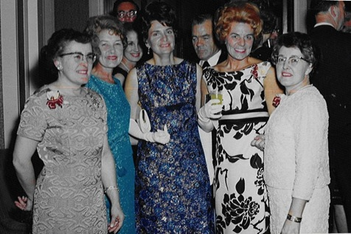
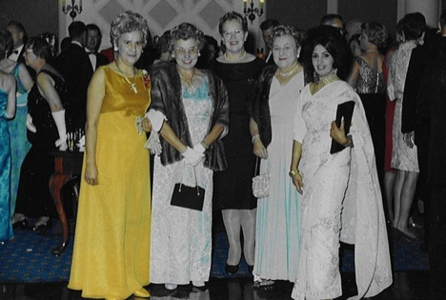
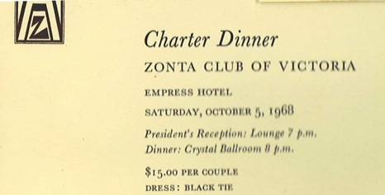

Slide 11
Zonta thanks Donors

Slide 12
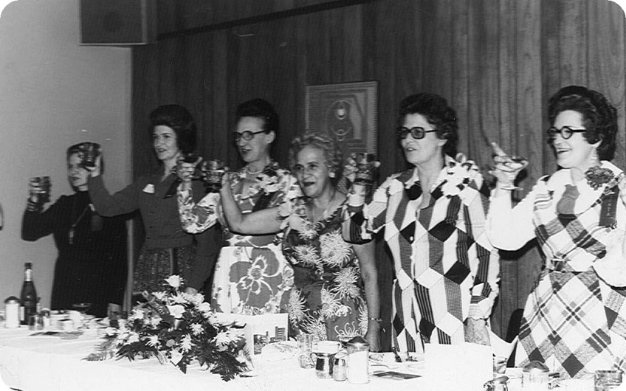

Slide 13
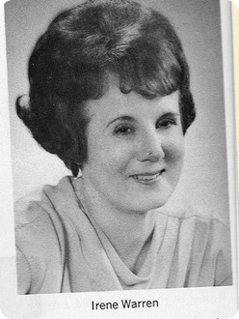
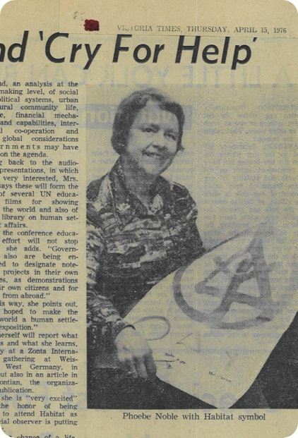
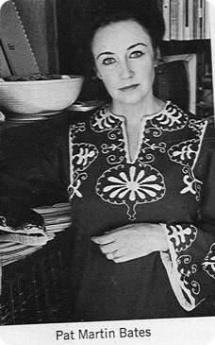

Slide 14
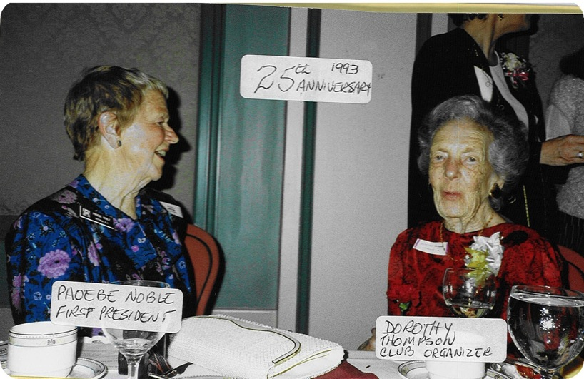

Slide 15
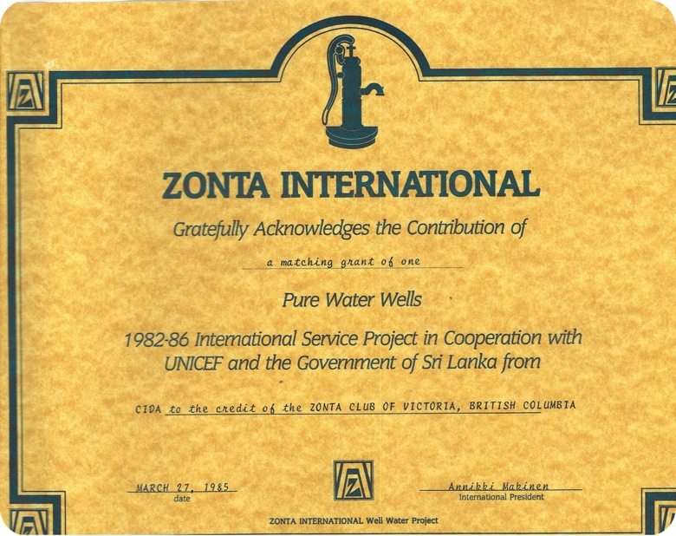

Slide 16
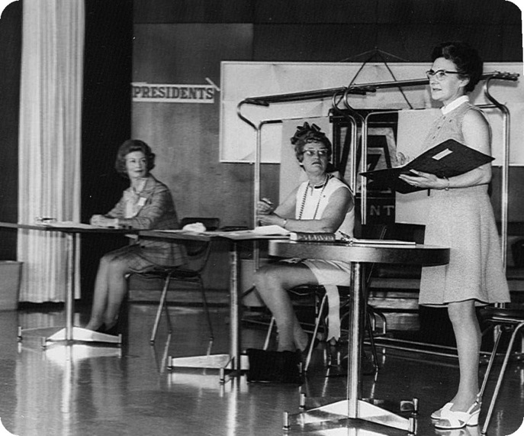

Slide 17
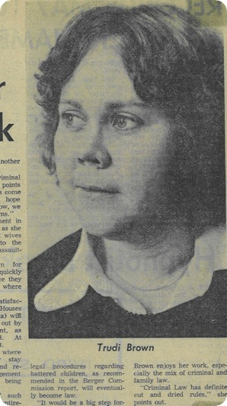
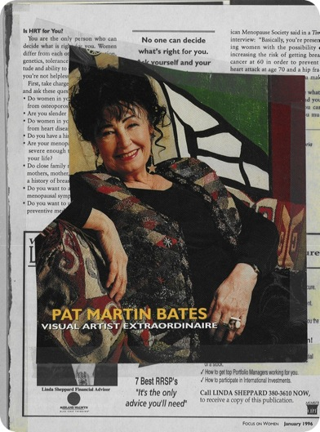
In the News

Slide 18
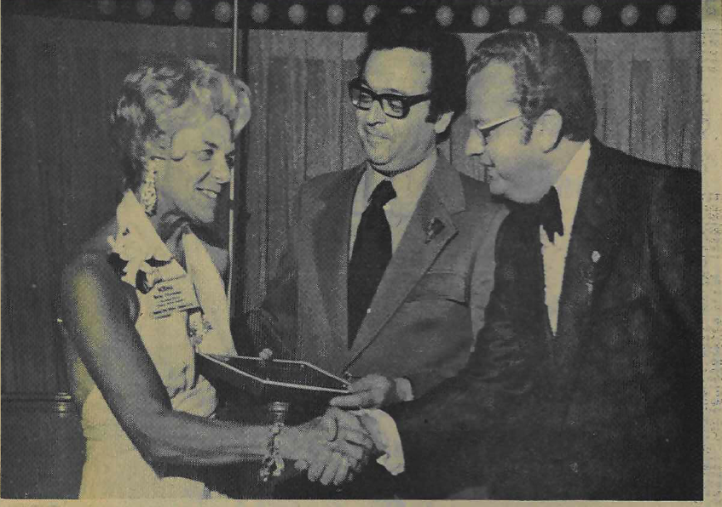

Slide 19
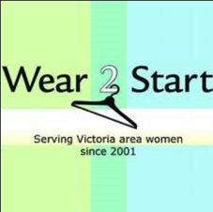
Zonta thanks Donors

Slide 20
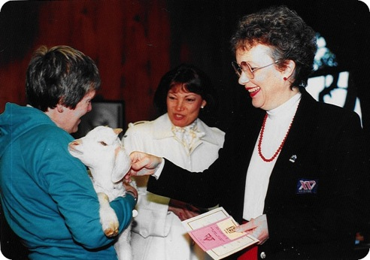
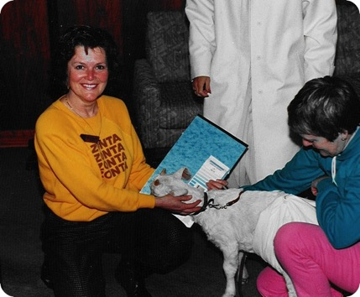
Getting their Goat

Slide 21
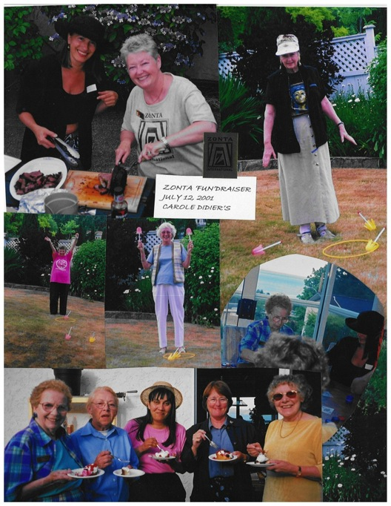

Slide 22
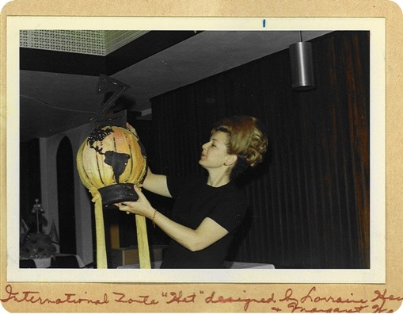
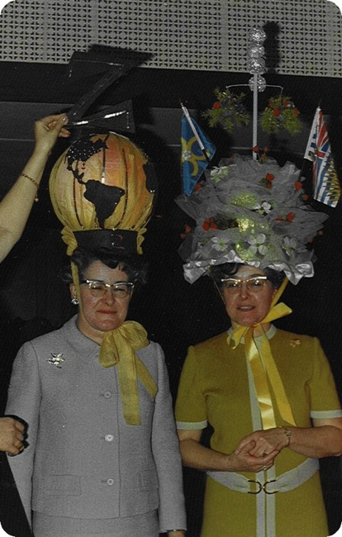

Slide 23
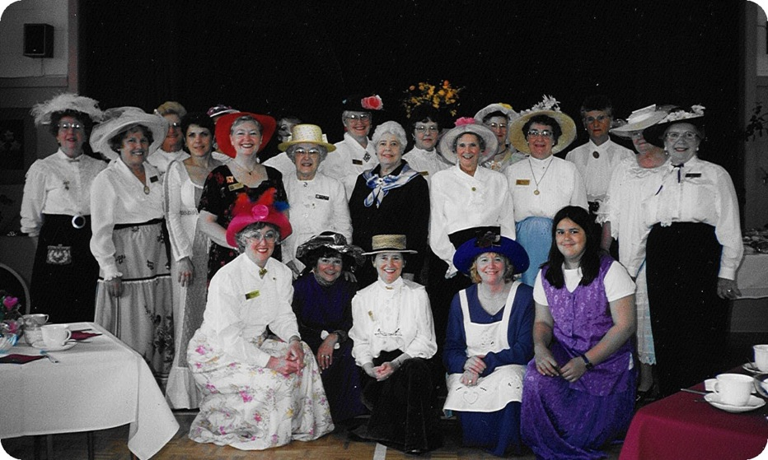
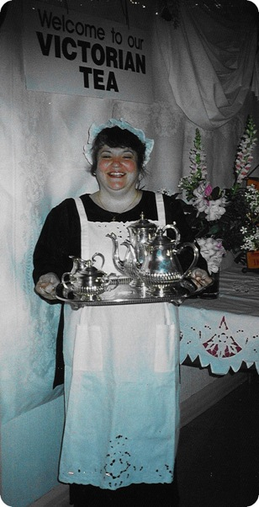
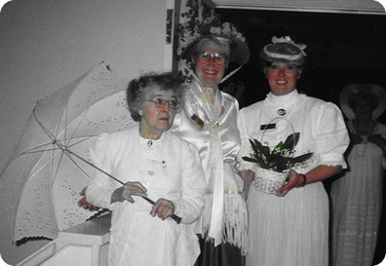

Slide 24
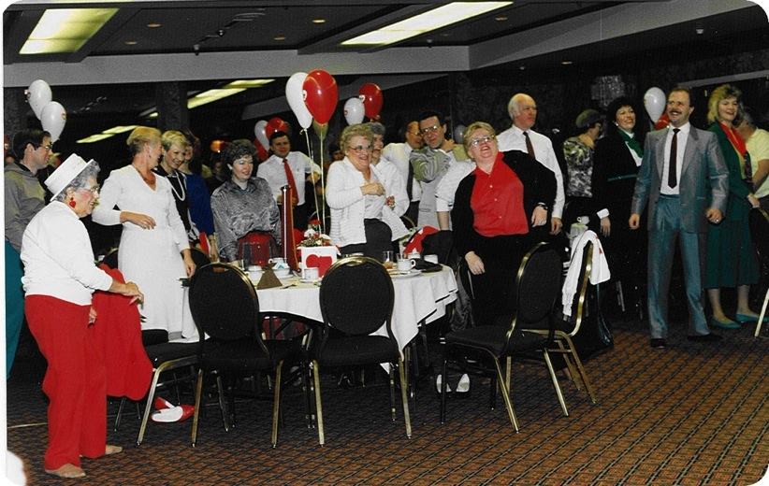

Slide 25
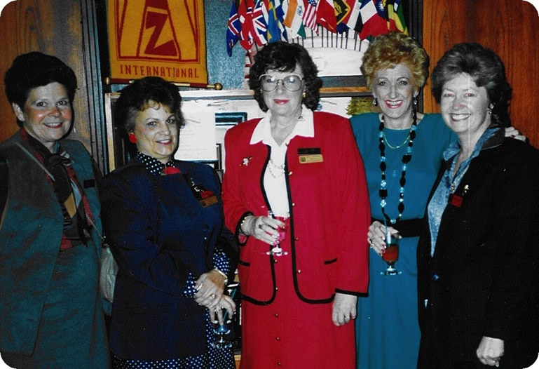

Slide 26
Zonta thanks donors
Kladia Robertsdottir Lewis

Slide 27
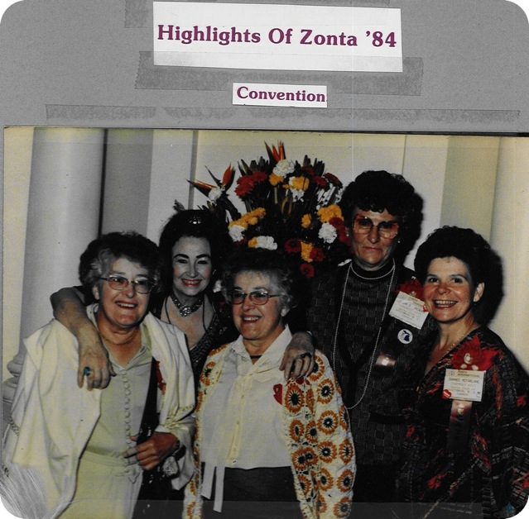

Slide 29
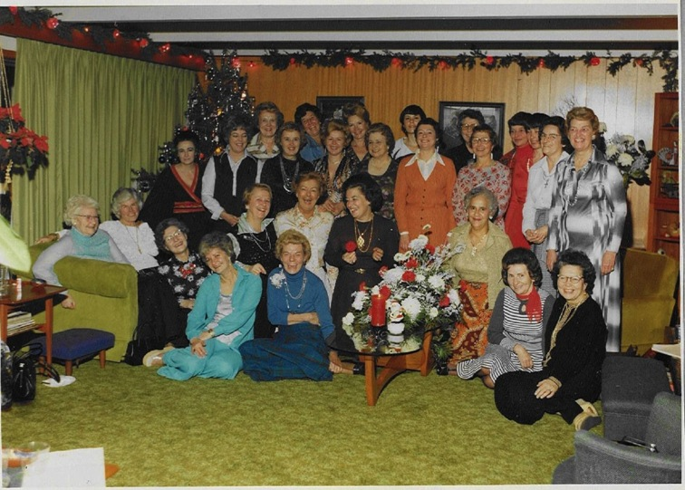

Slide 30
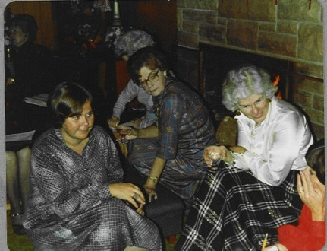
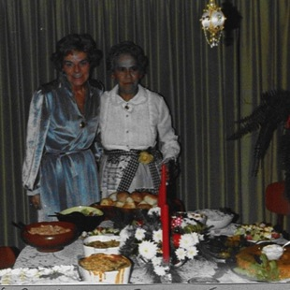
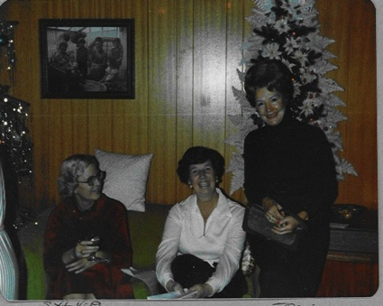
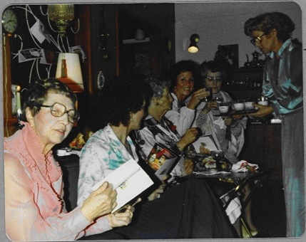

Slide 31
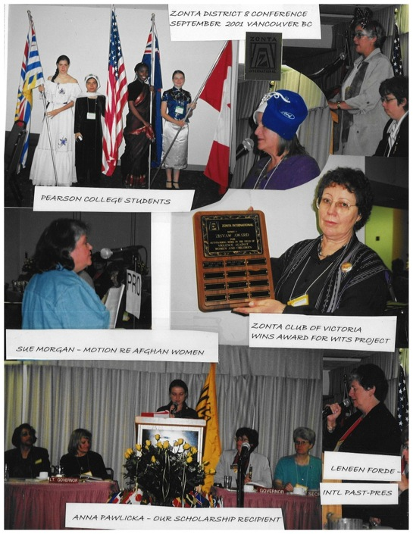

Slide 32
Zonta thanks Donors

Slide 33
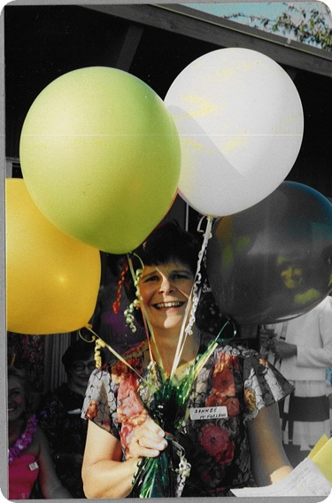

Slide 34
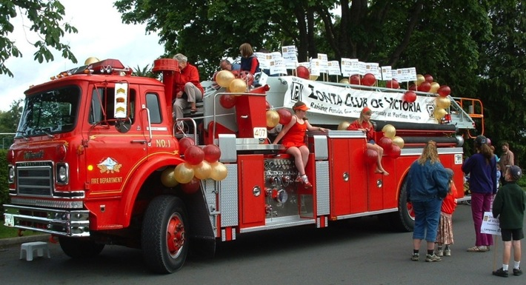
Oak Bay Tea Party Parade

Slide 35
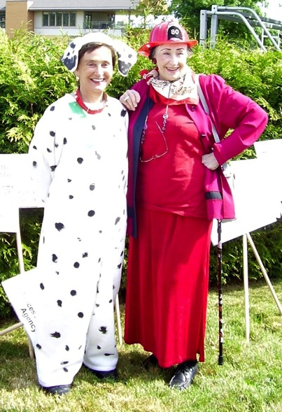
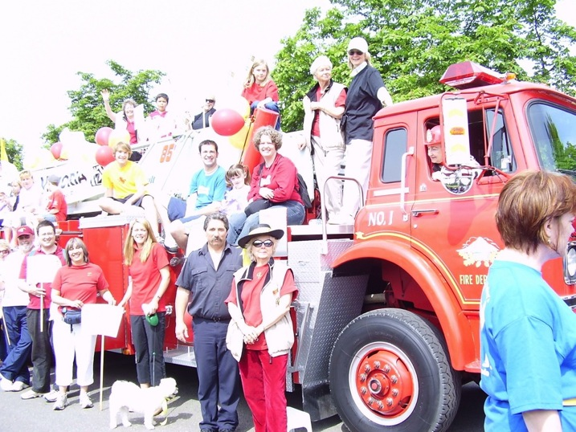

Slide 36
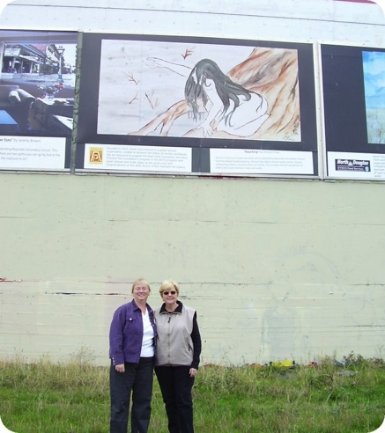
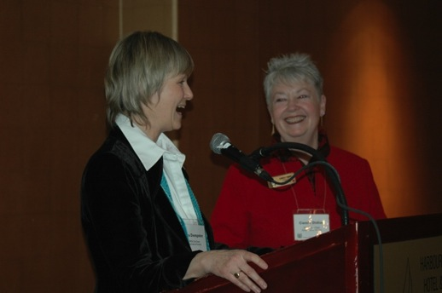
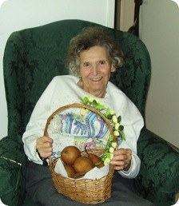

Slide 37
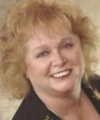
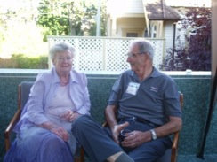
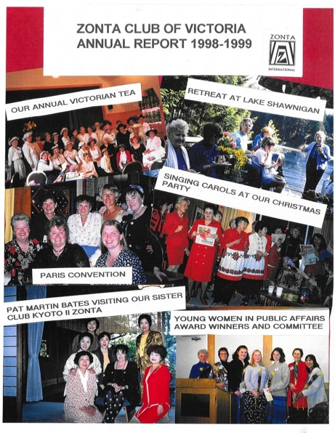
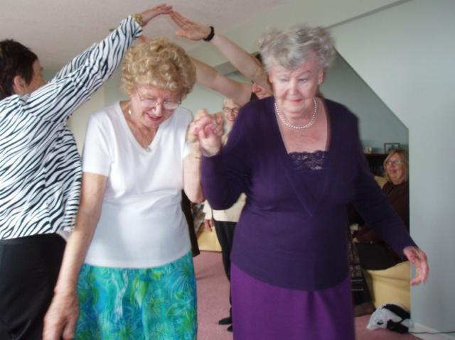

Slide 38
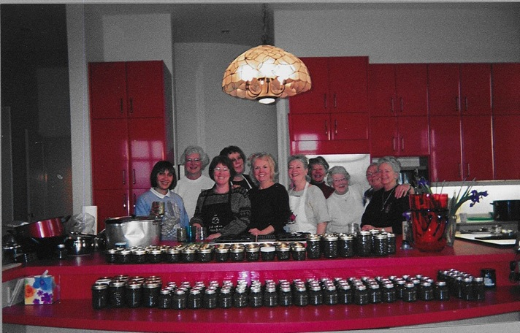
2004 Jamming Session

Slide 39
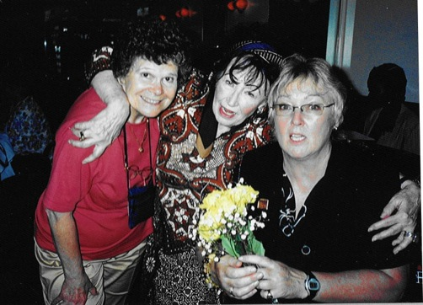
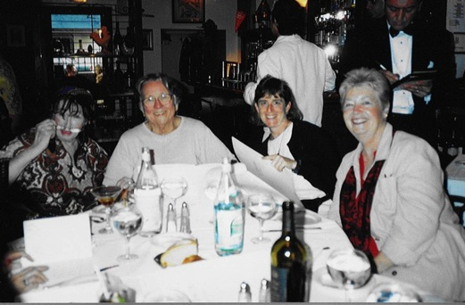
New York Convention
2004

Slide 41
Zonta thanks donors
Pat
Martin
Bates

Slide 43
Sponsor
at
Trackside
Art
Gallery

Slide 45
Convention- Melbourne 2006

Slide 46
Sister Club

Slide 50
Zonta Thanks Donors

Slide 51
Convention- Melbourne 2006

Slide 52
YWPA

Slide 53
More YWPA

Slide 56
Zonta Thanks Donors

Slide 57
Sisters, too, with Zonta Club of Ballarat (Australia)-
Catching up at San Antonio Convention
And Convention- Torino

Slide 58
Liaison with Pearson

Slide 61
Zonta Thanks Donors
Chaos Creative
Nikki Green
Diane MacRae

Slide 62
And Here’s Pat….

Slide 68
Zonta Thanks Donors

Slide 74
Zonta Thanks Donors
Susan Ryan
Helen and Jim Arnott
Susan Miller

Slide 78
Assorted Service Projects

Slide 79
That moment when you hear your club has
Not one but TWO
District/International Winners!

Slide 80
In the Legislature 25 October
Imagine a world in which women’s rights are recognized as human rights and every woman can live to her full potential. This is the vision of Zonta International. Zonta International improves women’s lives by increasing their access to education, health care, legal services and economic opportunities while supporting efforts to prevent and end violence against women and girls.

Slide 81
In the Legislature 25 October
The Zonta Club of Victoria is one of hundreds of clubs. In November, they’re celebrating 50 years of community service. They’re about to hold a fundraising event to support the HerWay Home program. HerWay Home is a non-judgmental health and social resource for pregnant women and mothers with young children or babies who have a history with substance use and who may be affected by mental health issues, violence and trauma.

Slide 82
In the Legislature 25 October
As the Zonta Club of Victoria turns 50, Zonta International is getting ready to celebrate its 100th year of service in 2019. That’s a century of empowering women.
Congratulations, Zonta, and thank you to local members for your amazing work in our community.
Mitzi Dean- MLA Esquimalt-Metchosin

