Slide 1
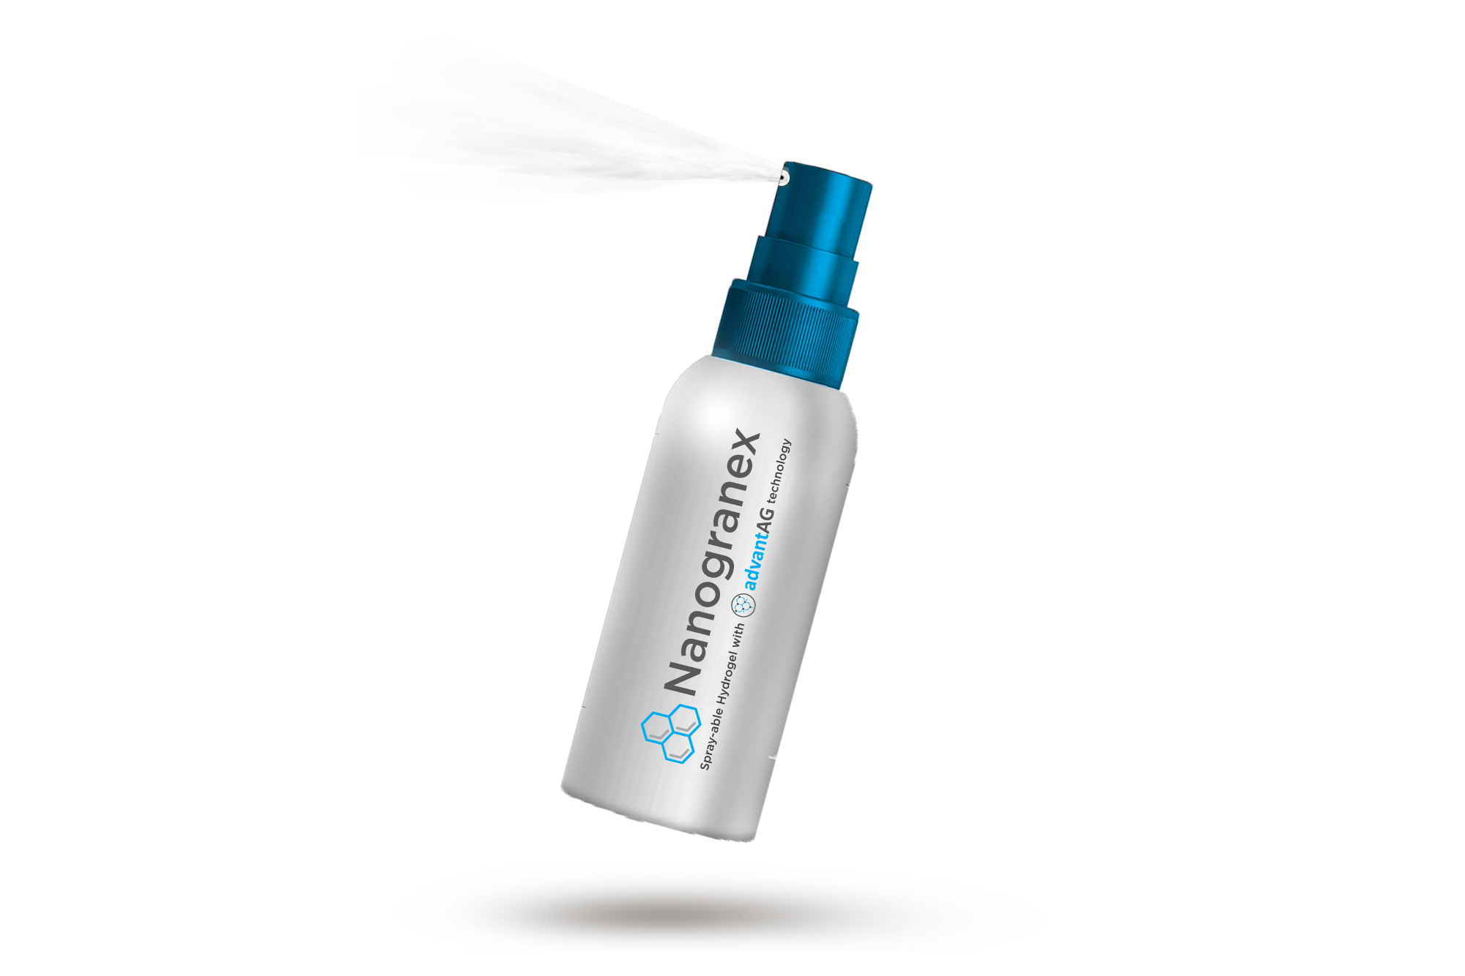

Global Advanced Wound Care - Disrupt The Game
Investment Opportunity Summary
March 2021
We believe all people should have access to high quality medical products that are affordable, highest performing in their class, and simple to use
STRICTLY CONFIDNETIAL & PRIVILEGED
This presentation is strictly intended for Genesis Pharmaceuticals and it’s authorized recipients. Any duplication, distribution or printing without written permission from Genesis Pharmaceuticals is strictly prohibited.

Slide 2
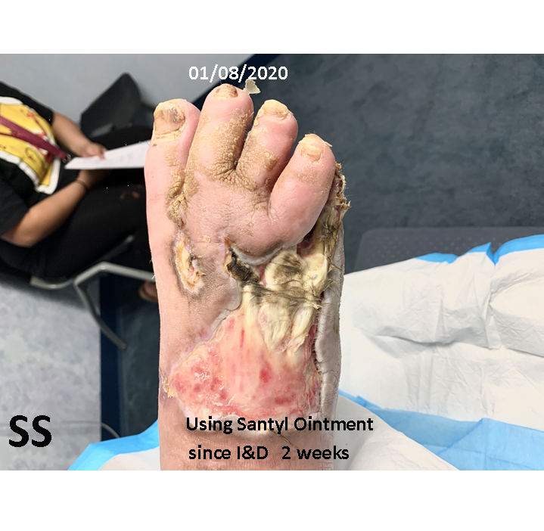
Case Study #1
Necrotizing Fasciitis scheduled for BKA, Patient opted into clinical study using Nanogranex® After little success with Santyl ointment and I&D
Notes:
Fastest growing segment in healthcare

Slide 3
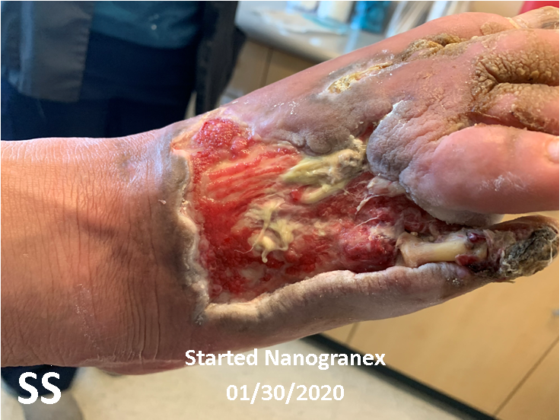
Notes:
Fastest growing segment in healthcare

Slide 4
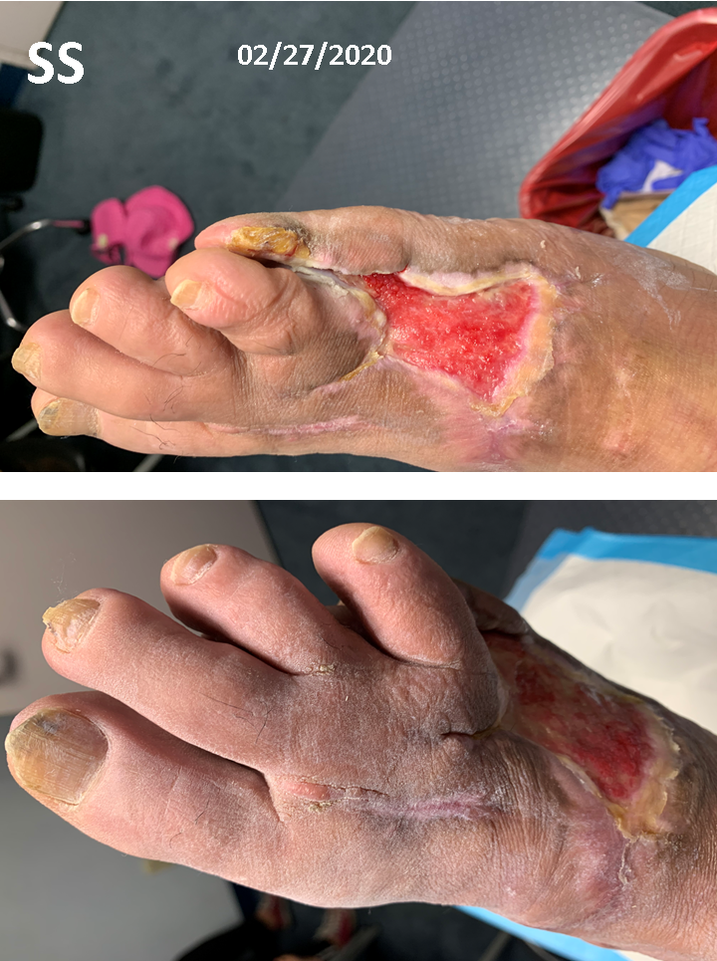

Slide 5
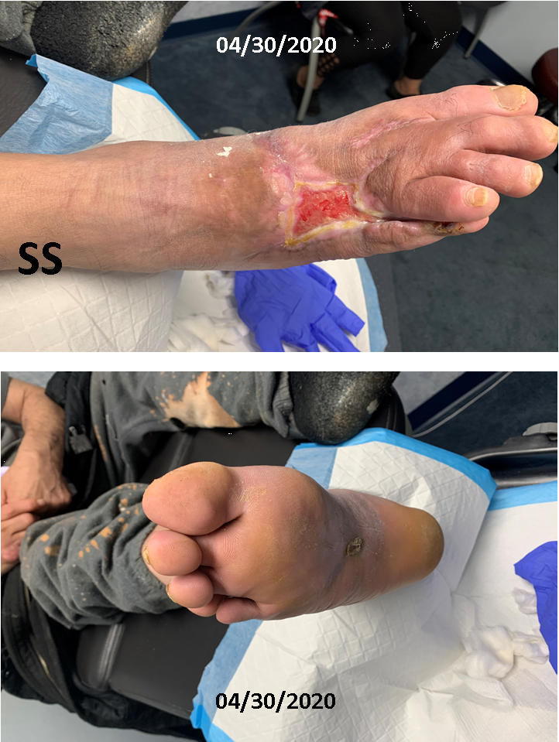

Slide 6
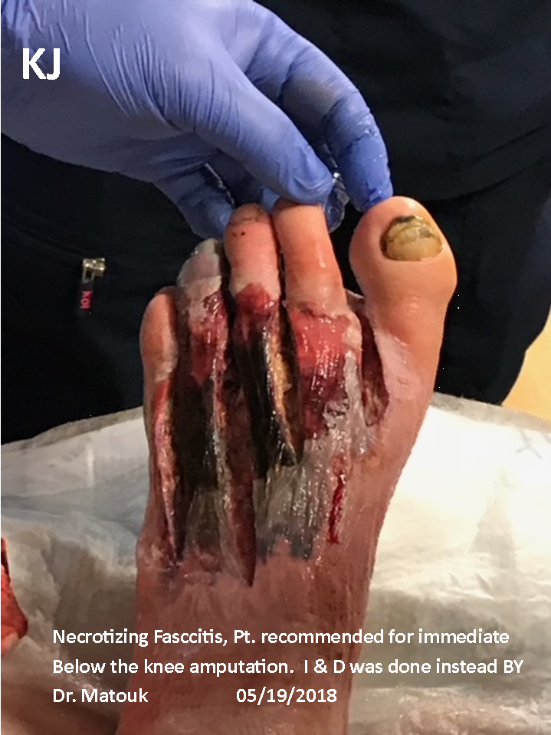
Case Study #2

Slide 7
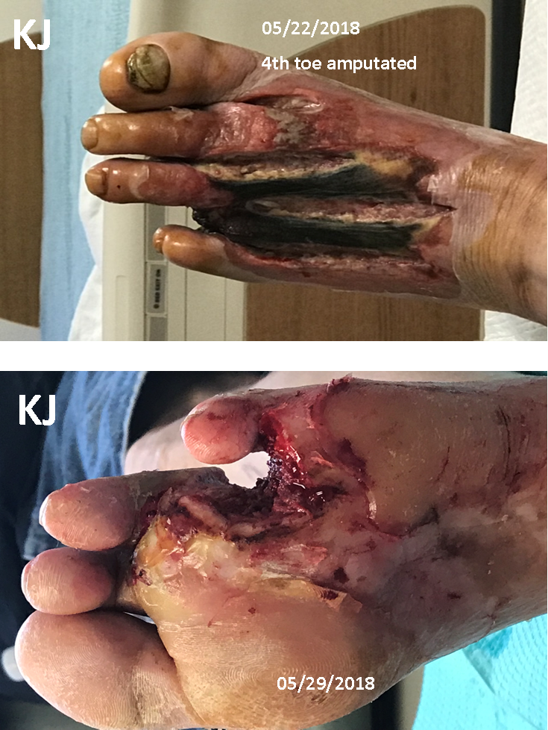

Slide 8
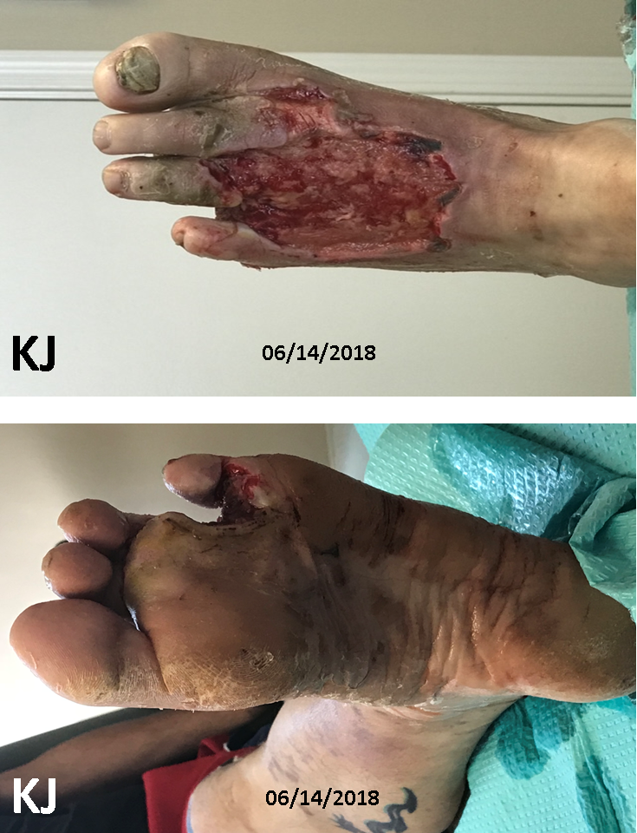

Slide 9
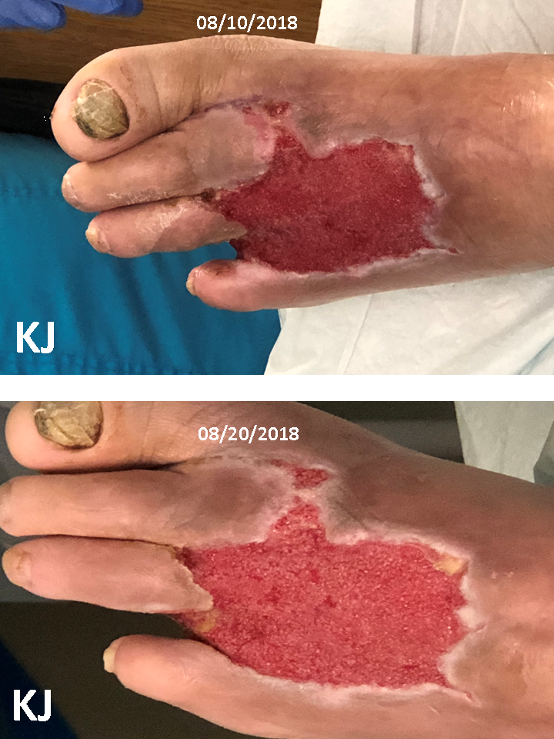

Slide 10
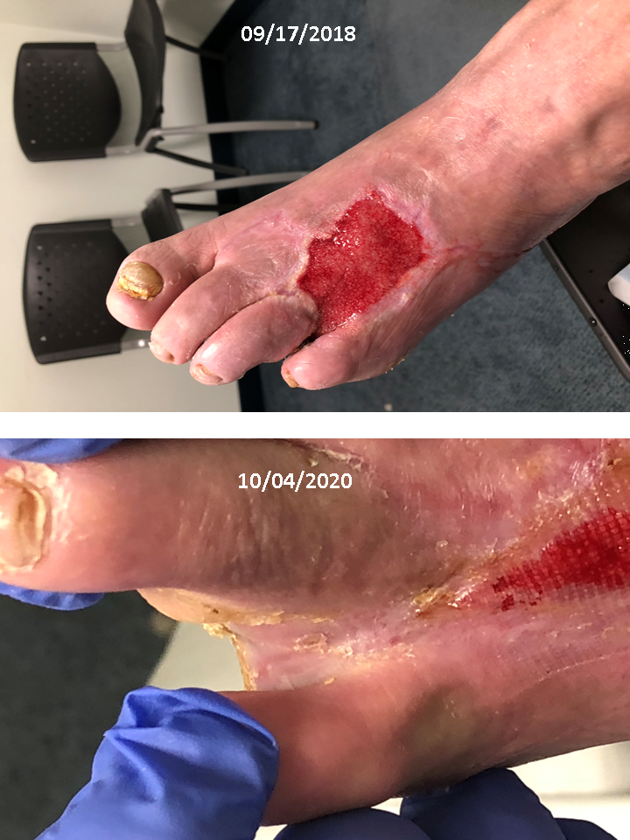

Slide 11
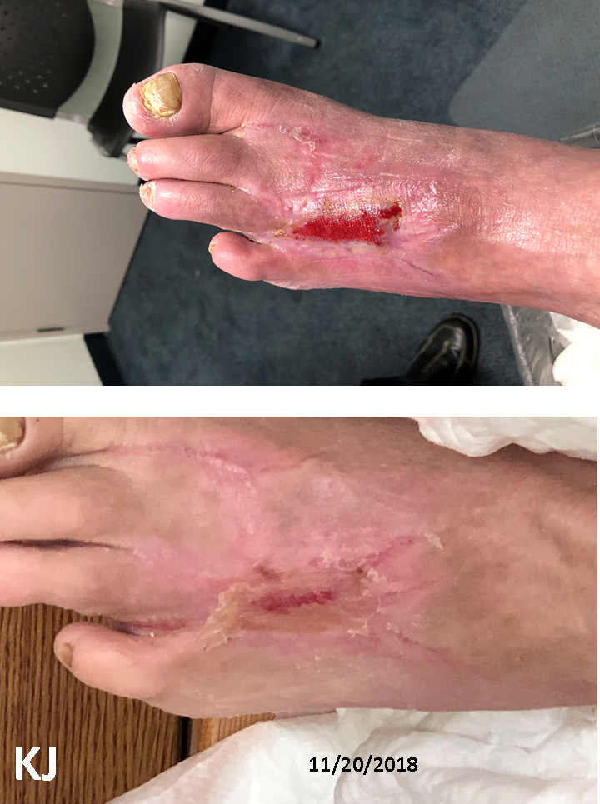
10/30/2018

Slide 12
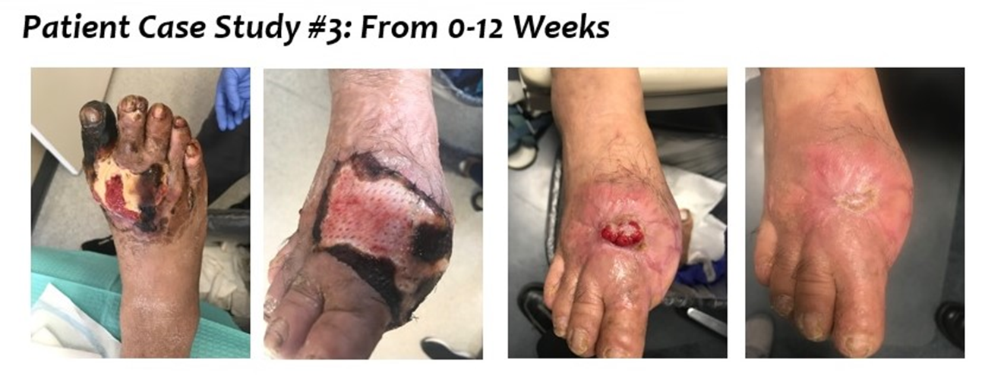
Stage 4 (gangrene) Diabetic Foot Ulcer scheduled for amputation
Patient opted into clinical study using Nanogranex®
Industry average to close a stage 4 ulcer: 54 weeks
Top performing advanced wound dressings to close stage 4 ulcer: 25 weeks
Nanogranex®: Patient’s foot was saved and wound closed in 12 weeks
Source: Global Market Insights, Literature Search, Genesis Team Analysis
Notes:
Fastest growing segment in healthcare

Slide 13
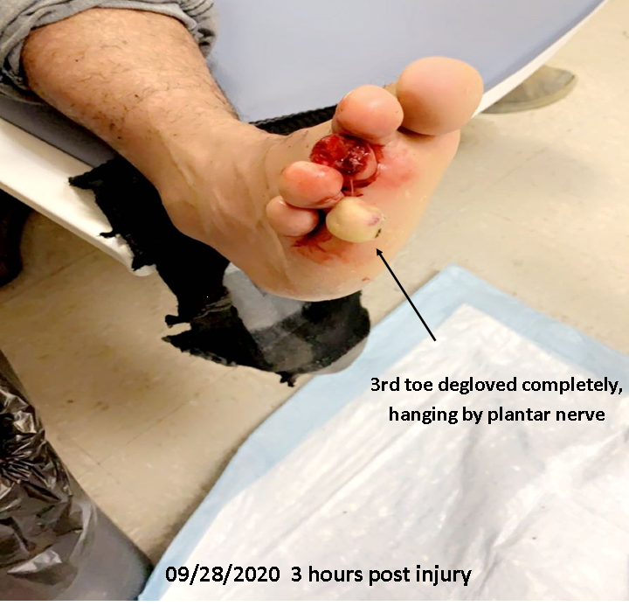
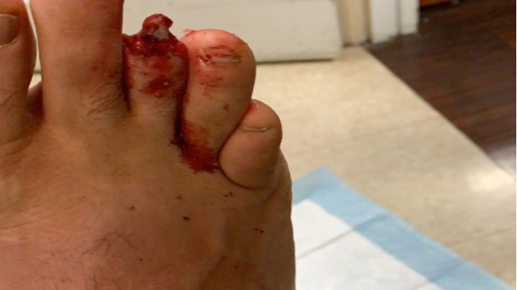
Case Study #4

Slide 14
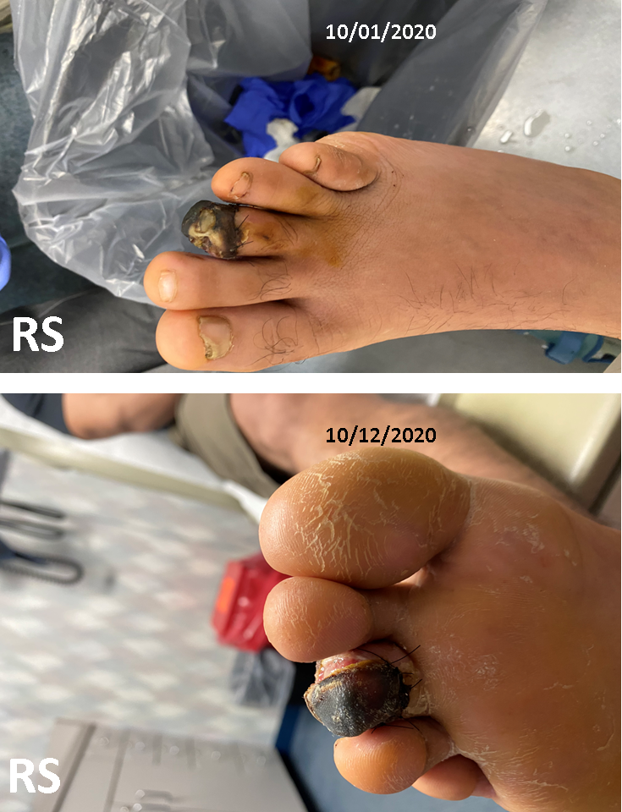
Toe was sutured back on at ER and nanoGranex daily dressing changes started immediately

Slide 15
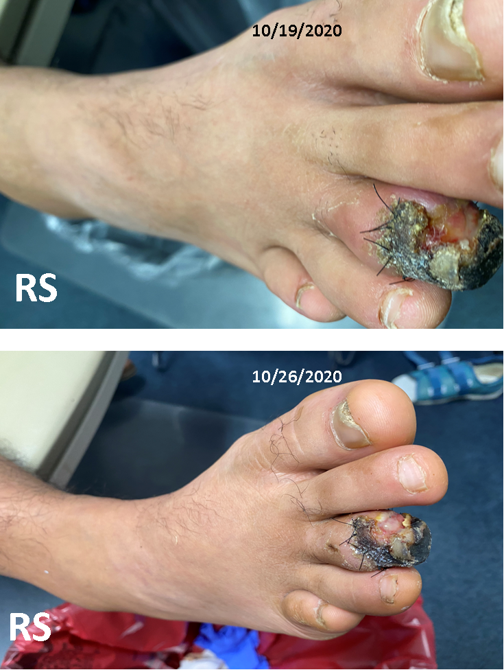
Tissue healing can be seen with granulation tissue and epithelialization visible after three weeks

Slide 16
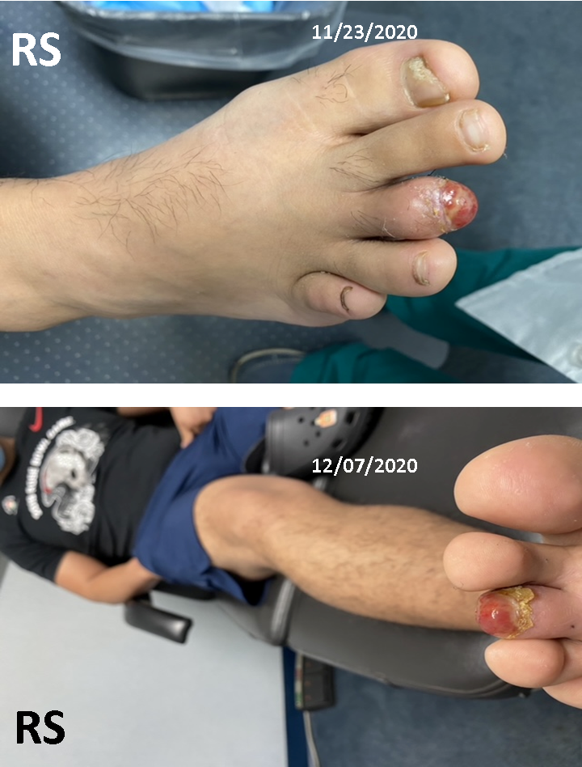

Slide 17
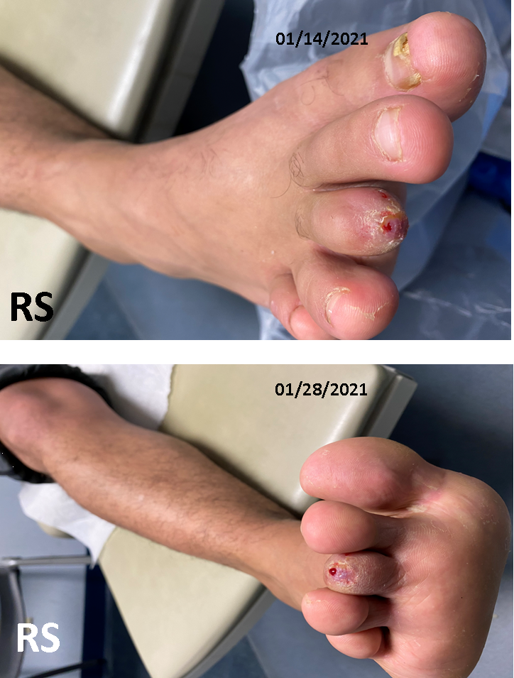
Complete regeneration of toe in 16 weeks. Normal procedure in degloving injuries is amputation of exposed bone proximal to bone exposure site and closure of soft tissue.

Slide 18
Nanogranex demonstrates superior performance against top tier advanced wound care dressings
The clinical performance of Nanogranex® is the most significant improvement in wound healing since the introduction of advanced wound care in 1985
Source: Global Market Insights, Literature Search, Genesis Team Analysis
Notes:
Fastest growing segment in healthcare

Slide 19
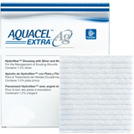
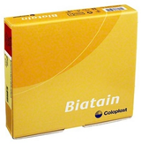
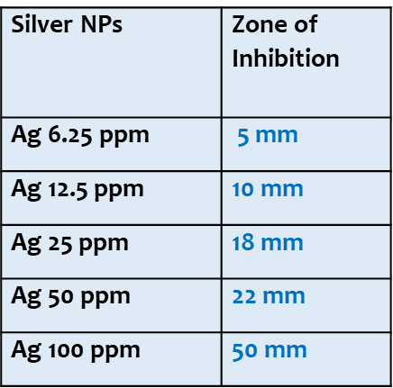
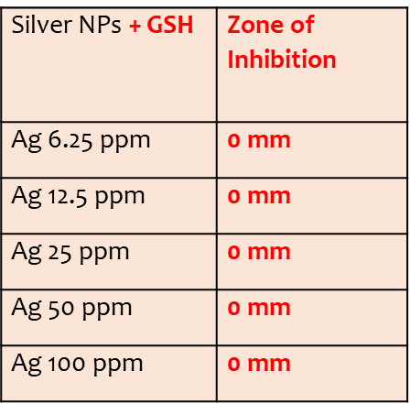


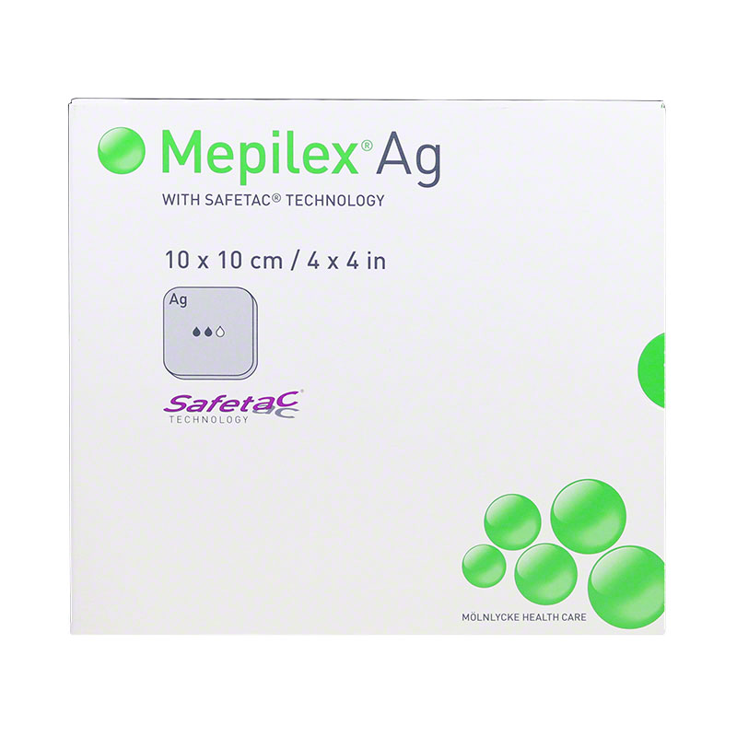
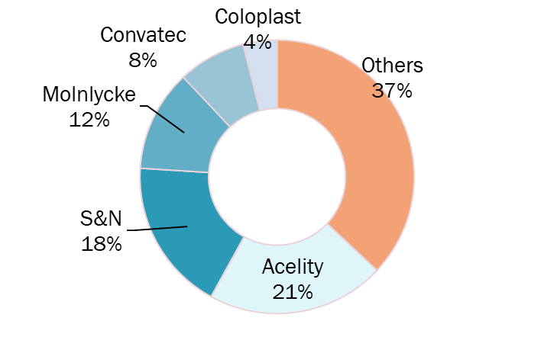

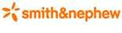
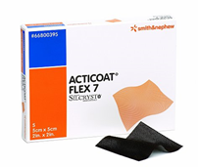

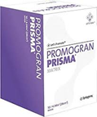
The Problem with Silver Dressings: They do not work in the wound environment
Silver Nanoparticles (NPs) against
P. aeruginosa in-vitro
Silver NPs against P. aeruginosa
in simulated wound environment
(Extracellular thiols added to petri dish)
Silver works great against bacteria
In a petri dish
When you add human wound fluid (GSH), which have compunds
(extracellular Thiols) to the petri dish, those compounds bind
to silver: silver cannot kill bacteria anymore
All of the major wound care players (left) have silver dressings.
Silver is absolutely proven to shut down when it interacts with
blood and wound fluid. Every advanced dressing to the left is a
glorified band-aid.

Slide 20
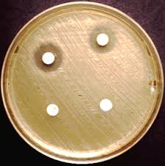
Introducing the world’s most powerful Silver sprayable wound gel: Nanogranex ®
Silver Nanoparticles vs. Nanogranex® (Silver Nanoparticles + Molecule X)
Tested Against Pseudomonas Aeruginosa in the presence of human wound fluid components (GSH)
Minimum Inhibitory Zone test
Silver Nanoparticles
currently Used in Advanced
Wound Care dressings
Nanogranex ®
Conclusion: The first & only silver dressing to maintain 100% potency in the human wound environment

Slide 21


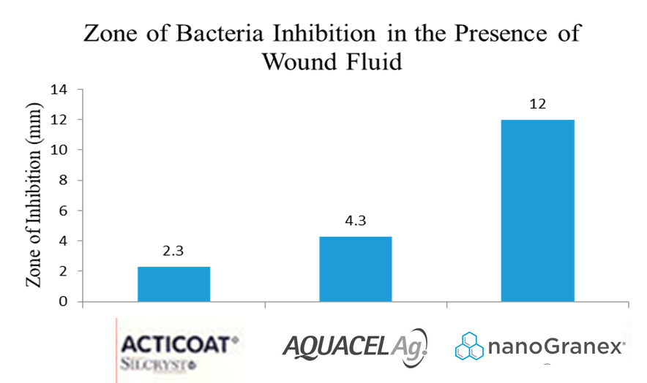

Superior Head to Head performance against market leaders: Nanogranex ®
Acticoat Ag vs. Aquacell Ag vs. Nanogranex®
minimum inhibitory Zone test against P. Aeruginosa
6x better performance over Acticoat Ag by Smith & Nephew
3x better performance over Aquacell Ag by Convatec

Slide 22
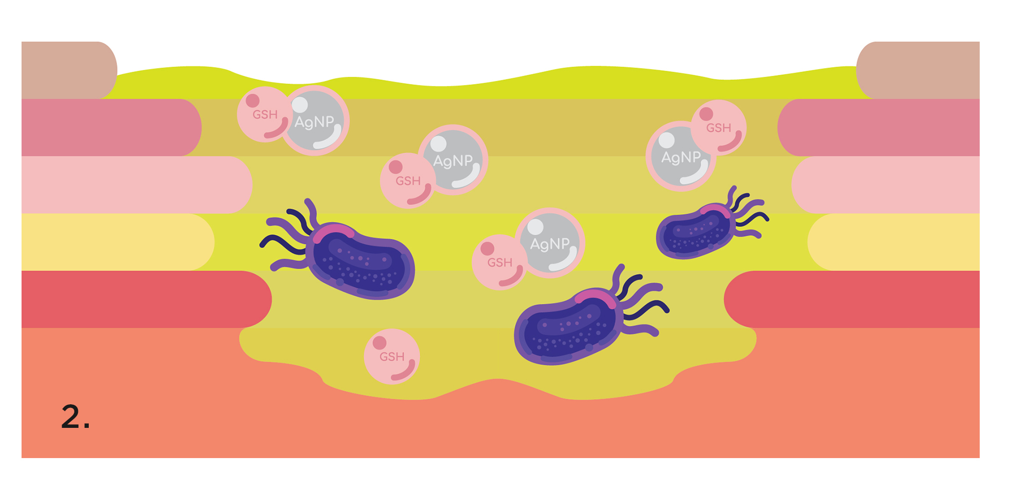
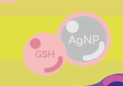
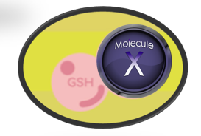
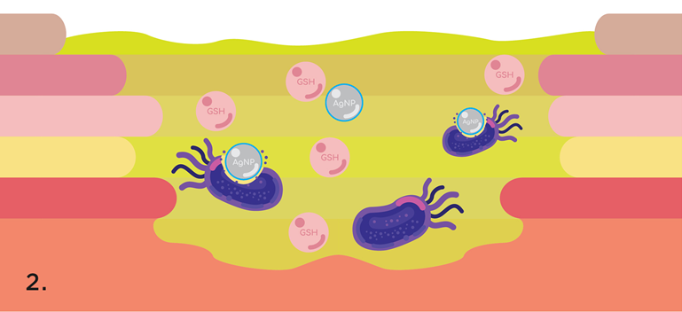


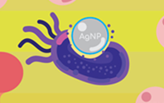
How Nanogranex® outperforms all silver dressings: Mechanism of action
PROBLEM
Thiol containing carrier proteins present in wound fluid and human blood
bind to silver at a 1:1 ratio, removing all antimicrobial properties of silver ¹
This problem affects ALL Silver dressings
Nanogranex® the only silver dressing that remains fully active In the wound site.
Nanogranex® with Molecule X
Molecule X has a higher binding affinity to and competitively inhibits thiol containing carrier proteins found in human wound fluid and blood: Reduced Glutathione (GSH)/ Cysteine/ Albumin.
Nanogranex® Leaves Silver unbound and fully active in the wound environment
6x antimicrobial performance over the market leading Smith & Nephew Acticoat Ag Dressings
Source: Inactivation of the Antibacterial Properties of Silver Ions by Biologically Relevant Compounds¹

Slide 23

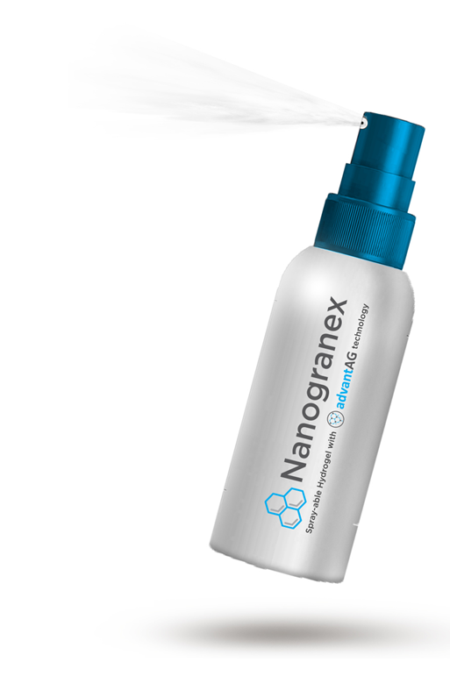
Nanogranex® is the most cost effective advanced wound care product available
Nanogranex® COGS (3oz) = $1.79
HCPC code: A6248 Reimbursed by Medicare/Medicaid at $52.32-60.00* per 3oz
97% margin before out of pocket charges
*(reimbursement depends on region)

Slide 24
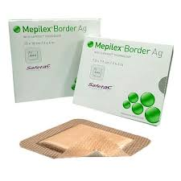
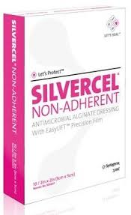
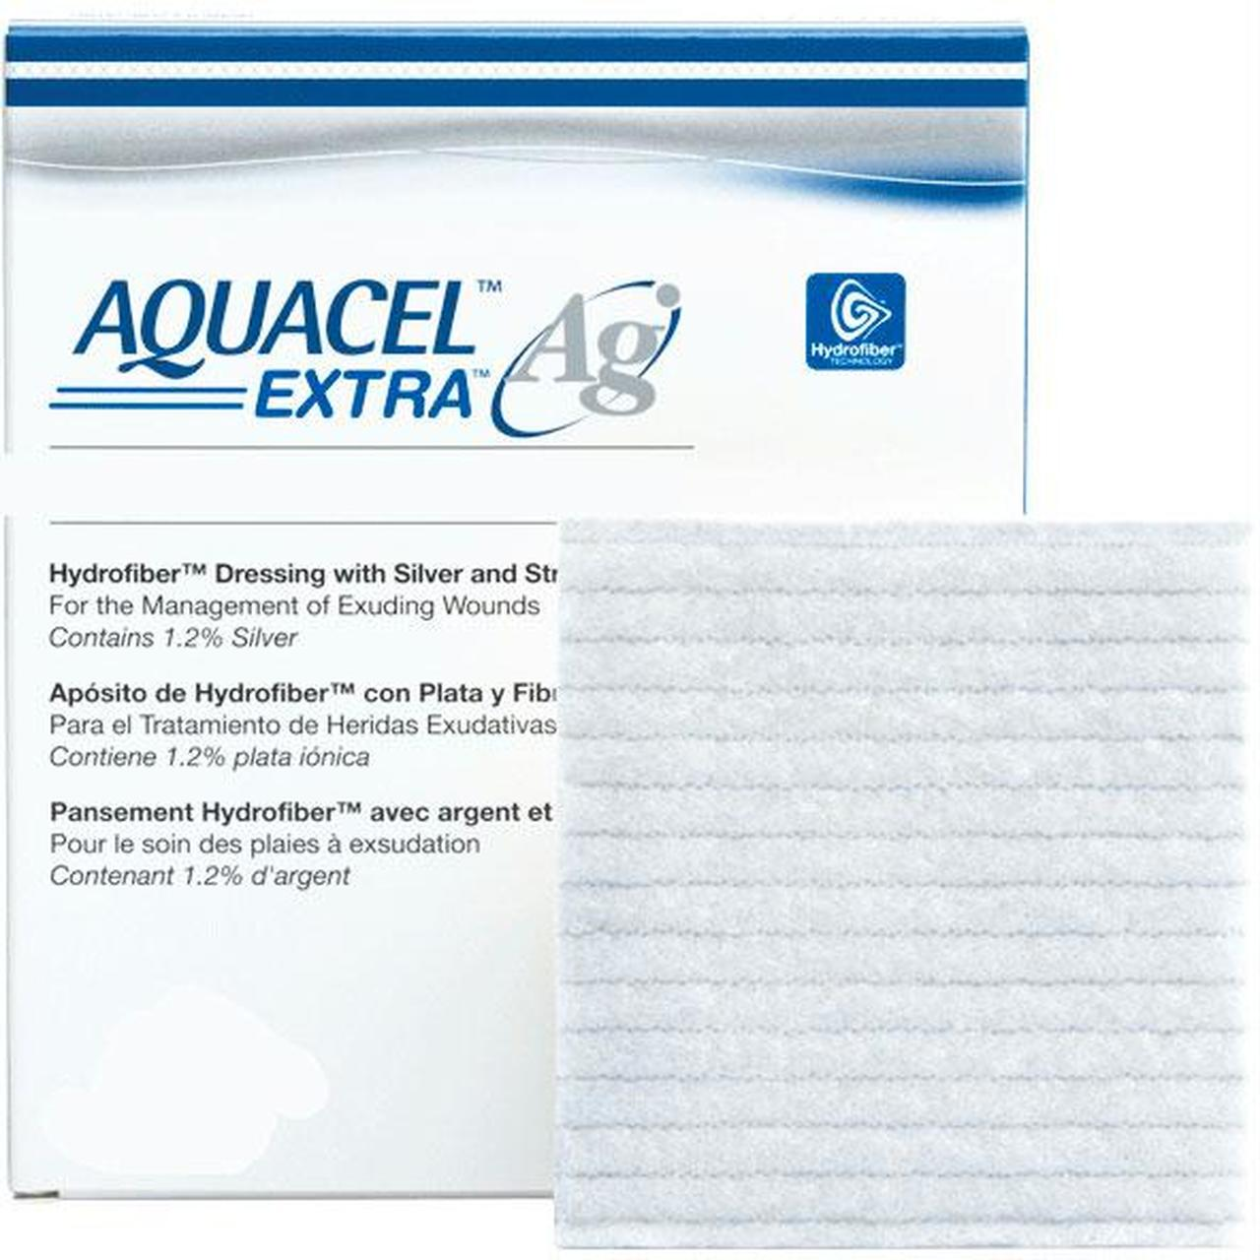
Nanogranex® is the most affordable advanced dressing available
High Product Costs Are The #1 Constraint On Domestic & Global Market Growth
Silvercel®
4 ¼ x 4 ¼
by Aceility
Mepilex®
4 x 4 inch
by Molnlycke
Biatain Ag®
4 x 4 inch
by Coloplast
Promogran Prisma®
4 ^{1/3} x 4 ^{1/3} inch
by Aceility
Acticoat Ag
4 x 4 inch
by Smith & Nephew
Aquacell Ag
4 x 5 inch
by Convatec
$15.36 per dressing
$30.72 per week
$16.08 per dressing
$32.24 per week
$11.60 per dressing
$23.20 per week
$15.10 per dressing
$30.20 per week
$12.10 per dressing
$24.20 per week
$22 per dressing
$44 per week
4 x 4 inch application
By Genesis Pharmaceuticals
$1.07 per application
$7.49 per week

Slide 25
Nanogranex® Health Economics
Significant reduction in cost across all factors
References
Posnett J, Gottrup F, Lundgren H, Saal G. The resource impact of wounds on healthcare providers in Europe. Journal of Wound Care, 2009;18(4):154-161
The World Bank, World Development Indicators (WDI) April 2011
Wild, S., Roglic, G., Green, A. et al. Global prevalence of diabetes: estimates for the year 2000 and projections for 2030. Diabetes Care 2004; 27: 1047-1053.
Bales I, 2009. Reaching for the moon: achieving zero pressure ulcer prevalence. J Wound Care. 2009 Apr;18(4):137-144
Reiber, G.E., Boyko, E.J., Smith, D.G. Lower extremity foot ulcers and amputations in diabetes. In: National Diabetes Data Group, National Institutes of Health. Diabetes in America (2nd edn). US Government Printing Office (NIH pub. no. 95-1468), 1995.
Drew P, Posnett J, Rusling L, on behalf of the Wound Care Audit Team. The cost of wound care for a local population in England. Int Wound J 2007;4:149–155.
Lindholm, C., Bergsten, A., Berglund, E. Chronic wounds and nursing care. Journal of Wound Care 1999; 8: 1, 5-10.

Slide 26
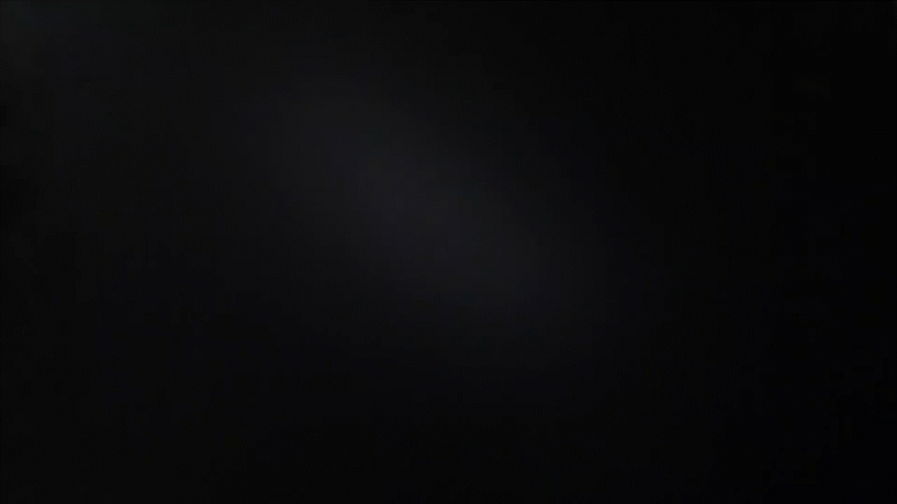
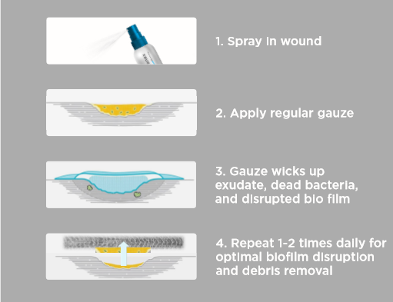
    Nanogranex®: The easiest advanced dressing to apply
    First sprayable gel formula makes application simple even for those with movement impairment
Sprayable Hydrogel
Video of the only sprayable hydrogel
    4 simple steps that any patient can easily use
Source: Genesis Team Analysis

Slide 27
    Ease of use is considered as important as clinical efficacy for market success according to Diligence Wound Care Global LLC
“almost every failed product in some way had inferior non-clinical considerations”
“the best performing wound care had one or more non-clinical benefits”
  Ease of use is significant factor for patient compliance and physician preference
    Patients describe the most common form of non-adherence as being intentional, dressings are a “hassle to change”.
Ease of use is significant factor in market success
“the best performing wound care products in the past decade had one or more non-clinical benefits (ease of use, cost) that set them apart from the competition. “
“Likewise, almost every failed product in some way had inferior non-clinical considerations, even if the clinical performance was slightly improved.”
57%
“dressings are a hassle to change”
Non-compliance rate in
wound care
Source: Diligence Wound Care Global LLC

Slide 28
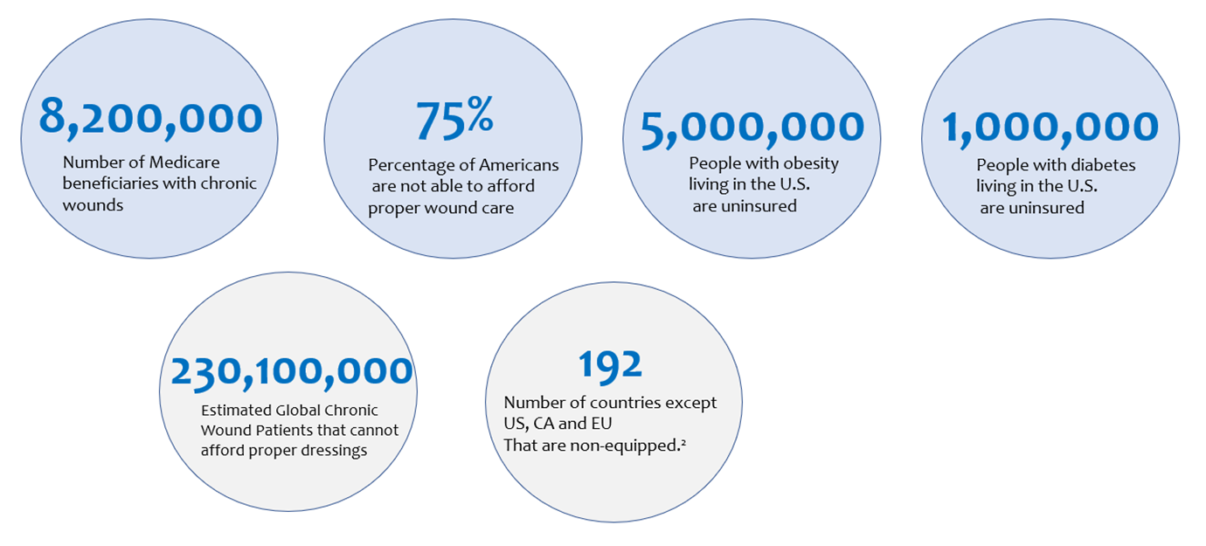
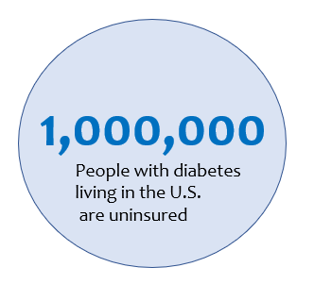
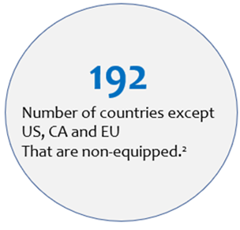
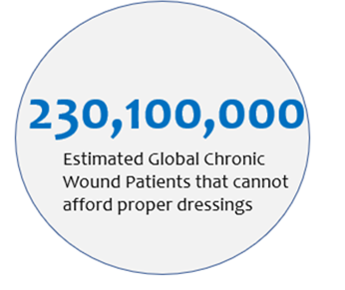
High Product Costs Are The #1 Constraint On Domestic & Global Market Growth
Limited Reimbursement Scenario Challenges Growth in the U.S.
    75% of Americans are not able to afford proper wound care²
    High cost of advanced wound care products over traditional wound dressing account for their limited adoption. ³
  APAC Wound Market Growing at 5.3% CAGR
  from 2017-2025¹
    High product costs are #1 constraint on global market growth¹
    Wound management care is one of the most under-penetrated areas in terms of technology. All markets except US, CA and EU are non-equipped.²
Source: Global Market Insights, Literature Search, Genesis Team Analysis
Notes:
28

Slide 29
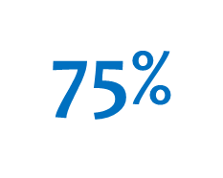

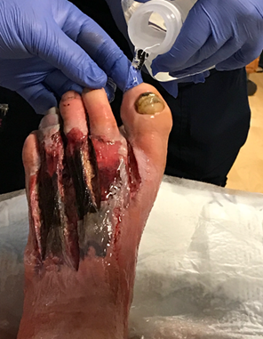
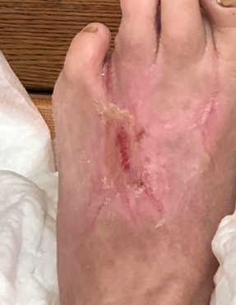
Competition problems solved by Nanogranex®
    Ease of Use
High Product Costs
    Current Silver dressings are not effective in wounds
Percentage of Americans
are not able to afford
proper wound care
Inactivation of the Antibacterial of Silver Ions by Biologically Relevant Compounds
Geraldine Mulley, ^{1 , *} A. Tobias A. Jenkins, ² and Nicholas R. Waterfield ³
“Extracellular thiols and human serum also significantly reduce the antimicrobial activity of silver wound dressings Aquacel-Ag (Convatec) and Acticoat (Smith & Nephew) to Staphylococcus aureus, Pseudomonas aeruginosa and Escherichia coli in vitro.”
230
Million
Global Wound Patients that cannot afford proper dressings
#1 Reason Wound Care companies fail: Novel technologies do not translate to clinical results
Stage IV wound
Dressing | Average weeks to heal
Standard wound care | 54.5
Allevyn Ag® Smith & Nephew | 21.9
Nanogranex® | 12.1

Slide 30
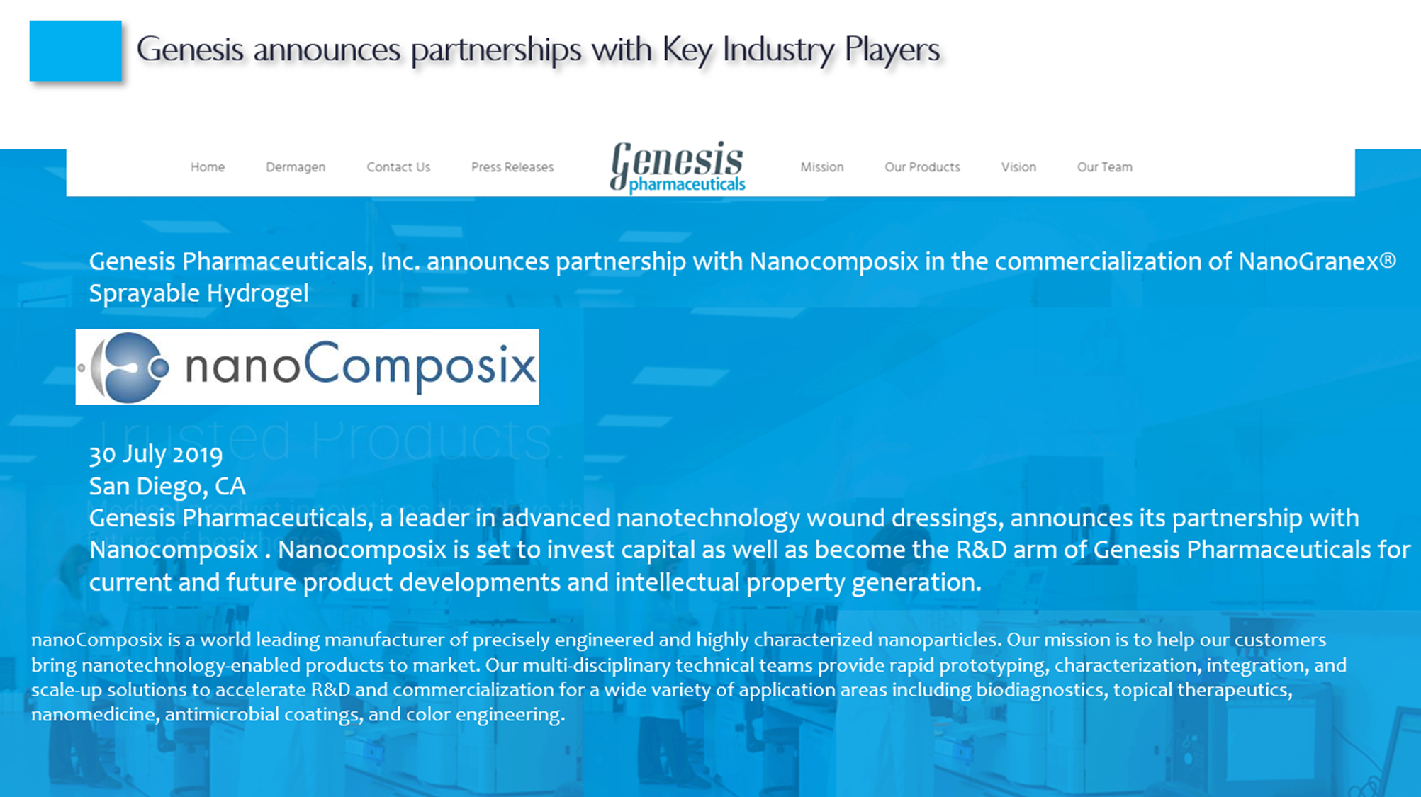
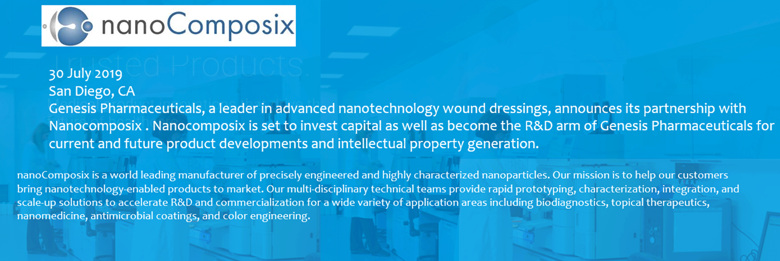
Genesis announces partnership with key industry player
Genesis Pharmaceuticals, Inc. announces partnership with Nanocomposix in the commercialization of Nanogranex® Sprayable Hydrogel

Slide 31


Regulatory: FDA Approval Plan and Projected Timeline
We are here as of: 1/1/20
120 Days
120 Days
7 Days
90 Days
$226,000
$175,000
$50,000
FDA fee: $2,738for small business
**Manufacture cGMP submission batch
FDA required studies
Prepare & Submit 510(k)
FDA to respond/ Clear Nanogranex®
Total Timeline & Budget for FDA clearance:
$453,738
9 months from current point
**As of Dec 2019, Genesis equity partner, Nanocomposix is now cGMP and will manufacture FDA submission batches and Clinical Study batches of Nanogranex®
Conducted by NAMSA Contract Research Organization
Prepared and submitted by NAMSA CRO
31

Slide 32
Regulatory: FDA Required Testing – No Human Clinical Trials
510(k) submission is being conducted by NAMSA CRO
Microbiology studies: 6-8 weeks of total testing
Being conducted by NAMSA CRO
Antimicrobial Kill Time Evaluation
1 solution Population: 1-5 x 10^6 CFU/mL
Replicates: 3
Organisms: 4
Pseudomonas aeruginosa ATCC 15442
Pseudomonas aeruginosa ATCC 27853
Staphylococcus aureus ATCC 33591 MRSA
Staphylococcus aureus ATCC 29213
Time Points:
12 hours and 24 hours
1 solution x 4 organisms x 3 replicates x 3 time points = 36 samples
GLP USP <51>
Testing Per the Method Includes:
Microorganism(s)
Bacteria:
E. coli ATCC 8739
S. aureus ATCC 6538
P. aeruginosa ATCC 9027
Fungi:
C. albicans ATCC 10231
A. brasiliensis ATCC 16404
Starting Concentration ◦ >1x105 CFU/mL
Substance ◦ 3 Test Substances (Category 2)
Contact Time(s) ◦ Set-Up/Time Zero ◦ Day 14 ◦ Day 28
• Tested in Single Replicate
Includes Neutralization/Recoverability Analysis
GLP USP <61>
Testing includes: Microorganisms for neutralization/recoverability analysis
P. aeruginosa ATCC 9027
S. aureus ATCC 6538
B. subtilis ATCC 6633
C. albicans ATCC 10231
A. brasiliensis ATCC 16404
Microbial enumerations ◦ Total aerobic plate count for bacteria
◦ Total aerobic plate count for yeast and mold
Substance ◦ 1 Test substance Tested in single replicate
Biocompatibility testing: 4 months of total testing.
Being conducted by NAMSA CRO
Cytotoxicity
How toxic is our product to human cell lines. We have already done this test 3rd party and scored a 2.
Qualitative evaluation involves observing the cells under a microscope and assigning a cytotoxic grade (0-4). The grade is based on estimated percent lysis (death) and on the morphology (appearance) of the cells.
Test materials pass the assay if the cytotoxic score is ≤ 2 (≤ 50% lysis).
Rabbit Pyrogenicity: evaluates if the body reacts to our actives as a foreign substance or infection. One of our actives is required for life and the other (silver) has been tested thousands of times. The body does not treat either as a pathogen.
Mutagenicity
The purpose of mutagenicity testing is to identify substances that can cause genetic alterations in somatic and/or germ cells. Again, Silver has been tested & cleared hundreds of times by FDA in this specific study and our other active is required for all cells to live.
28-Day subcutaneous systemic toxicity testing in rats
What happens if our actives get into circulation, do they affect vital organs.
Stability/ Packaging Validation: Data can be submitted at 90-day time point
Performed by Irisys Pharmaceuticals
We have samples that are 6 years old that are still stable.
According to the pre-sub minutes, FDA will take data from 3-month accelerated (heated chamber) studies at the time of submission, we just need to file the real-time data and update it accordingly for future potential audits.
A stability study stored at 3 storage conditions will be conducted.
The storage conditions and sampling points are:
40°C/75%RH with testing at the 1-month, 3-month and 6-month time point
30°C/65% RH with testing only if there is a negative trend at the higher temperature
25C/60%RH with testing at the 1,3,6,9 and 12- month points;
5C with testing at the 1-month point to cover low-temperature excursions during shipping

Slide 33
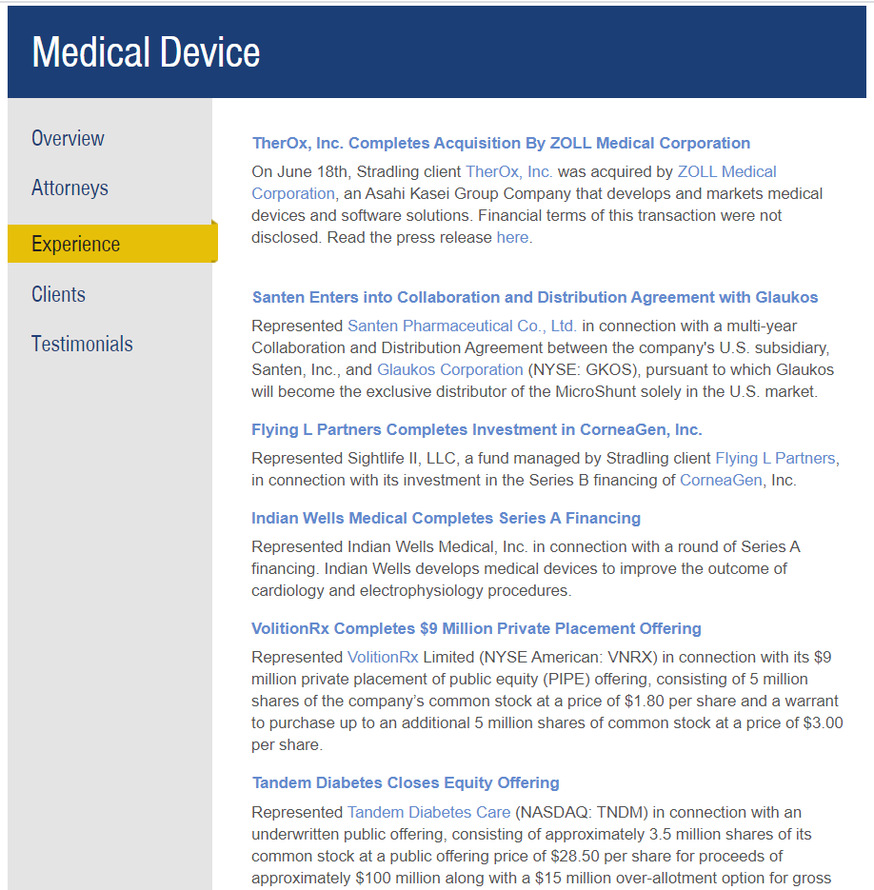

Experienced M&A, Medical Device, & Life Science Legal Team: Stradling Yocca Carlson & Rauth
Stradling Yocca Carlson & Rauth.
SYRC Medical Device
SYCR Life Sciences

Slide 34

Domestic Advanced Wound Management Market is Large and Growing
Market Growth Drivers
*
Aging Population
$35 Billion
*
Growing diabetics
*
Increase in surgeries
Known Global Market
*
Increase in ulcers
*
Advancement in technology
7.8%
Growth Inhibitors (Opportunities)
*
Cost of treatments
APAC Market CAGR
*
Lack of reimbursement instruments
Source: Global Market Insights, Literature Search, Genesis Team Analysis
Notes:
Fastest growing segment in healthcare

Slide 35














Recent Market Trends
Wound Care M&A activity for small players surges: Genesis Pharma well positioned for licensing/ acquisition
Currently being distributed by Medline and Prisma Medical
Source: Walden Group Report 2018, Literature Search, Genesis Team Analysis
Notes:
35
Imbed BioSciences, Microlyte Ag.
https://microlyteag.com/imbed-biosciences-closes-2-million-in-series-a-financing-to-commercialize-wound-healing-matrix/ : A biopolymer dressing with nanosilver. Currently being distributed by Medline and Prisma Medical.
Company: Vomaris, Technology: Procellera.
http://www.vomaris.com/vomaris-and-arthrex-announce-exclusive-global-distribution-agreement-for-procellera-technology/
Enzysurge, Fromerlly Silver Stream
https://www.enzysurge.com/?section=7
Distribution deals in India and South Korea. Silver ion solution with menthol for wound rinsing. Claim that menthol and silver have synergy and secured IP based on these claims.
Kinetic Concepts Inc, Wound vac (negative pressure wound care vacuum), first acquired by Aceility, now 3M is buying both:
https://www.medicaldevice-network.com/news/3m-acquires-acelity/
Hymed, Hydrolyzed collagen wound gel with silver
https://www.accessdata.fda.gov/cdrh_docs/pdf13/K132891.pdf
Distributed by DermaRite as DermaSyn Ag
https://hymed.com/
SilverStat dressing
http://www.silvrstat.com/

Slide 36

Recent Market Trends
Medical Device Firms Continue To Command High Multiples
Avg. Revenue Multiple: ~6X
Avg. EBITDA Multiple: ~21X
Source: Walden Group Report 2018, Literature Search, Genesis Team Analysis
Notes:
36

Slide 37
Recent Market Trends
Global Potential
USA Realistic Distribution
Avg. Revenue Multiple: ~6X
Avg. EBITDA Multiple: ~21X

Slide 38






Exit Strategy: Licensing & Acquisition potentials
Each Indication can be separately licensed to a region or partner

Slide 39
Investment Offer
To expedite it’s regulatory, clinical and go to market progress, Genesis is looking to raise $1.5 million at a pre-money valuation of $15 million.
The aforementioned investment shall help the firm accomplish specific goals along each of the key value drivers:
    Launch a market ready product
    Achieve regulatory approval
    Conduct clinical research to create new derivative products from the core IP
    File patents and create additional intellectual property
    Aggressively create monetization options via licensing, distribution and potential M&A options
This presentation further outlines the tremendous progress and innovation the firm has achieved and the plans for usage of funding to continue to make rapid progress.
We look forward to address any questions, provide additional information and our potential partnership.
39

Slide 40
Executive Summary
Advanced Global wound care market is large (~$10 Billion) and Total wound care market is valued at $35B growing (5.4% CAGR) rapidly
Several market forces are driving even more growth momentum
    Aging population
    Sedentary lifestyle and food choices driving obesity and diabetes
    Increase in ulcers and surgeries
    Advances in technology
Genesis believes that the “visible” wound care market is just the tip of the iceberg. There is a large, substantial and largely unserved/under served (“invisible”) market in the USA as well as several other parts of the world including Asia, Middle East and Greater Africa. This market dwarfs the “visible” market in developed economies by 3-4x
This invisible market is uncaptured/unserved or underserved due to two vital factors
    High cost of incumbent solutions/options
    Lack of ease of use/Highly invasive and costly procedures
Genesis Pharma’s solution is well positioned to serve both market segments with its clinically and fiscally disruptive wound care solutions
The firm has made tremendous progress since our last meeting and is now ready to submit it’s solution to FDA for regulatory approval. Firm has already studied and established the reimbursement cost codes, thus ensuring a clear payment model for providers. Lastly, on clinical front, the firm has an active pipeline of potential patents and additional research studies to be conducted
To expedite it’s regulatory and go to market process, Genesis is looking to raise $1.5 million at a pre-money valuation of $15 million. The forthcoming pages in this presentation outline the tremendous progress and innovation the firm has achieved and the plans for usage of funding to continue to make rapid progress
We look forward to address any questions, provide additional information and our potential partnership
Sources: *JAMA, **Wound Research Foundation, ***CDC, #CMS, Genesis Pharma Team Analysis
40

Slide 41
Disclosure
DISCLAIMER: All statements in this release that are not strictly historical facts are "forward-looking statements." Such forward-looking statements are based on Genesis Pharmaceuticals’ current assumptions, beliefs and expectations, and involve risks, uncertainties and other factors that may cause Genesis Pharmaceuticals’ actual results to be materially different from any results expressed or implied by such forward-looking statements. Risks, uncertainties, and other factors that could cause or contribute to such differences include, but are not limited to: ongoing and future intellectual property enforcement actions; the ability to successfully litigate or settle claims of patent infringement; Genesis Pharmaceuticals’ ability to obtain necessary financing, generate sufficient cash flow, and maintain appropriate indebtedness; and the increasing development of market competition. Genesis Pharmaceuticals is providing this information as of the date of this release of this presentation and, except as required by law, does not undertake any obligation to update any forward-looking statements contained herein as a result of new information, future events or otherwise.
41

