Slide 1
The Science of Reading Brain Based Learning
1) Neurologically, how do brains like to learn?
2) What prevents learning?
3) How does this apply to reading?
Joanne Coggins, Ph.D.
Intensive Integrated Reading Systems
RightingReading.com
Intensive Integrated Reading Systems, 2020©
Notes:
This morning we are going to learn how the brain likes to learn. Then we will begin talking about the Science of Reading and the Reading Brain specifically. I’ll be pulling in the information from the videos you have previewed as we go, but feel free to jump in with questions and comments as we go along. We learn by making connections to prior learning, right?! So connecting to this new content in an emotional or personal way (like thinking of your family or students!) will help you learn. Taking time to have those conversations is critical to the learning process—even when it seems like it is slowing us down. We can blaze through material, but it does no good if you don’t remember any of it tomorrow…or next week.

Slide 2
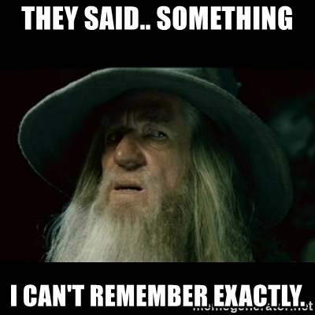
Making Memories
Short term memory
Working memory
Long term memory
Accessing memory

Slide 3
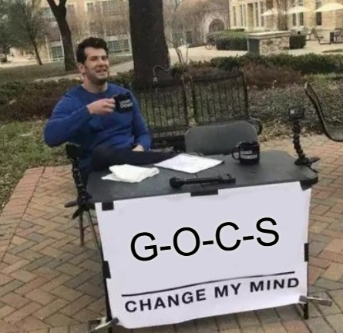
G—O—C—S
Group – Order—Connect—Self—Senses
Creating, naming, ranking categories
Make connections to content using:
Background knowledge
Own thoughts
Feelings
Experiences
Senses
Notes:
Connect to content by making connections to:
Activities facilitate student ownership of their own learning and enable them to find ways they learn best. Expressive learning vs. receptive hearing/seeing “content”
We have to work with the bits on information to get them onto the working memory desktop. Once bits are on the “table” we work to make them automatic and move them into long term memory. So we teach a phonics skill whole group to introduce it. Then we reintroduce it in small group and start working with the bits right away. Reading in context puts the new skills to use and helps build automaticity and connect to the overall structure of language and reading that their brains are wired for at this age.

Slide 4
How Fluid is Your Memory?
Making Learning Stick: Remember More & Forget Less
Intensive Integrated Reading Systems, 2020©

Slide 5
How many words did you remember?
Try to remember the words you see.
Write down the words you just saw.
truly
wonder
since
children
monitor
ape
cord
ice
noise
spatula
retire
mail
market
tulip
vision
Intensive Integrated Reading Systems, 2020©

Slide 6
Write any words you missed.
retire vision wonder
spatula ape ice
children monitor truly
mail cord tulip
market noise since
Intensive Integrated Reading Systems, 2020©

Slide 7
Mute your video feed.
Call your partner.
With your partner, make up a story using these words.
Do not write down your story.
Turn over your words list.
Intensive Integrated Reading Systems, 2020©
Notes:
The brain remembers 3-5 bits of info at a time for 2-3 seconds in short term memory.
5 step directions here, so I’m leaving them up as a visual reference!

Slide 8
Now how many words did you remember?
Write down the words from the list.
No cheating!
Intensive Integrated Reading Systems, 2020©

Slide 9
GETTING IT OUT ON THE TABLE
Short Term Memory Fades Quickly
2-3 seconds
4-5 bits of info
road sign
Long Term Memory
can last forever
be forgotten & reactivated
first time driving
Working Memory is the “Table”
highly variable
lasts longer
bits loosely connected
driving rules
Activating Memory
personal
sensory
connected
emotional
Intensive Integrated Reading Systems, 2020©

Slide 10
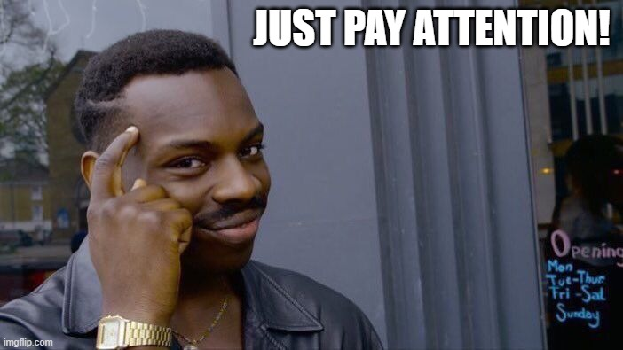
Notes:
“Look, Ms. Veatch, just pay attention!”
Why being a sage on the stage doesn’t work.

Slide 11
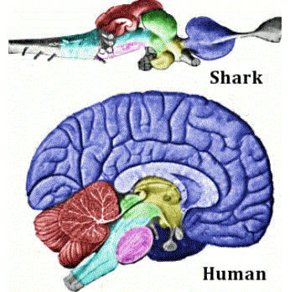
Why can’t sharks problem-solve or plan; and why they do not have language and emotions?
Sharks and humans share commonality of brain parts controlling fear responses, memory, autonomic functions.
When do humans act like sharks?
Partial graphic, lumenlearning.com, 2020
Intensive Integrated Reading Systems, 2020©

Slide 12
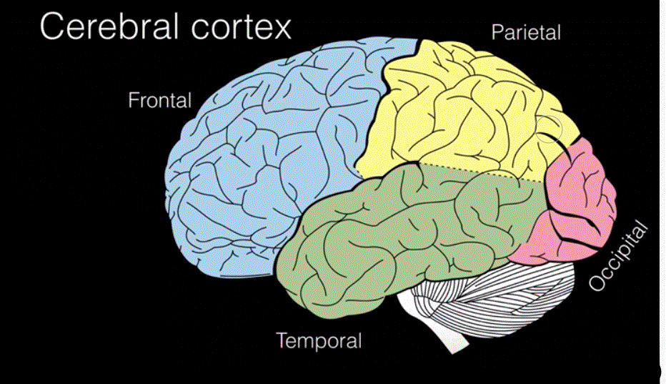
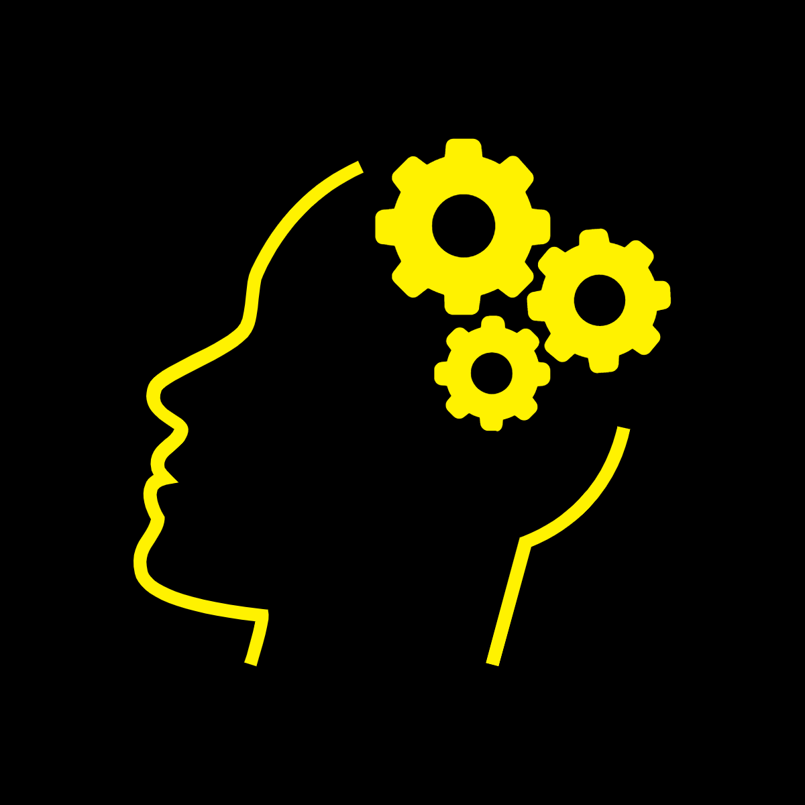
coordinate sensory info
decision making, problem solving, planning, working memory
vision
deep memory, language, hearing, emotion
Motor control, coordination, motor memory
Brainstem, hind- & midbrains, cerebellum
Intensive Integrated Reading Systems, 2020©
partial graphic, LumenLearning.com, 2020
Notes:
Hypothalamus deep in the brain (temporal lobe) is where long term memory resides.

Slide 13
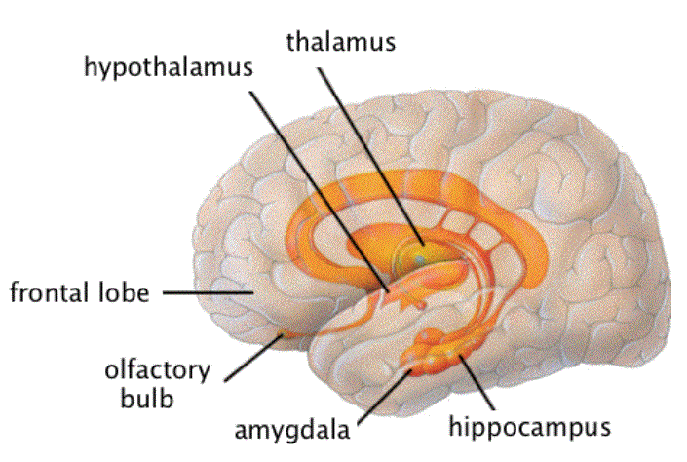
Limbic System—The Emotional Nervous System
Amygdala—emotional center of brain
Evaluates danger or pleasure and helps consolidate memory in hippocampus.
Sends out messages to increase heart rate or breathing, etc. (adrenaline & dopamine)
Stronger emotion = stronger memory!
Connecting new information to senses & emotions creates memories.
LumenLearning.com
Intensive Integrated Reading Systems, 2020©

Slide 14
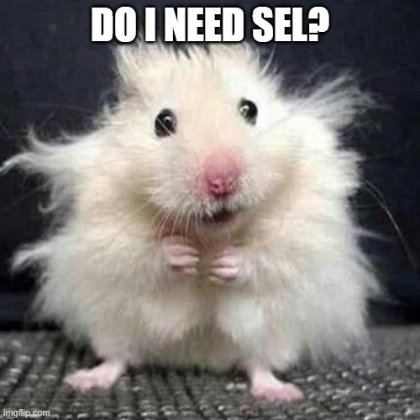
Social Emotional Learning in 3 Minutes
Encourage growth mindset—grow motivation & engagement
Chronic stress hijacks the brain
Limited comprehensible input
Not in the moment
Stressed brain activation
Students need to feel seen, valued, safe
Physical activities to refocus
Structure is good
Student choice
Intensive Integrated Reading Systems, 2020©
Notes:
Self-talk can be trained and should be taught explicitly to students.
Remember the self-improvement gurus who tell you to write your goals on post-its, put them on the bathroom mirror, and practice saying affirmative words?! It works!
Students should be taught to do this also. It’s the biggest part of learning a growth mindset. Think about families of resilient students – they are typically encouraged more than they are worthless or stupid.
We can and should model this for our students. And being mindful of our own self-talk will help us along the way.

Slide 15
Self-Talk awareness
Write down goals
SEL
Wait! How do we do that?
Say positive things out loud
Reward your own successes
WHAT ARE YOU TALKING ABOUT?
Intensive Integrated Reading Systems, 2020©
Notes:
Self-talk is that interior monologue
Academic language can be used to direct self-talk
Comment in chat about the things you say to yourself to keep going on hard days, for goals, to earn self-rewards, your goals…

Slide 16
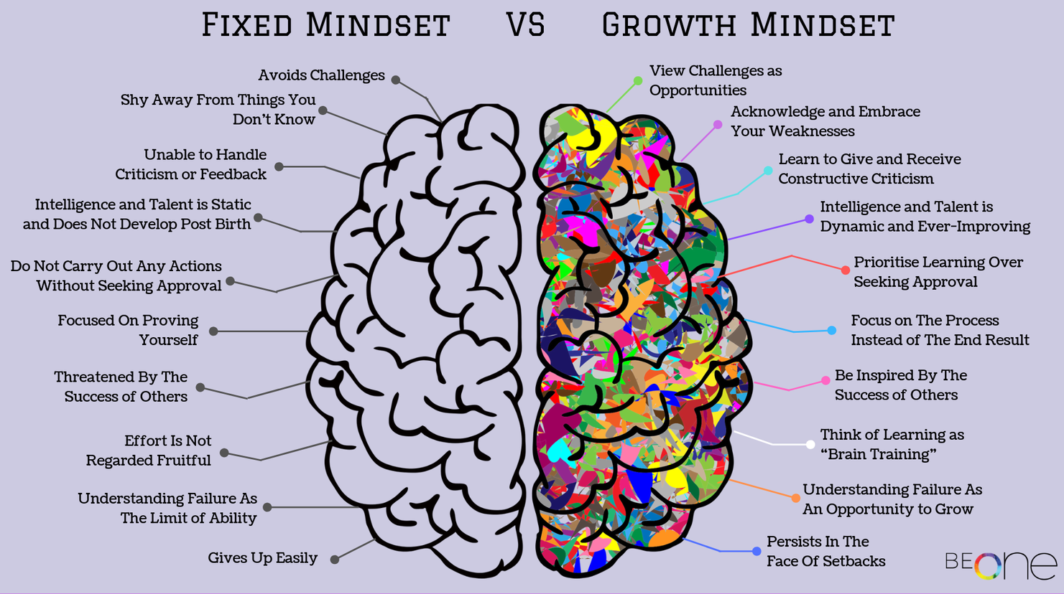
Fixed vs. Growth Mindset
Fixed vs. Growth Mindset
Change language to reflect effort—not intelligence
Making mistakes means you are learning!
Prasad, 2019
Notes:
Pie: Fixed mindset says there’s only so much pie and it’s decreasing. Growth mindset says there’s enough pie for everyone or we’ll make more pie. The pie is always increasing. Opportunity everywhere!
There are 10 descriptors on each side. Everyone pick one and give an example from your personal or professional experience.

Slide 17
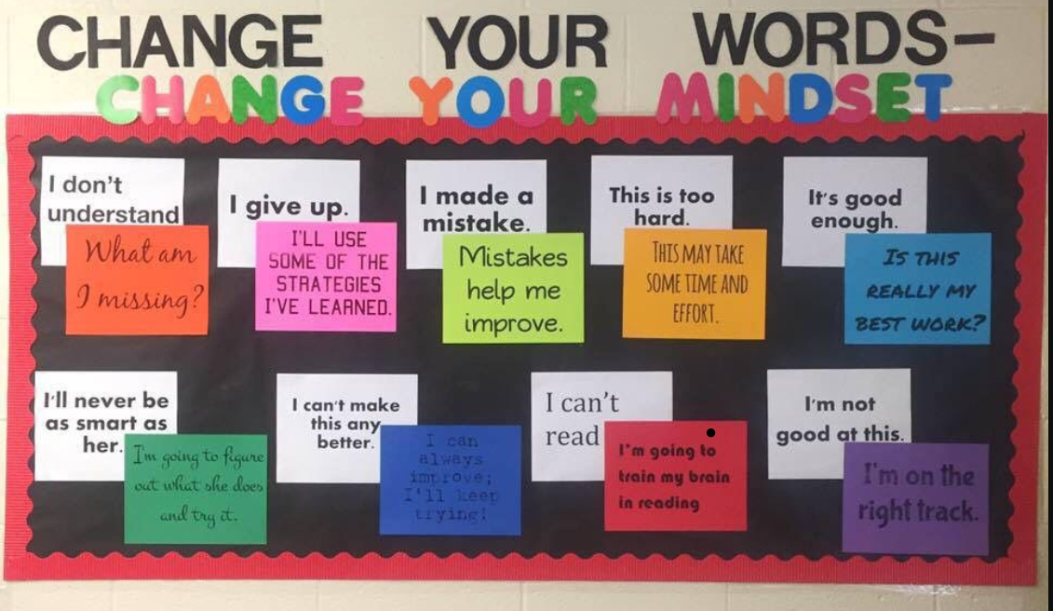
Pinterest, 2020
Notes:
Self-talk is that interior monologue
Academic language can be used to direct self-talk

Slide 18
Brain Based Learning Involves
Developing student metacognition
Improving student reflection, reasoning, & critical thinking skills
Using reading, digital tools, gaming, & problem-based learning to increase content knowledge and engage deeper learning.
Boosting retrieval practice and memory retention
Encouraging student motivation
Intensive Integrated Reading Systems, 2020©
Notes:
Metacognition is explicit instruction and awareness of how we learn.
Teach them G-O-C-S.
Model Growth Mindset academic language.
Fostering growth mindset grows students’ internal motivation.
GM necessary for exploration and experiential learning.
Be explicit amount improving memory and finding ways to connect to learning (KWL charts for older students. Conversation and pictures for younger ones.)

Slide 19
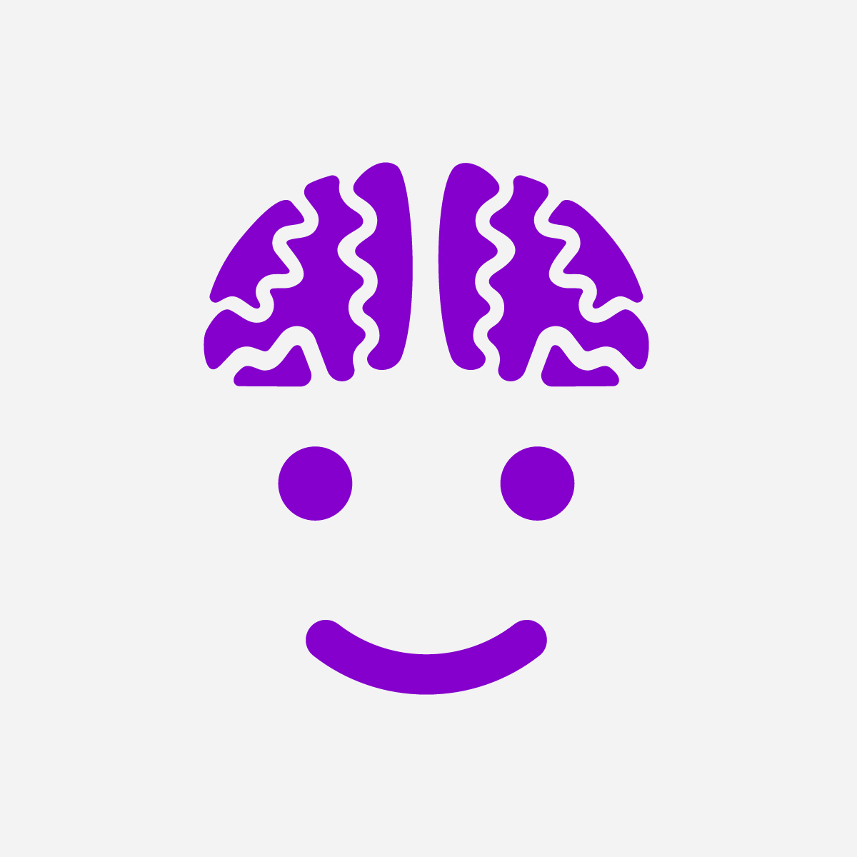
Teach in Brain Friendly Ways
The brain needs to be calm, and likes GOCS.
Short term memory lasts ______ seconds and can manage _____ bits of information
Working memory is variable and is the place where ____________
____________________________________________________.
Long term memory lasts ______.
It can be triggered by_________________________________.
2 - 4
3 - 5
connections
are made and attached to schema (background knowledge).
forever
senses, emotions, and other memories
Intensive Integrated Reading Systems, 2020©
Notes:
What are GOCS?

Slide 20
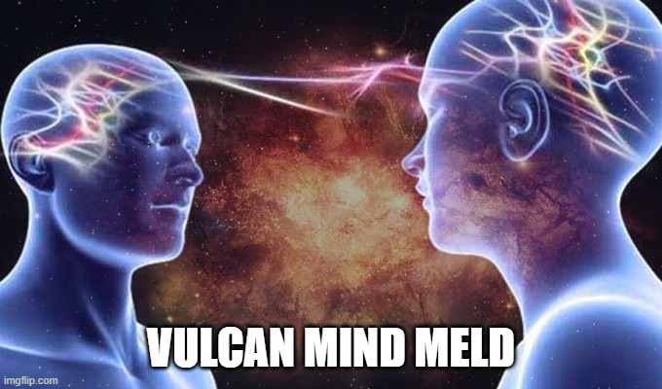
Increasing Learning Transfer
“Transfer” means applying acquired knowledge and skills to new situations
Spiral instruction
Cross curricular instruction (STEAM)
Teaching the small skill and then applying it to the whole.
Connecting lessons one to another
Making reciprocal connections in instruction (decoding/spelling)
Intensive Integrated Reading Systems, 2020©
Notes:
Transfer = Applying acquired knowledge and skills to new situations

Slide 21
Brain Break
Now: Coffee & Q&A Chat
What was interesting?
Was anything unhelpful?
What more do you want to know?
Next Up: The Reading Brain

