Slide 1
The Reading Brain
Joanne Coggins, Ph.D.
Intensive Integrated Reading Systems
RightingReading.com
Language Acquisition &
Reading Development

Slide 2
Children are Skeptics
Do you like me?
Can I trust you?
Do you know what you are doing?
Can you help me?
Notes:
What you should know about me:
28 years in the classroom: 12 teaching high school Spanish & English + 2 teaching elementary ESL & K-2 bilingually + 4 teaching elementary special education
More than $100,000 in Lindamood-Bell intervention training (+ other interventions)
Doctorate in literacy with focus on neuroscience of reading disabilities.
I’m the only psychometrician I know with such an extensive range of teaching areas and time in the classroom experiences.
I’ve always worked in Title 1 schools, and my favorite students to work with are the difficult ones.
Beyond the science & research I will share, everything I’m going to tell you I have experienced personally.
My husband is a deep dyslexic.
One of my students committed suicide mainly because his illiteracy was too painful.
I am utterly committed to improving reading nationwide. I work internationally with schools, prison systems, and post-secondary schools reforming educational instruction.
I love to learn. I’m intense. I have a huge sense of humor.
Our country is at a critical juncture: we are no longer a manufacturing economy. There are no jobs anymore for people who do not read well.

Slide 3
Burning Questions
What is the financial impact of illiteracy?
Prevention vs. Remediation: How much will it cost to fix it?
Neurologically, how do we create proficient readers?
Systemically, how do we fix our reading problem?

Slide 4
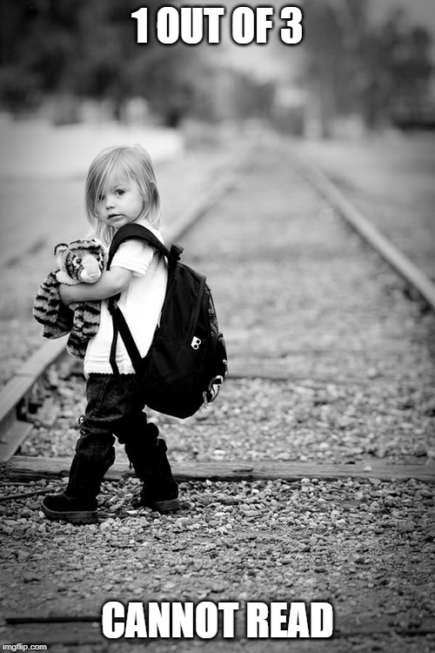
At the End of 4th Grade
Only 2 out of every 3 students will be “basic” or “proficient” readers.
1 out of every 3 students will be below basic in reading.
Reading remediation after 4th grade is unlikely.
Successful later remediation still means millions of fewer words read compared to peers.
Notes:
32% of 4th graders and 24% of 8th graders scored below "basic" on the NAEP. (This achievement level scoring means that one out of every three students in 4th grade cannot determine whether statements support a conclusion, make simple inferences, find the main idea, or infer the meaning of an unknown word from context.)
U.S. is ranked 17th out of 34 developed countries in reading in the world PISA, 2012)

Slide 5
Why Reading Matters
90+ million (4 of 10) U.S. adults are poor readers
Socially & economically disadvantaged
Adults with low literacy likely to:
Live in poverty
Engage in crime and other forms of social pathology
Live unhealthy, shorter lives
National Assessment of Adult Literacy Report (NAAL)
Notes:
60% of poor or non-readers end up stuck in low wage jobs making less than $16,000/year.
85% of all juveniles involved with the justice system are functionally illiterate. More than 60% of prison inmates are illiterate
The Surgeon General has declared illiteracy to be a national health crisis because more than 80% of our citizens cannot read well enough to follow doctor’s instructions about their personal healthcare. Specifically, they cannot read the labels on their medication to take it correctly, they cannot follow aftercare instructions from a hospital or doctor’s office visit, and they either cannot get a job with healthcare or they cannot navigate the paperwork well enough to apply for public assistance.

Slide 6
Follow The Money
85% of all juvenile offenders functionally illiterate
70% all prison inmates read below 4th grade level
Illiteracy & crime “welded together” (DOJ)
90% of welfare recipients were dropouts
$5k/year education vs $25k/year prison
20%-25% annual budget spent on SpEd/ESL
9%-15% of school pop identified as SpEd
National Assessment of Adult Literacy Report (NAAL)

Slide 7
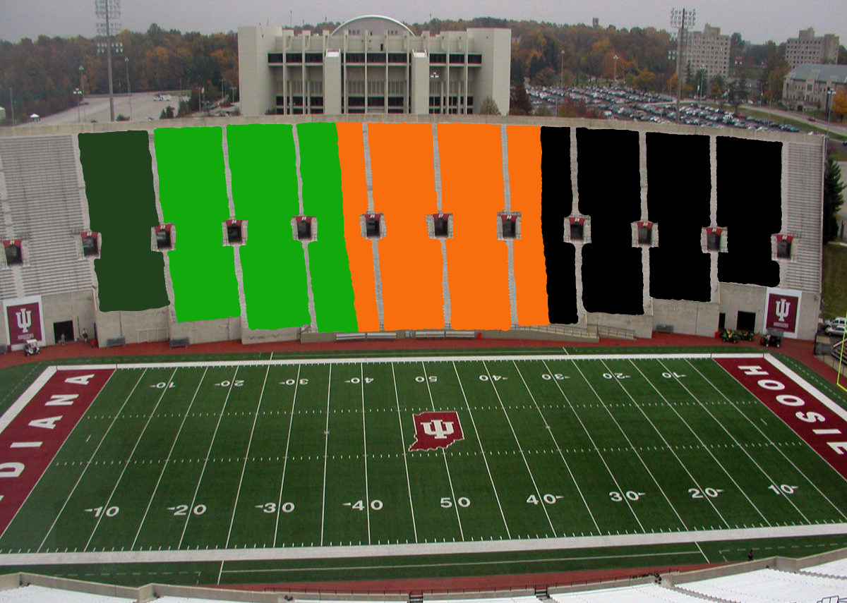
10%
27%
30%
33%
The Big Game
Notes:
Dark green = 10% advanced readers
Bright green = 27% proficient readers
Neon orange = 30% basic readers
Black = 33% non-readers
The sample 4th grade reading passage is truly a 3rd grade passage based on vocabulary and text complexity. Proficient readers are able to: recognize reasons related to plot, evaluate story characters & support opinion, interpret dialogue & story action,

Slide 8
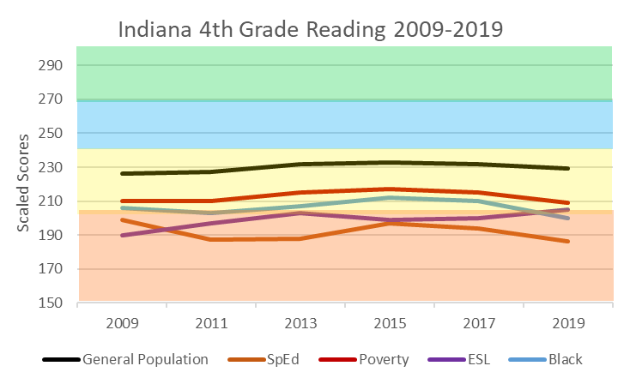
Advanced
Proficient
Basic
Below
Basic
National Assessment of Educational Performance (NAEP)
Notes:
Indiana lost significant ground last year compared with the rest of the country—8th largest state reading proficiency decrease among all states 2017 to 2019. 2015 & 2017 Indiana’s 4th grade reading averaged 40% and 41%. Below basic readers reduced to 25%-27% during those years.
Generally, the largest single department budget in a school district is Special Education/ESL. Improving those subgroups reduces SpEd numbers, which decreases the odds of dealing with OCR fines or out of court settlements for SpEd mistakes. Face it: We’re juggling hand grenades dealing with SpEd issues.
Biggest gains to be had in the low subgroups!
Look at the bottom lines! Many students qualify in several subgroups, and your subgroups are typically poor. Improve that subgroup cluster and you will cut costs…to reinvest in reading education. Biggest bang for the buck? k-3 tiers 1 & 2 instruction in the general education classroom.
Educate your school boards about reading. They need to be advocating to the public about funding needs and teacher support.

Slide 9
Cost of Prevention vs. Healing
Prevention
K-2nd in classroom $6,300 - $6,600
Remediation
2nd grader reading at grade level 1.0
Takes 1-2 years in RTI ($8,000 - $16,000)
7th grader reading at grade level 2.0
Takes 4-5 years in SpEd ($45,000 - $75,000)
*Likely to acquire functional literacy only
Notes:
80-120 hours instruction per grade level + current year
Optimal tier 1 and tier 2 instruction in the gen ed classroom. Tier 2 happens concurrently!!!
1 gen ed teacher + 1 additional teacher used in 4 classes
$5,000 teacher #1 + $1,300 teacher #2 = $6,250
An ounce of prevention here is worth more than a ton of cure because you just can’t truly catch them up they are so far behind.

Slide 10
Good News!
All can learn to read the words
Mechanical process
Many routes to comprehension
Brain plasticity
Balanced Literacy
Notes:
Kids love to read…even out loud. Just need proper support.

Slide 11
Reading is an unnatural act.
The brain is hardwired to develop language—not reading.
Notes:
Humans have been developing language skills for 60,000-200,000 years. We do it naturally when exposed to enough interactive spoken language. But reading is a recent event that is entirely synthetic. No one part of the brain has evolved to support “reading.” Instead, many parts of the brain must work together to get meaning from the written word. And that means that many things can go wrong. It also means that we need to show children how the “code” works in a systematic and orderly way rather than expecting them to figure out what took humans thousands of years to develop.

Slide 12
Language Acquisition
Baby brains
Language hardwiring
Brains slow down
Synaptic pruning
Fluid vs. crystal IQ
Time Sensitivity
Notes:
Super computer baby brains are hardwired for learning language. Listening to streams of sounds to determine words. Our brains slow down as we age, but we trade fluid intelligence for crystal intelligence. “Use it or lose it” and the language development time factor. Hearing/reading—not seeing/reading connection. Sound-symbol relationship. How much you understand of what you hear is directly related to how much you understand when you read.

Slide 13
Language Acquisition & Reading
Hearing-reading connection
Foundation for every skill
Complex process involving multiple operations.
Reading & listening are receptive skills
Writing & speaking are expressive skills
ELL reading is exponentially complex
Notes:
Inputs & outputs

Slide 15
The Simple View of Reading
Dyslexia?
Language Comprehension
Good Comp
Poor Word Rec
Good Comp
Good Word Rec
Good
Word Recognition
Poor
Good
Poor Comp
Poor Word Rec
Poor Comp
Good Word Rec
Poor
Language Impairment?

Slide 16
Neural signature on fMRI
Heritable
Unrelated to IQ
Looks like difficulty with:
sound blends
similarly sounding words
rhyming
visually similar words
spelling
multisyllabic words
Pig Latin (phoneme substitution)
D
Y
S
L
E
X
I
A
Notes:
Spelling:
May have trouble arranging letters in order
May spell words the way they sound vs. the way they look
May spell without using vowels
May spell the same word different ways on the same page
Remembering irregular words
Pronouncing multisyllabic words
Overlaps speech impairments:
Stuttering & saying letter sounds

Slide 17
Building Fluency
Vocabulary
Word
Recognition
Accuracy
Rate
Fluency
Reading
Success
Reading Volume

Slide 18
Hold the /fōn/!
phonemic awareness
ability to hear, identify, and manipulate word sounds
phonological awareness
letter-sound knowledge
necessary for phonics instruction
phonics
code we use to spell and read words
decoding
artificial
Notes:
Phonemic awareness is a BIG DEAL! They must develop phonemic awareness in order to: (1) make sound-symbol connections (2) identify beginning, medial, and final sounds (3) rhyme (4) perform sound substitutions (“cat” for “rat”). Without phonemic awareness you won’t get a fluent reader.
2nd grade is a big year because they have to finish getting their fluency skills and start focusing on reading comprehension. If they aren’t reading on grade level by the end of 2nd grade things start looking pretty grim. 3rd grade doesn’t focus on reading fluency. And after 4th grade there is very little chance of reading remediation for word level reading skills.

Slide 19
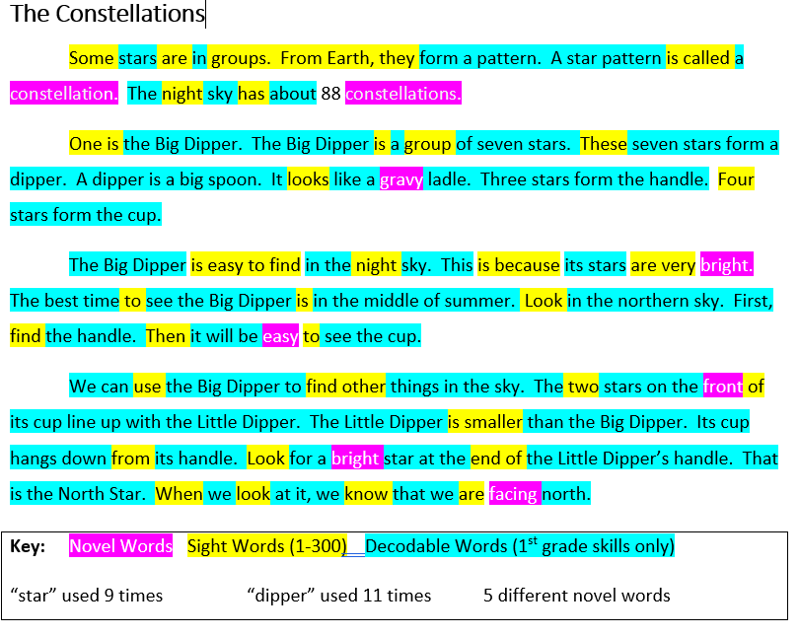
Balanced Reading Looks Like This at the end of 1st Grade
From The Six Minute Solution

Slide 20
Bridge to Skilled Reading
Language comprehension
Word Recognition
Background knowledge
Verbal reasoning
Vocabulary knowledge
Literacy knowledge
Language structures
Phonemic awareness
decoding
Spelling
Sight words
Increasingly strategic
Reading Comprehension
Increasingly automatic
Scarborough’s Reading Rope Revised.
Notes:
Skilled Reading – the fluent coordination of word reading and language comprehension processes. Scarborough’s Reading Rope Revised.
Learning-to-Read ⇒ Reading-to-Learn (Chall, 1983)

Slide 21
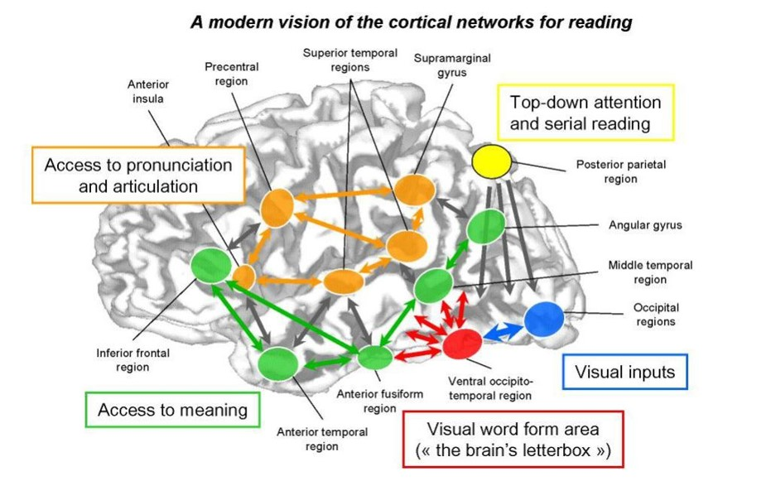
The Reading Brain
Notes:
Neurotypical brain most activity in left side with quick/direct access to frontal lobe for working memory. Dyslexia characterized by overactivation in occipital (back) region of the brain with long route to frontal lobe. Information lost along the way!

Slide 22
Why Phonics?
Reading is synthetic process
Developed over thousands of years
Balanced literacy most effective method
Fastest path to reading fluency
6 year-olds need to know the code
English does follow the rules
Notes:
Explanation of balanced literacy: phonics/decoding + sight words + reading in context
Whole language

Slide 23
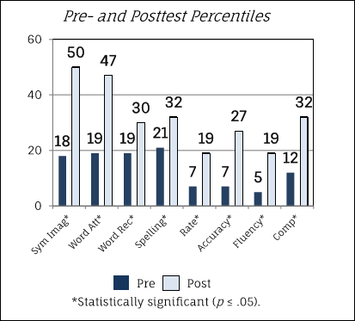
Phonics Instruction Works
Students with Reading Disability
Notes:
19 students in study. Many with multiple disability diagnoses (RD, LI, SI, Autism, ID, Other, HI)
(Avg. 86 hours).
2015-2016 school year
At this point no students would qualify for SpEd with a RD-Fluency.
At end of year 2 students either exited SpEd or requalified with RD-Comprehension.

Slide 24
In the Classroom
Small group instruction!
Teach the skill
Practice skill in isolation
RIC: Apply the skill
Cross curricular text
Deep reading , discussion, writing
Independent small groups
Learning is messy
Weekly progress monitoring
Lesson plan for year in place day 1
Notes:
Immediate skills deficit remediation
Weekly progress monitoring!
Independent practice of known skills for confidence, accuracy, & automaticity
Cross curricular text to work in social studies, science, math, character & values, health, etc.
Choose complex, rich text that is easy to sequence. Discuss inferences, plot movement, authors’ purpose, dialogue…
Tons of free materials to use!!!!!!!!!!!!

Slide 25
Why Aren’t We More Successful?
Teachers do not know what you just learned!
Elementary teacher prep = 1 reading course
Other teachers never taught to teach reading
Teacher Prep, Interventions, & The Reading Wars
Lack of explicit, ongoing professional development

Slide 26
How Do We Fix It?
Prioritize elementary reading.
Invest in order to break the cycle.
Teach teachers how to teach reading.
Teach students the code (phonics).
Educate stakeholders about reading.
Prevention vs. Remediation.
Make reading viral.
High stakes! Most important job we have!
Notes:
Invest in elementary grades tiers 1 & 2 instruction
Protected instruction time!
All reading skills for all students
Early & ongoing remediation
Scaffolded supports for all learners
School boards, admin, teachers need to know what is going on with reading.
School boards need to advocate for additional community funding & support reading focus as path to success for all children.
TONS of free reading materials available!!! Teachers do not have time to wade through
Put a workable scope & sequence in teachers’ hands and put the skills to the actual calendar!
Use social media to make reading viral!
Invest in teacher pd vs. reading intervention programs.
Look for grants and private investors

Slide 27
The Reading Brain
Joanne Coggins, Ph.D.
Intensive Integrated Reading Systems
RightingReading.com
Language Acquisition &
Reading Development

