Slide 1
The Science of Reading Language Acquisition & Reading Development
1) Neurologically, how do we create proficient readers?
2) Systemically, how do we fix our reading problem?
Joanne Coggins, Ph.D.
Intensive Integrated Reading Systems
RightingReading.com

Slide 2
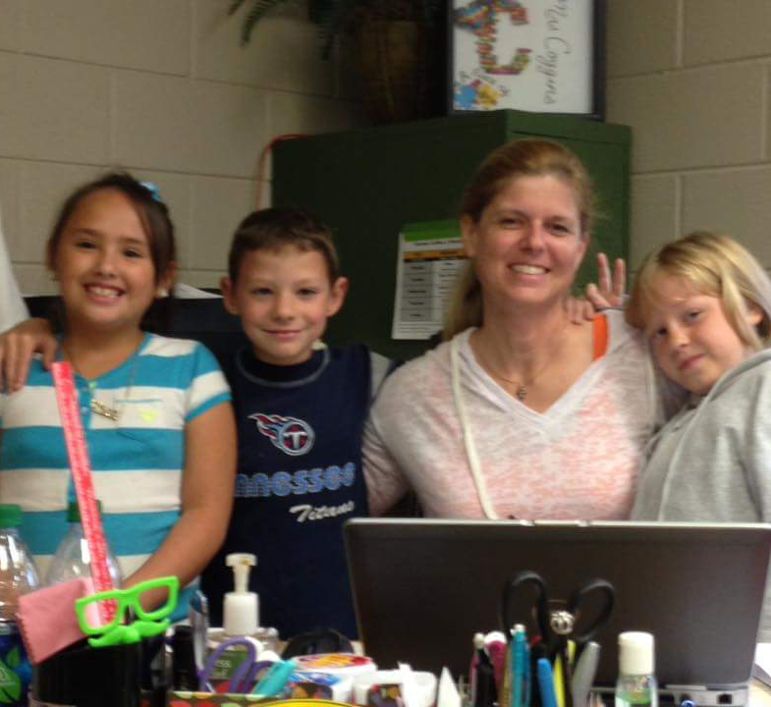
The Science of Reading…is about kids!
https://www.youtube.com/watch?v=J7nnCZ2W9h4&feature=youtu.be

Slide 3
Reading is an unnatural act.
The brain is hardwired to develop language—not reading.
Notes:
Humans have been developing language skills for 60,000-200,000 years. We do it naturally when exposed to enough interactive spoken language. But reading is a recent event that is entirely synthetic. No one part of the brain has evolved to support “reading.” Instead, many parts of the brain must work together to get meaning from the written word. And that means that many things can go wrong. It also means that we need to show children how the “code” works in a systematic and orderly way rather than expecting them to figure out what took humans thousands of years to develop.

Slide 4
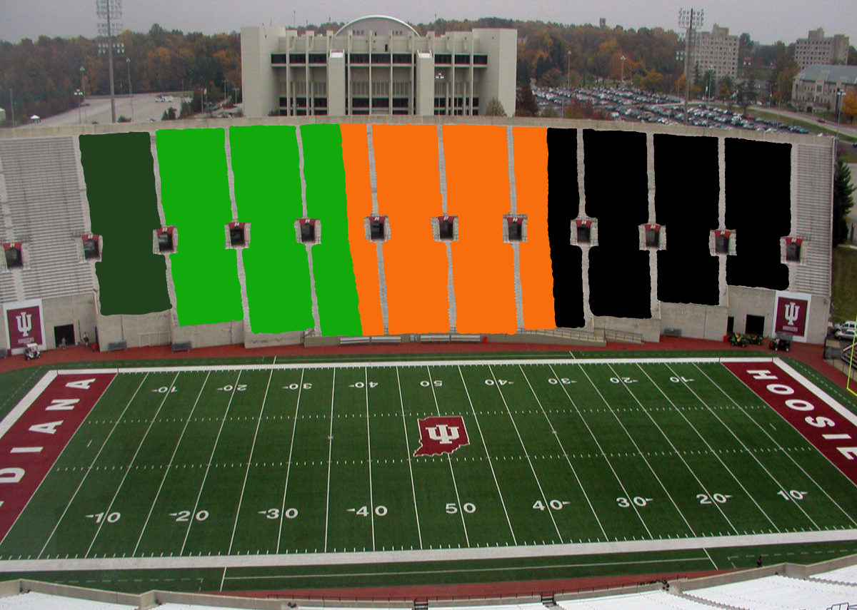
10%
27%
30%
33%
The Big Game
Notes:
Dark green = 10% advanced readers
Bright green = 27% proficient readers
Neon orange = 30% basic readers
Black = 33% non-readers
The sample 4th grade reading passage is truly a 3rd grade passage based on vocabulary and text complexity. Proficient readers are able to: recognize reasons related to plot, evaluate story characters & support opinion, interpret dialogue & story action,

Slide 5
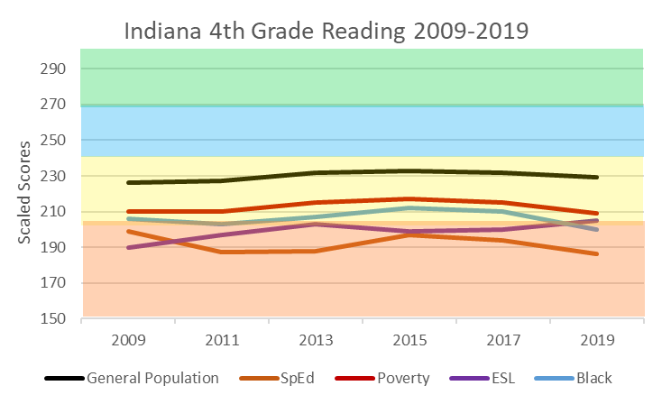
Advanced
Proficient
Basic
Below
Basic
National Assessment of Educational Performance (NAEP)
Notes:
Indiana lost significant ground last year compared with the rest of the country—8th largest state reading proficiency decrease among all states 2017 to 2019. 2015 & 2017 Indiana’s 4th grade reading averaged 40% and 41%. Below basic readers reduced to 25%-27% during those years.
Generally, the largest single department budget in a school district is Special Education/ESL. Improving those subgroups reduces SpEd numbers, which decreases the odds of dealing with OCR fines or out of court settlements for SpEd mistakes. Face it: We’re juggling hand grenades dealing with SpEd issues.
Biggest gains to be had in the low subgroups!
Look at the bottom lines! Many students qualify in several subgroups, and your subgroups are typically poor. Improve that subgroup cluster and you will cut costs…to reinvest in reading education. Biggest bang for the buck? k-3 tiers 1 & 2 instruction in the general education classroom.
Educate your school boards about reading. They need to be advocating to the public about funding needs and teacher support.

Slide 6
Good News!
All can learn to read the words
Mechanical process
Many routes to comprehension
Brain plasticity
Structured Literacy
Notes:
Kids love to read…even out loud. Just need proper support.

Slide 7
Language Acquisition
Baby brains
Language hardwiring
Brains slow down
Synaptic pruning
Fluid vs. crystal IQ
Time Sensitivity
Notes:
Super computer baby brains are hardwired for learning language. Listening to streams of sounds to determine words. Our brains slow down as we age, but we trade fluid intelligence for crystal intelligence. “Use it or lose it” and the language development time factor. Hearing/reading—not seeing/reading connection. Sound-symbol relationship. How much you understand of what you hear is directly related to how much you understand when you read.

Slide 8
Reading & Language Acquisition
Hearing-reading connection
Foundation for every skill
80% of all LD is RD
Reading & listening are receptive skills
Writing & speaking are expressive skills
ELL reading is exponentially complex
Complex process involving multiple operations.
Notes:
Inputs & outputs

Slide 10
The Simple View of Reading
Dyslexia?
Language Comprehension
Good Comp
Poor Word Rec
Good Comp
Good Word Rec
Good
Word Recognition
Poor
Good
Poor Comp
Poor Word Rec
Poor Comp
Good Word Rec
Poor
Language Impairment?

Slide 11
Neural signature on fMRI
Heritable
Unrelated to IQ
Looks like difficulty with:
sound blends
similarly sounding words
rhyming
visually similar words
spelling
multisyllabic words
Pig Latin (phoneme substitution)
Spectrum of disability
All with word level RD are dyslexic + others with less severe deficits
D
Y
S
L
E
X
I
A
Notes:
Spelling:
May have trouble arranging letters in order
May spell words the way they sound vs. the way they look
May spell without using vowels
May spell the same word different ways on the same page
Remembering irregular words
Pronouncing multisyllabic words
Overlaps speech impairments:
Stuttering & saying letter sounds

Slide 12
Building Fluency
Vocabulary
Word
Recognition
Accuracy
Rate
Fluency
Reading
Success
Reading Volume

Slide 13
Hold the /fōn/!
phonemic awareness
ability to hear, identify, and manipulate word sounds
phonological awareness
letter-sound knowledge
necessary for phonics instruction
phonics
code we use to spell and read words
decoding
artificial
Notes:
Phonemic awareness is a BIG DEAL! They must develop phonemic awareness in order to: (1) make sound-symbol connections (2) identify beginning, medial, and final sounds (3) rhyme (4) perform sound substitutions (“cat” for “rat”). Without phonemic awareness you won’t get a fluent reader.
2nd grade is a big year because they have to finish getting their fluency skills and start focusing on reading comprehension. If they aren’t reading on grade level by the end of 2nd grade things start looking pretty grim. 3rd grade doesn’t focus on reading fluency. And after 4th grade there is very little chance of reading remediation for word level reading skills.

Slide 14
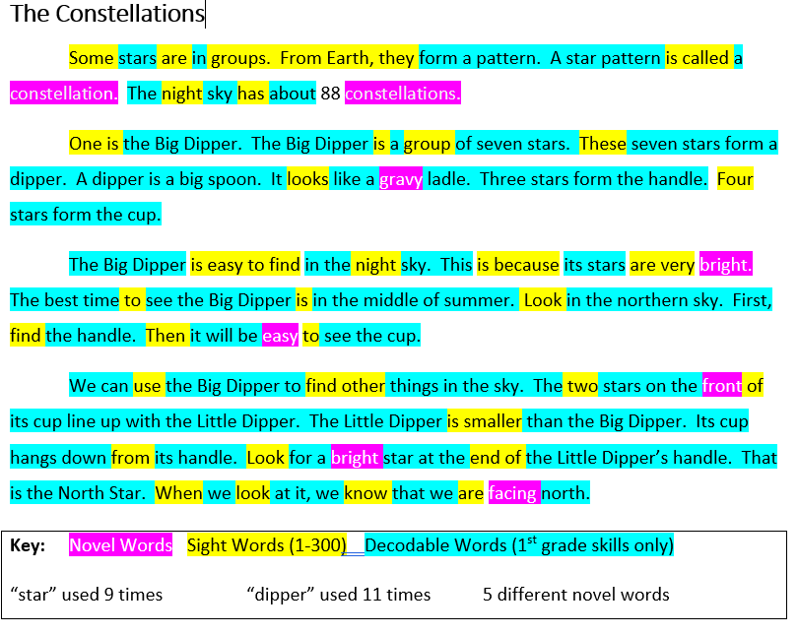
Balanced Reading Looks Like This at the end of 1st Grade
From The Six Minute Solution

Slide 15
Bridge to Skilled Reading
Language comprehension
Word Recognition
Background knowledge
Verbal reasoning
Vocabulary knowledge
Literacy knowledge
Language structures
Phonemic awareness
decoding
Spelling
Sight words
Increasingly strategic
Reading Comprehension
Increasingly automatic
Scarborough’s Reading Rope Revised.
Notes:
Skilled Reading – the fluent coordination of word reading and language comprehension processes. Scarborough’s Reading Rope Revised.
Learning-to-Read ⇒ Reading-to-Learn (Chall, 1983)

Slide 16
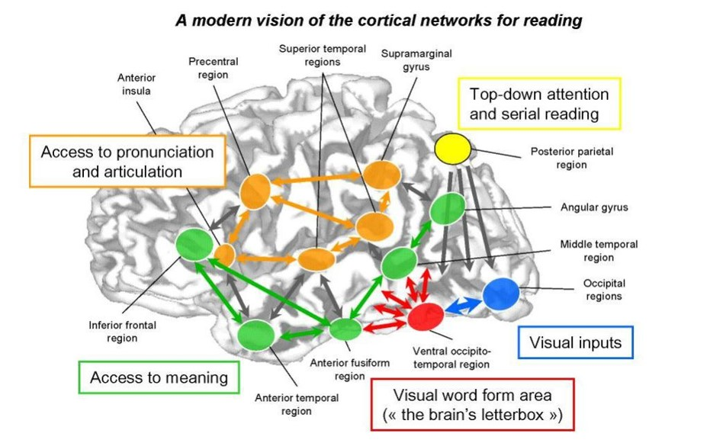
The Reading Brain
Notes:
Neurotypical brain most activity in left side with quick/direct access to frontal lobe for working memory. Dyslexia characterized by overactivation in occipital (back) region of the brain with long route to frontal lobe. Information lost along the way!

Slide 17
Reading Problems Addressed by Readable English
All Foundational Reading Skills
(phonological awareness, phonics, fluency, vocabulary, comprehension)
Poor sound-symbol recognition
Effortful decoding
Poor word recognition
Low volume of Words Read
Dysfluency (Fluency= Rate + Accuracy)
Limited vocabulary knowledge (MA)

Slide 18
How Do We Fix It?
Prioritize & scaffold reading!
Invest in order to break the cycle.
Teach teachers how to teach reading.
Teach students the code
Educate stakeholders about reading.
Prevention vs. Remediation.
Make reading viral.
High stakes! Most important job we have!
Notes:
Invest in elementary grades tiers 1 & 2 instruction
Protected instruction time!
All reading skills for all students
Early & ongoing remediation
Scaffolded supports for all learners
School boards, admin, teachers need to know what is going on with reading.
School boards need to advocate for additional community funding & support reading focus as path to success for all children.
TONS of free reading materials available!!! Teachers do not have time to wade through
Put a workable scope & sequence in teachers’ hands and put the skills to the actual calendar!
Use social media to make reading viral!
Invest in teacher pd vs. reading intervention programs.
Look for grants and private investors

