Slide 1
Welcome to the 2023 HOSA Spring Leadership Conference Registration Training

Slide 2
Registration Packets
I CANNOT SAY THIS ENOUGH, the registration packets we send out are the most important thing you will receive for the conference. This packet will contain all the forms you need, every deadline date, information about competitive events, hotel information and forms, courtesy corp and intern information, state and national service projects, scholarship forms etc. Most of the questions I receive through email can be answered with these packets. They will be emailed out some time in December from either Elizabeth or I. If your question cannot be answered in the packet, please email me! I would rather have a hundred questions beforehand than problems after.

Slide 3
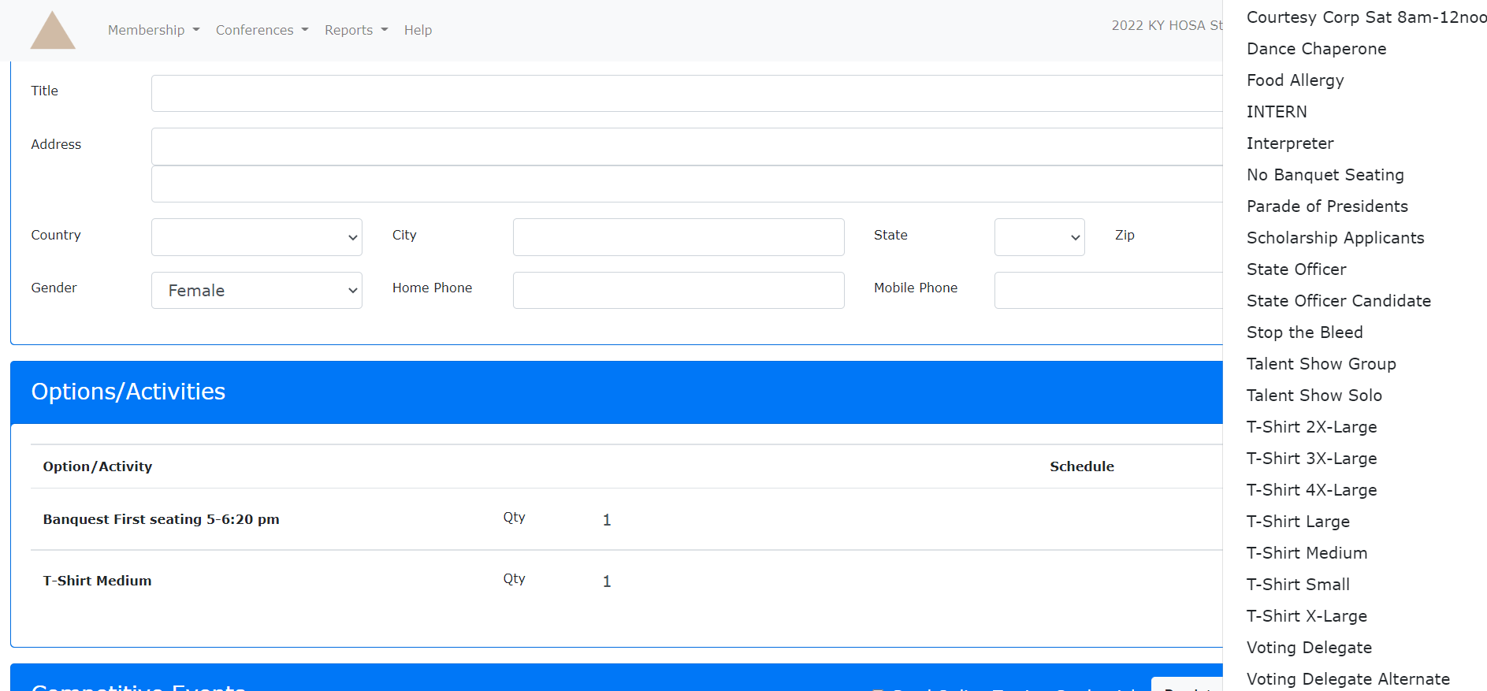
Online Registration
Make sure to check ALL options that apply to the student/advisor. Make sure to check the number of years you have been an advisor so we can get you service pins on your milestone years. Also make sure to check the correct t-shirt size for everyone. We order just enough shirts based on the online registration report so you will not be allowed to exchange sizes at the conference. Click the dropdown box under Options/Activities to select your options.

Slide 4
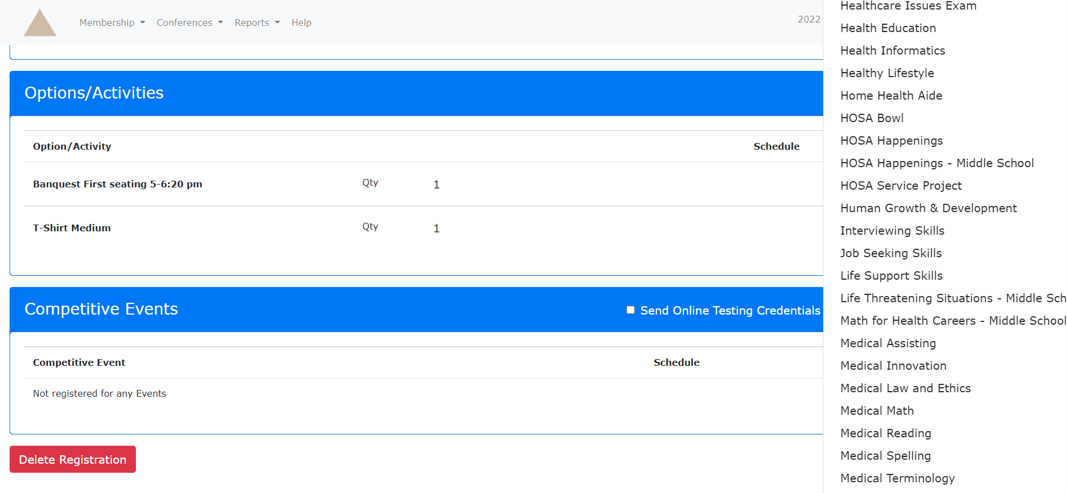
Students may only register for 1 event! Make sure they are positive on the event they want to participate in. Click the dropdown box under Competitive Events to select their event. Make sure you hit save once all options and events have been added.

Slide 5
Proctors
Make sure that your proctor information in the system is correct. Do not wait until the last minute to tell us that your proctor has not received the needed information to test the students. We encourage you to enter your proctor information when you register your students to assure that they receive the email with their login information when it is time to test.
You can’t proctor your own students. Please get another staff member in the school to act as your proctor.

Slide 6
The following is the paperwork that must be uploaded by the deadline date. Medical release, code of conduct and a copy of insurance is required for every person attending the conference (students, advisors, guests etc) please make sure to start filling these out early. There are issues with snow every year so please plan ahead so your paperwork is not late. Late paperwork or missing paperwork will result in late fees.

Slide 7
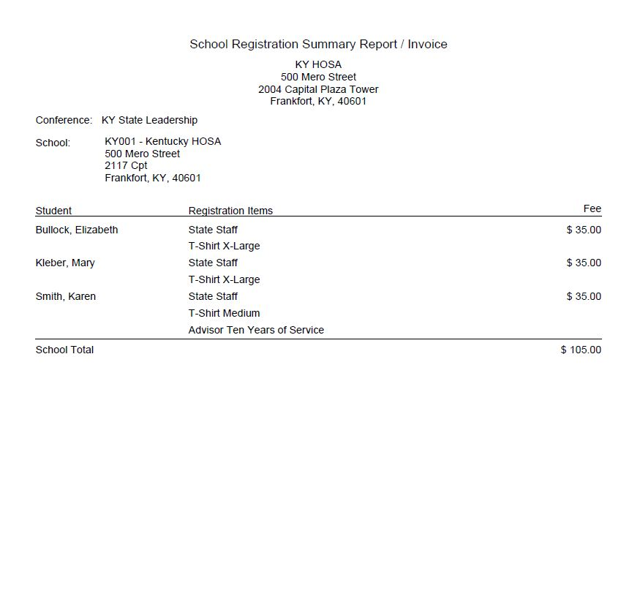
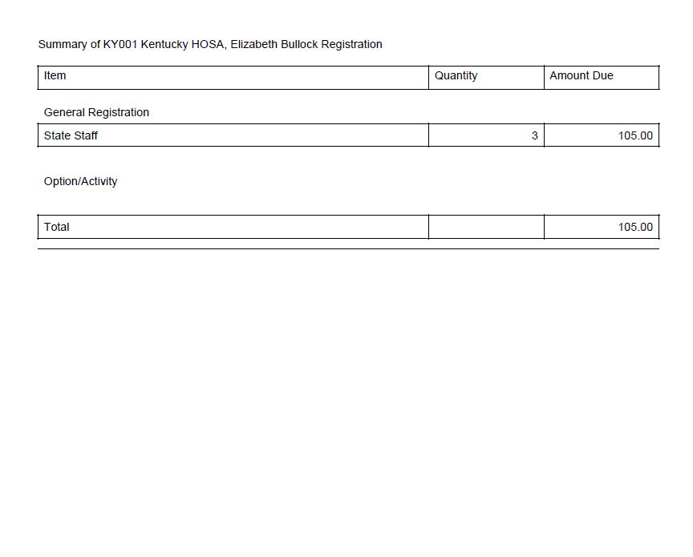
Registration Invoice
Please include a copy of the registration invoice. We need a full copy, the back page is very important during our registration process.

Slide 8
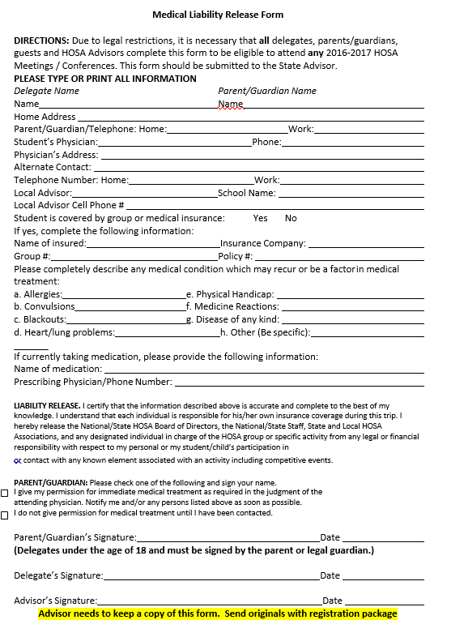
Medical Release Form
This is probably the most important form that we ask you to fill out. It tells us everything we need to know in case of an emergency. It has contact information, medical history/allergies, medications. This form allows us to pass along vital information in time of emergency. We ask that everyone makes sure that ALL parts of this form are filled out completely.
Make sure that the advisor information is filled out on every students. My advise would be to fill it in on one and then make copies.
Make sure you check this box or I will return the form to you. Also, if the student is 18, please write that in the parent/guardian signature line so I am not emailing and asking.
If there are no allergies or medical conditions, please write n/a instead of leaving it blank.

Slide 9
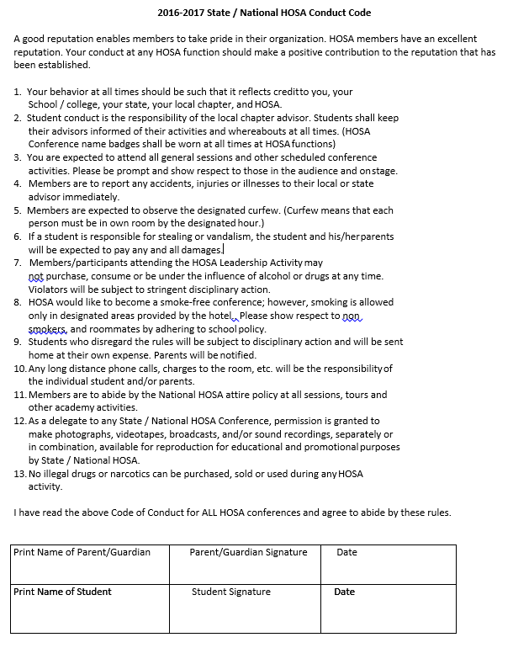
Code of Conduct
This paper is important because we expect all students, advisors and guests who attend the HOSA conference to follow these rules. You are representing our organization while you are attending the conference and we want HOSA to be represented in a positive manner.

Slide 10
We need a copy of the front and back of the insurance cards. If someone does not have insurance, you may get something on school letterhead stating they are covered under school insurance or a letter from the guardians stating that they take full responsibility for the child while they attend the HOSA conference.
HOSA
Student, Advisor or Guest

Slide 11
Deleted Registration/Subs
*You are able to delete registered guest out of the system up until the final day of online registration without having to pay for their registration.
*Once registration closes, you are responsible for paying the registration fee for anyone registered for conference regardless of it they come or not.
*If a person can’t attend conference, you may replace them with an alternate student. You will need to email this information to
kyhosa@education.ky.gov . You will also need to upload their forms to Wufoo.

Slide 12
Payment
*Payment is due by the deadline date as well. If we receive late payment, you will be charged the late fee.
*Please double check that you are paying the correct amount owed to us. You will find this amount on the last page of your “School Registration Summary Report/Invoice”
*You may pay online through Wufoo or mail a check. Make checks out to KY HOSA
*A receipt will only be given for whoever issued a check for payment.
*ATC advisors will not need to send in money for their registration. Once the online system has closes, I will email you a surveymonkey link. You will need to pass that along to your secretary and they will submit the template ID funding source where they want your registration pulled from, I will complete a DPR and KDE will pull the funds directly from your account. Again, this if for ATC advisors ONLY.

Slide 13
Late Fees!
If we do not receive your HOSA uploads with all the information needed by the deadline date, you will be charged a late fee. The first week late will be $25, the second week late will be $50. Sending in partial upload to make deadline will not get you out of paying the fee. If by the end of the second week we do not receive all your paperwork, you will not be allowed to attend the conference.
Please note that late fees are issued for multiple reasons. If the upload is received on time, but is incomplete (meaning ALL paperwork is in there), a late fee will be added. If the packet is not received by the deadline, a late fee will be added. If money is missing, a late fee will be added.

Slide 14
Banquet Seating
The banquet is first come, first serve. There should not be any holding seats for other schools or students. When you are registering online, there will be two options, banquet A and banquet B. The times will be listed beside them. Please check your preferred option for all attendees. We will try our hardest to give you the banquet you request, but it will be based on numbers and we have the final decision. There will be a form in your packet that shows which schools are going to each banquet.

Slide 15
Do
*Double check all the information on your online registration before the deadline. This means making sure names are spelled correctly, t-shirt sizes are accurate, and the students are competing in the right event. Also double check the spelling of the names. We generate an export to create name badges and some certificates so if it is wrong in the system, it will be wrong on those as well.
*Make sure to upload a copy of the online “Registration Summary Report/Invoice” with your paperwork.
*Make sure each attendee has a medical release form, code of conduct form and a copy of insurance.
*Make sure you packet is uploaded with all needed paperwork by the assigned deadline.
*Put all paperwork in order before uploading it to Wufoo. Put the forms in alphabetical order. This eliminates a lot of time trying to organize your papers for easy access.

Slide 16
Do
*Make sure you are registered as the correct status in the system. If you are an advisor, please mark advisor or the system counts you as a student.
*Make sure you are aware of your dates. Know when online registration ends, online testing begins and when to have your packets into central office by.
*Make sure you log advisor years of service, presidents parade members etc., into the online system or they may not be recognized.
*Remember to pay your HOSA dues on time and to National HOSA, not KY HOSA.
*Remember to link your teams in the system. All members of a team should have the same team number. If they are different or have ?’s, please let me know so I can help you fix it.
*Remember that even if you have an officer, or someone running for office, I still need a copy of their paperwork uploaded with the other students.

Slide 17
Do
*Read your packet before emailing in questions. Most answers are right there in the packet for you.
*Read your HOSA High Five EVERY Monday.
*Attend the posted office hours to ask questions or express concerns. We are there to help you with anything you need.

Slide 18
Do Not
*Do not fax or scan/email paperwork to me. The information on the forms you fill out for the students have sensitive information and KDE policy states it cannot be faxed or emailed.
*Do not wait until the last minute to register, put in a proctor, upload paperwork or test.
*Do not ask for extensions for testing, we will not extend those dates.

