Slide 1
Apparent Fundraiser

Slide 2

Fundraising on a Mission…
Haitian handmade products make raising funds easy and exciting for you!
Support Haitian moms & dads while raising money for your cause!

Slide 3
Fundraiser…
……….ZEro Risk!!
There is no risk and there are no upfront costs!
Apparent Project will receive & confirm your order, then send it to you. (When you have completed your fundraiser, you simply pay for items sold & then pay shipping & send any unsold items back.)

Slide 4
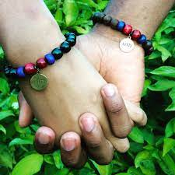
APparent Project Fundraiser
Papillon is partnered with Apparent Project to provide work opportunities for the beautiful people of Haiti.
Raises awareness of International Health & Education Concerns
Supports HOSA students while allowing for parents to work in Haiti, therefore providing for the health and wellness & educational opportunities for children.
Apparent Project
https://apparentproject.org/fund-raisers/

Slide 5
Who? YOUR HOSA partnering with ApParent Project
What? You receive a box of HANDMADE bracelets & ornaments to sell (suggested price - $12.00 each….you keep $6.00 & return $6.00 to ApParent)
When? Great fundraiser for Holiday presents!! Students love the mission of these items and proudly wear these bracelets!
Where? Set up at your local grocery, church, festival, or send with students to sell to family and friends
How? Order your box of items….sell all you can & return the rest!! NO upfront COST…. You pay AFTER you receive your box & sell your items!!
It REALLY is that Easy!!!

Slide 6
I encourage you to show the attached video before beginning to your students… showing items being made by the beautiful artisans in Haiti.
What an amazing way to help locally and internationally!
HOSA - Future Health Professionals - making a Difference locally & around the world!

Slide 7
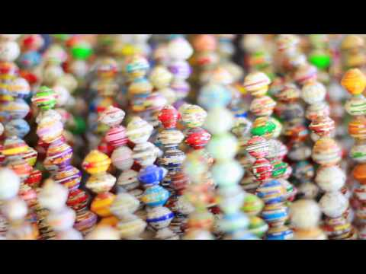

You make beautiful Things - Papillon
https://youtu.be/UTHS6WCqq58

Slide 8
Questions?
Karen Compton - RN
HOSA Advisor
Ec3 - Hardin County Schools
karen.compton@hardin.kyschools.us

