Slide 1
North Bend’s “Water Situation”

Slide 2
Welcome and Introductions

Slide 3
The Majority of the Community is with Us
NextDoor Poll Results: 92% of 505 Responders agreed North Bend should:
Provide Underlying and Vetted Supply/Demand Data “The Golder Report” is a year overdue
Have a New Water System Plan (the old one expired over 2 years ago) AND
Implements a Viable Mitigation Plan to Protect the Snoqualmie River
North Bend Should Implement a Building Moratorium
The City Ignored Us

Slide 4
Where We Started and Where We are Going
Initial Micro Focus (The Mule Pasture - A Park?)*
“TIPPING POINT” Sallal only had half the needed water certificates
Macro Focus - Impact of Overdevelopment on Water Availability for Residents and River Health
ACTION - Based on Poll Results – Develop and Deliver DEMAND LETTER
Stop issuing water certificates WITHOUT:
Peer and Community Reviewed Supply/Demand Report (Golder Report is over a year overdue)
Water System Plan (WSP)
Mitigation Plan (decade overdue)
*UPDATE: Mule Pasture can’t be developed without a number of lengthy steps outlined in Hearing Examiner, UTRC and DOH Correspondences
Notes:
And no WSP or Mitigation Plans BEFORE GOLDER REPORT

Slide 5
HERE ARE THE FACTS THAT CONCERN US

Slide 6
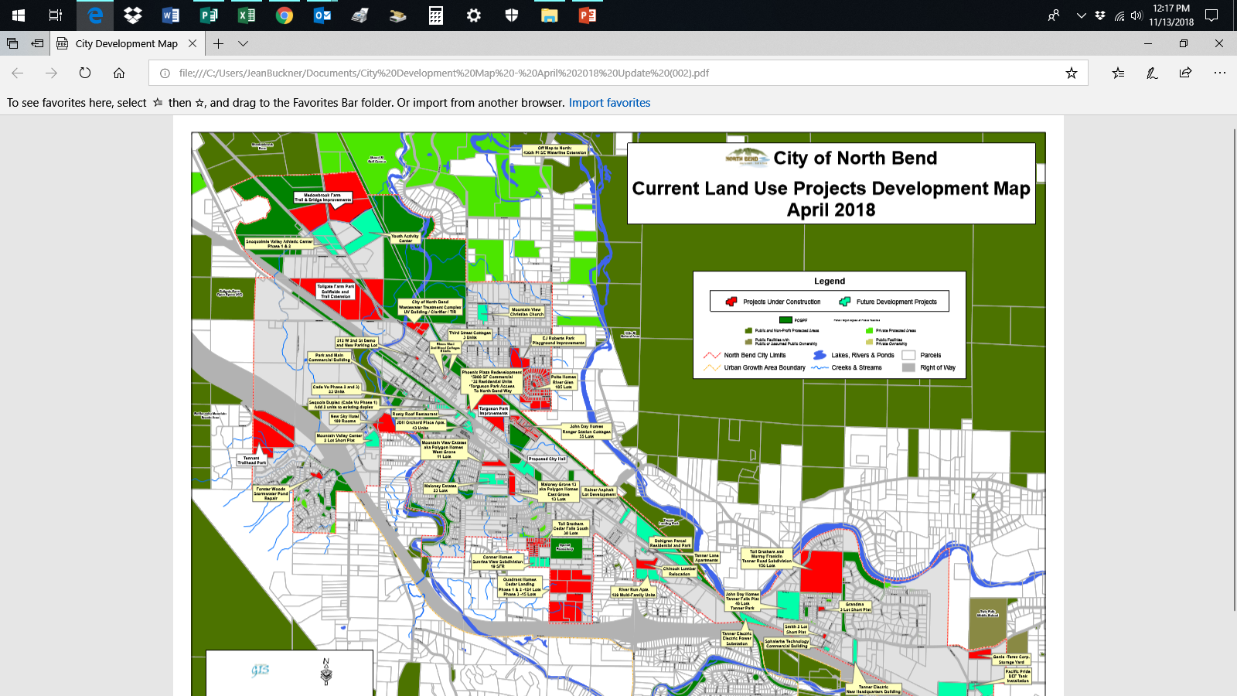
MICRO AND MACRO FOCUSES Cont…

Slide 7
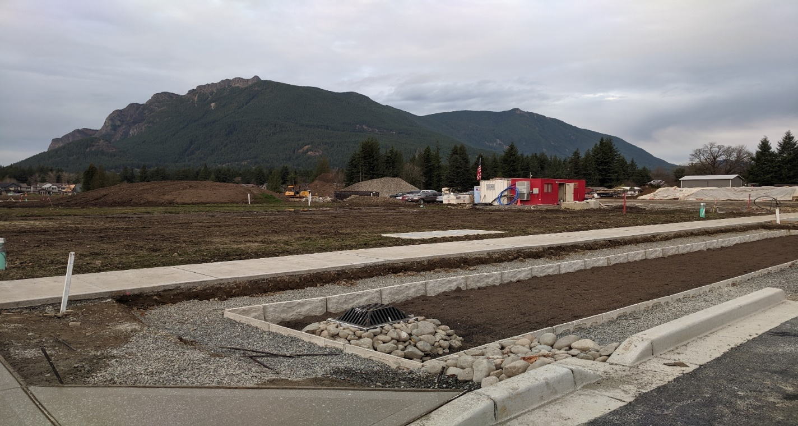
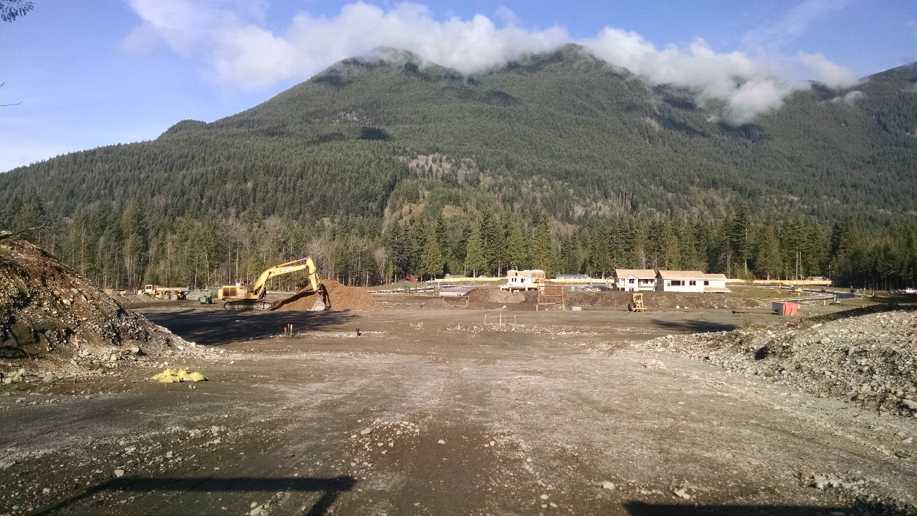
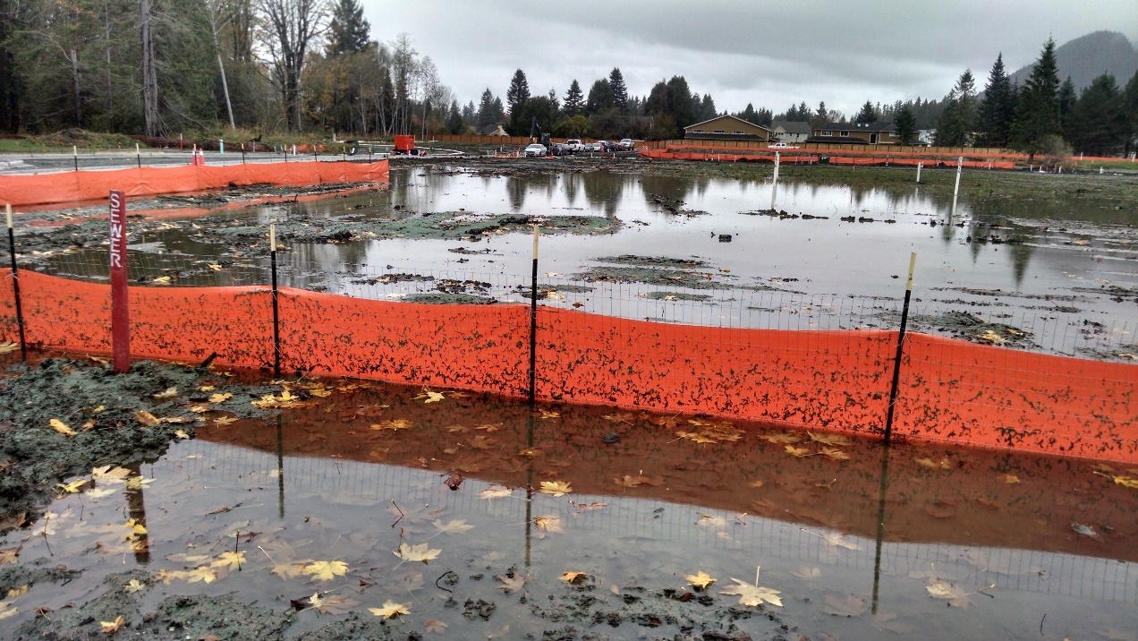

Slide 8
Where We Want to Go – Our Goal
A Thriving Livable Community, With Open Spaces and a Rural/ Outdoor Destination Character and Robust Infrastructure (Very Similar to North Bend’s Mission and Brand Statement)
East Side of City -- Currently Has No City Parks
This Vision Requires Plentiful Water for both CURRENT Residents AND The Snoqualmie River
Notes:
WHICH SHARES THE VERBIAGE HIGHLIGHTED IN TEAL
North Bend’s Mission/Brand Statement:
CITY MISSION STATEMENT
The mission of the City of North Bend is to create a highly livable community by working in partnership with its citizens to blend and balance the following principles: high levels of police, fire, and emergency medical services; healthy infrastructure; quality public services; all to support a strong local economy and the rural character of the community.
CITY BRAND STATEMENT
We are the small town that is creating the premiere outdoor adventure destination in the Puget Sound region.

Slide 9
Goal Cont…
.
We Want to See Development That:
Supports North Bend’s Vision and Brand Statements
Fits within REAL Constraints of our Resources – Including Water
Provides for a Healthy and Thriving Community AND a Healthy and Thriving River

Slide 10
The Problem
North Bend is on track to double its 2031 Growth Management Target - likely a decade early!
Development is occurring at Breakneck Speed:
WITHOUT Current Supply/Demand Data (a year overdue)
WITHOUT a full plan to protect the Snoqualmie River and (10 years overdue)
WITHOUT a current Water System Plan required by state law (2-5 years overdue)

Slide 11
The Problem Cont …
The City is Ignoring Citizens who believe these Washington State Requirements should be met BEFORE growth is Allowed to Continue

Slide 12
Our Solution
Engaged Highly Respected Water Rights Attorney Tom McDonald TO TURN UP THE VOLUME
Tom will Integrate:
research we’ve performed over the past 2 years
His legal understanding of water law
And deliver our demands to the City and State Enforcement Agencies
The “Demand Letter” will forcefully outline our position and call for a suspension of issuing water certificates until the requirements outlined above are met

Slide 13
Our Solution Cont …
The “Demand Letter” will forcefully outline why the City must suspend issuing water certificates until State Requirements are Met

Slide 14
Status of Contract
Underlying basis is flawed:
Sallal Wells should not be used as mitigation because they are ALSO in the Snoqualmie Basin – (See Appendix for support documentation) “Begging from Peter to Pay Peter”
City should not take on the demand of delivering water to a NEW customer without a current WSP

Slide 15
Requesting More Transparency by NB and Sallal Re Proposed Contract
No Meeting Notes available from PRRs
Not discussed as scheduled at CC Work Study 11/29/2019
The following should be complete before a contract is considered:
Supply/Demand Data (Golder Report)
Fully Vetted and Approved WSPs (both North Bend and Sallal)
Sallal Member Meetings
Then Consider a Possible Contract

Slide 16
The “Big Picture” Legal Landscape Where Citizens Prevailed
Foster v. The City of Yelm/DOE
Sara Foster Lost all Appeals Before Winning in The Washington Supreme Court
See Sara’s letter to Friends in Attachments Section Below
Other Relevant Cases where Citizens Prevailed:
Postema v. Pollution Control Board and
JZ Knight v. The City of Yelm/DOE
Other Cases

Slide 17
Friends Financials

Slide 18
Funding for Legal Support
GOAL - $8000 for DEMAND LETTER
Current Grants and Donations:
NW Fund for the Environment Grant of $3,000
GoFundMe = 765 in one week
Need Additional $4235 to Reach our Goal

Slide 19
Stay up to Date:
We regularly Update Current Status on:
Facebook: The Friends of The Snoqualmie Valley Trail and River
Website: http://fosvtr.org/
GoFundMe: https://www.gofundme.com/Friends-of-The-Snoqualmie-Valley-Trail-and-River

Slide 20
Q and A

Slide 21
Attachments:

Slide 22
Excerpts from Sara Foster Letter to Friends
I am Sara Foster and took a situation similar to the one that appears to be brewing in North Bend all the way to the Washington State Supreme Court. I won.
Like North Bend, Yelm was in the midst of a dramatic increase in residential development. We had already doubled our population in 10 years. City leaders wanted to continue this “growth” despite citizens voicing concerns about limited water resources.
Like many folks in North Bend, many of us were concerned that our wells and area Creeks and Rivers would be negatively impacted by what appeared to be an insatiable appetite for more “growth” which also meant a greater demand for water. We were concerned that the demand for more water for new development would end up drawing down our wells and rivers to dangerously low levels.
Regardless, the City moved forward with their plans to secure more water for development and provided “mitigation plans” to address our concerns. We argued that these plans didn’t mitigate anything – that they would do nothing to replace water taken from our wells and Rivers … It appears that in both situations the cities and DOE were working together to clear the way for increased development at the expense of the Rivers and existing residents with senior water rights.
In our case, we believed the logic and legal arguments presented by the Department of Ecology and The City of Yelm were simply in error. We appealed DOE’s decision all the way to the Washington State Supreme Court in the Case FOSTER v. WASHINGTON STATE DEPARTMENT OF ECOLOGY/CITY OF YELM WASHINGTON. And, we won. Our wells and Rivers would be protected. (See: https://caselaw.findlaw.com/wa-supreme-court/1715367.html)
This would be a nice clean place to end my story. But the story did not end there. During the final hours of budget negotiations in Olympia, in the wee hours of January 18th, 2018, interested parties were able to push legislation through, which essentially reversed our Supreme Court win – at least for Yelm and other Eastern Washington cities and at least for now. So, the story continues.

Slide 23
Sources of Placement of Sallal Wells in Snoqualmie River Watershed
Sallal Well Water Right and 2007 ROE (Report of Examination) “…Wells 1 and 2 located in the Snoqualmie River Watershed” (see top of page 19)
DOE Staff Notes
September 24th, 2018 email written by the former General Manager and approved by Sallal’s attorney shows that wells are in Snoqualmie Watershed and also that the water rights are “Junior to the Snoqualmie”
Statement by current Sallal General Manager at a Member Advisory Meeting on 10/8/2019 that Wells are in The Snoqualmie Watershed
Data Basin – Independent University Affiliated GIS mapping organization placed wells in Snoqualmie basin
Birds eye view from Rattlesnake Ridge heavily suggests wells are in the Snoqualmie Watershed
April 20, 2006 DOE Email (below)

Slide 24
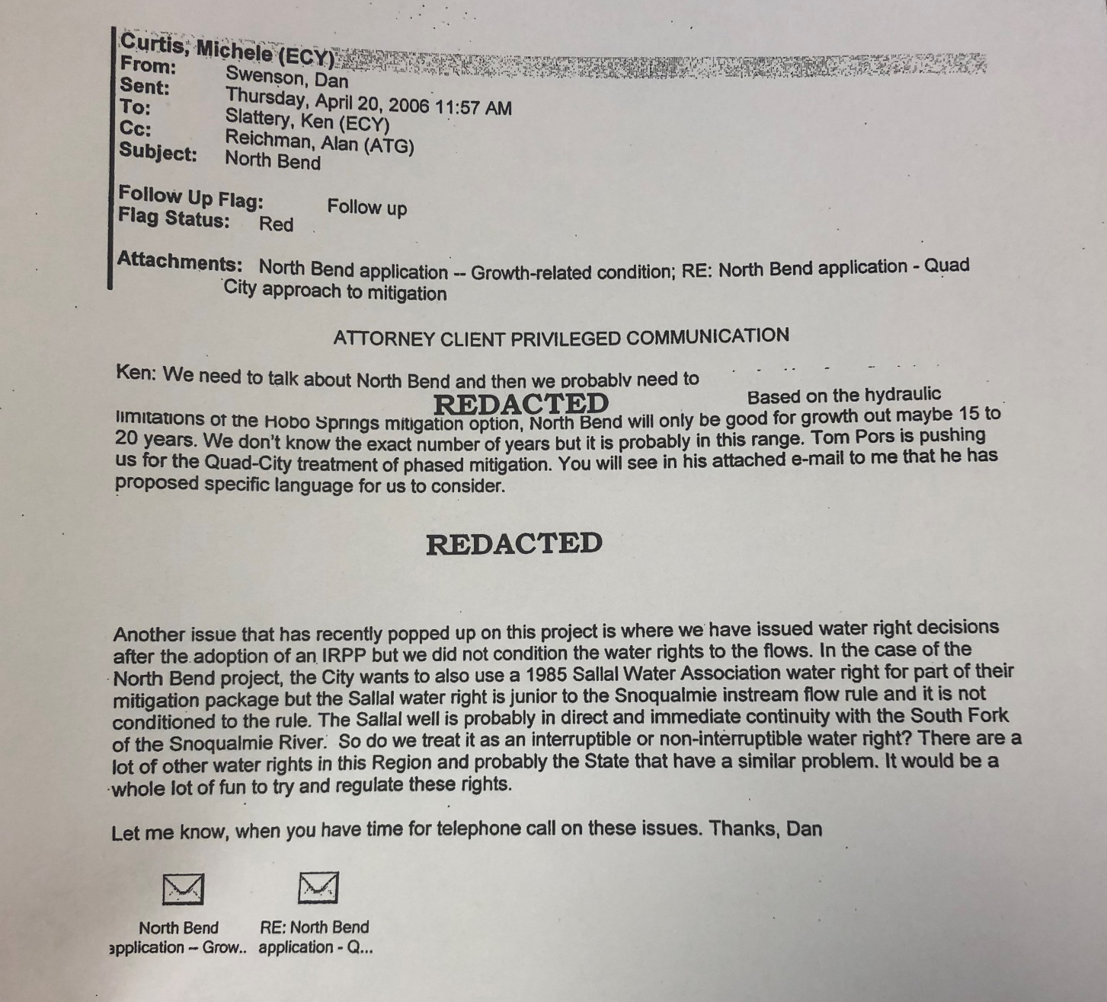

Slide 25
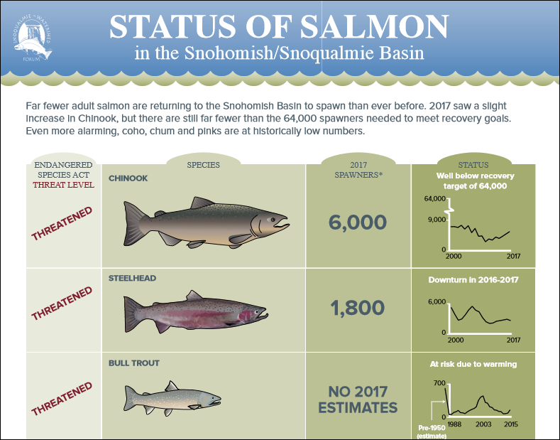
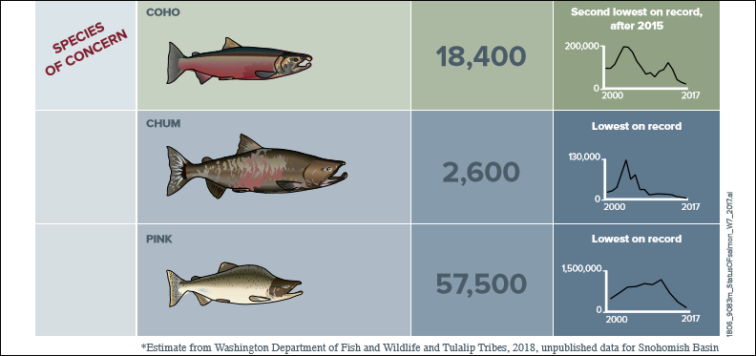

Slide 26
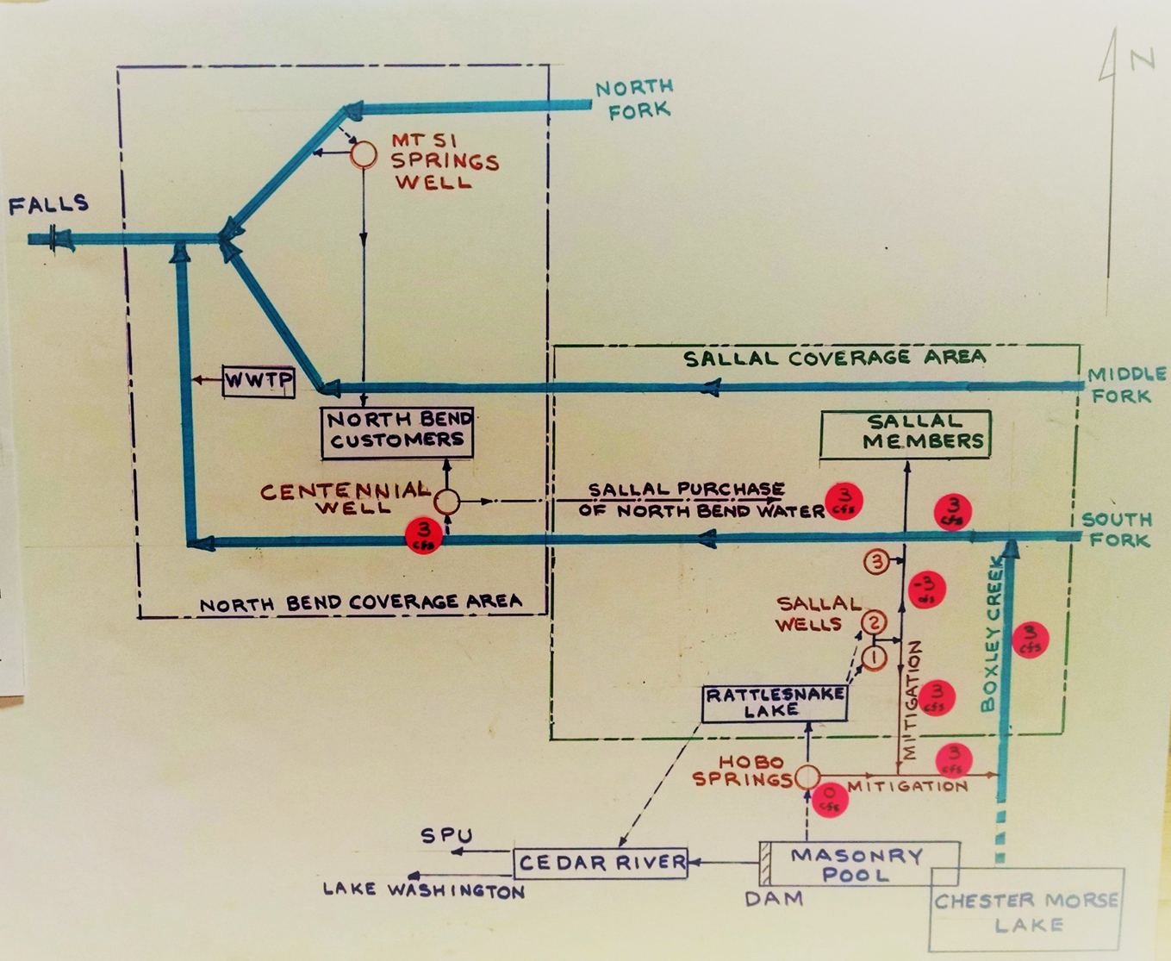
Schematic of Current/Proposed Water Situation

