Slide 1
S.A.V.E. Training
VA Office of Mental Health and Suicide Prevention (OMHSP)
Leslie Franklin, LCSW
Suicide Prevention Team
Oklahoma City VA HealthCare System

Slide 2
OKC VA HCS Suicide Prevention Team
Selonda Moseley, LCSW Leslie Franklin, LCSW
Mental Health Crisis Supervisor Community Engagement & Partnerships Coordinator
Alisha Fry, LCSW VACANT
Suicide Prevention Coordinator Community Engagement & Partnerships Coordinator
Charvee Cotrone, LPC Ilene Harrington, LCSW
Suicide Prevention Clinician VMET Social Worker
Mary Fortson-Harwell, LCSW
Suicide Prevention Clinician
Brettina Adams, LCSW
Suicide Prevention Clinician
Katie Becht Dougherty, LCSW
Suicide Prevention Clinician
VACANT
Suicide Prevention Clinician

Slide 3
Facts About Veteran Suicide

Slide 4
Suicide is a National Public Health Issue
Suicide is a national issue, affecting both the Veteran and general population.
Coronavirus Disease 2019 (COVID-19) pandemic has also placed additional strain on our Nation and on individuals and communities.
Suicide is a complex issue, with no single cause.
Suicide is often the result of a complex interaction of risk and protective factors at the individual, community, and societal levels.
Notes:
Suicide is a national issue, with rising rates of suicide in the general population. In addition, suicide rates are higher, and are rising faster, among Veterans than among non-Veteran adults.
Societal factors, such as economic disparities, race/ethnicity/LGBT disparities, homelessness, social connection and isolation, and health and well-being, play additional roles in suicide.
Coronavirus Disease 2019 (COVID-19) pandemic has also placed additional strain on our Nation and on individuals and communities
Our nation grieves with each suicide, necessarily prompting the collective tireless pursuit of evidence-based clinical interventions and community prevention strategies, critical to the implementation of VA’s National Strategy for Preventing Veteran Suicide.
Cerel, J., Brown, MM., Maple, M., Singleton, M., van de Venne, J, Moore, M., & Flaherty, C., How many people are exposed to suicide? Not six. Suicide and Life-Threatening Behavior, (2018) https://doi.org/10.1111/sltb.12450
Turecki, G., Brent, D.A. (2016) Suicide and suicidal behavior. Lancet. 387:12271,227–39.
Zalsman G., Hawton, K., Wasserman, D., van Heeringen, K., Arensman, E., Sarchiapone, M., … Zohar, J. (2016) Suicide prevention strategies revisited: 10-year systematic review. Lancet. 3:646–59.
Department of Veterans Affairs (2018). National Strategy for Preventing Veteran Suicide. Washington, DC. Available at https://www.mentalhealth.va.gov/suicide_prevention/docs/Office-of-Mental-Health-and-Suicide-Prevention-National-Strategy-for-Preventing-Veterans-Suicide.pdf.

Slide 5
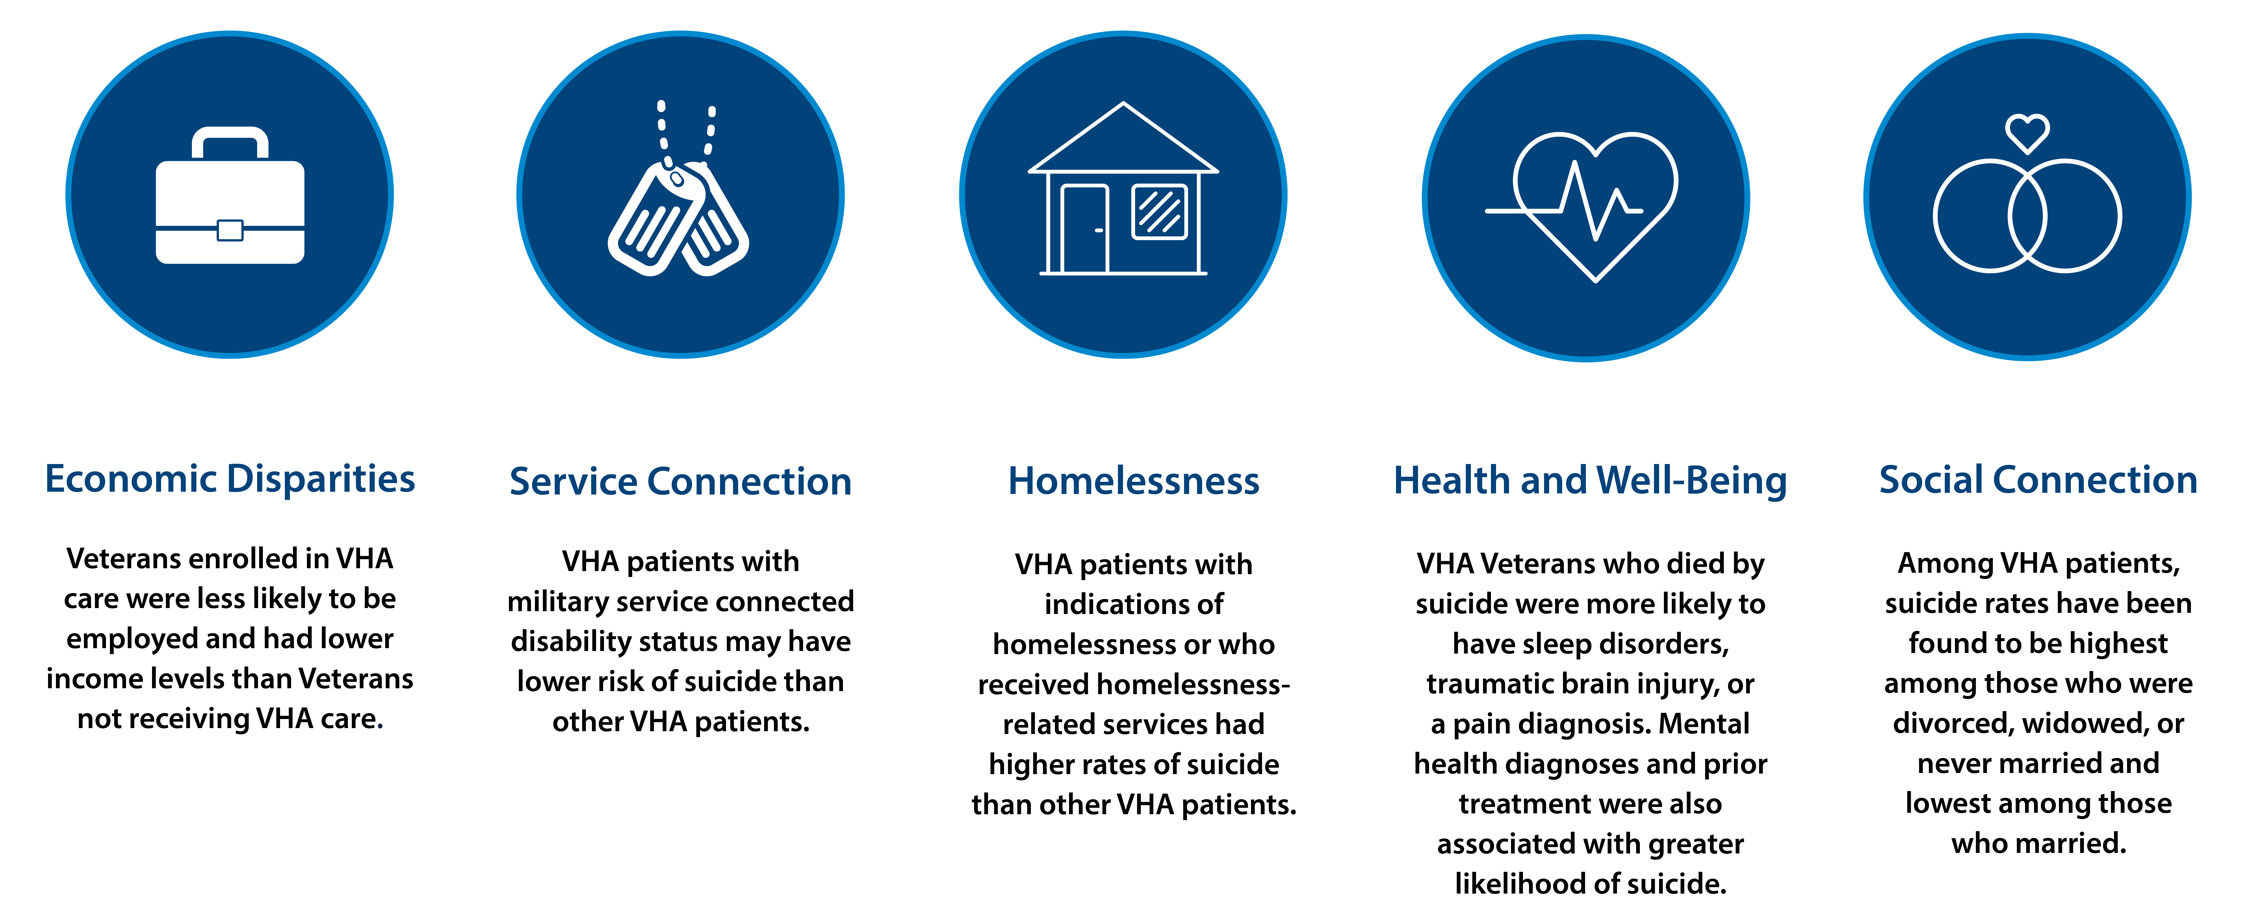
Veteran VHA Users Have Unique Experiences

Slide 6
Risk and Protective Factors
Risk
Protective
Prior suicide attempt
Mental health issues
Substance abuse
Access to lethal means
Recent loss
Legal or financial challenges
Relationship issues
Unemployment
Homelessness
Access to mental health care
Sense of connectedness
Problem-solving skills
Sense of spirituality
Mission or purpose
Physical health
Employment
Social and emotional well-being
Goal: Minimize risk factors and boost protective factors
Notes:
Risk factors are characteristics that are associated with an increased likelihood of suicidal behaviors. Some risk factors for suicide include: prior suicide attempt history, certain mental health conditions, access to lethal means, and stressful life events, such as divorce, job loss, or the death of a loved one.
Protective factors can help offset risk factors. These are characteristics associated with a decreased likelihood of suicidal behaviors. Some protective factors for suicide include access to mental health care, feeling connected to other people, and positive coping skills.

Slide 7
Key Findings:
2023 National Veteran Suicide Prevention Annual Report

Slide 8

2023 National Veteran Suicide Prevention Annual Report
Annual Report
  Reports on trends in Veteran suicide deaths from 2001-2021
  Focuses on suicide counts and rates among various Veteran subpopulations
State Data Sheets
  Examines state-level Veteran suicide deaths and compares to national and regional trends
  53 data sheets available for all 50 states, D.C., Puerto Rico, and U.S. territories
Access the reports online:
https://department.va.gov/suicide-prevention-annual-report/

Slide 9
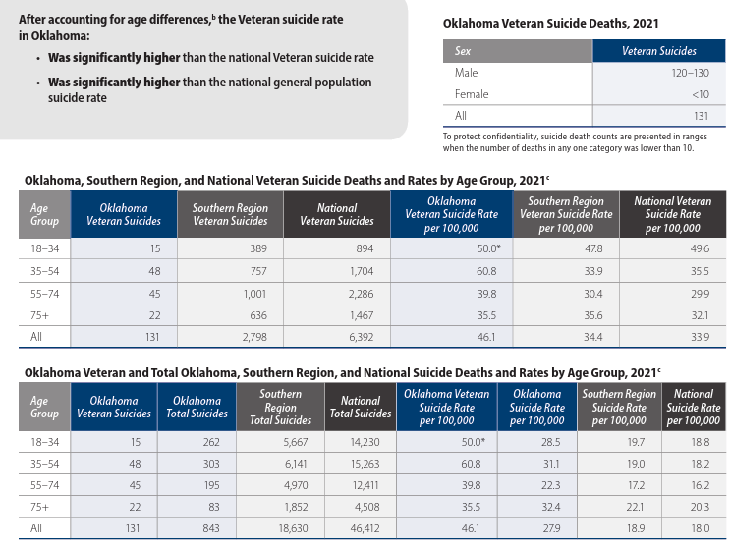
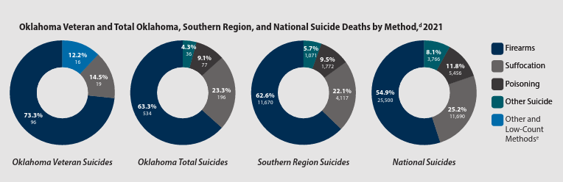
Oklahoma, Veteran Suicide Deaths, 2021

Slide 10
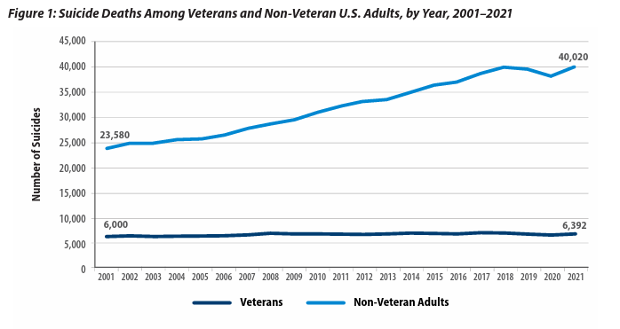
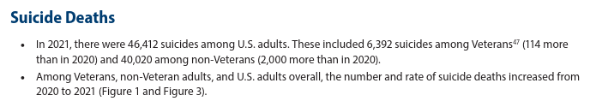
Veteran Suicide Deaths, Comparison 2001-2021
Notes:
6,261 Veterans died by Suicide in 2019 compared with 6,660 in 2018
Veterans accounted for 5,989 suicides in 2001, which represented 20.2% of suicides among U.S. adults in 2001; and 6,261 suicides in 2019, which, by comparison, represented 13.7% of suicides among U.S. adults in 2019.

Slide 11
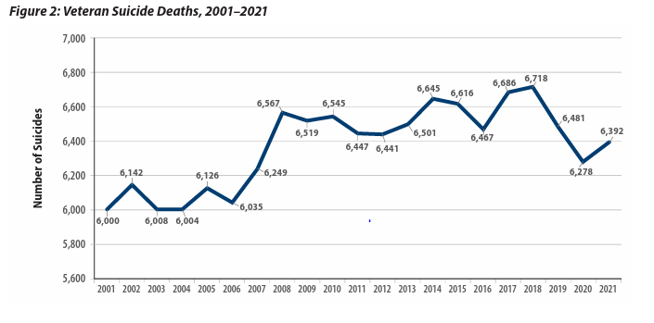
Veteran Suicide Deaths, 2001-2021
Notes:
From 2018 to 2019, changes in age- and sex-adjusted suicide mortality rates: Veterans - 7.2% decrease, Non-Veteran US adults - 1.8% decrease.

Slide 12
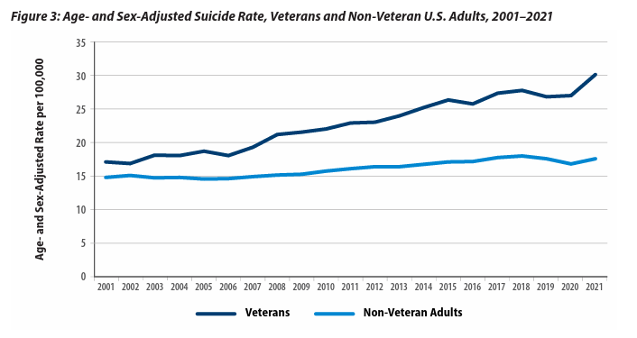
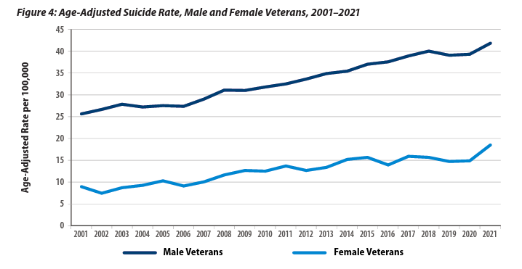
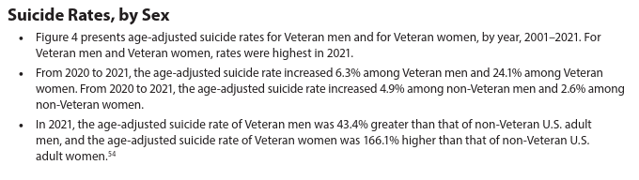
Age- & Sex-Adjusted Suicide Rates, Comparison 2001-2021

Slide 13
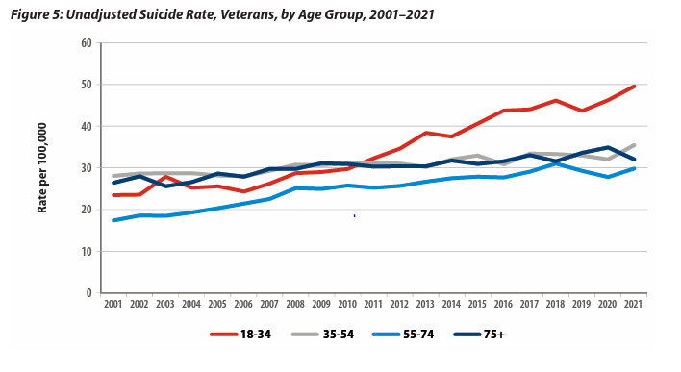
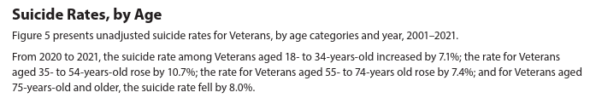
Suicide Rates by Age, 2001-2021

Slide 14
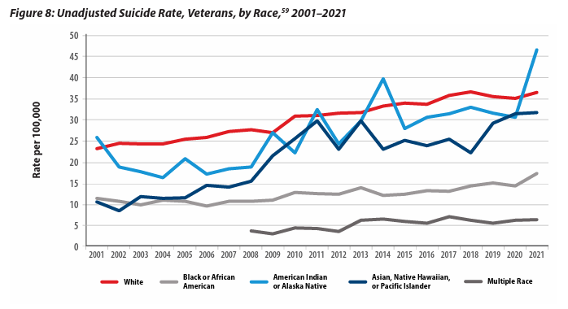
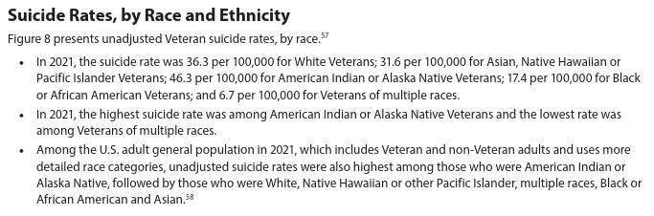
Unadjusted Suicide Rates by Race 2001-2021

Slide 15
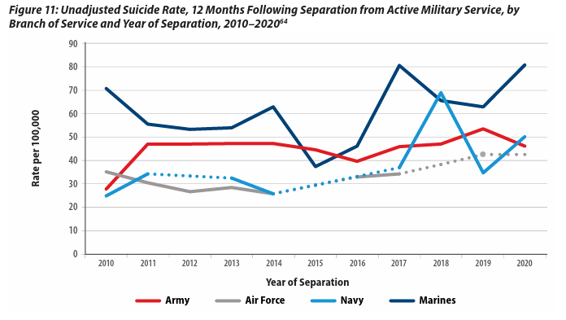
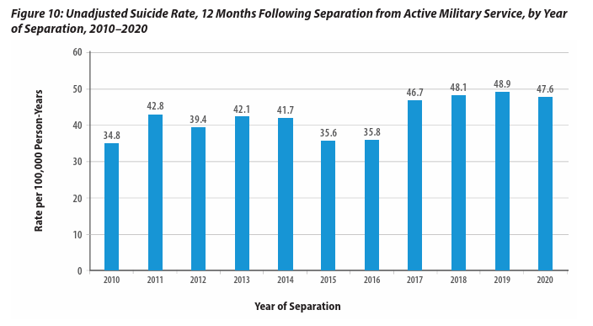
Suicide Rates in Year Following Military Separation, 2010-2020

Slide 16
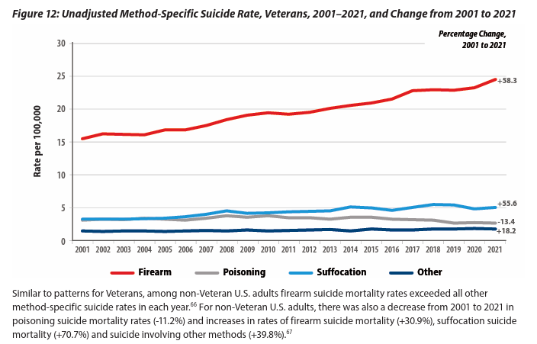
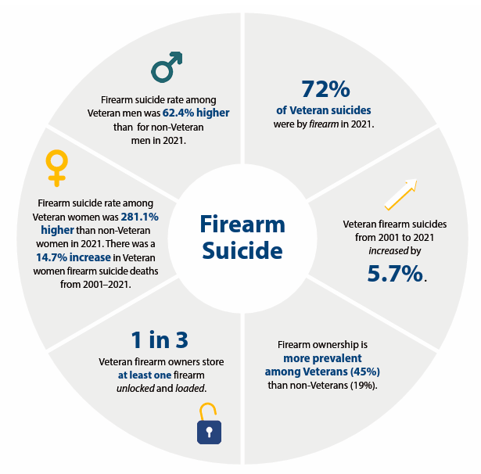
Suicide Deaths, Methods Involved, 2001-2021

Slide 17

Anchors of Hope
Suicide rates fell by 8.1% for Veteran men >75 years old.
From 2001-2021, suicide rates fell for recent Veteran VHA users with diagnoses of Sedative Use Disorder (-40.4%), Depression (-32.9%), PTSD (-27.6%), and Anxiety (-26.9%).
From 2020-2021, among recent Veteran VHA users 55-74 years old, the suicide rate fell by 2.2%
From 2020-2021, among male recent Veteran VHA users, suicide rates fell by 1.9% for those 18-34 years old.

Slide 18
2021 National Veteran Suicide Prevention Annual Report
Annual Report
  Reports on trends in Veteran suicide deaths from 2001-2019
  Focuses on suicide counts and rates among various Veteran subpopulations
State Data Sheets
  Examines state-level Veteran suicide deaths and compares to national and regional trends
  53 data sheets available for all 50 states, D.C., Puerto Rico, and U.S. territories
Access the reports online:
www.mentalhealth.va.gov/mentalhealth/suicide_prevention/data.asp

Slide 19
Veteran Suicide Deaths, 2001-2019
In 2019, the number of Veteran suicides (6,261) was the lowest since 2007.
Notes:
6,261 Veterans died by Suicide in 2019 compared with 6,660 in 2018
Veterans accounted for 5,989 suicides in 2001, which represented 20.2% of suicides among U.S. adults in 2001; and 6,261 suicides in 2019, which, by comparison, represented 13.7% of suicides among U.S. adults in 2019.

Slide 20
Age and Sex-Adjusted Suicide Rates,
Veterans and Non-Veteran US Adults, 2001-2019
Notes:
From 2018 to 2019, changes in age- and sex-adjusted suicide mortality rates: Veterans - 7.2% decrease, Non-Veteran US adults - 1.8% decrease.

Slide 21
Notes:
In 2019, adjusted suicide rates were 152% greater for Veteran men than Veteran women.
Rates for Veteran men were highest in 2018 (40.4/100,000) and fell 3.8% in 2019 (38.8/100,000)
Rates for Veteran women were highest in 2017 (19.9/100,000) and fell in 2018 (18.1/100,000) and again in 2019 (15.4/100,000), which represented a 14.9% decrease relative to 2018.

Slide 22
Unadjusted Suicide Rates, Veterans, by Race, 2001-2019
In 2019, suicide rates were highest among Veterans who were White
and lowest among Veterans who were Black or African American.

Slide 23
Unadjusted Suicide Rates, Veterans, by Hispanic Ethnicity, 2001-2019

Slide 24
Percentage of Suicide Deaths and Methods Involved, 2019
Firearms accounted for 70.2% of male Veteran suicides in 2019 (up from 69.6% in 2018) and 49.8% of female Veteran suicides in 2019 (up from 41.1% in 2018).

Slide 25
Anchors of Hope
Anchor 1: 399 fewer Veterans died from suicide in 2019 than in 2018.
Anchor 2: From 2005 to 2018, identified Veteran suicides increased on average by 48 deaths per year. A reversal totaling 399 lives within one year is unprecedented, dating back to 2001.
Anchor 3: Decrease in the adjusted suicide rate for Veterans from 2018 to 2019 (7%) was larger than any observed for Veterans 2001 through 2018. Veteran rate of decrease (7.2%) exceeded by four times the non-Veteran population decrease (1.8%)
Anchor 4: There was a nearly 13% one-year (unadjusted) rate decrease for female Veterans, which represents the largest rate decrease for Women Veterans in 17 years.
Anchor 5: COVID-19-related data continues to emerge and clarify, but data thus far does not indicate an increase in Veteran suicide-related behaviors.

Slide 26
Common Myths vs. Realities
Notes:
Even though suicide is a major public health concern, there are a lot of common myths and misinformation about suicide. Let’s talk about some of these. Having accurate information about suicide makes it easier to reach out to others and help them.

Slide 27

Common Myths vs. Realities
Myth
Reality
Asking about suicide may lead to someone taking his or her life.

Slide 28

Common Myths vs. Realities
Myth
Reality
Asking about suicide does not create suicidal thoughts. The act of asking the question simply gives the Veteran permission to talk about his or her thoughts or feelings.

Slide 29
Common Myths vs. Realities
Myth
Reality
People who talk about suicide are just seeking attention.

Slide 30
Common Myths vs. Realities
Myth
Reality
No matter how casually or jokingly said, suicide threats should never be ignored and may indicate serious suicidal feelings. Someone who talks about suicide provides others with an opportunity to intervene before suicidal behaviors occur.

Slide 31
Common Myths vs. Realities
Myth
Reality
The only one who can really help someone who is suicidal is a mental health counselor or therapist.

Slide 32
Common Myths vs. Realities
Myth
Reality
Special training is not required to safely raise the subject of suicide. Helping someone feel included and showing genuine, heartfelt support can also make a big difference during a challenging time.

Slide 33
The Steps of VA S.A.V.E.

Slide 34

Signs of Suicidal Thinking
Learn to recognize these warning signs:
Hopelessness, feeling like there is no way out
Anxiety, agitation, sleeplessness, or mood swings
Feeling like there is no reason to live
Rage or anger
Engaging in risky activities without thinking
Increasing alcohol or drug use
Withdrawing from family and friends

Slide 35
Signs of Suicidal Thinking
The presence of any of the following signs requires immediate attention:
Thinking about hurting or killing themselves
Looking for ways to die
Talking about death, dying, or suicide
Self-destructive or risk-taking behavior, especially when it involves alcohol, drugs, or weapons

Slide 36

Asking the Question
Know how to ask
the most important question of all…

Slide 37
Asking the Question
“Are you thinking about killing yourself?”

Slide 38
Asking the Question
Do’s | Don’ts
DO ask the question if you’ve identified warning signs or symptoms. | DON’T ask the question as though you are looking for a “no” answer. “You aren’t thinking of killing yourself, are you?”
DO ask the question in a natural way that flows with the conversation. | DON’T wait to ask the question when someone is halfway out the door.
Notes:
Use direct words and phrases, such as “killing yourself” and “suicide,” when asking about suicidal thoughts. Avoid using vague phrases such as “hurting yourself,” as these can have different meanings to different people. To emphasize this point, you can ask participants why it is so important to ask this question directly instead of indirectly. What may be the outcome of asking indirect questions? (Answer: indirect answers!)
Ask a direct question if warning signs (“invitations”) are evident. When “invitation statements” have been made, it can be helpful to use them as springboards to directly ask about a person’s risk for suicide. (E.g., “I want to better understand what you mean by ‘ending it all.’ Are you thinking about killing yourself?”)
Phrase questions in a way that indicates openness to listening and remain nonjudgmental no matter the answer. This is extremely important, as it will help the Veteran understand that people are willing to listen.
The question should not be an afterthought. It should be asked promptly once someone indicates that they may be at risk for suicide.
There may not be an optimal time to ask the question, and doing so may be discomforting. Acknowledge this and encourage participants to ask the question anyway.

Slide 39

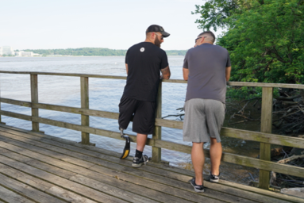
Validate the Veteran’s Experience
Talk openly about suicide. Be willing to listen and allow the Veteran to express his or her feelings.
Recognize that the situation is serious.
Do not pass judgment.
Reassure the Veteran that help is
available.

Slide 40

Encourage Treatment and Expedite Getting Help
What should I do if I think someone is suicidal?
  Don’t keep the Veteran’s suicidal behavior a secret.
  Do not leave him or her alone.
  Try to get the person to seek immediate help from his or her doctor or the nearest hospital emergency room.
  Call 911.
Reassure the Veteran that help is available.
Call the Veterans Crisis Line at 1-800-273-8255 and Press 1.
Notes:
No keeping secrets- if someone says they will talk to you about an issue “only if you promise not to tell anyone,” it’s important to be up front in saying you cannot make that promise because you care about them and want them to get any help that they may need. You don’t want to keep a secret and regret it.

Slide 41
When Talking with a Veteran at Risk for Suicide
Remain calm.
Listen more than you speak.
Maintain eye contact.
Act with confidence.
Do not argue.
Use open body language.
Limit questions — let the Veteran do the talking.
Use supportive, encouraging comments.
Be honest — let the Veteran know that there are no quick solutions, but help is available.
Notes:
Open body language signals interest in the other person and in the conversation. Maintain a relaxed posture, lean in closer, use direct eye contact, and nod in agreement to show your Veteran that you’re present in the moment with them.

Slide 42
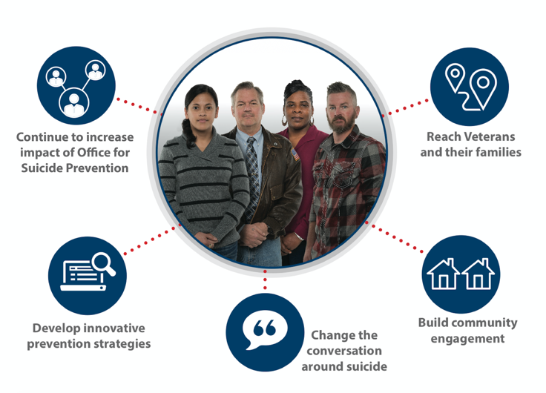
Suicide Prevention is Everyone’s Business

Slide 43
Lethal Means Safety

Slide 44
What is Lethal Means Safety?
In the context of suicide prevention, safe storage of lethal means is any action that builds in time and space between a suicidal impulse and the ability to harm oneself.
Effective lethal means safety education and counseling is collaborative and Veteran-centered. It respects the important role that firearms and medications may play in Veterans’ lives and is consistent with their values and priorities.

Slide 45
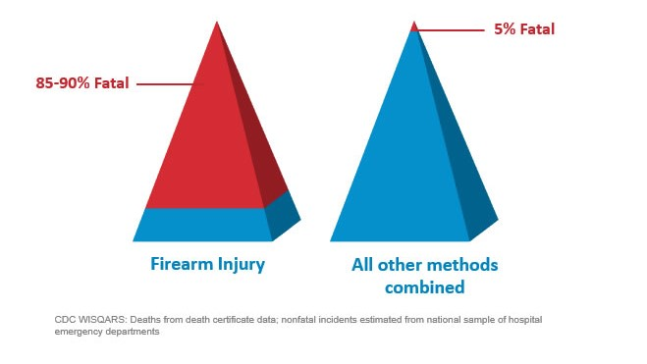
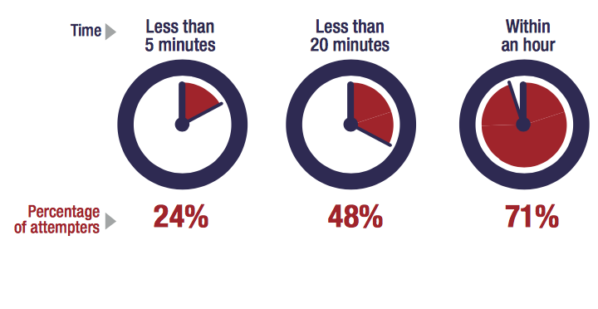
Most Suicidal Crises are Brief
Time from Decision to Action < 1 hour
Source: Simon, T.R., Swann, A.C., Powell, K.E., Potter, L.B., Kresnow, M., and O’Carroll, P.W. Characteristics of Impulsive Suicide Attempts and Attempters. SLTB. 2001; 32(supp):49-59.
Source: CDC WISQARS and US Dept. of Veterans Affairs
https://www.mirecc.va.gov/lethalmeanssafety/facts/
Notes:
Building in time and space between the impulse to act and the means to harm one’s self saves lives.
While some suicidal crises last a long time, most last minutes to hours. In one study of suicide attempt survivors:
47 percent said it took less than one hour between their decision to attempt suicide and their actual attempt.
24 percent said it took less than five minutes for them to act.
The time between when a person decides to die by suicide and they act on the decision is often very short. A 2005 study found that 71% of attempters estimating that the process took less than an hour. This reality underscores the importance of reducing access to means for those who are at elevated risk for suicide, until the risk period passes.
Access to lethal means increases suicide risk for everyone living in the home
Acute phase of a suicidal crisis is often brief.
Building in time and space—even 30-60 minutes—between impulse to act and the means to harm one’s self saves lives
We know that people rarely “substitute” one means for another. So, it is important to restrict whichever means they have in mind to use.
Means matter—how a person attempts suicide impacts how fatal the injury will be.
About 90% of firearm-related suicide attempts are fatal, as compared to approximately 5% of suicide attempts by all other mechanisms combined
Most who survive a nonfatal suicide attempt do not go on to die by suicide
Building in time and space between the impulse to act and the means to harm one’s self saves lives.
While some suicidal crises last a long time, most last minutes to hours. In one study of suicide attempt survivors:
47 percent said it took less than one hour between their decision to attempt suicide and their actual attempt.
24 percent said it took less than five minutes for them to act.

Slide 46
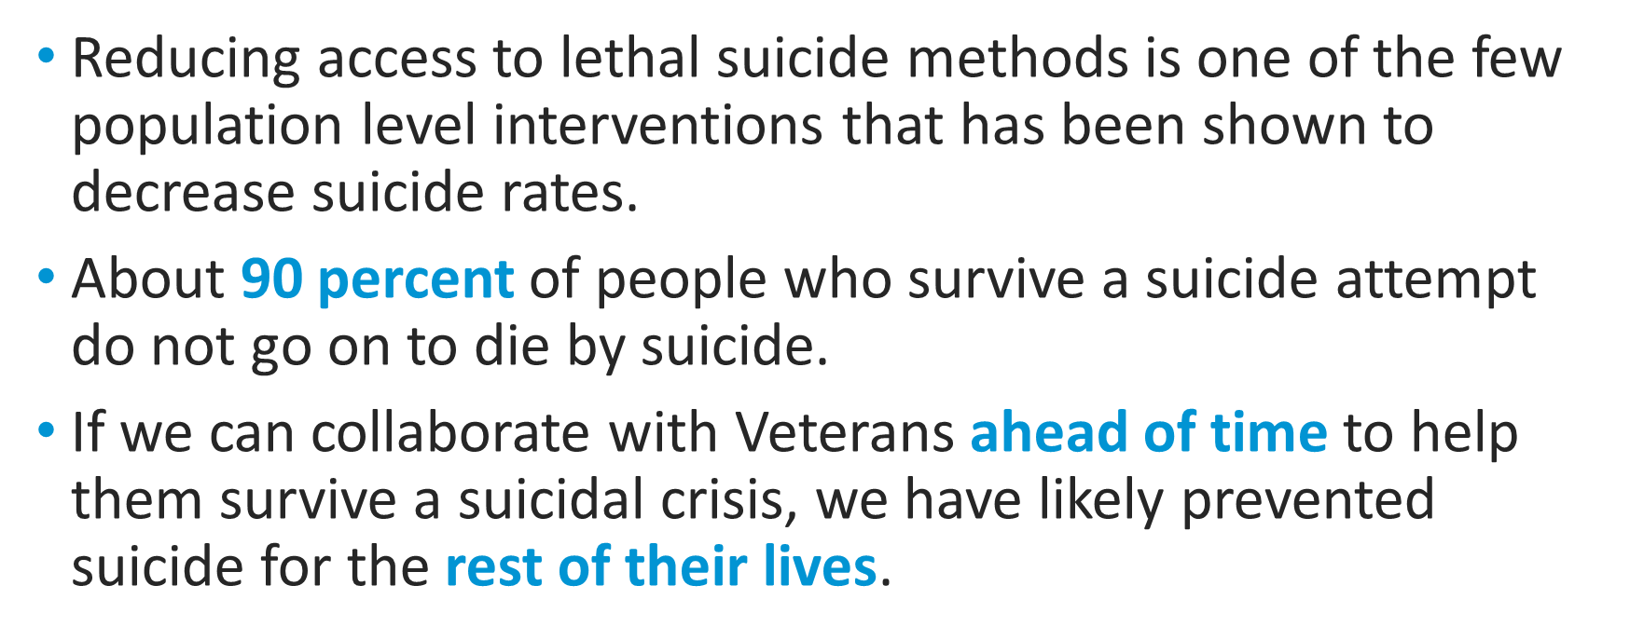
Lethal Means Safety Works
Notes:
In 1997, Australia instituted stricter gun safety measures, including minimum age restrictions, psychological evaluations, background checks, and waiting periods. The firearm suicide rate steadily declined by 4.7% each year, and researchers did not see a substitution effect.
The Israeli Defense Force saw a 40% reduction in the suicide rate among soldiers when it restricted soldiers’ access to firearms during weekend leave.
Firearm-related suicides in Indiana and Connecticut declined after those states enacted legislation allowing law enforcement officers to seize firearms from individuals they deem a risk to themselves or others.
Full citations:
- Kapusta, N. D., Etzersdorfer, E., Krall, C., & Sonneck, G. (2007). Firearm legislation reform in the European Union: Impact on firearm availability, firearm suicide and homicide rates in Austria. The British Journal of Psychiatry, 191(3), 253–57.
- Lubin, G., Werbeloff, N., Halperin, D., Shmushkevitch, M., Weiser, M., & Knobler, H. Y. (2010). Decrease in suicide rates after a change of policy reducing access to firearms in adolescents: A naturalistic epidemiological study. Suicide and Life-Threatening Behavior, 40(5), 421–24.
- Kivisto, A. J., & Phalen, P. L. (2018). Effects of Risk-Based Firearm Seizure Laws in Connecticut and Indiana on Suicide Rates, 1981–2015. Psychiatric Services, 69, 855–62.

Slide 47
Safe Messaging Practices
Adapted from the National Action Alliance for Suicide Prevention’s Framework for Successful Messaging

Slide 48
Practices to Avoid…
Avoid Oversimplifying
  Acknowledge that suicide is a complex and rarely, if ever has a single cause.
Avoid Conveying Suicide as Unsolvable
  Highlight solutions or action steps someone can take to seek help.
  Emphasize that suicide can be prevented.
Avoid Glorifying
  Avoid portraying or talking about suicide as a heroic, romantic, or honorable act as this can increase risk among vulnerable people.
Avoid Stigmatizing Language
Use | Avoid
“took their life” | “committed suicide”
“died by suicide | “failed suicide attempt”

Slide 49
Practices to Use…
Use Data Strategically.
  Highlight that the vast majority of people who think about and/or attempt suicide do not go on to die by suicide.
Incorporate Real Stories
  Incorporate voices of people with live experience as personal stories are a powerful way to promote hope, connection, and recovery.
Encourage Positive Awareness
  Encourage the promotion/inclusion of helpful resources—warning signs, tips on what to do, help-seeking information
Overarching Key Messages
  Suicide is often preventable.
  Suicide should be treated like any other health issue.
  Connection is a key protective factor
  Support is available.

Slide 50
Suicide Prevention 2.0
Public Health Strategy

Slide 51
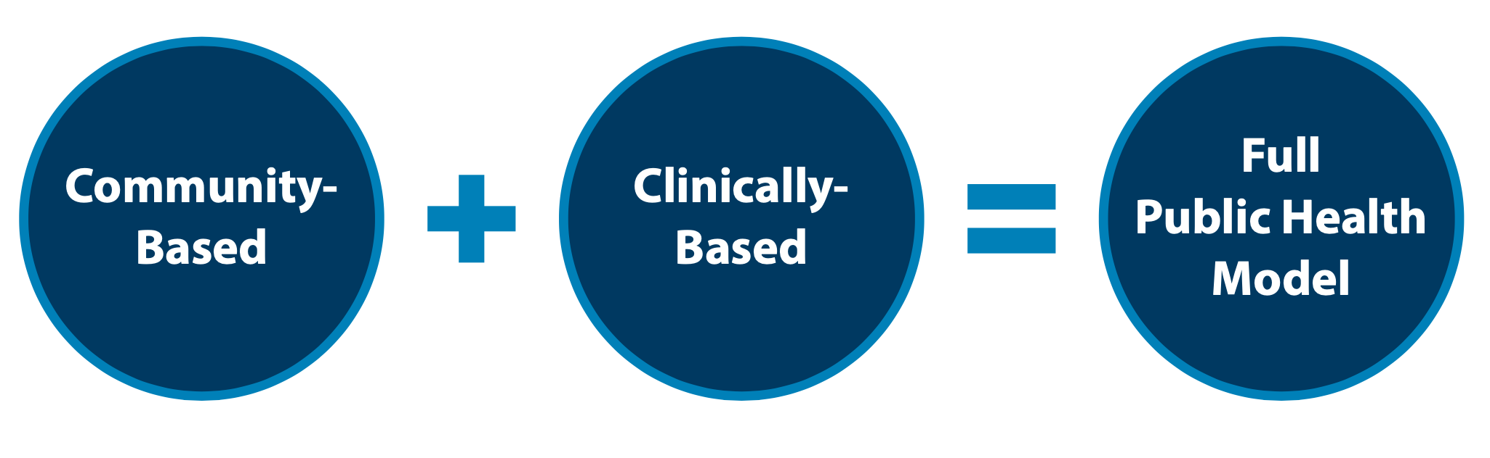
Public Health Strategy
VA's public health strategy combines partnerships with communities to implement tailored, local prevention plans while also focusing on evidence based clinical strategies for intervention. Our approach focuses on both what we can do now, in the short term, and over the long term, to implement VA’s National Strategy for Preventing Veteran Suicide.

Slide 52
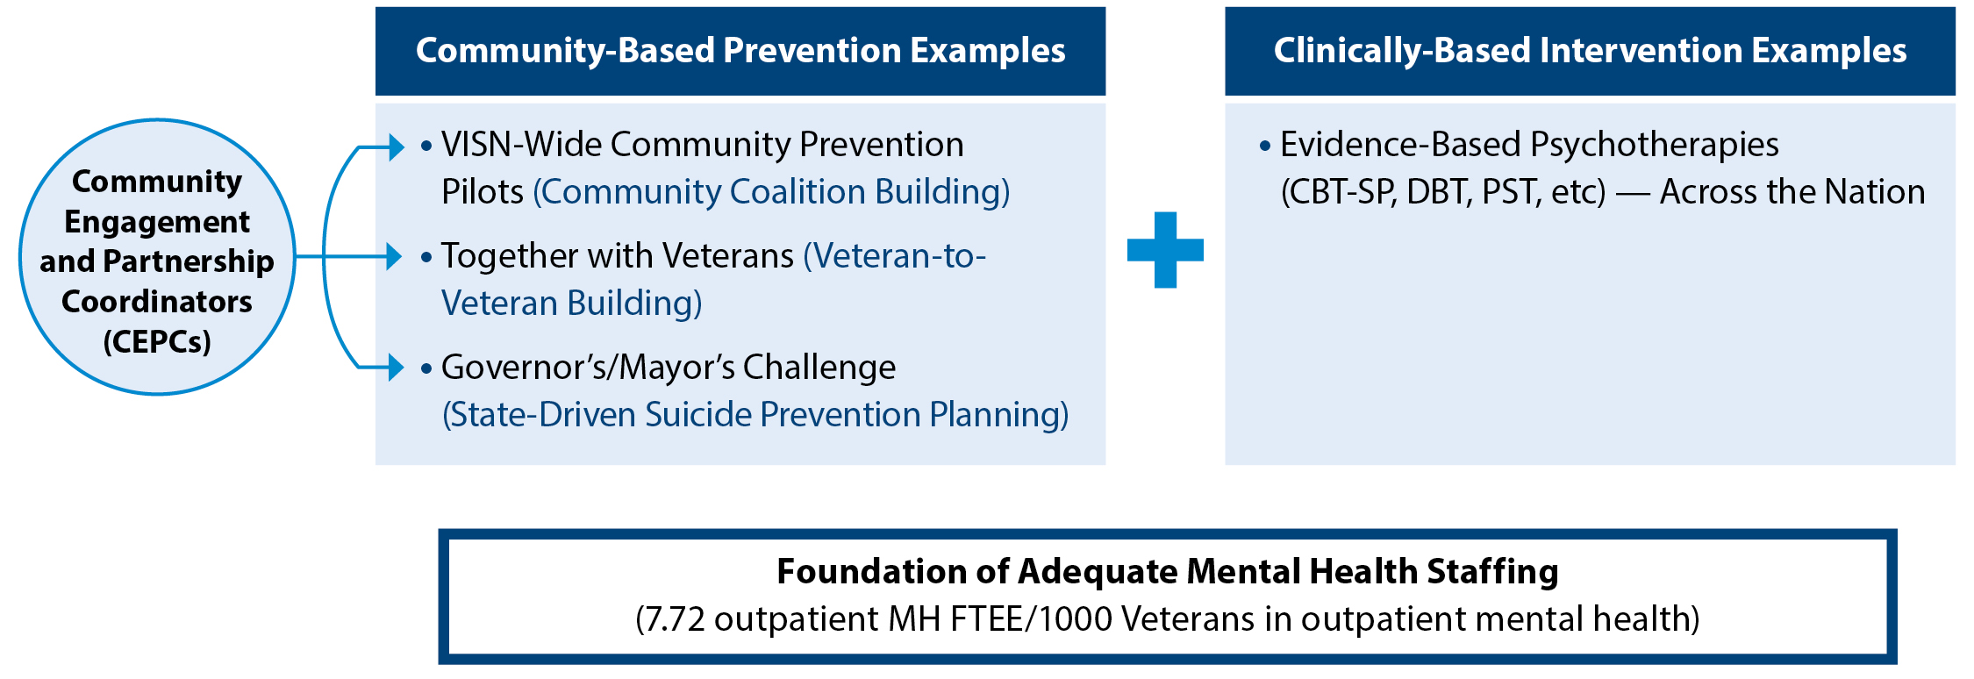
Suicide Prevention 2.0:
Combining Community & Clinical Interventions

Slide 53
Community-Based Interventions
Community-Based Interventions for Suicide Prevention (CBI-SP) serves as unifying model, from national to community levels, for all community-based efforts to end Veteran suicide.
The Governor’s Challenge is a collaboration with VA and SAMHSA where state policy makers partner with local leaders to implement a comprehensive suicide prevention plan.
Together with Veterans is focused on Veteran-to-Veteran coalition building and Veteran leadership development for suicide prevention.
Community Engagement and Partnerships for Suicide Prevention (VISN Expansion) is focused on facilitating community coalition building for suicide prevention
Outreach and Education provides SAVE, VHA facility partnerships, events, etc. through local Suicide Prevention Coordinators (SPCs) and does not change their critical role.
National Level
National VA Suicide Prevention Program
State Level
Governor’s Challenge
Community Engagement and Partnerships for Suicide
Prevention
Community
Level
Together With Veterans
Outreach and Education
Notes:
The Community-Based Interventions for Suicide Prevention serves as a unifying model aims to reach Veterans through multiple touchpoints – from national to community levels, for all community-based efforts to end Veteran suicide.

Slide 54
Resources
Notes:
Customize the Resources section based on your audience

Slide 55
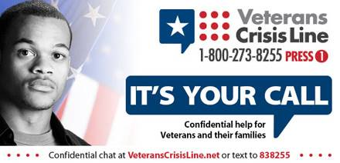
Free, Confidential Support 24/7/365
Veterans
Service members
Family members
Friends
Coworkers
Notes:
Veterans Crisis Line: The Veterans Crisis Line connects Veterans in crisis and their families and friends with qualified, caring VA responders through a confidential toll-free hotline, online chat, or text. Veterans and their loved ones can call 1-800-273-8255 and Press 1, chat online, or send a text message to 838255 to receive confidential crisis intervention and support 24 hours a day, 7 days a week, 365 days a year. More information is available at https://www.veteranscrisisline.net/.

Slide 56
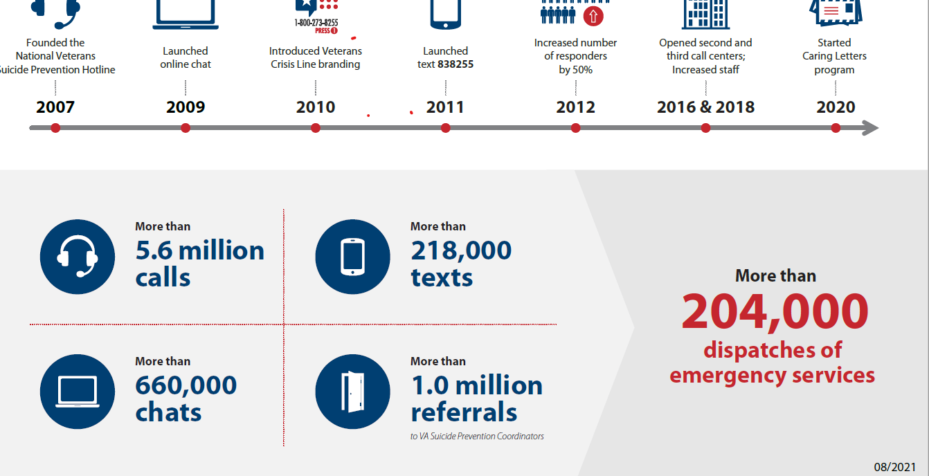

Slide 57
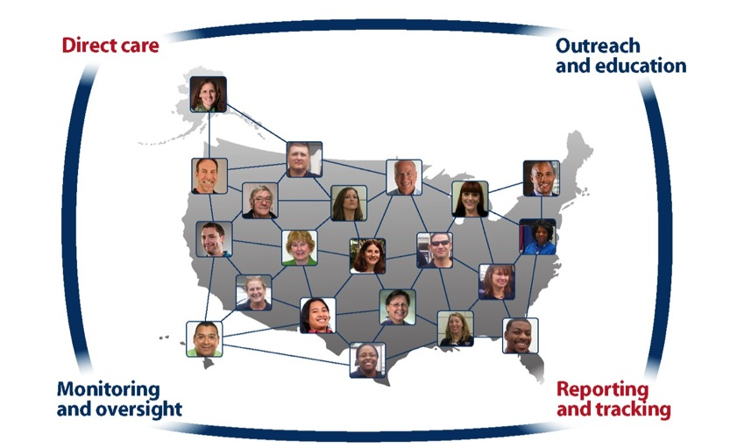
Find a Local VA SPC at VeteransCrisisLine.net/ResourceLocator
More than 400 SPCs nationwide.
Notes:
Resource Locator: This online resource helps Veterans easily find VA resources in their area including Suicide Prevention Coordinators, crisis centers, VAMCs, outpatient clinics, Veterans Benefits Administration offices, and Vet Centers. More information is available at: www.veteranscrisisline.net/ResourceLocator.

Slide 58
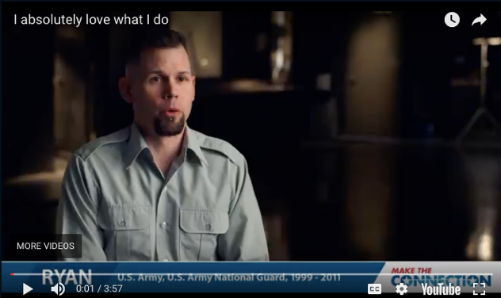
Make the Connection
Online resource featuring hundreds of Veterans telling their stories about overcoming mental health challenges.
https://maketheconnection.net/conditions/suicide
Notes:
Make the Connection: This online resource connects Veterans, their family members and friends, and other supporters with information and solutions to issues affecting their lives. More information is available at https://maketheconnection.net/.

Slide 59
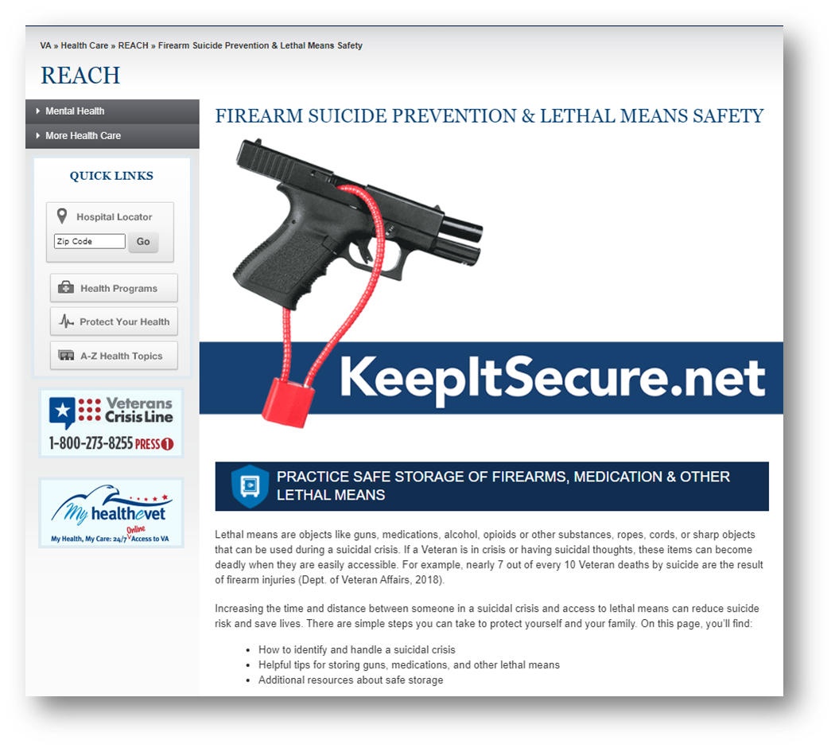
Practice safe storage of firearms, medications and other lethal means
Visit www.keepitsecure.net to learn more about the importance of firearm and other lethal means safety.
Nearly half of all Veterans own a firearm, and most Veteran firearm owners are dedicated to firearm safety.
Firearm injuries in the home can be prevented by making sure firearms are unloaded, locked, and secured when not in use, with ammunition stored in a separate location
There are several effective ways to safely secure firearms. Learn more and find the option that works best for you and your family from the National Shooting Sports Foundation at www.nssf.org/safety

Slide 60
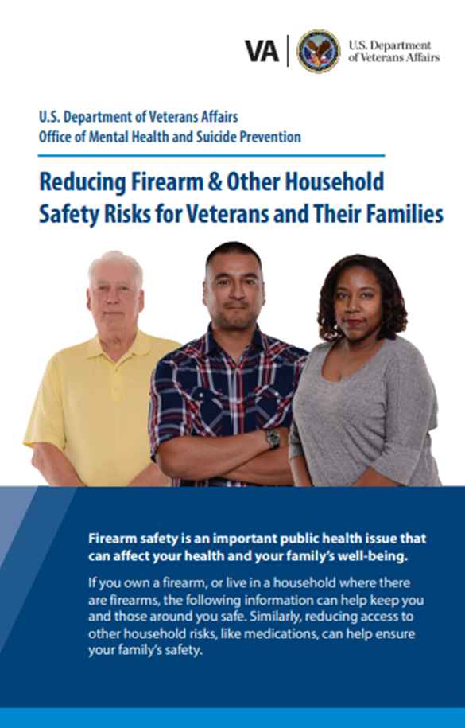
New Lethal Means Safety Resources
    Reducing Firearm & Other Household Safety Risks Brochure provides best practices for safely storing firearms and medications along with advice for loved ones on how to talk to the Veteran in their life about safe storage.

Slide 61
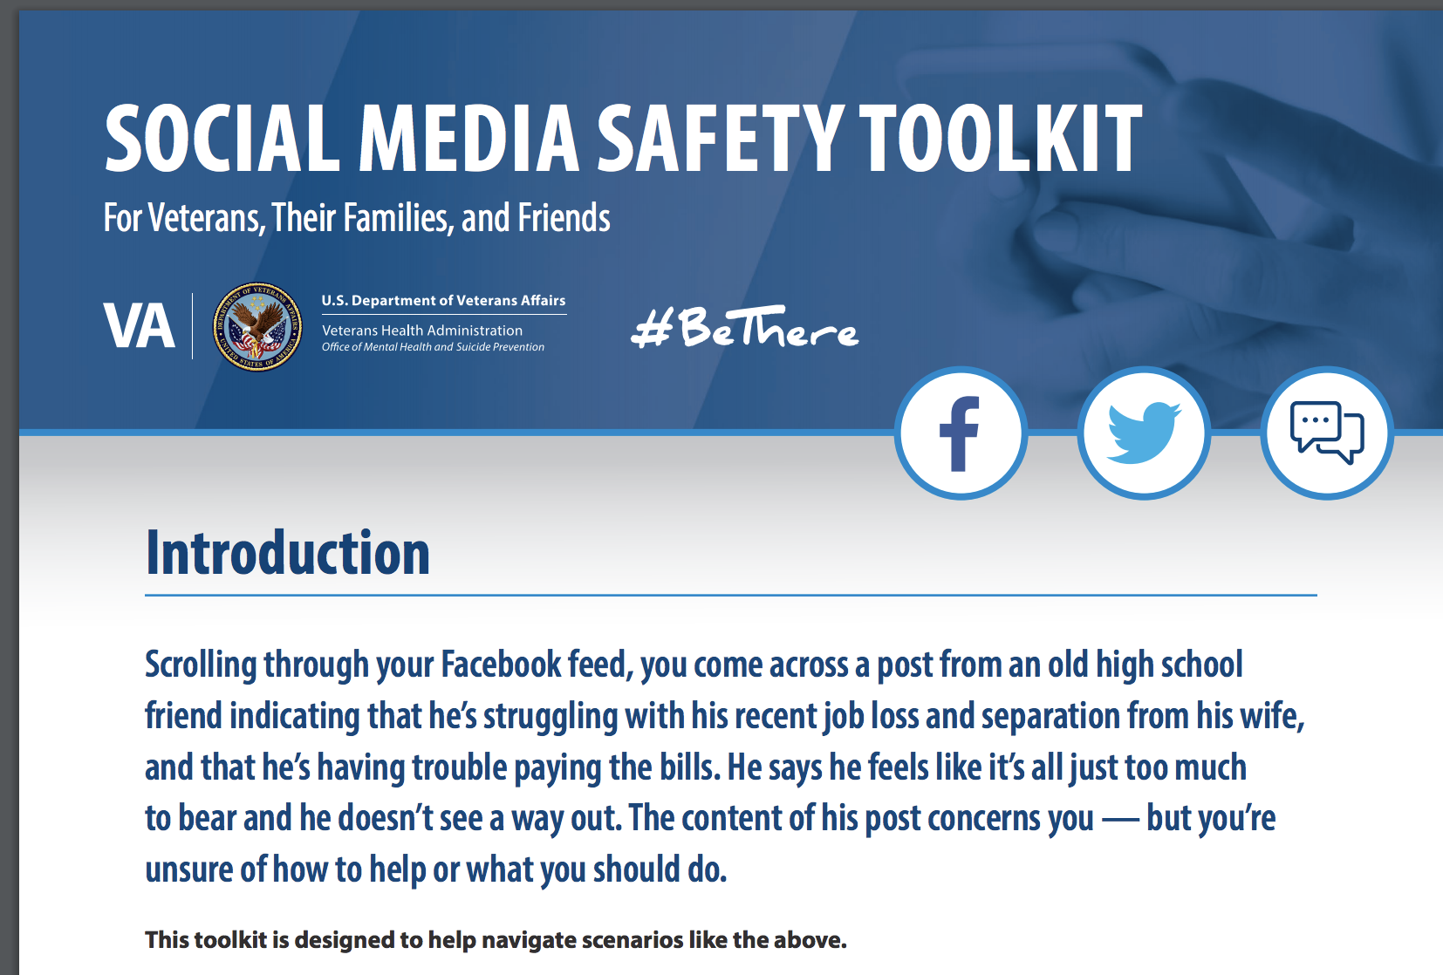

Social Media Safety Toolkit
As discussed in the National Strategy for Preventing Veteran Suicide, social media is an important intervention channel and a key piece of VA’s comprehensive, community-based suicide prevention strategy.
The Social Media Safety Toolkit for Veterans, their families, and friends equips everyone with the knowledge needed to respond to social media posts that indicate a Veteran may be having thoughts of suicide.
The toolkit includes best practices, resources, and sample responses.
Download at https://www.mentalhealth.va.gov/suicide_prevention/docs/OMH-074-Suicide-Prevention-Social-Media-Toolkit-1-8_508.pdf
Notes:
The Social Media Safety Toolkit for Veterans, Their Families, and Friends equips everyone with the knowledge needed to respond to social media posts that indicate a Veteran may be having thoughts of suicide. The toolkit includes best practices, resources, and sample responses.
As discussed in the National Strategy for Preventing Veteran Suicide, social media is an important intervention channel and a key piece of VA’s comprehensive, community-based suicide prevention strategy.
Many service members and Veterans are active on social media platforms, and some have posted to express emotional distress or thoughts of suicide. Social media has become a critical channel for VA and partners like you to reach Veterans in crisis with safe messaging and resources.
VA is sharing the Social Media Safety Toolkit among VA employees, with partner organizations, and throughout communities nationwide to help ensure that people who live and work with Veterans every day are equipped to reach Veterans with safe messaging and lifesaving resources.
Download the Social Media Safety Toolkit at https://www.mentalhealth.va.gov/suicide_prevention/docs/OMH-074-Suicide-Prevention-Social-Media-Toolkit-1-8_508.pdf.

Slide 62
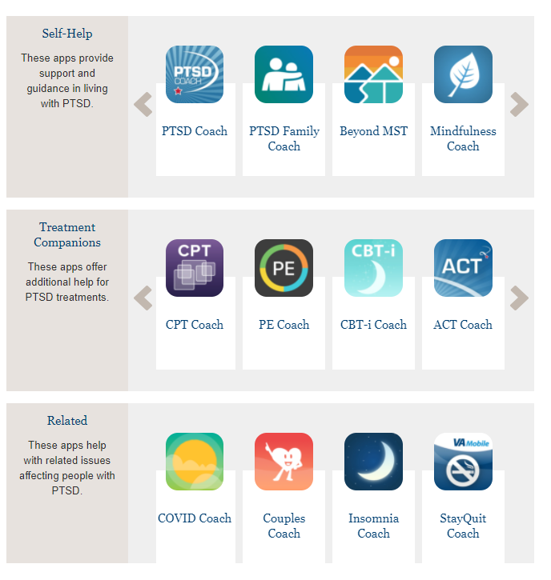
Mental Health Mobil Apps.
Mobile Apps - PTSD: National Center for PTSD (va.gov)

Slide 63
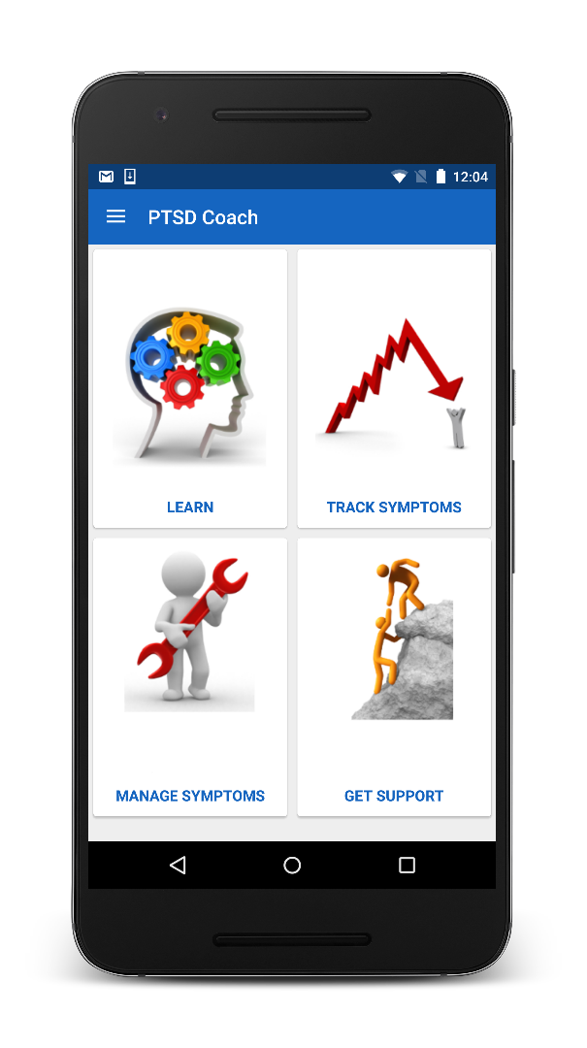
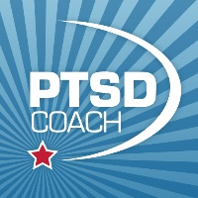
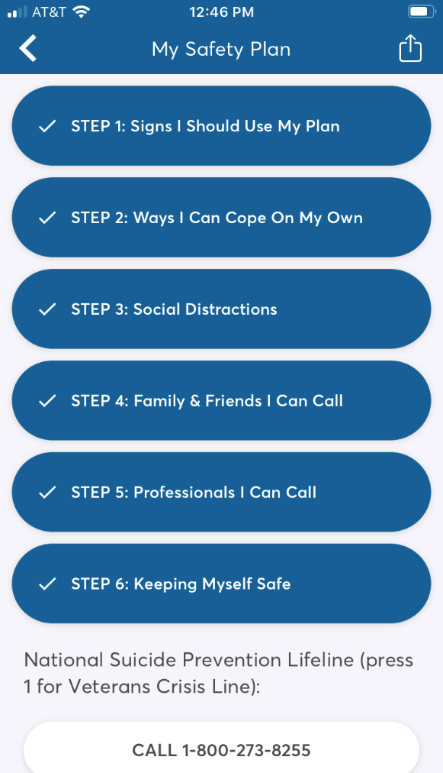
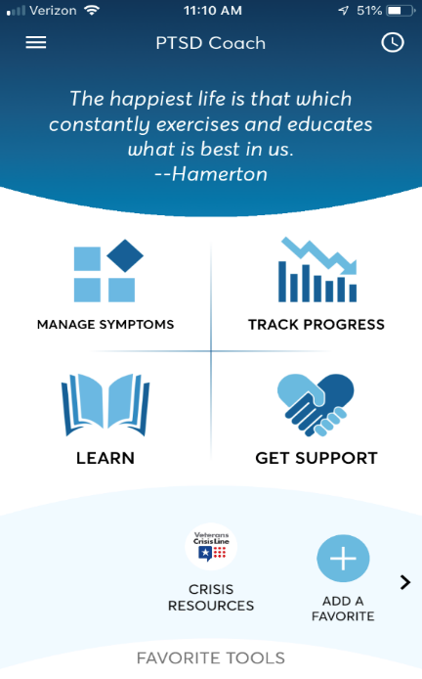
Safety Plan now in PTSD Coach!
To access the Safety Plan:
  Download* and open PTSD Coach
  Tap the lateral menu
  Tap Safety Plan
National Center for PTSD website:
https://www.ptsd.va.gov/appvid/mobile/ptsdcoach_app.asp
Notes:
The safety plan walks users through the creation of a detailed suicide safety plan. Users can create a safety plan on their own, with a provider, or with other supportive contacts.
The digital SP mirrors the paper plan currently being used. All of the steps, prompts, and resources on the paper plan are included in the digital version. The digital version even includes additional psychoeducational materials, which we’ll show you later.
Some may continue to have their plan on paper, and some may prefer to have it only on their phone. Some may want both! Hopefully by allowing them to access their plan in their preferred form, they may be more likely to keep it with them.

Slide 64
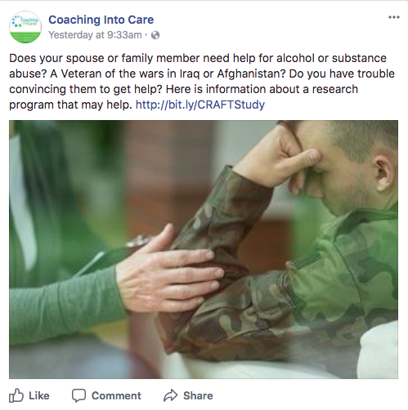
Coaching into Care
Program for families and loved ones of Veterans, helping them encourage the Veteran in their lives to seek support.
CALL 888-823-7458
Notes:
Coaching into Care (1-888-823-7458): A national telephone service of the VA, Coaching into Care aims to educate, support, and empower family members and friends who are seeking care or services for a Veteran. More information is available at https://www.mirecc.va.gov/coaching/.

Slide 65
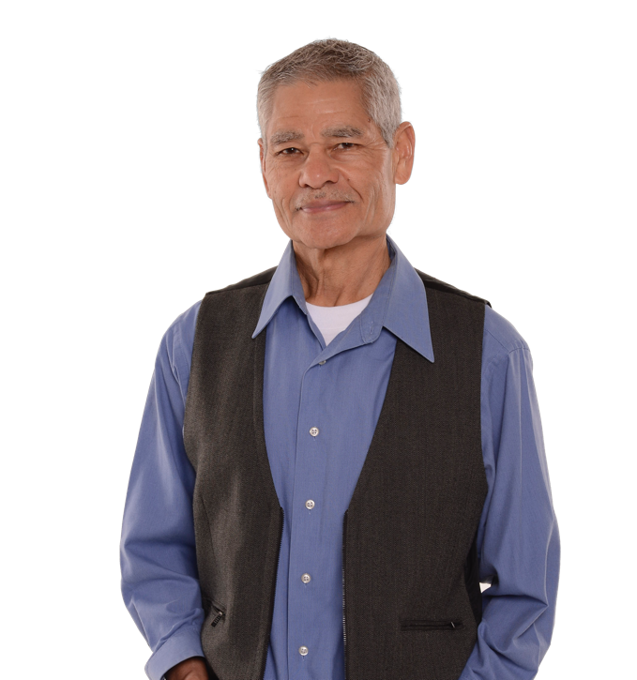
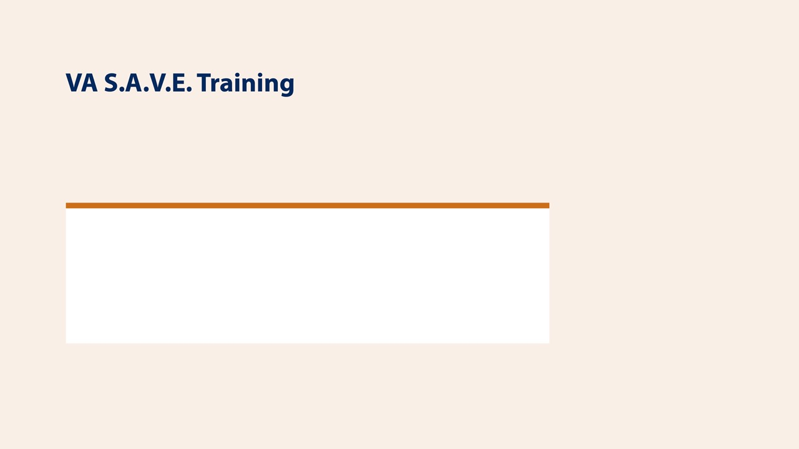

This free suicide prevention training video is less than 25 minutes long and available to everyone, 24/7. It's offered in collaboration with the PsychArmor Institute.
Available online for free: https://psycharmor.org/courses/s-a-v-e/

Slide 66
Questions?

