Slide 1

Duration of Efficacy: Shingles Vaccines
A NotebookLM

Slide 2
The Clinical Scenario
Patient Profile: 75-Year-Old Male, received Zostavax vaccine 9 years ago. Never had Shingles.
Clinical Question: Does Zostavax still provide effective protection against herpes zoster (Shingles) or is a Shingrix booster required?
A NotebookLM

Slide 3
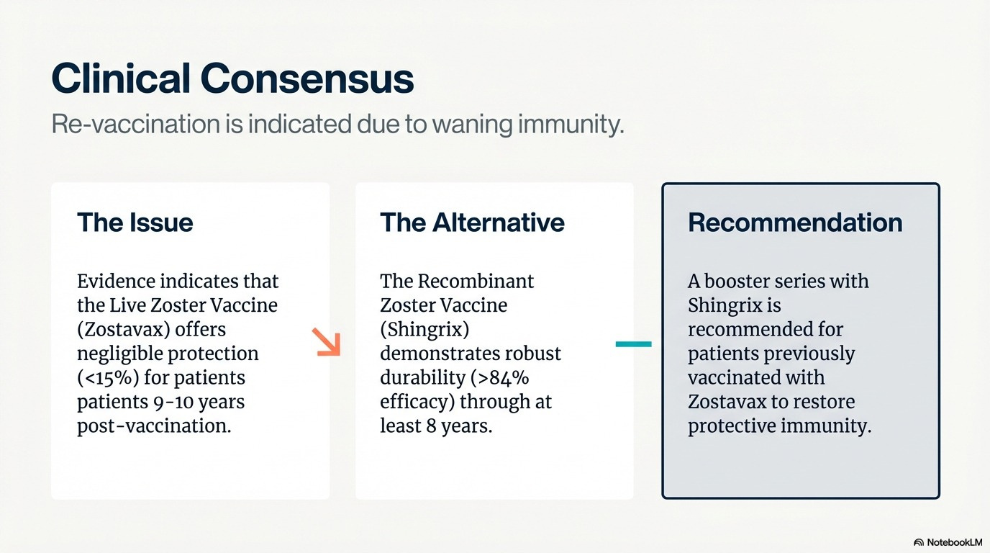
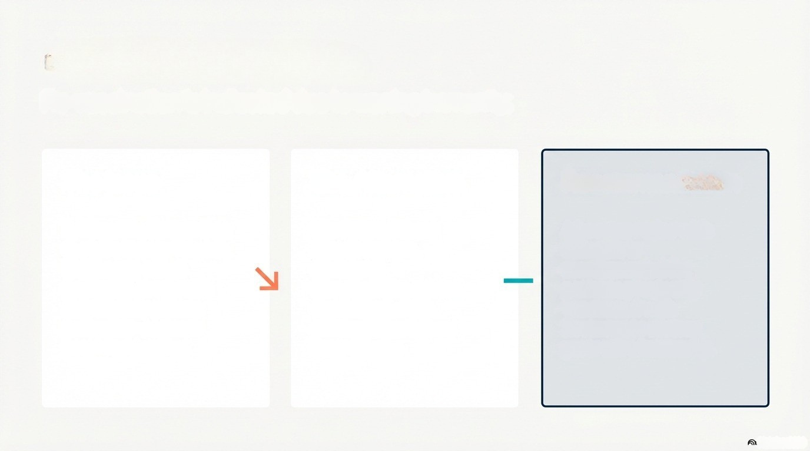
The Evidence and the Clinical Outcome:
Evidence indicates that
the Live Zoster Vaccine
(Zostavax) offers
negligible protection
(<15%) for patients
patients 9-10 years
post-vaccination.
The Recombinant
Zoster Vaccine
(Shingrix)
demonstrates robust
durability (>84%
efficacy) through at
least 8 years.
Patient reviewed evidence with primary care
physician.
Decision made to get a booster with Shingrix Vaccine.
NotebookLM

Slide 4
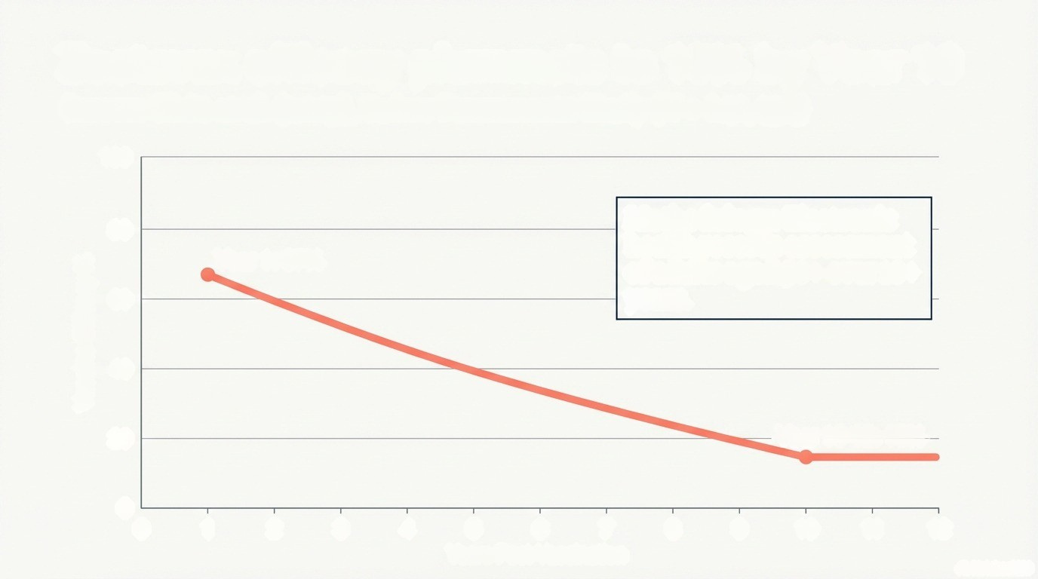
Study 1: Klein (2023); Zostavax Vaccine
Source: https://www.bmj.com/content/383/bmj-2023-076321
100
80
Study Details: aged 50+,
N=505,647 patients,
given Zostavax vaccine,followed
10+ years.
Year 1: 67%
60
Vaccine Efficacy %
40
20
Year 10-12: 15%
0
0
1
2
3
4
5
6
7
8
9
10
11
12
Years Post-Vaccination
A NotebookLM

Slide 5
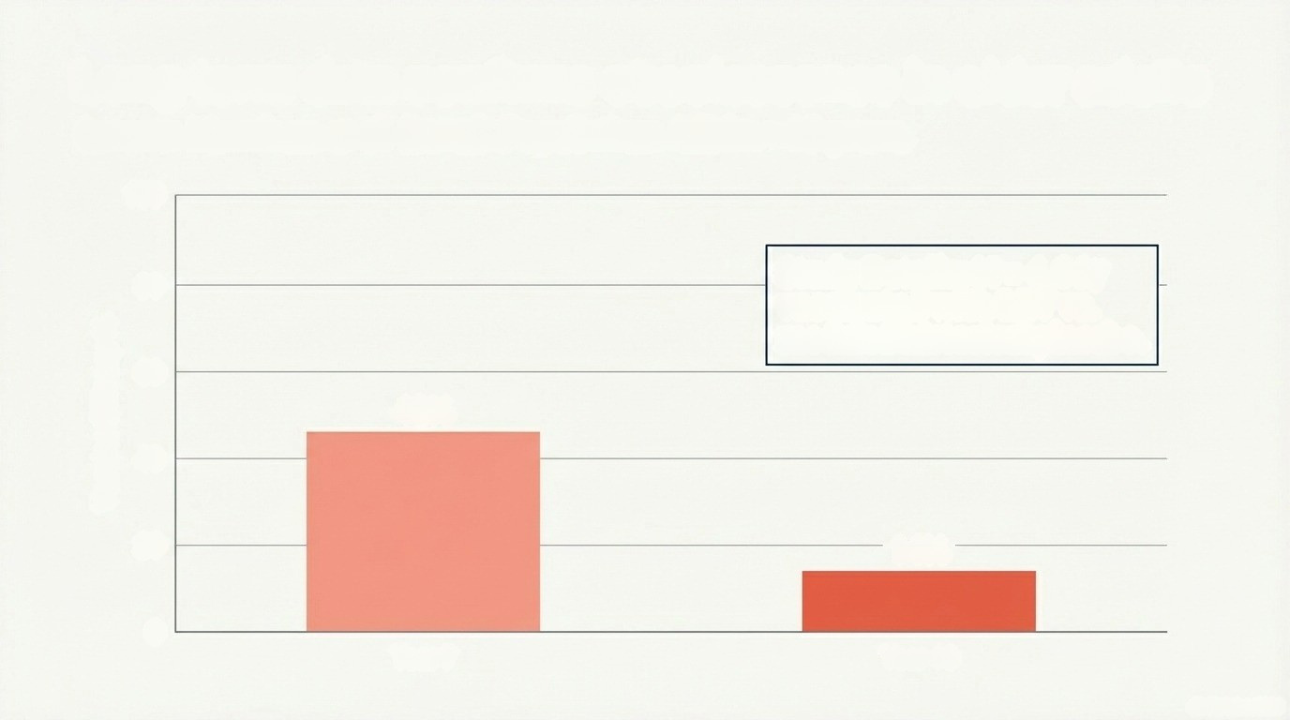
Study 2: Morrison (2015); Zostavax Vaccine
Source: https://pmc.ncbi.nlm.nih.gov/articles/PMC4357816/
100
Study Details: Average age 68 year old
N = 6,867 vaccinated with
Zostavax vs.placebo. Followed for
10+ years
80
60
0
46%
Vaccine Efficacy %
40
40
0
14%
20
0
Year 7
Year 10
A NotebookLM

Slide 6
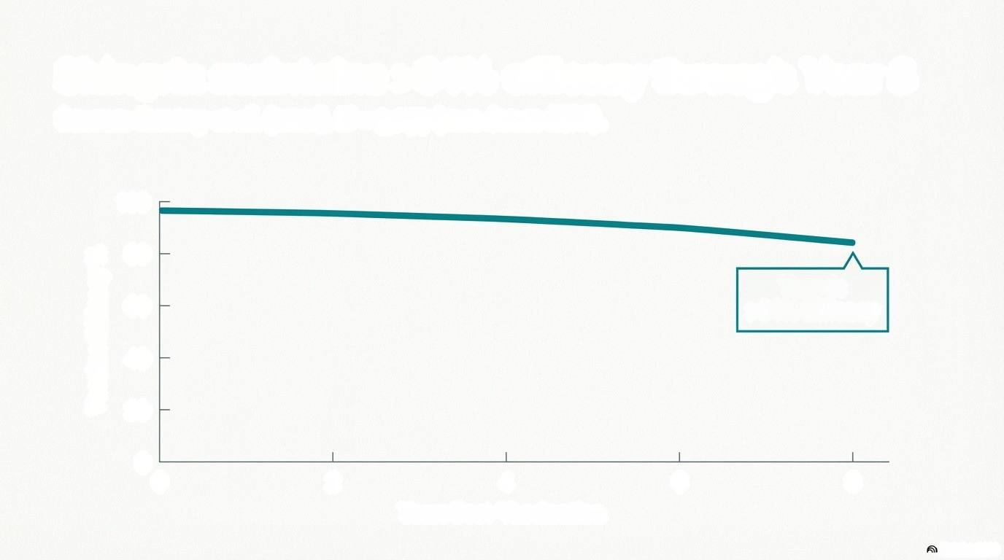
Study 3: Boutry (2021); Shingrix Vaccine
Source: https://academic.oup.com/cid/article/74/8/1459/6324611. N = 7,277 (two doses RZV).
100
80
60
Year 8:
60
>84% Efficacy
Vaccine Efficacy %
40
40
20
0
0
2
4
6
8
CO
Years Post-Vaccination
NotebookLM

Slide 7
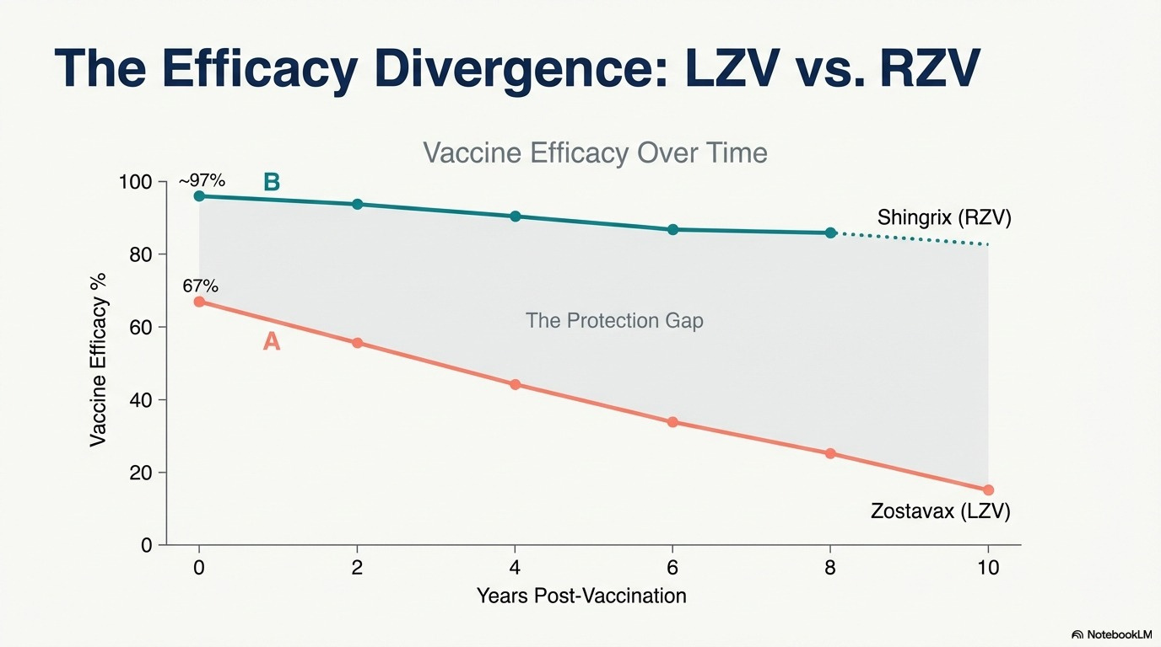

Slide 8
