Slide 1
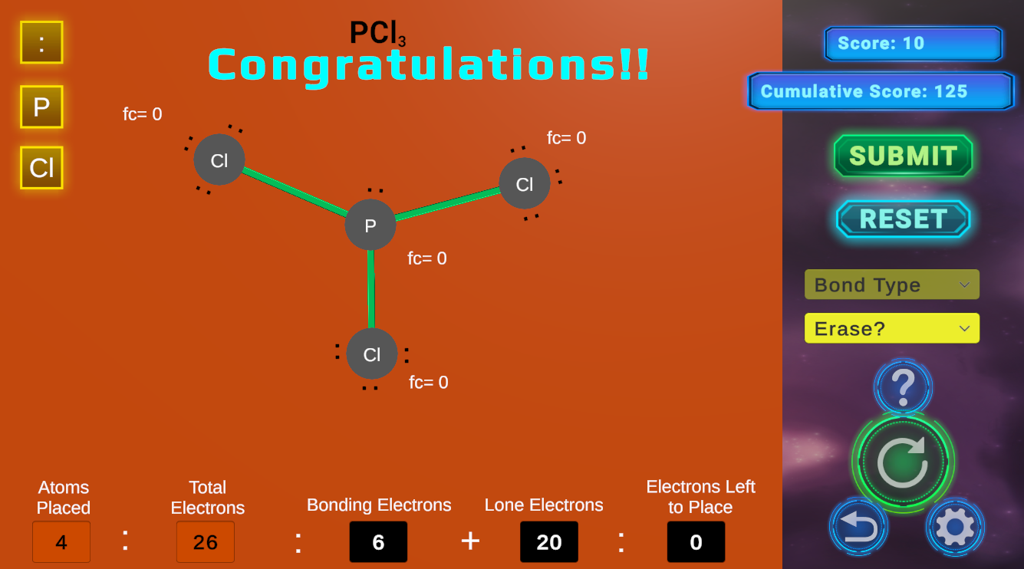
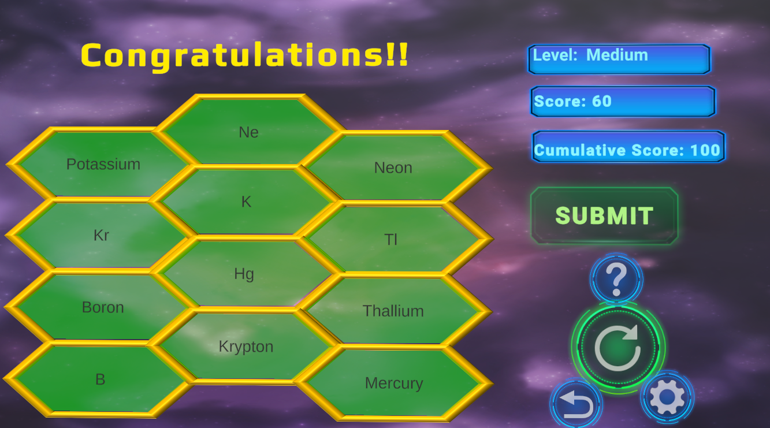

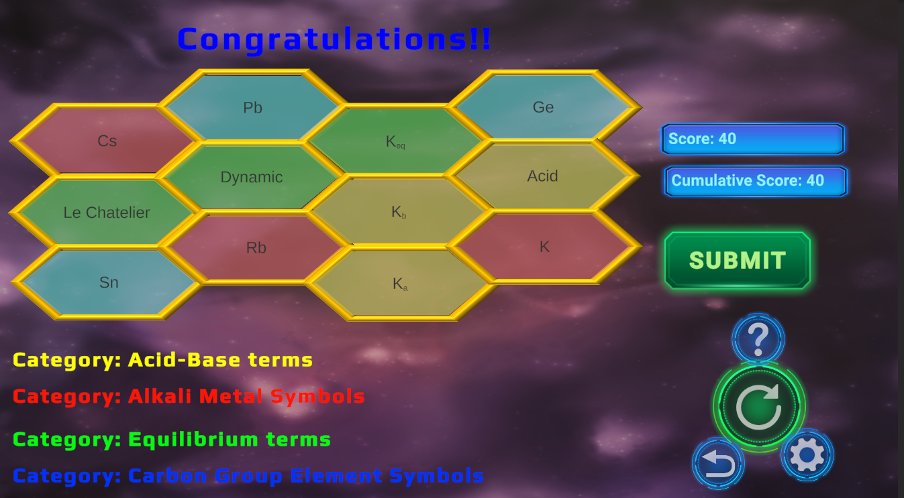
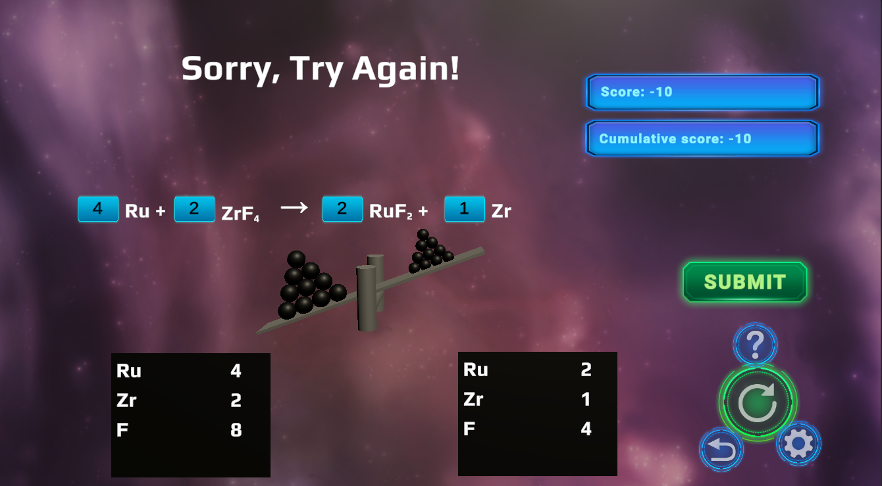
GAME
Game Environment!
GET IT HERE!!
CabezonGames.com
Terrific Graphics!
Unlimited problems!
13 different games!
Cabezon Games
No in-app purchases!
Covers all general chemistry!
Web-based, no downloads!
Instant Feedback!
Free!
No ads!
FREE CHEMISTRY
PRACTICE

